Slide 1
Research Analytics Strategy in a Leading Research Intensive UK University
Dr Giles A F Carden
Consultant Director of Product Strategy – Thomson Reuters

Slide 2
Outline
University of Warwick – a recent history
The research performance the critical factors
Research lifecycle and performance dimensions
Research analytics in action:
  UK Research Excellence Framework
  Bibliometric indicators
  Research income
  Research student numbers
  Impact
Concluding thoughts

Slide 3
The University of Warwick
A Recent History
3

Slide 4
The University of Warwick
Historical Context
1964-65
2000
2008
2013
2014
2015
The University of Warwick opens, taking its first cohort of 450 undergraduates when it received its Royal Charter in 1965.
The University establishes its Medical School and Warwick Ventures Ltd which has helped launch 60 companies since its inception.
University ranks 7th overall in the UK Research Assessment Exercise (RAE)
The £92m National Automotive Innovation Campus commences, jointly funded by the UK Government, Jaguar Land Rover and TATA Motors.
University ranks 7th overall in the UK Research Excellence Framework (REF)
Long established as one of the UK top ten research intensive universities with major global alliances and corporate relationships. Campus of 400 hectares hosting over 23,000 students and 5000 staff drawn from 120 countries across the globe. January 2015 advances plans for a campus in California.

Slide 5
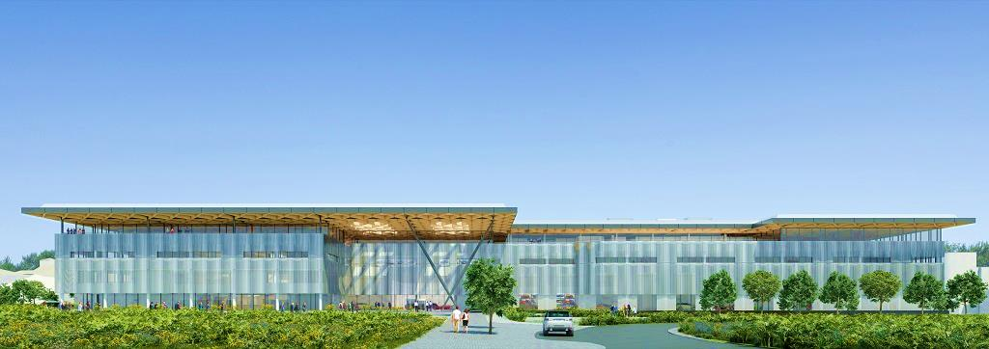




The University of Warwick
Partnerships and Alliances
National Automotive Innovation Campus (NAIC)
£100m joint enterprise between:
Jaguar Land Rover
TATA European Technical Centre
Warwick Manufacturing Group/ The University of Warwick
UK Government
Growing network of supplier companies
Due for completion in 2016

Slide 6





The University of Warwick
Partnerships and Alliances
Warwick – Monash alliance launched to collaborate on research, education and enhancing the experience of its students.
2011
Strategic partnership with the Liverpool School of Tropical Medicine (LSTM) announced to support joined up long –term research, focusing on improving quality of health and social care and influencing policy and practice.
University of Warwick is selected as CUSP’s sole European partner for the New York based initiative involving NYU, Carnegie Mellon, CUNY, Indian Institute of Technology in Bombay, University of Toronto and a number of industrial partners including IBM, Microsoft, Cisco and Siemens.
2012
2014
Warwick signs memoranda of understanding with Sun Yat-Sen University strengthening its relationships with Chinese institutions and providing new study opportunities for students.

Slide 7

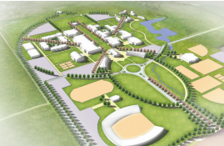
The University of Warwick
Sacramento, California, USA
Placer County, near Sacramento.
Funded by the University Development Trust.
600 of the 1,159 acres it received as a donation in December 2012 from Angelo K. and Sofia Tsakopoulos, William and Claudia Cummings and the Wayne L. Prim Family.
Small but comprehensive university in 10 years.

Slide 8

The University of Warwick
Vision 2015 Strategy
July 2006
Professor Nigel Thrift appointed Vice-Chancellor & President with an ambitious drive to improve research performance launching the overarching strategy Vision 2015 in 2007.
Vision 2015 Goal 1:
To make Warwick an undisputed world leader in research and scholarship.
Our commitment to be demonstrably a centre of world class research and innovation across all of our academic disciplines remains as strong as it always has been. This means that we must maintain our focus on the quality and impact of research and ensure that we are embedding our quality expectations in our internal processes, in particular those to support and develop existing staff and in the appointment processes when we seek to recruit new talent.

Slide 9
The Fundamentals of Research Performance
9

Slide 10
Research Performance - Critical Factors
A good overarching research strategy
Excellent people, critical mass, ‘academic magnetism’
Infrastructure, capital investment
Rewards and incentives, motivations
Review and analysis of outcomes
Accountability

Slide 11
The Research Lifecycle
Impact
Externalise
Venture capital
Article, Book
Patent, Licence
Analyse
Execute research
Results/Data
Seek external funding
Funding award
Seek & secure partners
Project formulation
Idea

Slide 12

Research Performance
Inputs
Income
Infrastructure
Research students
People

Slide 13
Research Performance
Outputs
Articles
Conference proceedings
Patents
Books
Post graduates
Social
Media

Slide 14
Research Performance
Impacts
Government Policy
Commercial Policy/Strategy
Societal change
Non-profit Sector Policy/Strategy
Revenue
Cultural added value

Slide 15
Research Analytics in Action
15

Slide 16
Research Excellence Framework
An assessment of UK universities research every 6 years.
Informs £1.5bn of funding allocations each year in England.
Massive reputational issue, informs national rankings.
Assesses publications/outputs, research impact, research environment including metrics on research income and PhD student award numbers.
Outcome allows detailed performance benchmarking across 35 disciplines and helps inform improvement strategies.

Slide 17
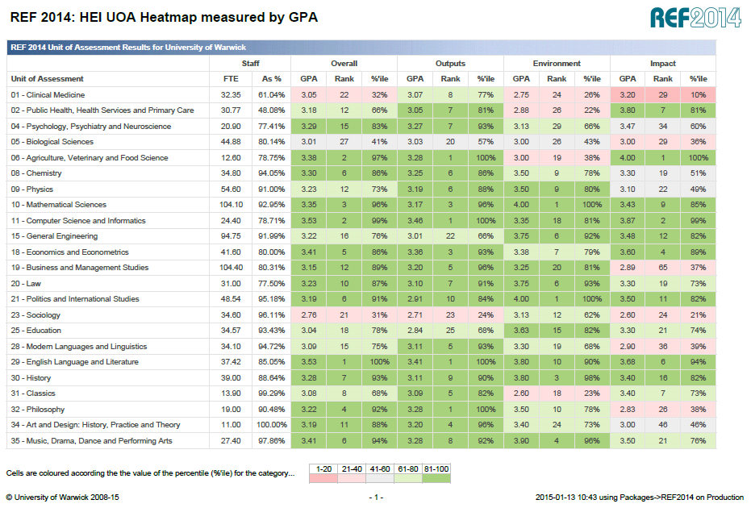
REF 2014 Heat map
Notes:
REF results as an example of reporting key data

Slide 18
How we use Bibliometric Indictors
Competitor analysis.
Benchmark and baseline your research to world standards.
Understand the global reach of your research.
Analyse collaboration networks.
Develop publications strategies and optimise citation rates.
Help inform hiring strategies.
Help inform reward and remuneration strategies.
Impact world rankings.

Slide 19
Publication & Citations Strategy
Volume of articles / books / monographs
Count of articles in key high JIF journals e.g. Cell, Nature family, Science, NEJM etc.
Subject field normalised citations’ count per paper, per researcher, groups of researchers
Key performance questions:
What should our publication strategy be?
Are we publishing in journals of the highest repute and impact?
Are we improving in terms of publication strategy?
Is our research showing citations influence above the world average?

Slide 20
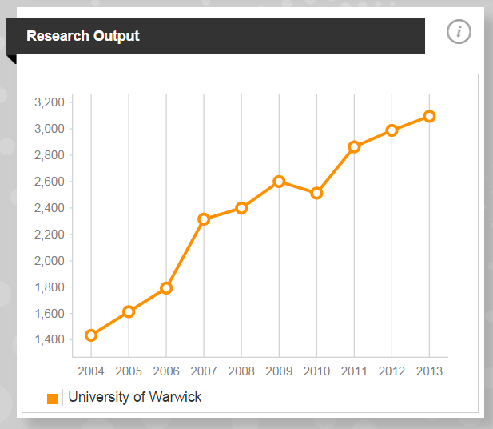
Research Outputs’ Productivity
University of Warwick productivity between 2004 and 2013

Slide 21
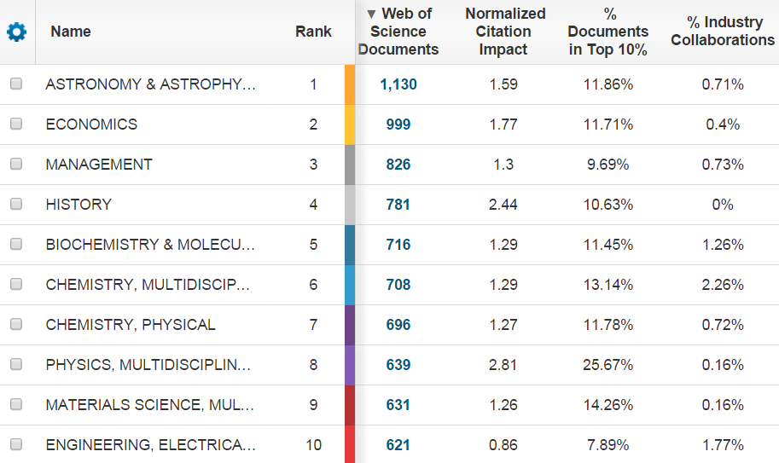
Assess the Strength of Disciplines

Slide 22
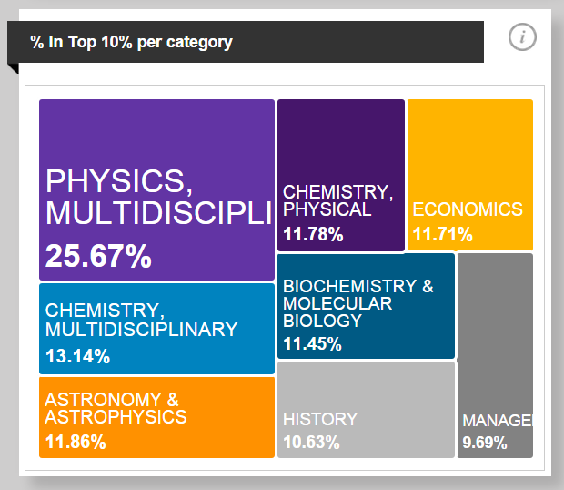
Discipline Strengths – Volume of Top 10% Outputs
Assess influence:
% of Top 10% articles in Specific disciplines

Slide 23
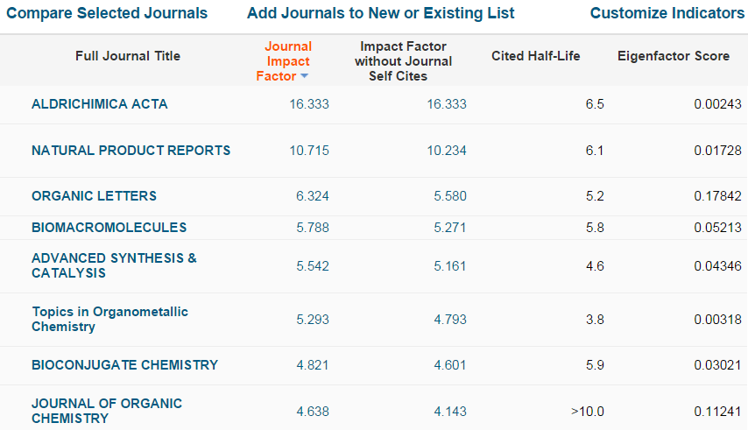
Determine Most Influential Journals
Journal Impact Factors: most influential journals

Slide 24
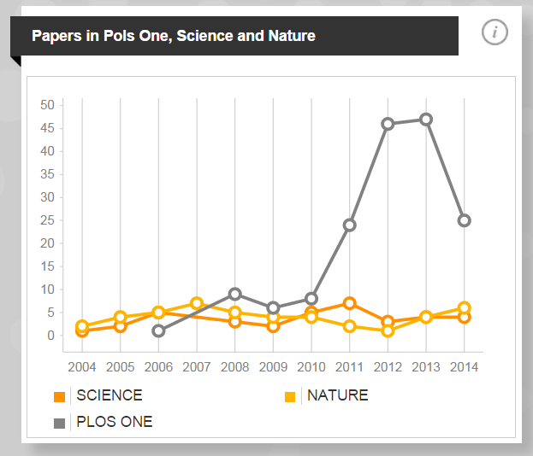
High Impact Journal Papers
Volume of articles / books / monographs
Count of articles in key high JIF journals e.g. Cell, Nature family, Science, NEJM etc.
Papers in major Journals

Slide 25
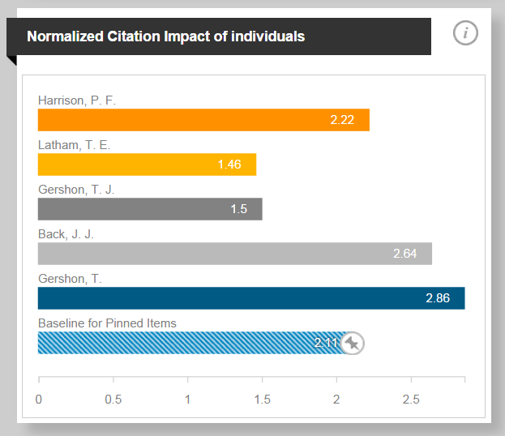
Researchers Citations Impact
Subject field normalised citations’ count per paper, per researcher, groups of researchers
Normalized Citation Impact for our researchers, and a baseline for a given group of individuals

Slide 26
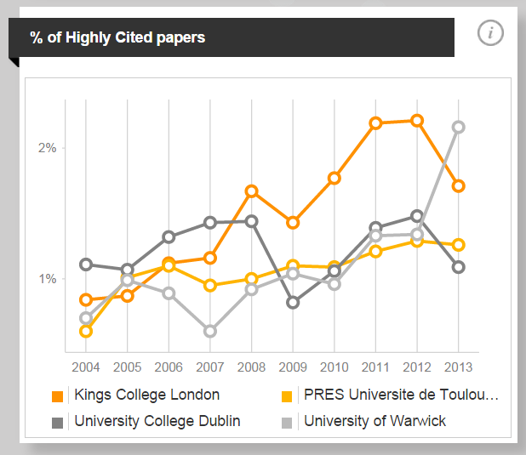
Benchmarking Highly Cited Papers - Normalised
Highly Cited papers produced by several institutions in proportion of their overall production

Slide 27
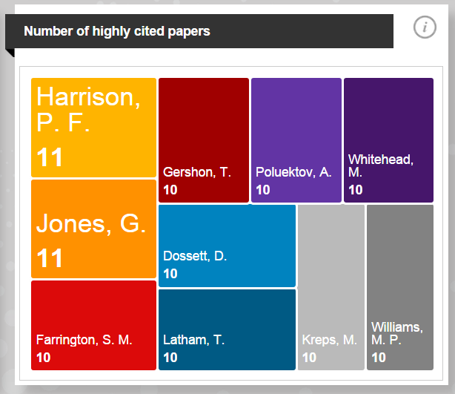
Highly Cited Papers by Researcher
Number of Highly Cited papers produced by a given group of our researchers

Slide 28
Global Collaborations Analysis
The co-authorship details (names, affiliations) enable one to analyse collaborations networks by a paper, researcher, group or researcher or institutions
Helps to inform internationalisation strategies
Key performance questions:
Who are we collaborating with?
How may prestigious collaborations do we have? e.g. with Harvard, MIT, Oxford, Cambridge, Max Plank Inst. etc.
How can we better leverage out international collaborations?
We have the possibility of forging a partnership or strategic alliance, how much are we already collaborating with the institution?

Slide 29
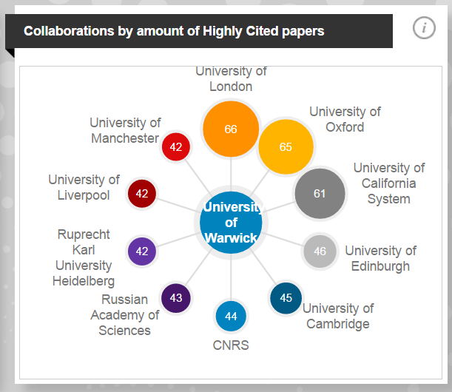
Global Collaborations – Volume of Articles
The co-authorship details (names, affiliations) enable one to analyse collaborations networks by a paper, researcher, group or researcher or institutions
Our collaborations, measured by amount of Highly Cited papers published

Slide 30
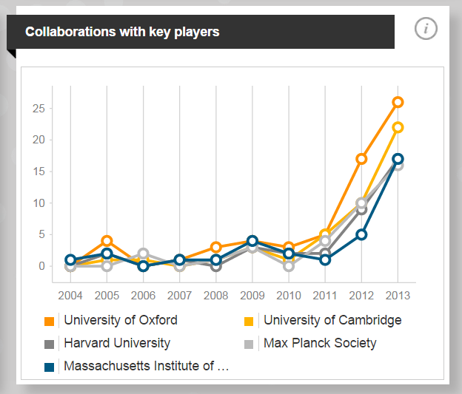
Comparing Collaborations – Volume of Articles
Collaborations
Helps to inform internationalisation strategies
Our collaborations with major institutions is growing

Slide 31
Grant / Contract Activity and Income
Grant applications, awards and success rates used as measures of capacity building.
How much research is funded externally versus internally?
Contracts with industry (link with publications with industry) measure of success in establishing commercial research relationships. Industrial collaboration can be determined with bibliometrics too.
What is the margin on specific funding sources?

Slide 32
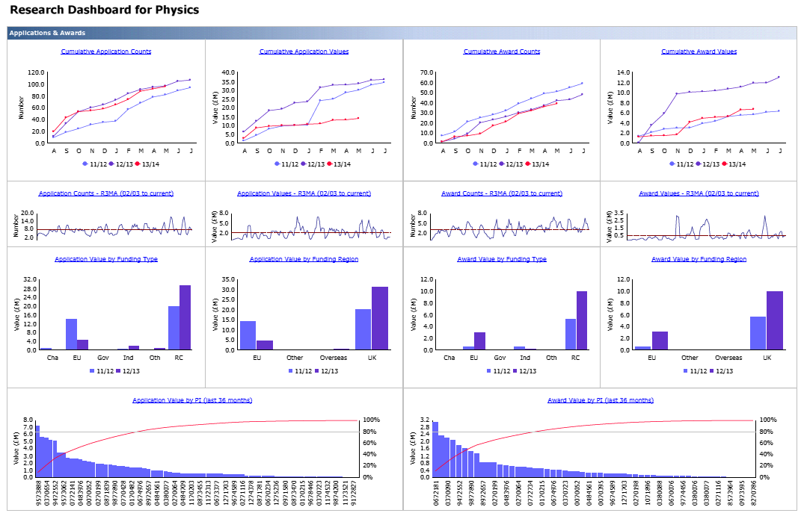
Research Income Pipeline Dashboard

Slide 33
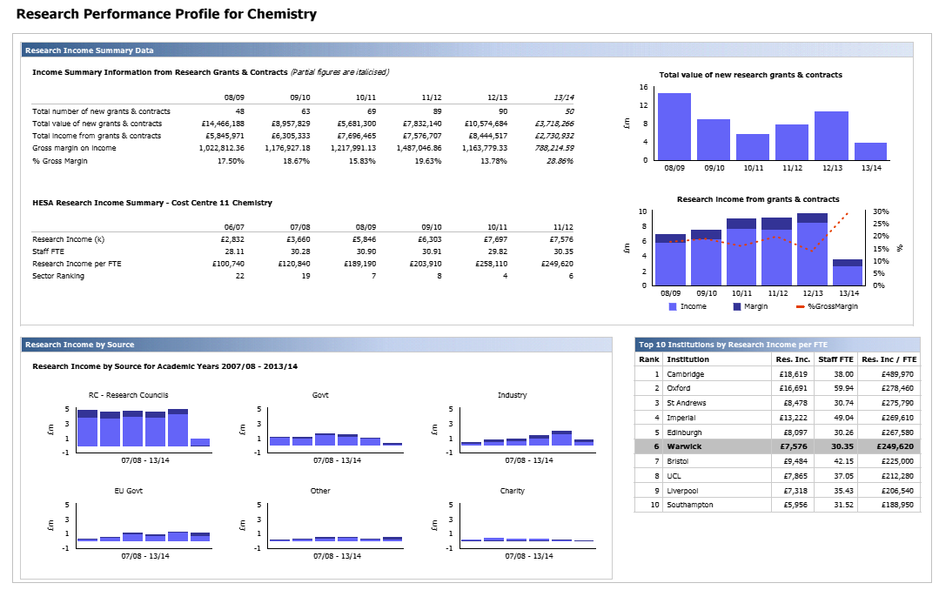
Research Performance Profile

Slide 34
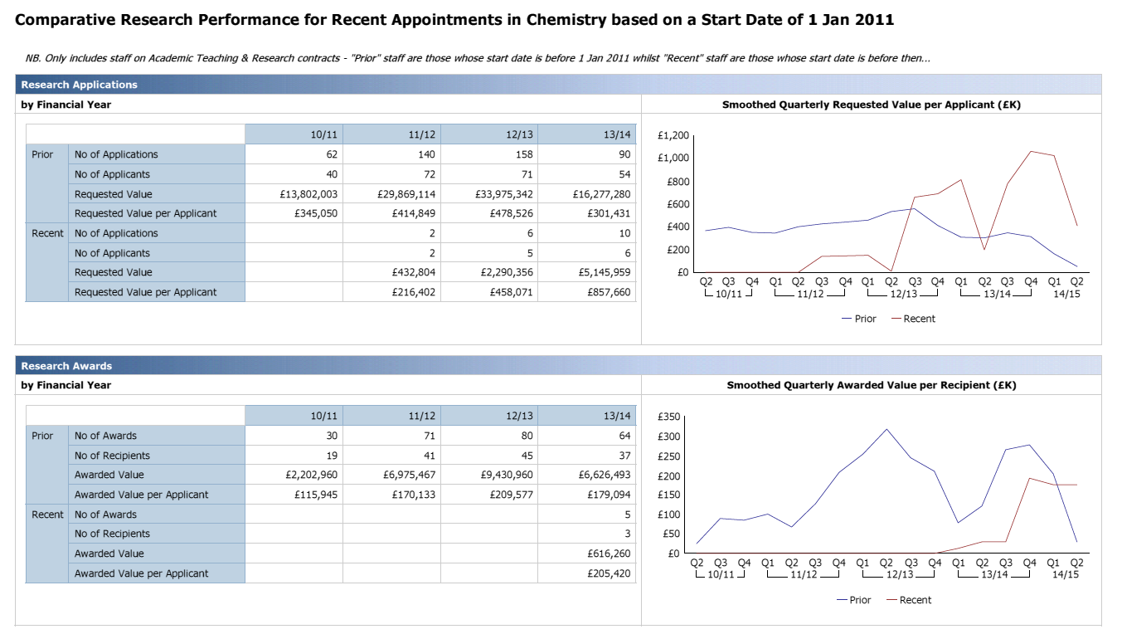
Comparative Research Performance

Slide 35
Research Students
Research student numbers are measures of vitality of the research environment and the subject’s ability to build research capacity.
Some research studentships are funded from external and / or competitive sources of funding, this can be used as a performance measure.
Numbers of studentships attracting industrial sponsorship can be a measure achieving successful commercial links.

Slide 36
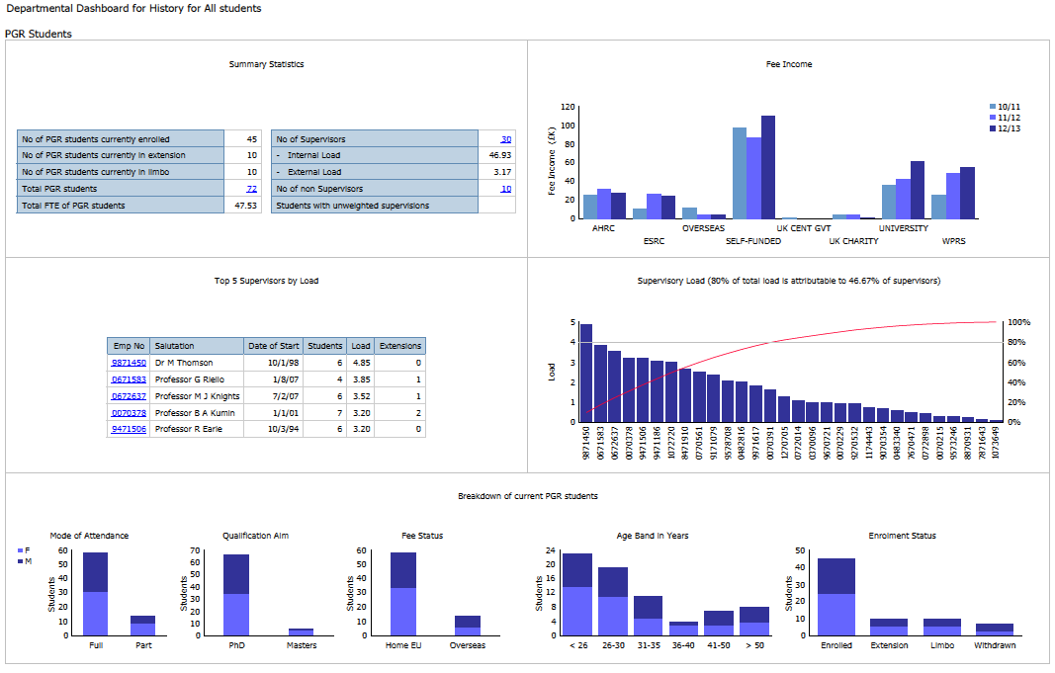
Postgraduate Research

Slide 37
Impact
Testimonials, corroborating statement from CEOs, politicians, policy makers and other key stakeholders.
Patent applications.
Licence income.
Start-up companies’ revenue.
Measured savings or efficiencies.
Media features.
Citations.
Key statistics e.g. from health agencies, exhibitions.
Digital analytics on web content access.
Reference in Acts, policy documents, national or international standards.
www.hefce.ac.uk/rsrch/REFimpact/

Slide 38
Concluding Thoughts
38

Slide 39
What Did We Achieve?
Improved academic staff accountability and performance
  Research planning meets annually to review departments’ performance
  Generated an environment where performance is more proactively reviewed
  Help to address underperformance
  Metrics are used, in part, to inform the Vice-Chancellor’s Advisory Group on reward and remuneration.
  Increase citations count
  Citations analysis has raised the profiles of these metrics and helped researchers to develop their publications’ strategy, this in turn has led to an increase in citations count.
Publications in higher impact journals, books with high reputation publishers
  Bibliometrics’ analysis has helped challenge and inform departmental publications’ strategy and fostered a culture of publishing in the very best journals.

Slide 40
What Did We Achieve?
Significant growth in research income
  As the University’s research performance has improved, it in turn has led to an increase in success in winning research grants and, in turn, has helped the University’s ability to attract leading researchers from across the globe. The research review process includes research income data and there are active process for challenging research income generation through the planning cycle.
Significant growth in research student numbers
  The University strategy had a goal to double PhD numbers by 2015. This motivated change and the University increased number significantly partly due to success in winning UK government funding and also from internal investment.
Used analytics in remuneration reviews, as “one tool in the kit”
  Citations and research income analytics have been used to help inform the University’s professorial pay and reward process.

Slide 41


What Did We Achieve?
A significant rise in THE World University Rankings
  The University has risen in recent years from 220 to 103 in the THE World University Rankings at 2014.
  The University ranks in the 81-90 range in the World Reputation Rankings
Other key University achievements
A Fields Medal in Mathematics
  Professor Martin Hairer won a Fields Medal in 2014
UK Times / Sunday Times University of the Year 2014
  Awarded University of the year award for a sting of achievements and for consistently featuring in the UK top 10 rankings.
Alan Turing Big Data Institute w. Cambridge, Oxford, Edinburgh and UCL
Cultural change
  Warwick has experienced a significant cultural shift accepting the need to positively and progressively manage performance and analytics have become a normal part of professional life.

Slide 42
The Future
There is significant potential to use a range of new data sources including ‘big data’ to better understand the reach, significance and impact of research.
Thomson Reuters, the largest information provider in the World, is exploring the potential to use a range of data sources to better understand the reach and impact of research.
An example is the use of Recorded Futures web intelligence software in InCites2 which scan public web sources such as news publications, blogs, social media, financial databases, government websites etc.
The next challenge is how to assess and measure the social, economic and cultural impact of research and, where possible, present it in an analytical context.

Slide 43

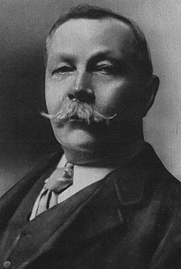
Two different perspectives….
“Experts often possess more data than judgement.”
Colin Powell
“It is a capital mistake to theorize before one has data.”
Sir Arthur Conan Doyle

Slide 44

Thank You For Your Attention
Email: giles.carden@thomsonreuters.com
http://uk.linkedin.com/in/gcarden
44

Slide 46
Globally Highly Cited Researchers
Lists (some) of the world’s most influential researchers by 21 subject fields
Count of researchers in the index is a considerable measure of esteem
One useful tool for recruitment
Impacts on the Shanghai Jiao Tong Academic Ranking of World Universities
Key performance questions:
Who are the most influential researchers in terms of citations?

Slide 47
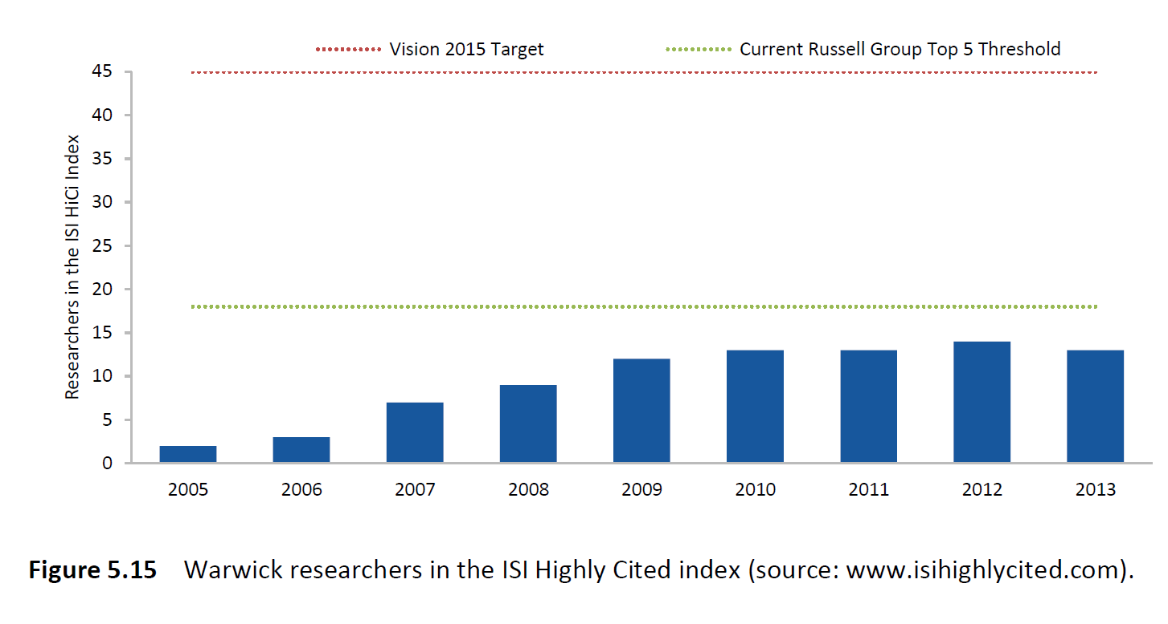
Growth in Globally Highly Cited Researchers

Slide 48
Research Analytics and Strategy
48

Slide 49
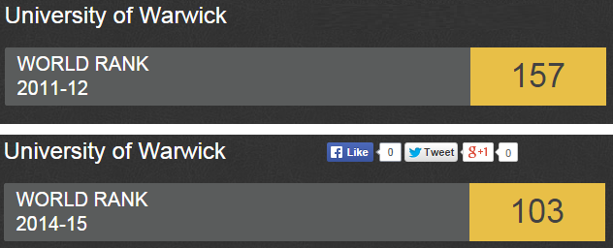
Research Analytics and Strategy
Rankings indicators
Gained 54 places in 3 years

Slide 50
Bibliometric Indicators
Bibliometrics - most comprehensive way of benchmarking and measuring the principal outputs of research.
Measure and benchmark across 251 subject fields in WoS core data set or at higher levels.
Assess the influence of your research outputs.
Use journal impact factors (JIFs) to establish most influential journals in subject fields.
Inform strategies to optimise citations’ count and reputation.

