Slide 1
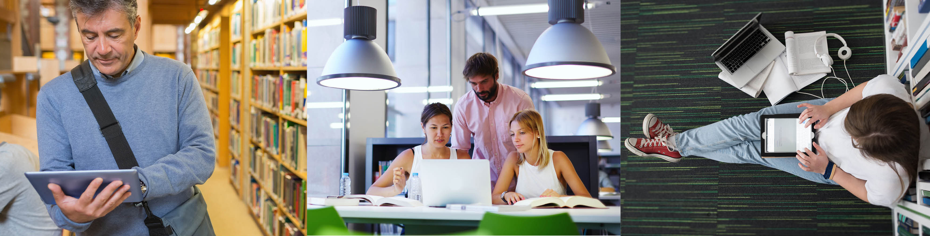
Making Open the Default

Slide 2
David Ball
University Librarian at Bournemouth 18 years
David Ball Consulting 2012-
Associate at Sero HE 2014-
SPARC E project officer PASTEUR4OA and FOSTER
Consortium of Uganda University Libraries
SPARC E consultant, OAPEN project officer HIRMEOS

Slide 3
SPARC Europe’s vision
“Driving to make more research accessible to all, and striving to make Open the default in Europe: For the academic community, education, industry, and for society.”
Making Open the default

Slide 4
SPARC Europe’s mission
“Our mission is to provide leadership to Europe’s research community to enable the conditions, opportunities and rights for more access to Europe’s research for all.”

Slide 5
We serve
Europe’s research policy makers at the EC, European Council, national research funders
The European academic library community
Europe’s research communities including research administrators and senior university management, associations of universities

Slide 6
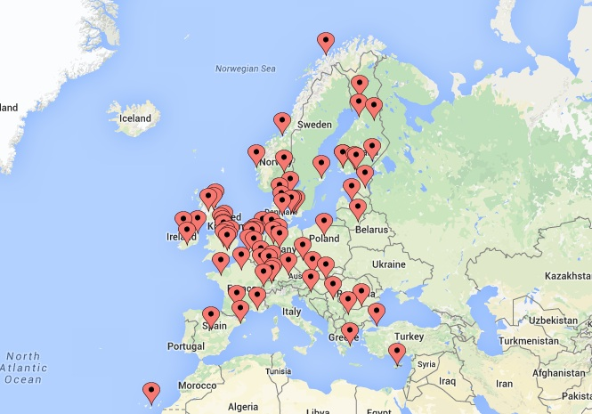
Members from 24 European countries
Notes:
CH, CR, S, FIN join
UPC Barcelona and Chalmers Uni leave

Slide 7
Our work
Driving Open Access
Expanding Open Data
Accelerating Open Education

Slide 8
Four programme areas
Influence Europe’s Open Science and Scholarship (OS) decision-makers & scholars
Back the European OS support community
Provide advocacy, guidance, tools and services in support of the implementation and monitoring of open policies
Share OS good practice and European experience

Slide 9
A variety of work
H2020 policy
Showcasing EU policy progress
The Open Access Citation Advantage Service
How Open is your Research?
Europe’s Open Champions

Slide 10
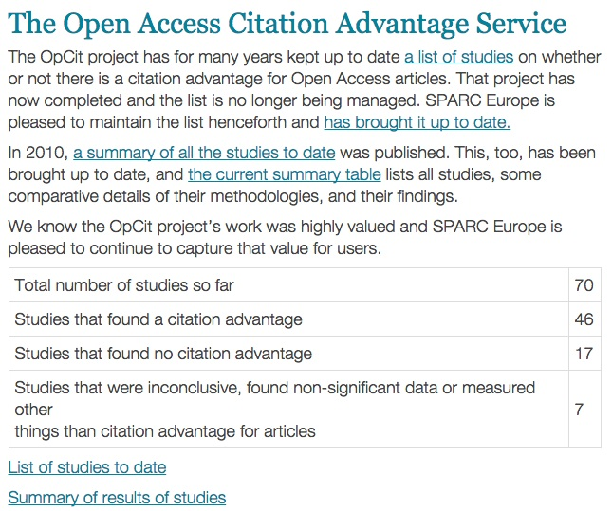
The Open Access Citation Advant age Service

Slide 11
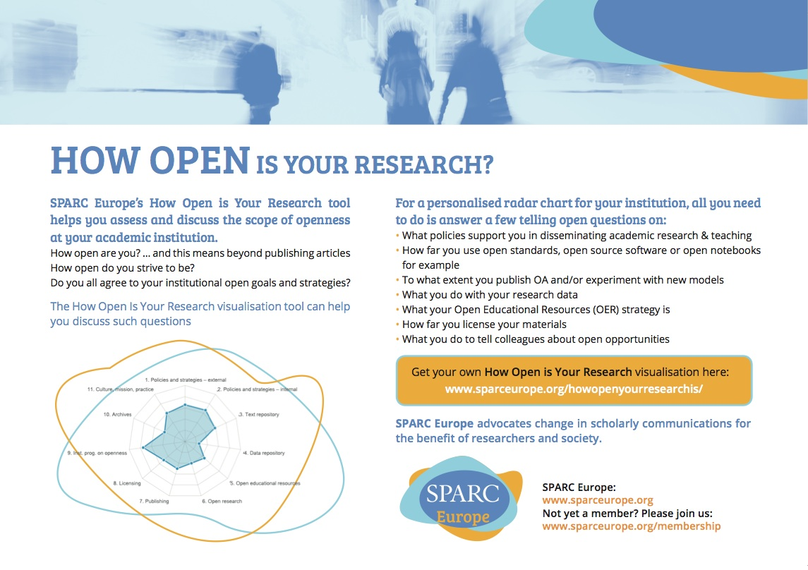
How Open Flyer

Slide 12
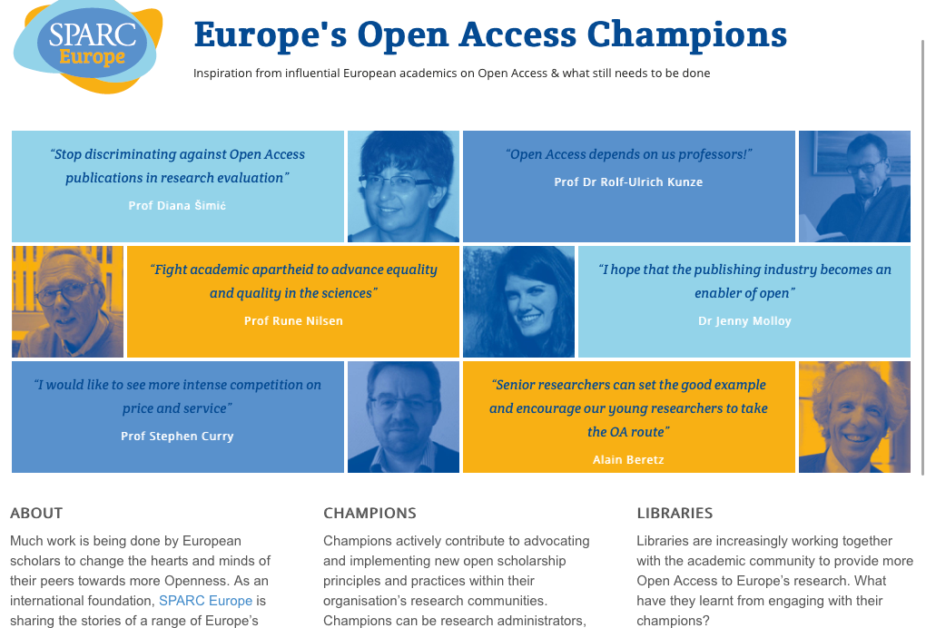
Europe’s Open Access Champions
* LIBER Innovation Award 2016 *
Notes:
http://openscholarchampions.eu/

Slide 13
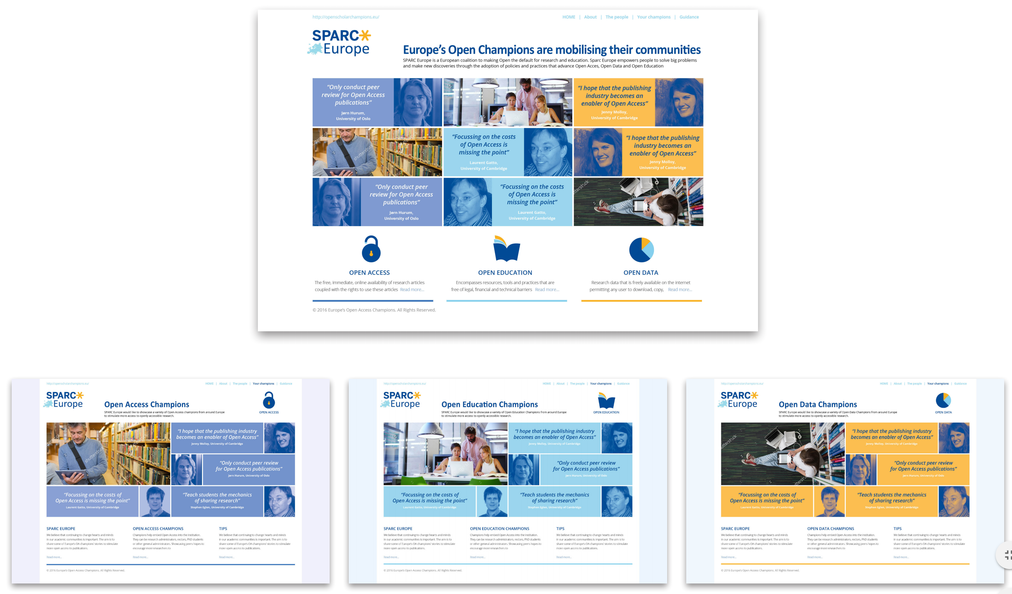
Europe’s open champions programme

Slide 14
Europe’s Open Data Champions
Follow the model of OA champions
Champions could be researchers, academic leaders, librarians…
Must be passionate, committed and persuasive, leading in their communities
Worked with DCC to develop a list of possible sources
15 countries

Slide 15
Europe’s Open Data Champions: First Steps
Targeted institutions leading national RDM pilots - asked to identify potential champions
Identified a number of potential champions from other institutions
Process: staff of member institutions will interview to a standard set of questions; interviews will be analysed and transcribed and made available through website; also recorded interviews.

Slide 16
Promoting Open Data in Europe
Europe’s Open Data Champions
The Open Data Citation Advantage Briefing
A snapshot of Open Data and Open Science Policies in Europe
An analysis of the European Open Science policy landscape (late Spring 2017)
Other advocacy tools
Notes:
15K

Slide 17
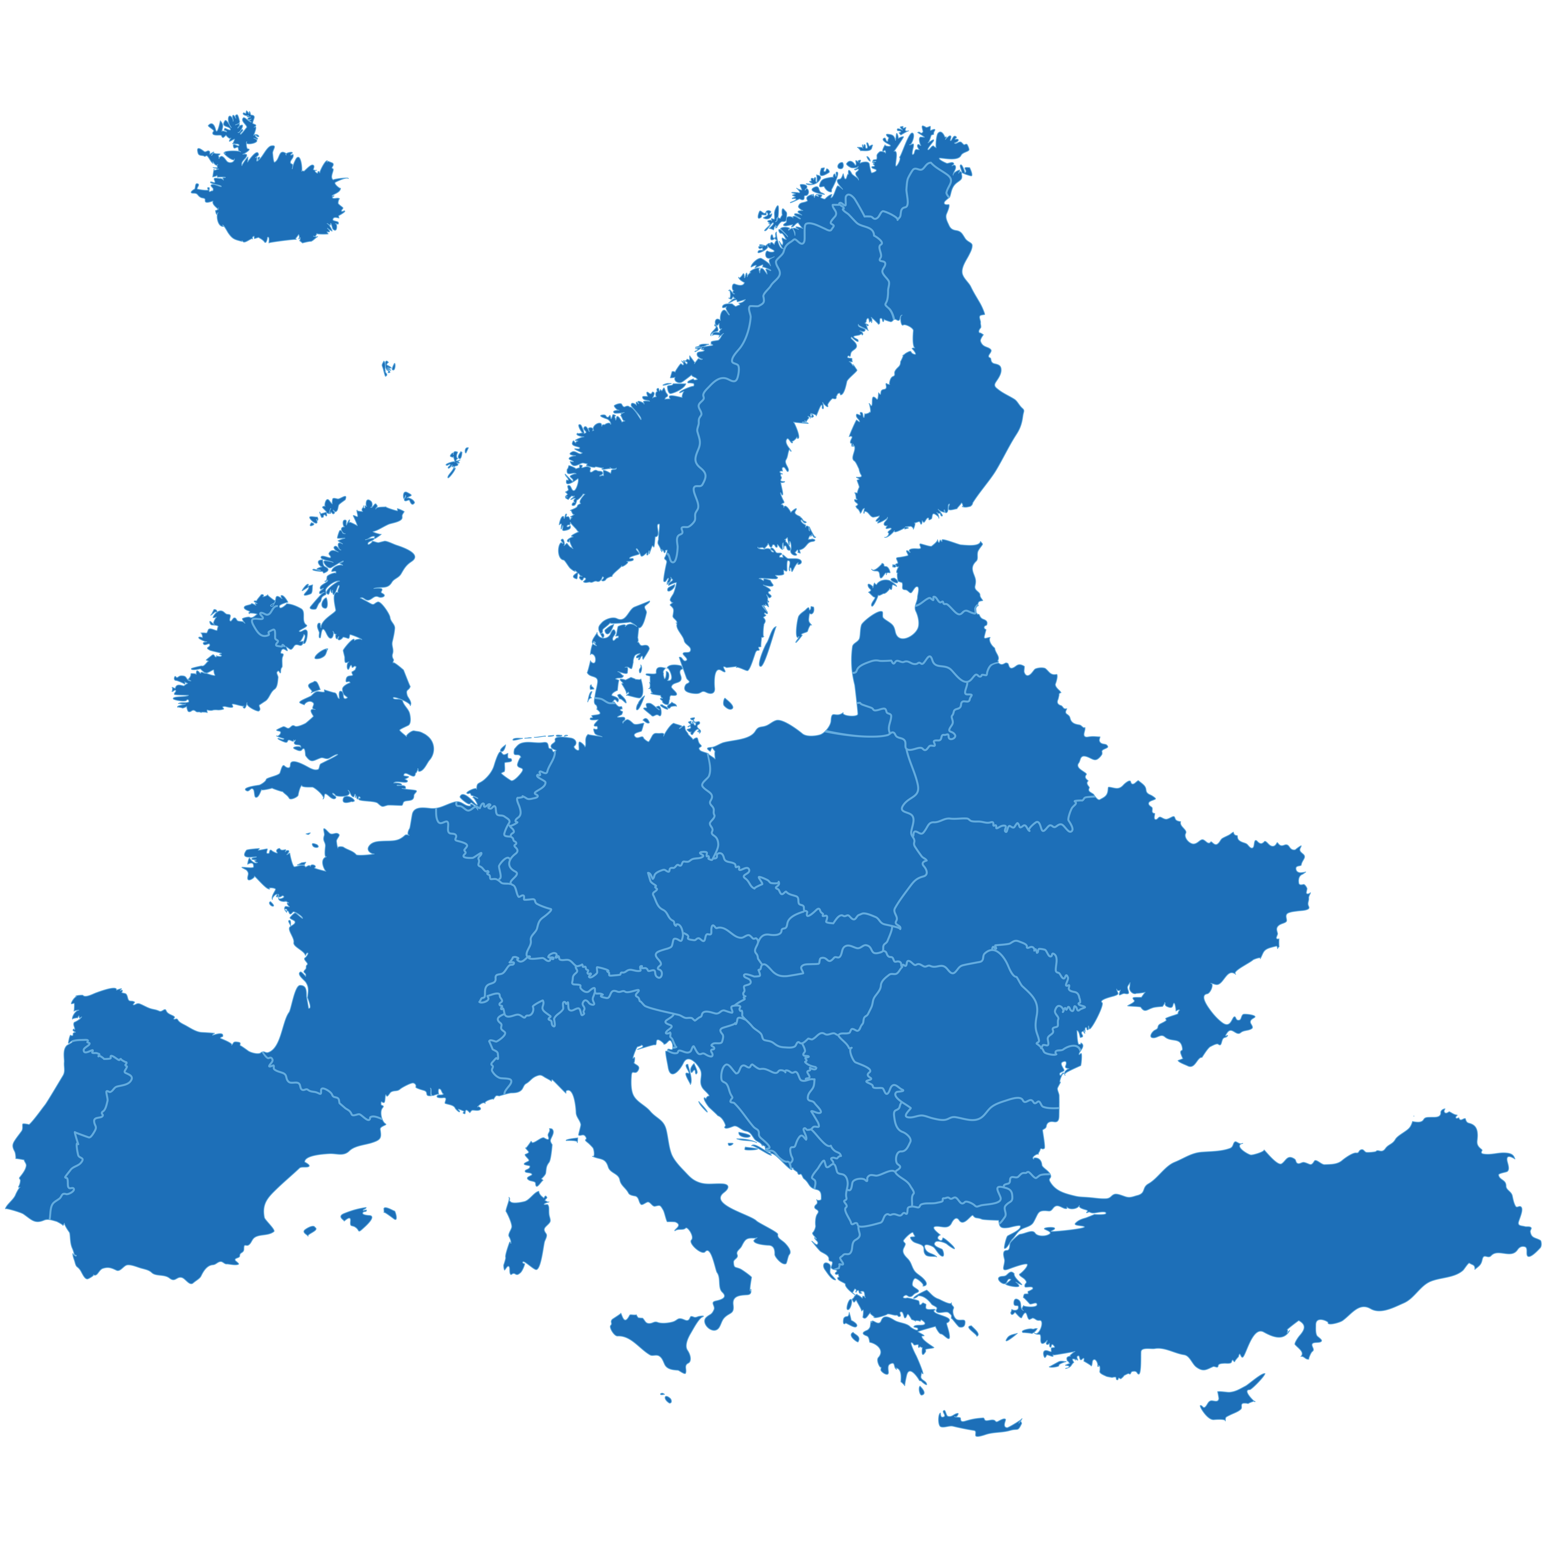
Mapping Open Science in Europe
Who
Scope & priorities
Personnel resources
Activities
Outputs
Sharing key results with the community

Slide 18
MOSE Key results
White areas
Manifold activities
Targeting groups such as young researchers and business, industry & SMEs
Policy enforcement
OER
OS leadership
OS information and knowledge aggregation services;
Recommendations and guidelines, briefing or position papers
Training and educational activities such as webinars and workshops
Conferences
Surveys

Slide 19
Recommendations and guidelines
Produced by about 66% of respondents
These respondents are being surveyed to detail what exactly they are producing:
  for each individual document target groups, topics, access, licence, URL
Enable us to draw together what is available
Examples of best practice
Eliminate duplication

Slide 20

Ensuring Sustainability
“To provide a new co-ordinated cost-sharing framework to ensure that non-commercial OS services that underpin the development of wider global open science are sustained in the future.”

Slide 21
A Global Sustainability Coalition for Open Science Services (SCOSS)

Slide 22
Developed and influenced by
LIBER
European University Association (EUA)
Science Europe
European Research Council
SPARC Europe
COAR
EIFL
SPARC
IFLA
Australasian Open Access Strategy Group (AOASG)
Council of Australian University Librarians (CAUL)
& Knowledge Exchange

Slide 23
Developmental work behind SCOSS
Making the Case
Terms of Reference
Evaluation procedure
Governance model

Slide 24
A Global Sustainability Coalition for Open Science Services (SCOSS)
First members in this initial phase include:
EIFL
LIBER
Council of Australian University Librarians (CAUL)
Australasian Open Access Strategy Group (AOASG)
SPARC Europe

Slide 25
The Process
Calls will be issued to OS services
Submissions will be evaluated by panel of SCOSS members
Panel will issue recommendations for funding to OS institutions
Projects funded for 2 years

Slide 26
SCOSS next steps
Pilot 1 begins
  Invitation to apply for funding issued (DOAJ and SHERPA/RoMEO)
  Evaluation of funding applications
  Decisions on funding
  Recommendations for funding issued to institutions globally
First Call for Tender in
late 2017

Slide 27
Please join us
If you are interested in a more open research and education for Europe,
please become a member
For more information:
http://sparceurope.org

Slide 28
Any questions?
David Ball
dball@sparceurope.org
SPARC Europe
www.sparceurope.org

