Slide 1
The Evolving Digital Ecosystem
Networked Services v. Silos
Tom Cramer
Assistant University Librarian for Digital Library Systems & Services
Stanford University
April 2017

Slide 2
Libraries are vast storehouses

Slide 3
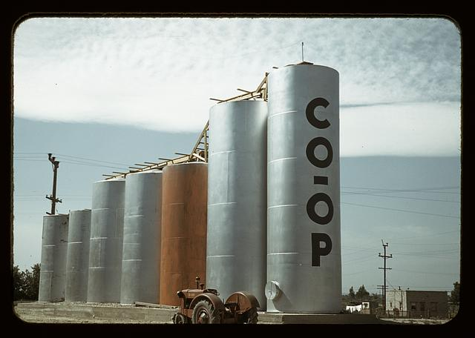
http://www.loc.gov/pictures/resource/fsac.1a34206/
Grain elevators, Caldwell, Idaho, by Lee Russell, 1941.
Notes:
What we realized is that we treat content and technology like silos.

Slide 4
Connections > Content
Notes:
Connections provide links to more content, Services, Patrons

Slide 5
1 + 1 = 11
Notes:
Connection to other content, to services, to users

Slide 6
3 Case Studies from Stanford
RIALTO Research Intelligence

Slide 7
Case Study 1

Slide 8
A Community
that develops Shared APIs,
implements them in Software,
and exposes interoperable Content
Notes:
Three things:
1.) APIs
2.) growing suite of compatible software
3.) community of adopters

Slide 9
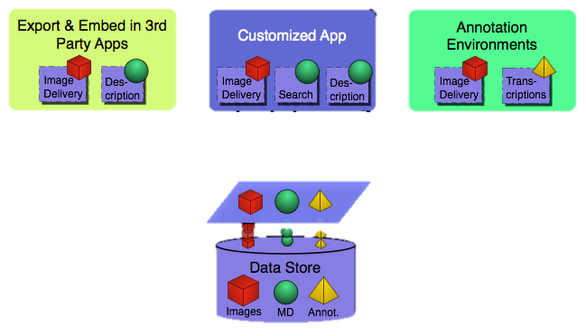
APIs Enable Interoperability

Slide 10
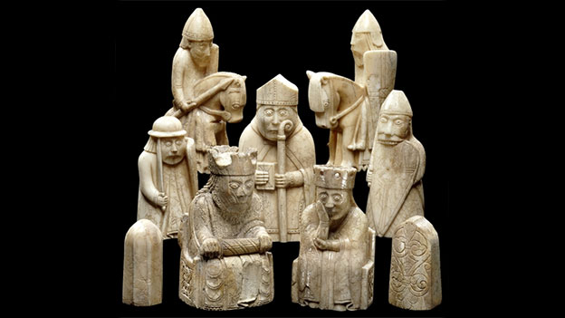
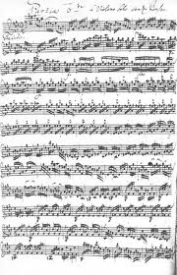
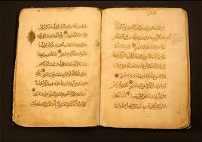
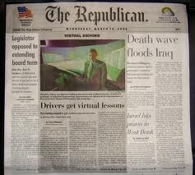
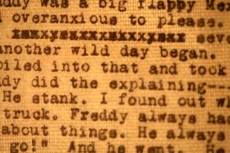
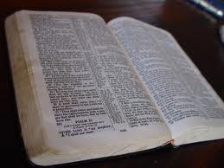
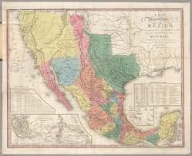
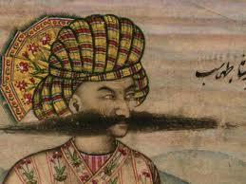
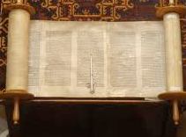
Images are fundamental information carriers for cultural heritage
Notes:
Lewis Chessmen in the British Museum, Page of Beineke MS 109 from Yale

Slide 11
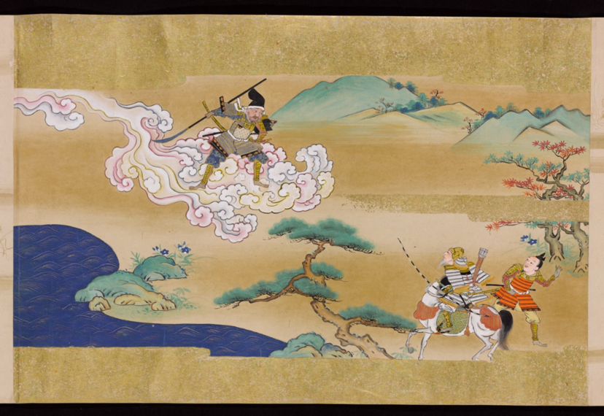
Deep zoom
Notes:
Princeton scroll: http://libimages.princeton.edu/osd-demo/?feedme=pudl0123%2F8172070%2F01%2F00000001.jp2

Slide 12
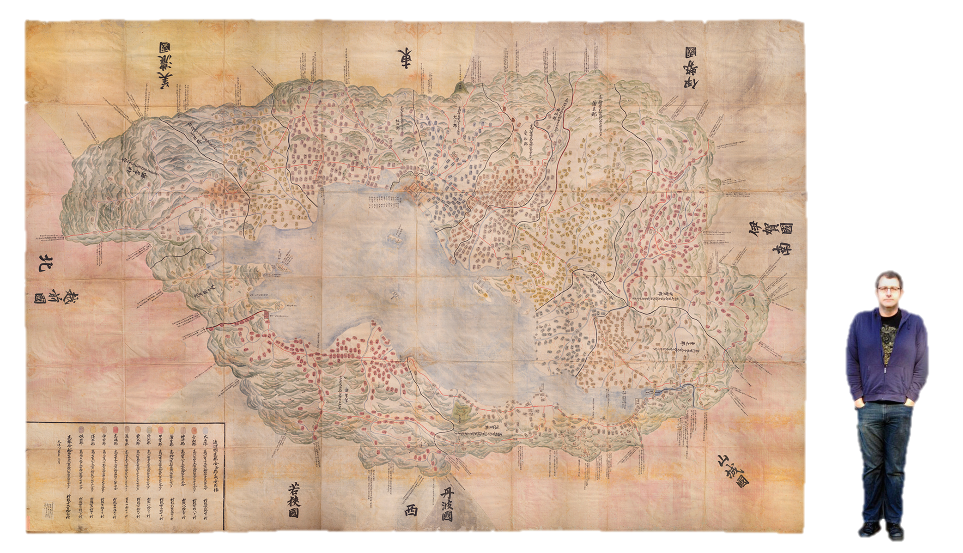
With even the largest of images
https://purl.stanford.edu/hs631zg4177
Notes:
https://purl.stanford.edu/hs631zg4177
http://library.stanford.edu/blogs/digital-library-blog/2015/11/adventures-oversized-imaging-digitizing-omi-kuni-ezu-jin-jiang
Omi Kuni-ezu
Japanese tax map from 1837. Drawn in the round; one is meant to stand in the center and then read it in any direction one faces
No longer possible with fragile, nearly 200-year old artifact
The map measures 11’x17’
Wayne is 6’4”
The scanned map is
34,342 x 22,939 pixels
787.8 mega pixels
1.27 GB file size
Composite of 158 individual images

Slide 13
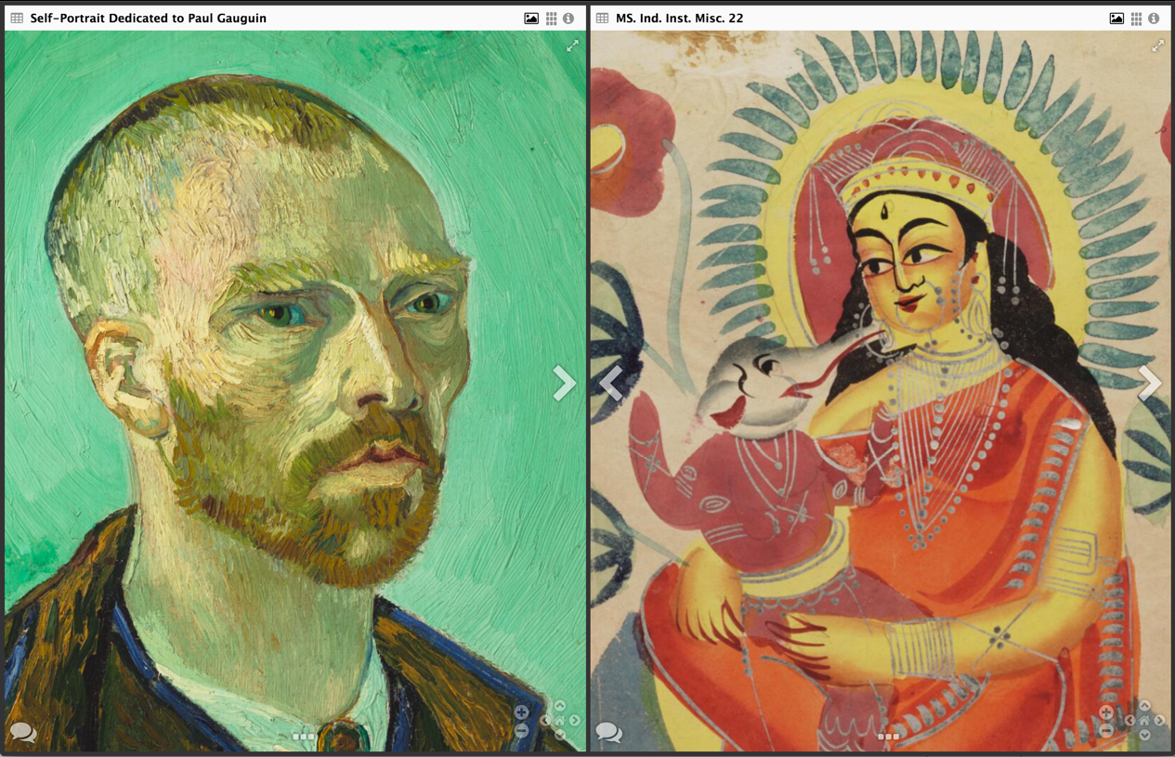
Compare
Notes:
Self portrait of VanGogh, for Gauguin, from Harvard.
Next to Kaligat paintings from Burma, from Oxford’s Digital Bodleian

Slide 14
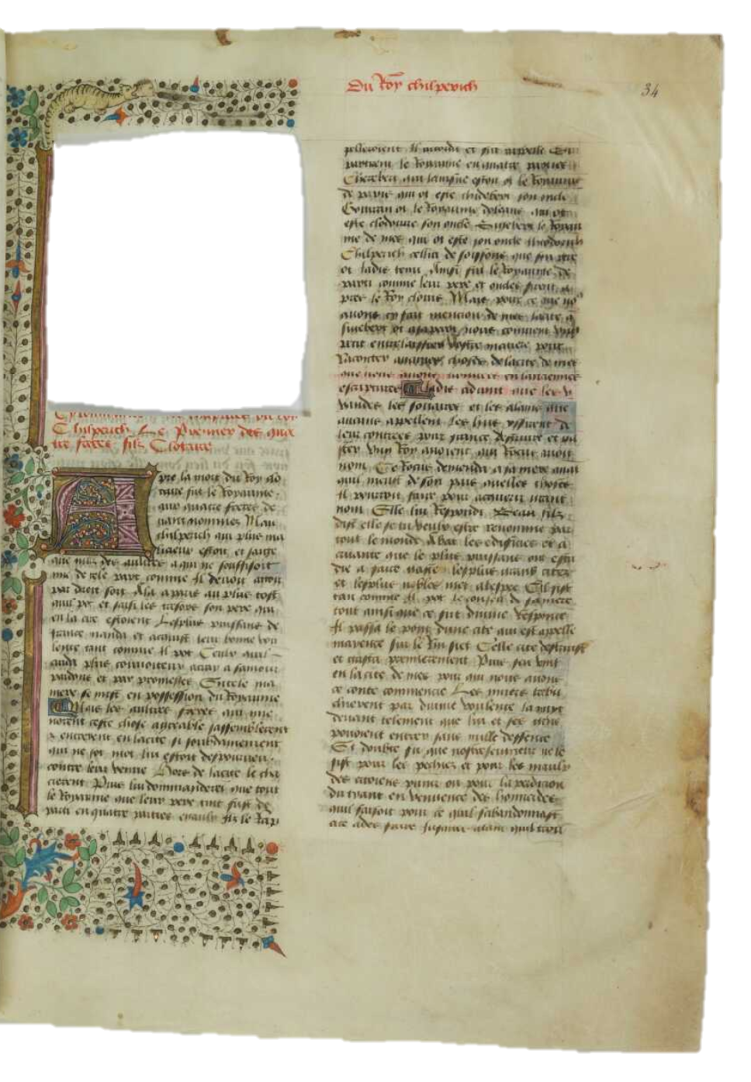
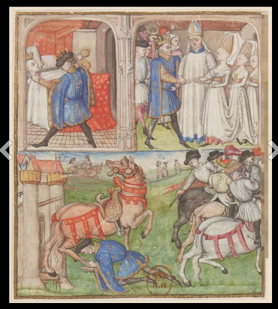
Collect
Le manuscrit 5 de la Bibliothèque municipale de Châteauroux, c. 1460
Folio in BVMM Miniature in the BNF
Notes:
Folio is in BVMM: Bibliotheque Virtuelle de Manuscrits medievaux, served by the IRHT (Institut de recherche d’histoire des textes)
Miniature was eventually acquired by the Royal Library and is now in the collection of the BNF

Slide 15
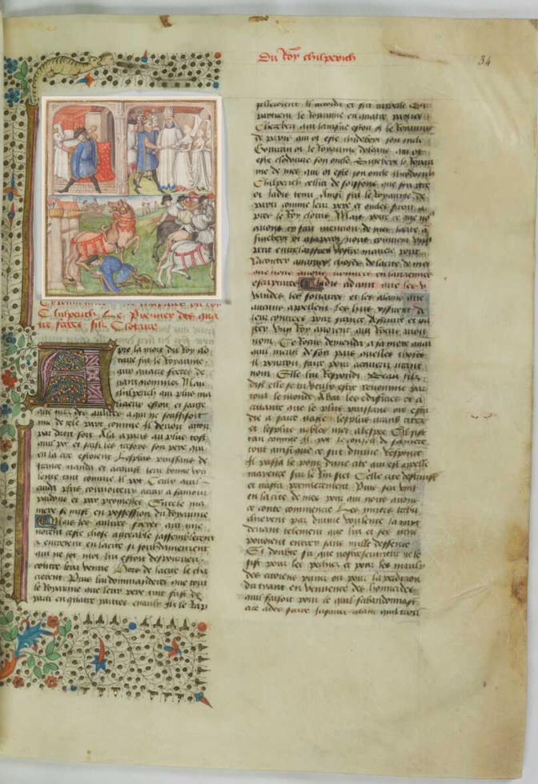
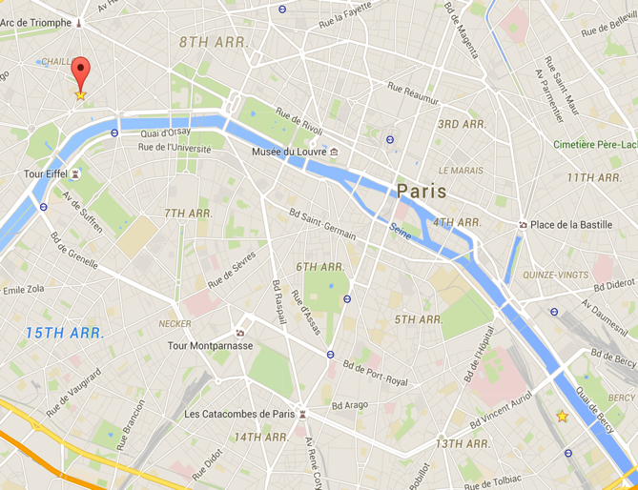
Reunite
IRHT
Paris
BnF
Biblissima: MSS of France
http://demos.biblissima-condorcet.fr/chateauroux/
Notes:
Folio is in BVMM: Bibliotheque Virtuelle de Manuscrits medievaux, served by the IRHT, Institut de Recherche d’Histoire des Textes)
Miniature was eventually acquired by the Royal Library and is now in the collection of the BNF

Slide 16
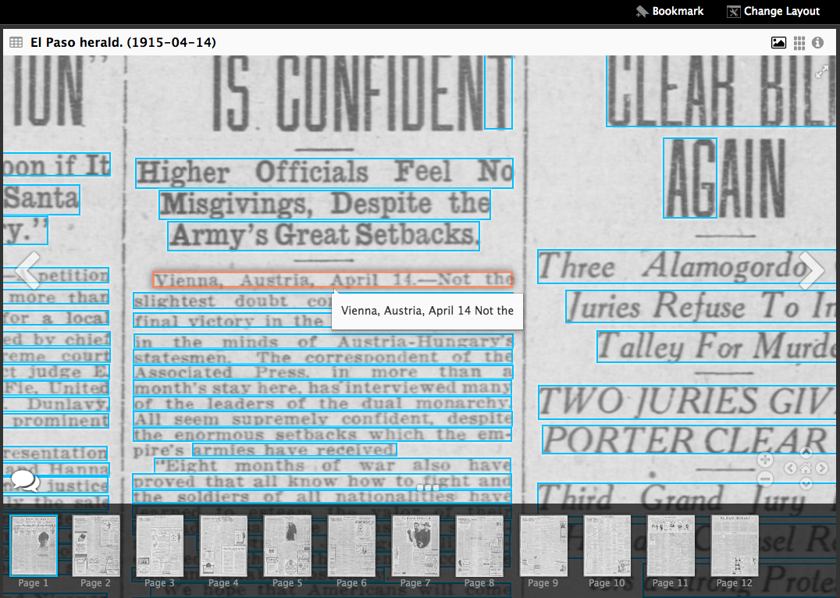
Search

Slide 17
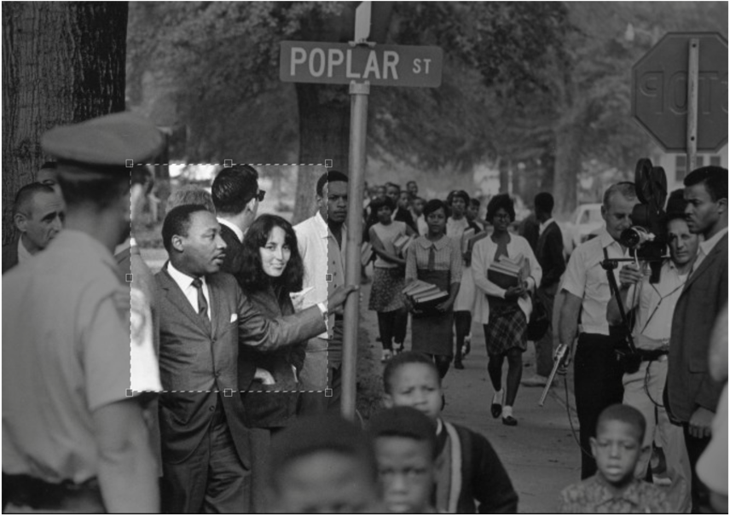
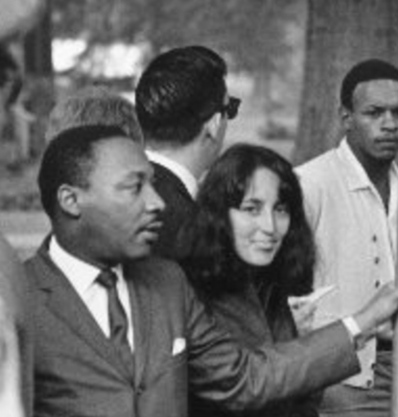
Cite and share (even regions of interest)
Martin Luther King Jr. & Joan Baez march to integrate schools, Grenada, MS, 1966
https://stacks.stanford.edu/image/iiif/hg676jb4964/679,/0/default.jpg

Slide 18
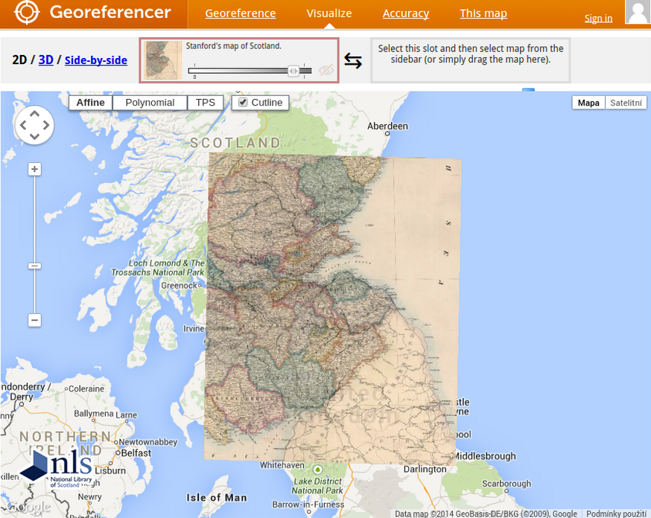
Analyze
Klokan Technology’s Georeferencer

Slide 19
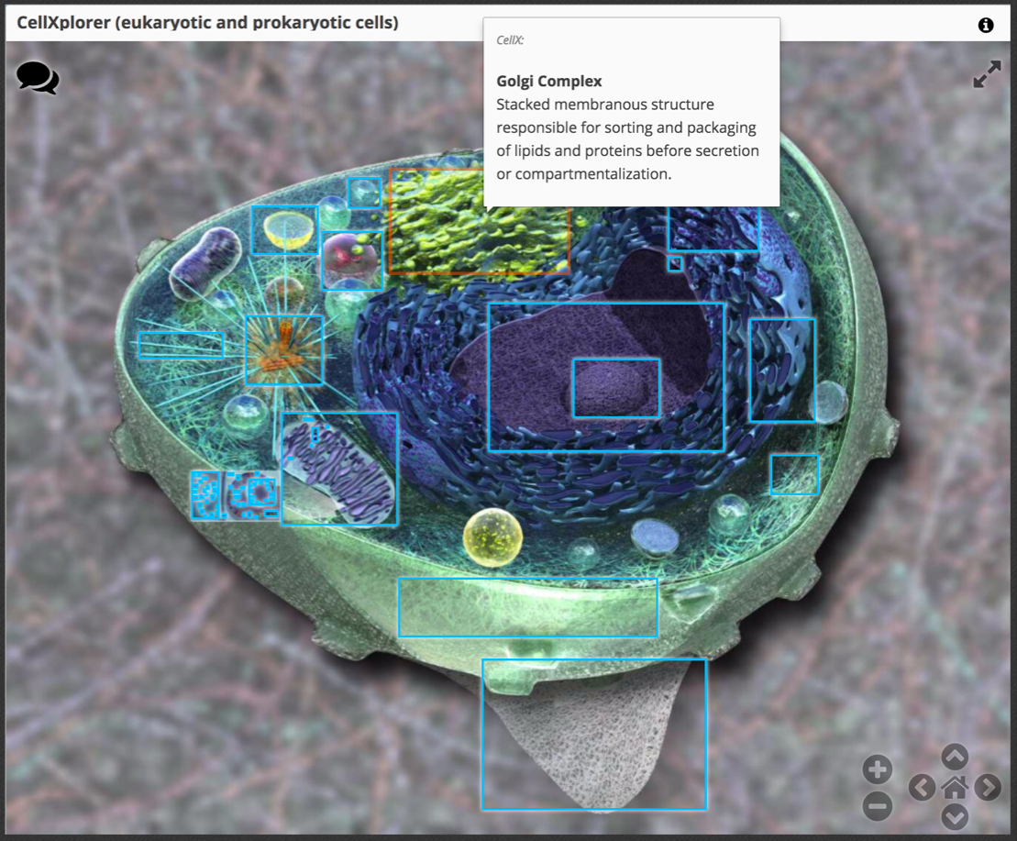
Annotate
https://courses.edx.org/courses/course-v1:HarvardX+MCB64.1x+2T2016/d16e07a5cec442eeb7cd9dfcb695dce0/
Notes:
https://courses.edx.org/courses/course-v1:HarvardX+MCB64.1x+2T2016/d16e07a5cec442eeb7cd9dfcb695dce0/

Slide 20
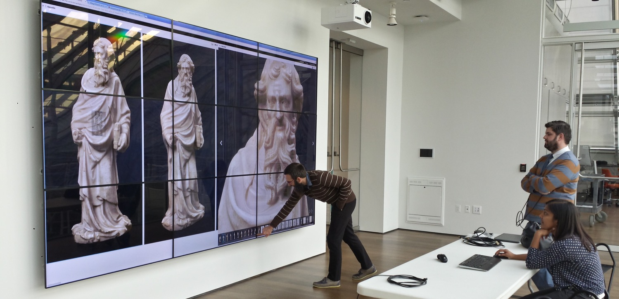
Interact
Opening
Photo: Jeffrey Emanuel Thanks to Harvard’s Fogg Museum and Rashmi Singhal
Notes:
UV: http://universalviewer.io/examples/
Mirador: http://sul-reader-test.stanford.edu/drag_and_drop/
The collection link is:
http://iiif.bodleian.ox.ac.uk/iiif/collection/XXXXX
where XXXXX is a keyword. I have some pre-canned searches that do more sophisticated searches based on our collection.
So:
Hebrew
Incunabula
Ephemera
HistoryandPolitics
WesternManuscripts
Oriental
Greek

Slide 21
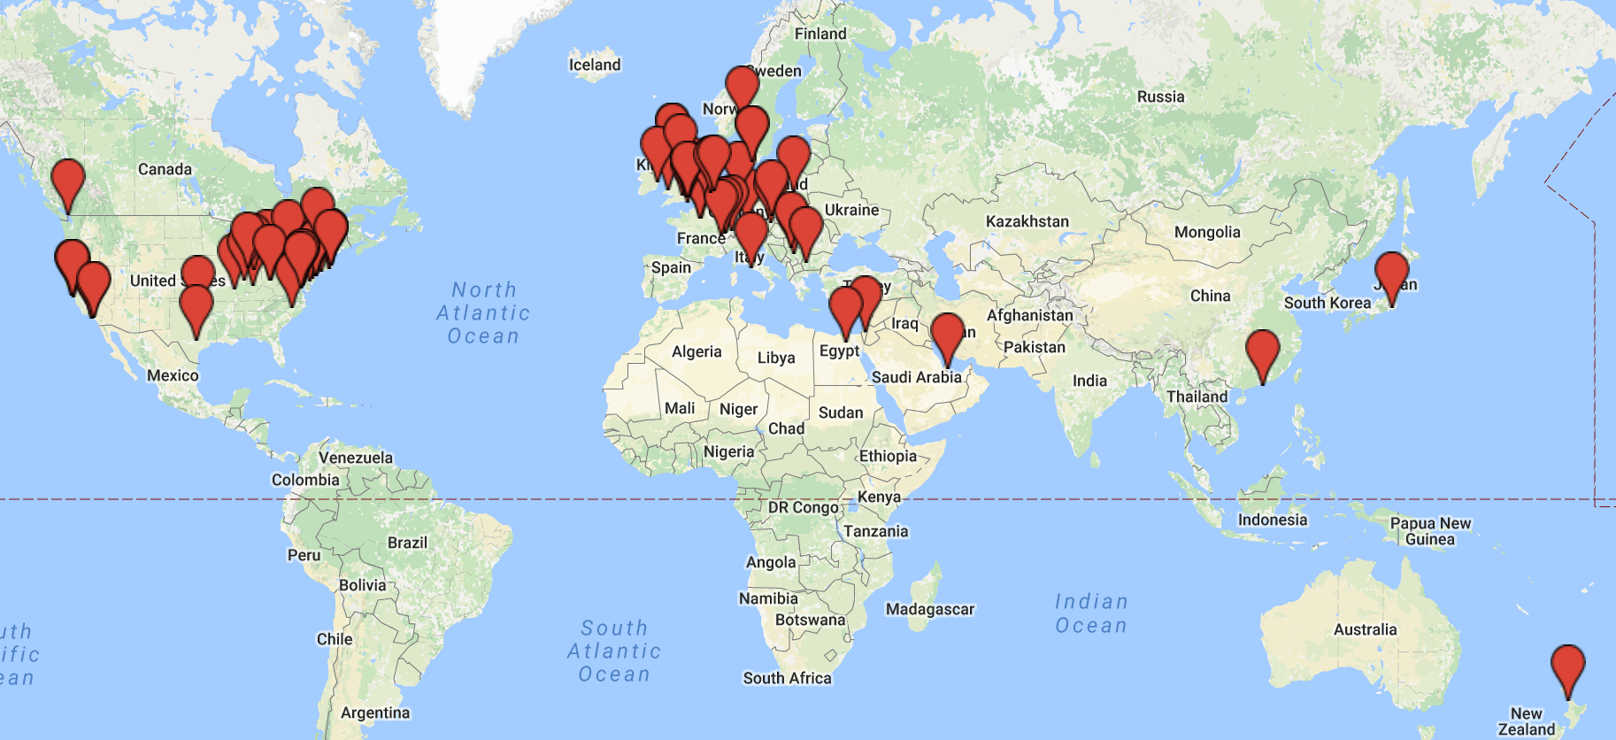
IIIF: Global Participation
Opening
Notes:
UV: http://universalviewer.io/examples/
Mirador: http://sul-reader-test.stanford.edu/drag_and_drop/
The collection link is:
http://iiif.bodleian.ox.ac.uk/iiif/collection/XXXXX
where XXXXX is a keyword. I have some pre-canned searches that do more sophisticated searches based on our collection.
So:
Hebrew
Incunabula
Ephemera
HistoryandPolitics
WesternManuscripts
Oriental
Greek

Slide 22
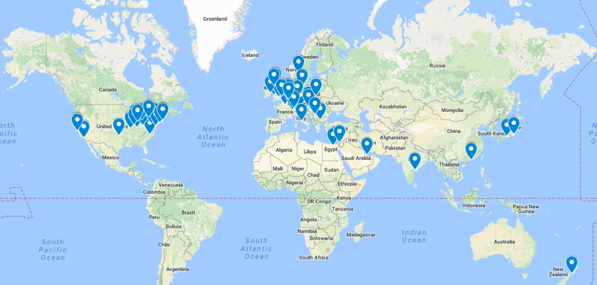
Universities and Research Institutions
Brown University
Cambridge University
Chinese University of Hong Kong
Columbia University
Cornell University
Ghent University
Gottingen State and University Library
Harvard University
Indiana University
Johns Hopkins University
Kyoto University Library Network
Leiden University
MIT Libraries
New York University Libraries
North Carolina State University Libraries
Ohio State University
Oxford University (Bodleian Library)
Pennsylvania State University Libraries
Princeton University Library
St. Louis University
Stanford University
University College Dublin
University of Basel, Digital Humanities Lab
University of Edinburgh
University of Glasgow
University of Hong Kong
University of Illinois at Urbana-Champaign
University of Michigan
University of Notre Dame
University of Oklahoma
University of Pennsylvania
University of Tokyo
University of Toronto
Wellcome Trust
Yale University
Projects
Biblissima
Data Futures Project (University of Westminster)
Digital Image Archive of Medieval Music (DIAMM)
e-codices – Virtual Manuscript Library of Switzerland
TextGrid
State / National Libraries
Bayerische Staatsbibliothek (Bavarian State Library)
British Library
La Bibliothèque nationale de France
Moravian Library (Moravská zemská knihovna)
Nasjonalbiblioteket (National Library of Norway)
National Library of Austria
National Library of Denmark
National Library of Egypt
National Library of Israel
National Library of New Zealand
National Library of Poland
National Library of Scotland
National Library of Serbia
National Library of Wales
Qatar National Library
Vatican Library
Firms
Cogapp
Digirati Ltd
Klokan Technologies
LUNA Imaging
Sirma Group
text & bytes
Museums / Galleries
Art Gallery of Ontario
Art Institute of Chicago
British Museum
Carnegie Art Museum
Harvard Art Museums
National Gallery of Art
The J. Paul Getty Trust
The Walters Art Museum
Yale Center for British Art
Aggregators
ARTstor
CONTENTdm
DPLA
Europeana
Internet Archive
Wikimedia Foundation
World Digital Library

Slide 23
IIIF Compatible Software
Image Apps
Mirador
Internet Archive Book Reader
Image Clients
Leaflet JS
IIP Moo Viewer
FSI Viewer
Image Servers
IIP Image
FSI Server
digilib

Slide 24
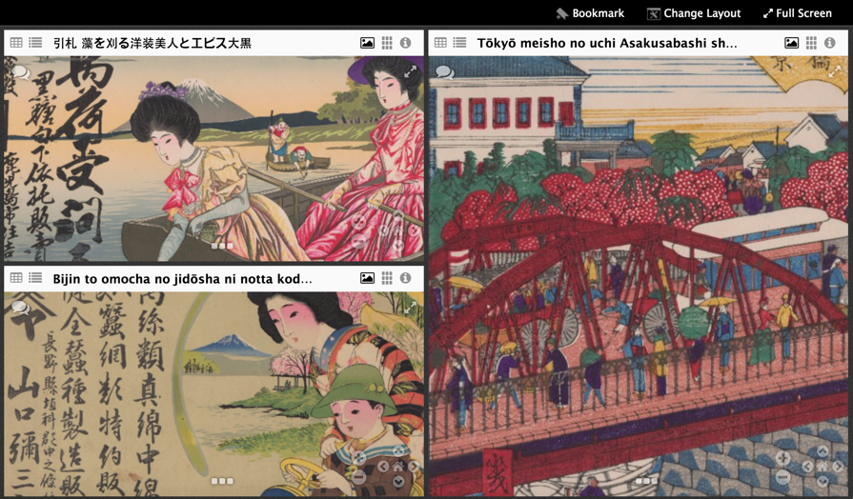
How people are using Mirador…
Instruction
Comparison
Annotation
Transcription
Unification
Computational imaging

Slide 25
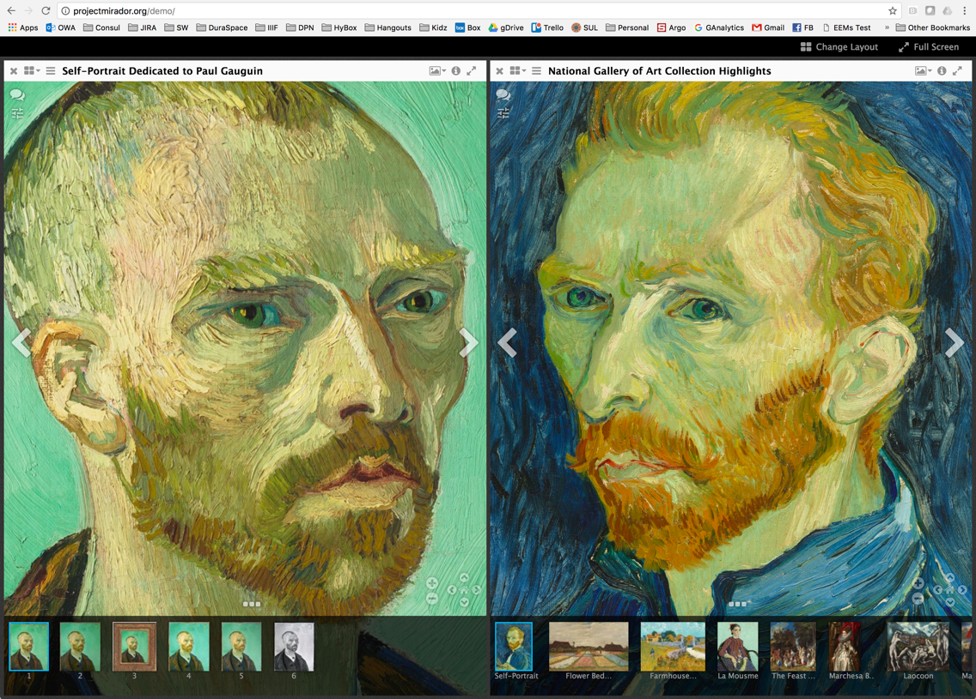
NGA: Compare & Contrast
Notes:
Compare & Contrast works of art

Slide 26
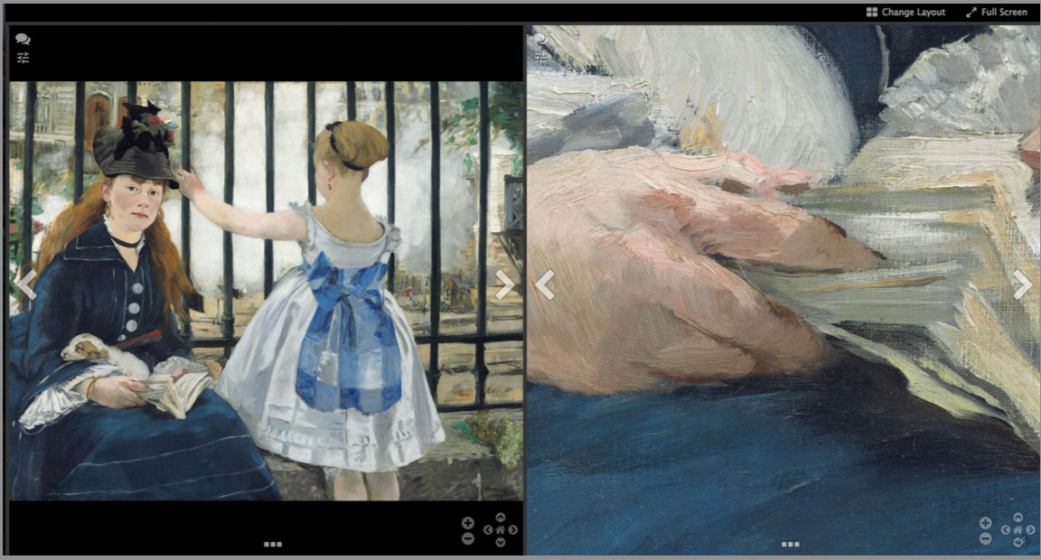
NGA: Close Ups in Context

Slide 27
NGA: Annotation of Details

Slide 28
NGA: Narrative & Interpretation
Notes:
Harvard looking at using Mirador loaded onto tablets in their museums.

Slide 29
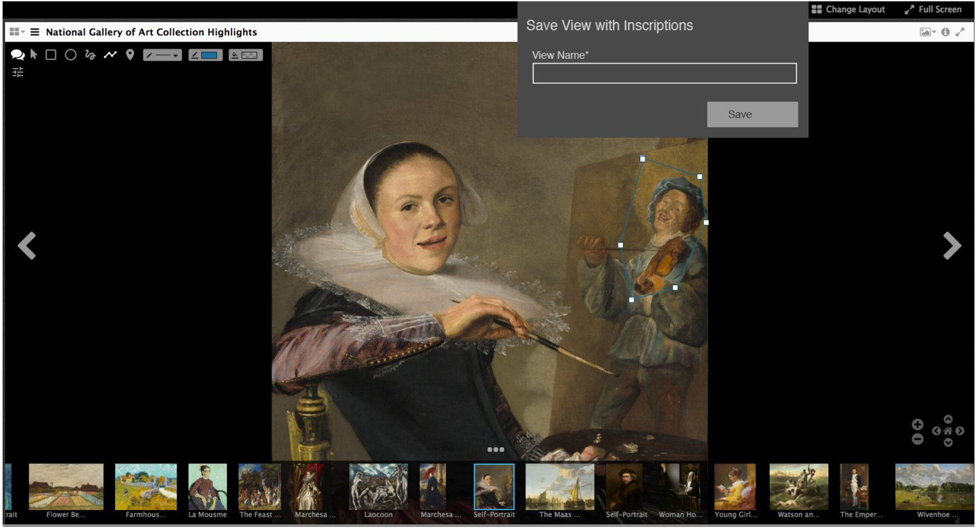
NGA: Scholarly Workbench
Notes:
Harvard looking at using Mirador loaded onto tablets in their museums.

Slide 30
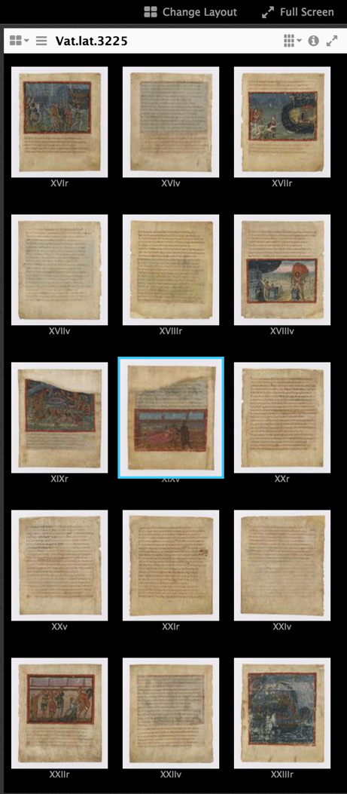
Mirador @ the Vatican
Scientific Analysis
Editorial Review
Interactive Display

Slide 31
Case Study 2
Notes:
IIIF is great. How do I use it?

Slide 32
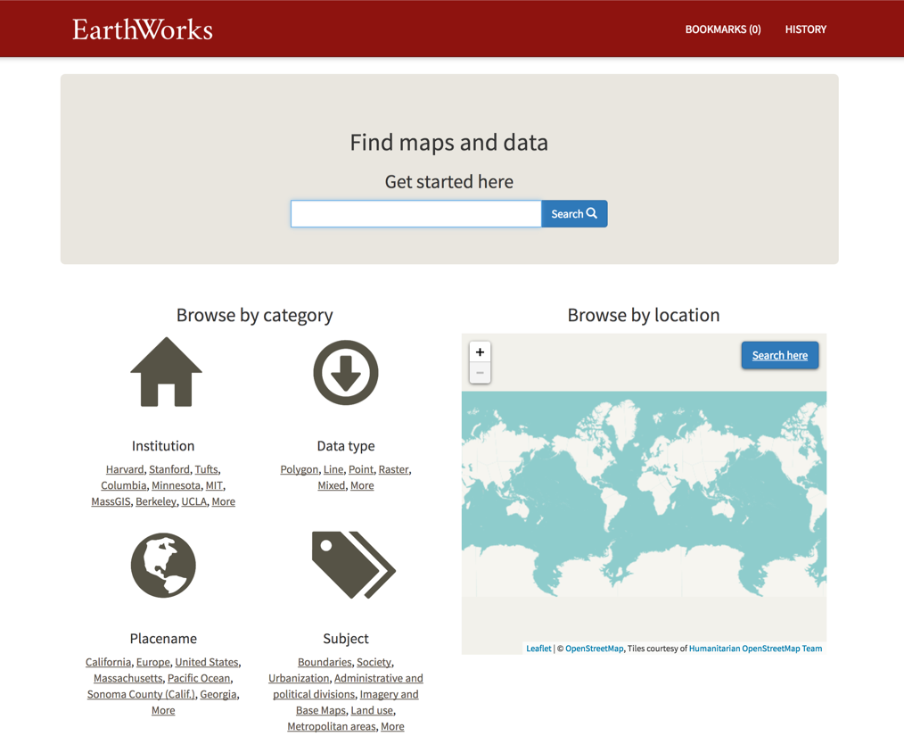
EarthWorks Geospatial Catalog
https://earthworks.stanford.edu

Slide 33
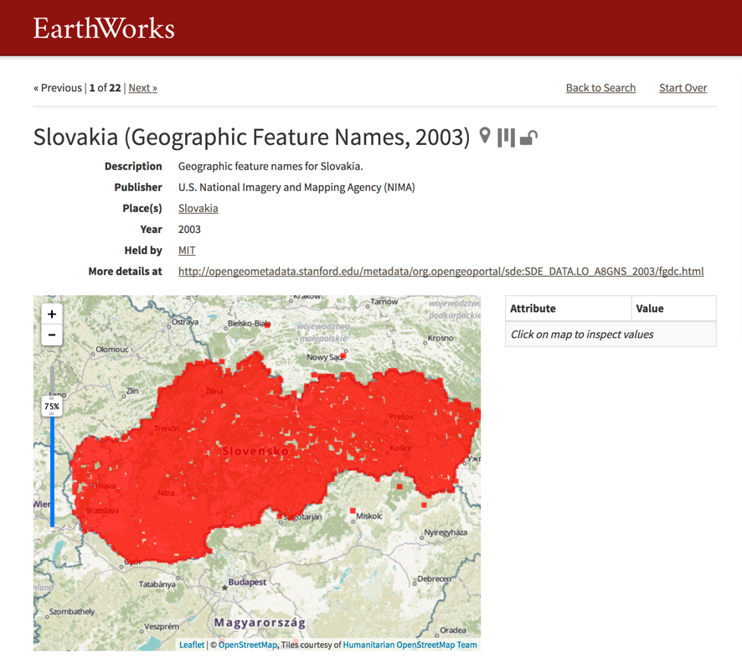
EarthWorks Geospatial Catalog
https://earthworks.stanford.edu/catalog/mit-lo-a8gns-2003`

Slide 34
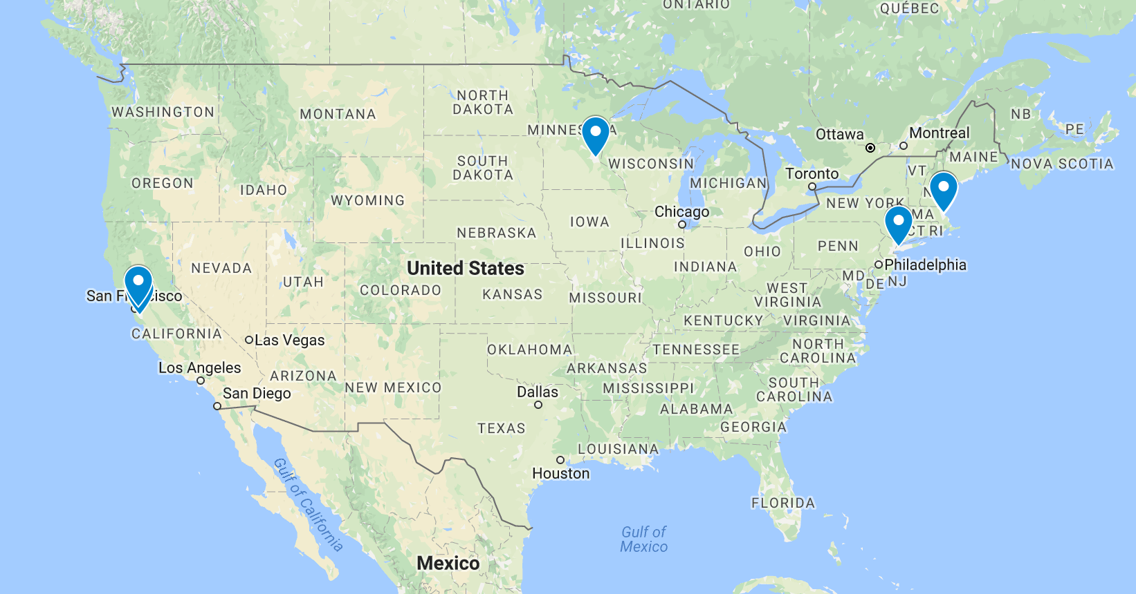
Content from Many Sources
Notes:
IIIF is great. How do I use it?

Slide 35
Content from Many Sources
Minnesota
Harvard
MIT
Berkeley
Columbia
Stanford
Princeton
Notes:
IIIF is great. How do I use it?

Slide 36
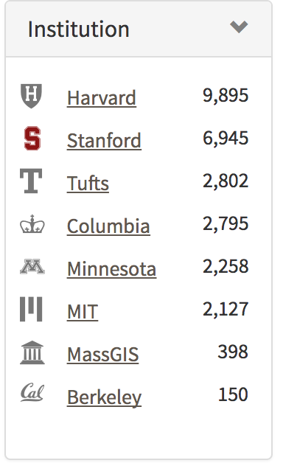
Content from Many Sources
Minnesota
Harvard
Berkeley
MIT
Stanford
Columbia
Princeton
Notes:
IIIF is great. How do I use it?

Slide 37
Content from Many Sources
Notes:
IIIF is great. How do I use it?

Slide 38
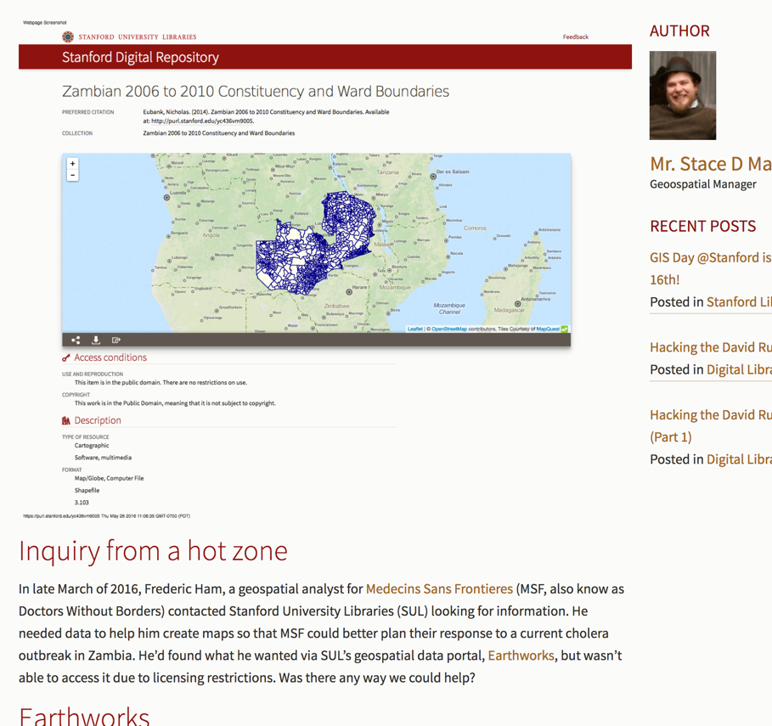
EarthWorks vs. Cholera
http://library.stanford.edu/blogs/digital-library-blog/2016/05/sdr-deposit-week-earthworks-action-against-cholera
Notes:
http://library.stanford.edu/blogs/digital-library-blog/2016/05/sdr-deposit-week-earthworks-action-against-cholera

Slide 39
Case Study 3
RIALTO Research Intelligence
Notes:
IIIF is great. How do I use it?

Slide 40
Who did what?
What research has Stanford produced?
Articles, Data & Projects
How many researchers have projects in X countries?
Which projects have had the highest output?
Who is working with temperature & rainfall data?
Which journals have published the most Stanford research?

Slide 41
RIALTO Research Intelligence
Stanford is a research enterprise; RIALTO (powered by VIVO) is a Research Intelligence system for Stanford. RIALTO tracks the University’s research output.
As a database, it captures and relates information on research artifacts (articles, data and more), research activities (grants/projects), and the people and groups who do them.
As an application, it provides intelligence and reporting on Stanford’s research activities and output.
Through its campus APIs, it supports visualizations and data mining for special purpose and ad hoc needs.
Through linked data, it is Stanford’s face to the Web of Data.

Slide 42
Stanford’s Research Information Ecosystem
SeRA
Research administration system; Propose & manage grants
Profiles
Researcher bios and networks; dashboard for research activity
Stanford Digital Repository
The SDR serves to capture, preserve and provide access to the University’s research output and contributions to the scholarly record.

Slide 43
IIIF Conference 2017
The Vatican, June 05-09 http://iiif.io/event/2017/vatican/

