Slide 1
Representing Campus Research Data in a Comprehensive Tool
David Minor Director, Research Data Curation Program UC San Diego Library

Slide 2
We’ve built a digital repository where we keep our digital collections, including research data.
http://library.ucsd.edu/dc
Notes:
We spent a number of years building a repository for campus research data
Facts about it
Couple of pics

Slide 3
Notes:
We spent a number of years building a repository for campus research data
Facts about it
Couple of pics

Slide 4
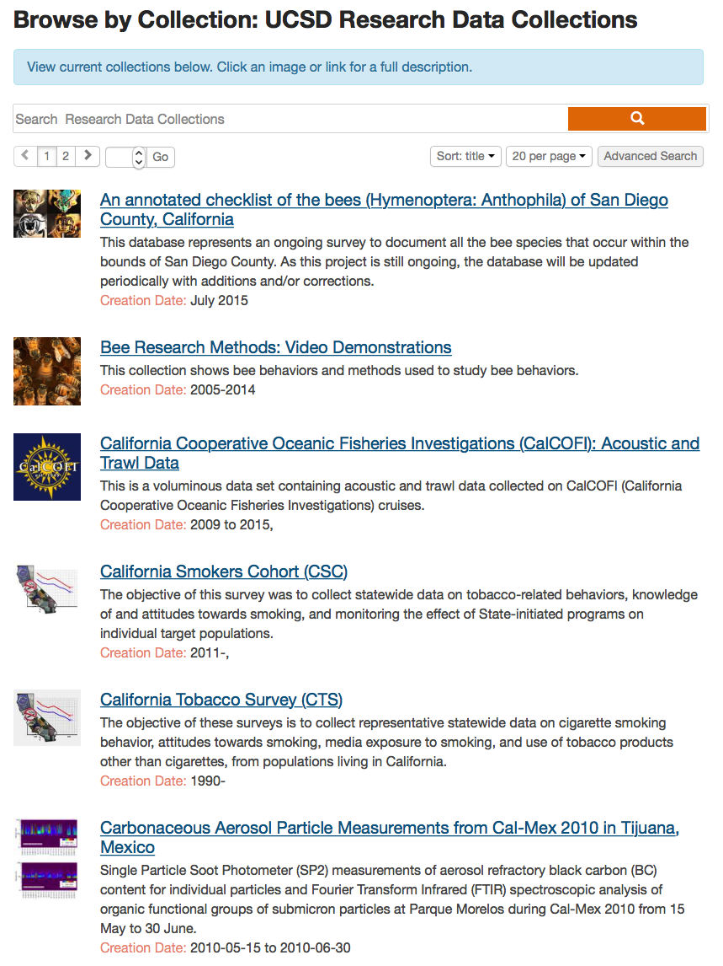
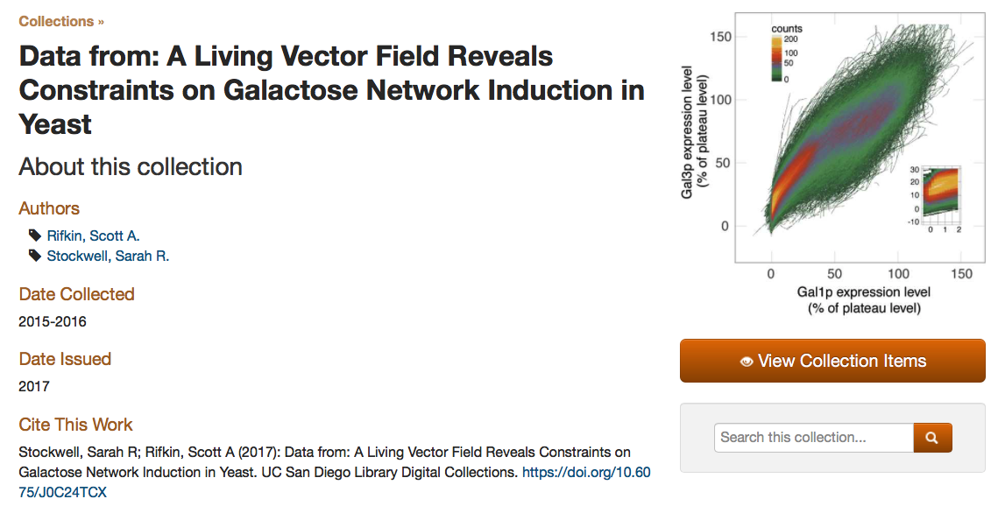
Notes:
It’s been moderately successful, and we’re kept busy adding data to it

Slide 5
But … 99% of campus research data will never go in our repository.
Notes:
We spent a number of years building a repository for campus research data
Facts about it
Couple of pics

Slide 6
Notes:
People are putting things in all kinds of places for all kinds of reasons
Some are mandated, some are preferences, some are just what people know
Some are government/non-profit, others are commercial
There’s all kinds of data in places like OSF that aren’t traditional repositories

Slide 7
Notes:
How do we capture all of this stuff??
And what about metrics, stats, etc.
How can we do this without ceding it to the commercial space?
Big push for institution to own/control as much of our own space as possible

Slide 8
Options
Spend $$$ with a commercial entity
Control issues
Trust issues
Create something from scratch
No staff for this
Not enough money for this
End up with a special snowflake

Slide 9
Ideally we wanted …
to work with a community to create something that works locally but is reproducible elsewhere
to leverage work/knowledge that already exists
to access information/data/metadata that we don’t even know about

Slide 12
https://share.osf.io

Slide 13
https://share.osf.io
Roughly speaking … think of a Europeana for research data.

Slide 14
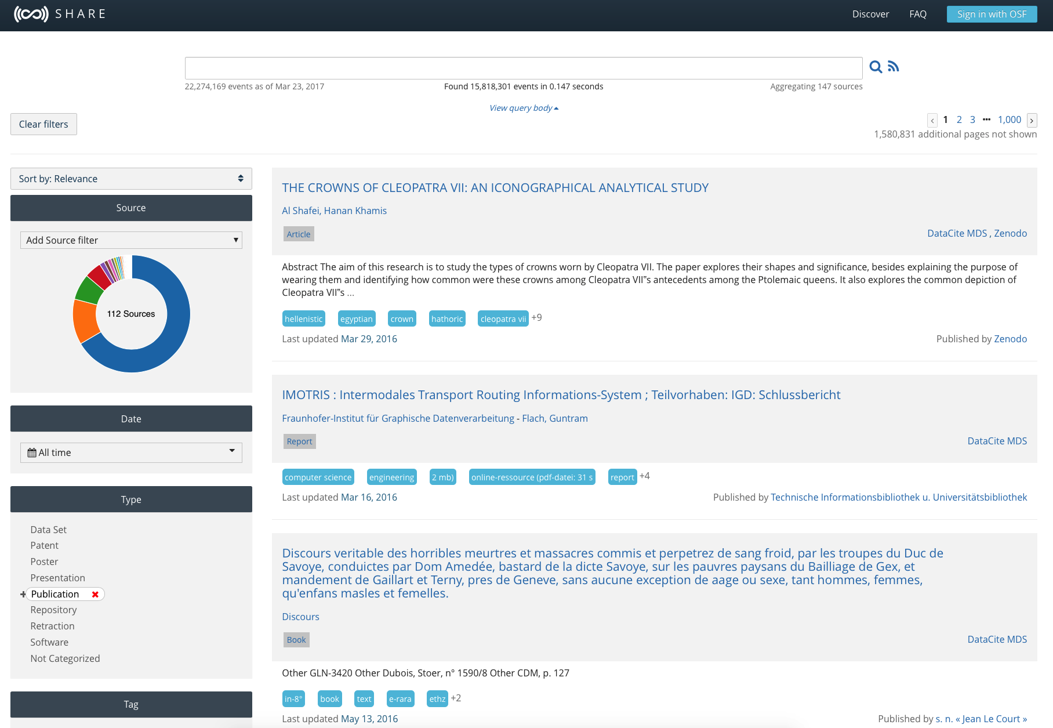
Notes:
How we were involved in SHARE
Pushing metadata there
Talking about ways to improve the metadata there
Trying to find best ways for our campus people to use SHARE
How do we leverage everything that’s there

Slide 15
LOTS of data
Performant
Comprehensive

Slide 16
What if … what if we could use the SHARE corpus to tell a story about our campus research?

Slide 17
It has the metadata about outputs.
It has information about publications.
It has data about funders.
How do we tie all of these things together and present them?

Slide 18
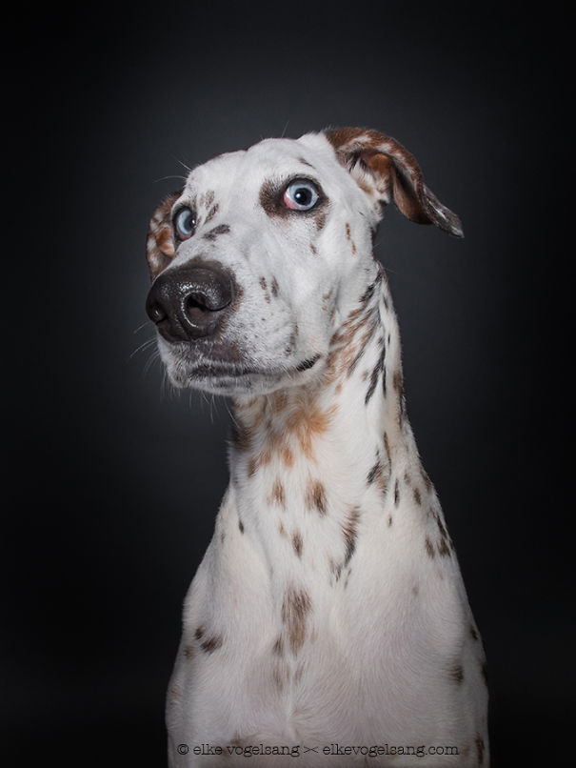
Let’s create a dashboard!
Simple in concept
Kinda hard to actually implement
Institutional naming
Inconsistent entries
No clear ties between funders and data

Slide 19
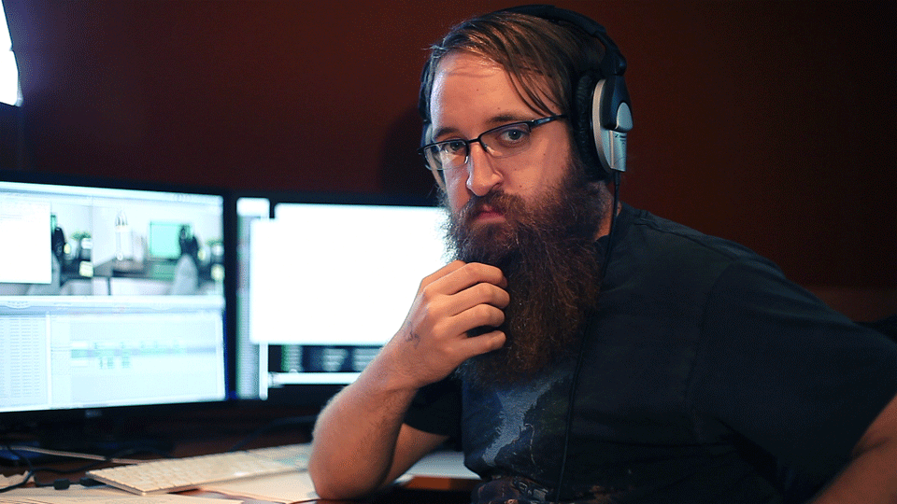

Slide 20
We just decided … LET’S DO IT
We had extensive discussions on:
how to identify our campus
how to present wide variety of outputs
how to brand

Slide 21
http://tritonshare.ucsd.edu

Slide 24
Created on the fly via query
Manually curated

Slide 25
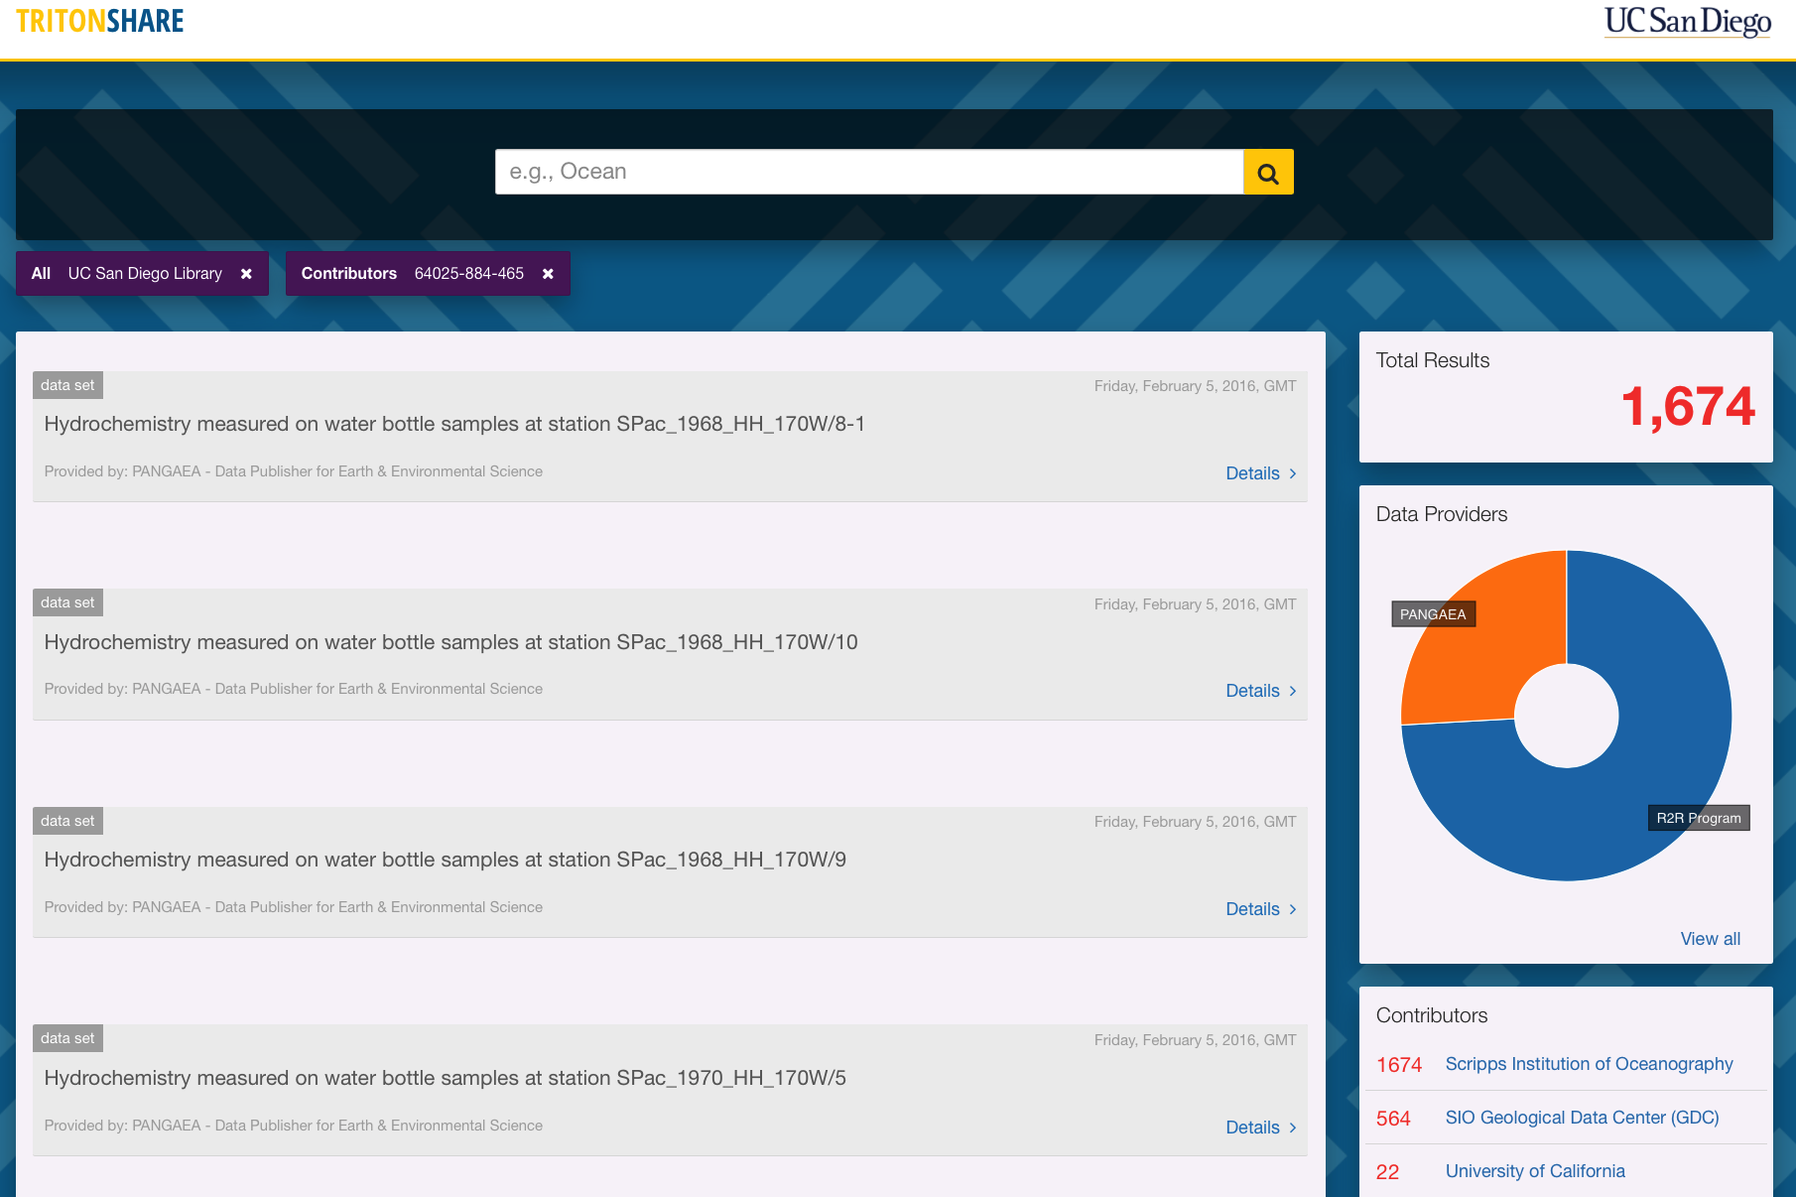

Slide 27
http://tritonshare.ucsd.edu

Slide 28
Up next …
General refinement of everything
Improvement of diverse metadata in catalog
Connecting improved metadata to sources
Creating custom interfaces for other institutions

Slide 29
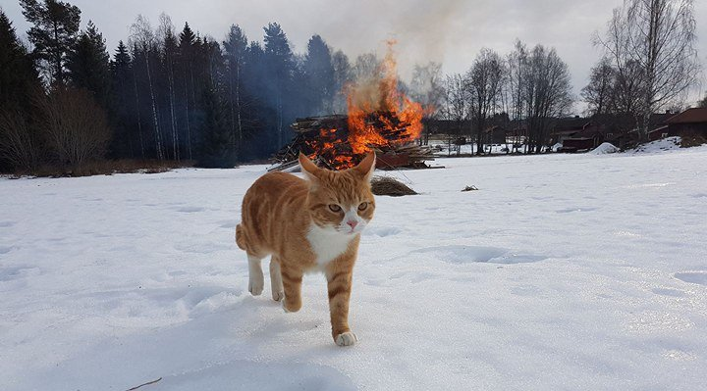
Thank you!
dminor@ucsd.edu

Slide 30
Acknowledgements
Slide 5: don’t know origin of image. Cute cat though.
Slides 6 and 7: all logos are copyright their respective owners. Used without explicit permission.
Slides 8 and 18: images copyright Elke Vogelsang – elkevogelsang.com
Slide 9: dunno. Is out there on lots of webpages.
Slide 19: your guess as good as mine.
Slide 29: Black Metal Cats, @evilbmcats.

