Slide 1
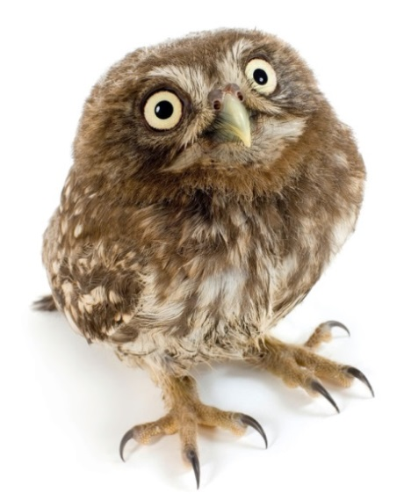
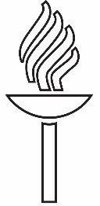
A Service Model for Green Open Access in Finland – Why, What and How?
ILIDE 2017, Jasná, Slovakia
4.4.2017
Pekka Olsbo
Head of Publishing
Open Science Centre
University of Jyväskylä

Slide 2
Three ways to open access
Gold OA: Open access journals, which may or may not charge a publishing fee.
Hybrid OA: Subscription based journals, where authors can buy their own articles open access.
Self-archiving, also known as green open access, refers to the practice of depositing articles in an institutional repository or a subject repository. An embargo period is usually needed.

Slide 3
Why Green Open Access? The Finnish perspective
In May 2016 the European Union announced that "all scientific articles in Europe must be freely accessible as of 2020"
Also Finland has set its goals for open access: 60 % OA in 2017, 90 % in 2020.
In Finland all researchers are encouraged (forced) to publish in journals listed in Finnish Publication forum How many open access journals do you think there are listed in Finnish Publication forum?

Slide 4
Why Green Open Access?
Publication forum Level 3 (the highest level): 1,5 % OA-journals Level 2: 1,3 % OA-journals Level 1 (the lowest): 4,5 % OA-journals
There is absolutely no way that Finland could in any way base it´s development of open science in gold open access!
Even though Finland has made hybrid OA deals with Taylor & Francis and Sage, and maybe one day with Elsevier too…
Not to mention what these deals would cost us.

Slide 5
Why Green Open Access?
Of course we have to support OA-publishing and Gold OA, but alone these are not a solution … to anything.
Unless we make a total change of paradigm in scientific publishing, we´ll need green open access (self-archiving) because: it´s cheap, it´s efficient, it´s easy, it doesn´t require (almost) anything from researchers, it gives tools for evaluating research output, and because it gives common good for everybody.

Slide 6
Who´s business is green open access?
Term self-archiving hints that it is the author, who should take care of green OA.
BUT we believe it is not …
University libraries are the key players and librarians should take care of everything.
Authors just take care of their files.
Our experience suggest that in order to succeed, practices of green OA need to be centralized.

Slide 7
Situation in Finland
Number of deposited articles in universities repositories

Slide 8
What has happened?
A big step has been taken in creation of centralized services; population of CRIS (research information system) and process of self-archiving are now libraries´ business.
Researchers don´t have to worry about reporting of their publications or the green open access – it is taken care of on their behalf.
But this is reality only in few universities.
So is everything ok and openness of Finnish research is on it´s way up? No.

Slide 9
What is being deposited?
Deposited articles in 2015

Slide 10
If final drafts are not deposited…
Process of self-archiving is not working the way it should.
We don´t get anything from the authors.
We just deposit what is already open somewhere else.
We don´t boost for open access.
Openness in Finland does not increase.
We are not doing what we should do!
We are only wishing not acting!

Slide 11
Development of green OA
Deposited articles in institutional repositories vs. total number of articles
in 4 Universities in Finland

Slide 12
Development in University of Jyväskylä

Slide 13
Development in University of Jyväskylä

Slide 14
How did we do it in the University of Jyväskylä?
Processes of CRIS and repository – cataloguing and publishing work seamlessly together.
Interoperability of IT-systems. A necessity.
Question of expertise, learning process, growth of knowledge, working in a small group of specialists.
Constant communication with researchers - show them benefits, make them think.
Keeping it simple.

Slide 15
Service model for open science in University of Jyväskylä: Open Science Centre
Centre started officially in January 2017
University library and University museums merged together
All open science activities centralized
Coordination of IT-services for research groups
All publishing activities working together; publishing, cataloging, reporting, open access, system development… The lifecycle of a publication in one hands

Slide 16
No demands for researchers but demand for services
If we set goals for open science, we have to understand what these goals require: - infrastructure - services - open science goals have to be strategic goals
Somebody needs to take the responsibility
Need for centralized service models – Open Science Centres

Slide 17
Thank You
Questions??
Contact
Pekka Olsbo
Open Science Centre
University of Jyväskylä
pekka.olsbo at jyu.fi

