Slide 1
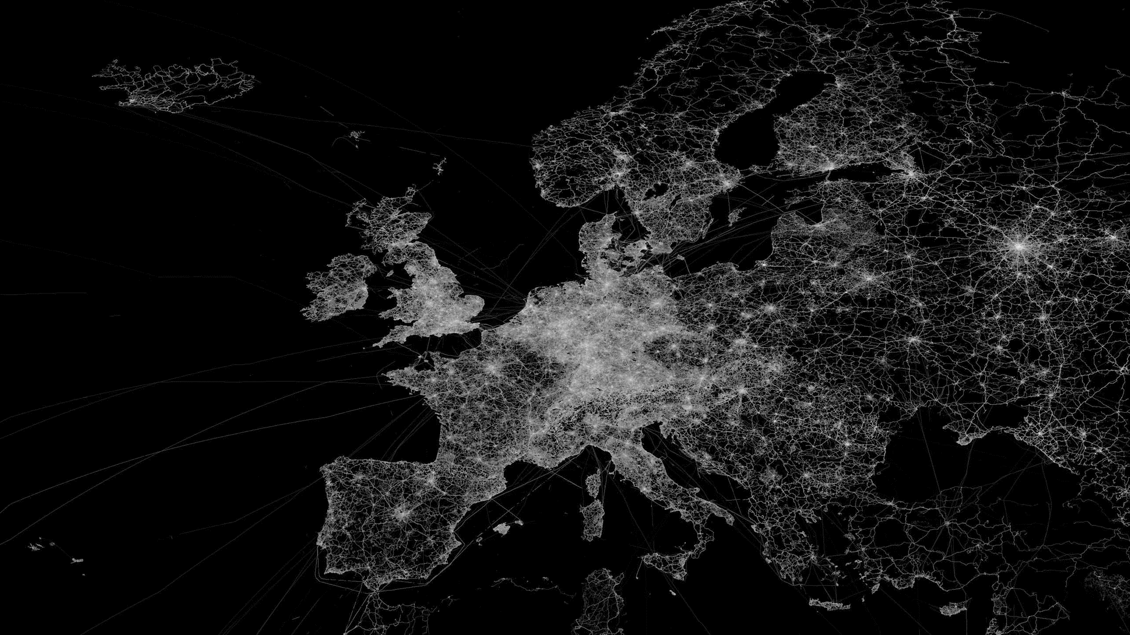
KeepSafe Europe Workshop
ILIDE Conference 2017
Lisa Otty, EDINA
Tom Cramer, Stanford University
Notes:
Introduce ourselves: Lisa is working on the KeepSafe project and will talk about that and the European national hosting projects it supports; Tom heads up work at Stanford, where the LOCKSS programme and a variety of other open source initiatives originate - he’s going to speak about the technologies that underlie national hosting and about the LOCKSS technology in particular. But before we get started, we’d like to have you introduce yourselves too. Go around the room:
Name
County
Any specific interests / reasons for attending this workshop

Slide 2
KeepSafe Europe
A Network of National Hosting Projects, supported by Stanford and led by EDINA at the University of Edinburgh
Notes:
The KeepSafe project is supported by Stanford and led by EDINA. It’s an initiative to develop and support a network of national hosting projects across Europe, these are projects which seek to create locally-hosted archive collections of e-journals and sometimes e-books.
We’re really here today because we hope that some of you might be interested in developing such projects in your own countries or regions, or indeed you might be aware of activities already underway that might benefit from the support of the network.

Slide 3
What are ‘National Hosting projects’?
Full-text archival collections of journal content held in their own country by libraries on behalf of their national research community.
Part of a Research Library Commons
Archive layer: networked above-campus
Future of research library collections
Shared activities at international scale to advance the cause of research librarianship in the service of scholarship
John MacColl, RLUK Conference 2017
Notes:
So, for clarity it is probably worth explaining exactly what we mean when we talk about national hosting projects. National Hosting projects are full-text archival collections of journal content held in their own country by libraries on behalf of their national research community. The levels of access they grant or would like to grant can vary quite a lot – some are planning dark archives, while others are looking to grant access in the case of trigger events or publisher platform failures.
They are part of is increasingly conceived of as an ‘archive layer’, part of a ‘library commons’ – this is an idea borrowed from John McColl, the Chair of RLUK, who gave a talk at this years Research Libraries UK conference. It’s worth watching the whole talk when made available online, but a key concept of this is the idea of an archive layer that sits above-campus
Made up of interconnected services and governed by the research library community. The principle thought behind this is how to manage collection development in the digital environment.
Which brings us onto the question of why the KeepSafe project and the national archiving projects it supports are necessary.

Slide 4
E-Journal Challenges
Changes to the library’s traditional role
Post-cancellation Access: License clauses are inconsistent and hard to manage
Managing subscription data over time: Entitlement rights are unclear (to both libraries & publishers; following transfer)
Notes:
To answer this question, we need to unpack some of the challenges that digital publishing models have introduced, challenges with which you will probably be very familiar.
Okay, as you will all be aware, one of the most significant changes that digital publishing has introduced is that rather than buying copies of content, as they did with print, libraries now subscribe to access content that publishers make available via their own platforms. In other words, libraries build webs of e-connections rather than e-collections – with digital they don’t have their shelves of back-copy the way they did with print. This changes the libraries traditional role as stewards of content, a change which has several significant implications.
For example, a potentially important issue arises when you want to cancel a subscription: how do you ensure that you get access to the content you have paid for when you don’t hold a copy? Publishers often maintain that they will continue to provide access for the years paid for, but as commercial entities publishers are subject to the pressures of the market, and they may choose to sell journals they hold, change their platform or they may even go out of business. License clauses can be very inconsistent and hard to manage: Libraries need to reference the perpetual access clause of their licenses at several points throughout the year: during the acquisition processes, electronic -> print format change and cancellation process. Each year, librarians spend time and effort both finding and then interpreting licences.
Managing subscription data over time is also increasingly complex: libraries now have to manage entitlement data—the data which documents which journals they have subscribed to for which year etc. - over the long term and this can be difficult to keep track of. This means it’s hard to know for certain what access a supplier should provide, and it’s an ongoing effort to keep the discovery system up to date. More broadly, it can be difficult to understand where access to a title comes from e.g. whether access is from a big deal bundle, from a single subscription, or as part of an archive backfile. Ideally, libraries are seeking a view of accepted subscription data without wading through original documents.
Often, a considerable amount of back and forth is required with publishers to reach an agreed understanding. It’s time consuming to try and clarify this, especially during busy renewals period.

Slide 5
Publishers provide perpetual access but….
Librarians avoid making claims due to effort required
No local resilience when external services interrupted
Limited capacity to deal with problems within library community
Subject to policy changes around access and pricing
Notes:
Often, a key criterion of continuing access policies is secure perpetual access to the journal via the publisher or via e-journal archives. But talking to librarians we have found that:
However, some libraries reported that they avoid making claims due to the time and effort required.
And there is no local layer of resilience, which means there is limited capacity within the library community to deal with problems should they arise.
Fundamentally, though, the results of the surveys conducted and our conversations demonstrates that the current solutions are not sufficiently addressing library problems.

Slide 6
73%
Found their approach to PCA wholly or partly unsatisfactory (Jisc Consultation, 2015)
are quite or very concerned that access could be lost following cancellation (SafeNet Survey, 2015)
89%
Notes:
Okay, so there is strong evidence that despite efforts to date, perpetual access remains a serious issue for libraries.
A Jisc consultation last year discovered 73% of respondents found their approach wholly or partly unsatisfactory.
A survey we conducted as part of the SafeNet project found that 89% of respondents were quite or very concerned about loss of access,

Slide 7
Notes:
But, as you are no doubt aware, there are already some solutions in place: There are global archives such as the US-based CLOCKSS and Portico, which are well established and do an excellent job on behalf of libraries, but they operate as third parties and therefore not within the policy control of libraries. And so there’s growing interest in supplementing the development of global archives with local solutions.
There is also the international LOCKSS programme, which operates typically at the individual library level. However, we have found in the UK that for many institutions the technical and resourcing requirements for setting up an institutional LOCKSS box are significant barriers.
National Hosting project typically expect to use the LOCKSS technology and collaborate around a national Private LOCKSS Network, creating economies of scale and concentrating technical expertise.

Slide 8
Managing Risk in a Changing World
Supplement external provision with local capability to:
Operate under local legal arrangements (e.g. copyright, data protection)
Protect against external policy changes (e.g. Brexit, Trump)
Protect against budgetary pressures (e.g. fluctuating exchange rate)
http://www.nasa.gov/images/content/115334main_image_feature_329_ys_full.jpg
Notes:
That long-term local stewardship idea is very much an attempt to manage risk.
External service providers operate under different legal jurisdictions.
The Trump administration shows that established policy positions can quickly change.
The exchange rate is putting new pressure on materials budgets.
Where can investments be made, at the institutional level, in support of national capability, or at the European level, to manage these risks.

Slide 9
The KeepSafe project
Edinburgh, July 2016
University of Liege, Belgium
Consortium of Swiss Academic Libraries, Switzerland
DTU Library, Denmark
NatHosting, Germany
CARE/CRUI, Italy
Kaunas University of Technology, Lithuania
Slovak Centre of Scientific and Technical Information, Slovakia
RLUK, UK
University of Edinburgh, UK
LOCKSS Program, Stanford University, USA
Notes:
Okay, to the KeepSafe project provides a space in which those involved in setting up national hosting initiatives across Europe can share knowledge and discuss their experiences and how to resolve some of the challenges they face.
As I mentioned at he outset the project is supported by Stanford and led by EDINA. There was an invited meeting in Edinburgh, in July 2016 – the list of those attending is on the left here. The goal was to explore prospects for European-wide collaboration building on developments to date.

Slide 10
Objectives of KeepSafe Europe
1. Securing Access to secure
Policy control of subscribed and bought digital content
Persistent and uninterrupted access
Post-cancellation access
Resilience following transfer between publishers
3. Transparent Entitlement to clarify
Clarity of entitlement to reduce anxiety and give confidence
Entitlement history to past subscribed and bought content
Process for gathering and populating an entitlement record
2. Legal Mechanisms to enable
Local load and custody of content
Innovative usage of content (e.g. via text mining)
Consistent licensing language to simplify negotiation
Sharing of negotiation experience
4. Knowledge Transfer to foster and enable
Sharing of experience
Sharing of knowledge about costs and business models
Development of governance structures
Sharing of technology
Notes:
At that meeting, we outlined a series of four objectives – I won’t read them through, as they are in your handout – but as an overview, they are around supporting one another in securing access, exploring legal mechanisms for local loads and their use, investigating how entitlement data is can be clarified and maintained, and sharing knowledge to enable other projects to benefit from the work we are all undertaking.

Slide 11
KeepSafe: National Projects
CARE/CRUI, Italy
SafeNet+, EDINA/University of Edinburgh, UK
NatHosting, Germany
Consortium of Swiss Academic Libraries, Switzerland
DTU Library, Denmark
Notes:
At present the group is composed of those who have projects either underway or about to begin:
Italy launched a national project in January.
The UK is running a project call SafeNet+, which EDINA is leading.
Switzerland and Germany launch their own projects in the second half of this year.
Denmark are undertaking a scoping study ahead of a full project proposal.
Smaller countries such as Belgium are investigating how to get involved: it is difficult for small countries to host enough network nodes to make a PLN viable, so there is the possibility that small countries may work together or with larger neighbours.

Slide 12
SafeNet+: National Archive Infrastructure
Service Governance & Management
Participation
Agreement
Distributed Digital Archive
Node
1
Node
2
Node
3
Node
4
Node
5
Node 6
Authorized Continuing and Post-Cancellation Access
Published
Entitlement Registry
Publishers
Content
Distributed Digital Archive Member
Publisher wishes to remain the priority access source
Licence Agreement
Notes:
So I can give you a sense of what one of these projects looks like, by talking very briefly about the UK’s SafeNet+ project.
This diagram shows the infrastructure that we are working towards.
A publisher deposits content into the SafeNet archive. We expect to use LOCKSS as a service platform, so the archive will be replicated at a number of organisations
We’ve extended the LOCKSS infrastructure to work at national / consortial level, adding support for Shibboleth authentication, Integration with Entitlement Registry, Per-institution COUNTER reports
Publishers will continue to supply primary access.
And the institution will use the SafeNet archive only if a publisher can’t supply access and the entitlement registry gives permission

Slide 13
SafeNet+: Entitlement Registry
Seeking a shared view between libraries and publishers
Process to capture assertions, improve quality and support clarification
“Assertions” as we know that historic record keeping is variable
Pragmatic approach in context of an imperfect world
Interested in the quality of information and the mechanism to improve it
Notes:
Publishers and libraries have both highlighted strong interest in the Entitlement Registry.
We’ve built a system that captures data around the idea of events. So subscription is an event, a transfer is an event.
Our goal is to establish a process to capture assertions about entitlement, and then have mechanisms to request clarification and improve quality over time.
We need to do this as we know that historic record keeping is variable, and we are searching for a pragmatic approach in an imperfect world.
Collectively, we should be interested in the quality of information and the mechanism to improve that.
And so we have introduced the idea of a query and dispute mechanism to request further evidence about an entitlement assertion.

Slide 14
Benefits of the national hosting approach:
Clarity of perpetual access arrangements in licences
Clarity of entitlement information for libraries
Ownership of content in national research infrastructure
Infrastructure gives a framework for discussion of continuing access arrangements
Notes:
So we can see how this kind of model can help clarify rights and entitlement issues,
And how a national archive has potential to become a key part of our research infrastructure.
It’s good risk management: it gives us control over long-term collection management and access decisions
It gives us a platform to ensure that community requirements and expectations can be met,
And it allows the conversation around best practice implementation of perpetual access clauses to take place directly between the UK community and publishers.

Slide 15
We welcome your participation in KeepSafe
Join the mailing list
Contribute to periodic conference calls
Attend future face to face meetings
lisa.otty@ed.ac.uk
a.rusbridge@ed.ac.uk
We welcome your participation in KeepSafe Europe.
Join the mailing list
Contribute to periodic conference calls
Attend future face to face meetings
Notes:
So some of the questions I’m interested in discussing later are around whether you know of comparable activity in your country or region, whether librarians in your country or region share the same concerns, and whether any of you are you interested in or are already developing a local hosting project.
We’re really keen to hear from others with interests in this area, and were keen to share our progress. Please do get in touch with me, or with Adam Rusbridge who is project manager on both KeepSafe and Safenet.
Thank you for listening.

