Slide 1
DIGITAL ARCHIVING PLATFORM Digital Resources Project

Slide 2
Digital Resources Project
2011 Start OPIS – 7 digitisation and 3 Infrastructural Projects
ULB:Central Data Archive Project (2012.01 - 2014.12)
ULB:Digital Resources Project (DRP) (2015.05 – 2015.12)
2015.05 RFP
2015.06 Project Proposal
2015.07 Project Contract
2015.07 – 11 Appl. Development
2015.11 ICT Installation
2015.12 Pilot harvest
DRP Mission & Goal
Systematic collection and longterm archivation of slovacical web publications and native e-Born content as of integral part of the Slovak cultural heritage.
Creation of technological and organisational infrastructure for archiving the Web and e-Born resources

Slide 3
DRP – Functional Requirements
Information system for
Survey
Registration
Harvesting
Collection
Processing
Preservation
Access
of e-Born Resources
Architecture (7)
Survey WWW (5)
Acquisition (9)
Scope (8)
Quality (6)
Reporting (3)
Catalogue (7)
Access (9)
Preservation (6)
Control (9)

Slide 4
DRP – Architecture

Slide 5
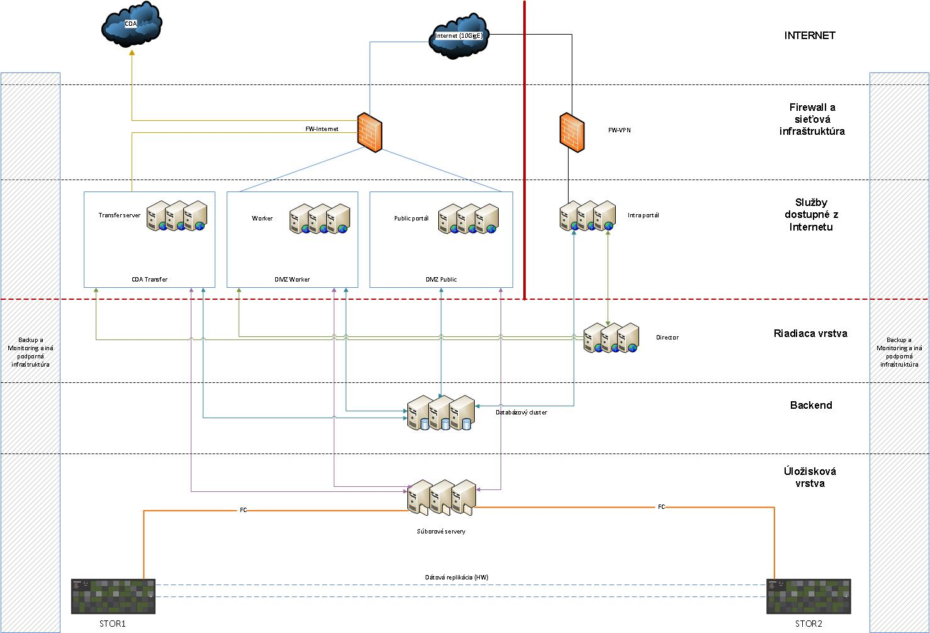
DRP – Technical Infrastructure
CISCO Server Cluster
Public portal Server
Internal portal Server
Workers 24x4 CPU
Hitachi Storage
8x8Gbps
800 Tbyte
CISCO
SAN 48x16Gbps
Firewall 8x10Gbps
Infrastructure

Slide 6
DIP – Software Warehouse
System SW
OS RHEL
Apache Tomcat
PostgreSQL
SOLR
ZooKeeper
RabbitMQ
Java 8u45
Python
Application SW
Heritrix
OpenWayback
Invenio
Wordpress
CLAMAV
Workflow
Cluster
IBM SmartCloud

Slide 7
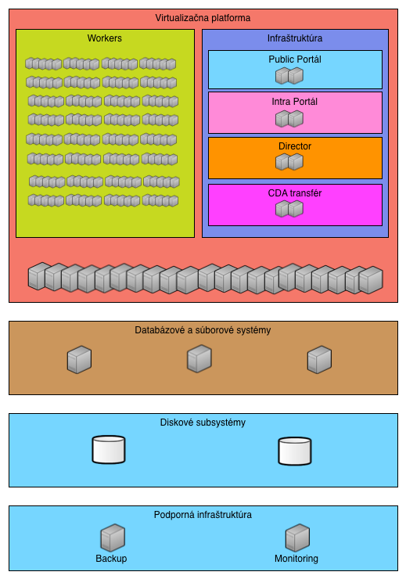
DRP – System Structure
Virtualisation Module
System Resources Management
Database Module
Relational DB, Data sharing
Storage Module
SATA(535), SAS(240), SSD(27) TB
Support Modules
Backup, Monitoring, Communication

Slide 8
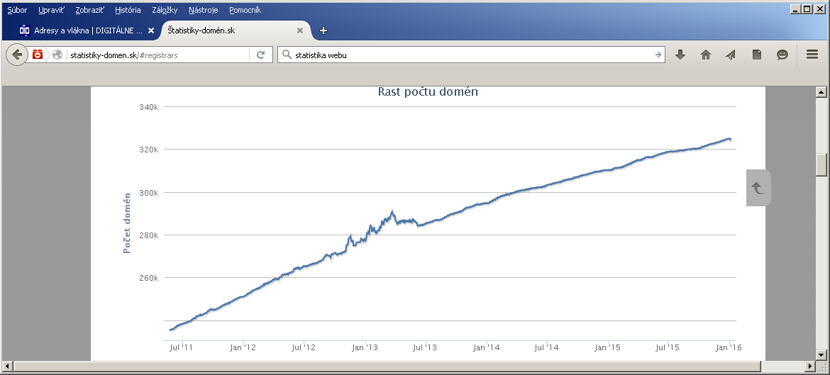
DRP – Resources I
nic .sk ≈ 370 000 sites
.eu, .info, .org, .???

Slide 9
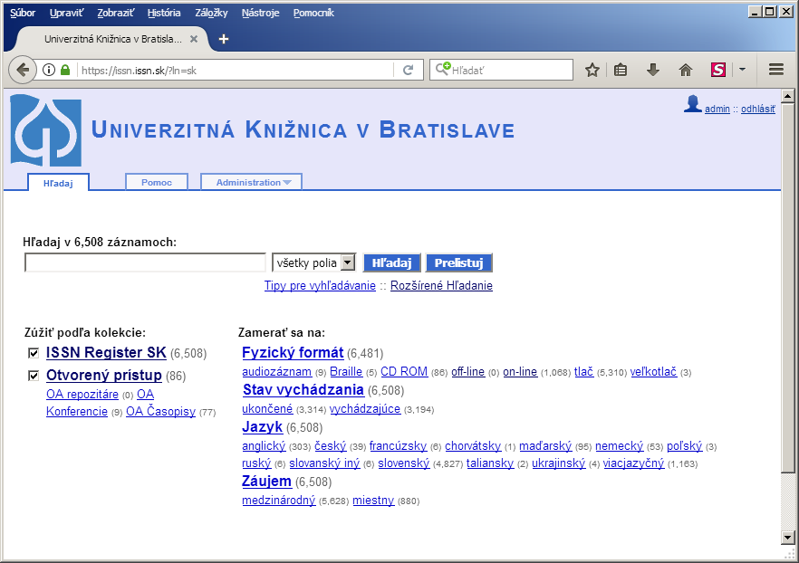
DRP – Resources II
e-Serials (issn.issn.sk)
6600 Titles
1100 on-line 17%
850 on-line live
250 on-line cancelled 20%
100 Open Access
e-Monographs (www.snk.sk)
5500 Titles
500 e-Born 11%

Slide 10
DRP – Resources III
WWW Collection Policy
.sk Domain Harvest 1xY
Thematic Harvest-events
Selective Harvest –Conspect
Agreements
e-Born Collection Policy
Agreements
Creative Commons
OpenSource

Slide 11
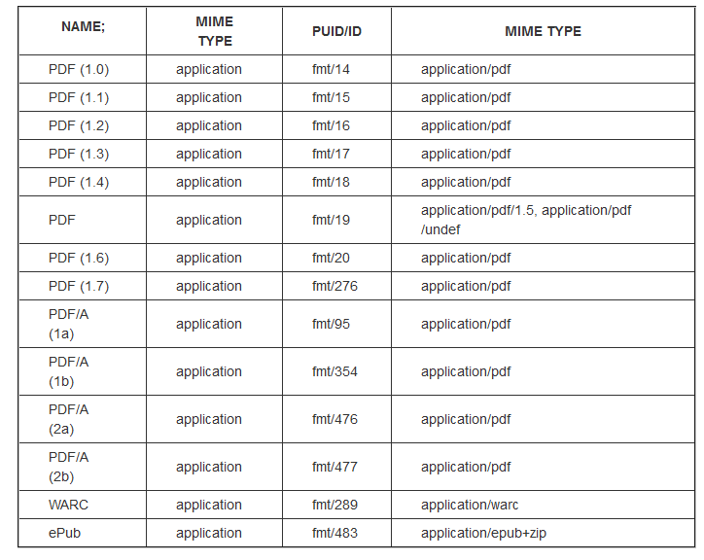
DRP – Accepted formats

Slide 12
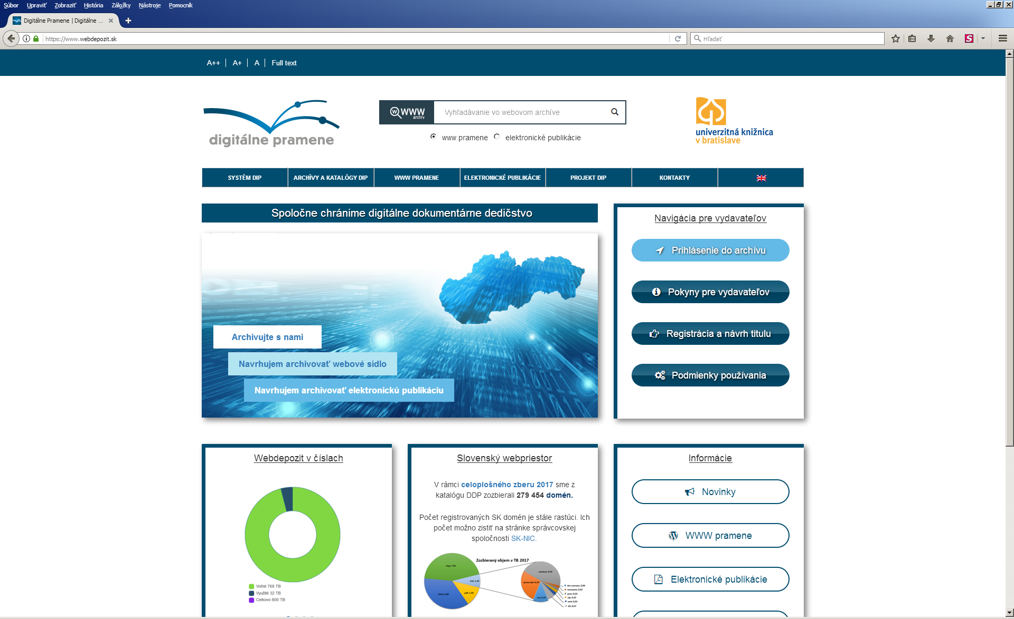
DRP – Public Portal

Slide 13
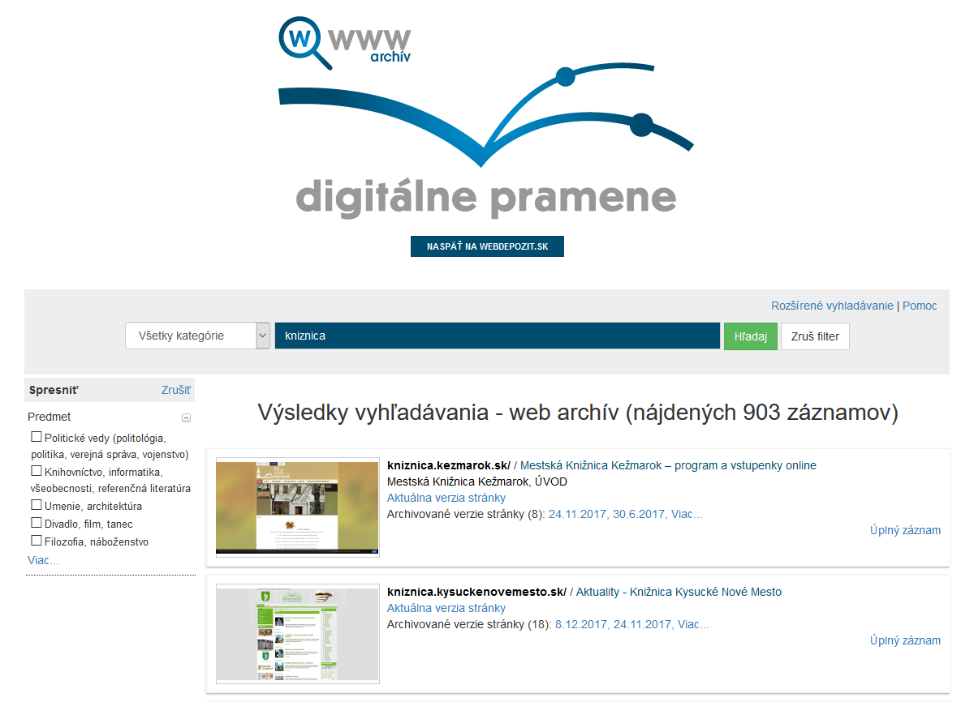
Keyword „kniznica“

Slide 14
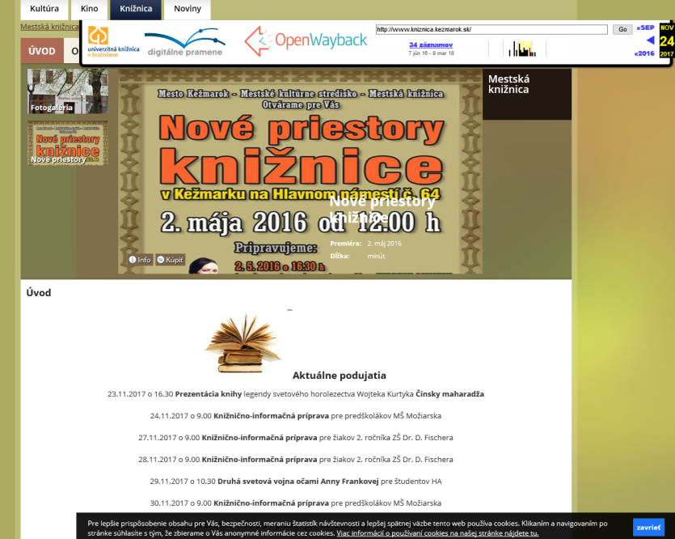
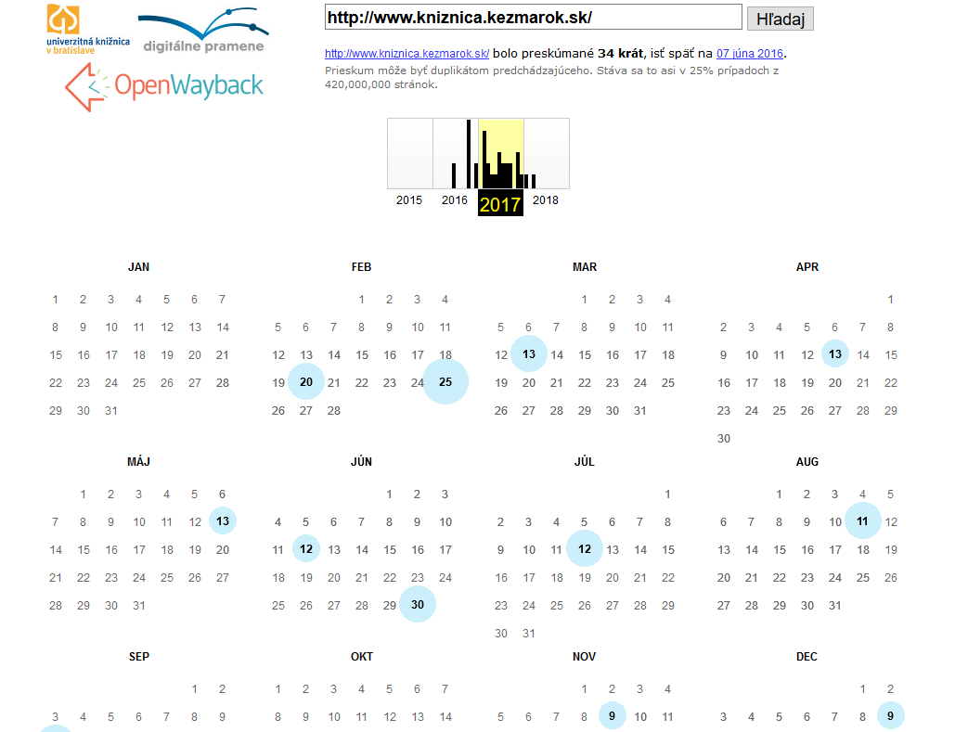
kniznica.kezmarok.sk/

Slide 15
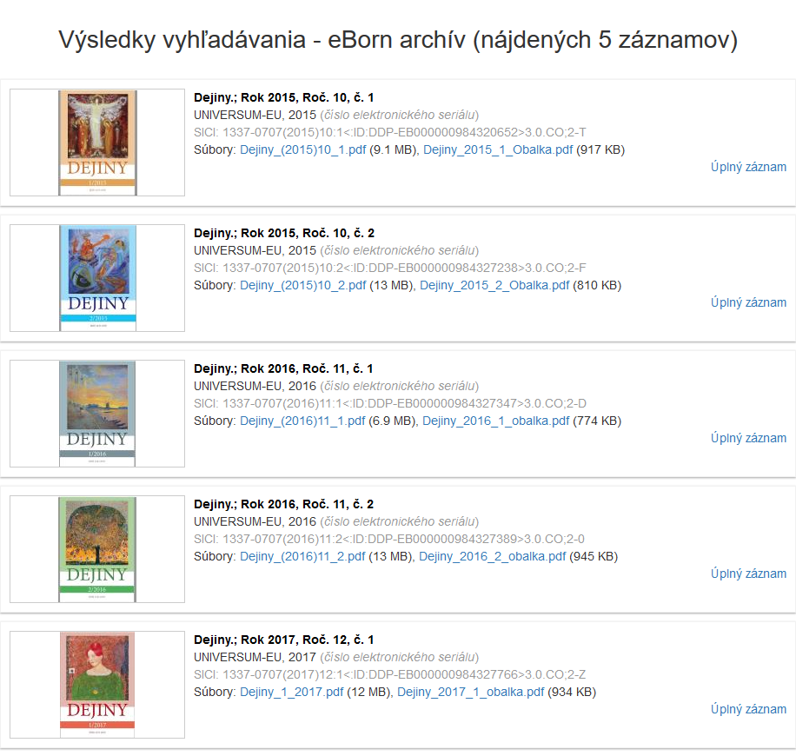
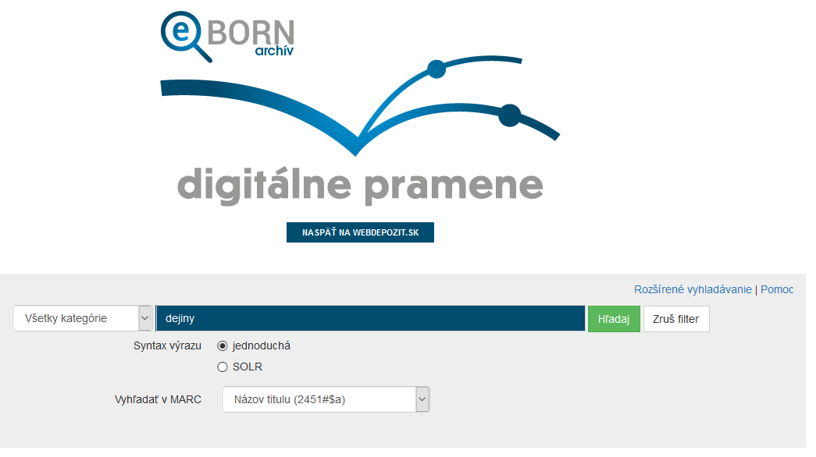
Title „dejiny“

Slide 16
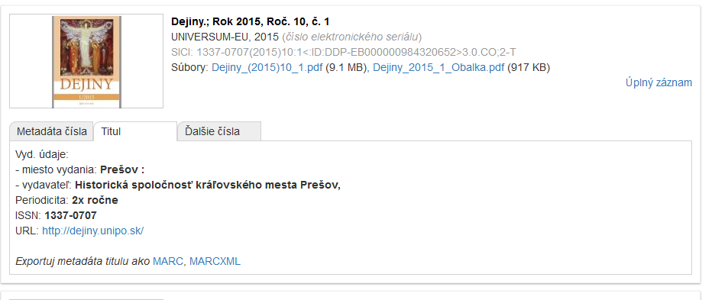
Dejiny; Rok 2015, Roč. 10, č. 1
001__ 984320686
003__ DIP_WWW
005__ 201612191232.0
006__ M
007__ cr c
0220_ $$235$$a1337-0707$$l1337-0707
02440 $$2SK:DDP$$a1337-0707(2015)10:1<:ID:DDP-EB000000984320652>3.0.CO;2-T$$qissue
035__ $$avtls001337070
044__ $$cSVK
072_7 $$2Konspekt$$a8$$xHistĂłria a pomocnĂ© vedy historickĂ©. BiografickĂ© ĹˇtĂşdie
080__ $$22009$$a93
099__ $$aurn:nbn:sk:ddp-eb000000984320652
099__ $$aurn:nbn:sk:ddp-eb000000763218908
1101_ $$aUNIVERSUM-EU
1101_ $$gs.r.o.
2101_ $$aDejiny
222__ $$aDejiny
24500 $$f2015$$nRoÄŤ. 10$$pÄŤ. 1
24500 $$aDejiny.
2451_ $$aDejiny.
260__ $$aPreĹˇov :$$bHistorickĂˇ spoloÄŤnosĹĄ krĂˇÄľovskĂ©ho mesta PreĹˇov,$$bHistorickĂˇ spoloÄŤnosĹĄ krĂˇÄľovskĂ©ho mesta

Slide 17
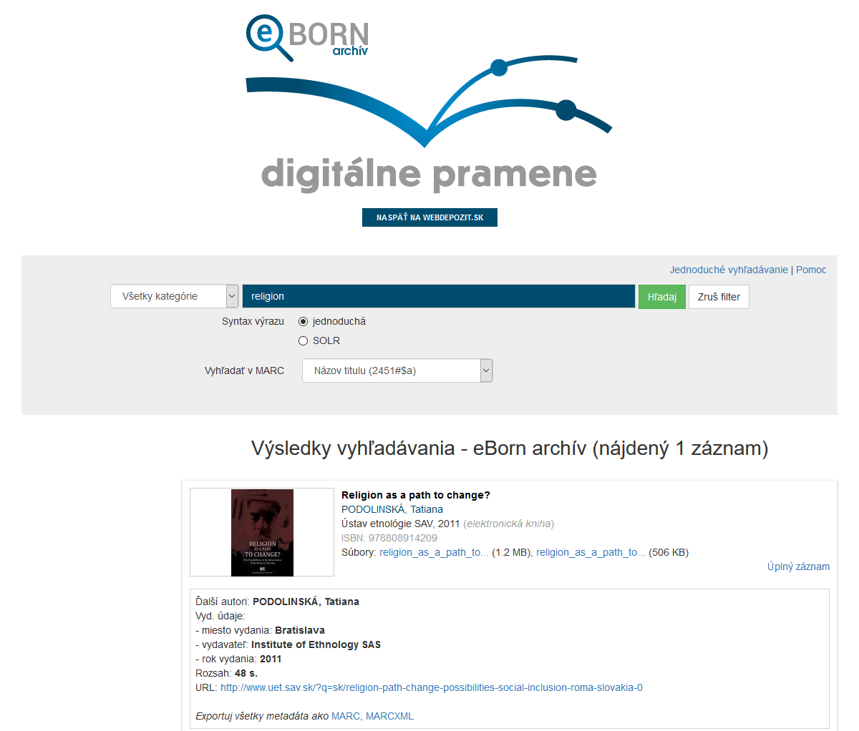
Title „Religion ...“

Slide 18
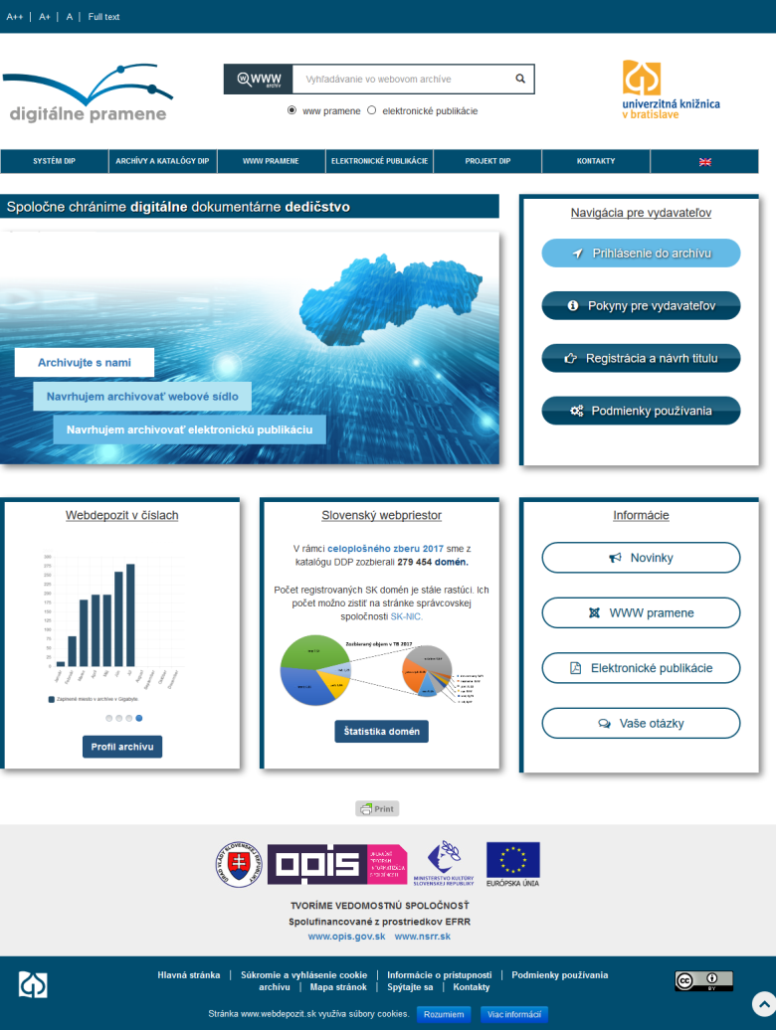
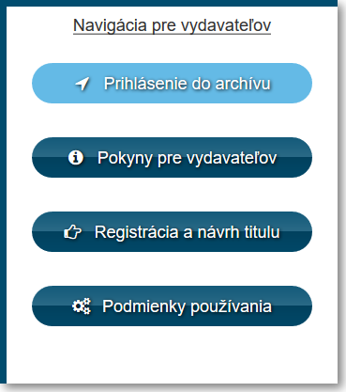
DRP – Publisher Interface

Slide 19
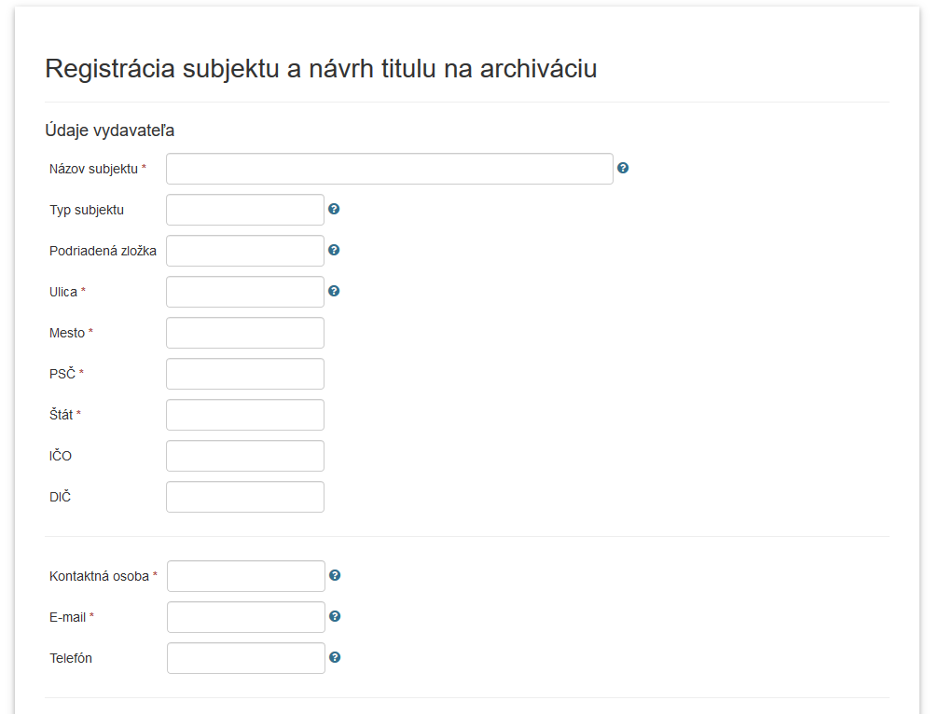
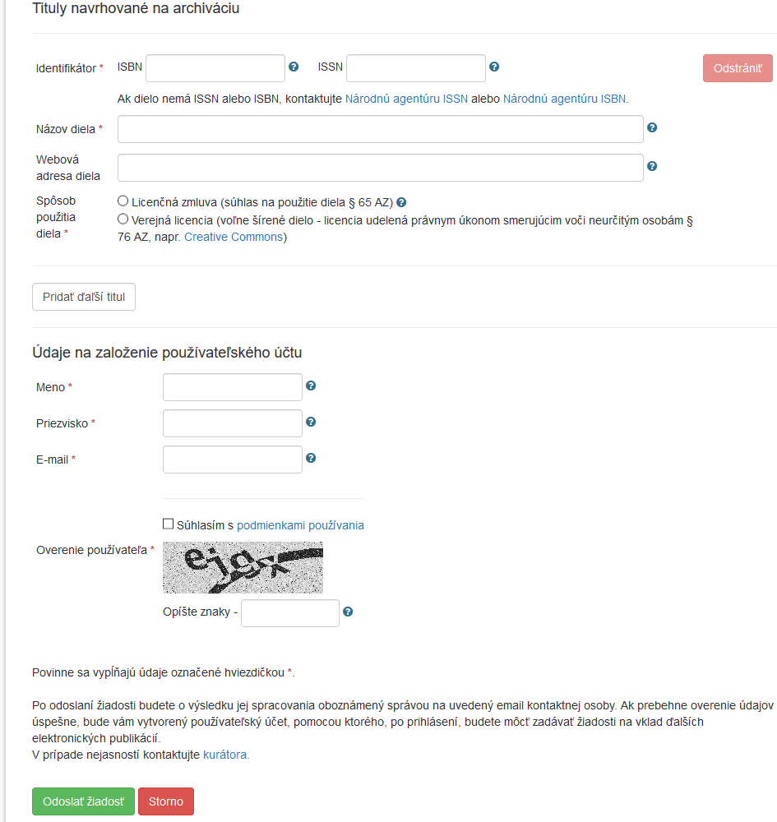
DRP – Registration

Slide 20
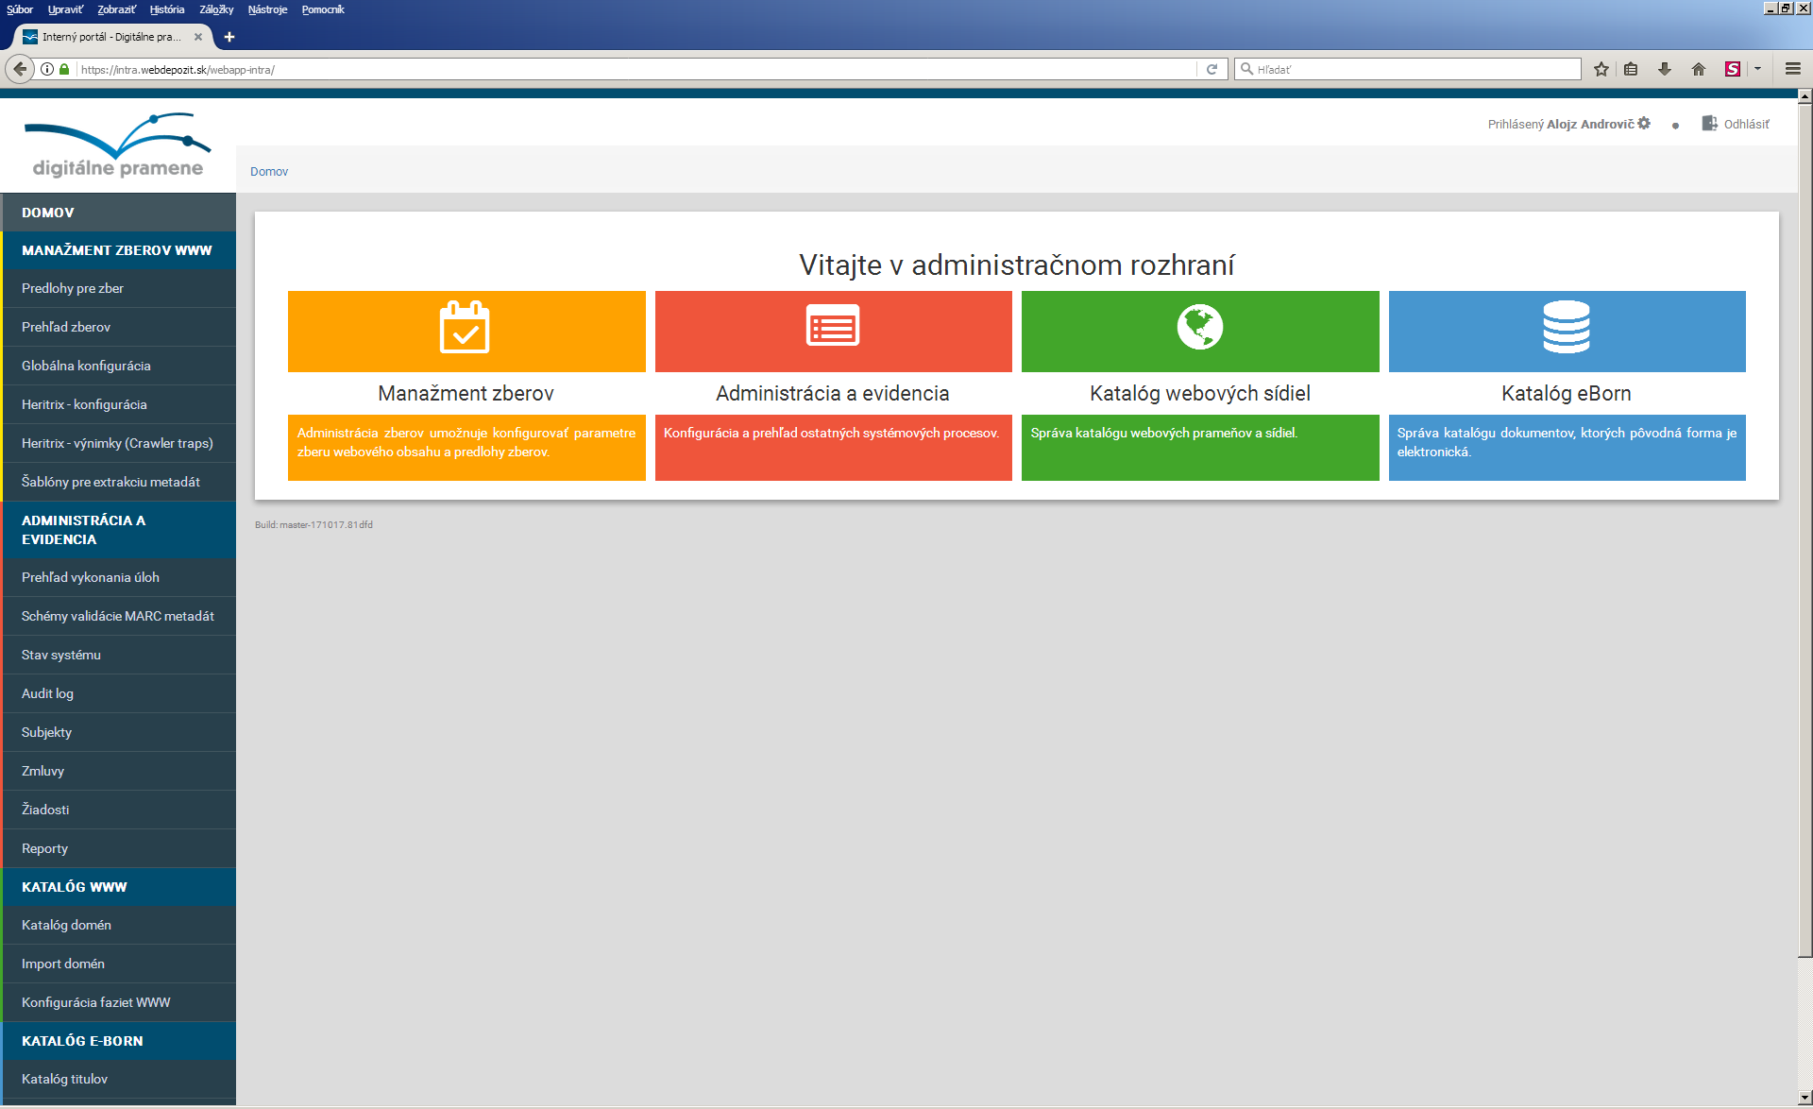
DRP – Curator Interface

Slide 21
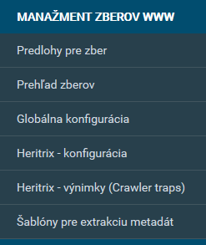
DRP – Curator Interface

Slide 22
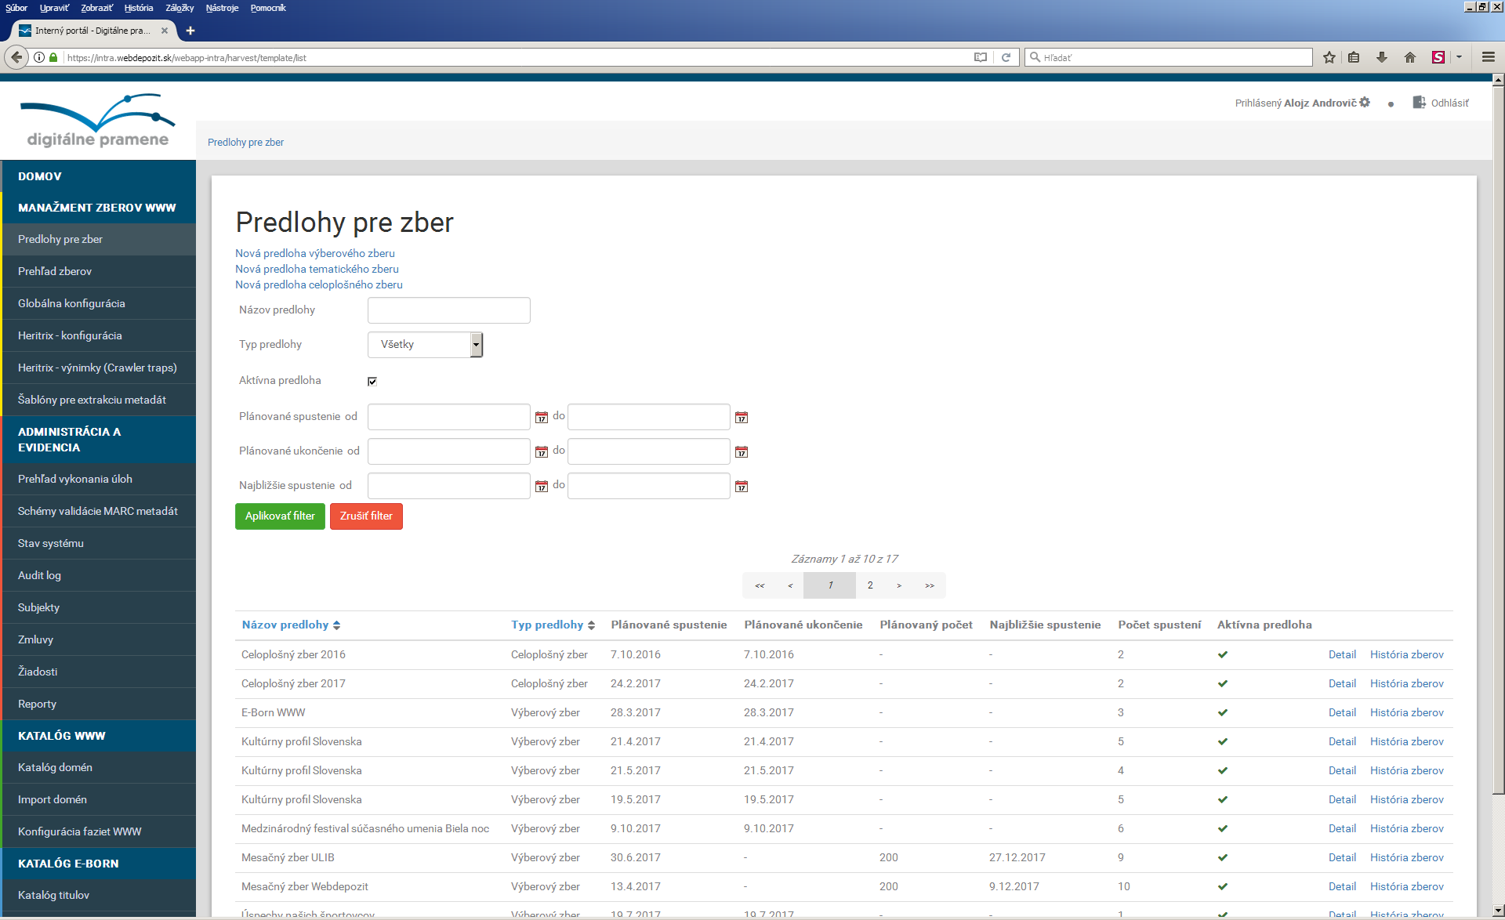
DRP – Harvest Control

Slide 23
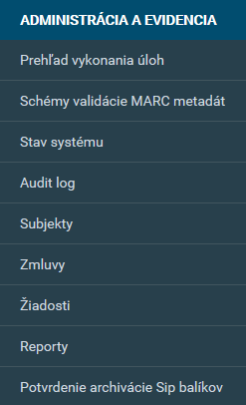
DRP – Curator Interface

Slide 24
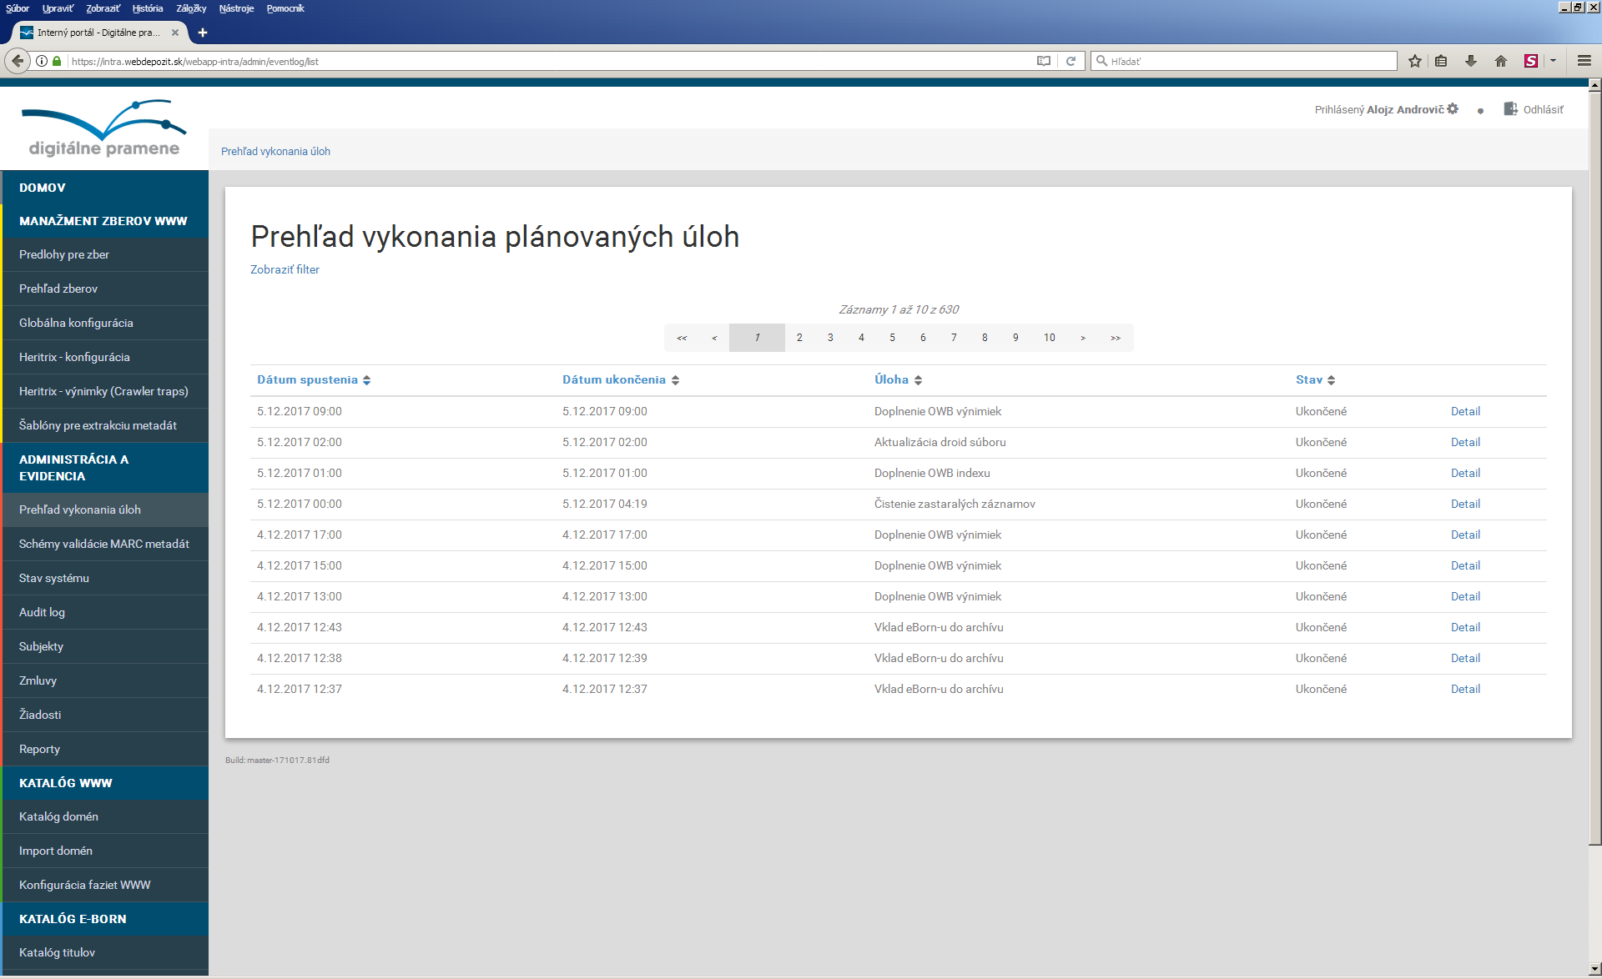
DRP – Administration

Slide 25
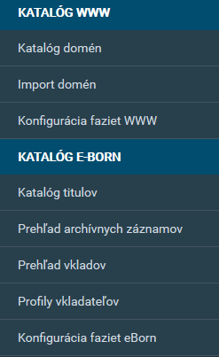
DRP – Curator Interface

Slide 26
DRP – WWW Catalogue

Slide 27
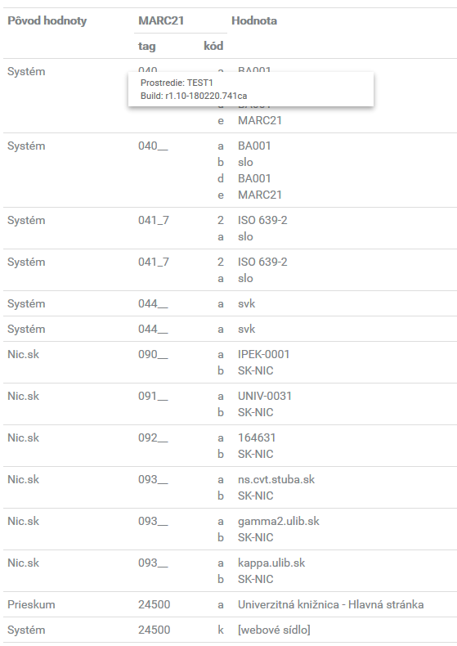
DRP – WWW Catalogue II

Slide 28
DRP – eBorn Catalogue

Slide 29
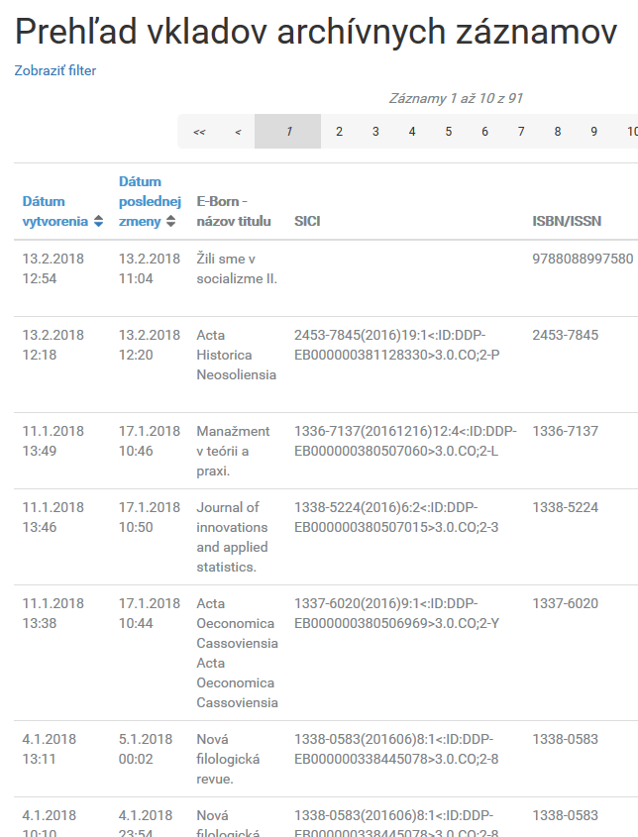
DRP – eBorn Catalogue II

Slide 30
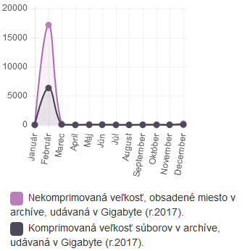
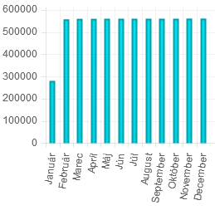
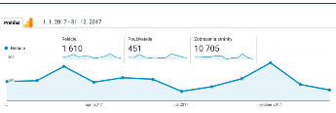
DRP – Figures 2017
Volume
WARC

Slide 31
DRP – Figures 2017

Slide 32
ISSN Register

Slide 33
ISSN Register

Slide 34
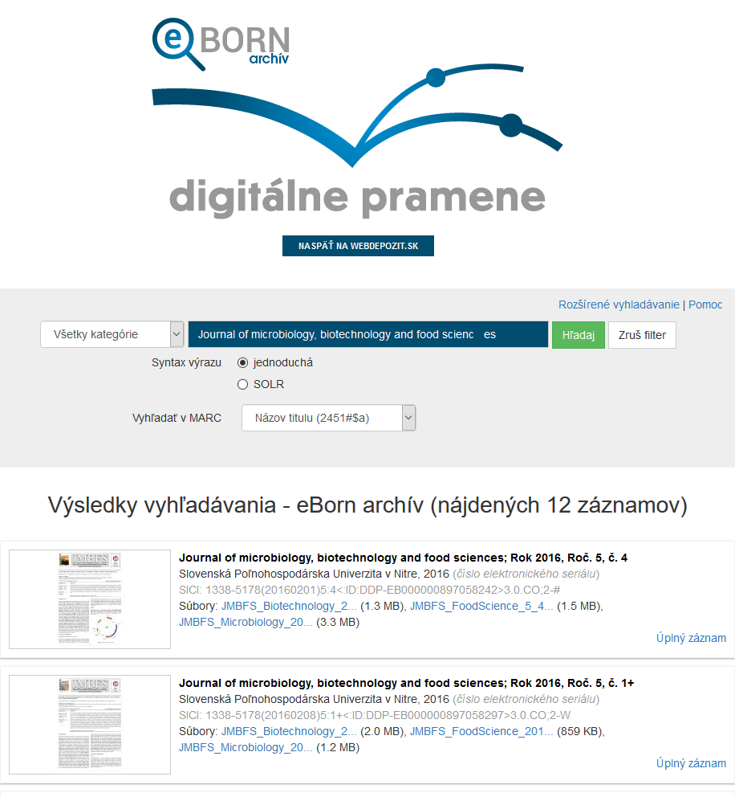
ISSN Register

Slide 35
DIGITAL ARCHIVING PLATFORM

