Slide 1
ILIDE Conference 2018
Interoperability
Rachel L. Frick
Executive Director
OCLC Research Library Partnership

Slide 2
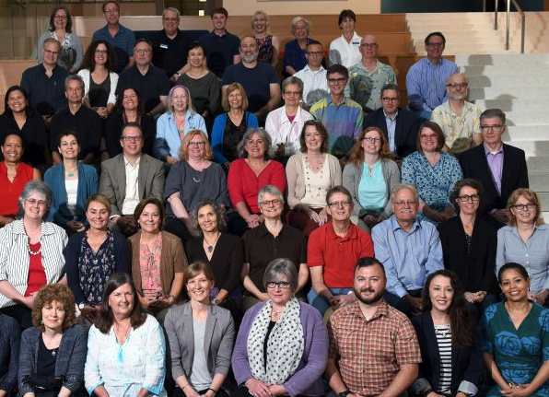
OCLC
Research
Karen Smith-Yoshimura
Jean Godby
Rebecca Bryant
Diane Vizine Getz

Slide 3
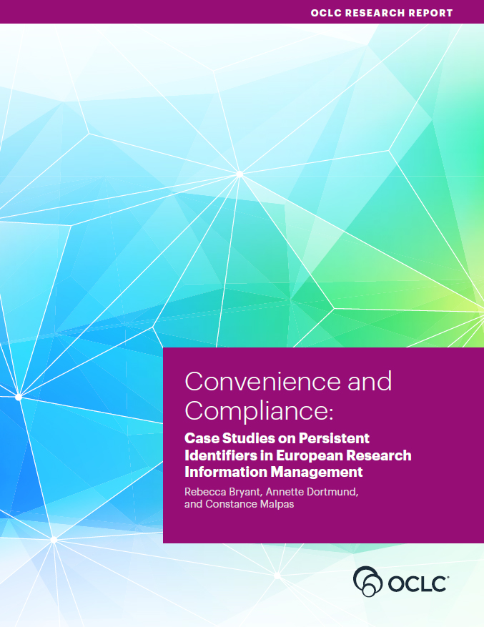
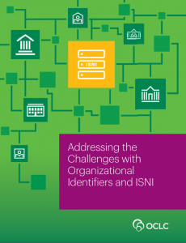

Slide 4
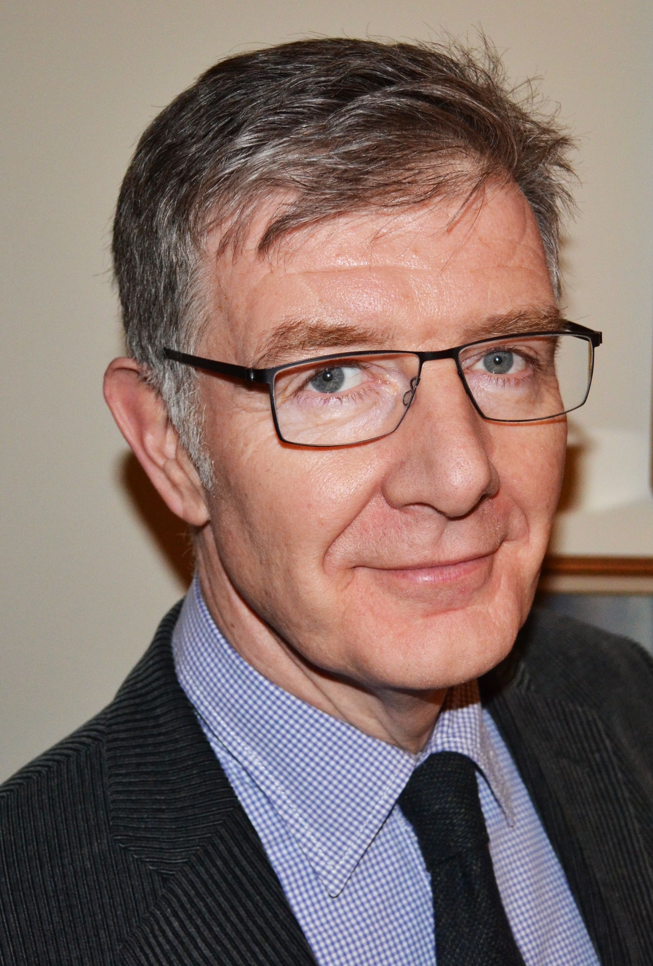
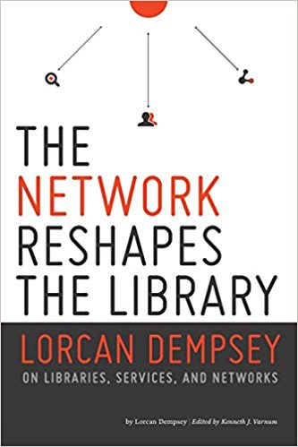
Lorcan Dempsey, VP Research, Chief Strategist

Slide 5
Three trends
Inside out
Facilitated
Collective

Slide 6
Reconfiguration of research work by network/digital
environment.
Inside out
collection

Slide 7
Reconfiguration of the information space by network/digital environment.
Facilitated
Collection

Slide 8
The specialized collection
Reconfiguration of the information space by network/digital environment.
Facilitated
Collection
The facilitated collection

Slide 9
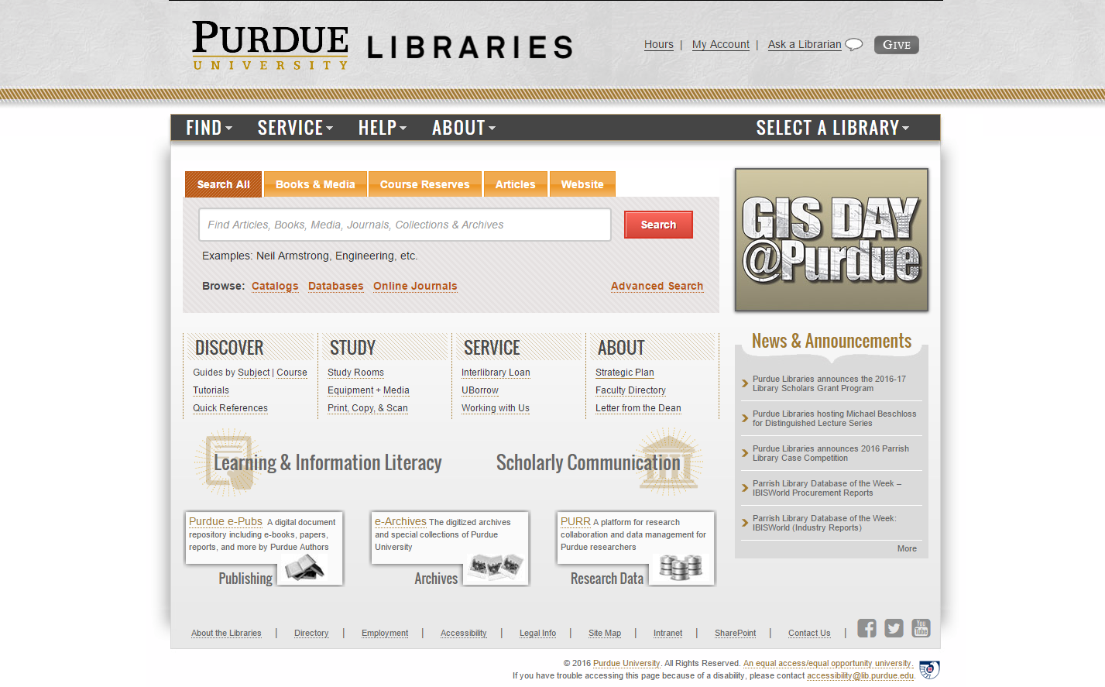
Outside in
Facilitated
Collective
Inside out

Slide 10
The ‘external’ collection:
Pointing researchers at Google Scholar;
Including freely available ebooks in the catalog;
Creating resource guides for web resources.
The ‘borrowed’ collection
The ‘shared print’ collection
The ‘shared digital’ collection
The evolving scholarly record
A collections spectrum
The ‘owned’ collection
The ‘licensed’ collection
The ‘demand-driven’ collection
The ‘facilitated’ collection
Note: Libraries have variable
Investments across the entire
spectrum
Purchased and
physically stored
Meet research and
learning needs in best way
@lorcand

Slide 11
Facilitated collections
Catalog
KB/Discovery
LibGuides, etc
Google, ResearchGate, etc …
Separation of discovery and collection?:
Focus shifts from owned to facilitated (available)?
Focus shifts from collection to other services (creation, …)?
Systemwide thinking becomes stronger?
Owned
Licensed
Available
Global
Figure: Discoverability redefines collection boundaries.
OCLC Research, 2015.

Slide 12
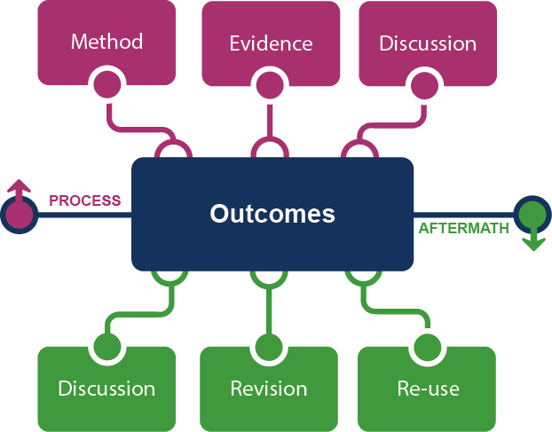
Supporting the creative process: the emerging scholarly record
Supporting the creative process:
the emerging scholarly record
Research outputs
Notes:
This is how we framed out the scholarly record in terms of nature and scope of what it might contain.
Start with published outcomes: the reporting of results, conclusions, ideas and so forth from a particular scholarly inquiry.
These outcomes are still the coin of the realm for scholarly activities, so they are privileged here at the center of the picture;
A lot of these outcomes take the form of text-based materials like books and journal articles, but often supplemented by additional materials such as video, graphics, and interactive programs.
Rest of scholarly record divided into two broad areas: process and aftermath
Process: process of scholarly inquiry; process by which outcomes are produced. Identified three categories of materials generated in this phase in which there is interest in including them as part of the scholarly record:
Method materials related to the methodology of scholarly inquiry (e.g., software, computer models, digital lab notebooks, sampling frames, experimental protocols, instrument calibrations)
Evidence raw materials/inputs to scholarly work (e.g., data sets, survey results, new or enhanced primary source documents, links to findings from other scholarly works);
Discussion refining and improving ideas, methods, conclusions (e.g., pre-prints, listserv/blog discussions, conference presentations, annotated commentary, grant proposals).
Anchoring outcomes directly to the methods employed, evidence used, and formative discussions conducted during the process of scholarly inquiry helps contextualize and deepen our understanding of these outcomes, facilitate replicability, and leverage results into new research.
Once the outcomes from a research project have been formally published or otherwise made available, scholarly activities surrounding that piece of work may still continue in the “aftermath” phase.
Activities in the aftermath phase may include Discussion (through similar channels as those in the process phase, but also post-publication formal reviews and commentary);
Revision published work can be revised in various ways (the work may be enhanced with additional findings; errors may be corrected or clarifications made, etc.)
Re-use (the work may be edited or re-packaged into new forms, such as conference presentations, summaries, blog posts, versions for the “popular media”, etc.).
Not saying that everything discussed here will end up in the scholarly record. But picture represents the maximal scope and depth of materials regarding which there is increasing interest in systematic collection and curation.
Note that some of the materials in the outlying components are becoming or might become outcomes in their own right. Data sets are a good example: in some disciplines the publication of an important data set is now considered a first-class scientific outcome.
More on the evolving scholarly record:
Lavoie, Brian, Eric Childress, Ricky Erway, Ixchel Faniel, Constance Malpas, Jennifer Schaffner, and Titia van der Werf. 2014. The Evolving Scholarly Record. Dublin, Ohio: OCLC Research.
http://www.oclc.org/content/dam/research/publications/library/2014/oclcresearch-evolving-scholarly-record-2014.pdf.

Slide 13








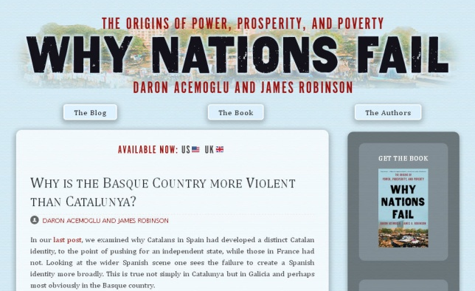


Notes:
http://global.oup.com/uk/orc/busecon/economics/carlin/

Slide 14
Creation, management and disclosure:
Vice president for research
R-
infra-structure
Medical center
Tech Transfer Office
CIO
News Bureau
Institutional Reporting
Research Data Management
Advancement & corporate relations
Provost
Data Warehouse
RIM/Profiling system
Digital scholarship
LIBRARY
Colleges & depts
Institutional Repository
User education & training
Disciplines & departments
Graduate school
Office of undergraduate research
Researcher
Research manager
Research support
Campus center for teaching & learning

Slide 15

Persistent IDs
as Lynchpins
Derive context
Provide points of reference
Transaction / Translation
Infer trust, provenance
Indicate preservation commitment
photos.de.tibo
https://flic.kr/p/4stXaP
https://creativecommons.org/licenses/by-nc-nd/2.0/
Notes:
photos.de.tibo
https://flic.kr/p/4stXaP
https://creativecommons.org/licenses/by-nc-nd/2.0/

Slide 16
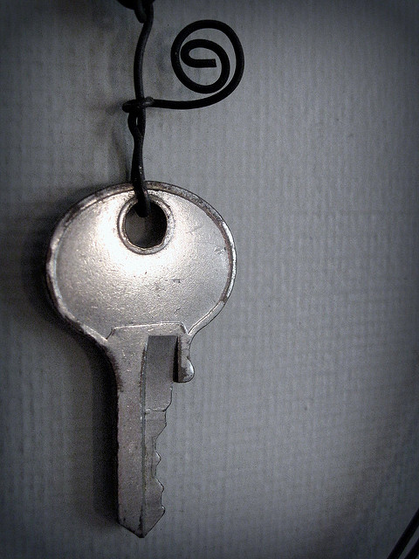
Key Attributes:
Unique (global/local)
Persistent
Actionable
Jenni Konrad
https://flic.kr/p/7awFZZ
https://creativecommons.org/licenses/by-nc/2.0/

Slide 17
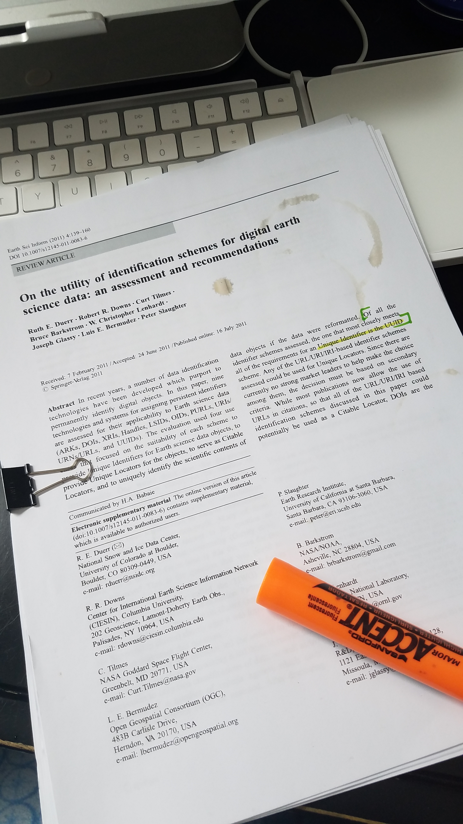
”On the utility of identification schemes for digital earth science data: an assessment and Recommendations ” – Duerr et al.
Provide user with simple ability for uniquely and unambiguously identify data of interest
Help user find and access data regardless of where they reside or how the responsibility for managing data has changed over time
Facilitate management of data over time and data citation
Should have a trust value
Notes:
Identifiers can indicate context – trust – commitment to preservation/archival intent
Article by Ruth Duerr

Slide 18
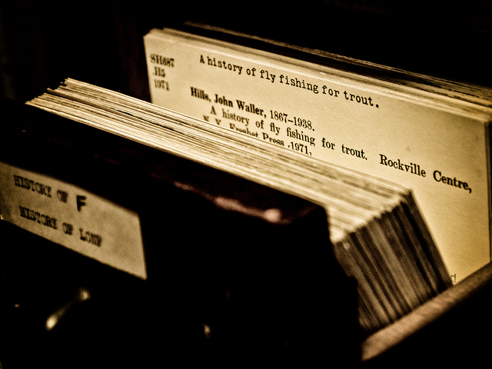
Call Number:
Local ID
Contextual Data
Point of Connection
Enables Curiosity
dawn m. armfield
https://flic.kr/p/hA9nn6
https://creativecommons.org/licenses/by-nc-nd/2.0/
Notes:
Catalog card
dawn m. armfield
https://flic.kr/p/hA9nn6
https://creativecommons.org/licenses/by-nc-nd/2.0/

Slide 19
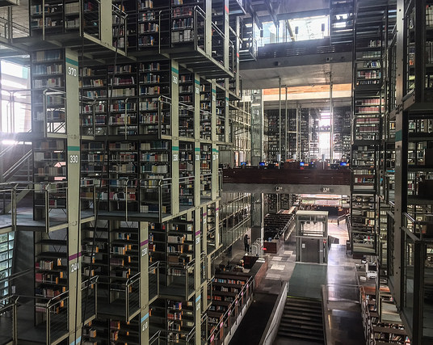
PID Examples:
Objects:
DOI
10.3334/ORNLDAAC/840
ARK http://example.org/ark:/12025/654xz321/s3/f8.05v.tiff
Person:
ORCID – Open
Scopus ID – Proprietary
Organization:
ISNI
Paul Keller
https://flic.kr/p/SG7LN1
https://creativecommons.org/licenses/by/2.0
Notes:
Doi llinks to a defined piece of intellectual property – one of the oldest digital Pid in existence, begun in 1998 Consists prefix (organization) suffix (object) in this case the last bit is a local ID
Archival Resource Keys –Since 2001
An ARK is represented by a sequence of characters that contains the label, "ark:". When embedded in a URL, it is preceded by the protocol ("http://" or "https://") and name of a service that provides support for that ARK. That service name, or the "Name Mapping Authority" (NMA), is mutable and replaceable, as neither the web server itself nor the current web protocols are expected to last longer than the identified objects. The immutable, globally unique identifier follows the "ark:" label. This includes a "Name Assigning Authority Number" (NAAN) identifying the naming organization, followed by the name that it assigns to the object.
https://flic.kr/p/SG7LN1
https://creativecommons.org/licenses/by/2.0/
https://www.flickr.com/photos/paulk/

Slide 20
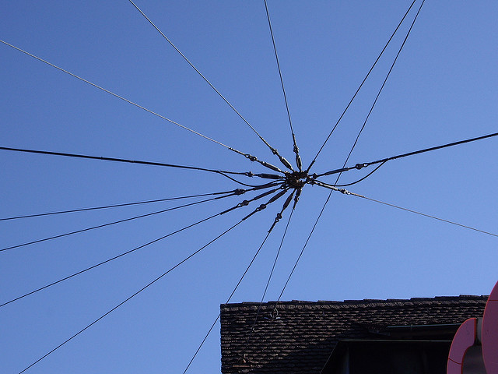
Sean Salmon
https://flic.kr/p/4x17RJ
https://creativecommons.org/licenses/by-nc/2.0/
Notes:
Sean Salmon
https://flic.kr/p/4x17RJ
https://creativecommons.org/licenses/by-nc/2.0/

Slide 21
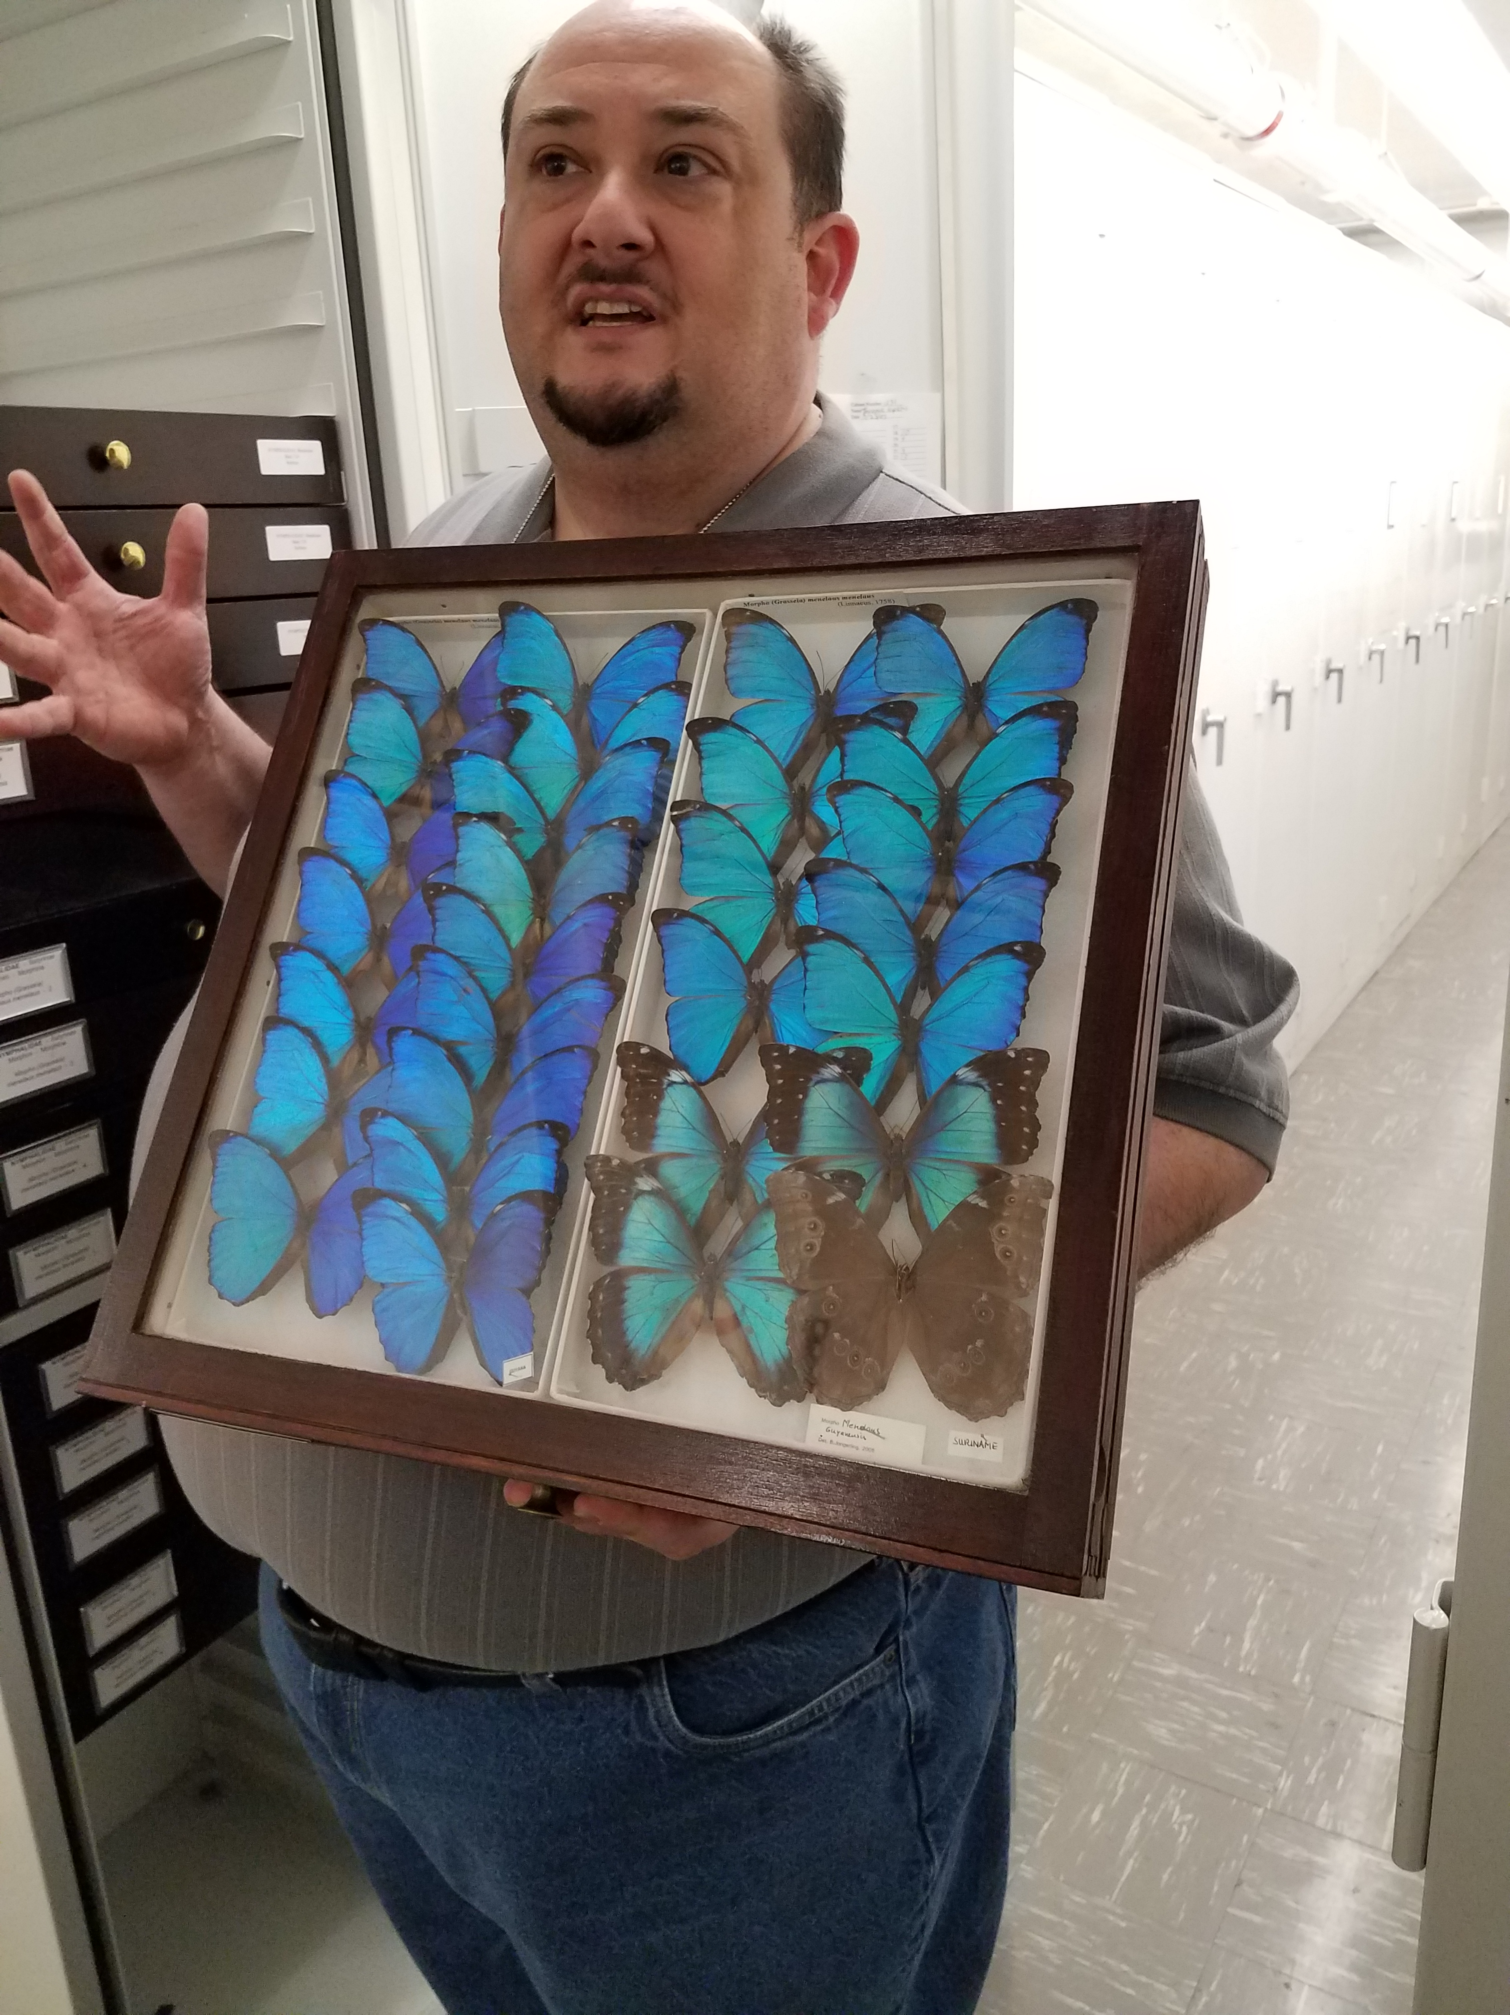
Identifiers help us contextualize our data’s story
For Machines
At Scale
Notes:
Context – Inference – Relationships

Slide 22
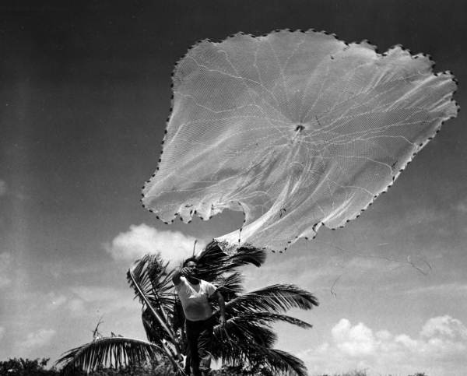
https://flic.kr/p/678bd8
Florida Memory project
Notes:
https://flic.kr/p/678bd8

Slide 23
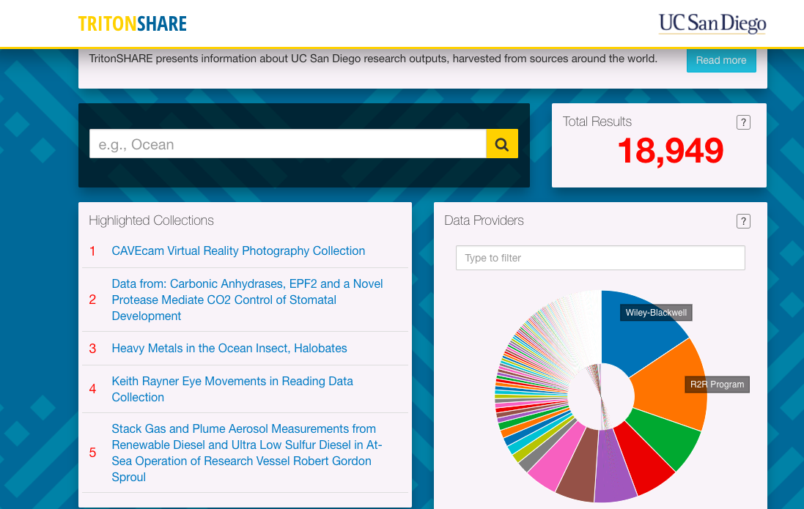

https://tritonshare.ucsd.edu/
http://www.share-research.org/
Notes:
SHARE API
Mmetadata fields for SHARE
https://osf.io/wur56/wiki/Metadata%20Analysis/

Slide 24
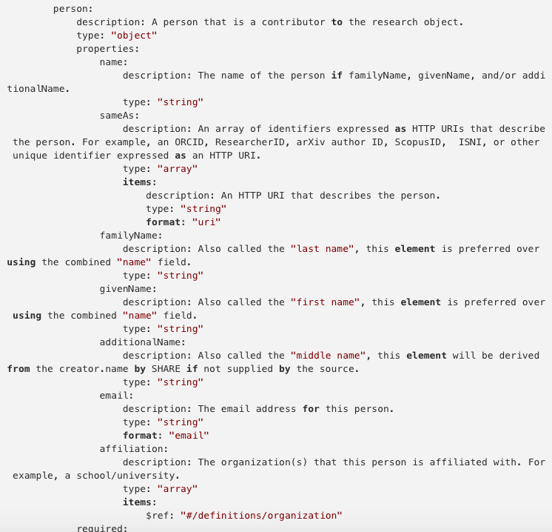
“Same As”
“See Also”
SHARE API Schema
Notes:
Person ID
Org IDs
Locator / preservation ids

Slide 25
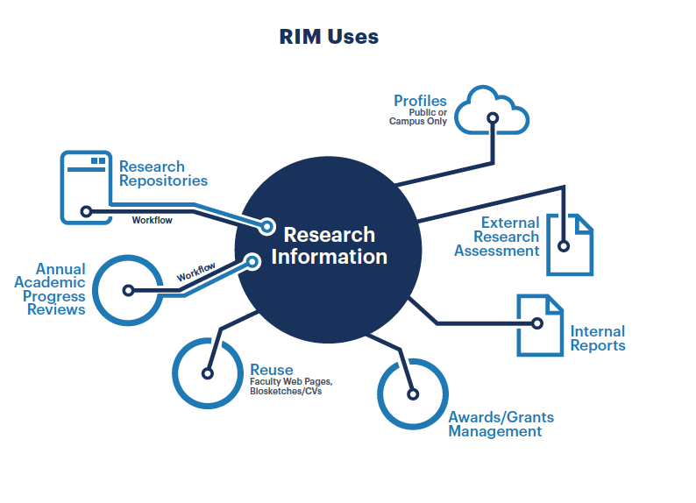
“RIM Uses” by OCLC Research, from Research Information Management: Defining RIM and the Library’s Role (doi.org/10.25333/C3NK88), CC BY 4.0
oc.lc/rim
Notes:
I expect this model to evolve over time, and it should work to represent new, extensible practices in research information management.

Slide 26
Person & organizational identifiers in RIM
Google Scholar ID (n=4)
SSRN (n=3)
Codice fiscale (Italy) (n=19)
by OCLC Research CC BY 4.0
Research Information Management (RIM) Systems: International Survey of Libraries, preliminary results (2018)

Slide 27
Researcher Identifiers Used in RIM
by OCLC Research CC BY 4.0
Research Information Management (RIM) Systems: International Survey of Libraries, preliminary results (2018)

Slide 28
THOR (Technical & Human Infrastructure for Open Science)
  Leverages ORCIS and DataCire to enhance interoperability between platforms by way of PID linking and service integration
HIRMEOS (High Integration of Research Monographs in the European Open Science Infrastructure
  Implementation of PID object, person and funder identifiers
Person ID play an increasing role with local and national efforts promoting ORCID adoption by researchers and integrating research Ids into local and national infrastructures
Notes:
RIM CASE STUDY
European commission has taken the long view toward future interoperability and datat exchange in the RIM space p.10 Numerous initiative that support standards and identifers to develop infrastructures for European Open Sicence

Slide 29
“Open Science objectives are seen as increasingly relevant today, and persistent identifiers for all objects available in research information regarded as the backbone of open science. One of our informants even told us, “I do not believe in open science without identifiers”… We observed increasing interoperability between local CRIS systems, institutional repositories and data archives driven in part by the need of user friendly workflows for researchers depositing research outputs in response to open science mandates. We expect open science efforts in Europe to continue to Influence the CRIS and identifies space”. page 24
Notes:
Identifiers are Key to Open - Research / Sceince workflow.

Slide 30
Drivers of persistent person identifiers
“Good practice” does NOT drive adoption
Need for improved workflows
Integration in CRIS systems
Internationalizing university research
Increased practice of publishing in English

Slide 31
Interoperable
Persistent
Sustainable
Jenni Konrad
https://flic.kr/p/7awFZZ
https://creativecommons.org/licenses/by-nc/2.0/
Notes:
We must be part the community if we want persistent identifiers – organizational sustainability, and identifiers that are used to be part of our workflows are key.

Slide 32
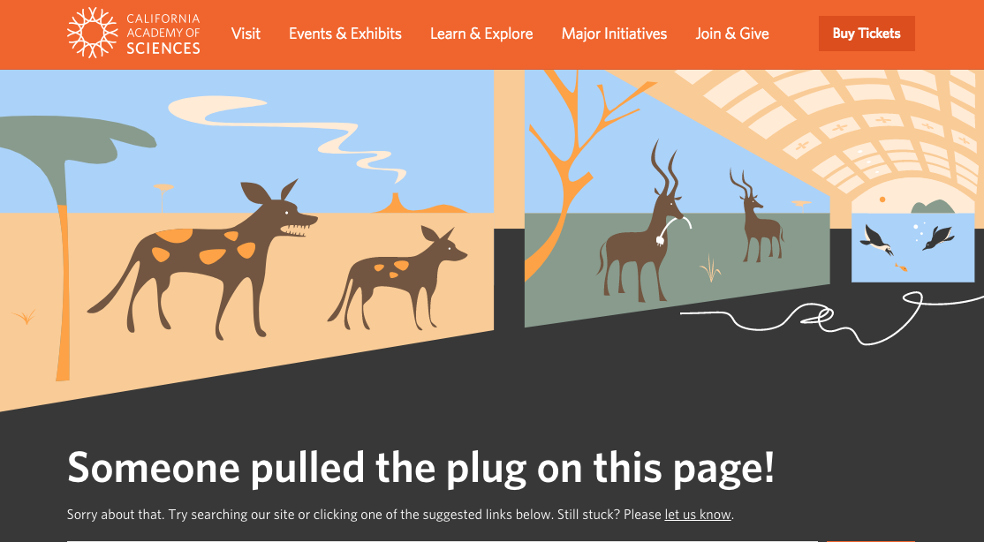

Slide 33
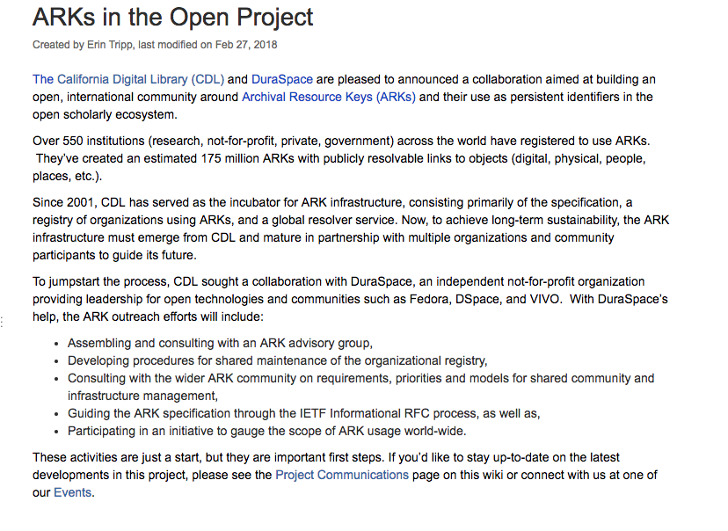
Notes:
ARK example

Slide 34

Started in 2016, most recent Jan 2018
Repository of presentations:
https://pidapalooza.figshare.com/
Description:
https://scholarlykitchen.sspnet.org/2018/02/08/getting-pid-word-pidapalooza-beyond/

Slide 35
Conclusions
Identifiers are key to research infrastructure inoperability and openness
Identifiers allow for effective/efficient collection, curation and reuse
Use unique, persistent (ideally actionable) identifiers when possible.
Globally unique is good, but if you only have local – that’s ok
Know the role of the identifier in the research workflow – and get involved with the organizations that run them
Notes:
Conclusion –
Identifiers are key to research infrastructure inoperability
Use unique, persistent (ideally actionable) identifiers when possible.
Global is good, but if you only have local – that’s ok
Know the role of the identifier in the research workflow – and get involved with the organizations that run them

Slide 36
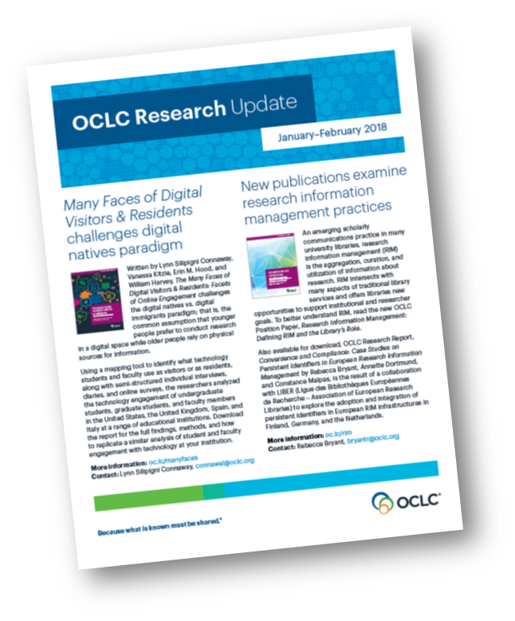
OCLC Research
Scale and accelerate library learning and innovation.
Works:
https://www.oclc.org/research/themes/research-collections.html
RIM Interest Group : oc.lc/RIM

Slide 37



Follow and Join the Discussions
Hanging Together blog:
hangingtogether.org
Works in Progress Webinars:
www.oclc.org/research/events/works-in-progress-webinar-series.html
Research news: www.oclc.org/research/news.html
youtube.com/oclcresearch
#oclcresearch #oclcrlp
facebook.com/OCLCResearch

Slide 38
Credit
Thanks to my colleagues Brian Lavoie, Constance Malpas, Rebecca
Bryant, Annette Dortmund, and Lorcan Dempsey.
Bryant, Rebecca, Annette Dortmund, and Constance Malpas. 2017.
Convenience and Compliance: Case Studies on Persistent Identifiers in European Research Information. Dublin, Ohio: OCLC Research. doi:10.25333/C32K7M
Smith-Yoshimura, Karen. 2015. Addressing the Challenges of Organization Identifiers. Dublin, OH: OCLC Research
Bryant, Rebecca, Anna Clements, Carol Feltes, David Groenewegen, Simon Huggard, Holly Mercer, Roxanne Missingham, Maliaca Oxnam, Anne Rauh and John Wright. 2017. Research Information Management: Defining RIM and the Library’s Role. Dublin, OH: OCLC Research. doi:10.25333/C3NK88
Duerr, Ruth E., et el , On the utility of identification schemes for digital earth science data: an assessment and Recommendations, Earth Sci Inform (2011) 4:139-160. Springer Verlag doi:10.1007/s12145-011-0083-6
Dempsey, L., (2016). Library collections in the life of the user: two directions. LIBER Quarterly. 26(4), pp.338–359.
DOI:http://doi.org/10.18352/lq.10170

Slide 39
http://naturalhistory.si.edu/rc/cp/_img/imageGallery/clarkPhotos/Birds_staff_lg.jpg
Notes:
http://naturalhistory.si.edu/rc/cp/_img/imageGallery/clarkPhotos/Birds_staff_lg.jpg

