Slide 1
DDP/DAP Design and Technology Overview
Ľubomír Hribík
Notes:
Personal info:
I work for TEMPEST company located in Bratislava, the capital city of Slovakia. My job position is IT Business Analyst - mainly focused on Library and Digital Archives Solutions.
I took my part in DDP project from its beginning. I was the head analyst of the whole solution and I am still supporting it now by creating requirements for its improvement or extension.
DDP was project for University Library in Bratislava.

Slide 2
REQUIREMENTS
Catalogue with .sk domains and manually added URLs
Archive with almost identical copies of live webpages
Archive for e-born documents
Support for future e-born legal deposit
Integration with CDA archive (OAIS compliance)
Challenges:
Catalogue vs Archive
Metadata standard (?)
SK legislative vs Copyright law of EU
Effective web harvesting

Slide 3
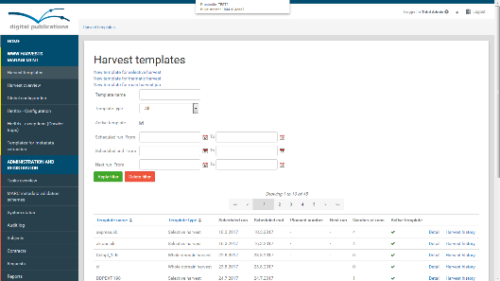
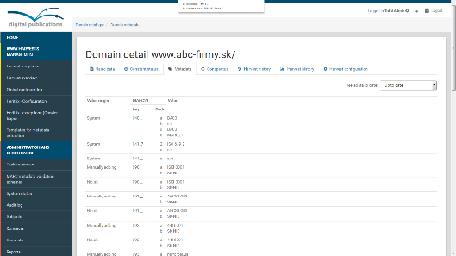
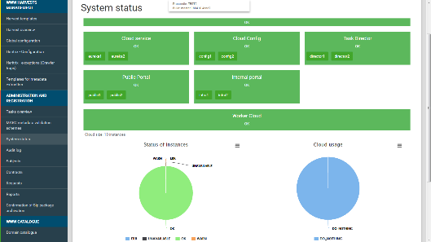
Web archive
Our decisions:
Catalogue updated periodically by Discovery process
MARC21 standard – GUI editor, versions, system MD
Harvest: 1 crawler instance -> 1 URL from catalogue
Faster archiving: one virtual machine for each crawler
Orchestration platform (MQ, priority, other system tasks)
Browsing archive divided into 3 areas (public, library, curator)
Public content: need to sign contract/agreement with author
Inspiration from others:
Heritrix and OpenWayback were the best alternatives (UK)
Respecting robots.txt, crawler traps (CZ)
Notes:
Main battle - Web catalogue vs Web archive brought us to versioning, metadata editor and finally to WEMI model

Slide 4
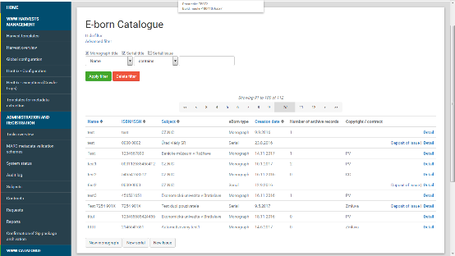
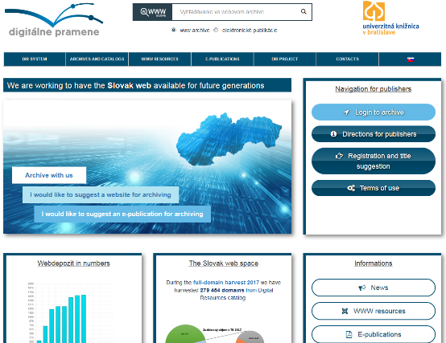
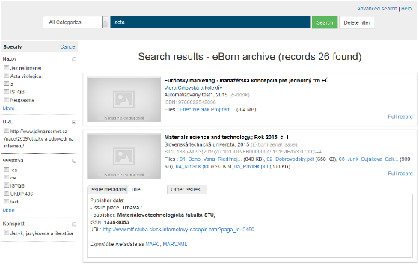
E-born deposit
Design inspired by WEMI model and also applied on webarchive
(Catalogue -> work, Archive -> manifestation-items)
Management of subjects, contracts and access rights
(new role: Producer, CC or signed agreement, public/library)
Cooperative/assisted work with Producers (special GUI for them, can register through online form)
Prepared for legal deposit (plans to launch it on start of 2018 but it was postponed)
CDA integration: same format tools (but can have own format strategy, ingest could be configured/selective)
Serials as continually updated web pages (new type: webserial)
special type of harvest tpl, metadata as for a serial, issue is linked to harvest run

Slide 5
ARCHITECTURE

Slide 6
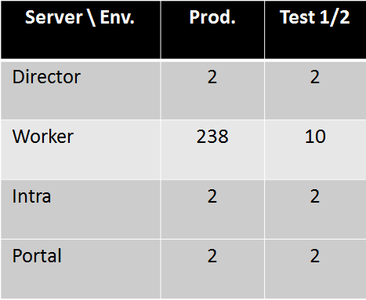
ENVIRONMENTS
Scheme of infrastructure:
Number of VMs:

Slide 7
Backend Processes
Discovery
Periodically collects metadata about domains
Stores collected metadata as MARC fields
Updates availability status of domains
Harvest
Reads harvest jobs from RabbitMQ (orchestration platform component)
Creates instances of Heritrix for processing of harvests
Manages Heritrix instances via API
OWB support process
Builds of OWB index files
Generates OWB blacklists (3 different sets – public, library, curator)

Slide 8
Backend Processes
SK-NIC update
Periodically downloads file from Slovak Top Level Registry
Adds new domains if not present in catalogue
Updates information about domains in catalogue
Can be run manually by operator (selects file to import)
DROID signatures update
Update of signature files for Digital Record Object Identification
CDA (LTP) archivation
Creates SIP package for each manifestation
If quota is reached (time or amount) then starts ingest process
Creates submission orders for all processed SIPs (to ingest)
Stores result (state) of SIP processing to the catalogue

Slide 9
Production ISSUES
Quality of harvested data
Too complex crawler configuration
Cyclic links in WARC file
Deduplication strategy (vs our design concept)
Harvest issues
Complaints from content provider (suspicion of plagiarism)
Risky harvest without obey robots.txt
Ban from ISP provider due to suspicion of DOS attack

Slide 10
DAP Digital archive platform

Slide 11
DAP Design Highlights
DAP is new (extended) version of our previous digital archive product
Integrates modules from CDA and DDP projects into one software solution
Supports both archiving and bibliographic work
MARC21 as metadata standard (native)
Modular architecture (core/add-ons)
Performance scaling (horizontal/vertical)
Web app user interfaces (redesign, translations)
Automated workflow and distribution of tasks

Slide 12
DAP ARCHITECTURE LIST OF COMPONENTS
Core
Repository with orchestration platform and interface for its object curators
Digital archive with framework, LTP module
Add-ons
Webarchive with discovery, web crawler and browser
Legal deposit / E-Born bibliographic records (FRBR)
Logistics and stock management for cold storage

Slide 13
DAP ARCHITECTURE logical model

Slide 14
DAP homepage www.Digitalpreservation.sk/EN

Slide 15
THANK YOU
FOR YOUR ATTENTION
Ľubomír Hribík
IT Business Analyst
e-mail: lubomir_hribik@tempest.sk
mobile: +421 917 493 588
Company reception phone
+421 (2) 502 67 111
Company reception fax
+421 (2) 502 67 100
Information
info@tempest.sk
Sales
obchod@tempest.sk
www.tempest.sk
TEMPEST a. s.
Galvaniho 17 / B
821 04 Bratislava 2
Slovenská Republika

