Slide 1
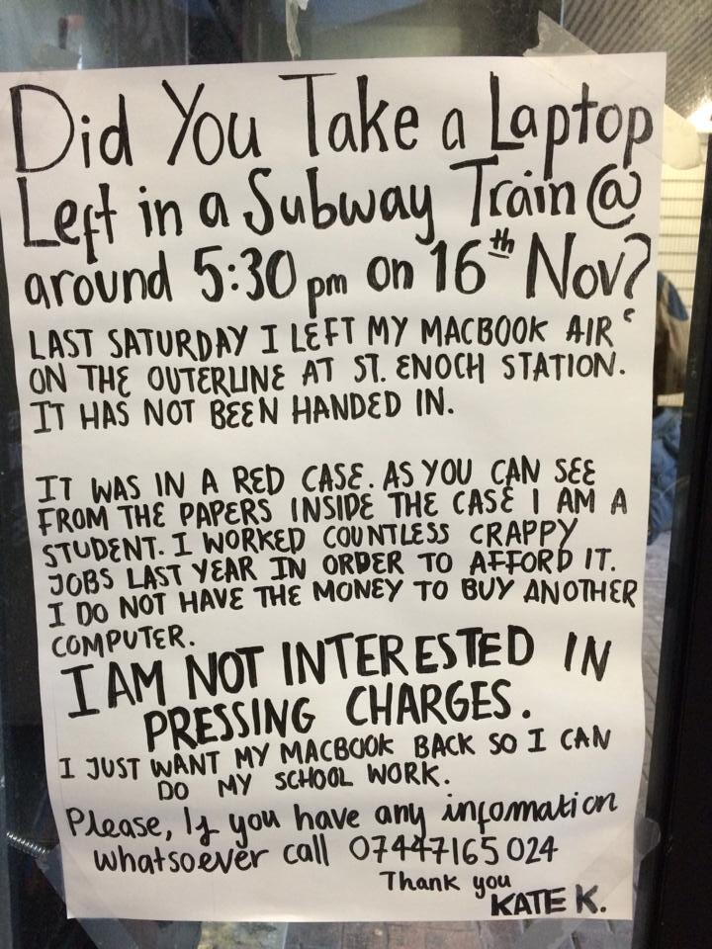
Certification, Sustainability and Advocacy
The problem of success
The Business Case?
Environmental
Financial
Social
William Kilbride
@williamkilbride

Slide 2
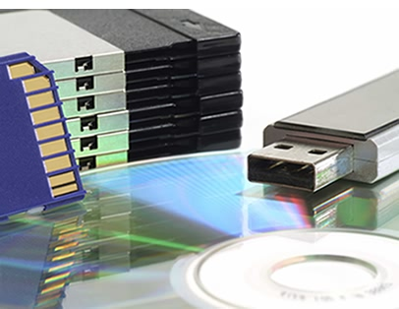
Technology: the paradox of obsolescence
Digital preservation systems are products of their own generation
They are subject to the same processes of obsolescence as the objects they safeguard
They are a contingent solution to an enduring problem
The drivers of this change are outside of our control
How do we respond
to change like this?

Slide 3
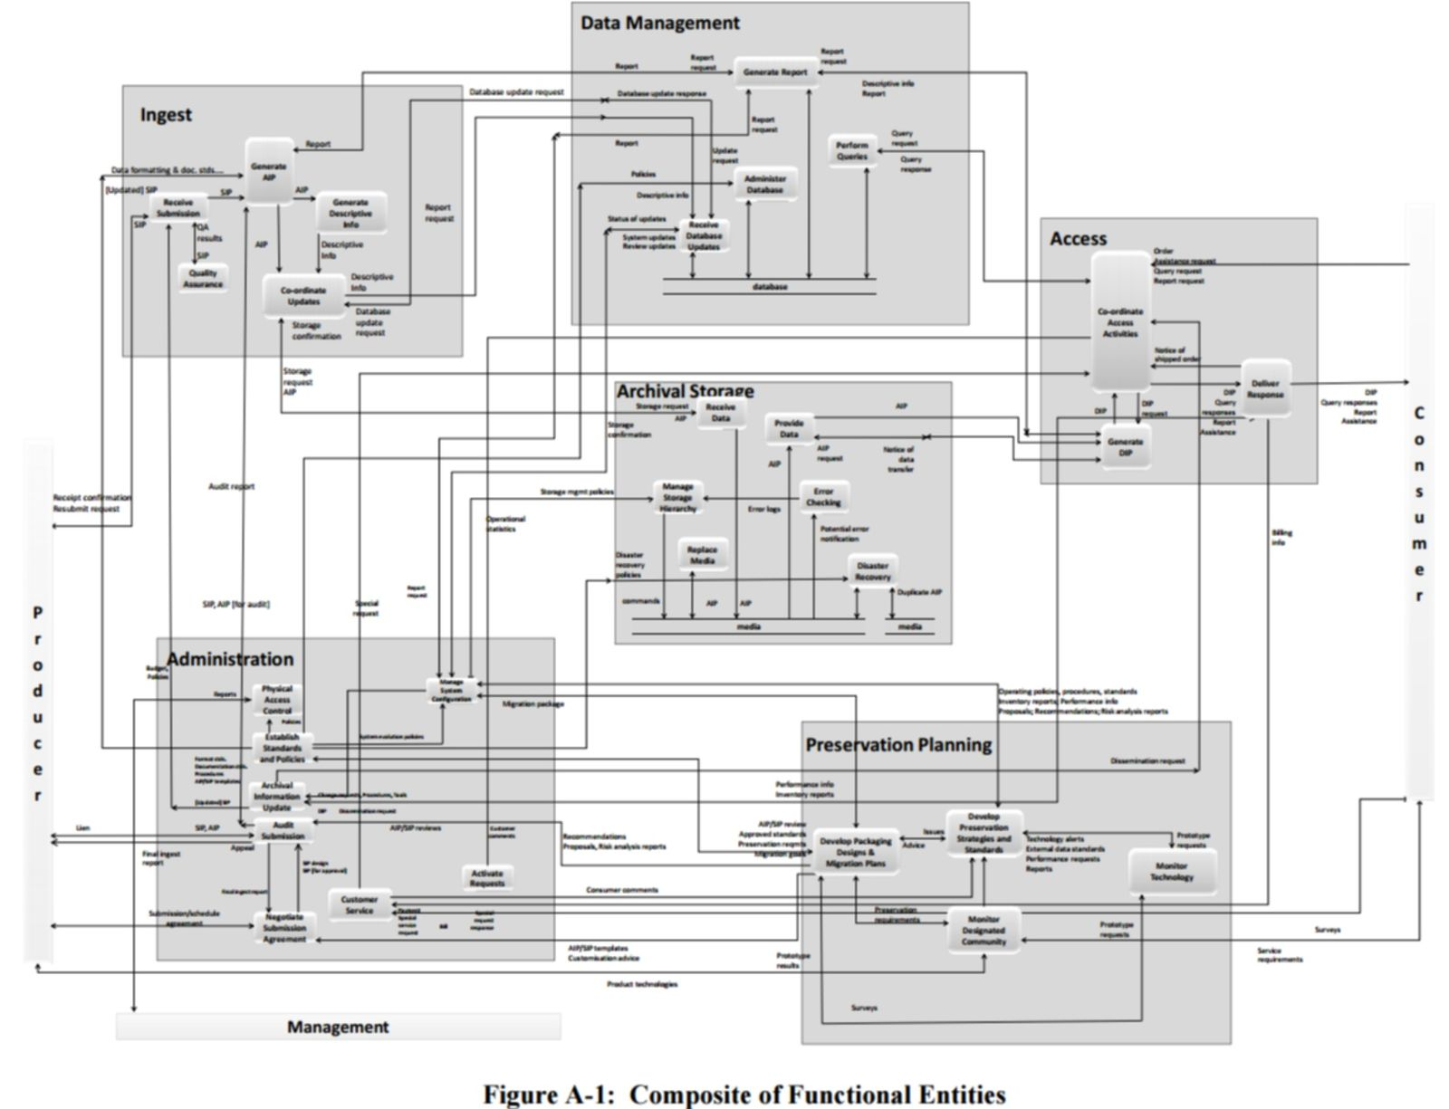
resilient, modular, redundant, standards-based …
… and by the way, this one component is what the entire IT industry thinks you mean when you talk to them about digital preservation

Slide 4
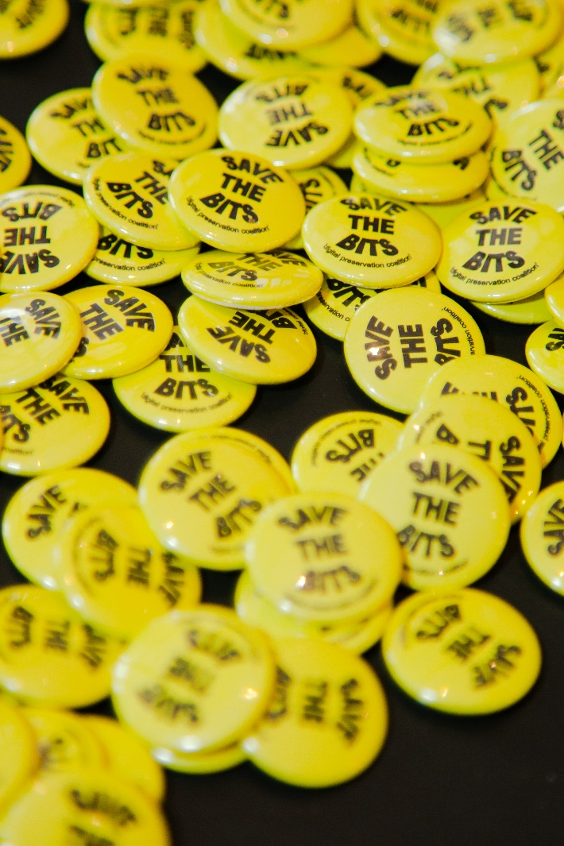
So, in Digital Preservation, standards matter
Operational Standards:
OAIS, PREMIS, METS …
Assessment standards:
CoreTrustSeal, ISO16363, DIN31644
Maturity Modelling:
CARDIO, AIDA, NDSA Levels …

Slide 5
Certification? A proxy for success…
DRAMBORA
Digital Repository audit based on risk assessment
Core Trust Seal (was Data Seal of Approval)
Lightweight self certification methodology
Nestor Seal
Participation in distributed network for preservation, national basis DIN 31644
ASD-STAN LOTAR
Industry specific project to integrate OAIS with STEP to ensure legal verification of CAD / CAM and PDM data
Trusted Digital Repository
Criteria describing ‘trust’ in preservation
TRAC and RAC (ISO 16363)
Certification of trustworthy status

Slide 6
Core Trust Seal …
16 criteria
Self assessment, peer reviewed
DSA and WDS
Strong community presence
Focus on research data services
Nestor Seal
43 criteria
Self assessment, peer reviewed
DIN Standard, service from DNB
Open to all
Community of practice (Germanic)
ISO 16363
105 Criteria
Externally audit
ISO standard
Open to all
Limited community

Slide 7
See also:
Benchmarking and Capability Models
5 step model
Charles Dollar (DPCMM)
AIDA / CARDIO
NDSA Levels of Preservation
Adrian Brown’s Maturity Model (Civil Service)
Preservica
…

Slide 8
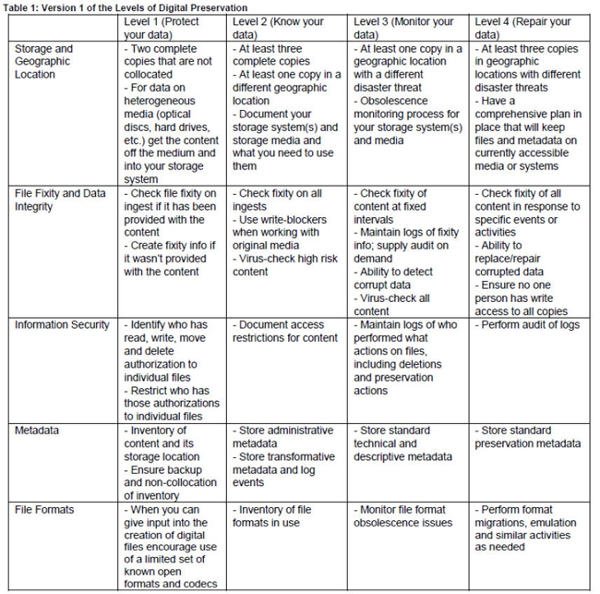
NDSA Levels of Digital Preservation

Slide 9
In Digital Preservation,
this is what success will look like:
Oops!
I’ve not seen one of them since 1997. What should I do now?
Virtualize
Migrate
Emulate

Slide 10
I will come back round in a moment. But now …
Digital preservation and the Triple Bottom Line:
Financial
Environmental
Social

Slide 11
Financial Outcomes

Slide 12
…money turns out to be the major problem facing the future of our digital heritage. (Rosenthal 2012)
Data creation:
Approx 60% per annum
Storage capacities:
Approx 40% per annum
IT Budgets:
Approx 2% per annum

Slide 13
The Brute Force DP Business Model 3:1
Charge
for access
Charge
at ingest
Charge for your
know-how

Slide 14
Derived demand
Depreciable durable assets
Non-rivalrous (aka The Free Rider)
Temporally dynamic
Path dependent

Slide 15
http://www.4cproject.eu/dcsm

Slide 16
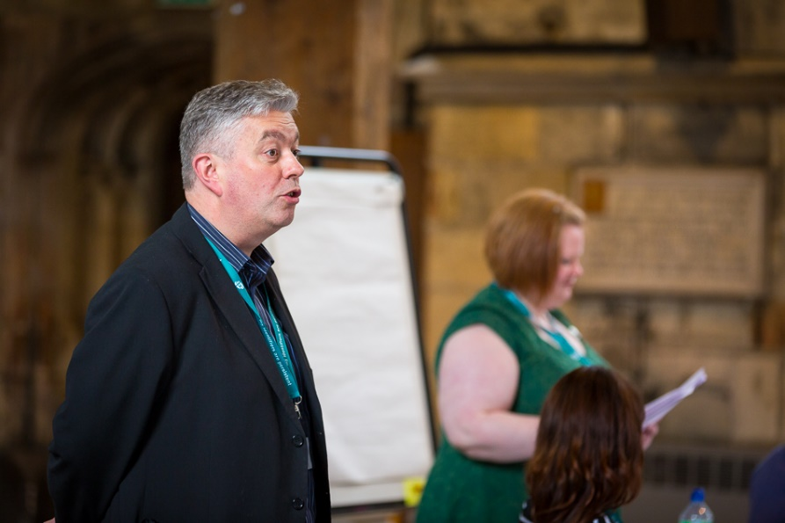
DP and cost benefits
Focus on costs
DP expensive?
NO! DP as unfunded mandate
Capital and revenue
Focus on Value
Do we know the value of our data
Focus on benefits
Return on investment
Free riders (deferred benefits)
Economic impacts

Slide 17
Timing 1: Lifecycle costs of a repository
Spend
Maturity
Acknowledge
Externalize

Slide 18
When to intervene? A complicated question.
Imagine a digitization project.
Begin
Digital objects
Plan
Capture
Delivery
Image Processing
Publish data
Obsolescence
Pilot
Quality assure
Release Value
Resource description
Fund
Project
Propose
Invite
Scope
Infrastructure and technological innovation
CONTINUITY ready made

Slide 19
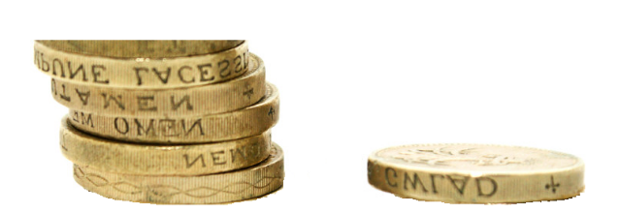
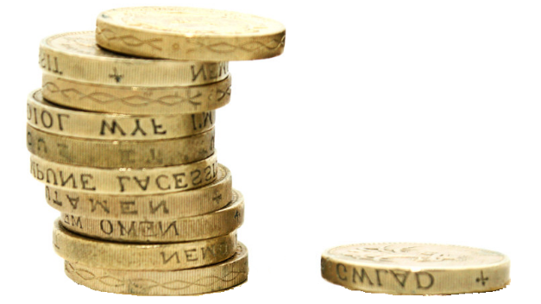
Benefit/cost ratio of net economic value to ESDS operational cost 5.4 to 1 Increase in returns on investment in data and related infrastructure arising from additional use facilitated by ESDS (counter-factual) up to 10 to 1 Beagrie (forthcoming)

Slide 20
Environmental Outcomes

Slide 21
DP and Environmental
Impact
(UK HE 2009)
116m GBP Electricity Costs pa
500,000 tonnes CO₂
Digital Preservation?
Managed replication
Deduplication
Confident deletion (aka disposal)

Slide 22
Social Outcomes

Slide 23
What’s the problem?
Digital data (images, documents etc) have value
They create opportunities
...but...
Access depends on software hardware and people
Technology and people change
...therefore...
Constantly emerging barriers to reuse
So, constantly emerging barriers to opportunities
My point: data loss is not the only problem, perhaps not even the main problem

Slide 24
We do preservation because we want :
1. Transparency
e.g. Data Protection, Freedom of Information …
2. Safety
e.g. detection, disaster, recovery, audit …
3. Knowledge
e.g. scientific value, access to heritage …
4. Wealth
e.g. efficient business, management of IP …
5. Health
e.g. research, safe innovation …
6. Environmental improvement
e.g. evidence-based policy development …
1. Legal compliance
e.g. Sarbanes-Oxley, Data Protection …
2. Regulatory compliance
e.g. power generation, aviation ….
3. Legal protection
e.g. patents, mis-selling, detection …
4. Unanticipated exploitation
e.g. petro-chemical, pharmaceuticals ….
5. Business continuity
e.g. product recall, disaster recovery …
6. Business value
e.g. the right information to the right people at the right time in a format they can use

Slide 25
Why Digital Preservation?
Digital preservation is not just about ‘data’:
Digital preservation is not just about ‘access’:
Digital preservation is not just about ‘risk’:
It’s about
people and opportunity
Safer
Smarter
Healthier
More creative
More transparent
Wealthier
Greener
Fairer

Slide 26
It’s not about avoiding data loss: it’s about coming good on the digital promise
It’s not about a digital dark age: it’s about a better digital future.

Slide 27
Digital preservation is not just about ‘documents’:
Digital preservation is not just about ‘archives’:
Digital preservation is not just about ‘compliance’:
it’s about
people and opportunity
Don’t start with the bits and bytes: start here!

Slide 28
success = certification?
success = sustainability
sustainability means advocacy
advocacy, a process not an event
So … certification most useful when
it creates a narrative, for advocacy.

Slide 29
Some Links …
A foot on the desk is worth two in the door:
http://www.dpconline.org/blog/a-foot-in-the-door-is-worth-two-on-the-desk
Digital Prerservation Business Case Toolkit:
http://wiki.dpconline.org/

Slide 30
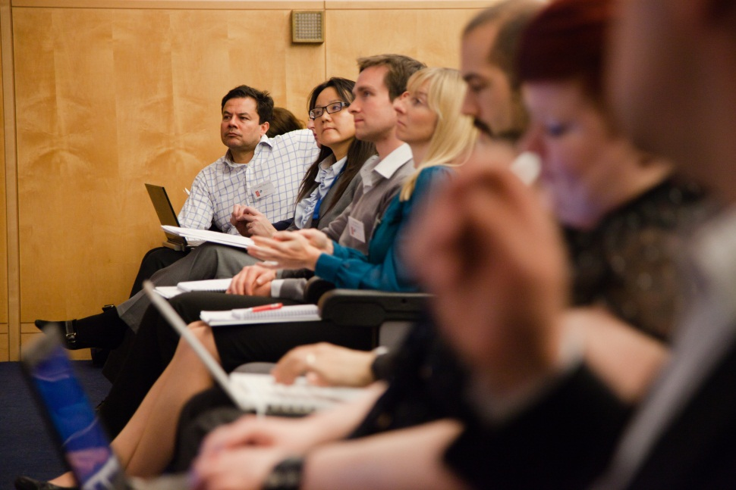
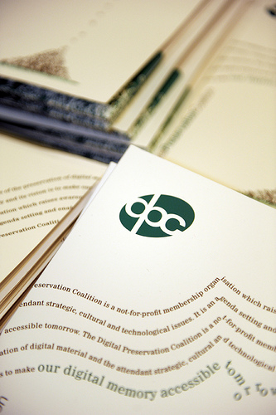
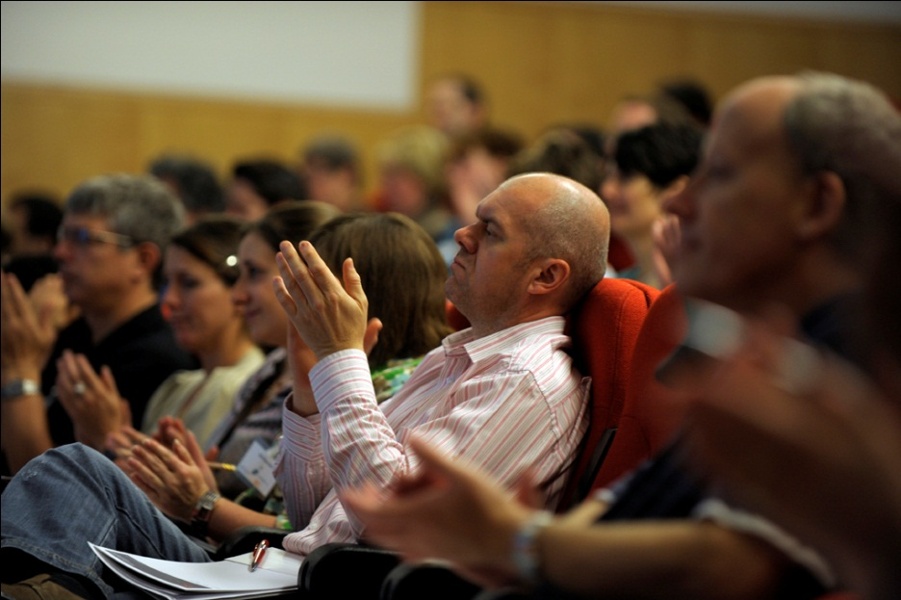
DPC as a partner and friend!
Join us: http://www.dpconline.org/join-us

Slide 31
Certification, Sustainability and Advocacy
The problem of success
The Business Case?
Environmental
Financial
Social
William Kilbride
@williamkilbride

