Slide 1
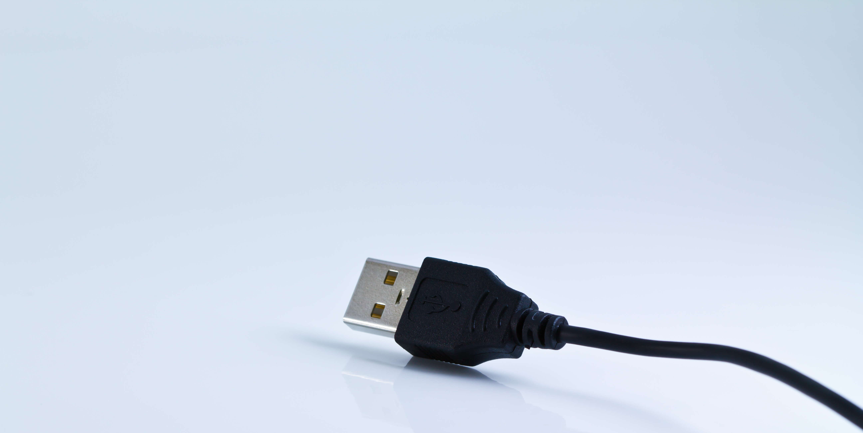
Skills for digital preservation
ILIDE Conference 2018
16 April 2018
Sarah Mason
Bodleian Libraries
#DP0C
Image: CC Dooder, Freepik.com

Slide 2

Overview
DPOC project overview
Skills for digital preservation
  Background
  Findings
Upskilling for digital preservation
Recruiting for these skills
Image: CC Freepik.com
Notes:
Overview of the talk today:

Slide 3
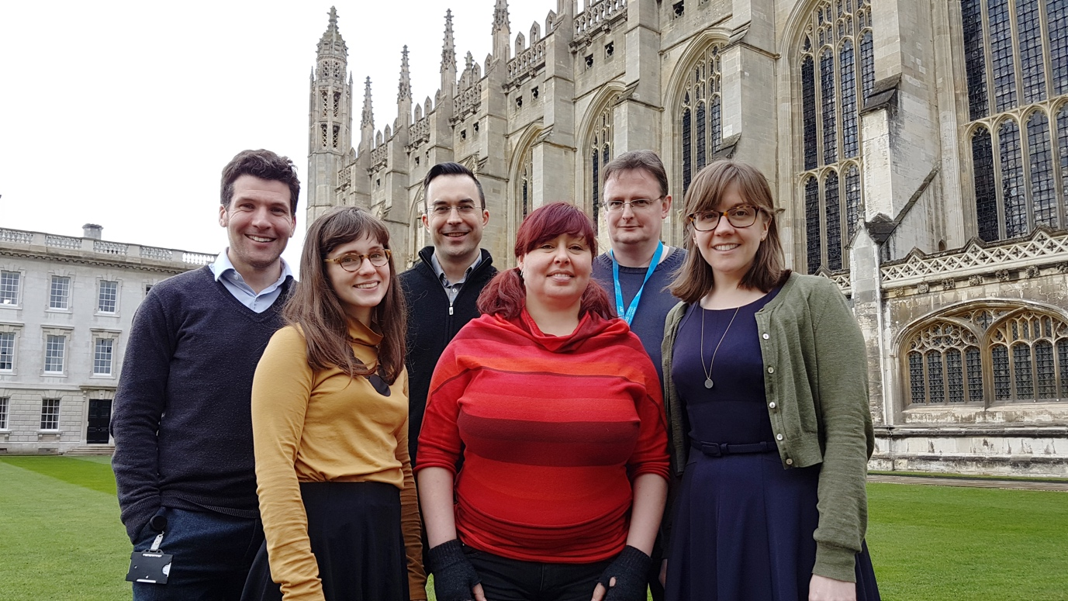
Digital Preservation at Oxford and Cambridge (DPOC) project
2 year project funding by the Polonsky Foundation
3 Fellows mirrored at each institution
Policy & Planning
Outreach & Training
Technical
Notes:
2 year project funded by the Polonsky Foundation – address digital preservation challenges at Bod & CUL – 3 Fellows at each
idea was first discussed with the Polonsky Foundation after they had funded large digitisation projects at each library – a worry over the long-term preservation and accessibility of their investment in these digital assets. First stage of project was auditing people, technology, collections and processes – this is where looking at skills really came in…

Slide 4
What are the issues?
Still a new and developing field
  Constantly changing – especially technology
  Lots of theory but more limited in practice
What are the necessary skills? There will be new skills
  Training for existing staff
  Job descriptions – rewriting existing & creating new ones
  How do you structure digital preservation teams?
Staff retention
  staff are both a key resource and asset
  How do we keep and grow them?
Source: Digital Preservation Coalition
Notes:
- What are the issues to being able to understand the skills we need?
- This field is new and constantly changing – while there is quite a bit of established theory, there is limited experience of practice at many places
There will be new skills necessary – new metadata standards, new legal requirements, new technical skills – how do we design training programmes to make sure staff have these skills (or budget to see enough staff externally)
Well will need updated roles for these new skills – perhaps new roles entirely
We need to think about how to structure our teams so that skill compliment each other – overlap where necessary – not every team needs the same skills, we are all different!
- because skills have not been decided on, because roles are still evolving at many organisations, roles might not be official or recorded and work is often being done ad hoc – so hard to pinpoint what skills are necessary
Invest in your team and then you need to retain them – they are a key resource and our greatest asset – how do we keep them and help them grow? How do we give them time to learn and explore and research some of the more complex DP issues?

Slide 5

Understanding digital preservation skills
We come from diverse backgrounds
  Technical
  Collections
  Maths, sciences, arts, film, music etc.
  Libraries, museums, archives
Photography & photographic collections background
Museums & libraries
Photographer – collection digitization
Image: Ian Wallman
Notes:
Those of us the work in digital preservation and those that have yet to come from diverse backgrounds and therefore bring a strong range of skills – this is a strength of the field, because in diversity we can learn from each other, we can bring a range of subject and area specific skills to digital preservation field that will strengthen it
For example I come from:
Strong photographic background – in documentary and historical processes
I also have a strong collections management background, specializing in photographic collections
Most of my early experience came from museums, before I transitioned into libraries – mainly state libraries in Australia where I was a photographer and involved in collection digitization and some cataloguing
Also in training and outreach programmes – and eventually I found myself more involved with digital preservation and then I ended up working on this project
You’ll find most of our paths are not straightforward – you’ll find most of us learned along the way about digital preservation – but why is that? And what exactly did we have to learn?

Slide 6
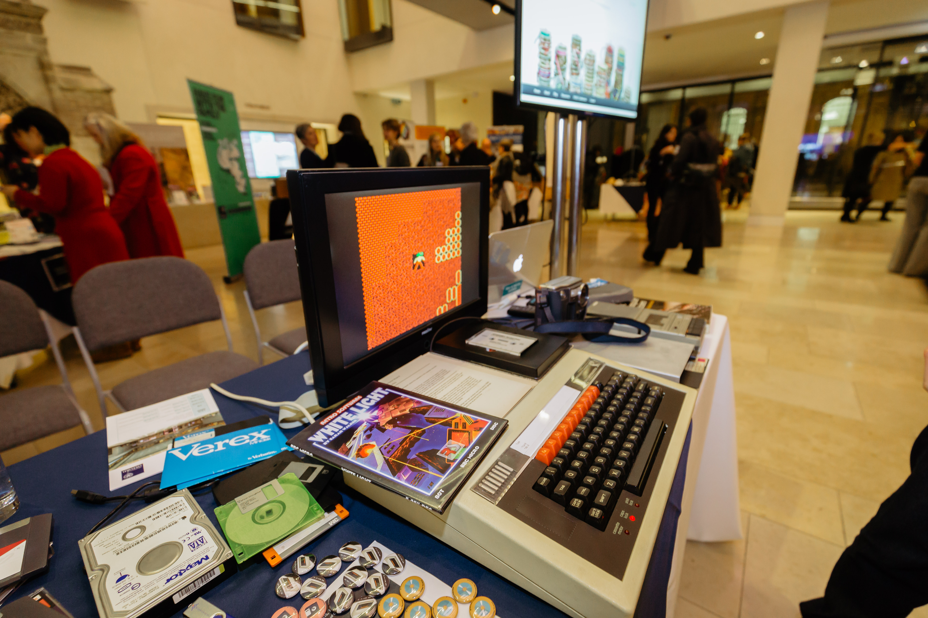
Understanding digital preservation skills
Lots of skills are necessary – but they are not all new
You cannot and do not need to learn everything – who can you work with?
Old skills through a “digital preservation” lens
Notes:
In order to start to understand what skills were best to prepare staff for digital preservation – first beware that it isn’t easy and there is no one prescriptive list to follow – there are no 10 skills needed to make it work – BUT
there are lots of new skills to learn – and this can make it overwhelming to know where to begin for your own learning – but it can also make trying to know what skills are necessary for structuring a team also complicated
And I will outline just how complex some of the frameworks and reports can be – especially when you are trying to understand what you need to learn
But what you will see today through this talk is that there are a lot of OLD skills that you need to see through a “digital preservation” lens – so understanding digital preservation and understanding the language of it is where you need to start

Slide 7
Looking closer at skills for digital preservation
DigCurV curriculum framework
  http://www.digcurv.gla.ac.uk/index.html
Preparing the Workforce for Digital Curation report (National Research Council)
  https://www.nap.edu/catalog/18590/preparing-the-workforce-for-digital-curation
The open data imperative: How the cultural heritage community can address the federal mandate report (Council on Library and Information Resources)
  https://www.clir.org/pubs/reports/pub171/

Slide 8
DigCurV Curriculum Framework
Notes:
We used the DigCurV Curriculum Framework as the basis for our skills audit
DigCurV - Digital Curator Vocational Education Europe - was an EC-funded lifelong learning initiative. (until about 2013)
The aim was to support and extend vocational training for digital curation and preservation staff in libraries, archives and museums
They did this by outlining the skills needed for disciplines like digital preservation so that courses could be created to help develop these skills

Slide 9
DigCurV Curriculum Framework
3 lenses: Executive, Manager, Practitioner
110 different skills
4 skill categories:
  Knowledge and Intellectual abilities (KIA)
  Personal Qualities (PQ)
  Professional Conduct (PC)
  Management and Quality Assurance (MQA)
Notes:
DigCurV
Is made up of 3 lenses: Executive, Manager, Practitioner – each lenses has skills necessary to fulfil that role – these roles are based on job responsibilities, NOT job title – there are progression pathways through the different lenses (hands-on, project, strategic)
110 different skills and attributes spread across the different lenses – so not every lens has all 110 skills – but at you can see there are still many skills
4 major categories: Knowledge/Intellectual Abilities, Personal Qualities, Professional Conduct, Management/Quality Assurance

Slide 10
DigCurV Curriculum Framework
Notes:
each skill also has a different level of competency attached to depending on the lens, ranging from a basic awareness to a deeper understanding and then having advanced knowledge of or the ability to do it
So helps you to know basically how much you need to know for each skill
So it looks simple to use, until you look deeper

Slide 11
DigCurV Curriculum Framework
Is able to select and apply appropriate technological solutions
Notes:
For starters, the Practitioner Lens has 59 skills attached to it – that is still quite a few, but if you start to look careful at them, you might already have a number of them. For other skills, they are more complex than they look, for example:
Is able to select and apply appropriate technological solutions – what does that mean? For starters, you need a certain level of technical ability, you need to know all of the possible technical solutions for digital preservation and be able to apply them or know enough about the solutions/have enough technical ability to learn them – so that’s several skills to develop - from technical skills to understanding the technological solutions – also skills like problem solving and ability to learn

Slide 12
DigCurV Curriculum Framework
Is able to execute analysis of and forensic procedures on digital objects
Notes:
Or how about this one?
Is able to execute analysis of and forensic procedures on digital objects– this skills has a few things going on – you need to understand what digital objects are and how to do analysis on them, so what software programs are available to you use? You also need the technical skills to use them. Then you need to understand what forensic procedures are and how to use the software and hardware for those procedures – as well as the various issues that need to be considered before using forensic procedures.
Suddenly skills that seems straightforward in DigCurV seem less simple and it seems there is more to learn.
So how do the two reports stack up? Are they any clearer?

Slide 13
Preparing the Workforce for Digital Curation
11 skill areas:
General background and abilities
Data practices
Data collection and management
Data analytics
Presentation and visualization
Archiving and preservation
Technologies, tools, and infrastructure
Policy and planning
Values and principles
Services and support
Management and administration
Notes:
The National Research Council’s Preparing the Workforce for Digital Curation set out 11 skill areas – it was an ambitious skill set and some are more suited to digital preservation than others.
So let’s look at some of the areas that involve digital preservation – are they straightforward or not?
Archiving and preservation seems the obvious area where skills lie…..so we can look at that

Slide 14
Archiving and Preservation
Ensuring the integrity and security of digital resources
Deploying appropriate approaches for long-term preservation: such as media refreshment, emulation, migration
Understanding digital preservation concepts & models
digital forensics for digital collecting purposes
Notes:
The report lists several skills such as:
Ensuring the integrity and security of digital resources
Deploying appropriate approaches for long-term preservation: such as media refreshment, emulation, migration
Understanding digital preservation concepts & models
digital forensics for digital collecting purposes – BUT THAT’S NOT ALL - ALSO
Technical areas that includes information technology skills such as those related to traditional IT departments: managing a local server, a computer cluster, a cloud computing resource, or any combination of these. But also technical skills related to preservation software, digital forensics and more
They also include a broad understanding of how preservation requirements are addressed for digital resources, which do not enjoy the permanence of physical artifacts and require, instead, sustained attention.

Slide 15
Preparing the Workforce for Digital Curation
11 skill areas:
General background and abilities
Data practices
Data collection and management
Data analytics
Presentation and visualization
Archiving and preservation
Technologies, tools, and infrastructure
Policy and planning
Values and principles
Services and support
Management and administration
11 skill areas:
General background and abilities
Data practices
Data collection and management
Data analytics
Presentation and visualization
Archiving and preservation
Technologies, tools, and infrastructure
Policy and planning
Values and principles
Services and support
Management and administration
Notes:
And one final thing: archiving and preservation is not the only skill areas in this report linked to digital preservation
There are theses as well (CLICK)
So then it means there are more skills to understand than previously thought – and the report needs to be read carefully so each skill can be picked out and understood

Slide 16
The Open Data Imperative Report
4 skill areas:
Contexts
Management & Administration
Functions
Data skills
Notes:
Lastly, The Open Data Imperative report from the Council on Library and Information Resources looked at a range of skills needed for digital curation and preservation
It looked at both DigCurv and Preparing the workforce for Digital Curation report – it tried to simplify skills by creating only 4 skill areas:
Contexts
Management and administration
Functions
Data skills
And when we look at any of the areas does it feel any simpler to understand what skills will help you and your organisation do digital preservation? Let’s see

Slide 17
Skill area: Contexts
Requirements for a deep familiarity with cultural, disciplinary, organizational backgrounds
Notes:
Context is about understanding your organisation and what you are collecting – most people will already have these skills
But is also about understanding digital preservation – and this is what is key here and probably a key skill – learning the terms, concepts, models etc.

Slide 18
Skill area: Management & Administration
Topics include:
advocacy & outreach
policy development
standards implementation
strategies
auditing
technical infrastructure
education & training
Notes:
Under the management in administration area there are more skills required – some people in your organisation will already have, but they will also need:
To understand digital preservation standards and auditing tools
Understanding how to write a digital preservation policy and develop strategy
What technical infrastructures are necessary for digital preservation

Slide 19
Skill area: Functions
Appraisal
Acquisition or destruction
Research
Forensics
Monitoring
Tools & workflows
Preservation planning
Digitization
Storage management
Records management
Rights management
Notes:
But when you get to the functions area – suddenly there are more skills than you realise just by look at this list – these are the functions you need to perform, but not the skills you need
Each of these functions has a range of skills that the report does not list, but that you need and will have to consider

Slide 20
Skill area: Data skills
Analytics
File formats
Metadata & vocabularies
Databases
Provenance & authenticity
Linkages, citation, identifiers
Notes:
And then when you get to data skills – the skills required to understand the digital files in your collections – it seems as though the listen is a lot more complex
These skills are specifically related to understanding and using the data – as well as describing the data for the ability to identify & search & to prove authenticity (an archival term that means the data (or any digital file) is what is says it is meant to be)
So this report breaks things down into simple skills areas, but then you are required to use the appendix to clearly understand what skills you and your organisation needs for digital preservation.

Slide 21
So what does this mean for us?
What skills do we need to do digital preservation in our organisations?
Image: CC Dooder, Freepik.com
Notes:
So what does this mean for us? There are a lot of skills listed in frameworks and reports – more than one person can fulfil, right?
So what skills do we really need to do digital preservation in our organisations?
All of them. But here is the catch: you do not need to have them all. You need a range of people that do….
BUT….What can get us STARTED???
There are basic knowledge and skills that we should all have to we can work together and share a common digital preservation language – especially because your teams are likely to be spread across diverse departments

Slide 22
The basic skills for digital preservation
Domain & digital preservation background knowledge
Technical skills
Metadata standards
Understanding users & their needs
Understanding legal requirements
Project management & preservation planning skills
Communication skills
Problem solving & willingness to learn and adapt
Notes:
These are the basic digital preservation skills to start with – even this list seems long – but for most things you will have a good understand of parts of each skills - the rest is about gaining familiarity with digital preservation as it fits in with each skills and then becoming more confident with it

Slide 23
Domain & digital preservation background knowledge
Understanding your organisation and what digital objects you collect
Basic terms, concepts, standards and models for digital preservation
  Fixity – data integrity
  Authenticity, provenance
  Digital forensics
  Maturity modelling
Basic digital preservation tools & systems available
Notes:
You should know your organisations well and you should know about the digital objects you are collecting – and hoping to collect in the future
Gaining a familiarity with digital preservation is crucial – learning all of the major terms & concepts is important - as well as the major standards & models – where a lot of the terms come from – it will help make it easier to speak to the community, read literature about digital preservation and understand the tools and why they are being used for digital preservation – these are some terms to learn, but this is just a small sample (Sharon has mentioned a lot today and worth learning more)

Slide 24
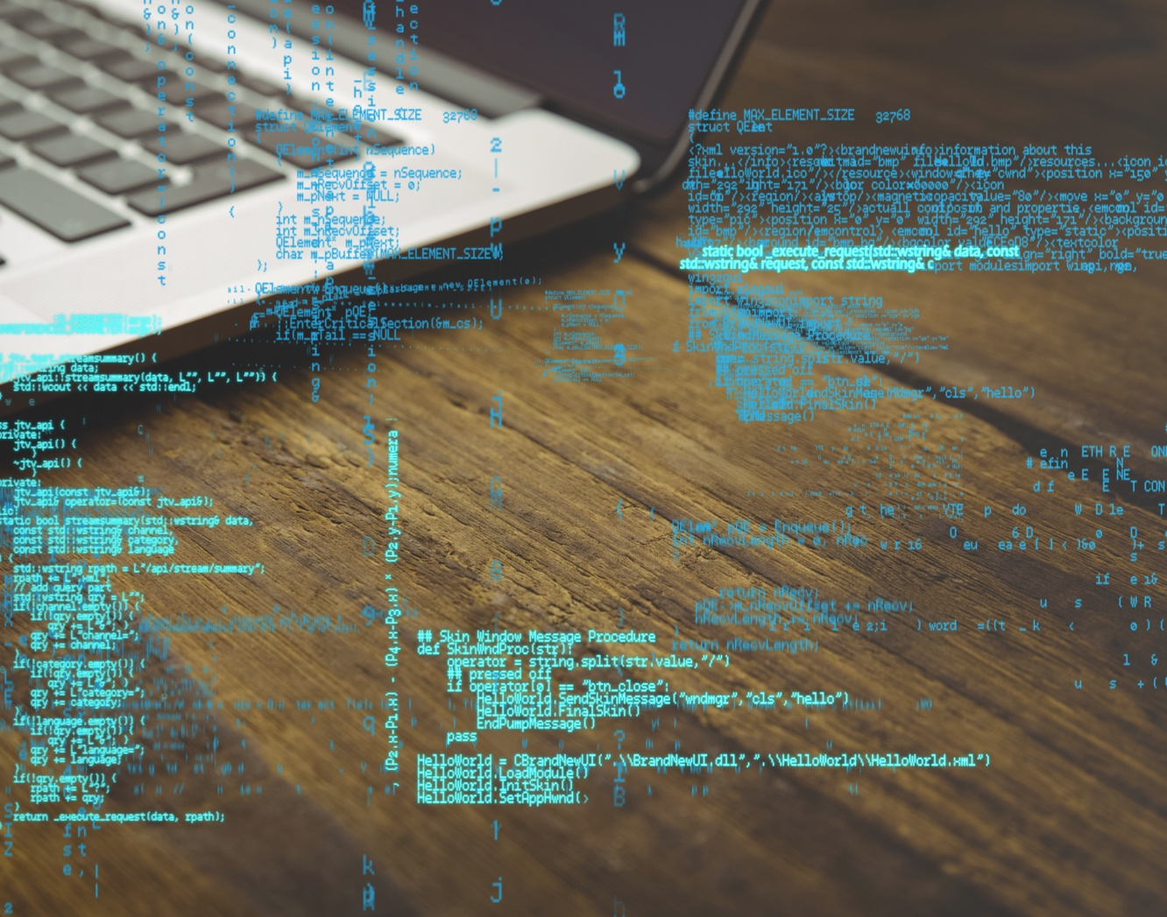
Technical skills
Technical requirements for digital preservation
File formats, validation & conversion methods, data integrity techniques
Forensic technologies & disk imaging software
Digital preservation & repository management systems
Basic coding in languages like Python
Basic Unix shell scripting
Experience with XML, HTML, databases, XSLT
Understanding how different systems & programs contribute to digital workflows
Image: CC Starline, Freepik.com
Notes:
This list is a range of technical skills that will be useful for digital preservation - expertise in these areas will be beneficial for some of the team members – but for many some basic skill or familiarity will be enough to work with the rest of the team – if you have a passing familiarity with these tools & techniques that is generally enough for much of the team – so long as some are more expert in these things
-One key one for the whole team to know well and for the organisation to be familiar with is: understanding how different systems & programs contribute to digital workflows & ultimately preservation -- able to make alterations & service changes, make the best choice to balance needs of users & preservation, able to understand & then articulate the value of preservation to users – the how & why are important to know, but often left out in favour of just “getting the job done”
More important than coming with these skills – is the willingness to learn them – there will always be new technology to tackle, new problems to solve (those skills I mentioned before) - important to support them, encourage them

Slide 25
Metadata standards
Your organisation’s descriptive metadata schemas and standards
  Dublin Core, MODS, METS
Mark up languages such as XML
Preservation metadata
  PREMIS schema – Preservation Metadata Implementation Strategies
  PROV-O
Linked open data
Notes:
You will probably know or people in your team will know a lot about the descriptive metadata in use at your organisation - you may also want to be sure you are familiar with standards and schemas like Dublin Core, METS and MODS since they are commonly used for digital collections – the same with mark up languages like XML as many of these standards or schemas are written this way – because it is machine/human readable and you can validate your XML to make sure you have done it correct
But you also was to learn about preservation metadata and standards you can use to potentially record it, like PREMIS (library of congress) although there are other standards that can work as well such as PROV-O
Linked open data is another area you maybe want to be familiar or have a team member that understands more if you want to eventually exploit the potential of it

Slide 26
Understanding users & their needs
Understanding legal requirements
Project management & preservation planning skills
Make your digital collections useful to users
Give them searching and use abilities in line with their needs and habits
Understanding legal requirements in relation to digital preservation
  Donor agreements?
Digital preservation requires ongoing planning and monitoring
Notes:
Many of you will already know your users – but it is important to keep reviewing them, engaging with them and figuring out how they want to use your digital collections so you can provide them access in meaningful ways.
Many of you will already know about lot about the legal requirements for your organisations and your collections – it is important to understand how these things will impact digital preservation as much as access – especially when considering donor agreements and things of that nature
Project management is important to DP – definitely a managerial skill, but everyone engages with certain aspects of it – another important part is preservation planning – being able to monitor your collections & make decisions about future care of digital objects based on that – digital preservation is an ongoing activity – need to match that

Slide 27
Communication skills
Problem solving & willingness to learn and adapt
“soft skills”
Communication for advocacy
  Communicate up/down/sideways
  Internal and external
  Training
Problem solving – creative solutions
Digital preservation requires ongoing learning and adapting to changing technologies and cultural landscapes
Notes:
These are more “soft skills” also known as people skills - maybe that makes them harder to learn, but just as important
Communication for advocacy
Communicate up/down/sideways
Internal and external
Training
Problem solving – creative solutions
Digital preservation requires ongoing learning and adapting to changing technologies and cultural landscapes

Slide 28
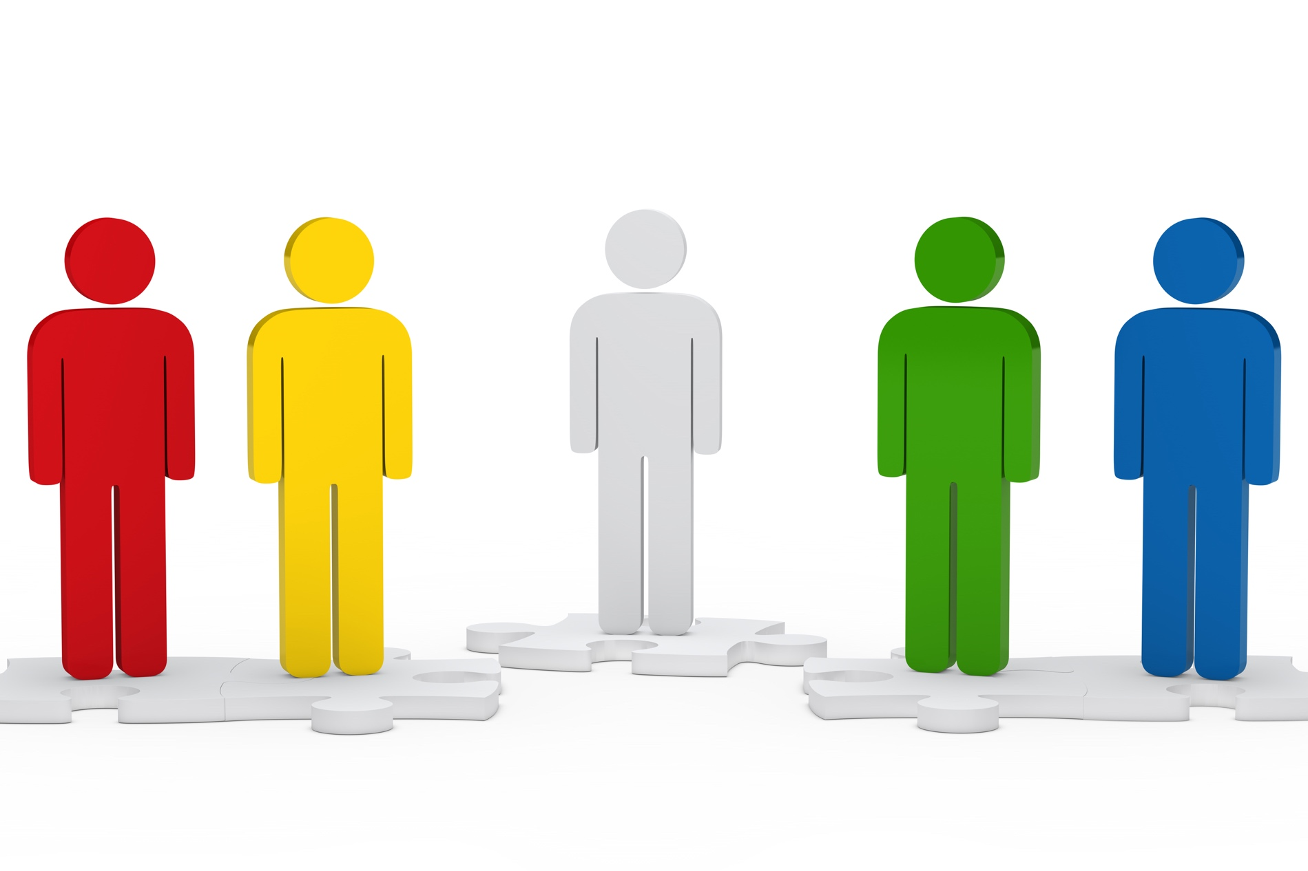
Recruitment of future staff
Supporting current staff
Notes:
Every organisation is different – they have different digital preservation needs, different digital collections and the people and teams that will support digital preservation will look different
Not every role needs all of these skills (or could support them) – those skills should ideally be spread across different roles in a team or across different departments – planning for some overlap (succession planning)
Those skills (and those in DigCurV) form basis for update job descriptions, design new ones & recruit for those skills – a lot of skills are not exclusive to DP & might already be there, how can we role DP into it?
Make sure to create teams that compliment each other with those skills – no one person will fully possess all of these skills
Supporting current staff is important – be sure to help them upskill if you are going to rewrite their positions to give them new responsibilities – send them to training, give them time to complete self-directed training
What is important to understand is that due to technology and the amount of theory vs practice, this field is always changing and staff involved in DP will always need to reskill and retrain – management must allow them the time to learn and play with new programs, new technology in order to decide how best to implement them at your organisation

Slide 29
Upskilling current staff
Digital Preservation Coalition (DPC) handbook
  https://www.dpconline.org/handbook
Library Carpentry/Software Carpentry
  Codecademy.com, Khanacademy.org, Lynda.com (paid)
DPOC resources – contact us for training materials
  www.dpoc.ac.uk
Notes:
Resources to start upskilling
DPC - handbook
Library carpentry / software carpentry
Online free courses - codecademy, Khan academy
Lynda.com (not free, but some places will provide this free like libraries and universities)
DPOC – contact us if you want help with training resources – will be making some training materials available by this June – other resources for training & upskilling are also there

Slide 30
Remember: it is not only about IT
Notes:
IT staff and IT skills will not be enough to address digital preservation – there will be other skills involved – which is why relying solely on one person or your IT department for all of your digital preservation needs does not work
They need to understand the basic concepts of digital preservation as well, so don’t leave them out of training! - for example that it is not only about having backups, which is a common misconception

Slide 31
Conclusions
Reports and frameworks can be useful to help design teams & identify gaps
You already have skills for digital preservation, you just need to see them through a “digital preservation lens”
No one person will have all of the skills, you need to work together – and you need a common language for that
You will need to upskill for digital preservation and you will need to recruit new staff – update your job descriptions to make this easier!

Slide 32

Is it just a skills gap or an awareness and advocacy gap?
Image: CC Jannoon028, Freepik.com
Notes:
Each of us will leave you with a final question - ME: Is it really just a skills gap we are dealing with or is it also an advocacy and an awareness about digital preservation gap? As more people in a team understand what digital preservation is and how it affects their work and the way they think, the more likely we are to design and maintain services that consider preservation as much as access.
Buy-in from management & executive will provide the resource needed for training, the time required to learn and test problems – often we are so focused on getting the job done with such limited resources that we forget that learning/trying is a crucial part of our digital preservation jobs.

Slide 33
Thank you!
Sarah.mason@bodleian.ox.ac.uk
www.dpoc.ac.uk
@BDLSS
#DP0C

