Slide 1
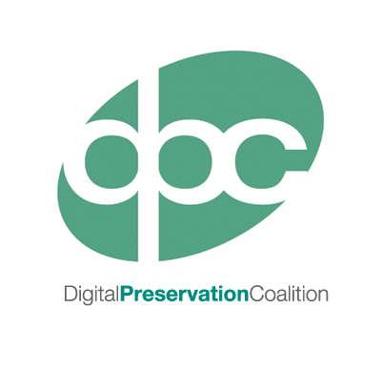
Getting Started: An Introduction to
Digital Preservation

Slide 2
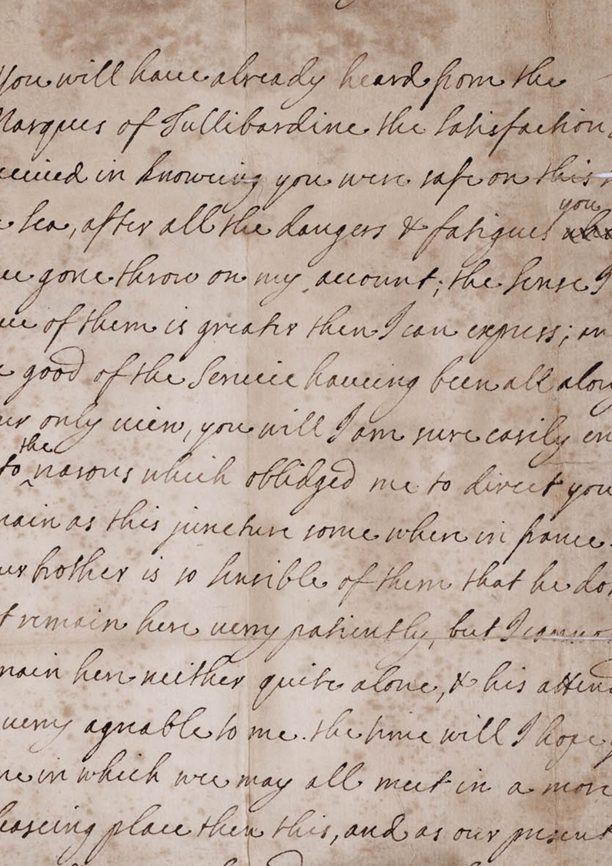
Traditional Media
Robust
Tangible
Independently understandable
Experienced in assigning value
Well-developed approaches to preservation
Notes:
Traditional objects are generally quite robust
They are tangible, we can hold them in our hands
Are generally independently understandable (if you speak the language they are written in…..)
We are quite experienced in understanding their worth and assigning value to such objects

Slide 3
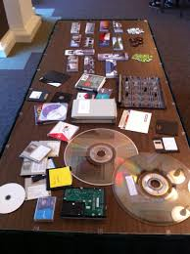
Digital Information
Ephemeral
Need technology & documentation to interpret
Obsolescence
  Media
  Formats
  Software/Hardware
  Documentation
How to estimate value?
New skills and solutions
But also new opportunities!
Notes:
Digital objects are ephemeral by their very nature
They very susceptible to obsolescence as they are entirely dependent on the media they are stored on, the accessibility of their file format and often require documentation to use and understand them
Managing issues such as rights can also be much more difficult, from protecting copyright to ensuring personal data is protected
They require us to gain new skills to care for them, or for us to work with new groups of colleagues with different skills groups (particularly IT specialists)
But they do also bring a whole host of new benefits, in particular the ability to make content accessible to users.

Slide 4
What’s the Problem?
Digital data (images, documents etc.) have value and create opportunities
...but...
Access depends on software, hardware and people
…and…
Technology and people change, creating barriers to reuse
...therefore...
We need to actively manage data to protect and create opportunities

Slide 5

Why We Preserve….
Legal and Regulatory Compliance
Increased Efficiency
New Revenue Streams
Improving Health
Protecting the Environment
Enabling Research
Documenting Cultural Heritage
Ensuring Transparency and Accountability

Slide 6
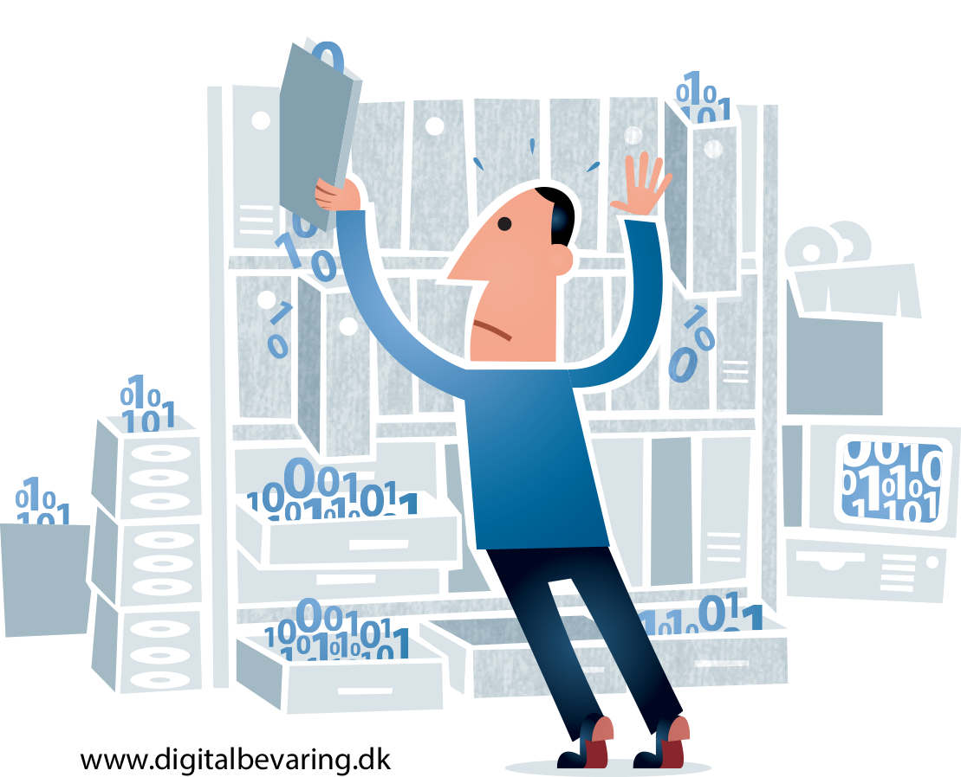
Digital Preservation: A Tale of Three Models….

Slide 7
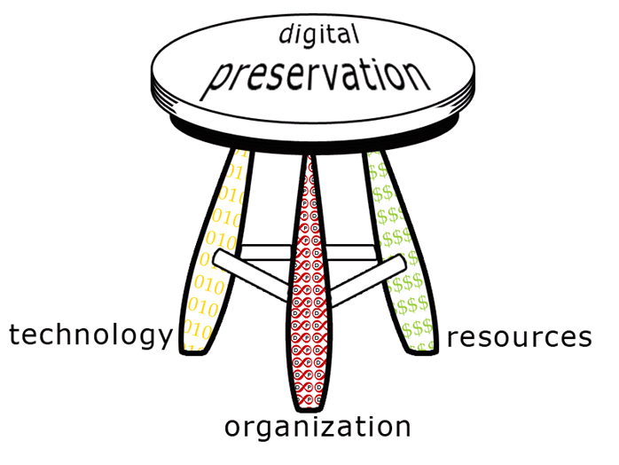
DP Models: Three Legged Stool
http://dpworkshop.org/dpm-eng/conclusion.html

Slide 8
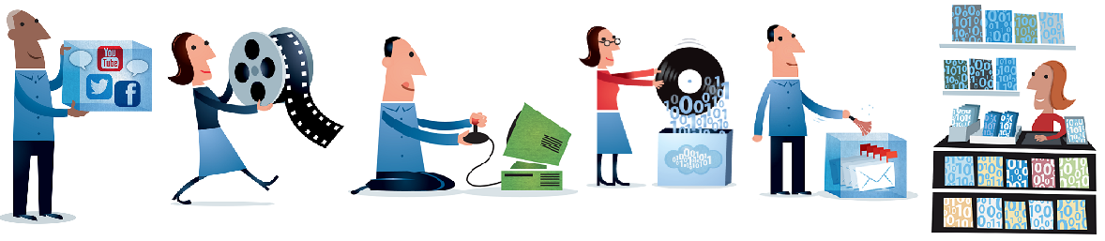
More on the Three Legged Stool
Technology
Storage/Back-Up
Repository Systems
Tools
Fixity
Security
Organisation
Policy & Strategy
Planning
Procedures
Risks and Benefits
Staffing
Resources
Business Planning
Cost modelling
Funding
Sustainability
Staff skills
Illustration by Jørgen Stamp digitalbevaring.dk CC BY 2.5 Denmark

Slide 9
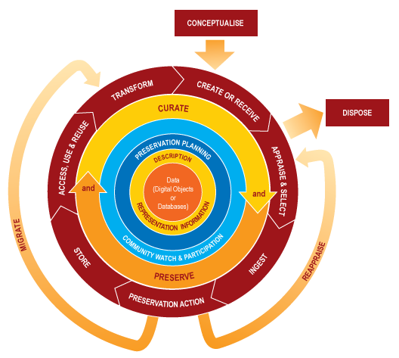
DP Models: DCC Life-Cycle
http://www.dcc.ac.uk/resources/curation-lifecycle-model

Slide 10
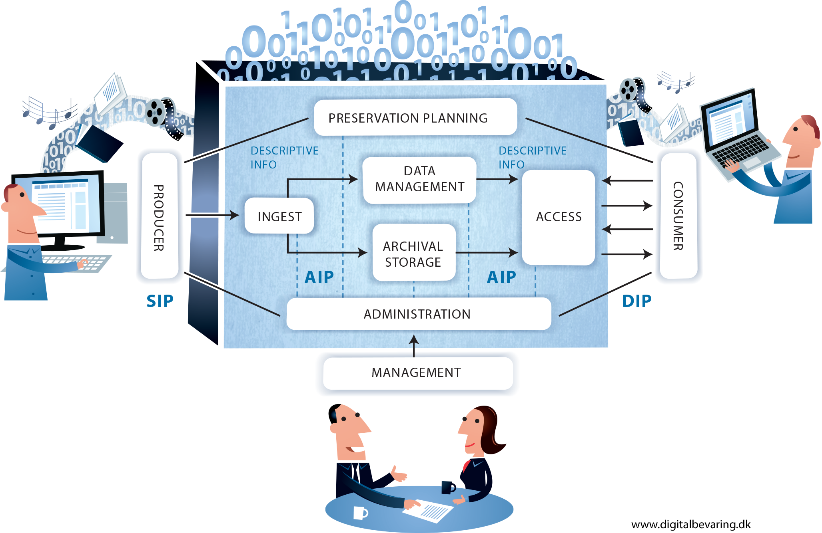
DP Models: OAIS
Notes:
While it is far from perfect the Open Archival Information System model is one of the keystones of Digital Preservation. In particular it provides much of the terminology used within the field. This diagram represents it’s functional model at the highest level. As well as the key functions of an OAIS that it shows (such as Ingest, Preservation and Access) it also includes various information packages. These information packages contain the digital material to be preserved along with its accompanying metadata and within OAIS these exist in 3 different forms across the lifecycle:
The Submission Information Package
The Archive Information Package
The Dissemination Information Package
To accompany this functional model the OAIS also describes an information model that lays out what types of metadata (specifically called Representation Information in OAIS) should be included in the information packages to facilitate preservation.
Full OAIS Standard: https://public.ccsds.org/pubs/650x0m2.pdf
Brian Lavoie’s Tech Watch Report on OAIS: http://dx.doi.org/10.7207/twr14-02

Slide 11
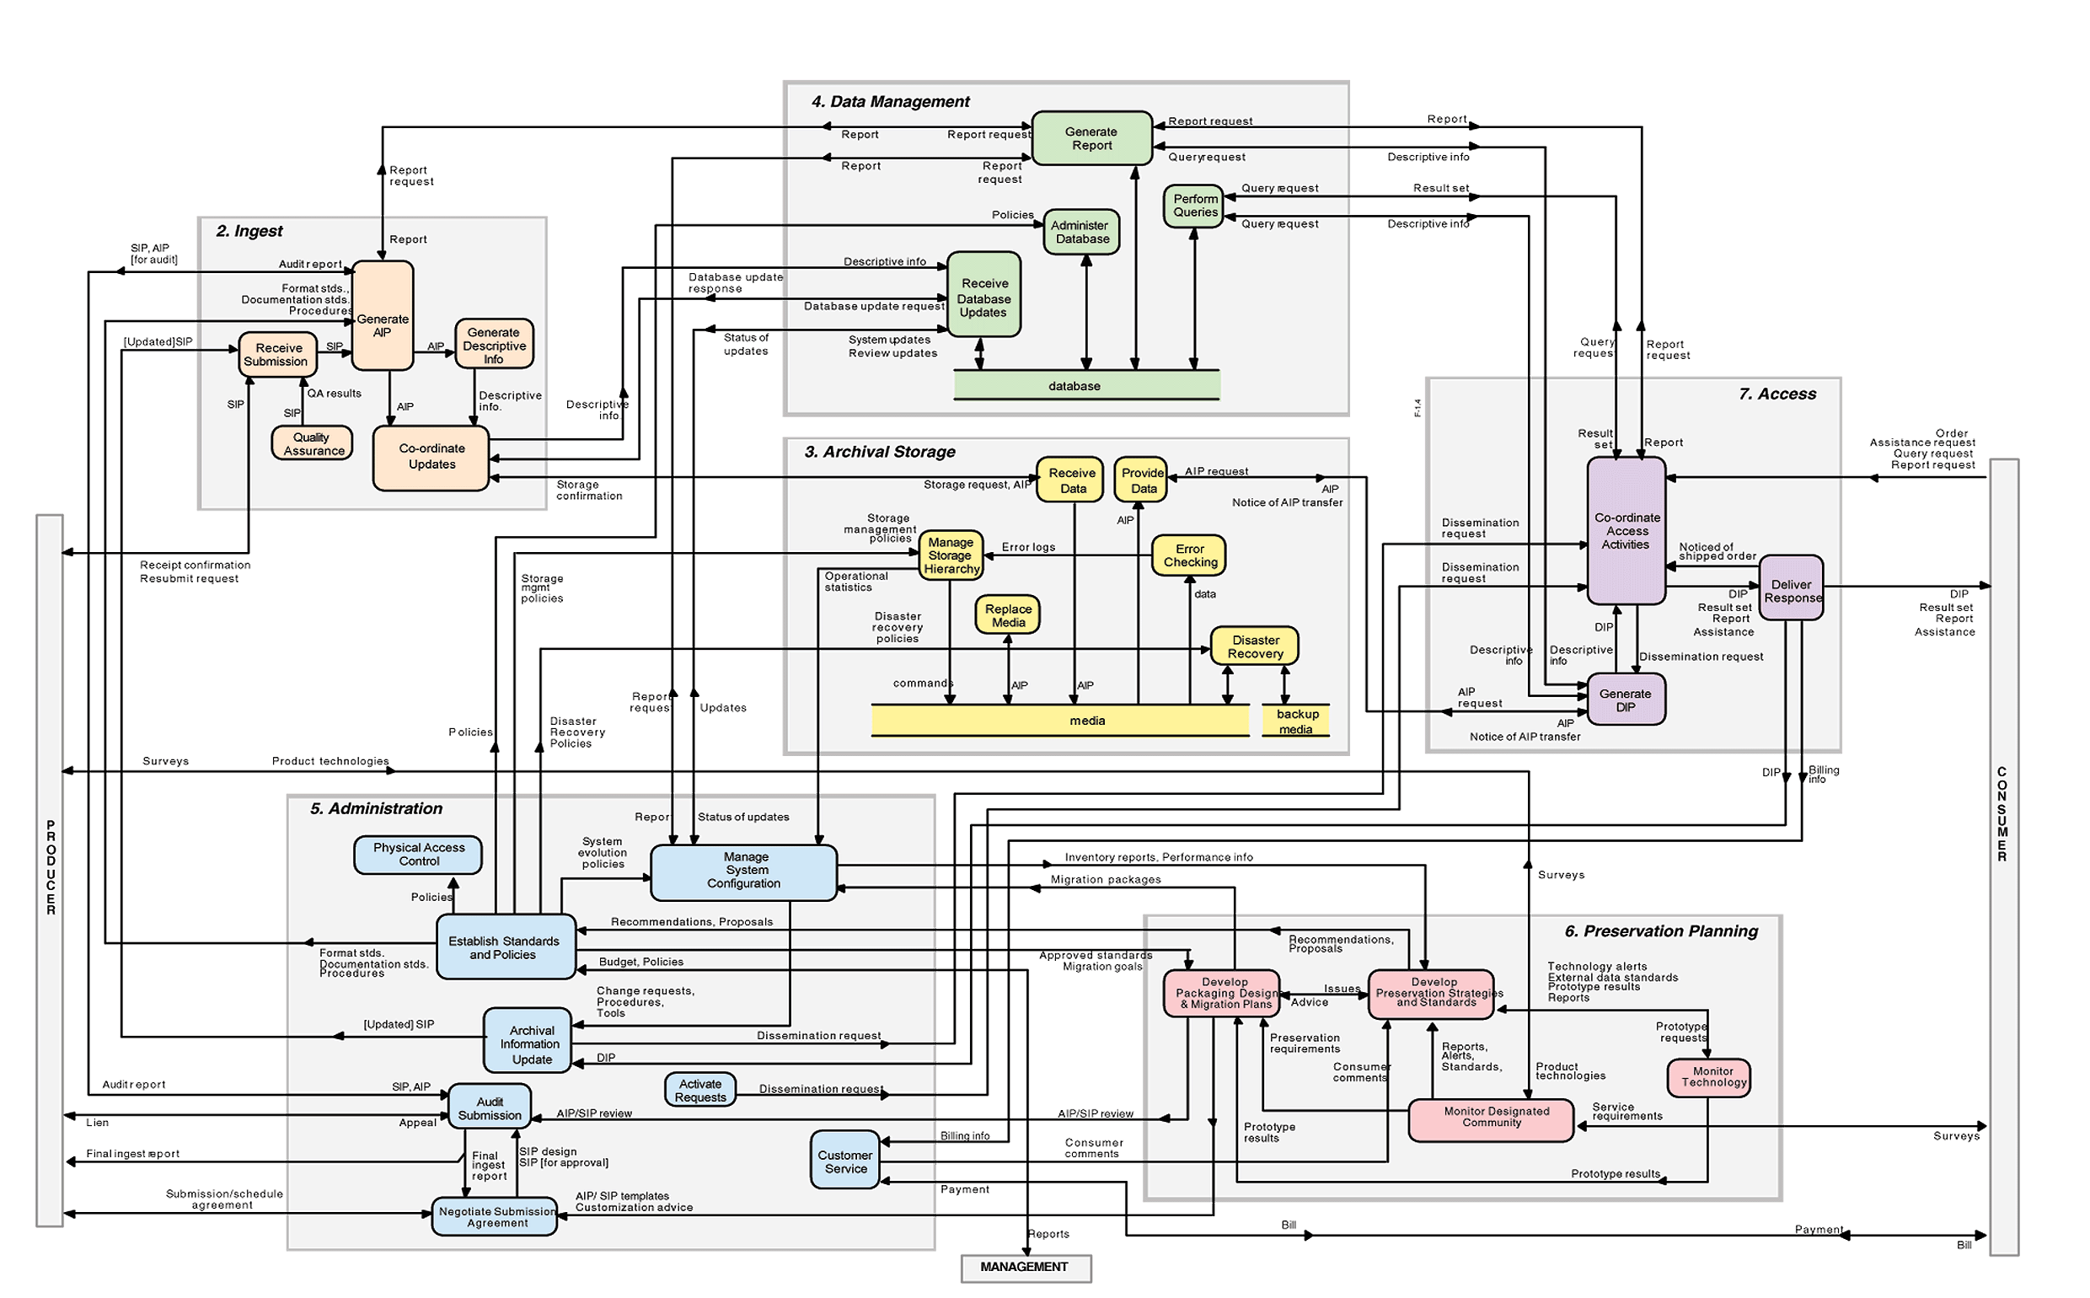
The full functional model

Slide 12
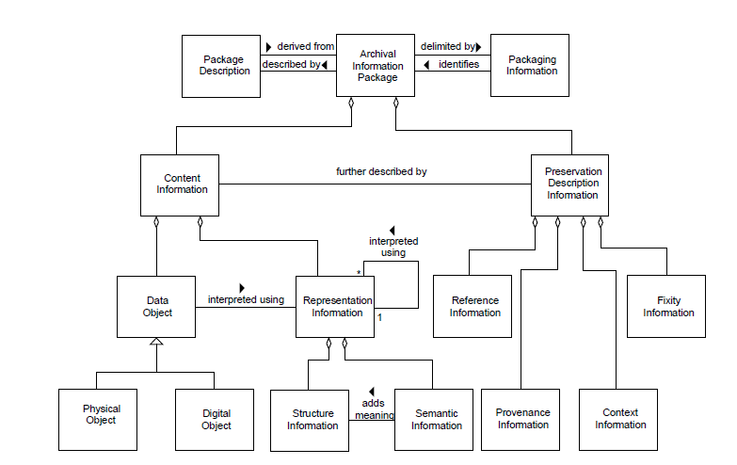
The OAIS Information Model

Slide 13

How do you measure compliance?
Certification
CoreTrustSeal
ISO 16363
DIN 31644
Maturity Modelling
NDSA Levels
DPCMM
5 Organizational Stages
E-ARK Maturity Model

Slide 14
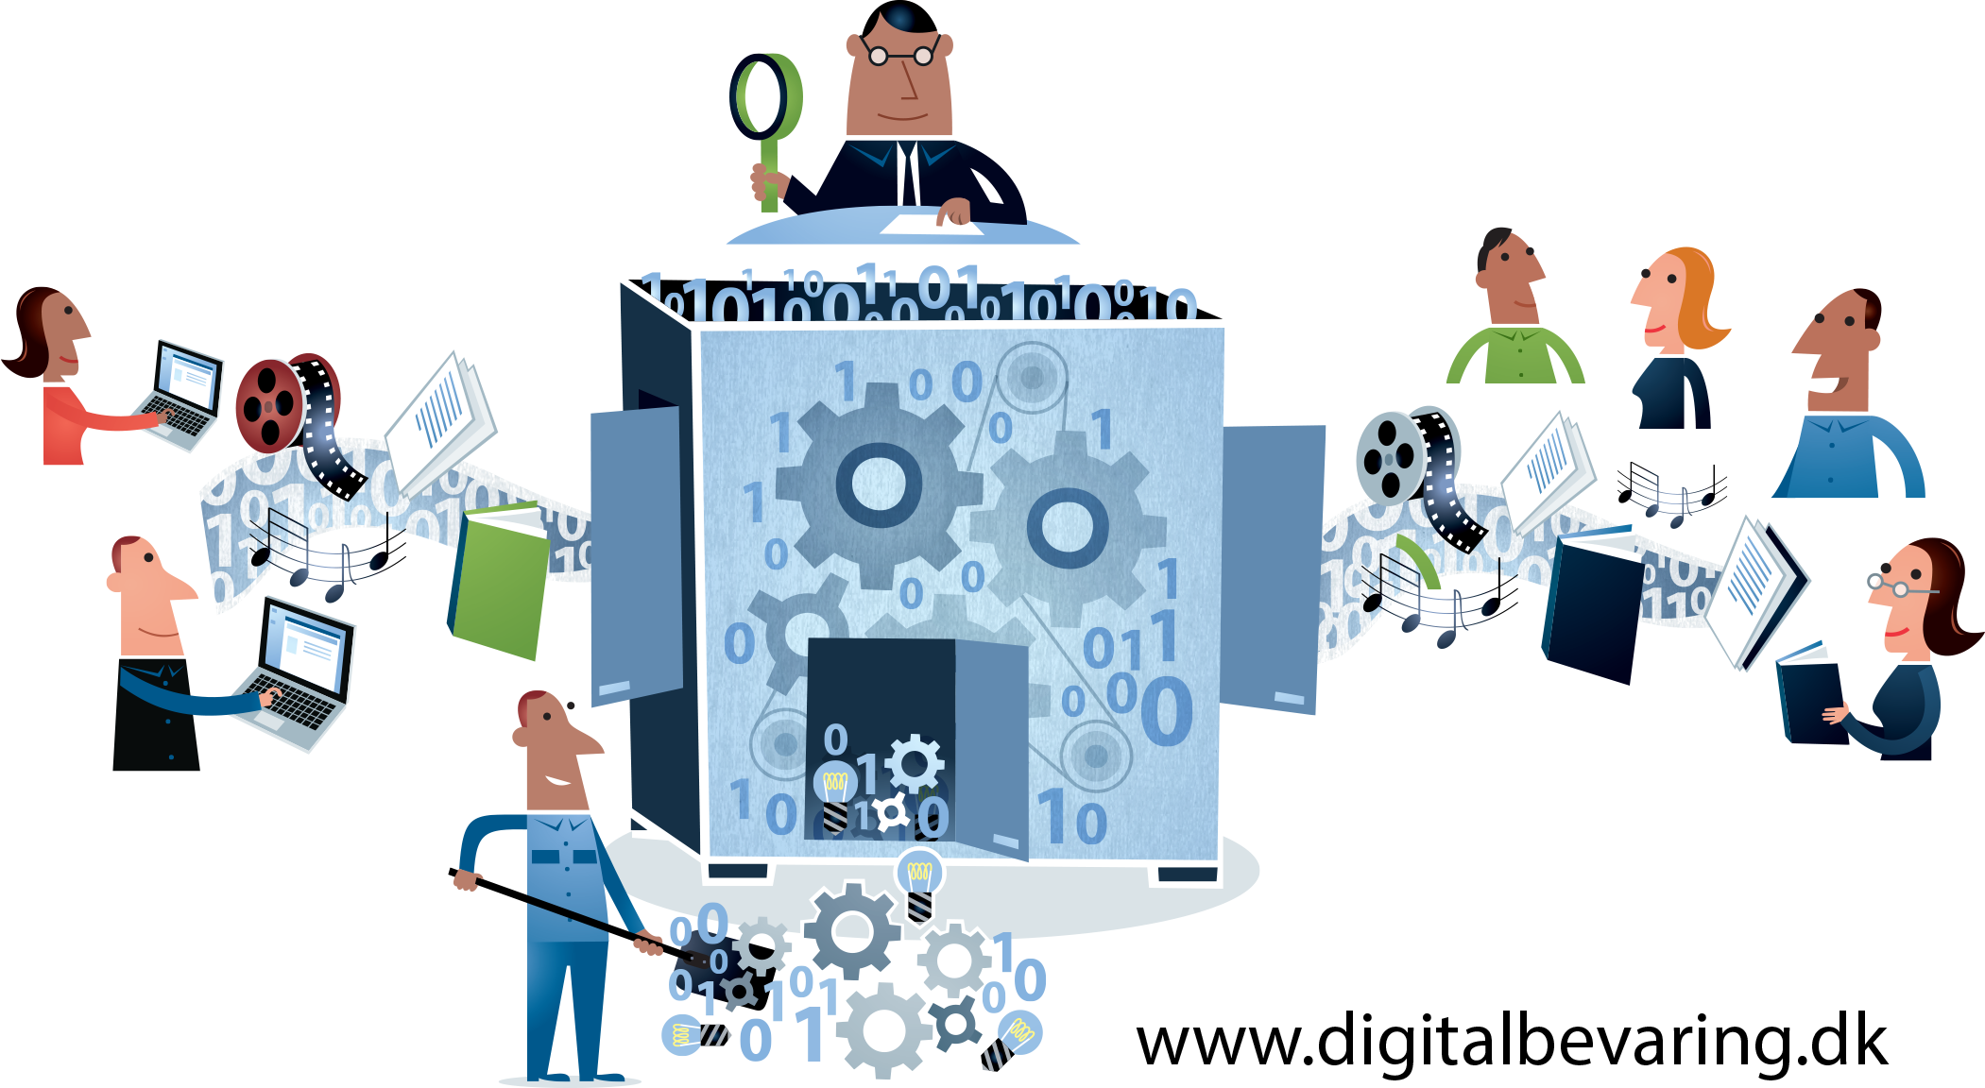
Some More Standards….

Slide 15

Why Do We Need Standards?
Provide a common understanding and approach
Allow us to share experiences, collaborate and build on the work of others
Help build sustainable systems and operating models
Accelerate capability-building
Help to build trust in our services

Slide 16

Metadata Standards
PREMIS
METS
Domain-specific, e.g. MARC, ISAD(G)
Type-specific, e.g. Z39.87, DDI
Container formats, e.g. BagIt, MPEG-21, WARC

Slide 17
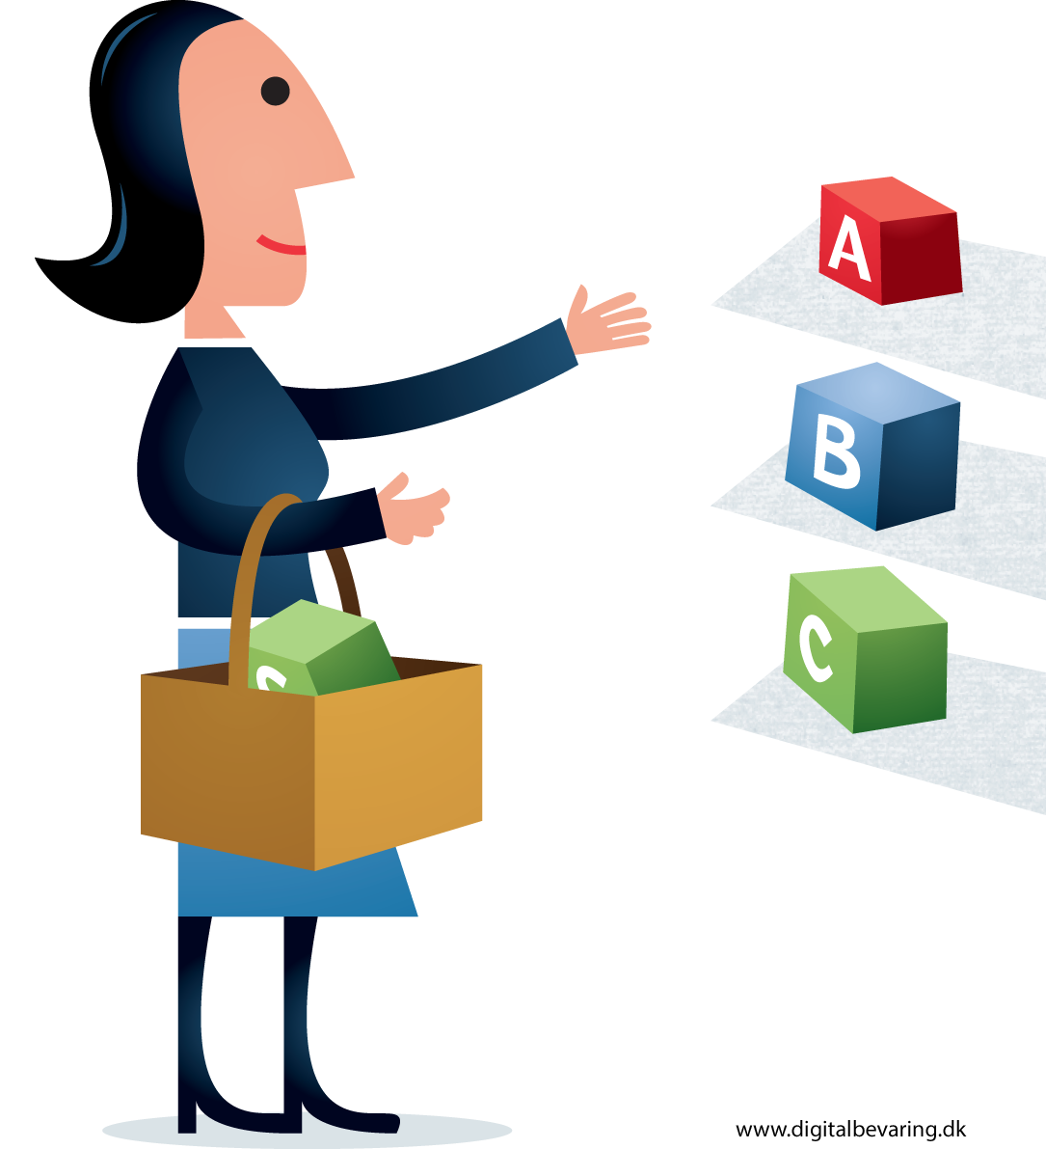
File Formats
Open Document Format & Office Open XML
JPEG-2000
PDF/A
TIFF
Industry Foundation Classes for BIM
STEP: Standard for the Exchange of Product model data (ISO 10303)

Slide 18

Cost Models
Keeping Research Data Safe (1 and 2)
LIFE project (1-3)
4C project and survey of existing costs models

Slide 19
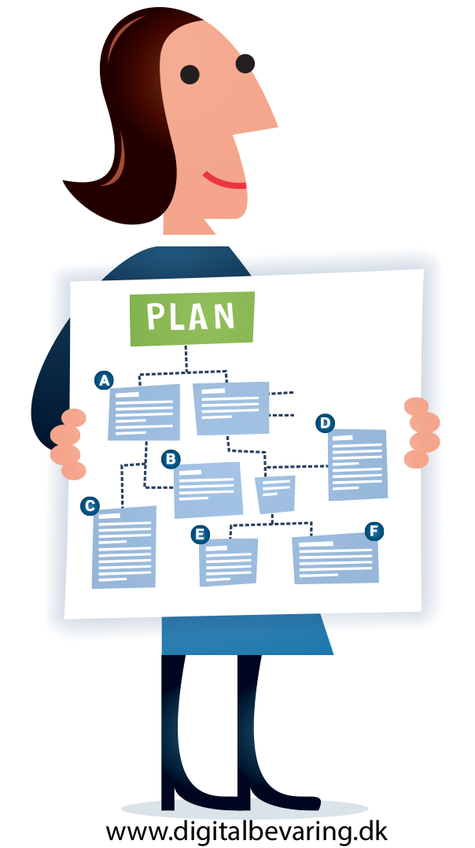
Local Standards
Transfer:
  Formats
  Documentation
  Packaging
  Agreements
Metadata

Slide 20
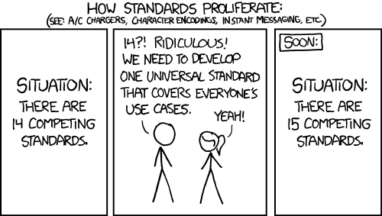
Standards, beware!

Slide 21
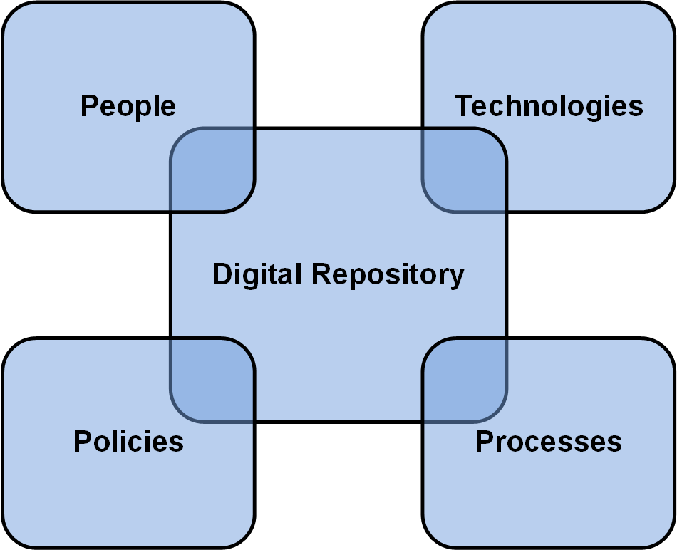
Remember the Big Picture!

Slide 22
Models and standards are powerful tools
but...

Slide 23
Models and standards are powerful tools
but...
Equipping people with the right skills is even more powerful

Slide 24
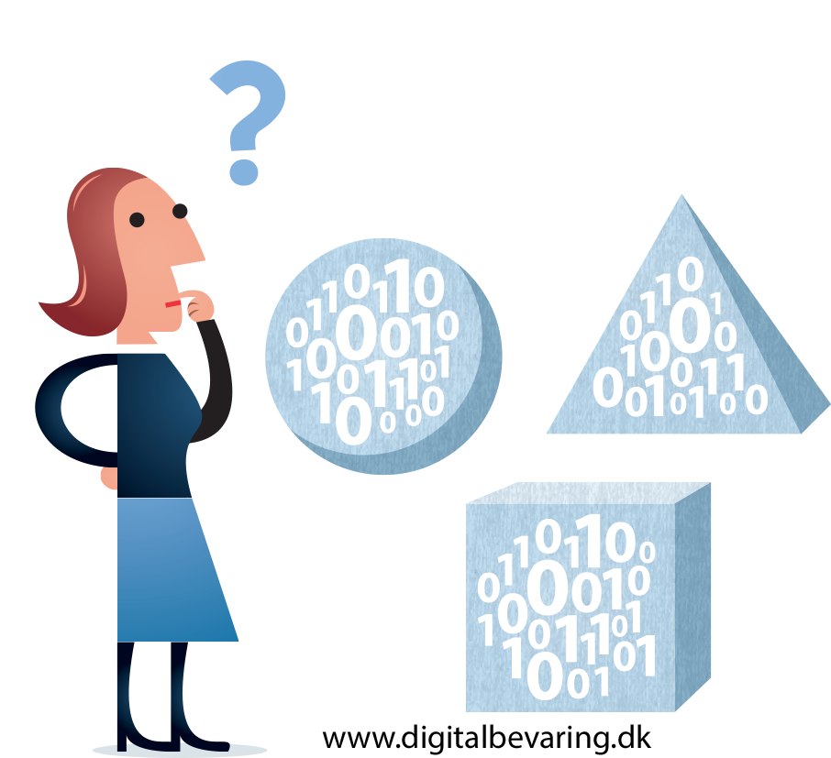
Preservation Methods

Slide 25

Approaches to Preservation
Bit-Level
Migration
Emulation
Hardware Preservation
Digital Archaeology
Virtualisation
etc.……
Illustration by Jørgen Stamp digitalbevaring.dk CC BY 2.5 Denmark

Slide 26
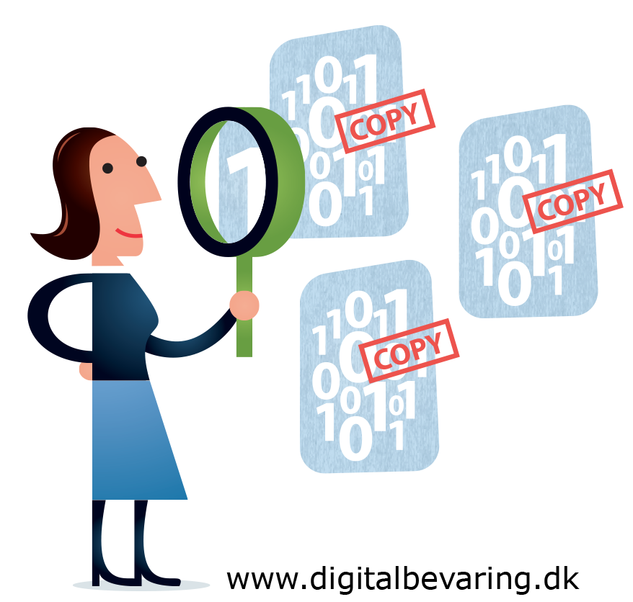
Bit-Level Preservation
File Manifest/ Digital Asset Register
Storage
  Multiple copies
  Back-up
Security
Fixity Checking

Slide 27



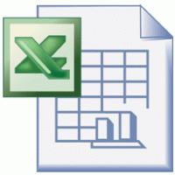
Migration
“Normalisation”
To New Versions
Notes:
There are two main forms of migration for digital preservation, and it is possible to use one or both.
The first is a method often referred to as ‘normalisation’. This is where all files of a particular type (for example, text documents) are ‘normalised’ to one file format.
The example on the slide shows Word documents being normalised to PDF. For images this could be JPEGs and GIFs normalised to TIFFs.
The choice of normalised files format used will depend on the needs of the organisation and its users.
The second method involves migrating old file formats to newer versions when they are at risk of becoming obsolete.
This could be migrating an old .xls spreadsheet to a newer .xlsx format.
Both methods have their positives and negatives:
Normalisation creates homogenous, easier to manage collections and means that users need to know how to use fewer files types.
Migrating to new versions means that files can be accessed in current computer environments.
Both processes can be automated but quality control is incredibly important and careful consideration must be given to migration pathways to avoid loss of data and functionality.

Slide 28
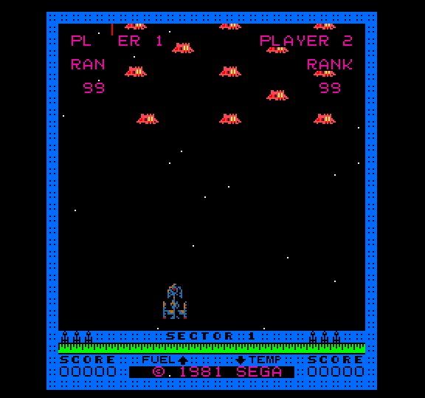
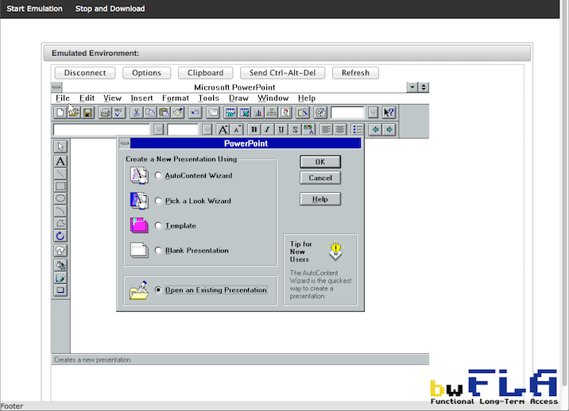
Emulation
Notes:
Emulation is the process of recreating the original environment in which a file was created and used via a layer of specially written software: the emulator.
 Emulation has been particularly successful in the world of computer games, where enthusiasts will create emulators to allow them to play older games.
 It is also an increasingly popular preservation method and several projects have produced emulators for everything from early browsers to old versions of PowerPoint. Many of these emulators are freely available, either online or as software downloads.
Emulation perhaps seems like the ideal version of digital preservation as it allows users to access the files in their originally environment, providing a more authentic experience.
It is however, very resource intensive and emulators will require updates (or their own emulators) as computer environments change.
It can also be difficult to confirm the emulator truly captures the original environment unless there is still access to an original example to compare.

Slide 29
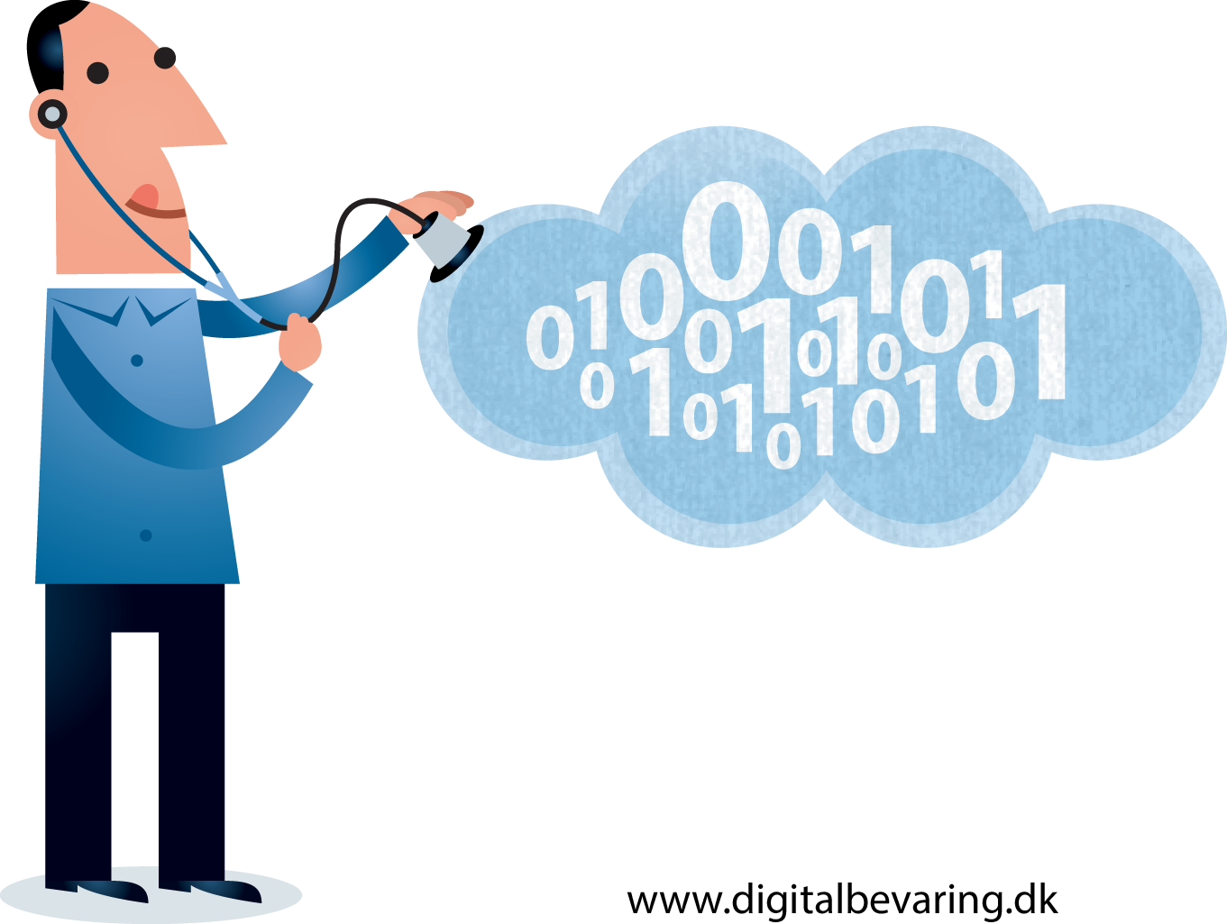
One More Thing….

Slide 30
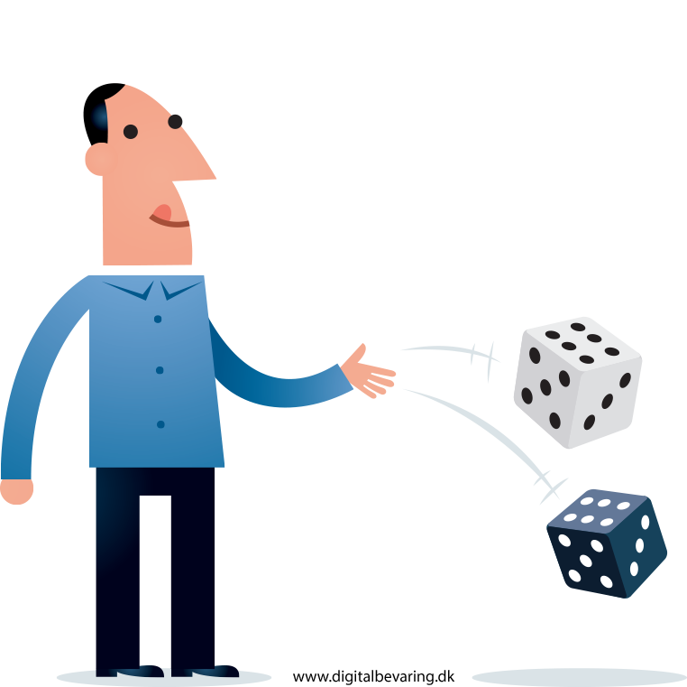
Risk Management
Identifying risks is a key stage in successful digital preservation
Useful for:
Policy development
Building a business case
Identifying requirements
Making preservation decisions
Resources: DRAMBORA, SPOT, TNA

Slide 31

Some Key Messages
It’s about more than storage
Be prepared to advocate for DP
Know the opportunities and benefits
Collaboration is essential
Investing in people is as important as technology
The DPC is here to help!

Slide 32
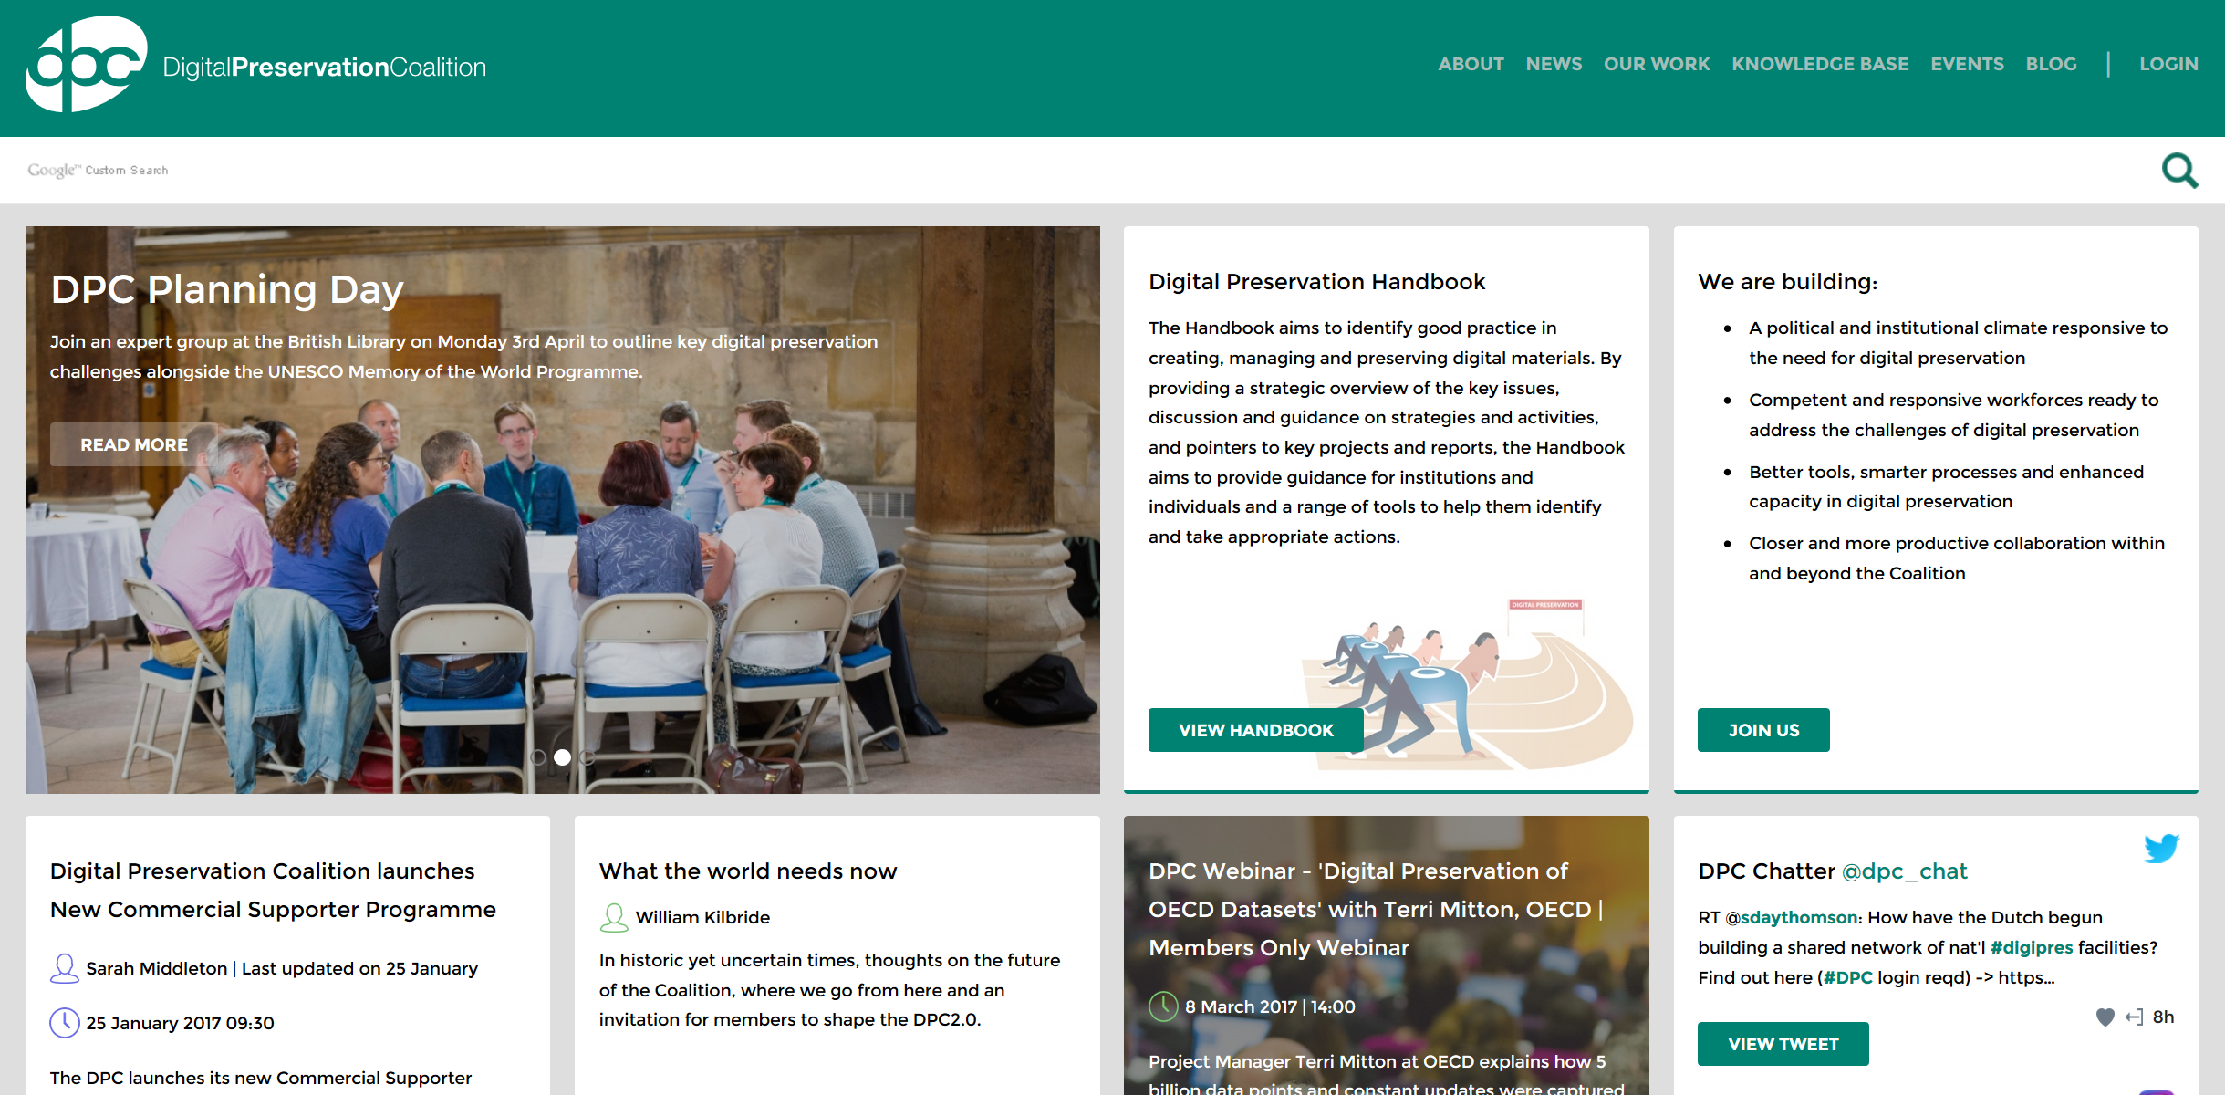
Digital Preservation Coalition
http://www.dpconline.org
Notes:
68? members
4 strategic areas
Shiny new website
Responsive design
Easier access to resources

Slide 33
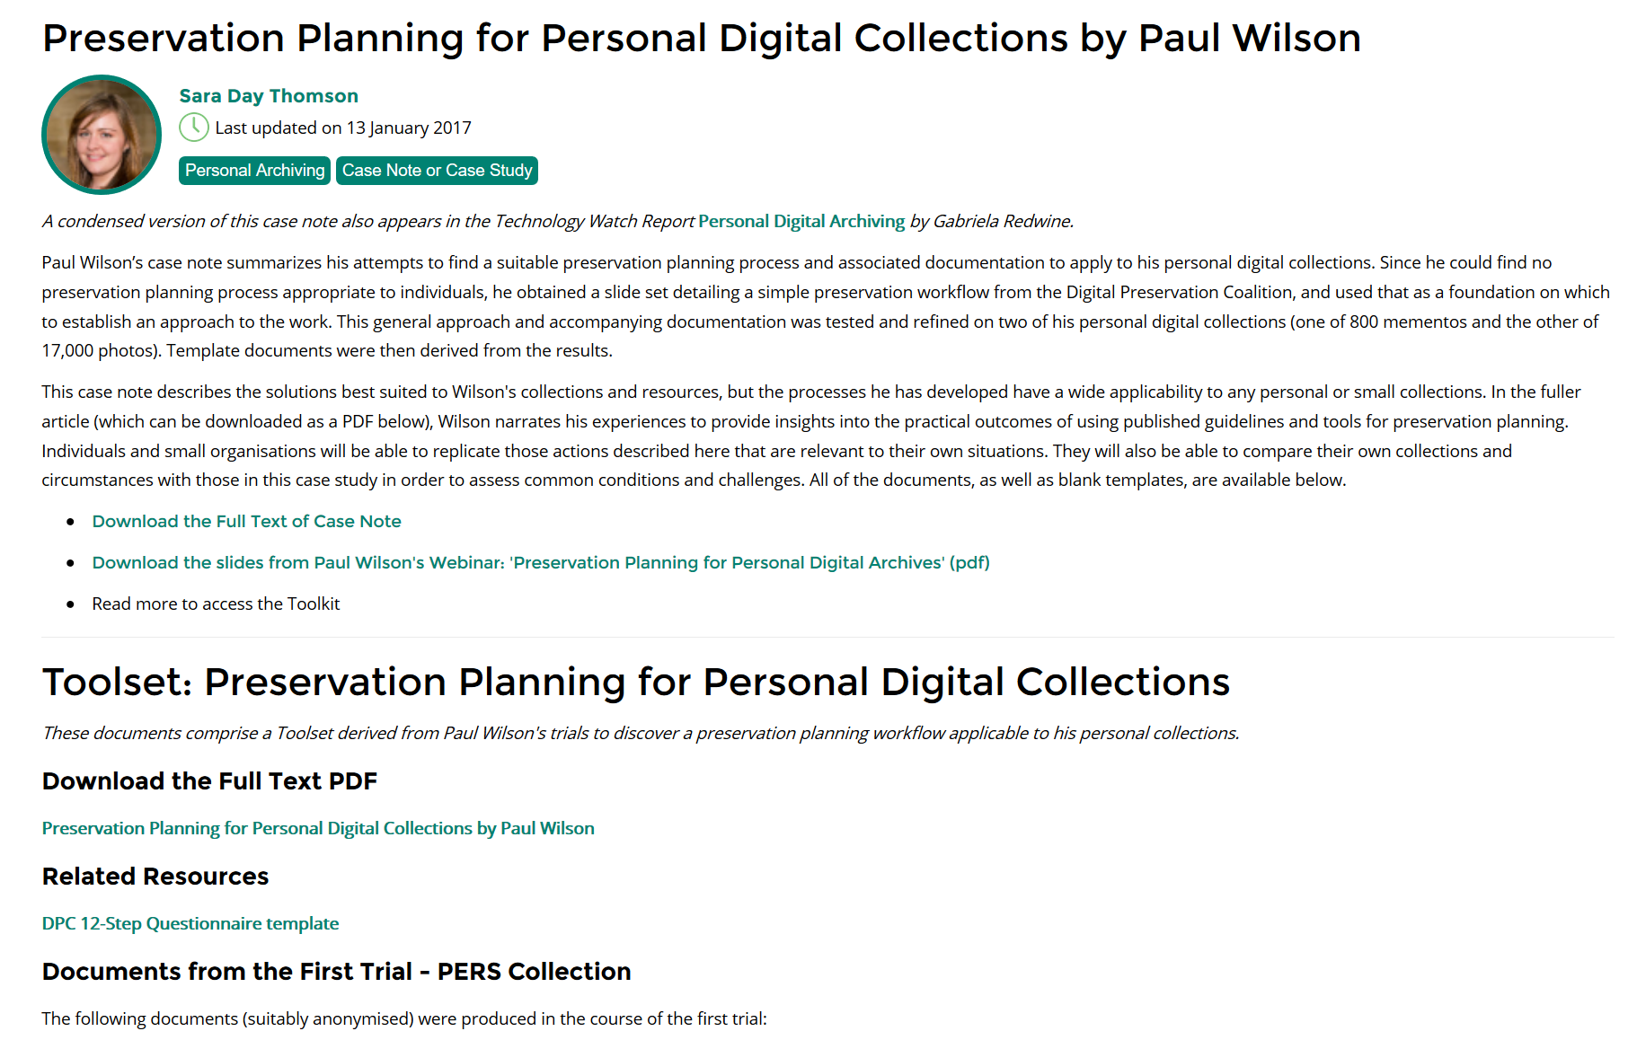
Blog and Case Notes

Slide 34
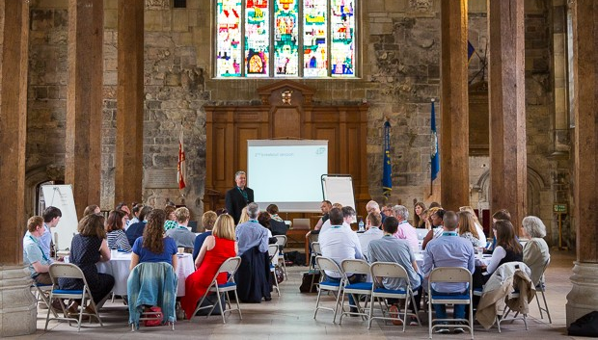
Networking
Notes:
Important part of all our events
Peer to peer learning
Planning Day
Counting the Bits

Slide 35
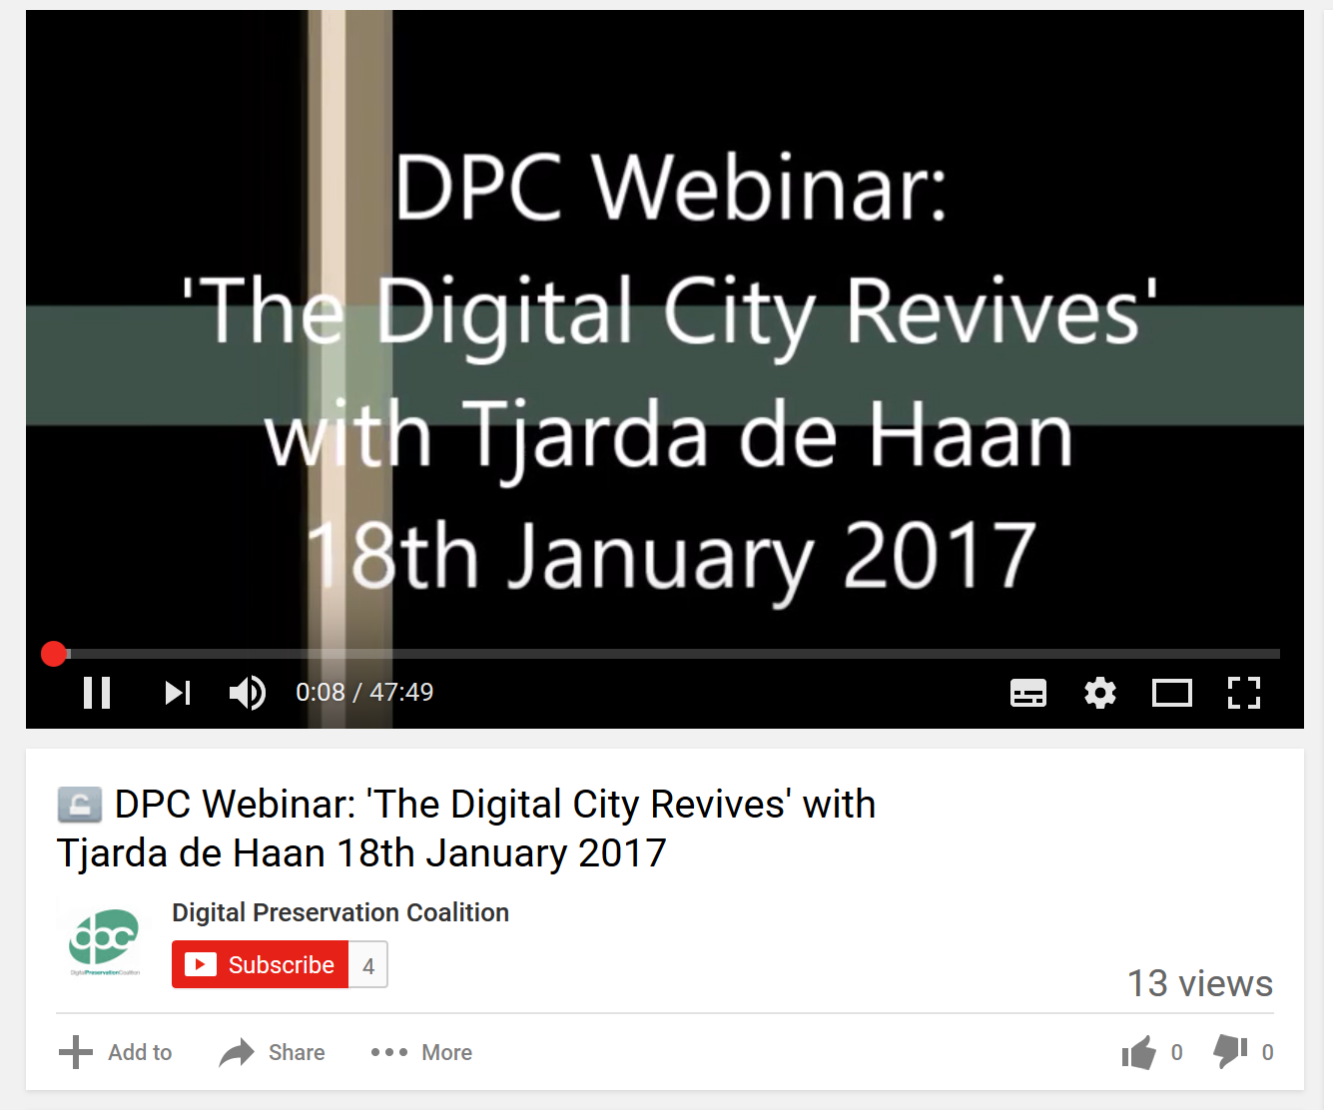
Webinars
Notes:
Covering a wide range of digital preservation issues
Tool demos
Research project updates
Case studies
Important resources

Slide 36
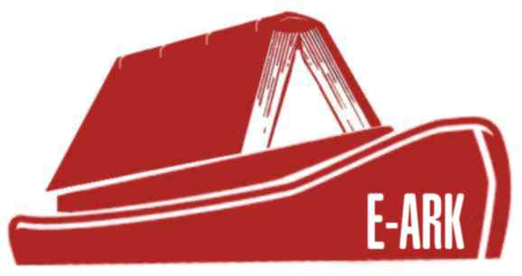

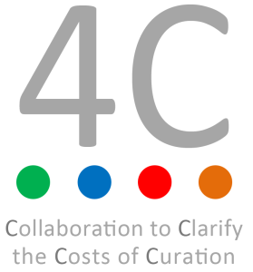



Research Projects
Notes:
E-ARK: http://eark-project.com/
VeraPDF: http://verapdf.org/
TIMBUS: http://timbusproject.net/
4C: http://www.4cproject.eu/
APARSEN: http://www.alliancepermanentaccess.org/index.php/about-aparsen/aparsen-deliverables/
SPRUCE: http://wiki.opf-labs.org/display/SPR/Home

Slide 37
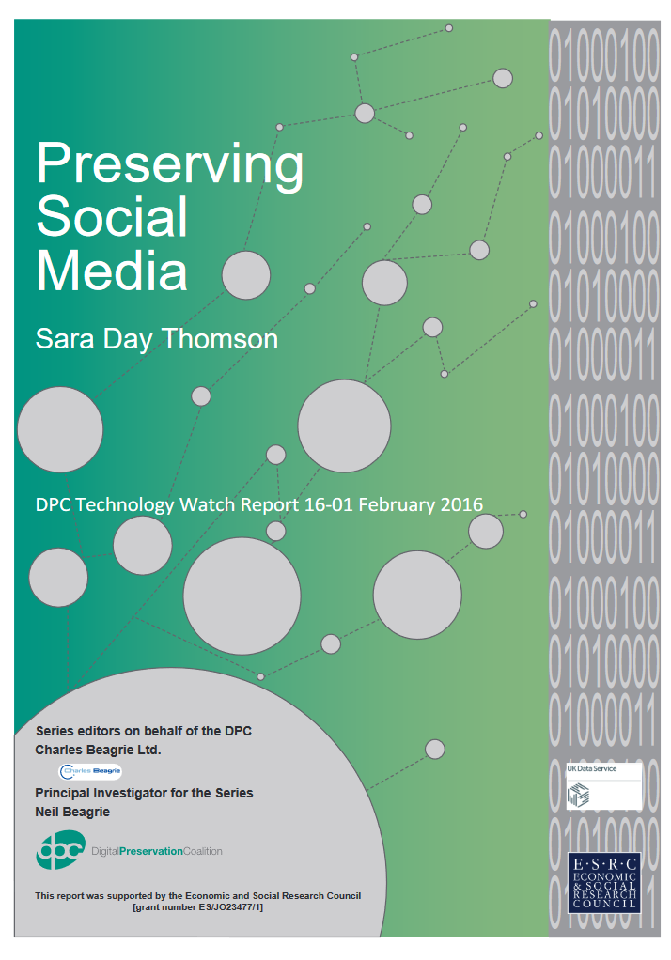
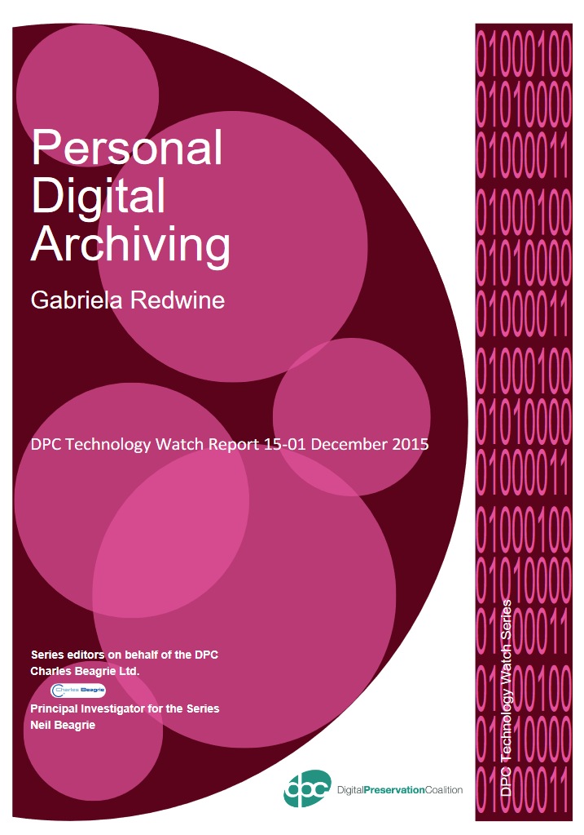
Tech Watch Reports
Notes:
http://www.dpconline.org/knowledge-base/tech-watch-reports

Slide 38
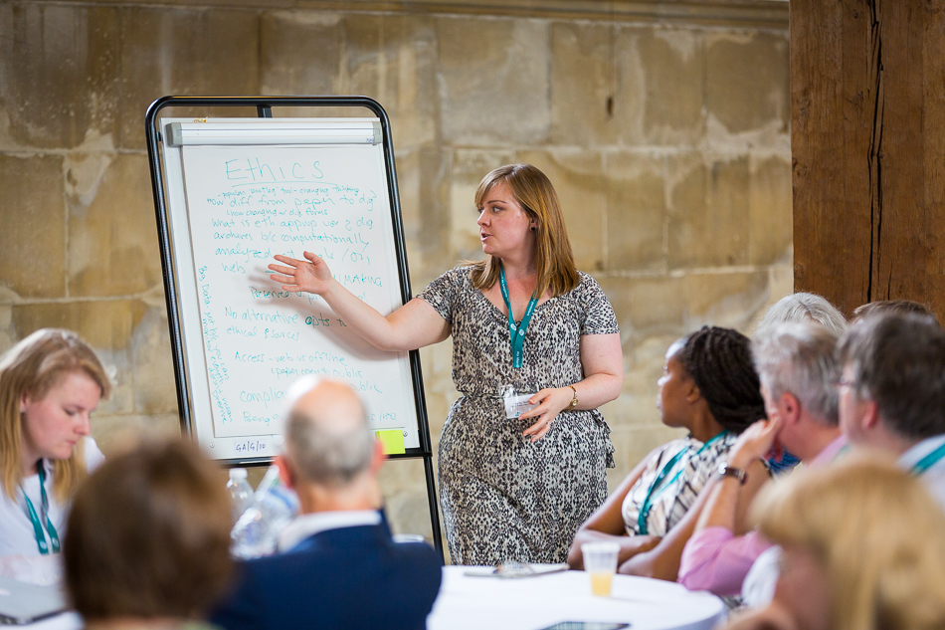
Training Workshops
Notes:
Getting Started and Making Progress: http://www.dpconline.org/events
Short videos of GS online via the Handbook: http://dpconline.org/handbook/getting-started

Slide 39
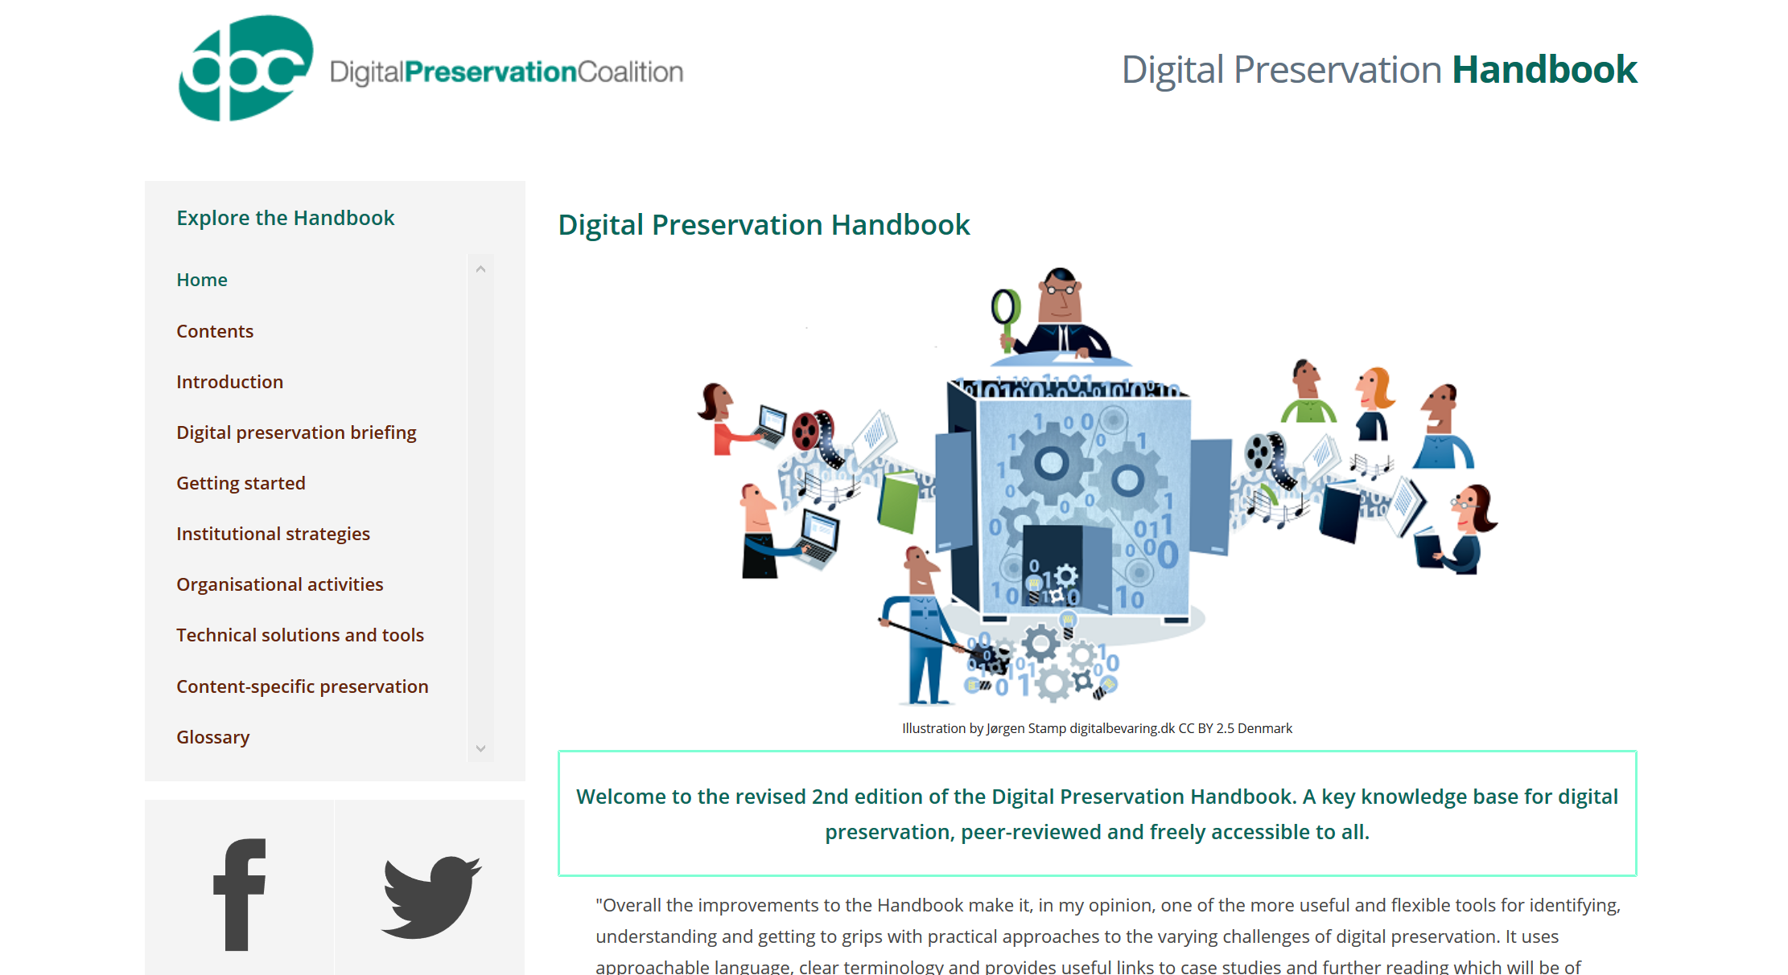
Digital Preservation Handbook
Notes:
http://dpconline.org/handbook

Slide 40
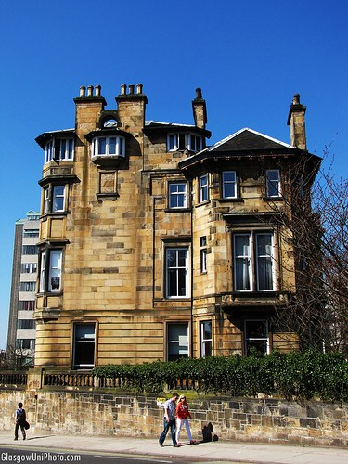
Questions?
sharon@dpconline.org
www.dpconline.org
@SharonMcMeekin
(@williamkilbride @prwheatley)

