Slide 1
COAR and Next Generation Repositories
David Minor UC San Diego
[Your name here]
With significant input from Andrea Bollini, Petr Knoth, Eloy Rodrigues, Kathleen Shearer, Herbert Van de Sompel, Paul Walk, David Wilcox, and the COAR NGR Working Group

Slide 2
COAR:
Coalition of Open Access Repositories

Slide 3
Who is COAR?
• An international association founded in 2009.
Members & Partners: over 120 institutions from 35 countries in Africa, Asia, Australasia, Europe, North and South America
Objectives:
Strategic voice for repositories
Interoperability and alignment across repositories and regional networks
Capacity building
Support the development of value added services
Notes:
But first a few words about who we are…
COAR grew out of the DRIVER project
The COAR office is based in Gottingen, Germany and I am based in Montreal, Canada.
We are a very light weight organization with I am the part time Executive Director, we have two part time staff in Gottingen.
We are funded through membership fees – which are 500 Euros per year, and some grant funding as well.
We currently have members and partners from around the world and working to build our membership base. We have one Australian member – the Queensland University of Technology
We have very low membership fees to enable institutions from all regions and countries around the world to be able to participate.

Slide 4
COAR’s Vision
A global knowledge commons based on a network of open access repositories

Slide 5
Next Generation Repositories
Major strategic priority for COAR
Working Group launched in April 2016
The problem: Repositories have not fully realized their potential and function mainly as passive, siloed recipients of the final versions of their users’ conventionally published research outputs
Aim: to identify functionalities and architectures for the next generation repositories within the context of scholarly communication

Slide 6
Next Generation Repositories Working Group, 2016-2017
Eloy Rodrigues, chair (COAR, Portugal) Andrea Bollini (4Science, Italy) Alberto Cabezas (LA Referencia, Chile) Donatella Castelli (OpenAIRE/CNR, Italy) Les Carr (Southampton University, UK) Leslie Chan (University of Toronto at Scarborough, Canada) Chuck Humphrey (Portage, Canada) Rick Johnson (SHARE/University of Notre Dame, US) Petr Knoth (Open University, Jisc, UK) Paolo Manghi (CNR, Italy) | Lazarus Matizirofa (NRF, South Africa) Pandelis Perakakis (Open Scholar, Spain) Jochen Schirrwagen (University of Bielefeld, Germany) Daisy Selematsela (NRF, South Africa) Kathleen Shearer (COAR, Canada) Tim Smith (CERN, Switzerland) Herbert Van de Sompel (Los Alamos National Laboratory, US) Paul Walk (EDINA, UK) David Wilcox (Duraspace/Fedora, Canada) Kazu Yamaji (National Institute of Informatics, Japan)

Slide 7
Next Generation Repositories
Next Generation Repositories
Vision
To position repositories as the foundation for a distributed, globally networked infrastructure for scholarly communication, on top of which layers of value added services will be deployed, thereby transforming the system, making it more research-centric, open to and supportive of innovation, while also collectively managed by the scholarly community.

Slide 8
Envisions repositories as nodes in a larger network, contributing their collective contents to a global knowledge commons on top of which value added services can be built.
Next Generation Repositories

Slide 9
Next Generation Repositories
Objectives
To achieve a level of cross-repository interoperability by exposing uniform behaviours across repositories that leverage web-friendly technologies and architectures, and by integrating with existing global scholarly infrastructures specifically those aimed at identification of e.g. contributions, research data, contributors, institutions, funders, projects.
To encourage the emergence of added-value services that use these uniform behaviours to support discovery, access, annotating, real-time curating, sharing, quality assessment, content transfer, analytics, provenance tracing, etc.

Slide 10
Next Generation Repositories
Principles
Distribution of control
Inclusiveness
Public good
Intelligent openness
Sustainability

Slide 11
Next Generation Repositories
Design assumptions
Focus on the resources themselves, not just associated metadata
Pragmatism
Evolution, not revolution
Engage with users where they are

Slide 12
Next Generation Repositories
Methodology
Identify major use cases
Determine functionalities/behaviours
Develop conceptual models
Define technologies and architectures
Publish recommendations (November 2017)
Support adoption and implementation

Slide 13
Current repositories
Next generation repositories
Services we can develop with repositories today
Services we can develop with the next generation of repositories
Conceptual layer
Usage interactions and metrics
Comments
Peer-reviews
Messages
Conceptual layer
Global sign-on
Metadata
Metadata
Content
Links between resources
Notifications
Interoperability
Interoperability
Persistence layer
Persistence layer
By Petr Knoth
Notes:
One of the key aims of the COAR NGR group is to help us to overcome the challenges that still make it difficult to move beyond repositories as document silos. The group wants to see a globally interoperable network of repositories and global services built on top of repositories fulfilling the expectations of users in the 21st century. During this talk, I will address several use cases the COAR NGR working group aims to enable in the next generation of repositories. They include more effective techniques for metadata and content discovery & synchronization, enabling social notification feeds (including commenting and peer-review), supporting data mining, enabling recommender systems and offering new ways for comparing usage of content across repositories.
1. Discovering metadata that describe a scholarly resource
2. Discovering the identifier of a scholarly resource
3. Discovering usage rights
4. Recognizing the user
5. Commenting, annotating, and peer-review
6. Automated recommender systems for repositories
7. Providing a social notification feed
8. Resource syncing and notification
9. Data mining
10. Supporting researchers’ workflows
11. Comparing usage
12. Preservation

Slide 14
Next Generation Repositories
Conceptual Model - Core Concepts
Sets of resources each with a URI
Resources may or may not be connected
Connected resources may or may not be physically stored in the same repository
Many different services can mirror, utilize, enhance, enrich, extend, derive (etc.) from the resources
Enable reimagined User Services to interface with global set of resource(s) accessible via URI(s
By Andrea Bollini and David Wilcox
Notes:
There is no requirement to store them in the same repository for them to utilized by the same service(s), logically grouped, etc.
assumed could interact with the resources as if they were within the same physical repository

Slide 15
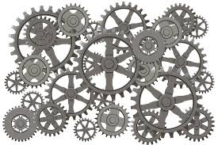
Next Generation Repositories
A new level of interoperability
In the past years we have focused on interoperability at the repository level, now we need interoperability at the resource level (and below)
Resources need to talk to each other to be reusable, this in turn will make the repositories the basis of a global scholarly ecosystem
By Andrea Bollini and David Wilcox

Slide 16
Next Generation Repositories
Three vertical discovery mechanisms
Batch – Transferring bulk data
Navigation – Helping robots to find resources in repositories by means of navigation
Notification – Enabling robots to subscribe to changes in repositories
By Petr Knoth
Notes:
There is no requirement to store them in the same repository for them to utilized by the same service(s), logically grouped, etc.
assumed could interact with the resources as if they were within the same physical repository

Slide 17
Quick examples
By Petr Knoth
Notes:
There is no requirement to store them in the same repository for them to utilized by the same service(s), logically grouped, etc.
assumed could interact with the resources as if they were within the same physical repository

Slide 18
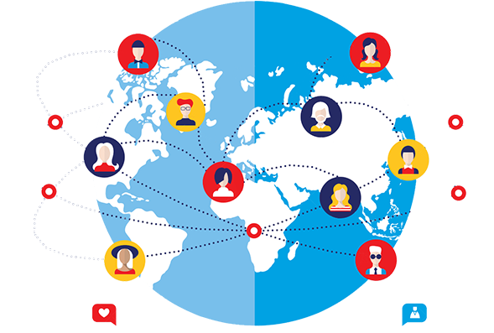
Next Generation Repositories
Global user recognition
As a user, I want my repository to recognize me and other users so that I can be connected with other users who I know, leave comments and be informed of content that is of interest to me.
By Petr Knoth
Notes:
There is no requirement to store them in the same repository for them to utilized by the same service(s), logically grouped, etc.
assumed could interact with the resources as if they were within the same physical repository

Slide 19
Next Generation Repositories
Transparent Social Network over Repositories
Annotation
Commenting/social interaction
Notification feed
Recommender systems
All in a transparent and distributed environment
By Petr Knoth
Notes:
There is no requirement to store them in the same repository for them to utilized by the same service(s), logically grouped, etc.
assumed could interact with the resources as if they were within the same physical repository

Slide 20
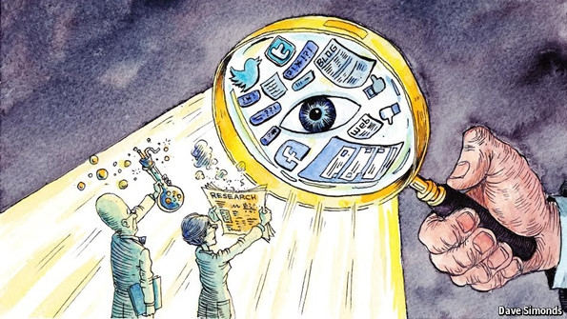
Next Generation Repositories
Research Assessment
Comparing usage
Peer-reviews
Open citations
Open Peer Review
Notes:
There is no requirement to store them in the same repository for them to utilized by the same service(s), logically grouped, etc.
assumed could interact with the resources as if they were within the same physical repository

Slide 21
Next Generation Repositories
Final Report: Behaviours and Technical Recommendations of the COAR Next Generation Repositories Working Group (November 2017)
https://www.coar-repositories.org/files/NGR-Final-Formatted-Report-cc.pdf (pdf)
http://ngr.coar-repositories.org/ (website)
https://github.com/coar-repositories/ngr/tree/master/webroot/content/behaviour (GitHub)

Slide 22
Next Generation Repositories
Behaviours and Technical Recommendations
NGR Behaviours:
Each behaviour is described and links to the related technologies, protocols and standards recommended by the Working Group

Slide 23
Next Generation Repositories
Behaviours and Technical Recommendations
NGR Behaviours:
Exposing Identifiers Declaring Licenses at the Resource Level Discovery Through Navigation Interacting with Resources (Annotation, Commentary, and Review) Resource Transfer | 6. Batch Discovery 7. Collecting and Exposing Activities 8. Identification of Users 9. Authentication of Users 10. Exposing Standardized Usage Metrics 11. Preserving Resources

Slide 24
Next Generation Repositories
Behaviours and Technical Recommendations
Technologies, Standards and Protocols
a snapshot of the current status of technology, standards and protocols available to support each behaviour.
The Next Generation Repositories Working Group has explicitly focused on the generic technologies required by all repositories to support the adoption of common behaviours.

Slide 25
Next Generation Repositories
Behaviours and Technical Recommendations
Technologies, Standards and Protocols
Activity Streams 2.0 COUNTER Creative Commons Licenses ETag HTTP Signatures IPFS International Image IIIF Linked Data Notifications ORCID and other author IDs OpenID Connect | 11. ResourceSync 12. SUSHI 13. SWORD 14. Signposting 15. Sitemaps Social Network Identities Web Annotation Model and Protocol WebID and WebID/TLS WebSub Webmention

Slide 26
Next Generation Repositories
Behaviours and Technical Recommendations
Technologies, Standards and Protocols
Two examples…

Slide 27
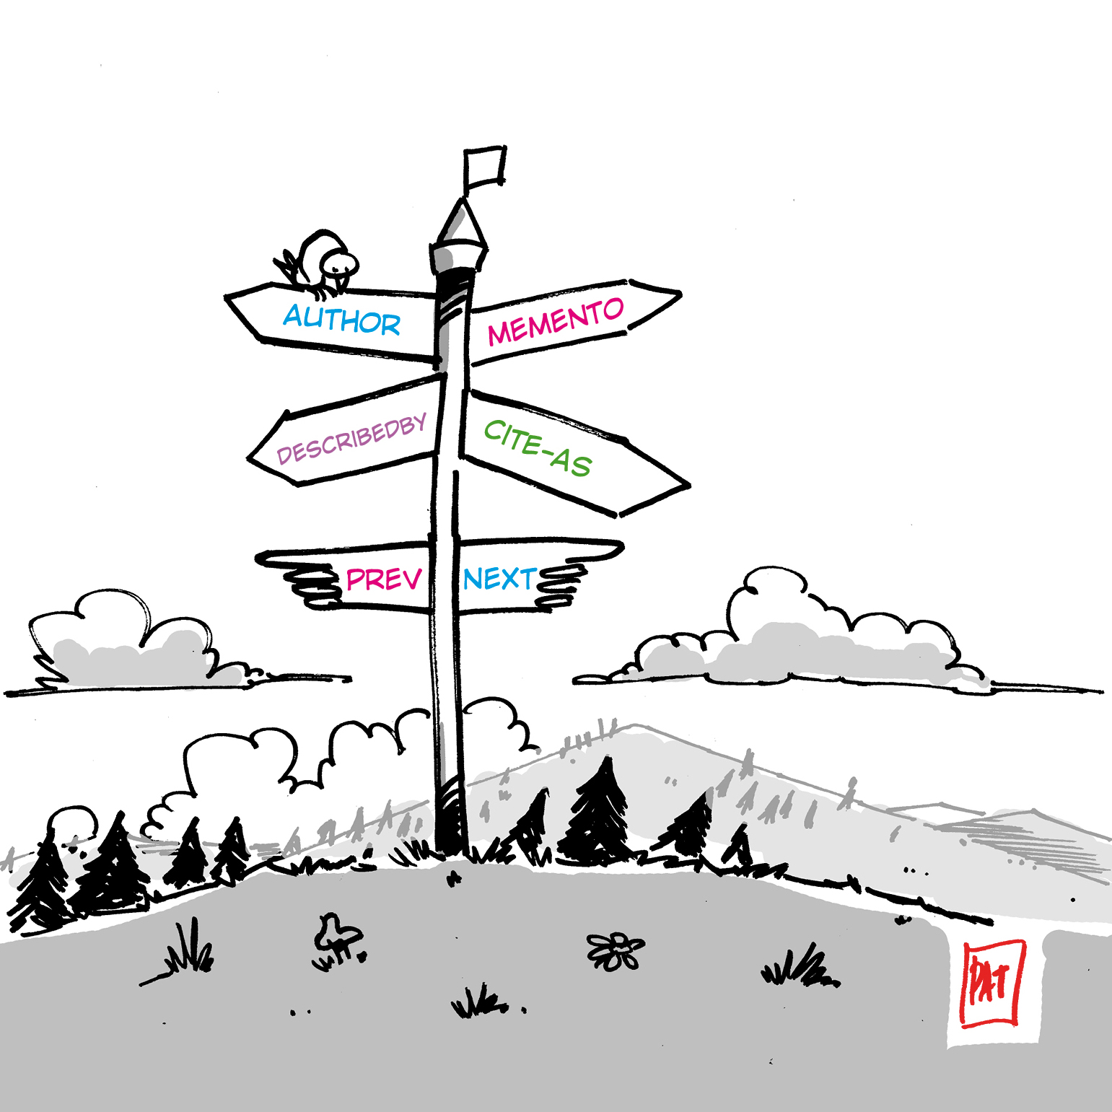
Next Generation Repositories
Signposting - an approach to make the scholarly web more friendly to machines exposing relations as Typed Links in HTTP Link headers
The following discovering patterns are currently defined:
Author
Bibliographic Metadata
Identifier
Publication Boundary
Image courtesy of Patrick Hochstenbach.
http://signposting.org/

Slide 28
Next Generation Repositories
ResourceSync
Successor of the OAI-PMH protocol and much more…
Faster, reliable and scalable
Allows real-time notification (and recovering of missed messages)
Drives resource synchronization: content and metadata are both managed
http://www.openarchives.org/rs/1.1/resourcesync

Slide 29
Next Generation Repositories
Next Steps

Slide 30
Next Generation Repositories
Implementation of technologies in repository platforms
Working with open source platforms to implement recommendations
Organizing regional projects to support development costs and contribute resources: OpenAIRE Advance (Europe), National Institute of informatics (Japan), US NGR Implementers Group

Slide 31
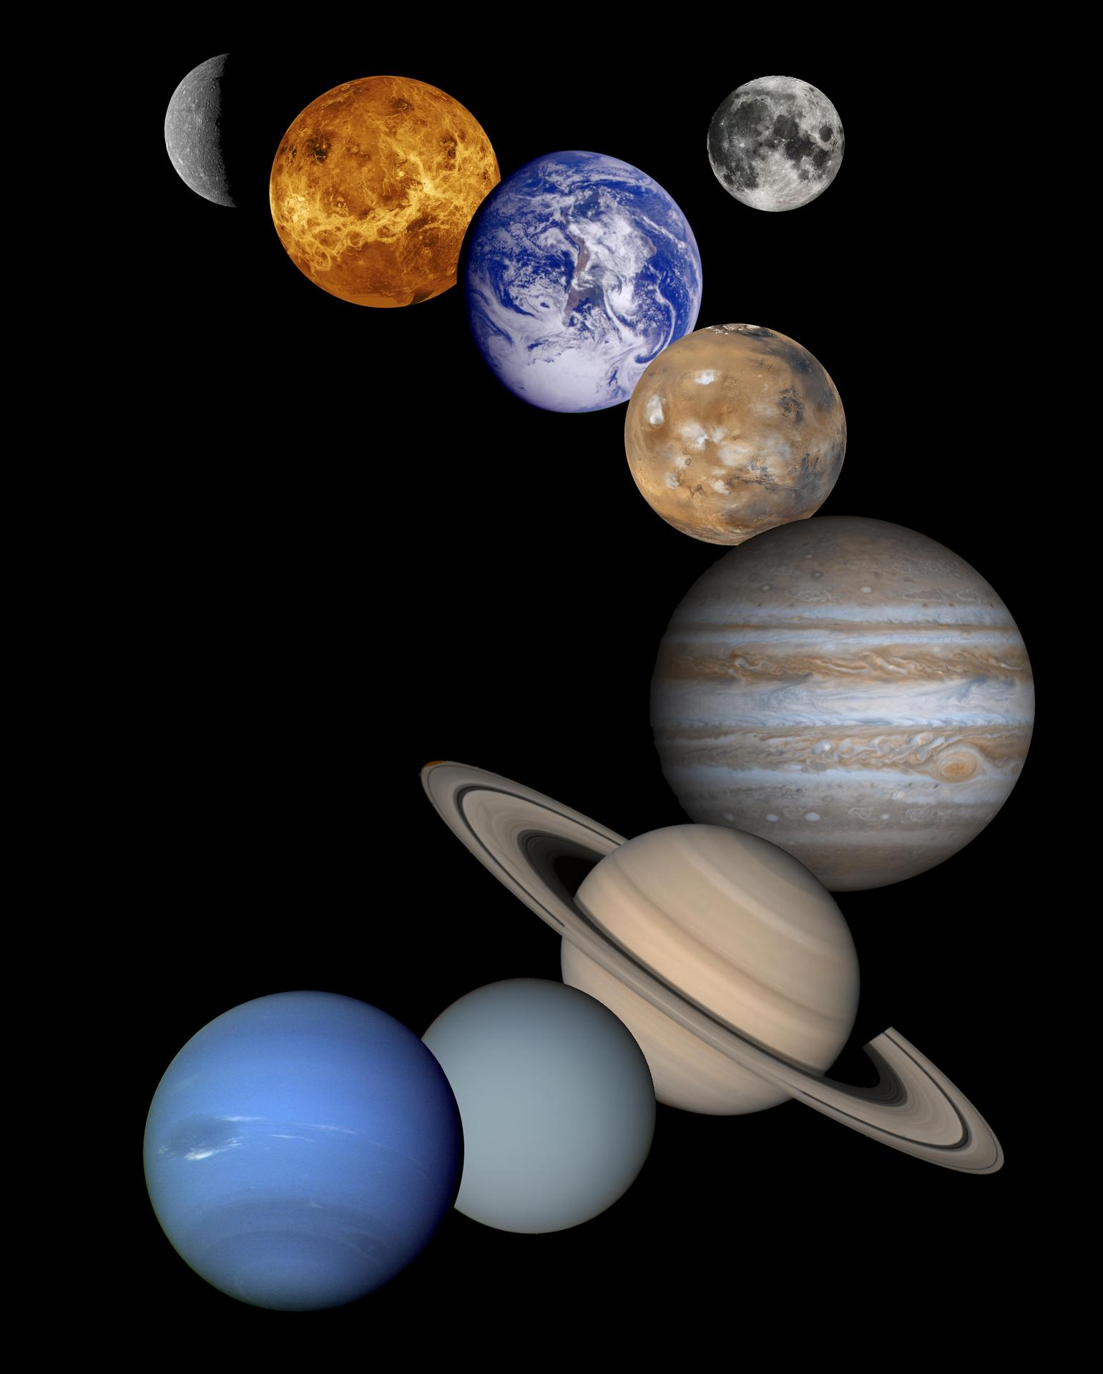
Next Generation Repositories
Development of network or hub services
Aligning Repository Networks Accord, May 2018
Technical and Strategic Meeting of 20 Repository Networks, May 14 & 15, 2018 in Hamburg, Germany
Pilot Projects 2nd half 2018 (Open Peer Review, Common Standards for Usage Statistics, Recommender Systems)

Slide 32
Next Generation Repositories
Ongoing monitoring of new technologies, standards and protocols
COAR Next Generation Repositories Editorial Group
-Andrea Bollini -Kathleen Shearer
-Rick Johnson -Herbert Van de Sompel
-Paolo Manghi -Paul Walk
-Eloy Rodrigues -Kazu Yamaji

Slide 33
Thanks! For more information, contact Kathleen Shearer, COAR Executive Director kathleen.shearer@coar-repositories.org

