Slide 1
The surprising history of data curation
David Minor Director, Research Data Curation Program UC San Diego Library

Slide 2
Terms and definitions

Slide 3
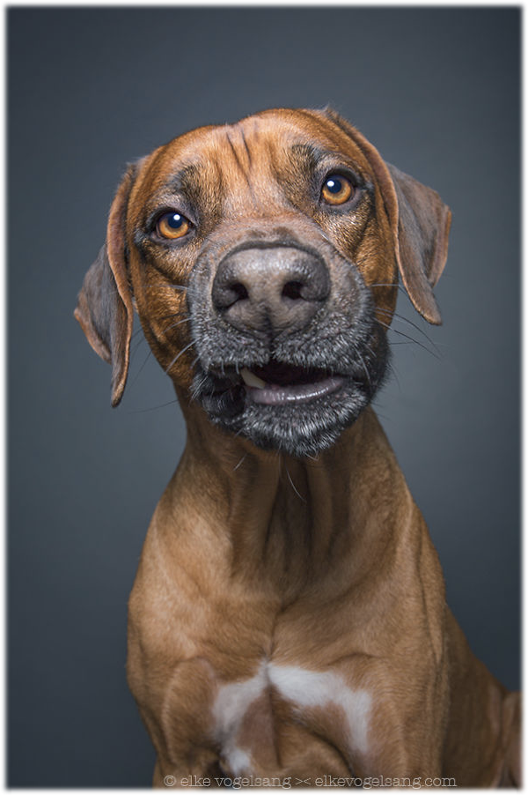
Research data management
Digital curation
Data curation
eScience
Just pick one.

Slide 4
Working with research outputs to ensure they are findable, understandable and usable - now and in the future.

Slide 5
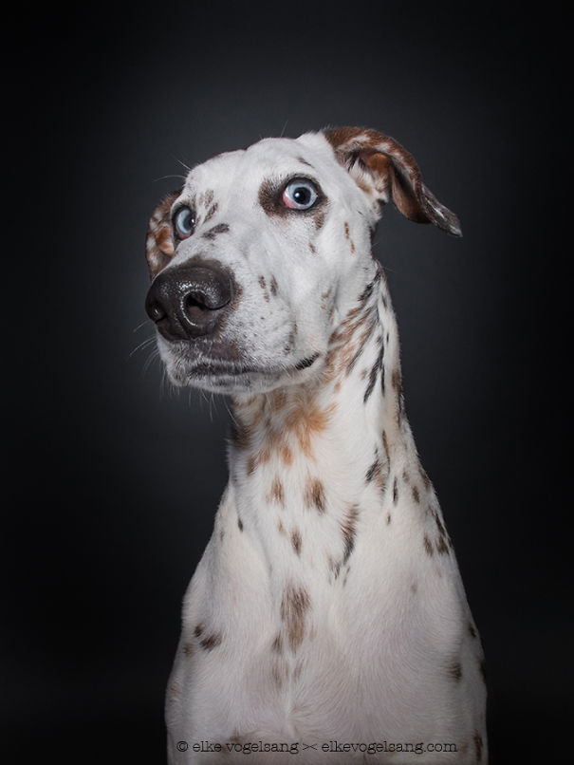
Most people think data curation is a new field.
Wrong!

Slide 6
Data curation has a long and rich history.

Slide 7
The starter:
The International Polar Years

Slide 8
International Polar Years
The First International Polar Year (1882-1883)
The Second International Polar Year (1932-1933)
International Geophysical Year (1957-58) (Also referred to as the Third IPY)
The Fourth International Polar Year (2007-2008)

Slide 9
International Geophysical Year – 1957-58
Established World Data Center system
The United States hosted World Data Center "A" and the Soviet Union hosted World Data Center "B." World Data Center "C" was subdivided among countries in Western Europe, Australia, and Japan
Each World Data Center was equipped to handle many different data formats, including computer punch cards and tape—the original computer media. In addition, each host country agreed to abide by the organizing committee’s resolution that there should be a free and open exchange of data among nations.

Slide 10
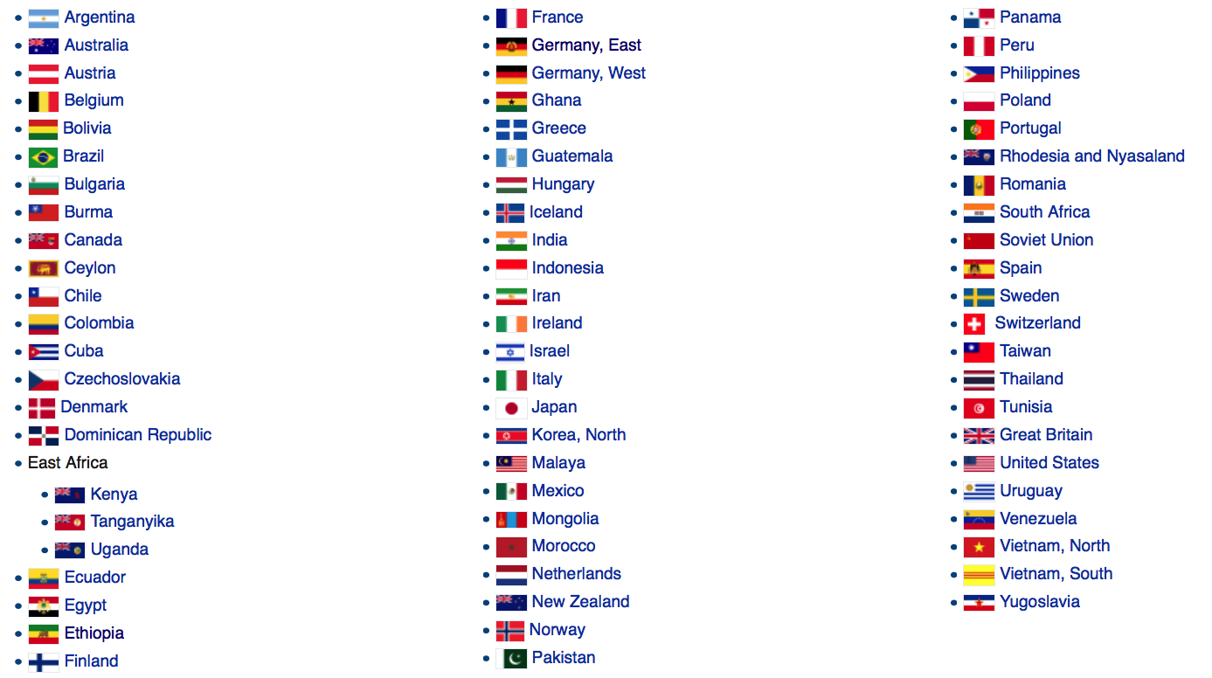
Countries that participated in the International Geophysical Year:
Source: https://en.wikipedia.org/wiki/International_Geophysical_Year#World_Data_Centers

Slide 11
What happened next?
Social science services

Slide 12
The United States

Slide 13
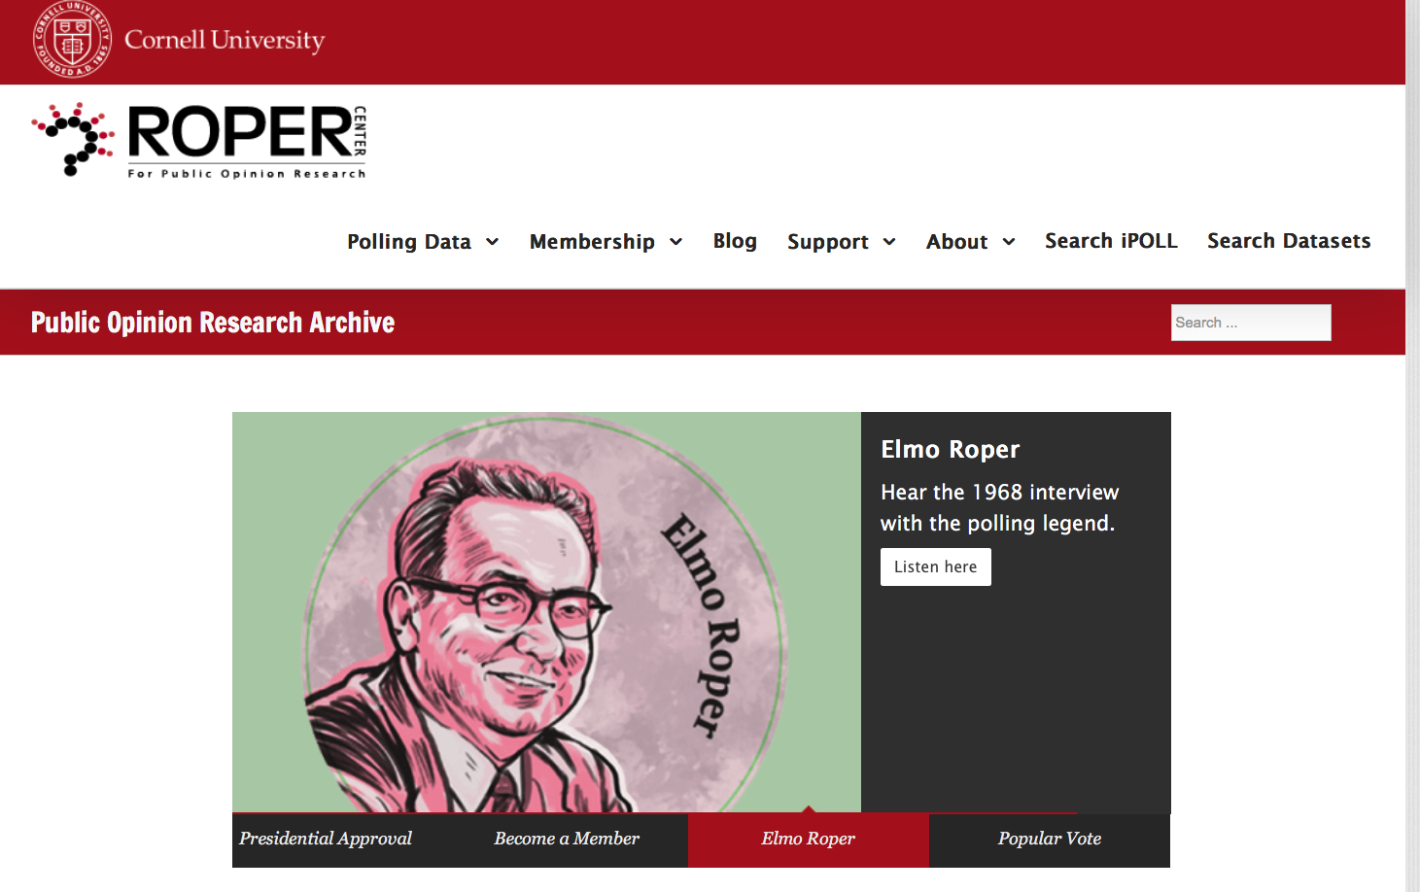
Roper Center
Founded 1947
… a center which would collect, index, publicize in academic journals, and make available to scholars the polling data available from commercial and academic polling units in the U.S. and abroad. [Roper] hoped that such a center would allow for new ways of conducting research, such as compiling data from multiple surveys, and would be a treasure trove for future historians and current academic investigators alike.

Slide 14
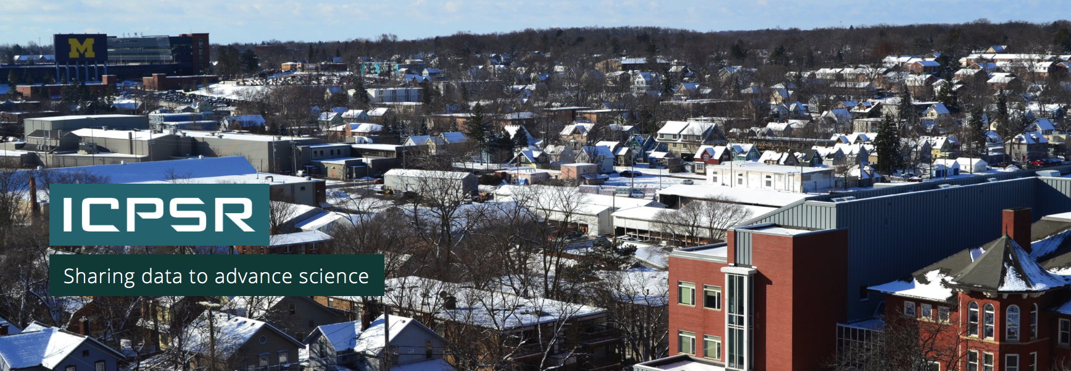
ICPSR Inter-university Consortium for Political and Social Research
Founded 1962
Over 8,000 discrete studies/surveys with more than 65,000 datasets. Since the beginning has had a major focus on training in quantitative methods to facilitate effective data use.

Slide 15
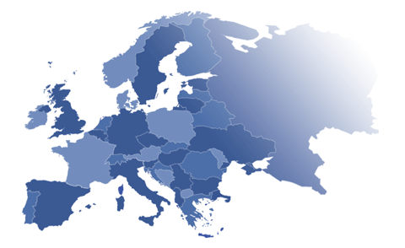
Europe

Slide 16
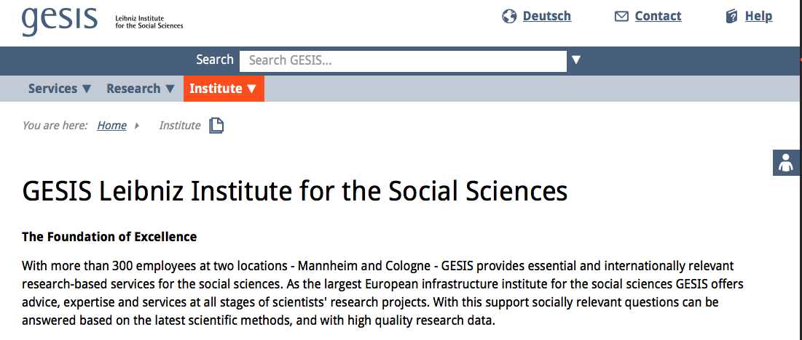
Central Archive for Empirical Social Research
Founded 1960 at the University of Cologne
Was later incorporated into what we now know as GESIS – Leibniz Institute for the Social Sciences.
European social science data archive … which uses machine readable data for quantitative research either of a specific aspect or regarding crosscultural or cross-national research. Source: Historical Social Research / Historische Sozialforschung, Vol. 16, No. 3 (59) (1991), pp. 152-158

Slide 17
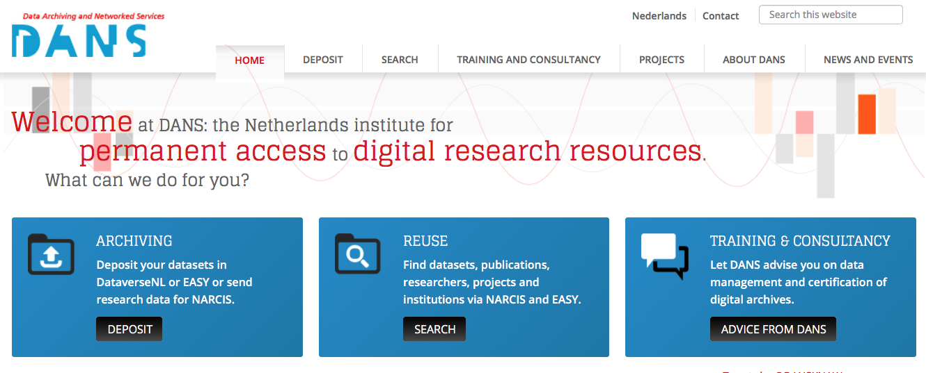
Steinmetz Archive
Founded 1964
Now DANS (Data Archiving and Networked Services)
The Steinmetz Archive is a data-archive which collects the basic data of (predominantly Dutch) social science research. By basic data we mean the (anonymous) raw data from quantitative empirical research or statistical administrations, as recorded in machine-readable form (on magnetic tapes, disks, punched cards, or other media). The purpose of archiving these data is to make them accessible for further use. By accumulating a large number of datasets over the years, a unique source of data for social science research has been generated.

Slide 18
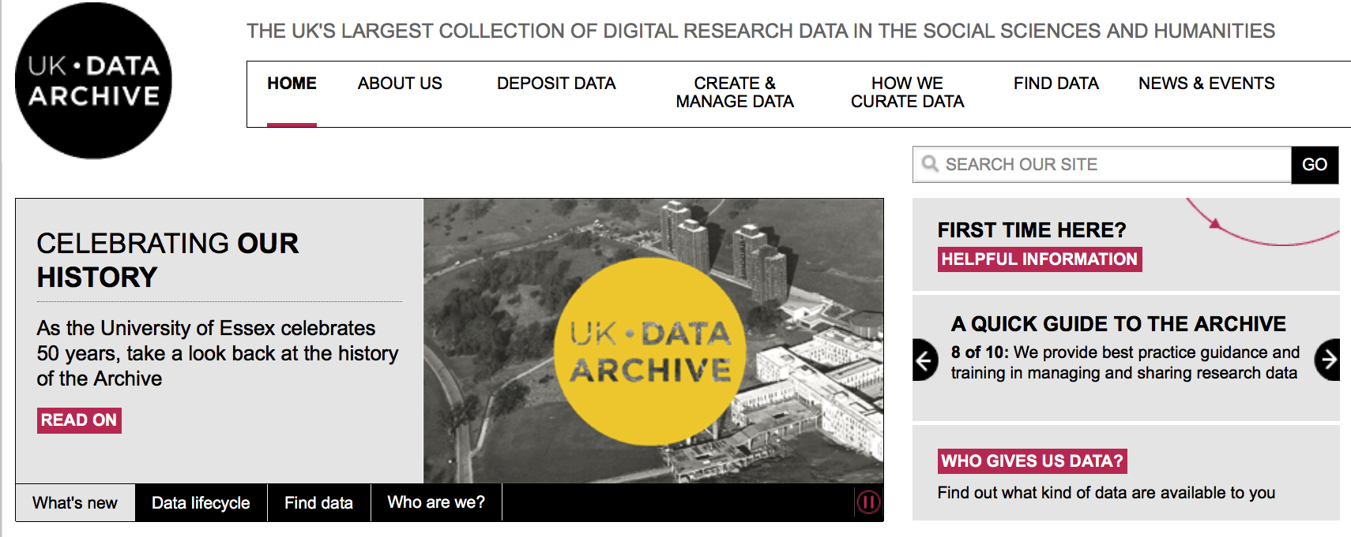
Social Science Research Council Data Bank
Founded 1967 at the University of Essex
Now UK Data Archive
… the centre for storing data derived from social surveys … in order that the data can be analyzed by others besides the original sponsors. The secondary analysis will often involved more than one survey deposited in the Bank. The bringing together of data from surveys which would otherwise be scattered, or indeed destroyed after primary analysis, will therefore have a “multiplier effect” in increasing the information to be obtained by secondary analysis.
SOCIAL SCIENCE RESEARCH COUNCIL DATA BANK University of Essex Wivenhoe Park Colchester (Essex). Director : Professor A.M. Potter . https://doi.org/10.1177/053901846700600606

Slide 19
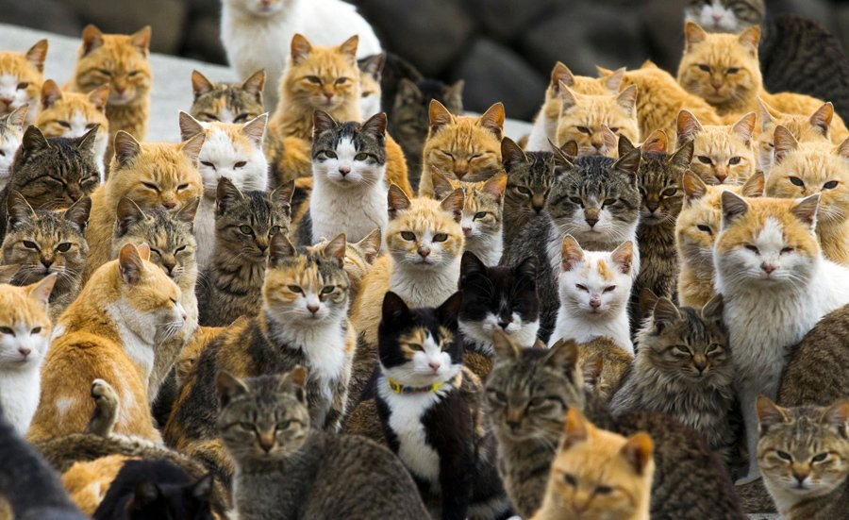
Organizations

Slide 20
Digital Curation Centre
Launched 2004, based on a recommendation from JISC

Slide 21
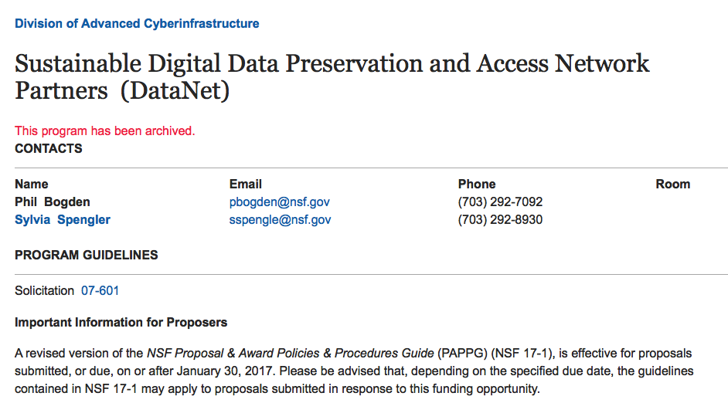
DataNet
NSF’s Office of Cyberinsfratucture
First proposed in 2008
Five total projects funded
Most notable is DataONE
Others: Data Conservancy, SEAD, DataNet Federation Consortium, Terra Populus
https://www.nsf.gov/funding/pgm_summ.jsp?pims_id=503141

Slide 23
Commonalities

Slide 24
Bringing together data from many places
Bringing together data of many formats
Protecting data
Allowing research across datasets
Creating new knowledge looking at data

Slide 25
Working with research outputs to ensure they are findable, understandable and usable - now and in the future.

Slide 26
What’s next?

Slide 27
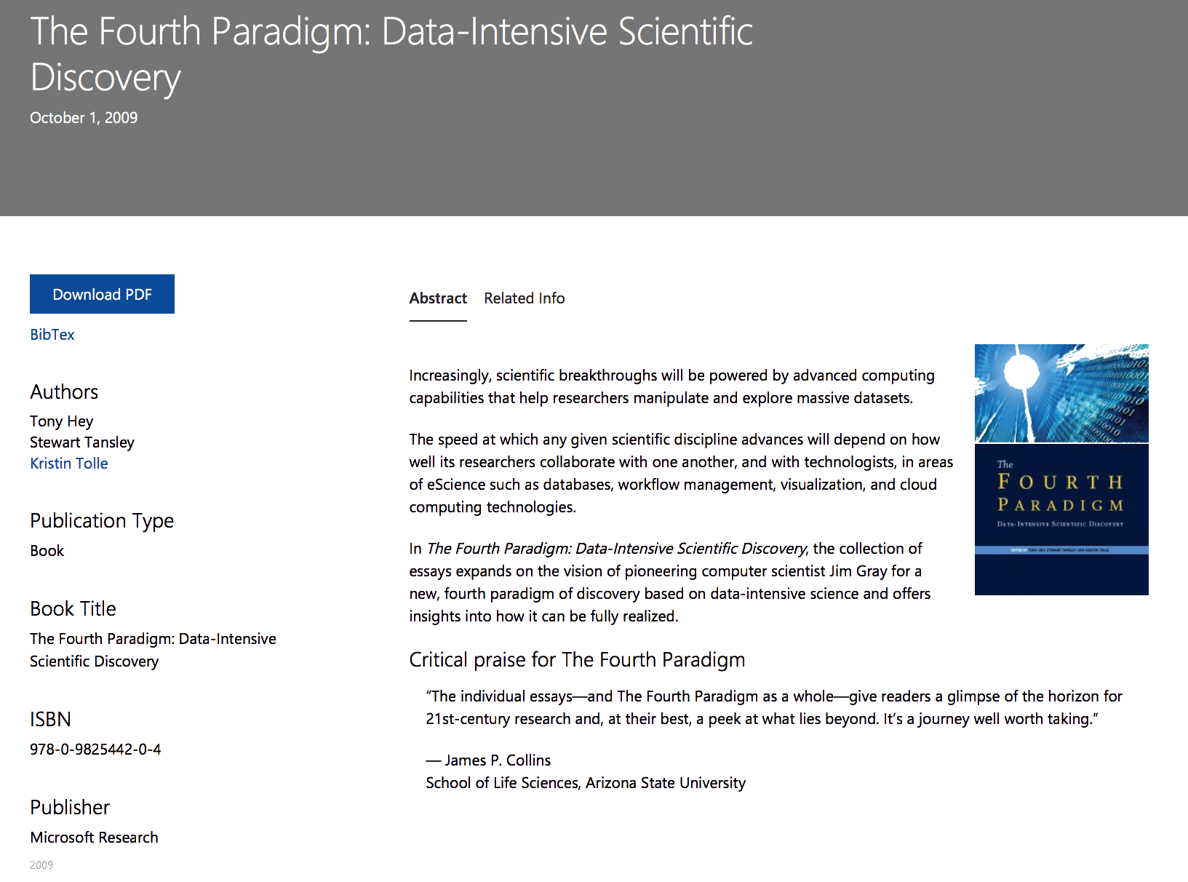
https://www.microsoft.com/en-us/research/publication/fourth-paradigm-data-intensive-scientific-discovery

Slide 28
Our challenge:
How do we get back to the polar year philosophy?
Share data across infrastructures
Create new knowledge from data aggregation
Protect data from negative forces
Use data to make the world better

Slide 29
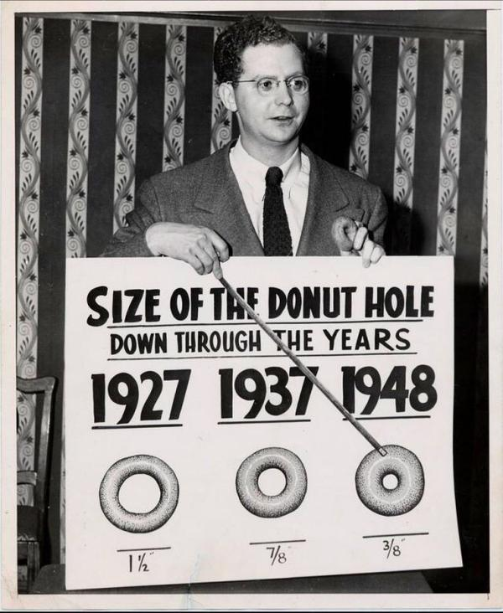
Thank you!
David Minor
dminor@ucsd.edu

Slide 30
Images:
All dog pictures are copyright Elke Vogelsang, who retains all rights.
All cat pictures are from the Black Metal Cats twitter account.
All pictures are used without explicit requests. I hope that’s OK.

