Slide 1
Open Access in the humanities research in Finland and Sweden
Pekka Olsbo
Head of Open Science Services
Open Science Centre
University of Jyväskylä
ILIDE 2018

Slide 2
Goals of the presentation
What is the current OA situation of the humanist research in Finland and Sweden?
How should we understand the information that national research portals tell us about Open Access?
Note: analysis presented here is based on the metadata given by the public interfaces of the national research portals.

Slide 3
Data sources
Finland, Research Publications Portal Juuli: http://www.juuli.fi/
Sweden, Swepub, Academic publications at Swedish universities : http://swepub.kb.se/

Slide 4
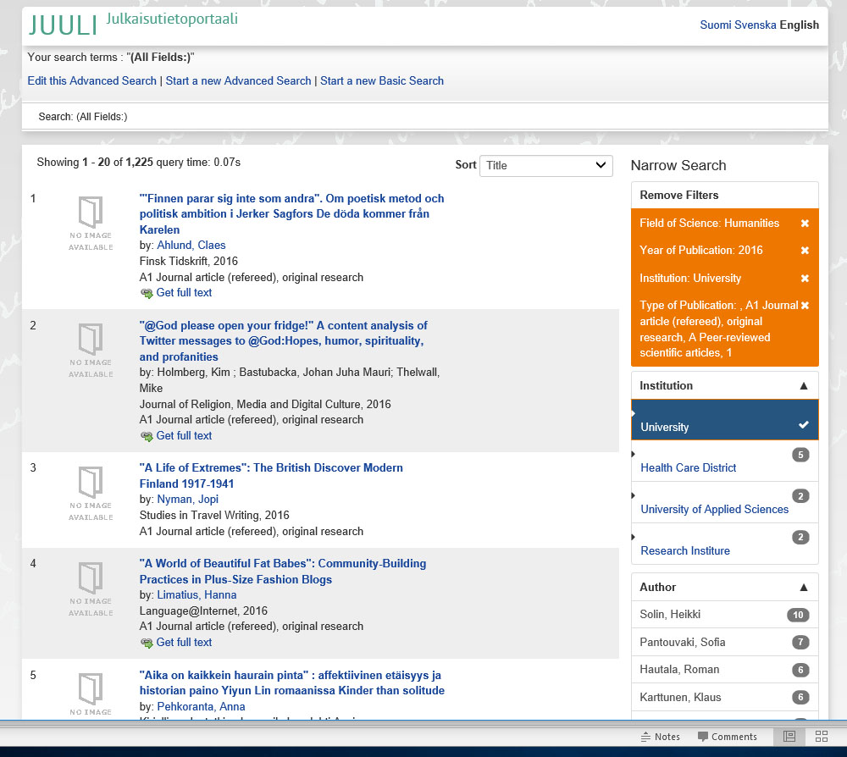
Juuli Finnish Research Publications Portal

Slide 5
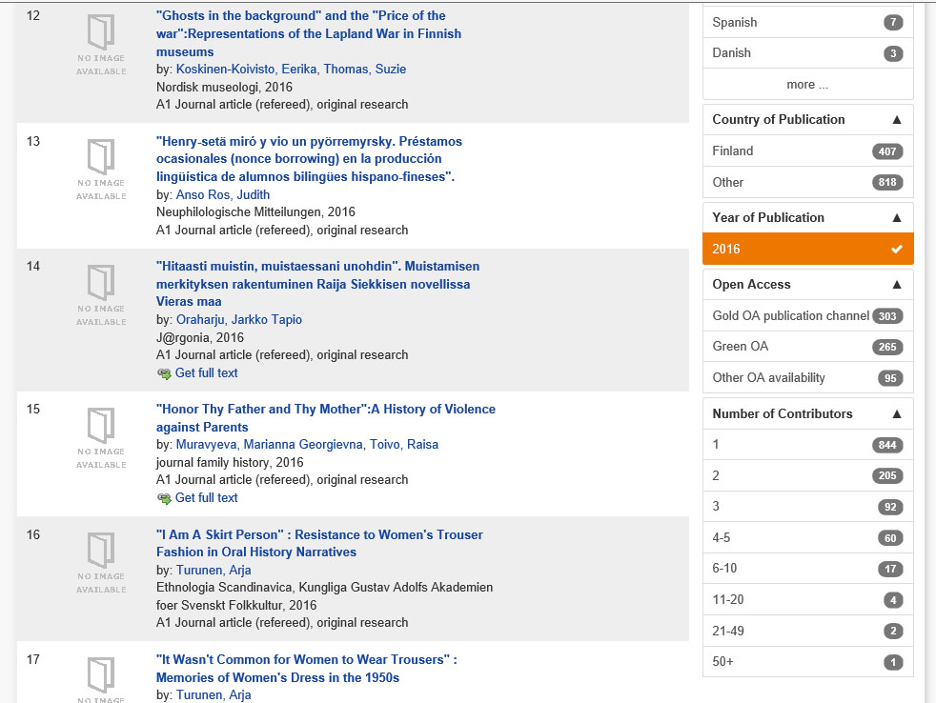
OA in Juuli
Overlap!

Slide 6
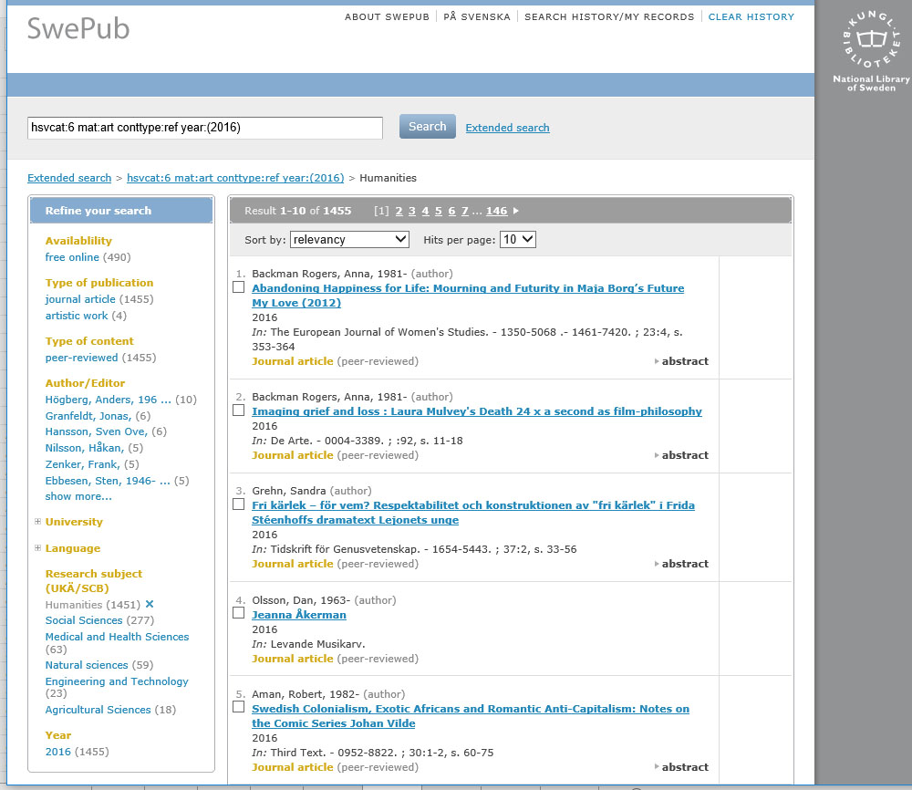
Swepub, Academic publications at Swedish universities

Slide 7
Definitions of Open Access

Slide 8
Definition of Open Access
Finland, Definition by the Ministry of Education and Culture
publication is available 1) immediately in the publisher’s service and/or 2) stored in the organisation’s publication archive or an archive in the field of science either immediately or after the embargo specified by the publisher.
The publication can be read, printed out and copied on the Internet free of charge and in an accessible way.
The publication is publicly available in a service offered by the publisher or the research organisation which enables harvesting the publication’s metadata and indexing its content.
The publicly available version of the publication is either the final self-archived version of the publication or the final version published in the publisher’s service, depending on the publication contract or the publisher’s policy. If the publication is refereed, the open access version must also be refereed.
Publication data collection instructions for researchers 2016

Slide 9
Definition of Open Access
Sweden Definition by Vetenskapsrådet (Swedish Research Council)
What is referred to internationally as open access means, in brief, that the research results can be found via a search on the Internet and can be read by everyone, free of charge and that the material is free to reuse. There are different methods for providing accessibility where scientific articles are concerned, often referred to as gold, green and hybrid publishing. The term ‘gold’ is used in different ways,4 though it is used here as set out below:
1) the researcher publishes an article in an open access journal (gold)
2) the researcher publishes in a traditional subscription-based publication and thereafter a copy of the manuscript is published open access via a digital archive as soon as the publication permits this (green/selfarchiving)
3) the researcher publishes the article in a traditional subscription-based publication and, for a fee, the article is made open access with immediate effect (hybrid). Proposal for National Guidelines for Open Access to Scientific Information

Slide 10
Results: Open Access in humanities in Finland and Sweden 2016–2017

Slide 11
Total share of OA: peer reviewed articles in scientific journals
2016: articles OA OA %
Finland 1221 491 40,21 %
Sweden 1451 489 33,70 %
2017 articles OA OA %
Finland 1138 564 49,56 %
Sweden 1519 471 31,01 %

Slide 12
Total share of OA: peer reviewed articles in scientific journals

Slide 13
5 major universities in FIN and SWE

Slide 14
5 major universities in FIN and SWE

Slide 15
5 major universities in FIN and SWE

Slide 16
Total share of OA: monographs (humanities)
2016: books OA OA %
Finland 333 74 22 %
Sweden 309 56 18 %
2017 books OA OA %
Finland 351 73 21 %
Sweden 300 58 19 %

Slide 17
Total share of OA: all publications (humanities)
2016: publ. OA OA %
Finland 6360 1820 29 %
Sweden 7750 1975 25 %
2017 publ. OA OA %
Finland 6186 2007 32 %
Sweden 7403 1843 25 %

Slide 18
Conclusions
Can we make any?

Slide 19
What did we see?
All universities in Finland have improved their OA numbers in humanities
Growth of humanities OA very fast in Finland 2016–2017
Almost all universities in Sweden have gone down in OA
But are these facts?

Slide 20
Why did we see what we saw?
Finland
Positive development is a fact
Growth in OA is based on improved cataloging processes (“Jyväskylä model”) and due to that, better quality of metadata
“Other OA” (hybrid) is growing fast
Embargoed publications are regarded as open in Juuli-portal
Sweden
Negative development is not necessarily a fact
Is the quality of metadata good enough?
Embargoed publications are not regarded as open in Swepub

Slide 21
The effect of embargo – case University of Jyväskylä
2017: 120 peer reviewed journal articles in humanities, 92 open access (77 %), out of those, 33 still under embargo (17.4.2018). Immediate OA 49 %
2016: 136 peer reviewed journal articles in humanities, 91 open access (67 %), out of those, 4 still under embargo (17.4.2018). Immediate OA 64 %
http://tutka.jyu.fi/tutka/

Slide 22
The effect of embargo – case University of Jyväskylä
2017 all publications from the humanities research:
712 publications
432 open access
OA= 61 %
Embargoed (17.4.2018) 70 publications
Immediate OA 51 %
http://tutka.jyu.fi/tutka/

Slide 23
What should we learn?
After natural sciences, humanities research is the second in openness in Finland, in Sweden much lower
We need to know the number of embargoed publications
We should be able to trust the metadata
Interfaces of national research portals need to be developed from open access point of view, like: https://www.narcis.nl
EU monitoring: OA policy requirements.
total number of research outputs subject to the policy,
total number of full-text OA research outputs in the repository,
the number of embargoed full-text items that will become OA at a later date. (Principe 2018)
Guideline for the development of national research portals?

Slide 24
Thank You!
Contacts:
Pekka Olsbo
Head of Publishing
pekka.olsbo@jyu.fi
+350 50 581 8355

