Slide 1
Open Science from a researchers perspective.. or .. ‘The academic life of Carl Otto’ Dr Charlotte Wien Professor of Scholarly Communication Head of Research and Analysis The University Library of Southern Denmark Twitter: @CharlotteWien

Slide 2
Saint Augustine (AD 396)
“Any statements by those who are called philosophers [are] like the silver and gold, which they did not create but dug, as it were, from the mines of providence, which is everywhere.” Saint Augustine (AD 396)

Slide 3
My cv in brief
2018: Professor of Scholarly Communication, The University Library of Southern Denmark
2016: Head of Department, Research and Analysis, The University Library of Southern Denmark
2015: Assistant Dean of Research and Graduate Studies, ZU, Dubai
2014: Full Professor, College of Communication and Media Science, ZU, Dubai
2000: Associate Professor, Department of Journalism, SDU, Denmark
1998: Assistant Professor, Department of Journalism, SDU, Denmark

Slide 4
Carl Otto…

Slide 5
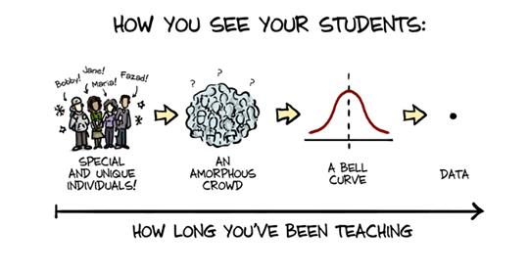
Teaching

Slide 6
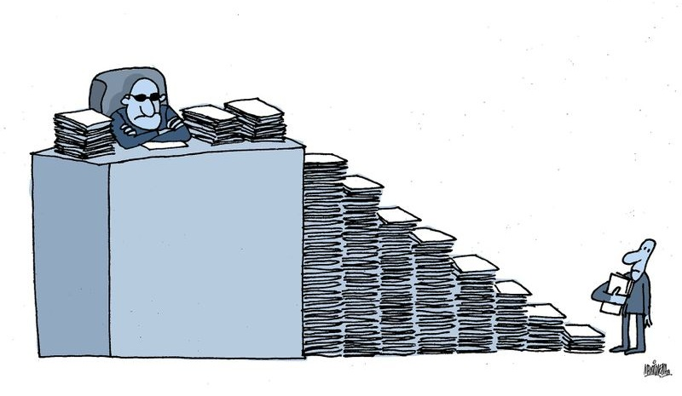
University services

Slide 8
Becomming a full professor
A position must open in the field
Someone dies or retires
Application
Including publications
International assessment commitee
Three peers from the field evaluating publications
Hiring committee
Only applicants assessed qualified by assessment committee will be considered

Slide 9
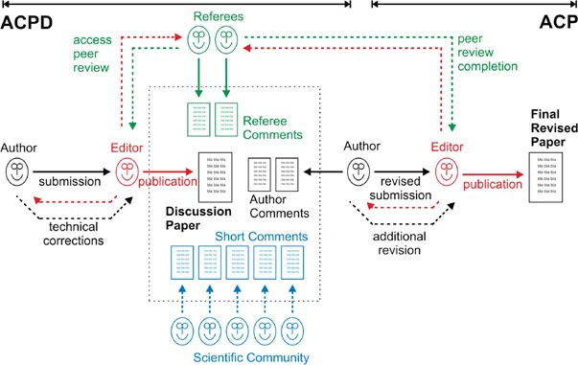
The long haul of research
Five years idea to publication from start to finish is not unusual

Slide 10
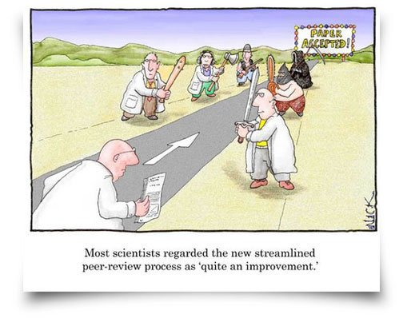
Research

Slide 11
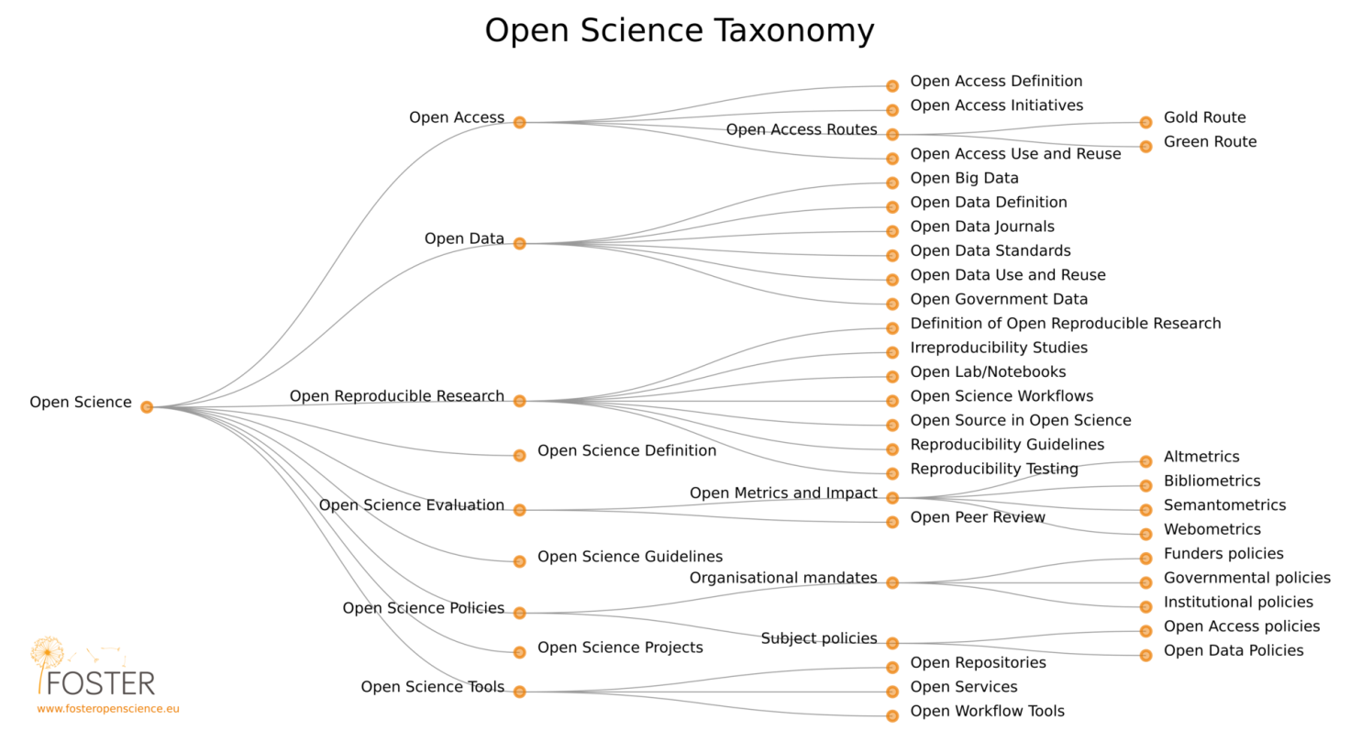
Open complexity

Slide 12
Creating incentives
Dangling a carrot in front of a donkey—or anyone else for that matter—is not nice, and not fair, unless you eventually plan to give it up to them (Vera Narzarian)
For example:
Fellowships financed by publishing compagnies
Awards by Research Libraries
Change assessment criterias
Establish software prices

Slide 13
Thank you for your attention
Dr. Charlotte Wien
Professor of Scholarly Communication
Head of the Research and Analysis Department
Head of Research Services
University Library of Southern Denmark
E-mail: chw@bib.sdu.dk
Web: findresearcher.sdu.dk:8080/portal/en/person/chw
Twitter: @CharlotteWien

