Slide 1
09 April 2019 – ILIDE Conference
Trends, Shifts, and Understanding our Position:
Insights from OCLC Research
Rachel L. Frick
Executive Director, OCLC Research Library Partnership
Notes:
Welcome and Introduction. [Changes in Knowledge Creation Process]

Slide 2
Foundational Principles
The Evolving Scholarly Record
Shift to Inside out & Facilitated Collections Workflows
Anyone can get anything, anywhere, anytime.
Notes:
The outputs from scholarly research have changed
The models and workflows surrounding the management of collections have changed
The expectations of

Slide 3
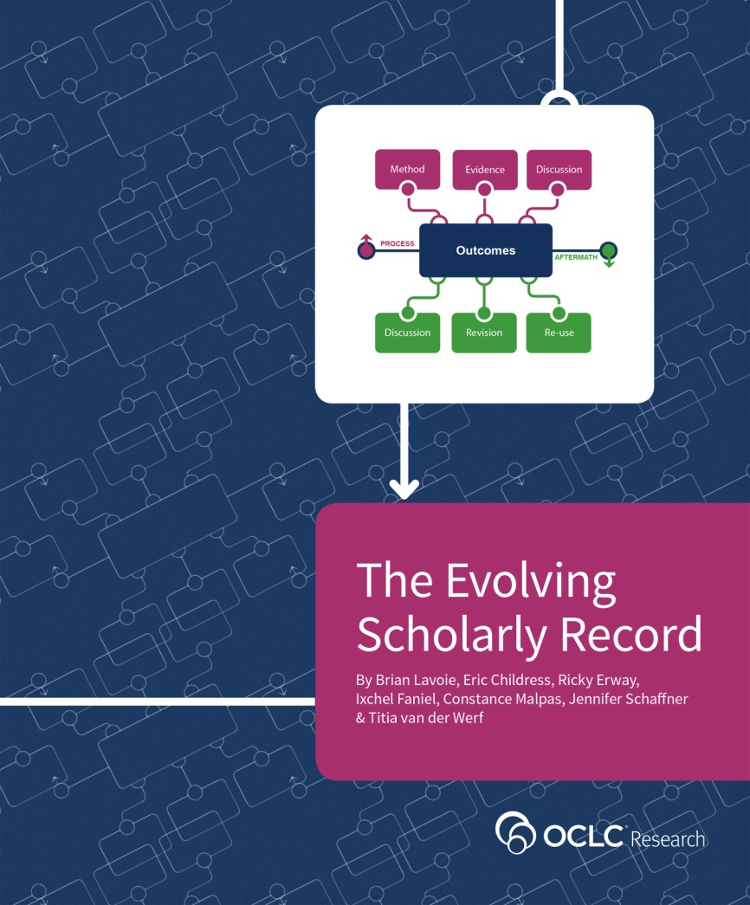
The Evolving Scholarly Record: Drivers
Shifting formats: print centric to digital & networked
Expanding boundaries: articles/monographs to research data, computer models, lab notebooks, blogs, e-prints
Changing characteristics: formal, outcome-focused, static to formal/informal, process-focused, dynamic
Reconfiguring stakeholders: new paths for scholarship lead to new stakeholders and new stakeholder roles
(Lavoie et al., 2014)
http://oc.lc/esr
Notes:
Provides a framework for understanding changes in the scholarly ecosystem
Foundational to our work on Research Information Management
French translation now available

Slide 4
The Inside-out Library
“is about more deeply engaging with the creative life of the university, mobilizing library services and expertise to support the creation, curation, and discoverability of institutional assets (research and learning materials, researchers…).”
(Dempsey, 2017, p. 342)
Image: https://www.flickr.com/photos/kevinrechts/8652482836 by kaveman743 / CC BY-NC 2.0

Slide 5
Collections Spectrum
A print logic: the distribution of print copies to multiple local destinations
A network logic: a coordinated mix of local, external and collaborative services are assembled around user needs
A collections spectrum
The ‘owned’ collection
The ‘facilitated’ collection
Purchased and physically stored
Meet research and
learning needs in best way
(Dempsey, 2017)

Slide 6
The mission of librarians is to
improve society through facilitating knowledge creation in their communities…
Being embedded in the life of the user…

Slide 7
Library On-demand
Notes:
Increasingly, expectations for library services are being shaped by their end-user’s experience with other commercial services and websites. They expect intuitive discovery. They expect one-click ‘ordering/delivery’ of ‘p’ and ‘e’ materials. They expect the fulfillment of physical library materials to be as fast as services like Amazon. Uploading their creations to Etsy, And the
ability to return physical materials as easily as returni
The value relates to the ability to meet research and learning needs in the best ways available
using a variety of resources, whether or not they are owned or licensed locally; and also to mobilizing library expertise
ng items from Zappos.

Slide 8
Synthesis of Recent Research
Notes:
In the following cycle of presentations, OCLC program officers and researchers will share recent OCLC Research into European practices related to research information management, persistent identifiers, linked data and open content.
OCLC Europe, Middle East and Africa Region Council Innovation Survey
OCLC / EuroCRIS Research Information Management Survey
Convenience and Compliance: identifier case studies
RDM Investigations: oc.lc/rdm
OCLC Global Council Open Content Survey

Slide 9
OCLC Innovation Surveys
In 2017, OCLC Research was encouraged by OCLC EMEA Regional Council to sharpen intelligence around research library needs and priorities outside the United States
2017: survey of library directors at 238 institutions in the UK, the Netherlands, Germany, Austria, Switzerland, Denmark, Spain, France, and Italy
2018: survey of library directors in CARL and CAUL
2019: Global Analysis

Slide 10
Top Level Initial Observations
Support for researchers: high interest in getting staff / faculty skilled up. Opportunity to highlight good work we’ve already done.
Special collections: still seen as being central even if they may have fallen below the fold in terms of the “top three” priorities
Linked data: not being well understood by library leadership (and it may even be viewed with skepticism).
Open access: good area for further exploration and discussion.
Notes:
Support for researchers: everyone is investing in this area, and getting staff skilled up (as well as giving faculty skills so that they can help themselves) is a real challenge. OCLC Research has been doing good work in this area, so how can we leverage our investment with their needs?
Library as place: I think we could have devoted an entire day of discussions to student services and the role of the library; how libraries are adapting spaces to a variety of needs (quite contemplation and serious study to social / collaborative space). Interviewees did not see much of a distinction between library as social space versus library as collaborative work space. They can’t tell the difference and they aren’t sure their students would differentiate.
Special collections and linked data: Special collections are still seen as being central even if they may have fallen below the fold in terms of the “top three” priorities or areas for innovation. Linked data did not make the cut likely due to it not being well understood by library leadership (and it may even be viewed with skepticism). My takeaway from this is that there is a role for OCLC Research to play in helping to articulate the elevator pitch for linked data, without getting into the weeds of RDF triples and the like.
Open access: In our interviews we were unable to really dig into open access (and where opportunities are for OCLC in particular). If we were going to repeat the survey, we’d want to delineate various open access touchpoints (in this survey we only asked about “publishing”). I think it is very worthwhile to spend time in upcoming group discussions on open access, but we should be careful about how we frame this (here I’ll lean on Titia and others!).

Slide 11
Research Support

Slide 12
Research Data Management (RDM):
“activities and processes associated with the [research] data lifecycle, involving the design and creation of [research] data, storage, security, preservation, retrieval, sharing, and reuse….”
(Cox & Pinfield, 2014, p. 300)
1
Research Information Management (RIM):
“the aggregation, curation, and utilization of metadata about research activities.”
(Bryant et al., 2017, p. 6)
2

Slide 13
Research Information Management
Research Information: Metadata about research activities and outputs (e.g. projects, publications, …)
Research Information Management (RIM): Aggregation, curation, & utilization of research information (e.g. in CRIS systems)
Notes:
These are called CRIS systems in Europe, but they are often called other things in other parts of the world, particularly in the North America, where we might be referring to these by other names like “Faculty Activity Reporting” system or “Researcher Profile system.” The goals and even processes may vary, but the central effort of metadata collection is the same.

Slide 14
Institutional Collaborators
(Bryant et al., 2017)

Slide 15
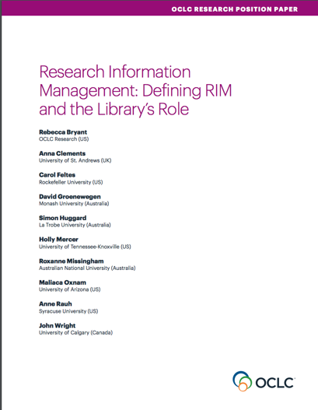
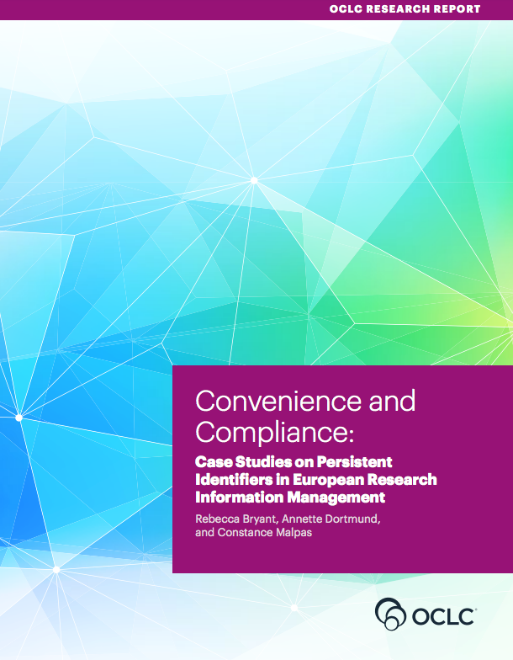
OCLC Research publications on Research Information Management
oc.lc/rim
Notes:
An area of recent research for OCLC is research information management, as we recognize this as an important emerging service categories for libraries. We’ve been developing an arc of research to describe, explain, and document international practices in research information management.
In 2017 we released a position paper on research information management, which I’ll talk a bit more about in a minute.
That year we also published a research report, conducted in collaboration with LIBER, documenting case studies in persistent identifiers in research information management.
Adoption of persistent identifiers (PIDs) in European RIM workflowsPIDs: Important infrastructure for unambiguous referencing and linking of resources (e.g. ORCID, ISNI, ARK, DOI, …)Case studies on Finland, The Netherlands, Germany based on interviews with selected institutions
We have also been collaborating with euroCRIS on an international survey on Research Information Management Practices, which was published in late 2018, providing a quantitative view of RIM practices worldwide.
Though all of these research efforts, we have sought to better understand what constitutes research information management (i.e., the different use cases), and how the library is supporting these activities.

Slide 16
Defining RIM and the Library‘s Role
oc.lc/rim
Notes:
To define research information management and to offer models to explain metadata sources, uses, and institutional stakeholders.
To articulate the specific value proposition of libraries within research information management.

Slide 17
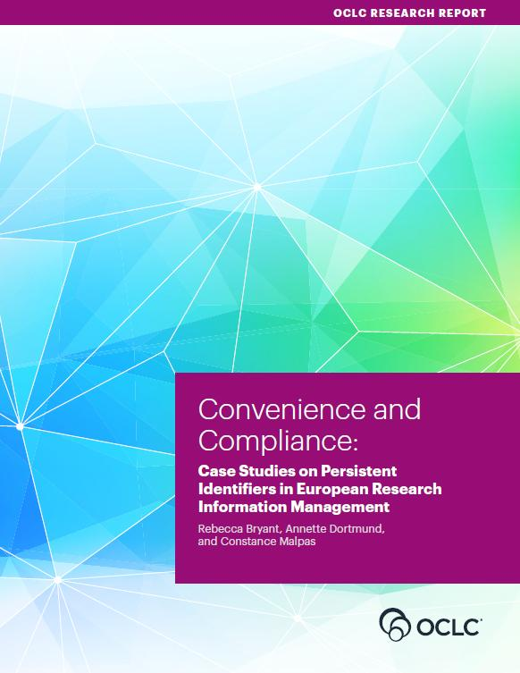
Convenience and Compliance
oc.lc/rim
Notes:
Adoption of persistent identifiers (PIDs) in European RIM workflows
PIDs: Important infrastructure for unambiguous referencing and linking of resources (e.g. ORCID, ISNI, ARK, DOI, …)
Case studies on Finland, The Netherlands, Germany based on interviews with selected institutions

Slide 18
Practices and Patterns
oc.lc/rim
Notes:
In 2018 r euroCRIS and OCLC Research, along with RLP library partners, have been working to survey international practices, which builds upon previous euroCRIS/EUNIS research. Together we developed a survey which ran from October 2017 to January 2018, and we heard back from 381 respondents in 44 countries. Published in
Our goals with this survey are broad, foundational. [discuss general goals, limitations, etc.] - While comprehensive, the survey cannot (and does not intend to) reveal all the nuances of specific geographic environments. Results strongly suggest that follow-up national- or regional-level surveys or
general insight into global trends
The report details the complexity of RIM practices and examines how commercial and open-source platforms are becoming widely implemented across regions, coexisting with a large number of region-specific solutions as well as locally developed systems. It also considers the urgent need for system-to-system interoperability—with both internal and external systems—and demonstrates how the use of identifiers, standards, and protocols are perceived as most valuable when they can also facilitate interoperability.

Slide 19
What characterizes RIM in Europe?
Country specific factors and infrastructures play an important role
Environments different but still have many similarities
National or European mandates or funding requirements are strong drivers of CRIS adoption where they exist.
In their absence ROI remains unclear.
Internal uses of RIM are welcome benefits but rarely drive CRIS adoption.
Notes:
COMPLIANCE.

Slide 20
Survey confirmed findings for Europe
Results confirmed “Convenience & Compliance” findings regarding drivers of RIM adoption.
RIM have multiple uses, with some variation by region
as a registry of the institution’s research outputs
for external & internal assessment or to manage OA compliance
less so to enable discovery of potential research collaborators
Merge of RIM / IR functional categories stronger in Europe
US is the outlier, not representing or leading global practices
Notes:
First, it was heartening to see that findings from C&C were confirmed by the survey responses. Compliance is a strong drimer of RIM.
Second, RIM serves many uses, and these vary by region.
Third, a trend we had observed earlier, the functional merge of RIM and IR categories, became visible, especially in Europe.
And fourth, and this may or may not come as a surprise to you, although it did not to us, the US is the outlier in this field.

Slide 21
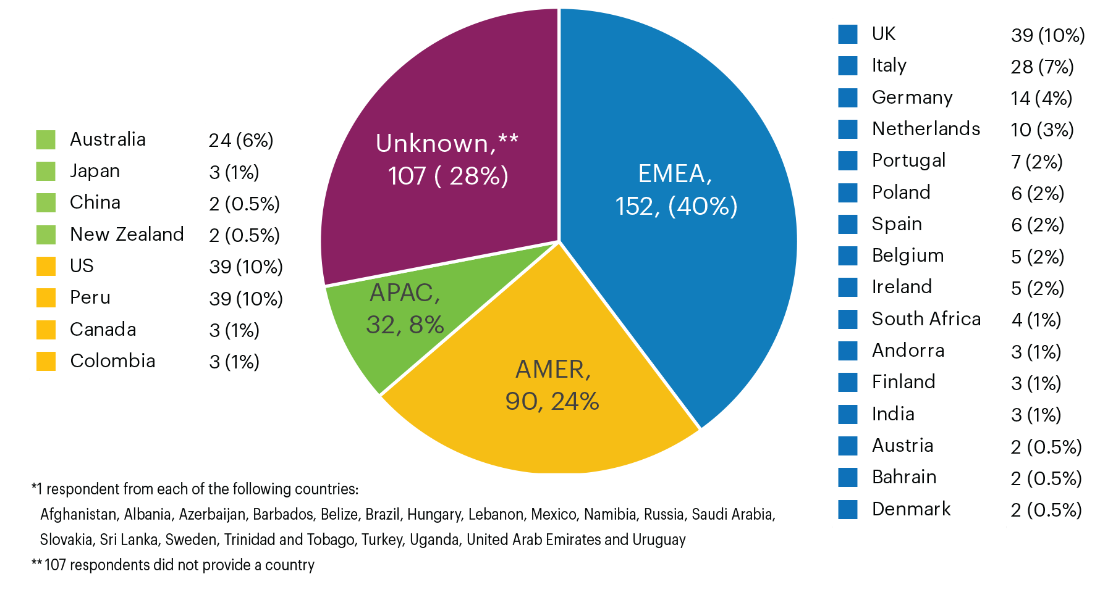
RIM Survey responses: geographic overview 381 survey respondents from 44 countries
“Total number of survey respondents, by broad region” by OCLC and euroCRIS, Practices and Patterns in Research Information Management: Findings from a Global Survey (DOI:10.25333/BGFG-D241), CC BY 4.0
Notes:
As you can see we had a large number of survey respondents from EMEA, but RIM is no longer just a European phenomenon.
Obviously, the survey cannot (and does not intend to) reveal all the nuances of specific geographic environments, and responses from some countries are sadly missing, but we were still able to identify some trends.

Slide 22
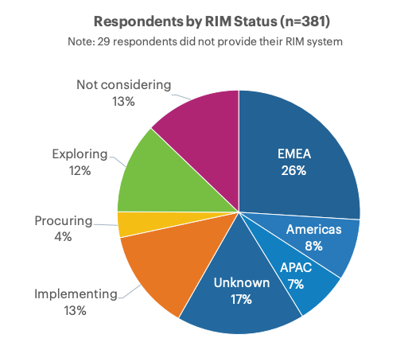
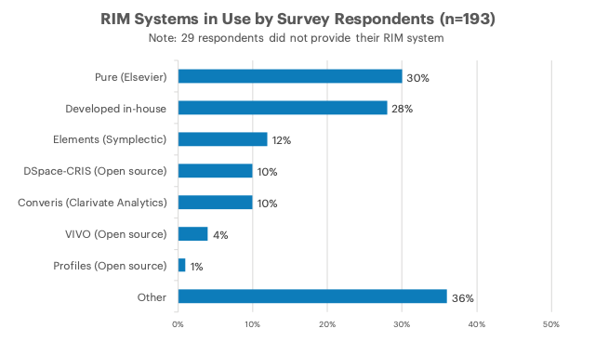
Research Information Management Systems Well over half (58%) have a live RIM System
Practices and Patterns in Research Information Management: Findings from a Global Survey (DOI:10.25333/BGFG-D241), CC BY 4.0
Notes:
****Read the following (from the next slide) while allowing participants to continue viewing this slide:*******
Note that we invited research institutions at any stage of RIM adoption to participate
58% indicated they have a live RIM system, and another 13% are in process of implementation.
Reveals a quickly shifting landscape, with many institutions currently exploring RIM
> 200 institutions with an active RIM provides a significant sample
More synthesis may reveal regional differences
Diversity of RIM systems in use
Elsevier Pure and locally-developed systems have highest adoption
The “Other” category is also significant, featuring entries like IRIS (Italy), ResearchMaster (Aus/NZ), OMEGA-PSIR (Poland), InfoEd

Slide 23
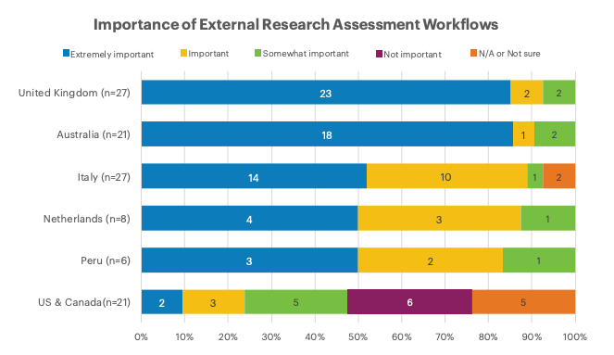
Practices and Patterns in Research Information Management: Findings from a Global Survey (DOI:10.25333/BGFG-D241), CC BY 4.0
Notes:
What we mean by that is illustrated here. This slide talks about the importance of external research assessment workflows.
Unsurprisingly this is highly important in the UK and in Australia, with their strong research assessment regimes, somewhere in the middle in other European countries like Italy and the Netherlands, and completely different in the US & Canada, below.
Figure 20. Importance of RIM function “External Research Assessment” by country.

Slide 24
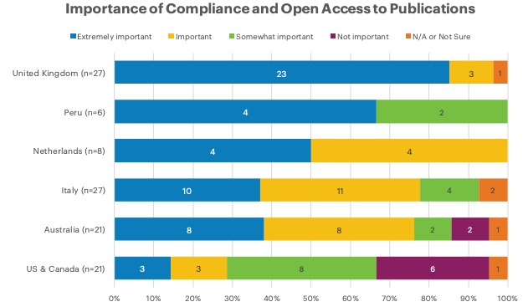
Practices and Patterns in Research Information Management: Findings from a Global Survey (DOI:10.25333/BGFG-D241), CC BY 4.0
Notes:
Although regional differences in responses related to Open Access to publications are not quite as stark, it’s easy to see which countries’ funders have Open Access mandates. In the US, compliance with open access to publications mandates is the responsibility of the researchers rather than their institutions.
Figure 21. Importance of RIM function “Compliance and Open Access to Publications,” grouped by country.

Slide 25
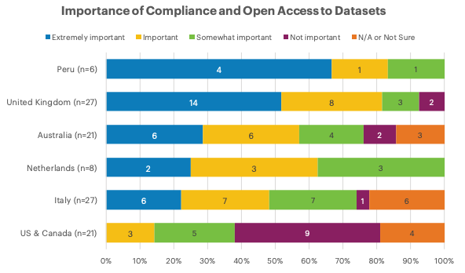
Practices and Patterns in Research Information Management: Findings from a Global Survey (DOI:10.25333/BGFG-D241), CC BY 4.0
Notes:
We see the lines drop back a bit for Open Access to Datasets. Mandates regarding access to publications have been around longer, so the responses to this function are likely to align more closely with the previous one in future surveys.
Figure 22. Importance of RIM function "Compliance and Open Access to Datasets," grouped by country.

Slide 26
Interoperability

Slide 27
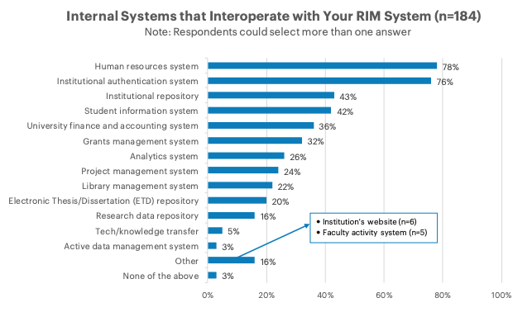
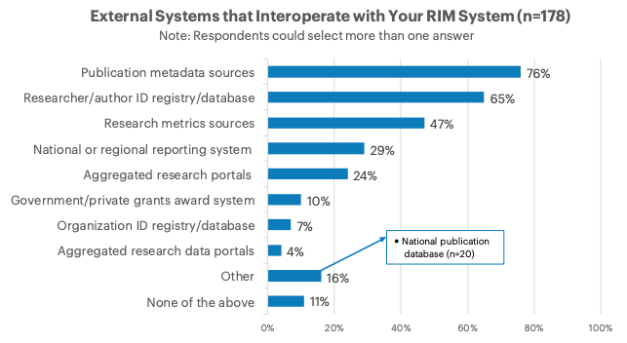
RIM systems interoperate with multiple internal and external systems
Practices and Patterns in Research Information Management: Findings from a Global Survey (DOI:10.25333/BGFG-D241), CC BY 4.0
Notes:
This could be useful to share in the published slide deck, but I’d like to move right on to the regional comparisons.
Respondents were presented with lists of external and internal systems and were asked with which of them their RIM interoperates. The internal systems most indicated as being interoperable include HR and authentication systems; external systems include publication metadata sources and researcher/author ID registries/databases.

Slide 28
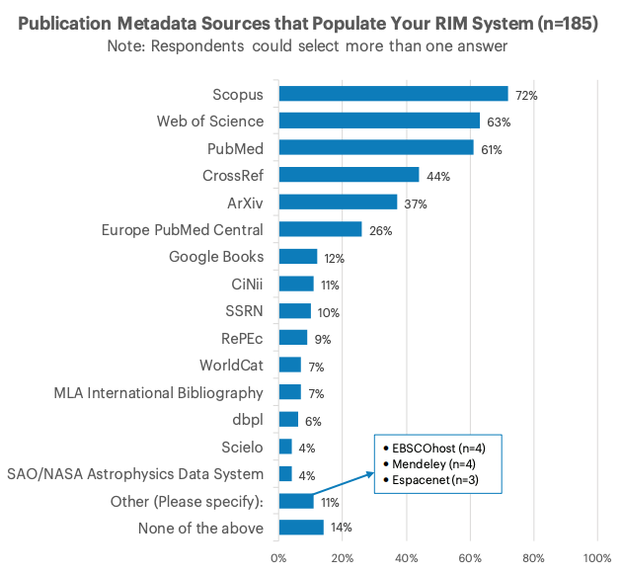
Practices and Patterns in Research Information Management: Findings from a Global Survey (DOI:10.25333/BGFG-D241), CC BY 4.0
Notes:
Figure 48. Sources of metadata used to populate live RIM systems.

Slide 29
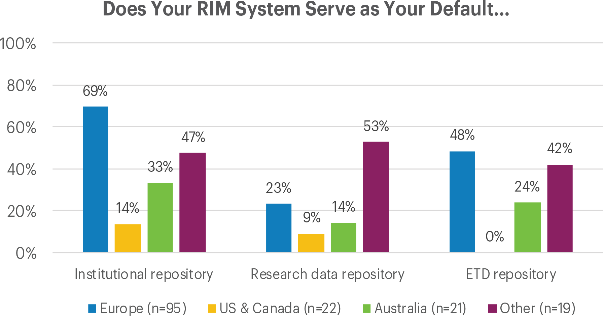
“Institutions with a live RIM system reporting that their RIM system serves as their default institutional repository/ETD repository/research data repository, with regional subdivisions” by OCLC and euroCRIS, Practices and Patterns in Research Information Management: Findings from a Global Survey (DOI:10.25333/BGFG-D241), CC BY 4.0
Notes:
Figure 27. Institutions with a live RIM system reporting that their RIM system serves as their default institutional repository/ETD repository/research data repository, with regional subdivisions

Slide 30
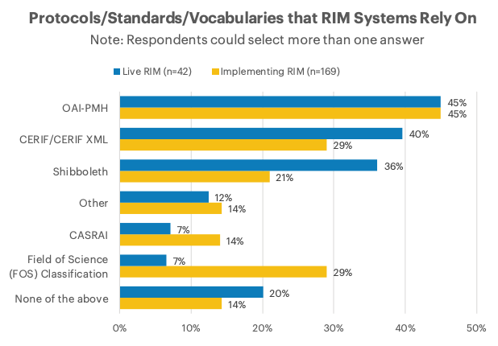
Practices and Patterns in Research Information Management: Findings from a Global Survey (DOI:10.25333/BGFG-D241), CC BY 4.0
Notes:
Figure 51. Protocols, standards, and vocabularies in use for both live and implementing institutions.
Interoperability is important – a significant degree of RIM systems interoperate with multiple institutional systems – including IRs
Institutions leverage publications metadata harvesting
OAI-PMH & CERIF-XML important standards

Slide 31
Some summary findings
Interoperability is important – a significant degree of RIM systems interoperate with multiple institutional systems – including IRs
Institutions leverage publications metadata harvesting
OAI-PMH & CERIF-XML important standards
“We have three best of breed RIM systems that are interoperable to some extent, so we have as good a RIM infrastructure as is currently possible. The key to successful RIM going forward will be to improve and maximise interoperability.”
“There is much room for improvement in the area of system interoperability. Only when such improvement takes place will the actual potential of RIM systems start to be realized.”
Notes:
While I don’t plan to display this slide in the presentation, I’d like to include it in the published deck. II believe we can cover these points in the previous, information rich slides.

Slide 32
Persistent identifiers

Slide 33
Some summary findings
Congruent with our qualitative Convenience and Compliance findings
Strong adoption of person identifiers
ORCID becoming a de facto standard in scholarly literature, but other identifiers also needed and used
Organizational identifiers largely unused
oc.lc/rim

Slide 34
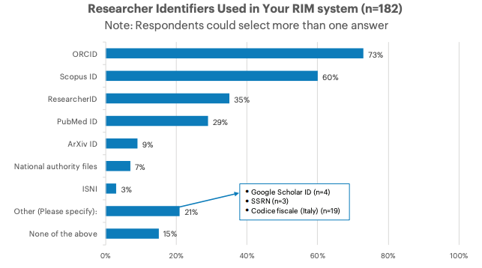
Practices and Patterns in Research Information Management: Findings from a Global Survey (DOI:10.25333/BGFG-D241), CC BY 4.0
Notes:
Figure 49. Researcher and person identifiers in use in live RIM systems.

Slide 35
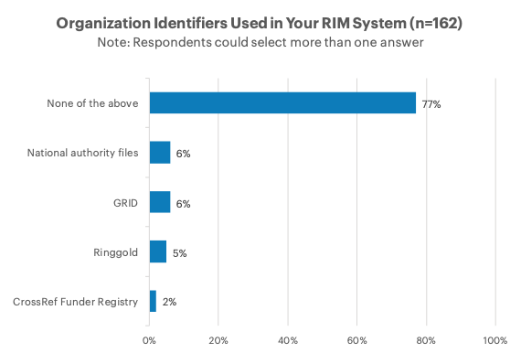
Practices and Patterns in Research Information Management: Findings from a Global Survey (DOI:10.25333/BGFG-D241), CC BY 4.0
Notes:
Figure 50. Organizational identifiers in use in live RIM systems.

Slide 36
More Information:
Rebecca Bryant, PhD, Senior Program Officer, OCLC Research
bryantr@oclc.org @RebeccaBryant18
https://orcid.org/0000-0002-2753-3881
Anna Clements, Assistant Library Director, University of St Andrews; euroCRIS
akc@st-andrews.ac.uk @AnnaKClements
https://orcid.org/0000-0003-2895-1310
Jan Fransen, Service Lead for RIM Systems, University of Minnesota
fransen@umn.edu
https://orcid.org/0000-0002-0302-2761
Webinar
https://www.oclc.org/research/events/2019/013019-eurocris-oclcresearch-survey-of-rim-practices.html
oc.lc/rim

Slide 37
the Impact of shifting to Open

Slide 38
“What has become entirely unambiguous, though, is that libraries are now expected—by researchers, funders, faculty colleagues, and especially end-users—to provide services that support open materials and workflows as fully as any other kind of content.​”
~R.L.Frick, http://www.oclc.org/blog/main/an-open-discussion/
Notes:
OCLC, a global library cooperative, supporting thousands of libraries in making information more accessible and more useful to people around the world. We provide shared technology services, original research and community programs that help libraries meet the ever-evolving needs of their users, institutions and communities.
Access to education remains significantly stratified – by geolocation, social background and many other factors –and there are many opportunities for improvement in the communication of science. OCLC supports library missions to enhance access to authoritative information – and with open content we provide libraries with free materials to substantially increase content for their users.
Together with librarians, publishers, partners we are working towards better dissemination of knowledge. Together we make breakthroughs possible.
Libraries are now expected—by researchers, funders, faculty, and especially end-users—to provide services that support open materials
“Open” in context to the library community is generally describes how content is published, accessed and used. (Depending on who you ask) there’s a general acknowledgment that the term “open” describes a continuum, rather than defining a specific set of criteria.
NEXT: How we define open content

Slide 39
Framing the Open Content discussion
Purpose
The discussions aim to engage a global audience of librarians in a joint exercise:
to map and align their open content efforts
to explore current library investment in this type of content
to build a common foundation for cooperation to widen access to free, online content.
Notes:
The “WHY” of this effort is an important question, too. What do we want to achieve? Answering this question is essential to having a meaningful conversation.
Our main aim was to engage a global audience of librarians in a joint exercise to map and align their open content activities, to help cultivate a shared understanding of how much they are already invested in this type of content and how they can meaningfully work together to leverage these efforts. With discussion we wanted to build a common foundation for cooperation to widen access to free, online content. Our goal was to elevate the conversation to address high-level, cross-regional, cross-sectoral questions. What are libraries doing now to support Open Content? What can be done to leverage these efforts and create more synergy at the global level? in which areas can scale make a difference? and how can OCLC help?
We wanted to discuss these questions f2f in group conversations and so we developed a Discussion Guideline.
But we also wanted to scale the conversation by surveying as many libraries as possible.

Slide 40
Defined Open Content
Open and freely available
Accessible immediately and online
Digital and usable in a digital environment
Acknowledging the "continuum of openness"
Notes:
The scope is intentionally expansive and includes all open content that is relevant to the large diversity of libraries. We define is as the full range of freely available, unrestricted, online content (including OA-scientific articles and e-books, pre-prints, open educational resources, governmental and non-governmental publications, grey literature, open datasets, open collections from digitized heritage, web-resources like YouTube videos, news websites, any freely available born-digital materials, etc.).

Slide 41
Summary Findings
705 responses from 82 different countries
72% are Research and University libraries
91% are currently involved in Open Content activities
Current top 3 Open Content activities:
Supporting users/instructors/digital literacy programs
Promoting the discovery of Open Content
Operating an institutional repository
Notes:
Survey data collected between November 2018 – January 2109.
705 respondents from 82 different countries completed, or partially completed, the survey.
Half (49%) from the Americas; just over 1/3 (36%) from EMEARC and 15% from Asia Pacific.
Nearly ¾ of the respondents are Research and University libraries.
Most libraries (91%) are currently involved in Open Content activities and most of them plan to be involved in more/other Open Content activities

Slide 42
Total responses by region
Half (49%) of the respondents are from the Americas region; just over a third (36%) from EMEA and 15% from Asia Pacific.
Notes:
This chart shows you the responses by OCLC Region.
This is interesting information for you as Global Council. It gives you an idea of how engaged libraries in your region are with OCLC in talking about open content.
The OCLC regions are time zone-based – a pragmatic organizational structure to manage communications and run a global enterprise. However, comparing library data by time zone regions is usually not very purposeful.

Slide 43
Total responses by country by OCLC region
AMERICAS (n=346) |  | EMEA (n=256) |  |  |  |  |  | Asia Pacific (n=103)
United States | 298 | United Kingdom | 37 | Sweden | 4 | Cyprus | 1 | Australia | 30
Canada | 31 | Germany | 20 | Lebanon | 3 | Czech Republic | 1 | Philippines | 23
Jamaica | 4 | Turkey | 17 | Zambia | 3 | Denmark | 1 | Pakistan | 14
Argentina | 3 | France | 16 | Algeria | 2 | Ethiopia | 1 | Indonesia | 9
Trinidad & Tobago | 3 | Netherlands | 15 | Belarus | 2 | Guinea-Bissau | 1 | Taiwan | 8
Mexico | 2 | Poland | 15 | Ghana | 2 | Hungary | 1 | Bhutan | 4
Antigua & Barbuda | 1 | Nigeria | 11 | Ireland | 2 | Iraq | 1 | China | 3
Bahamas | 1 | Spain | 9 | Kyrgyzstan | 2 | Kazakhstan | 1 | New Zealand | 3
Bolivia | 1 | Austria | 7 | Lesotho | 2 | Kuwait | 1 | India | 2
Peru | 1 | Greece | 7 | Malawi | 2 | Lithuania | 1 | Japan | 2
Venezuela | 1 | Italy | 7 | Saudi Arabia | 2 | Namibia | 1 | Nepal | 1
 |  | Norway | 7 | Switzerland | 2 | Romania | 1 | Palau | 1
 |  | Azerbaijan | 6 | Uganda | 2 | Russia | 1 | Singapore | 1
 |  | Zimbabwe | 6 | Afghanistan | 1 | Sierra Leone | 1 | Sri Lanka | 1
 |  | Macedonia (FYROM) | 5 | Bahrain | 1 | Slovenia | 1 | Vanuatu | 1
 |  | South Africa | 5 | Belgium | 1 | Swaziland | 1
 |  | Armenia | 4 | Botswana | 1 | Tanzania | 1
 |  | Kenya | 4 | Bulgaria | 1 | United Arab Emirates | 1
 |  | Serbia | 4 | Cameroon | 1
Notes:
This is where you see the imbalances creep in.

Slide 44
Total responses by library type
Nearly three-fourths of the respondents are from Research & University Libraries (72%) and another 8% are from other Educational Libraries.
Notes:
There is another imbalance in the representativeness of the responses: nearly three-fourths of the respondents are Research & University Libraries (72%). Other categories are: Educational (8%), Public (8%), Special (7%), National (2%) and Other (3%).
The imbalances are driving the statistics of the totals. In other words, the totals are reflecting the responses of the majority group.
Keep this in mind when I show you the figures of the total responses, in the following slides.
When looking at the totals you are mainly seeing what the group of Research & University libraries have responded. And with 42% of responses coming from the US, the US perspective will also influence the totals significantly.
That said, and now that you are aware of the caveats, I will show you the main results of the total responses.
Where there are significant differences by region or library type, I will signal this.

Slide 45
Open content activities – Current and Planned – by Total Respondents
None/Not sure
Current (9%)
Plan to (28%)
Notes:
Most (91%) are CURRENTLY and 72% PLAN to be involved in open content activities
Half and more than half are CURRENTLY involved in:
supporting users/instructors/ digital literacy programs (65%);
promoting the discovery of open content (61%);
institutional repository (60%);
supporting authors/researchers/ teachers (58%);
digitizing collections (57%); and
selecting open content not managed by the library (54%)
Digital Collections Library.
A tenth or more PLAN to be involved in most of the open content activities. Data services and deep interactions with open content score highest.
Many of those planning to get involved in specific open content activities are also currently involved in open content activities.
9% indicated that they are not supporting open content or not sure about this.

Slide 46
Regional differences
 | Americas | EMEA | AP
> 3 years | digital collections library; digitizing collections; deep interactions with open content | institutional repository; supporting authors/res/teachers; supporting users/instr/digital literacy | bibliometrics; assessment; data services; born-digital deposit/web-archive; advocacy & policies
Current | promoting the discovery of open content; selecting open content NOT managed by the library | advocacy & policies; institutional repository; data services; bibliometrics | institutional repository; data services; bibliometrics
Planned | Assessment | digital collections library; born-digital deposit/web-archive data services; deep interactions with open content; publishing | digital collections library; born-digital deposit/web-archive
Notes:
Significantly more … compared to
Respondents from region x are more likely to have been involved in … compared to
Significantly more EMEA respondents (compared to Americas) PLAN to be involved in data services; digital collections library; deep interactions with open content; publishing; and born-digital (legal) deposit/Web-archive.
Significantly more respondents from the Americas (compared to EMEA) PLAN to be involved in assessment.

Slide 47
Investment in Open Content Activities: Total Respondents
Total Respondents | Budget line item | FTE allocation | Project money | Other | No source of investment | Not sure
Data services (n=168) | 33% | 46% | 12% | 8% | 11% | 16%
Digital Collections Library (n=284) | 47% | 36% | 19% | 7% | 12% | 14%
Institutional repository (n=340) | 52% | 37% | 12% | 5% | 12% | 11%
Publishing (n=197) | 37% | 38% | 17% | 10% | 12% | 15%
Digitizing collections (n=320) | 37% | 31% | 35% | 8% | 13% | 12%
Born-digital (legal) deposit/Web-archive (n=108) | 38% | 32% | 15% | 10% | 15% | 17%
Bibliometrics (n=129) | 27% | 43% | 7% | 7% | 19% | 13%
Deep interactions with open content (n=73) | 23% | 26% | 14% | 11% | 21% | 18%
Assessment (n=114) | 16% | 32% | 8% | 10% | 25% | 21%
Supporting authors/researchers/teachers (n=329) | 19% | 35% | 8% | 8% | 26% | 16%
Supporting users/instructing/digital literacy programs (n=373) | 17% | 35% | 8% | 6% | 30% | 14%
Advocacy and policies (n=285) | 18% | 33% | 8% | 7% | 32% | 13%
Selecting open content NOT managed by the library (n=316) | 16% | 27% | 7% | 7% | 36% | 17%
Promoting the discovery of open content (n=357) | 16% | 28% | 5% | 7% | 37% | 13%
In planning for expenses/investment, please indicate if the source of investment for each of your current open access activities is a budget line item, full-time equivalent (FTE) allocation and/or project-specific funding. (Select all that apply.) (Table sorted in descending order based on “no source of investment”)
Notes:
Respondents had difficulty in addressing the question about the percentage of their library’s total budget expenditures spent on current open content activities.
However, they indicated that most open content activities are covered by budget line items and FTE staff time allocations in the libraries’ planning and budgeting (highlighted in orange: activities covered mostly by budget line items and FTE as reported by respondents engaged in these activities)
Those activities for which respondents reported having mostly no source of investment or not being sure about, are (highlighted in blue):
Selecting open content NOT managed by the library
Promoting the discovery of open content

Slide 48
Successfulness of open content activities
More than half of the respondents indicate their current open content activities are measurably successful.
Nearly a third of the respondents report their:
Institutional repository (32%),
Digital Collections Library (32%)
Digitizing collections (31%)
have been very successful.
Only 10%-20% report not measuring the success of their open content activities.

Slide 49
Summary
Overall respondents report that they are well invested in open content.
They support open content across the full range of service categories.
The most stable activities seem to be the operational activities, which are reported to be both most mature and very successful (institutional repositories and digital collections library).
Notes:
What do these results tell us?
Respondents are overall well invested in open content. They support open content across the full range of service categories. Most open content activities are covered by library budget line items and FTE staff time allocations.
The most stable activities seem to be the operational activities, which are reported to be both most mature and very successful (institutional repositories and digital collections library).

Slide 50
Summary
Involvement in open content activities is growing and subject to shifts: 75% report planning new activities. Compared to the Americas, respondents from EMEA and AP are more likely to engage in new and a wider range of activities, and to want to accelerate the impact.
New areas of academic interest score highest among planned activities and are preferred areas for achieving accelerated impact.
Notes:
The open content activities of the respondents are subject to shifts. 9% report they have stopped one or more activities but more importantly, nearly ¾ report planning new activities.
Compared to the Americas, respondents from EMEA and AP are more likely to engage in new and a wider range of activities, and to want to accelerate the impact.
The relatively new areas of academic interest (data services; deep interactions with open content) score highest among planned activities and these are also the areas where respondents wish to accelerate impact.

Slide 51
oc.lc/open
Notes:
The group has already started. It looks at the big challenges and the low hanging fruit and makes progress in small steps.
Where are we today? What do we have in the Index (49 Million e-books and articles are identifiable as OA)? How do we identify open content and surface it? How can we help discovery of open content in WC Discovery and WorldCat.org (100 Million users/year)? How do we shift from privileging print to privileging open access?

Slide 52
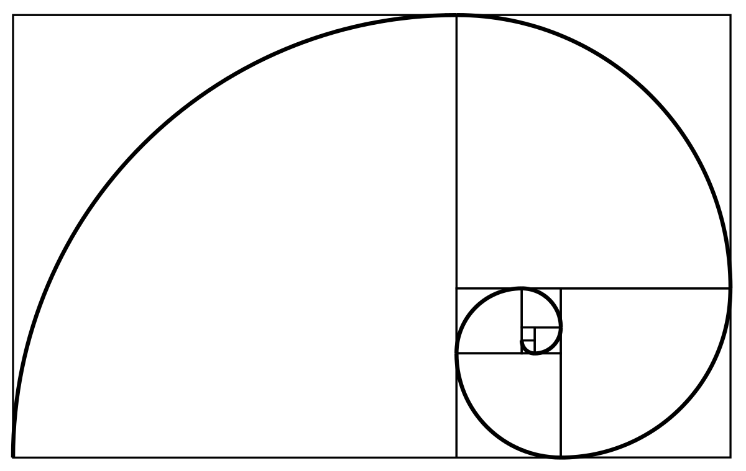
This Photo by Unknown Author is licensed under CC BY-SA
Notes:
I don’t have the answers – but this is what I know for sure

Slide 53
“…metadata and discovery operations will be retooled with a focus on managing inbound and outbound data flows, and maximizing the network visibility of distinctive information assets.”
~Lorcan Dempsey
https://www.liberquarterly.eu/articles/10.18352/lq.10170/
https://flic.kr/p/qAb2mY
Notes:
We need to view this from both a technical and inventory control perspective and user centric discovery side

Slide 54
Enable Curious Exploration for New Knowledge Creation
Marine biologists reused price data from the New York Public Library’s collection of 45,000 restaurant menus along with other sources to test whether abalone stocks were being overharvested in the 1920s.
(Enis 2015)
Image: https://www.flickr.com/photos/albamass__canvas/5315308442 by AL BaMass / CC BY-NC-ND 2.0
Notes:
We keep the end user in mind -

Slide 55
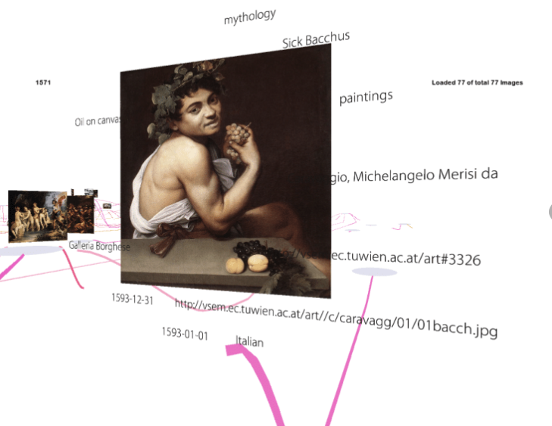
Social Interaction with Cultural Heritage on the Web - Scientific Figure on ResearchGate. Available from: https://www.researchgate.net/figure/Close-up-of-an-artwork-Existing-metadata-is-displayed-around-the-virtual-canvas_fig2_220940480 [accessed 4 Apr, 2019]
Notes:
Allow for multiple layers of context and voices of authority and interpretation

Slide 56
Notes:
Provide efficent easy pathways to trusted, reliable, resources

Slide 57
“It’s a confusing environment”
Notes:
This is a confusing environment.
The move to open access in various forms is advancing but without a single trajectory. There is a variety of national open access initiatives, different funder mandates, and variously developed institutional regimes. Materials will be made available open access in different ways (institutional repositories, publisher websites, subject repositories, …) and with different conditions attached.
The licensing model, and the big deal, that have so characterized collection building activity in recent years, continue to be pressured and library organizations are responding in different ways. Single article purchase or ‘loan’ may become more common. Transition will involve an uneven mix of pay to publish and pay to read options.
The routes by which research materials are available have diversified and new publishing models are emerging (megajournals, for example) as publishers position themselves in a changing context. The uneasy relationship between publishers and social research systems will evolve. The larger commercial publishers are extending the range of productivity, aggregation, and other product options they make available. Acquisitions by Elsevier in recent years are telling (Mendeley, Bepress, Pure, SSRN, Hivebench, 1Science, …).
At the same time, there is growing interest for open access to other linked research artifacts – research data, methods, software – which further complicates the ecosystem.
Access to the journal literature is fragmented in various ways, albeit with Google Scholar as a notable unifying funnel to a large part of the scholarly universe.

Slide 58
“…the library view is shifting somewhat from management of a locally acquired collection to facilitating access to a broader range of scholarly resources.
The value relates to the ability to meet research and learning needs in the best ways available
using a variety of resources, whether or not they are owned or licensed locally; and also to mobilizing library expertise
in assisting faculty and students be effective in a complex information environment.”
Lorcan Dempsey, 1 April 2019
http://orweblog.oclc.org/the-facilitated-collection-redux-a-note-on-collections-as-a-service-the-university-of-california-and-elsevier/
https://flic.kr/p/rdHcwg

Slide 59
You got this!
This Photo by Unknown Author is licensed under CC BY-SA

Slide 60
References
Bryant, R., Clements, A., de Castro, P., Cantrell, J., Dortmund, A., Fransen, J., … Mennielli, M. (2018). Practices and patterns in research information management: Findings from a global survey. Dublin, OH: OCLC Research. https://doi.org/10.25333/BGFG-D241.
Bryant, R., Clements, A., Feltes, C., Groenewegen, D., Huggard, S., Mercer, H., … Wright, J. (2017). Research information management: Defining RIM and the library’s role. Dublin, OH: OCLC Research. doi:10.25333/C3NK88.
Bryant, R., Dortmund, A., & Malpas, C. (2017). Convenience and compliance: Case studies on persistent identifiers in european research information management. Dublin, Ohio: OCLC Research. doi:10.25333/C32K7M
Carter, B. @archeoscape. (2019, January 31). “…we examined data from Mark Lehner's Giza (Egypt) excavations. Great for students to get hands-on experience with archaeological data. Thanks Lehner et al. and @OpenContext cc @ekansa”. [Twitter Post]. Retrieved from https://twitter.com/archaeoscape/status/1091034237342486528
Cox, A. M., & Pinfield, S. (2014). Research data management and libraries: Current activities and future priorities. Journal of Librarianship and Information Science 46(4), 299-316. doi:10.1177/0961000613492542.

Slide 61
References
Dempsey, L. (2017). Library collections in the life of the user: Two directions. LIBER Quarterly, 26(4). https://www.liberquarterly.eu/articles/10.18352/lq.10170/.
Dempsey, L. (2019). The Facilitated Collection Redux: A note on collections as a service, the university of California, and Elsevier. April 1, 2019. http://orweblog.oclc.org/the-facilitated-collection-redux-a-note-on-collections-as-a-service-the-university-of-california-and-elsevier/
Enis, M. (2015). “Wisdom of the Crowd | Digital Collections.” Library Journal, July 13. http://lj.libraryjournal.com/2015/07/technology/wisdom-of-the-crowd-digital-collections/#_.
Faniel, I. M., Austin, A., Kansa, E., Kansa, S. W., France, P., Jacobs, J., … Yakel, E. (2018). Beyond the archive: Bridging data creation and reuse in archaeology. Advances in Archaeological Practice, 6(02), 105-116. https://doi.org/10.1017/aap.2018.2.
Faniel, I. M., Frank, R. D., & Yakel, E. (In Press). Context from the data reuser’s point of view. Journal of Documentation.
Faniel, I. M., Kriesberg, A., & Yakel, E. (2016). Social scientists’ satisfaction with data reuse. Journal of the Association for Information Science and Technology, 67(6), 1404–1416. https://doi.org/10.1002/asi.23480
Faniel, I.M., & Connaway, L. S. (2018). Librarians' perspectives on the factors influencing research data management programs. College & Research Libraries 79(1), 100-119. https://doi.org/10.5860/crl.79.1.100

Slide 62
References
Faniel, I.M., & Yakel, E. (2017). Practices do not make perfect: Disciplinary data sharing and reuse practices and their implications for repository data curation. In L.R. Johnston (Ed.), Curating research data volume 1: Practical strategies for your digital repository (pp. 103-125). Chicago: Association of College and Research Libraries Press.
Lavoie, B., & Malpas, C. (2015). Stewardship of the evolving scholarly record: From the invisible hand to conscious coordination. Dublin, Ohio: OCLC Research. https://doi.org/10.25333/C3J63N.
Lavoie, B., Childress, E., Erway, R., Faniel, I., Malpas, C., Schaffner, J., & van der Werf, T. (2014). The evolving scholarly record. Dublin, Ohio: OCLC Research. https://doi.org/10.25333/C3763V.
Prepare for the next evolution of libraries: Carnegie Mellon University. (n.d.). https://www.oclc.org/en/member-stories/carnegie-mellon.html.
Wilkinson, M. D., Dumontier, M., Aalbersberg, Ij. J., Appleton, G., Axton, M., Baak, A., … Mons, B. (2016). The FAIR Guiding Principles for scientific data management and stewardship. Scientific Data, 3, 160018. https://doi.org/10.1038/sdata.2016.18
Yakel, E., Faniel, I. M., & Maioriana, Z. (In Press). Virtuous and vicious circles in the data lifecycle. Information Research.

