Slide 1

Breaking the waves: Creating a database for copyright policies for Polish scientific journals
Kamila Kokot
ILIDE International Conference, April 8-10, 2019
CC BY-NC 4.0

Slide 2
Breaking the waves:
Creating a database for copyright policies for Polish scientific journals
database for copyright policies for Polish scientific journals
CC BY-NC 4.0

Slide 3

Breaking the waves:
Creating a database for copyright policies for Polish scientific journals
CC BY-NC 4.0

Slide 4
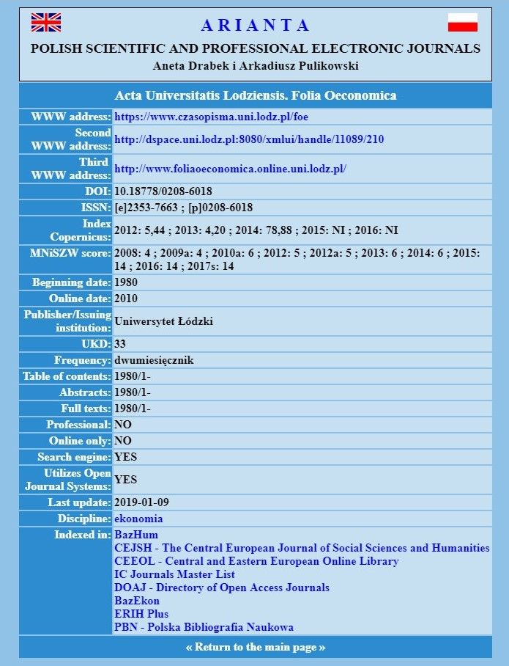
Breaking the waves:
Creating a database for copyright policies for Polish scientific journals
CC BY-NC 4.0

Slide 5

Breaking the waves:
Creating a database for copyright policies for Polish scientific journals
What do we need to know?
self-archiving policy
data sharing policy
type of license
embargo
APCs
pixabay.com
CC BY-NC 4.0

Slide 6
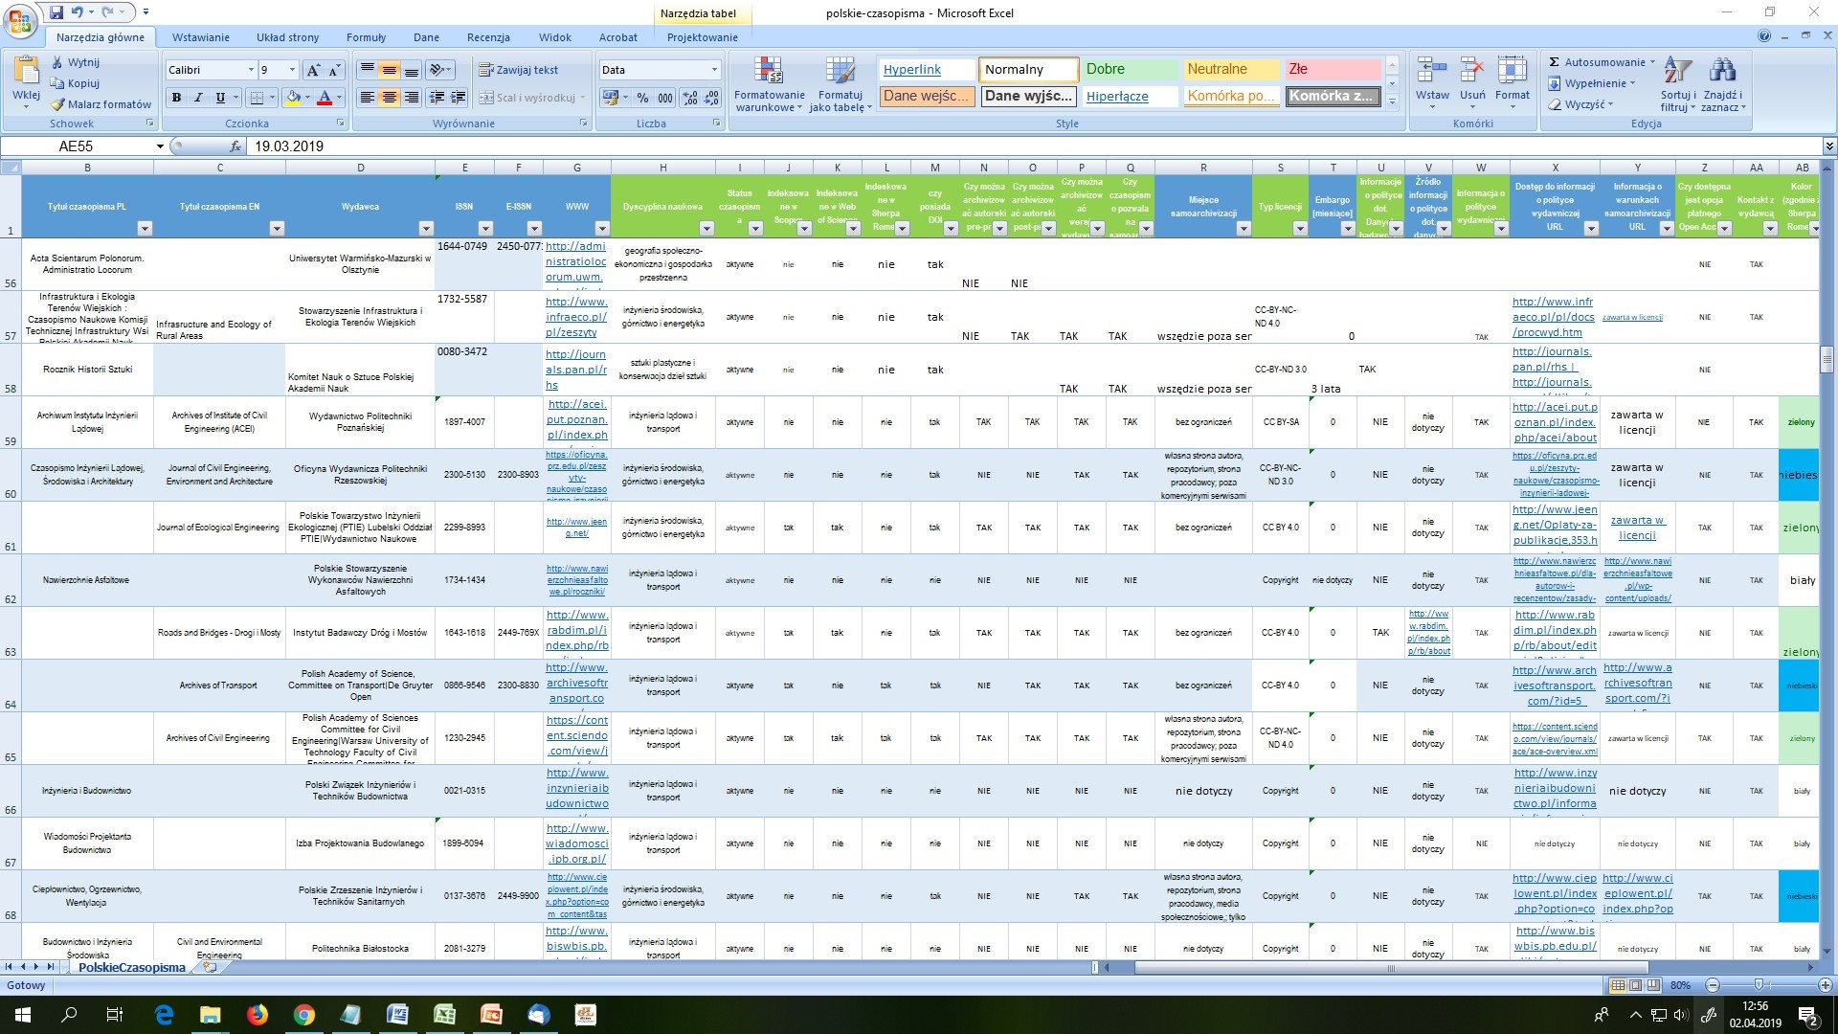
Breaking the waves:
Creating a database for copyright policies for Polish scientific journals
Basic Excel Template
CC BY-NC 4.0

Slide 7
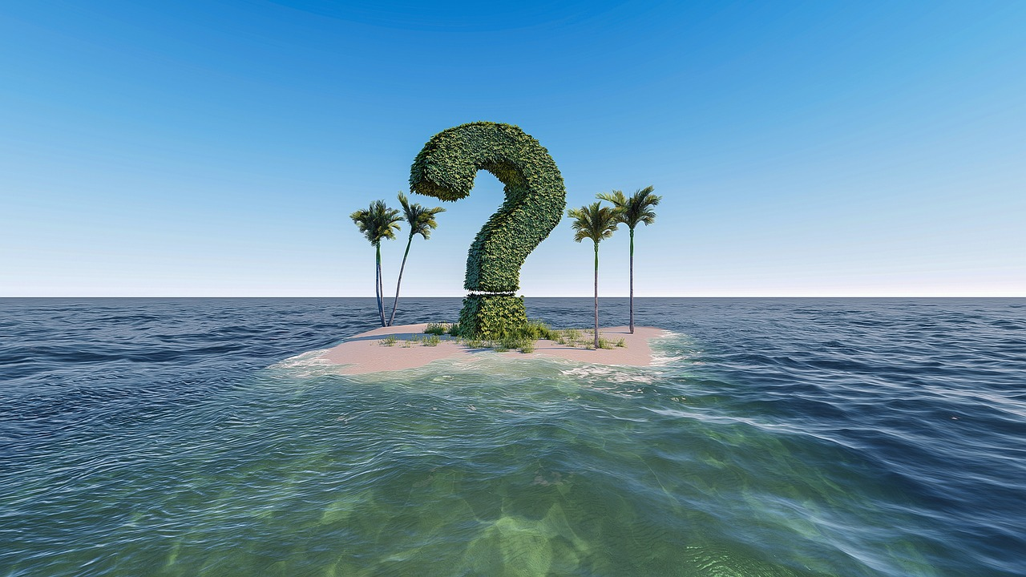
Breaking the waves:
Creating a database for copyright policies for Polish scientific journals
The most common problems:
lack of information or information is missing
information is not current
down websites and broken links
pixabay.com
CC BY-NC 4.0

Slide 8

Breaking the waves:
Creating a database for copyright policies for Polish scientific journals
Difficulties with publishers and editors :
no answer
problem with basic definitions
problem of understanding how the CC Licenses work
CC BY-NC 4.0
pixabay.com

Slide 9
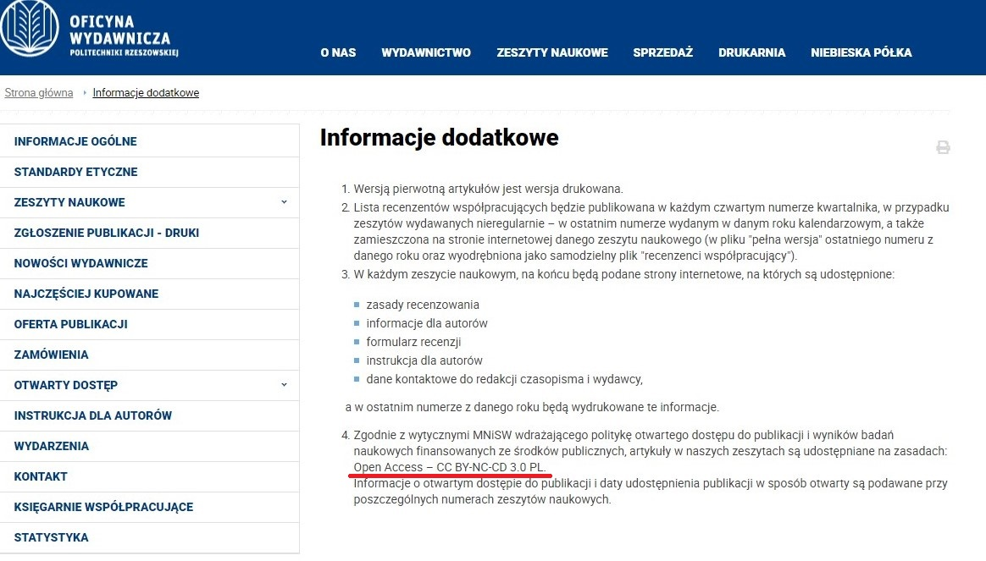
Breaking the waves:
Creating a database for copyright policies for Polish scientific journals
CC BY-NC 4.0

Slide 10
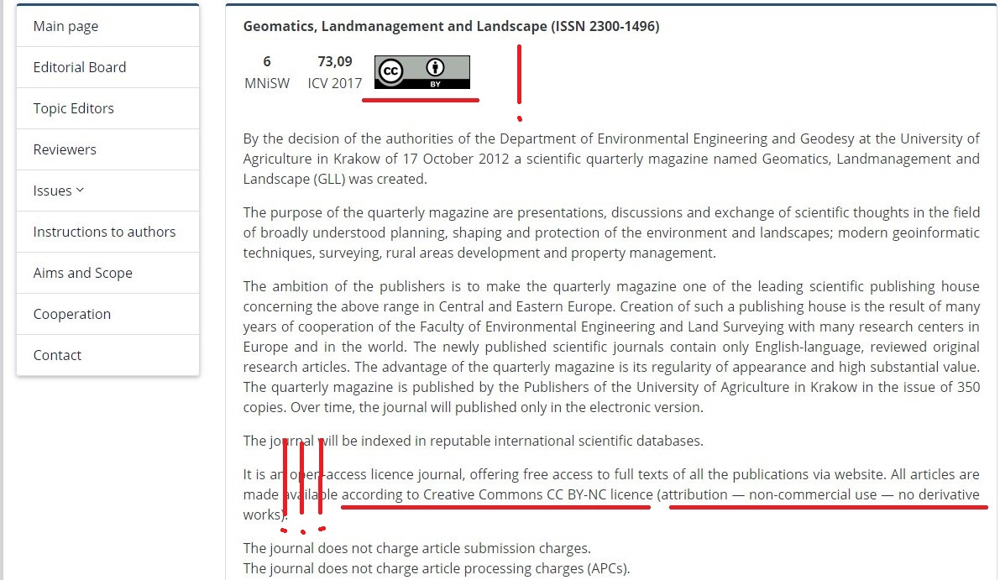
Breaking the waves:
Creating a database for copyright policies for Polish scientific journals
CC BY-NC 4.0

Slide 11
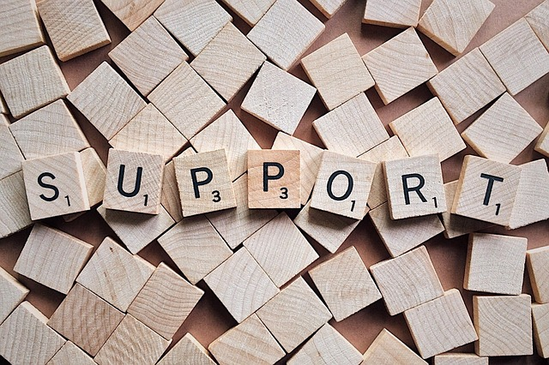
Breaking the waves:
Creating a database for copyright policies for Polish scientific journals
Our tasks:
explaining the definitions
explaining conditions of the Creative Commons Licenses
showing benefits of Open Access Publication model
explaining data sharing policy
pixabay.com
CC BY-NC 4.0

Slide 12
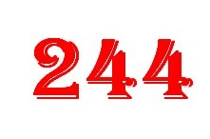
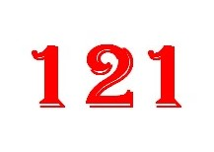
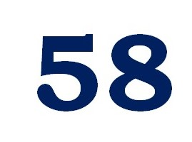
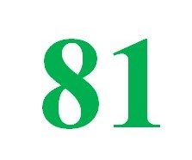
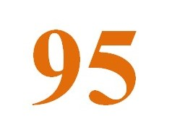
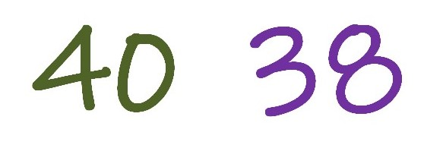
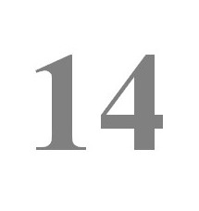
Breaking the waves:
Creating a database for copyright policies for Polish scientific journals
Our statistics:
CC BY-NC 4.0

Slide 13

Thank you!
pixabay.com
CC BY-NC 4.0

Slide 14
Project ,,MOST DANYCH‚’
is co-financed by the European Regional Development Fund
within the Operational Programme Digital Poland 2014-2020
CC BY-NC 4.0

