Slide 1
DARIAH-CZ consortium and accession of the Czech Republic to DARIAH ERIC
Martin Lhoták
Library of the Czech Academy of Sciences
ILIDE 2019, Jasná

Slide 2
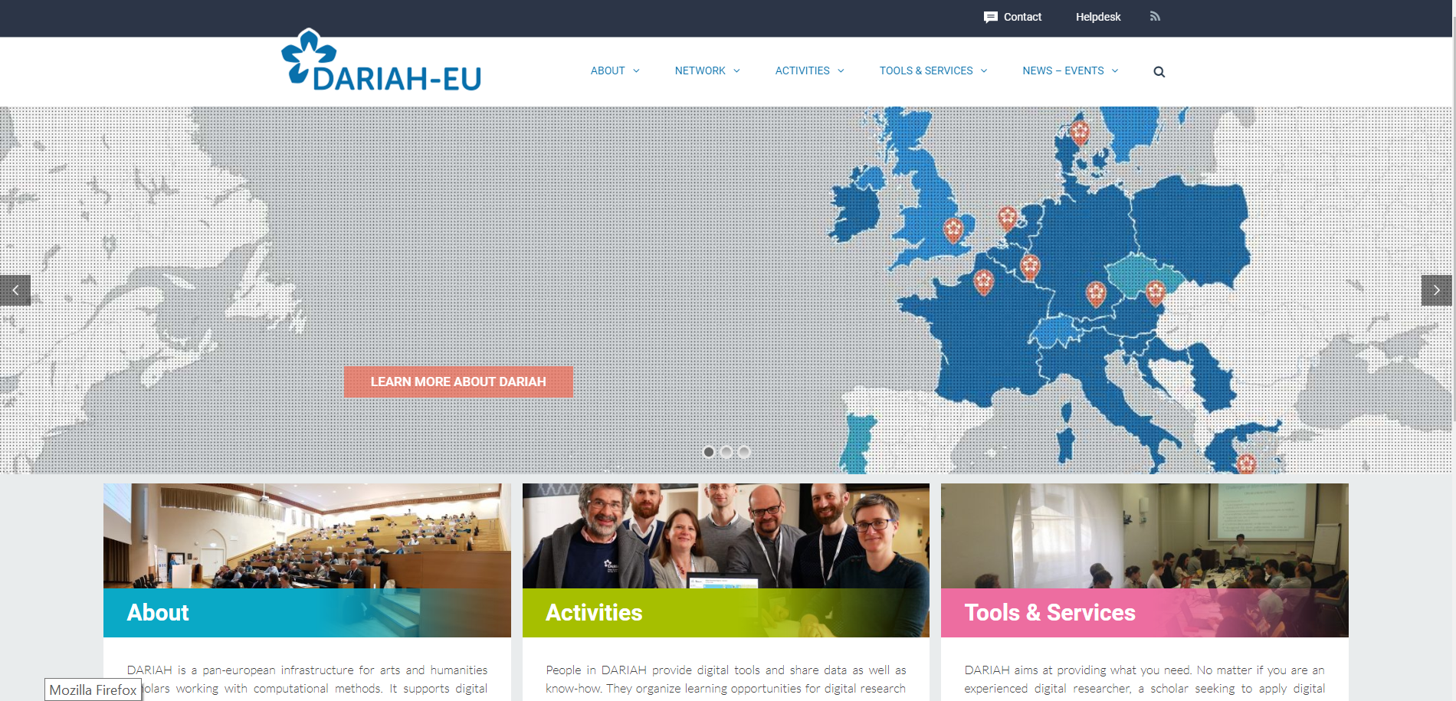
https://www.dariah.eu/

Slide 3
Arts and Humanities research in the digital era - challenges
Localization and hosting of digital sources
Documenting and connecting to analog sources
Environments for managing, exploring and enriching digital material
Communication of results in the digital world
Multidisciplinary collaboration with computer science research
Community acceptance of paradigm changes
Notes:
only a very limited part of the sources in cultural heritage institutions has been digitized - see Enumerate report http://enumerateproject.wordpress.com/2014/03/07/latest-enumerate-report-highlights-continuing-digital-policy-gap/

Slide 4
Goals of DARIAH infrastructure
Enhance and support digitally-enabled research and teaching across the Arts and Humanities
Providing technological components to work with digital objects
Training researchers and working with communities
Providing guidance about standards and best practices
Build connected network of tools, information, people and methodologies
Pulling together national initiatives
Helping communities to integrate the digital shift

Slide 5
Brief history
2006: DARIAH @ ESFRI Roadmap
2008 – 2011: Preparatory Phase project — Preparing DARIAH
2011 – 2013: Transition Phase establishing the DARIAH-ERIC
2014-2018: Construction Phase of DARIAH-ERIC
2019-: Operational Phase
Notes:
Centres de ressources numériques (2005)

Slide 6
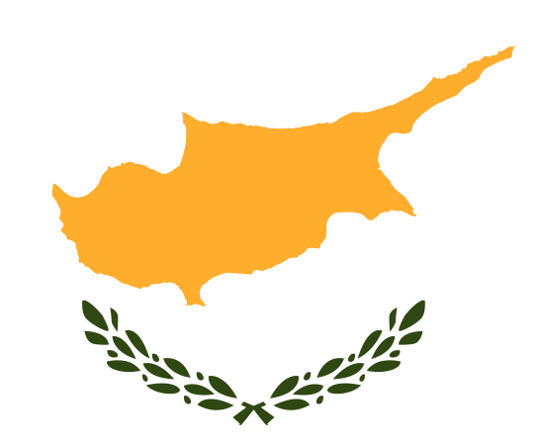
Founding members
Founding Members
Austria
Belgium
Croatia
Cyprus
Denmark
France
Germany
Greece
Founding Members
Ireland
Italy
Luxembourg
Malta
Netherlands
Serbia
Slovenia
Candidate countries and associated members
Lithuania
Poland
Portugal
Spain
Switzerland
Czech Republic
United Kingdom
Finland
Israel
Notes:
6

Slide 7
DARIAH-EU High-Level Principles
community-driven (22 working groups)
inclusive (addressing the humanities as a whole, not the digital humanities in particular)
promoting openness
enabling transnational collaboration
promoting standards and best practices
strong focus on teaching and training
delivering easy-to-use services and resources

Slide 8
Some DARIAH-EU Driven Services
Single Sign-On
DH Course Registry – together with CLARIN
Open Archive HAL – preprints and other scholarly documents
Geo-Browser – visualisation of spatio-temporal data
TextGrid – scholarly editing
Hypoteses – academic blogs in different languages
#dariahTeach – YouTube channel with how-tos
TERESAH – registry of digital tools for the arts & humanities
DARIAH-DE Repository – Humanities research data

Slide 9
Working Groups …
Text and Data Analytics – Visual Media and Interactivity –GeoHumanities – Women Writers in History – Training and Education – Digital Methods and Practices Observatory (DiMPO) – Lexical Resources – Community Engagement – Digital Annotation – Image Science and Media Art Research – Medievalist’s Sources (MESO) – Guidelines and Standards
(GiST) – Ethics and Legality in the Digital Arts and Humanities (ELDAH) – …
Plan to establish Library WG

Slide 10
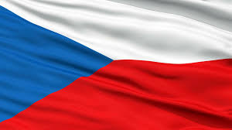
DARIAH-CZ Digital Research Infrastructure for the Arts and Humanities Czech node of the DARIAH ERIC - Digital Research Infrastructure for the Arts and Humanities https://lindat.mff.cuni.cz/en/dariah

Slide 11
DARIAH-CZ
“Digital humanities”
Enable, support digitally-enabled research
Users
Researchers in Arts and Humanities
Technology
Repository (resources), Services, Applications
Current status
Approved by the Czech government to include DARIAH-CZ on Czech National Roadmap of Large Research Infrastructures for 2019-2022
Proposal to join LINDAT/CLARIN: LINDAT/CLARIAH-CZ

Slide 12
Main Goals for 2019-2022
Becoming stable part of DARIAH ERIC
Membership of Czech Republic
Integrated with LINDAT/CLARIN by Jan. 1, 2020
Operational and fully connected by Jan. 1, 2021
Construction phase (2019-2020), following preparations (2017-18)
Collect data, assess quality, completeness, licencing, determine main repository(ies)
Prioritize, convert data / metadata
Operational phase (2021-)
Repositories running and connected to DARIAH central hub
Services
integrated existing services
new services: search in multimodal data, statistics, visualization

Slide 13
Timeline of DARIAH-CZ w/relation to LINDAT/CLARIN
LINDAT/CLARIAH-CZ
LINDAT/CLARIN est. 2010, operational since Jan. 1, 2014
CLARIN ERIC est. 2012 (Utrecht, NL)
DARIAH ERIC est. 2014 (Paris, FR)

Slide 14
Institutions
Charles University, Prague
Faculty of Mathematics and Physics (CS School)
Faculty of Arts (multiple departments)
Univ. of West Bohemia, Pilsen (Applied Sciences)
Masaryk University, Brno
Faculty of Informatics, Faculty of Arts (multiple departments)
Academy of Sciences of the Czech Republic
Library of the Academy of Sciences
Institute of the Czech Language
Institute of Philosophy
Institute of History
National Library, Prague
Moravian Library, Brno
National Film Archive, Prague
National Gallery, Prague

Slide 15
Research Fields
Linguistics, computational linguistics
History, historical bibliography
Study of culture
History of art
Philosophy
Film and film history including new audiovisual media
Visual arts
Musicology and history of music
Ethnology
Archaelogy/egyptology
… and interdisciplinary areas of the above

Slide 16
The Workplan
Current situation
Existing collections – at all institutions
Varying degree of
Digitization, metadata description, access and availability
Construction phase
“inventory” (18 (sub)projects identified)
E.g. MEMORI (IP CAS, CAS Library), Archive Jan Patocka, …
Metadata unification (DARIAH compatible)
Technology development for access

Slide 17
Workplan scheme
User applications – search,
Statistics, visualization, …
Digtized
collections
Open & std.
metadata
Accessible &
searchable data

Slide 18
LINDAT/CLARIAH-CZ Management Structure
Head (PI) of
LINDAT/CLARIAH-CZ
Management Board
(1 Rep. each partner)
Project Manager (CU)
Institute of Philosophy AVCR
Library
AVCR
International Advisory Board
Charles University (FA, FMP)
Univ. of West Bohemia (FAS)
Moravian Library
Masaryk Univ. FI, FA
National Gallery
IT Systems coordinator (CU)
Administrator (CU)
National Library
Data / metadata curation
Access team
GA Expert / National coordinators
CLARIN, DARIAH ERICs’ Committee and WG member(s)
Text tools development
Data management
Repository team
Speech tools development
Data management
Regional Universities Outreach
History Institute AVCR
National Film Archive
Coordination within MEMORI
Data / metadata curation
Access team
Data / metadata curation
Access team
Data / metadata curation
Access team
Data / metadata curation
Access team
Data / metadata curation
Access team
Data / metadata curation
Access team
Data / metadata curation
Access team
Data / metadata curation
Access team
Coordination MEMORI / AJP
AVCR Library
IT support team
CLARIN ERIC
& DARIAH ERIC
Charles University (CU)
Coordinating hosting institution
MEYS - Funding / Evaluation
GA Representatives to DARIAH and CLARIN ERICs
User Group
Institute of Czech Language AVCR
Data /
Metadata curation
Internet
Language Reference Book
Data /
Metadata curation
RIDICS
Data & Services

Slide 19
Thank you!
Martin Lhoták
lhotak@knav.cz
with use of materials prepared by
Frank Fischer, Director of DARIAH ERIC
and
Jan Hajič, Head of LINDAT/CLARIAH-CZ

