Slide 1
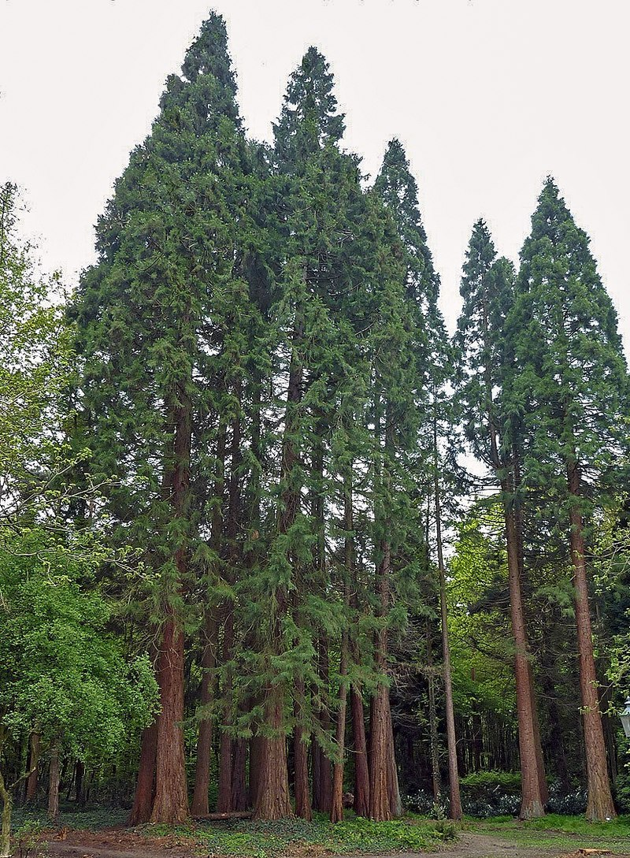
Data Stewards as Research Consultants
J.S. Love (j.s.love@tudelft.nl)
Data Steward, Industrial Design Engineering, TU Delft
ILIDE Conference, 8-9 April 2019, Jasná, Slovakia
Redwoods. Source: Wikimedia Commons
Notes:
Image source: Wikimedia Commons By Sverrir Mirdsson - Own work, CC BY-SA 3.0, https://commons.wikimedia.org/w/index.php?curid=10307889

Slide 2
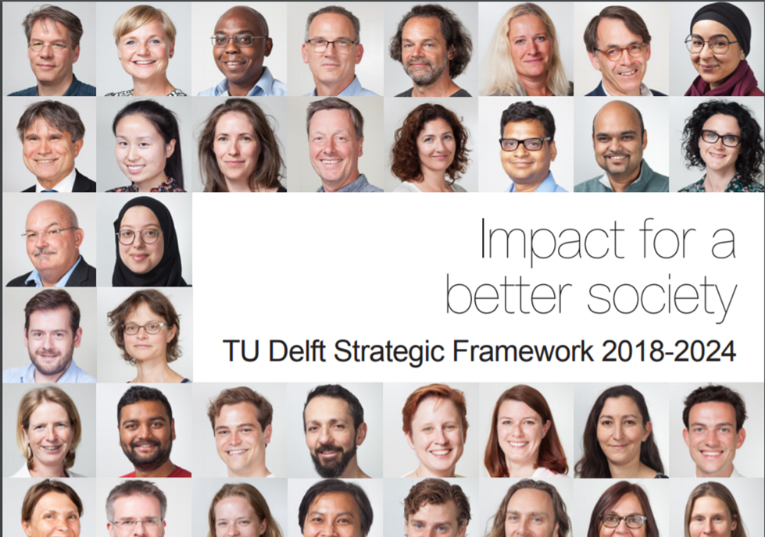
Four major principles:
Excellence, Impact, Engagement and Openness
Slide credit: Marta Teperek
https://openworking.wordpress.com/2018/02/04/tu-delft-strategic-framework-2018-2024-what-does-it-mean-for-open-science/
Notes:
Slide credit: Marta Teperek

Slide 3
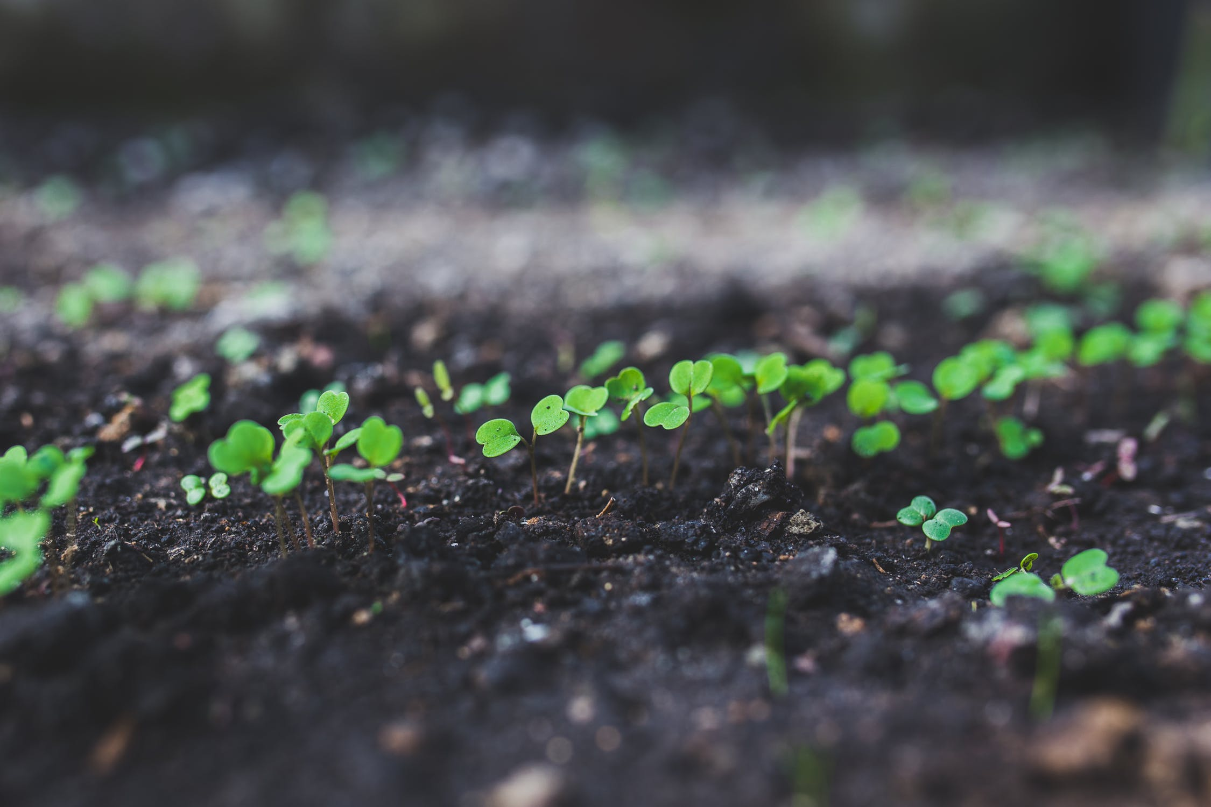
Strategic support for Data Stewardship
Central funding to kick-start Data Stewardship at TU Delft
3 years: start of 2018 - end of 2020
Slide credit: Marta Teperek
Notes:
Image credit: Marta Teperek

Slide 4
Key principles behind the project
Research is central
Data stewards are consultants, not police!
Objective: improve culture (not compliance)
Slide credit: Marta Teperek
Notes:
Slide credit: Marta Teperek

Slide 5
Coordination from the Library
Slide credit: Marta Teperek
Notes:
Image credit: Marta Teperek

Slide 6
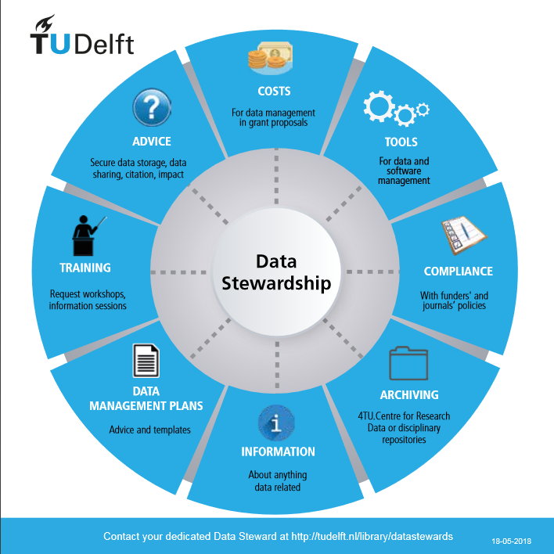
What is Data Stewardship?
Planning, Processing, Preserving
The Basics:
plans for grants (DMPs)
storage options
The Not-so-basics: research data consultants
Slide credit: Marta Teperek
Notes:
Image credit: TU Delft Data Stewards

Slide 7
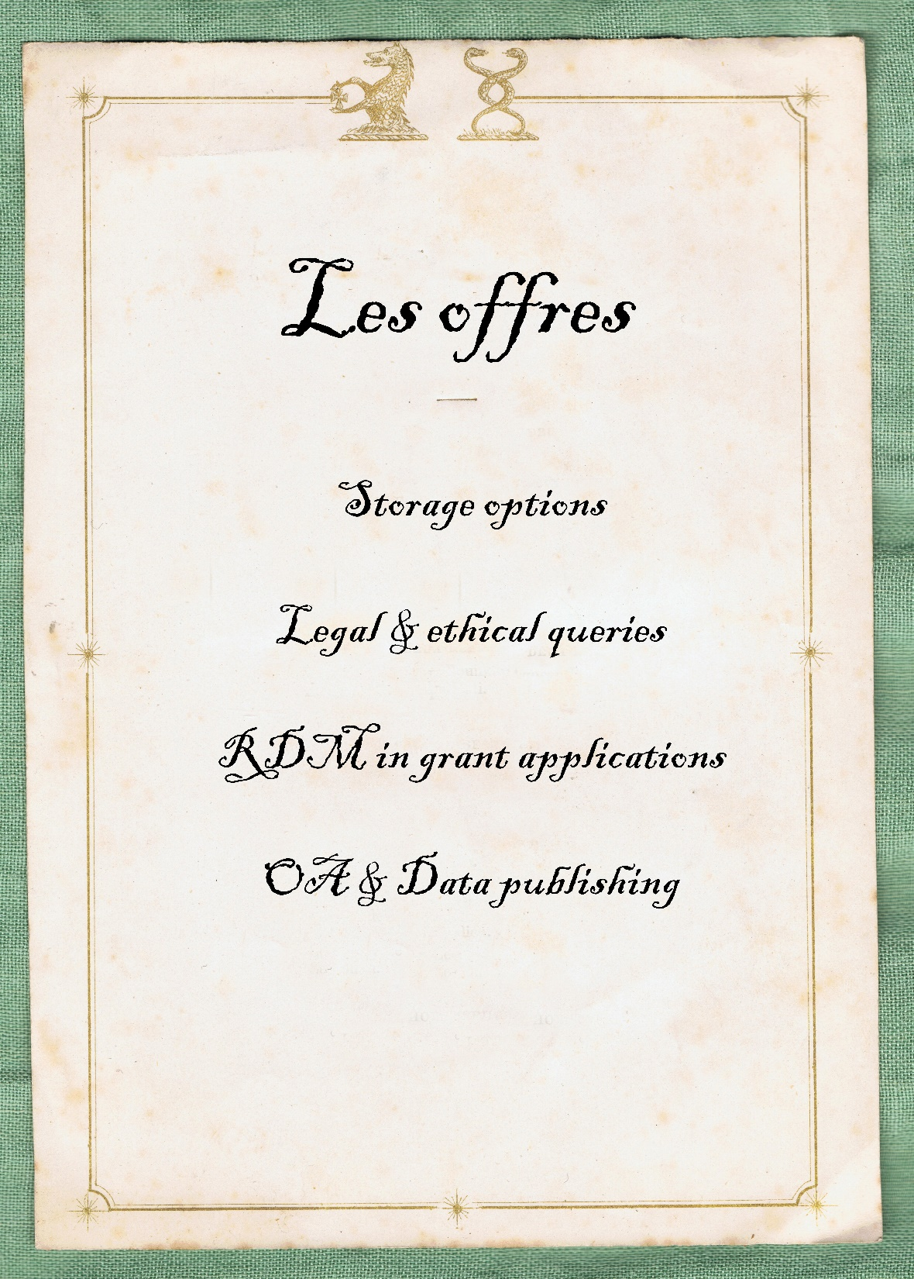
Daily Data Steward Activities
Notes:
Image source: ‘An English menu card for the household of Col. Bisse-Challoner, c. 1838-1860’, Wikimedia commons, https://en.wikipedia.org/wiki/Menu#/media/File:Menu_card_with_crests_of_T.-C._Bisse-Challoner,_mid_19th_century,_as_used_in_Mayfair_or_Surrey,_UK.jpg. (modified)

Slide 8
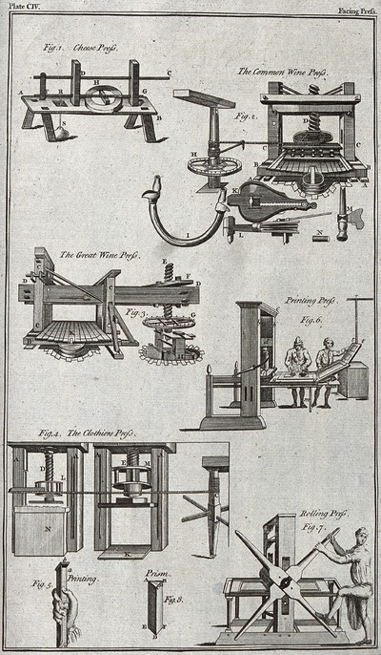
Extended Data Steward Activities
Sample cases
Design & Emotion outputs (Zenodo, Webrecorder)
DINED (new research phase)
Spatial Data Repository
'Six types of press: cheese, wine (two), printing, clothes, and rolling. Engraving.' . Credit: Wellcome Collection. CC BY
Notes:
Image source: https://wellcomecollection.org/works/qu6jvzv7

Slide 9
The Story Thus Far …
245+ queries
Electronic Lab Notebook & Software Carpentry Pilots
Qualitative Feedback (external & internal)
Upcoming: RDM Survey Redux (Summer 2019)
2018 Data Stewards’ Activity Report: https://openworking.wordpress.com/2019/01/25/data-stewardship-at-tu-delft-2018-report/
Image credit: ‘Flower and leaves of the Plumeria tree’, Wellcome Collection
Notes:
Image Source: The Wellcome Collection, https://wellcomecollection.org/works/hqbrtn5q (CC-BY)

Slide 10
Thank you
TU Delft Data Stewards’ Open Working blog: https://openworking.wordpress.com/
Data Stewards’ Zenodo Repository: https://zenodo.org/communities/datastewards/

