Slide 1
Handwritten Text Recognition and Keyword Spotting. Two powerful technologies for archives and libraries
Günter Mühlberger
University of Innsbruck,
Digitisation and Digital Preservation Group

Slide 2
Agenda
Handwritten Text Recognition – Technology
Transkribus Platform
Sharing is caring or (Open) Data and the future of Transkribus

Slide 3
Technology

Slide 5
Text recognition

Slide 6
und kluge Veranstaltung/des Käyserl.General Feld=Marschall Lieutnants
innere seyn mögte und ob die eingereichte. Druck.
יוחנן בן נורי וכי מה אכפת להם הע

Slide 7
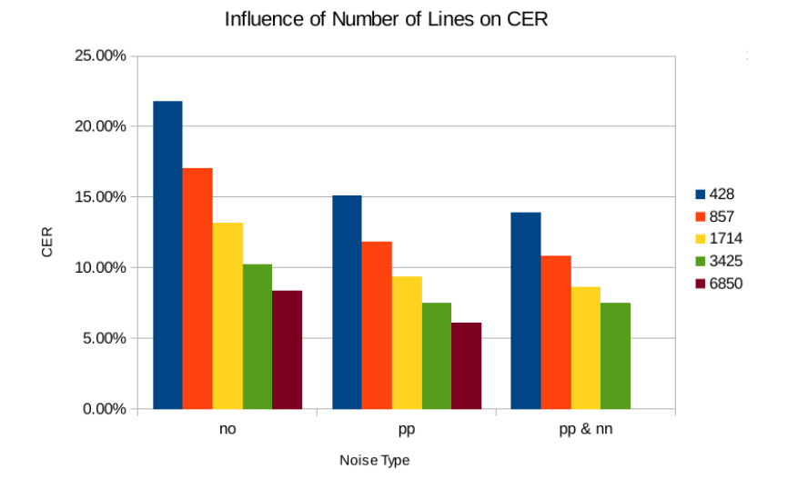
Source: Gundram Leifert (CITlab)

Slide 8
Progress in the READ project – since 2016
Dataset | SPRNN (=2016) | HTR+ (e2017) | HTR+(e2018)
StAZH | 14,48*
Bozen Ratsprotokolle | (24,39)
All figures as CER – Character Error Rate
No dictionaries
Source: CITLab team

Slide 9
Progress 2017 (not implemented)
Dataset | SPRNN 2016 | HTR+ (e2017) | HTR+(e2018)
StAZH | 14,48* | 4,45
Bozen Ratsprotokolle | (24,39) | 6,70
All figures as CER – Character Error Rate
Source: CITLab team

Slide 10
Progress end of 2018 (implemented)
Dataset | SPRNN 2016 | HTR+ (e2017) | HTR+(e2018)
StAZH 19th C. | 14,48* | 4,45 | 2,97
Bozen 17th C. | (24,39) | 6,70 | 4,89
All figures as CER – Character Error Rate
Source: CITLab team

Slide 11
Some results

Slide 12
Konzilsprotokolle - Brandshagen
Council protocols from the University of Greifswald, Germany
Late 18th century German Kurrent writing
One writer, clear writing, however not readable for ordinary German speaking people due to the fact that the writing style has changed completely
Training set: 35.743 words = 182 pages
CER on test set = 3,1% (without dictionary)
WER on test set = 13,1% (without dictionary)

Slide 14
For this page: CER = 2,2% / WER = 10,3% (with dictionary)

Slide 15
Medieval writing
Cooperation with Dominique Stutzmann and CNRS (Institut de recherche et d'histoire des textes) Paris
Data were created as part of the HIMANIS project
Can be searched with Keyword Spotting at HIMANIS
Many different hands, similar style
French and Latin
Training set of 550.381 words or 1197 pages
CER on test set = 6,4%
WER on test set = 22,1%

Slide 19
For this page: CER = 6,02 / WER = 19,6 (without dictionary)

Slide 20
Printed text - newspapers
Wiener Diarium – in cooperation with Austrian Academy of Science
Newspaper from 18th century
Bitonal scans with partly challenging quality
Training set: 179.997 words or 345 pages
CER on test set = 0,81
WER on test set = 3,02

Slide 23
For this page: CER = 0,6 / WER = 3,0% (without dictionary)

Slide 24
Conclusion
Layout Analysis and Automated Text Recognition for historical documents can be done with excellent results for printed books and good or very good results for handwritten documents!

Slide 25
Keyword Spotting

Slide 26
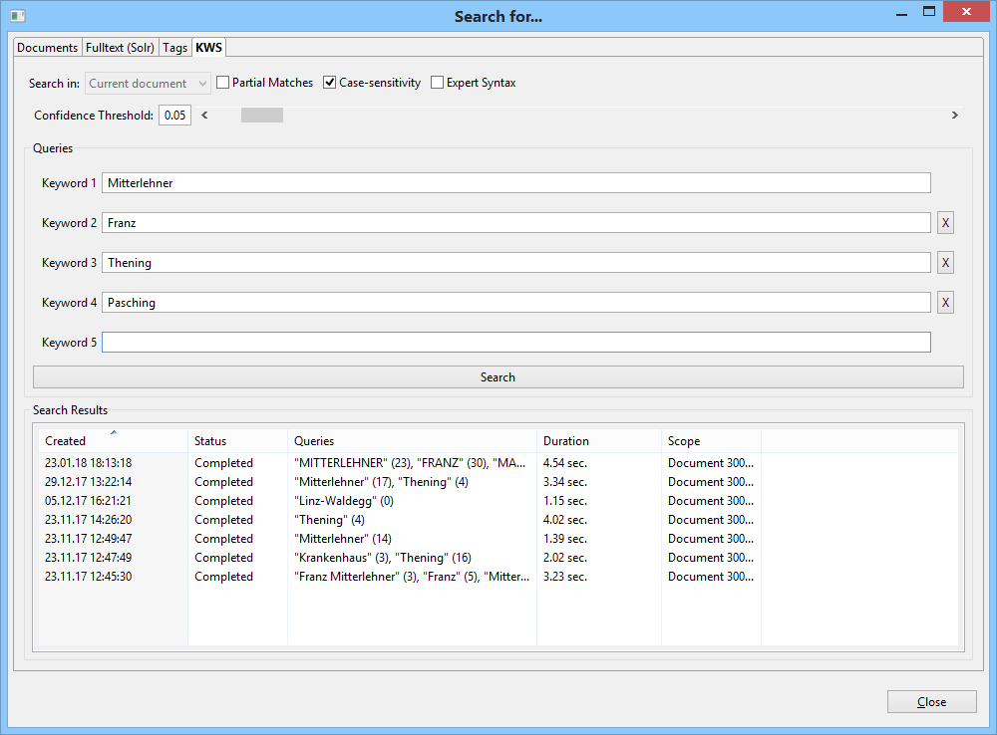

Slide 28
Mitterlehner – Moiveshekner (CER=58%)

Slide 33
Transkribus – expert client

Slide 41
Transkribus - platform

Slide 42
Transkribus User Conferences – 2017 + 2018

Slide 44
Last week…
Images Uploaded by users: 77382
New Users : 397
Active Users / Unique Logins : 948
Created Documents: 863
Exported Documents: 233
Layout Analysis Jobs: 2049
HTR Jobs : 1021

Slide 45
Training data
January 2019
228 HTR Models trained by Transkribus users
Overall training data in Transkribus (February 2019)
Pages: 204.359
Words Wörter: 21.200.035
About 120 person years producing this amount
About 2-3 Mill. EUR value

Slide 46
Sharing is caring

Slide 47
Software…
…will come and go, data will remain!

Slide 48
The real value of Transkribus are the data and the community which produces this data (for their own purpose).

Slide 49
Transkribus future
Projects ends on 30th June 2019
However, there is a strong demand for Transkribus services so that maintenance of the platform is already safeguarded until 2021
EU Project NewsEye (2018-2021)
German Science Funds project (2019-2020)
Project with National Archive Finland (2019)
Project with National Archive Netherlands (2019-2020)
National project with cadastre documents from Tyrol (2019-2020)
Project with Trinity College Dublin (2019-2021)
Project with State Archive Zurich (2019-2020)
More to come and under negotiation!

Slide 50
European Cooperative Society (SCE)
Cooperative
Enables independent entities (institutions, organisations, companies) to collaborate and to set up a common business
Ownership and sharing of data is in the heart of the SCE
Main features of an SCE
Open to new members: low barrier: 1000 EUR share as a minimum
Democratic constitution: Board of directors – General meeting
No shareholder value
Direct benefit of members is the main goal
Customers become owners, owners become customers
Subscription fees for using Transkribus – page based fees for HTR services

Slide 51
Current state of affairs
Statutes
Pre-final
Board of directors will be formed in the next weeks
Founding act shall take place before summer holidays
Founding members
University Innsbruck, University Greifswald, Technical University Valencia, National Archive Finland, British Library, University Library Belgrade, Diocesan Archive Passau, University Rostock, ZAMG Vienna, Geneanet France, etc..
Everyone invited to join!
Business
Official start of business on 1st of July (keep fingers crossed!)
Most founding members committed to run medium or large scale projects with Transkribus
Financing of the platform is already safeguarded until e2020

Slide 52
Thank you for your attention!
Further information
https://read.transkribus.eu/
https://transkribus.eu/
https://read.transkribus.eu/coop/
This project has received funding from the European Union’s
Horizon 2020 research and innovation programme under
grant agreement No 674943.

Slide 53
http://scantent.eu/

