Slide 1
Enabling FAIR – landscape and next steps
Fiona Murphy, Murphy Mitchell Consulting Ltd
: 0000-0003-1693-1240
ILIDE, Jasná, 9 April 2019
DOI: 10.5281/zenodo.2633607
Notes:
Introduce myself. Thank you for the opportunity,

Slide 2
Article in Nature journal Scientific Data: Wilkinson, M. D. et al. The FAIR Guiding Principles for scientific data management and stewardship. Sci. Data 3:160018 doi: 10.1038/sdata.2016.18 (2016).

Slide 3
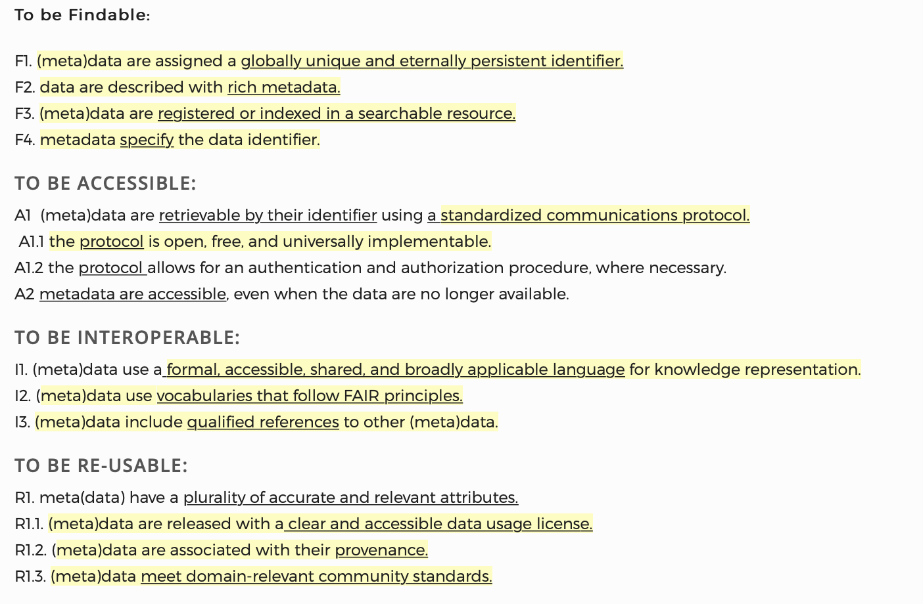

Slide 4
European commission
PUBLISHERS

Slide 5
Aligning and Operationalising
In what direction(s) does the aligning take place – and at what pace?
To what [outputs, actions, processes] does FAIR apply?
How to manage internally within one’s own institution/domain?
How to work with others, e.g. Research Data Alliance, GOFAIR?
What resources are required?

Slide 6
European commission
PUBLISHERS

Slide 7
FSCI2019: FORCE11 Scholarly Communications Institute
Registration, sponsorship, travel scholarships open for August 2019!

Slide 8
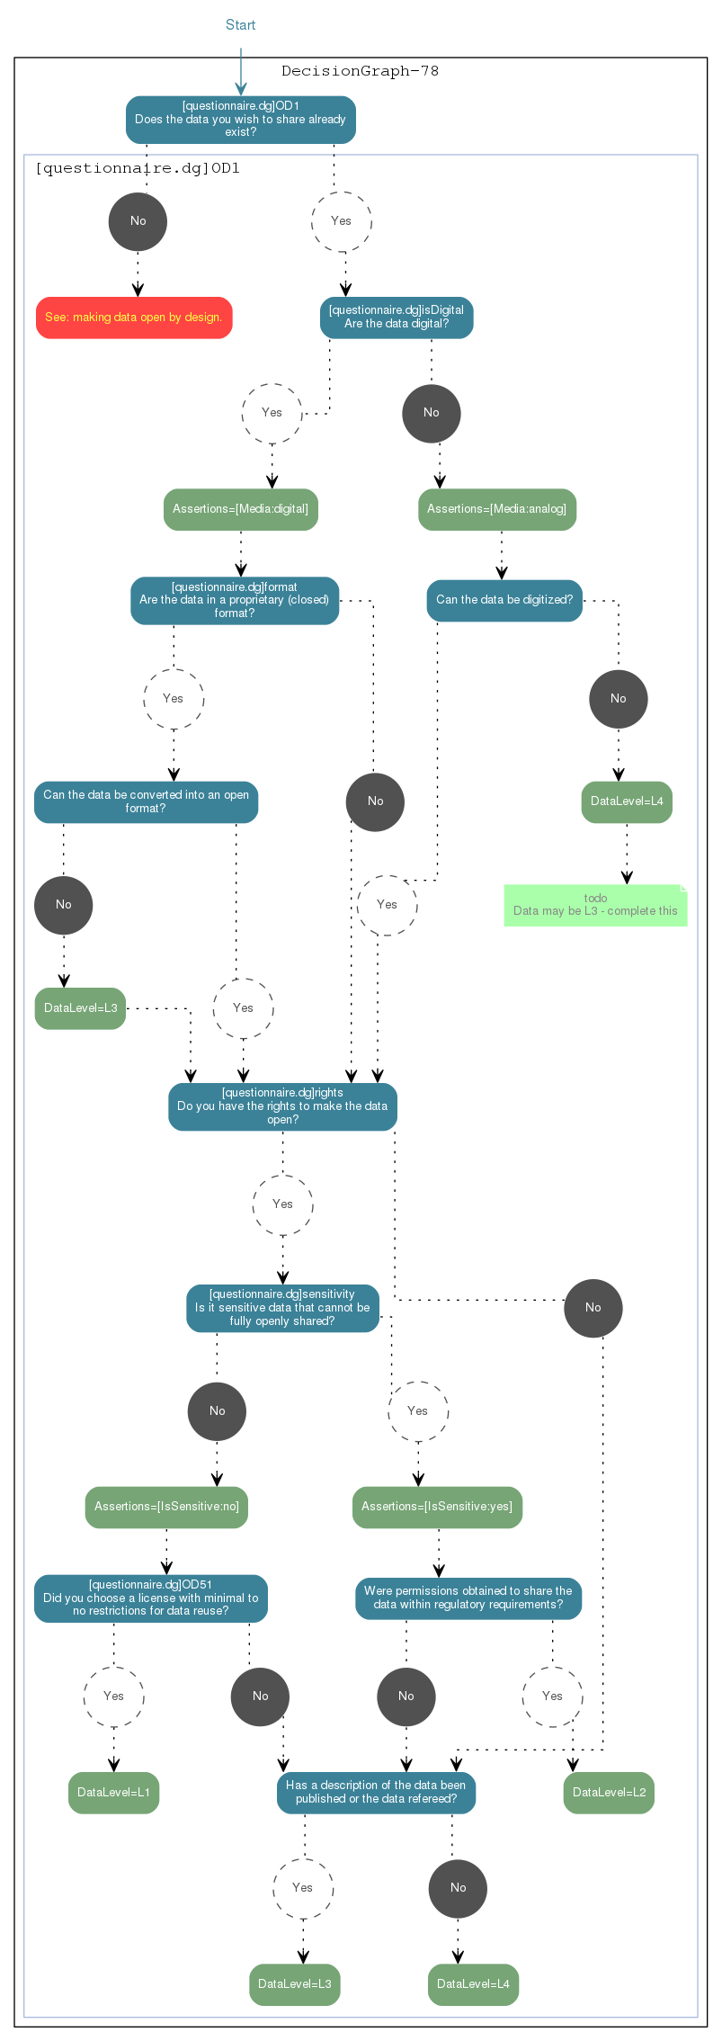
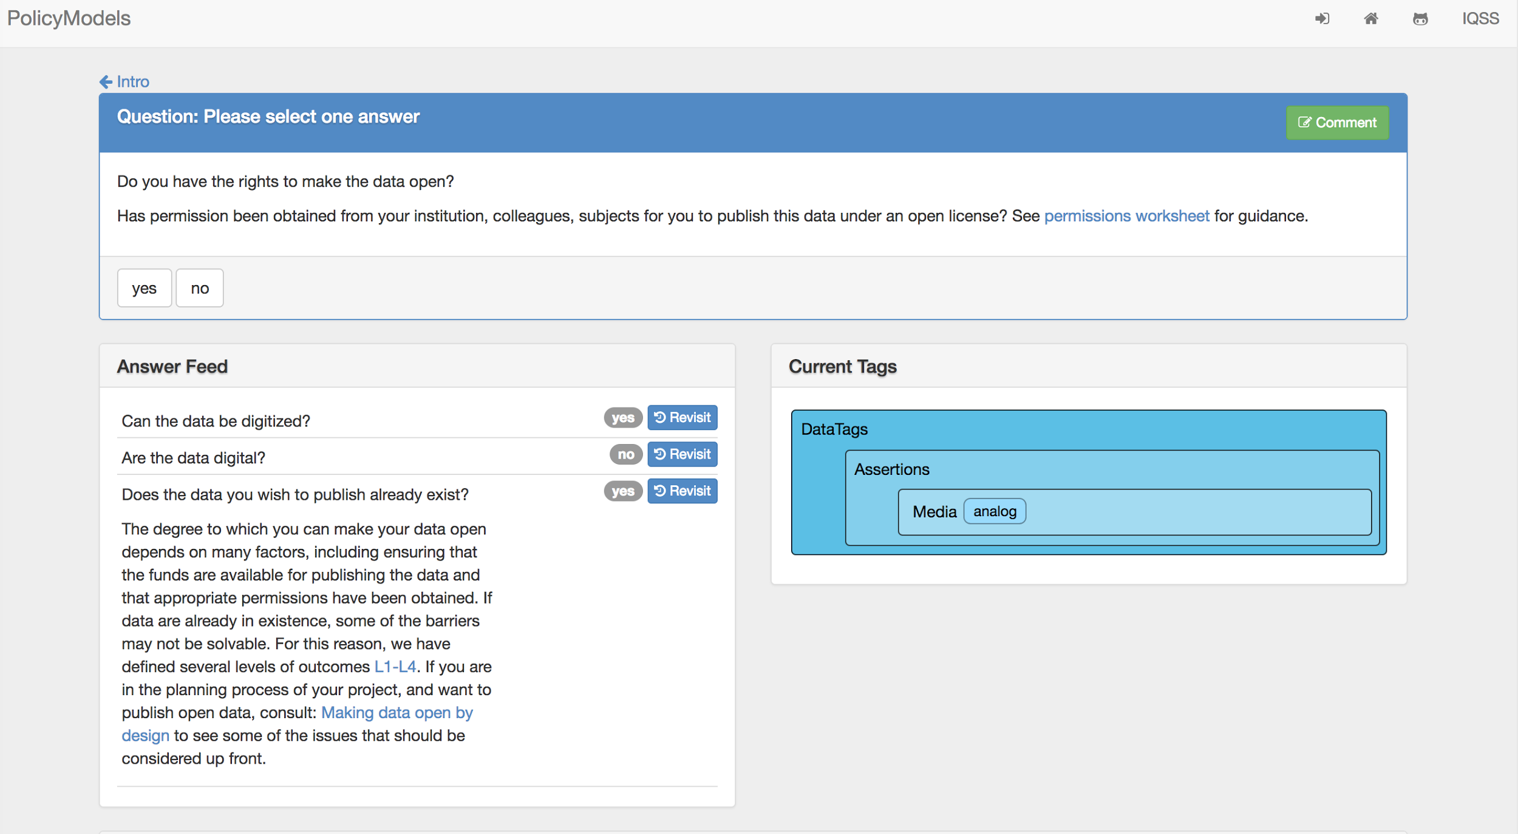
Decision Trees
Notes:
Work open fair and citable way. Produce open fair and citable outputs

Slide 9
Domain metadata
Standards
Repository recommendations
Community protocols
Persistent identifiers
Reach back into the workflow

Slide 10
References
Belmont Forum Data Publishing Policy Project: https://doi.org/10.5281/zenodo.1476871
FAIRsharing as a community approach to standards, repositories and policies: https://doi.org/10.1038/s41587-019-0080-8
DANS FAIR Data Assessment Tool (prototype): https://www.surveymonkey.com/r/fairdat
Enabling FAIR Data Commitment Statement, Roadmap and FAQS: http://www.copdess.org/enabling-fair-data-project/ (see also ‘Enabling FAIR Data’ Zenodo community)
RDA FAIR Data Maturity Model Working Group: https://www.rd-alliance.org/groups/fair-data-maturity-model-wg

Slide 11
Thank you!
@DrFionalm
fiona@murphymitchellconsulting.com
0000-0003-1693-1240
DOI: 10.5281/zenodo.2633607

