Slide 1
Power to the People? Committing the Scholarly Community to the Development of Open Science in Finland
ILIDE Conference, Jasná, Slovakia, 9.4.2019
Pekka Olsbo, University of Oulu

Slide 2
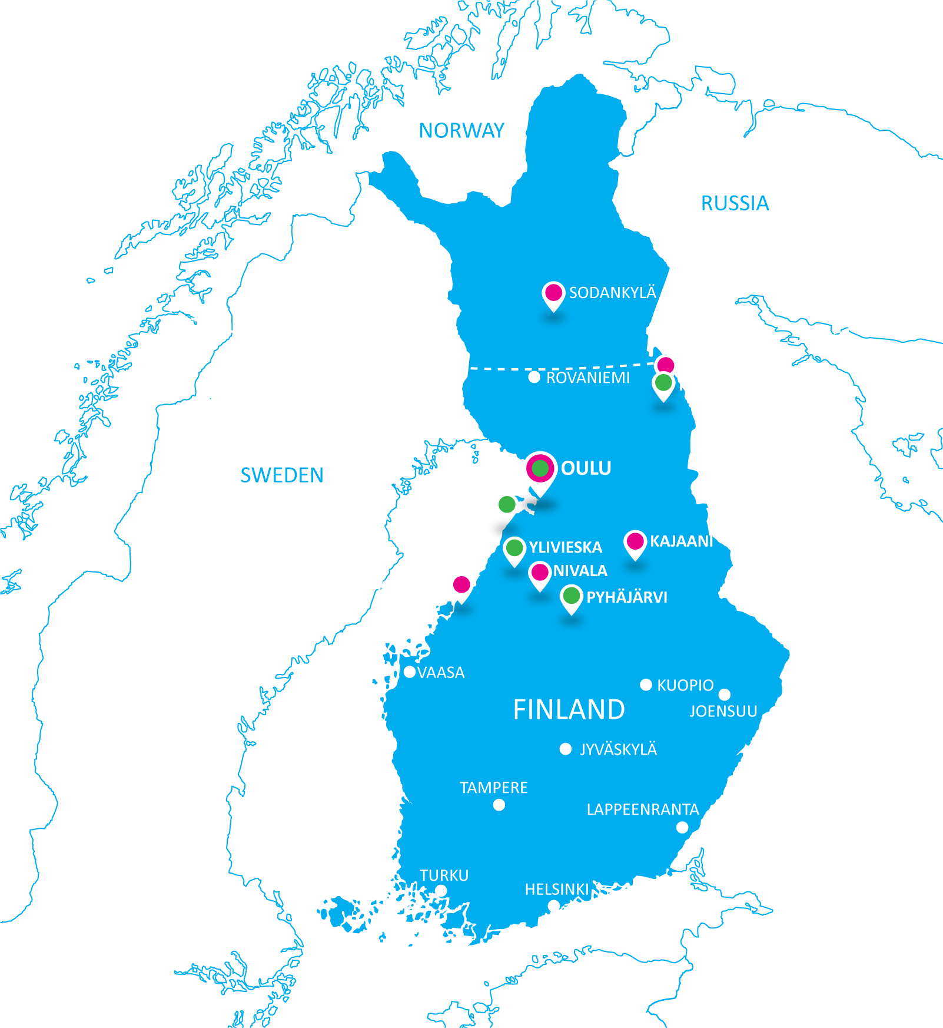
University of Oulu
Linnanmaa campus, Oulu
Kontinkangas campus, Oulu
Sodankylä Geophysical Observatory
Oulanka Research Station, Kuusamo
Kajaani University Consortium
Kokkola University Consortium
Kerttu Saalasti Institute, Nivala
Summer University of Northern Ostrobothnia
Oulu, Kuusamo, Pyhäjärvi, Raahe, Ylivieska

Slide 3
Contents of this presentation
The short story of Finnish Open Science so far
The new Action Programme for the Finnish Scholarly Community by the UNIFI: the Finnish universities’ council of rectors
The Federation of Finnish Learned Societies as a coordinator
The creation of National Open Access Strategy

Slide 4
The short story of Finnish Open Science
Open Science and Research Initiative (2014-2017):
Open science and research leads to surprising discoveries and creative insights: Open science and research roadmap 2014–2017. http://urn.fi/URN:ISBN:978-952-263-319-4
The Open Science and Research Handbook
https://www.openscience.fi/sites/avointiede.fi/files/openscience%20handbook.pdf
Impact of the Finnish Open Science and Research Initiative
http://urn.fi/URN:NBN:fi-fe2016112229504
Evaluation of Openness in the Activities of Research Institutions and Research Funding Organisations in 2017
http://urn.fi/URN:NBN:fi-fe2017111350612
New funding model for universities: https://minedu.fi/en/steering-financing-and-agreements
1,2 Coefficient for open publications

Slide 5
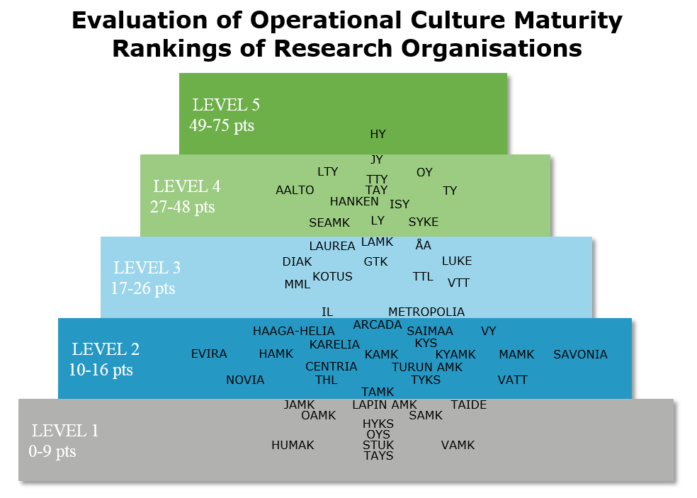
2016

Slide 6
The new Action Programme for the Finnish Scholarly Community by the UNIFI: the Finnish universities’ council of rectors
In summer 2017, UNIFI: the Finnish universities’ council of rectors, set up a working group to consider solutions for research data management at different stages of the research lifecycle. It was decided to produce an Open Science and data operational programme for the entire scholarly community.

Slide 7
MEASURES
1
An Open Science coordination
Body will be established
The permanent coordinating body will
promote interoperability between national solutions and will make
it more agile in dealing with emerging
challenges.

Slide 8
MEASURES
2
Funding Open Science
The transformation of an Open Science culture is not just a change of attitudes.
Open Science requires direct financial
investments in services, infrastructure and staff.

Slide 9
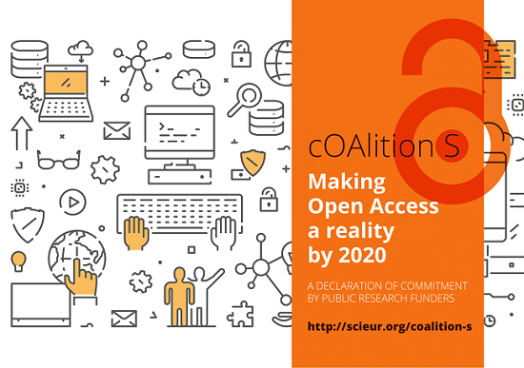
MEASURES
3
Producing a national open
Publication policy
The national open publication policy takes a position on issues such as embargoes, self-archiving, hybrid publications and different types of cost models.
Academy of Finland joins cOAlition S

Slide 10
MEASURES
4
Commitment to DORA and recognition of transparency as a merit for the research career
The DORA declaration, published in 2012, calls for the release of platform-based indicators and instead focus on content in the evaluation of research and researchers. International work on the development of transparency indicators is still ongoing. The most promising models should be piloted at a national level when employing staff and allocating research funding.

Slide 11
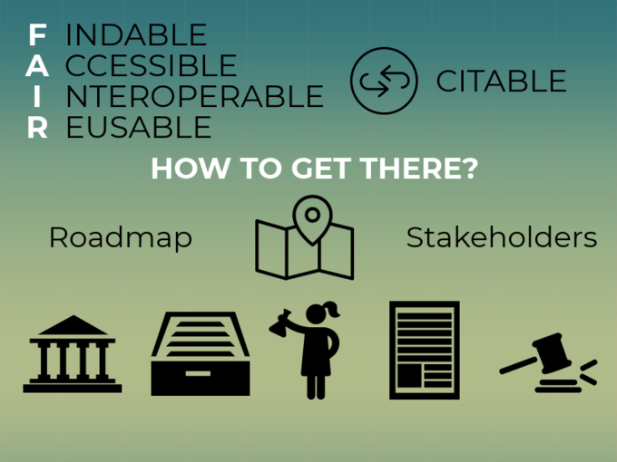
MEASURES
5
Implementing a data reference road
The National Committee for Data published a Finnish data citation road map in spring 2018.
Referring to the research data promotes the implementation of the FAIR principles and encourages researchers to manage the
data responsibly.
This work by Heidi Laine is licensed under a Creative Commons Attribution 4.0 International License.

Slide 12
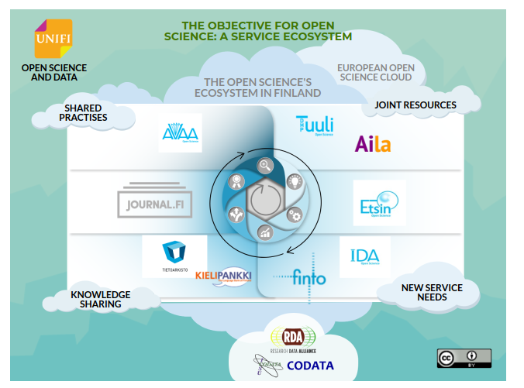
MEASURES
6
Ensuring that the research services produced are needed.
The dialogue and cooperation between the CSC and research organisations and researchers will ensure that nationally produced services meet the needs of research.

Slide 13
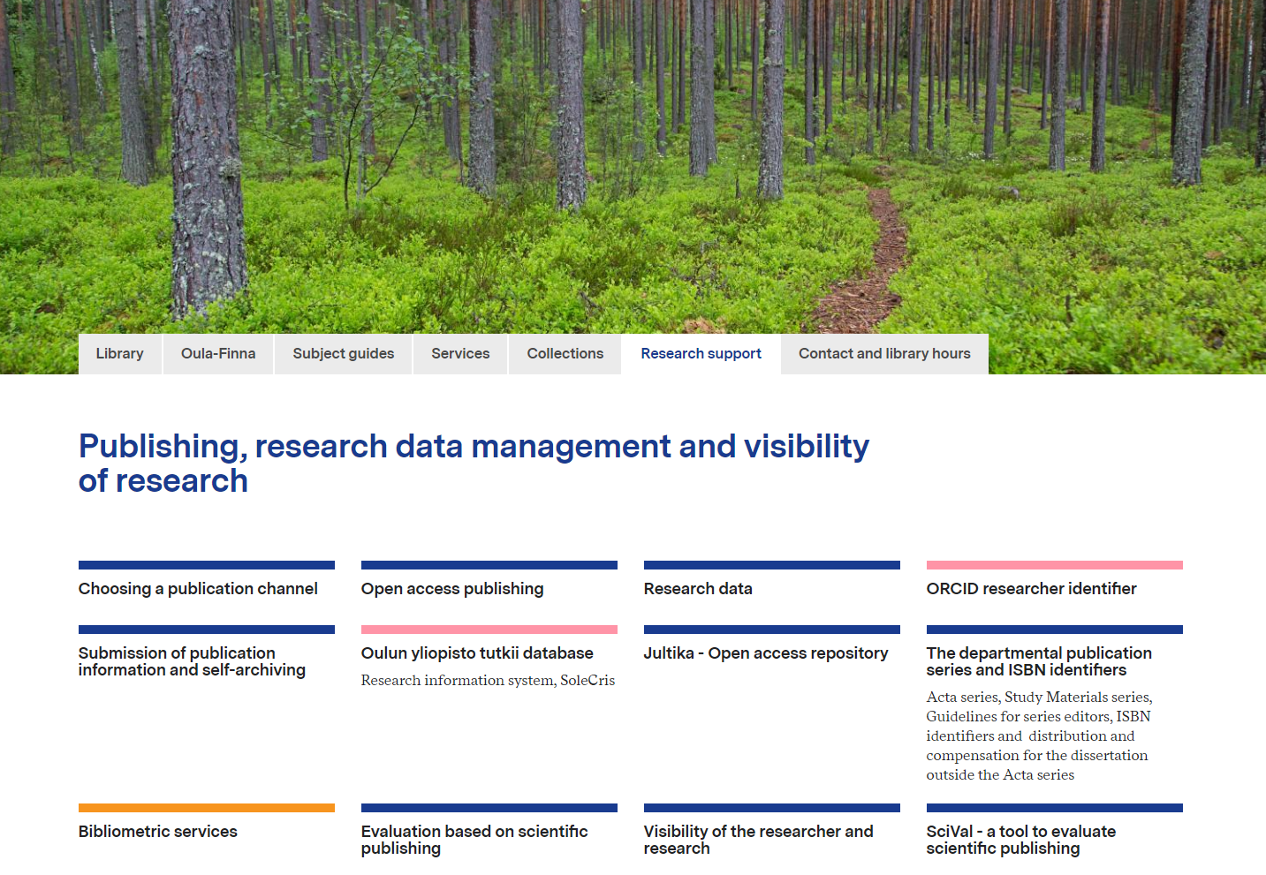
MEASURES
7
Providing research services on a one-stop-shop basis
The researcher does not need to
know whether his or her service
is produced by a university, CSC
or a commercial supplier. The
local support services act as a
gateway between the researcher
and the service provider.

Slide 14
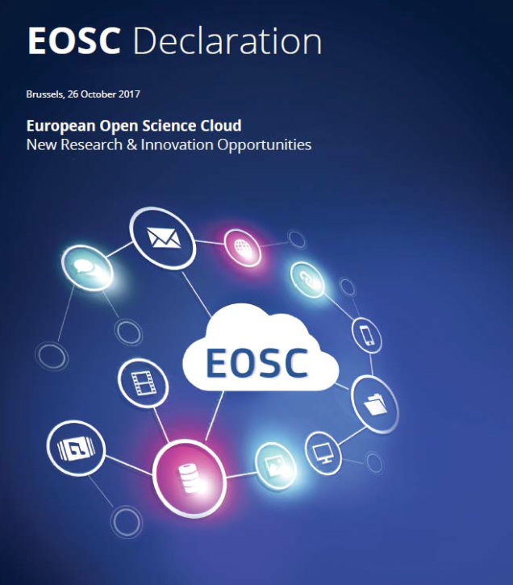
MEASURES
8
Commitment to the European
Open Science Cloud Declaration
Finnish research organisations will
sign the EOSC declaration and
undertake one of the measures
outlined therein.

Slide 15
Open Science coordination

Slide 16
Preparation and discussions with the whole scholarly community
Participating organisations
UNIFI
Arene
TULAnet
Academy of Finland
National Library
FSD
National Archive
CSC
Open Knowledge Finland
FUN – The network of Finnish University Libraries
Ministry of Education and Culture

Slide 17
Incentives and merits
Model for the Coordination
Indicators and metrics
Citizen science
Decisions
Scholarly Community
Open Data
Open Education
Open Access
National publications
Data policy of journals
FAIRDATA
New Publishing platforms
EOSC
Internetional aggreements
Peer Review
Data citation
Led by
Lifelong learning
Open educational platforms
Science education

Slide 18
More than 200 people involved with working groups
Strategy Group
Expert Group Scholarly Community
Expert Group Open Data
Expert Group Open Education
Expert Group Open Access

Slide 19
National Open Access strategy

Slide 20
National Open Access Strategy is produced by the Strategy Group
Strategic principles:
Turn to a fully open publishing model should not increase the costs of publishing.
The costs of open publishing are fully transparent for everyone.
Open publications should fulfill high quality requirements of scientific publishing.
Fulfilling the goals of immediate openness are respected when evaluating researchers.

Slide 21
National Open Access Strategy is produced by the Strategy Group
Strategic goals:
By 2022 all new scientific publications will be immediately open.
By 2022 all scientific publications include open license, like CC-BY
Research organisations and funders will create a common model for creating new open publications platforms and turning existing ones open.
Scientific community will create a common publishing and funding model for national open publishing.

Slide 22
National Open Access Strategy
Open for comments for the public.
Open preparation of the action plan.
Strategy Group will finalize the strategy after comments in October 2019.
Will be published during Open Science seminar in November 2019.

Slide 23
Conclusion?
Is all this worth the trouble?

Slide 24
Is it worth working for national strategy, when Plan S, and EU sets us the principles and goals? Yes it is, because we need actions in order to reach the goals! But…
Most of the visions (so far) in the strategy were already introduced in the report of previous open access working group already in 2015: http://urn.fi/URN:NBN:fi-fe2016122731713 (only in Finnish)
Is the whole research community really committed, when majority of members in working groups still come from libraries?

Slide 25
… and after all, we´ve done pretty good job during the last years..

Slide 26
Thank You! Questions and comments: pekka.olsbo@oulu.fi + 358 50 433 8697

