Slide 1
Funding Trends,
Research Policy & Innovation
How new types of data change the way we look at science
(Arctic science)
Igor Osipov, PhD
Chair, UArctic Institute for Science Analytics
Professor, Far Eastern Federal University
www.uarctic.org
Vice-President, Academic & Government
Digital Science (UK)
www.digital-science.com

Slide 2
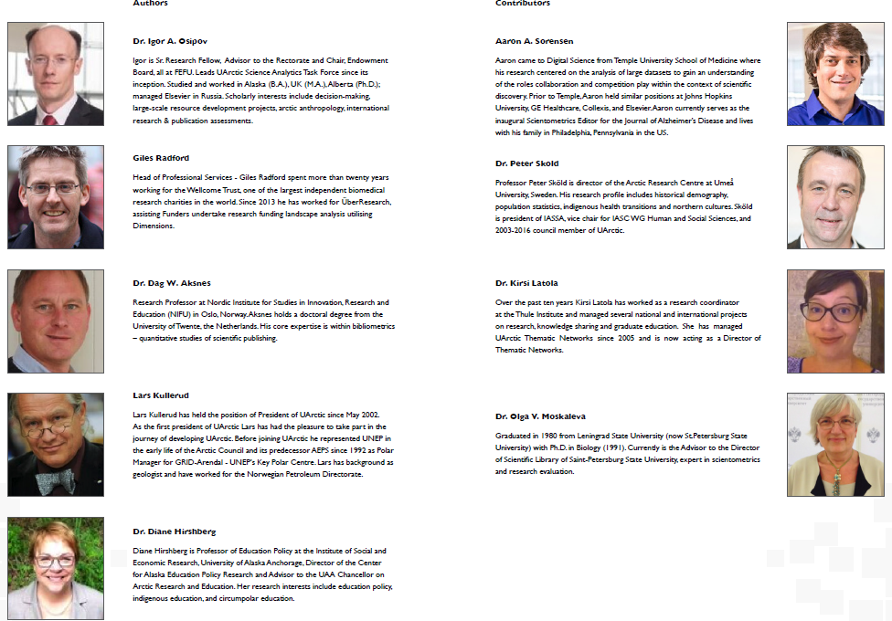
An Academic Journey: 2015-2017
Dr. Igor Osipov, Task force Chair, Research Fellow, FEFU
Dr. Dag W. Aksnes, Research Professor, Nordic Institute for Studies in Innovation, Research and Education (NIFU)
Dr. Diane Hirshberg Professor, UAA
Dr. Olga Moskaleva, Professor, St. Petersburg State University (SPBSU)
Dr. Lars Kullerud, President of University of Arctic (UiT / UArctic)
Dr. Peter Skiold, Professor, University of Umeä (ARCUS)
Dr. David Carlson, Director, World Climate Research Program (UN).
Dr. David Hik, Professor, University of Alberta (U of A)
Dr. Susan Henrichs, Provost and Vice Chancellor, UAF

Slide 3
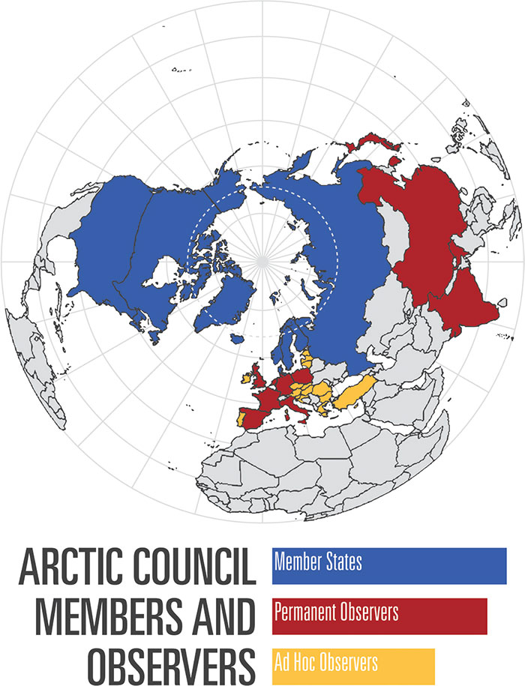
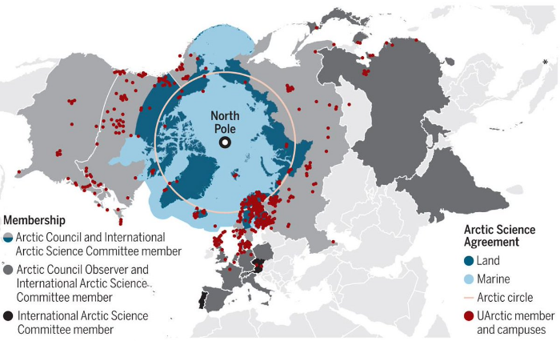
What’s University of the Arctic?

Slide 4
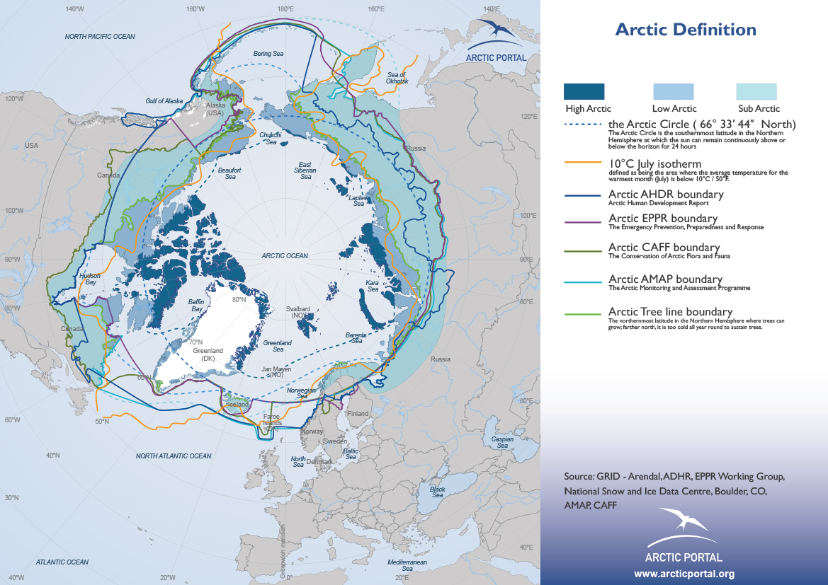

Slide 5







Established Project Partnerships

Slide 6
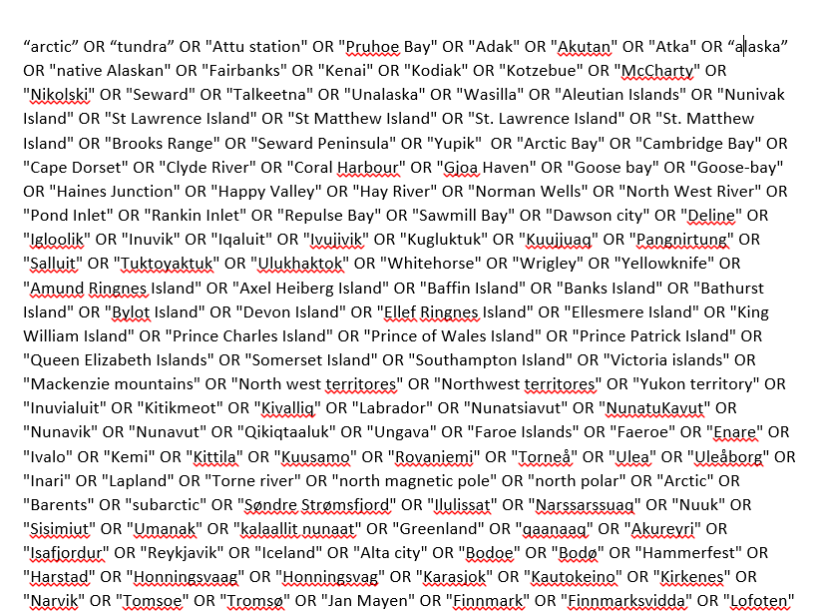
Actual Project Task: Arctic Research Category (teaching and fighting the machine)

Slide 7
Actual Project Task: Research Category (teaching the machine)
Grants
Indexed Pubs
RINC pubs
Altmetric Mentions

Slide 8
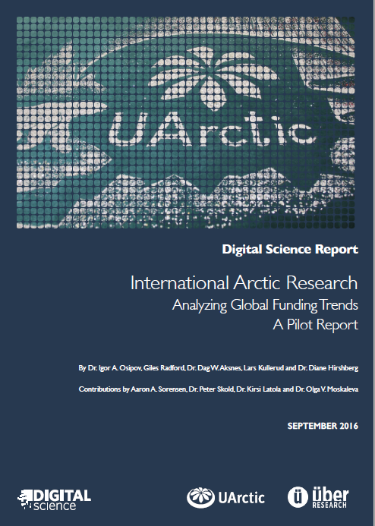

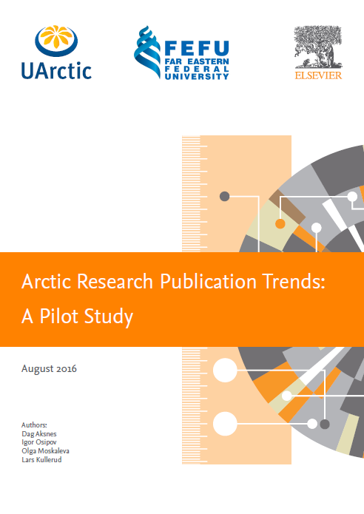
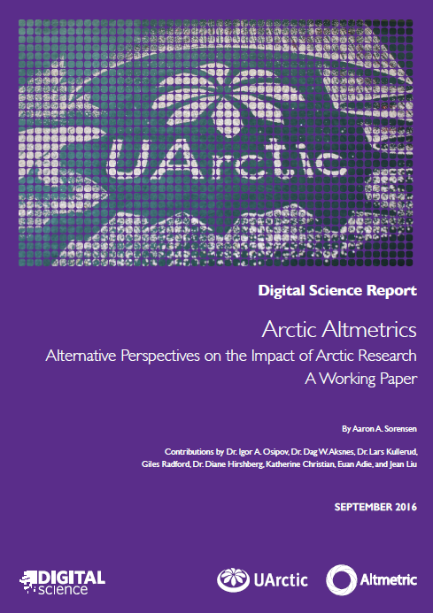
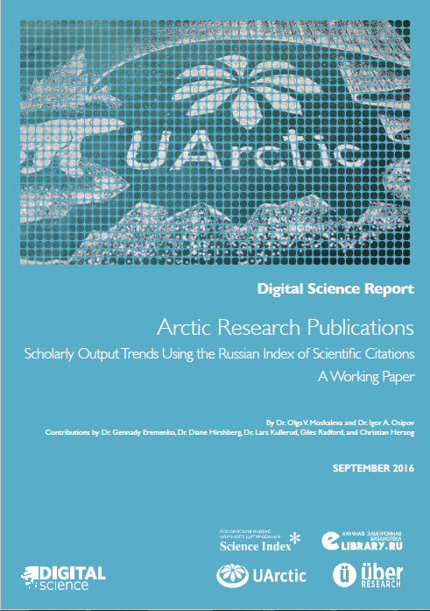
Institute Pilot Results (2015-2017 – 18 months)
International Arctic Research: Analyzing Global Funding Trends (2016 - 2017)
Arctic Research Publication Trends
Arctic Altmetrics – Alternative Perspectives on the Impact of Arctic Research
Arctic Research Publications: Russian Science Citations Index

Slide 9
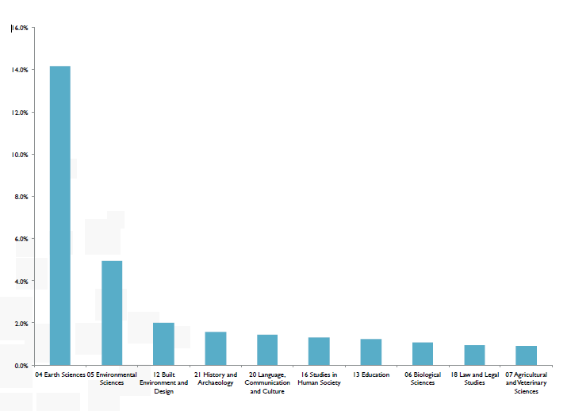
Some outcomes (FoR Analysis)

Slide 10
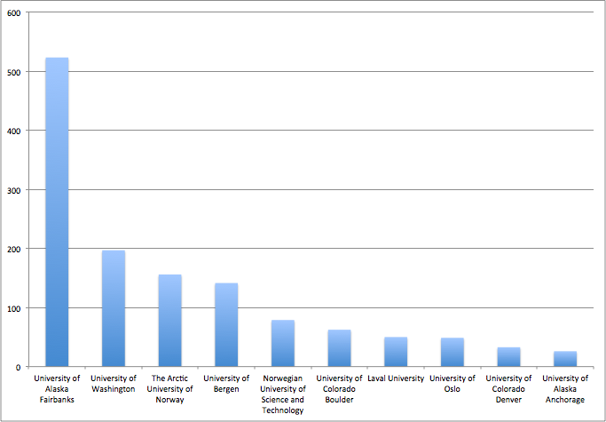
Some outcomes (Top funded organizations)

Slide 11
Output of Arctic Category in Scopus (top 6 fields)

Slide 12
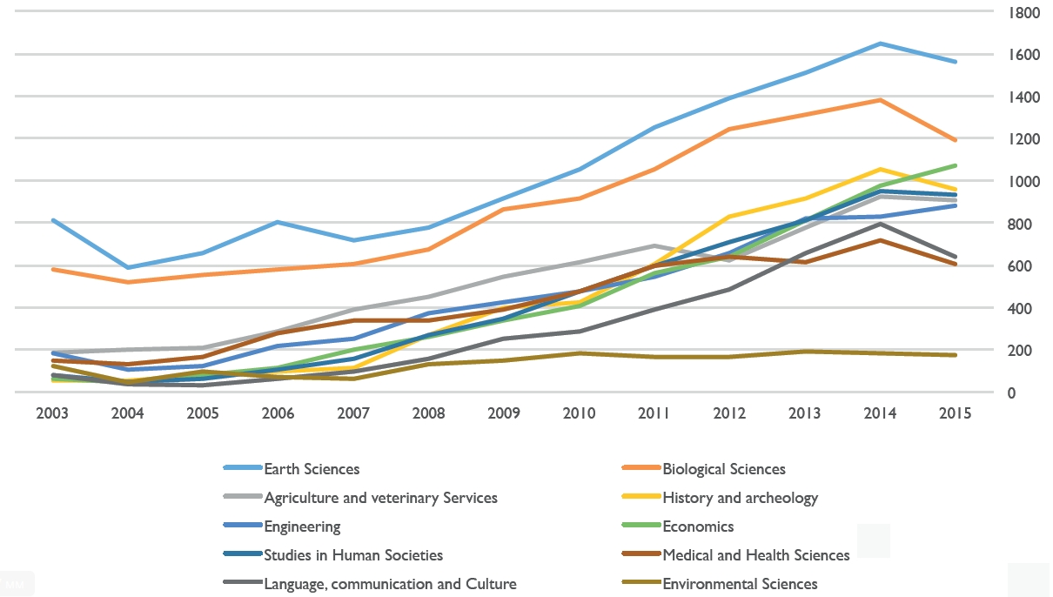
Output of Arctic Category in RUS Science Index

Slide 14
Then we were asked to help build
DIMENSIONS https://app.dimensions.ai

Slide 15
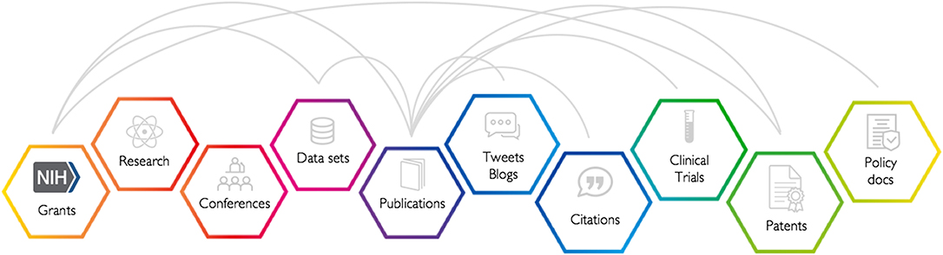
Reasons we agreed were simple:

Slide 16
Actual Project Task: Research Category (teaching the machine)
SEARCH TASK / KEYWORDS
Grants
(4.3 mln)
Indexed Pubs
(97 mln.) incl Open
Patents (38 mln.)
Clinical Trials
(0.4 mln)
Policy Documents
(0.4 mln)
Organizational Profiling
Altmetric (Social Attention)
Repository Matls. References (Figshare)
Researcher Profiling

Slide 17
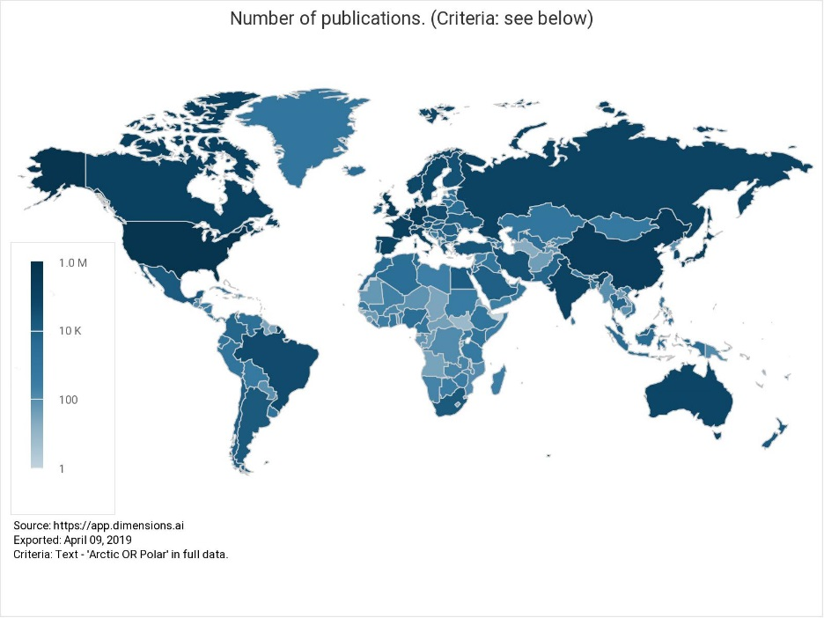
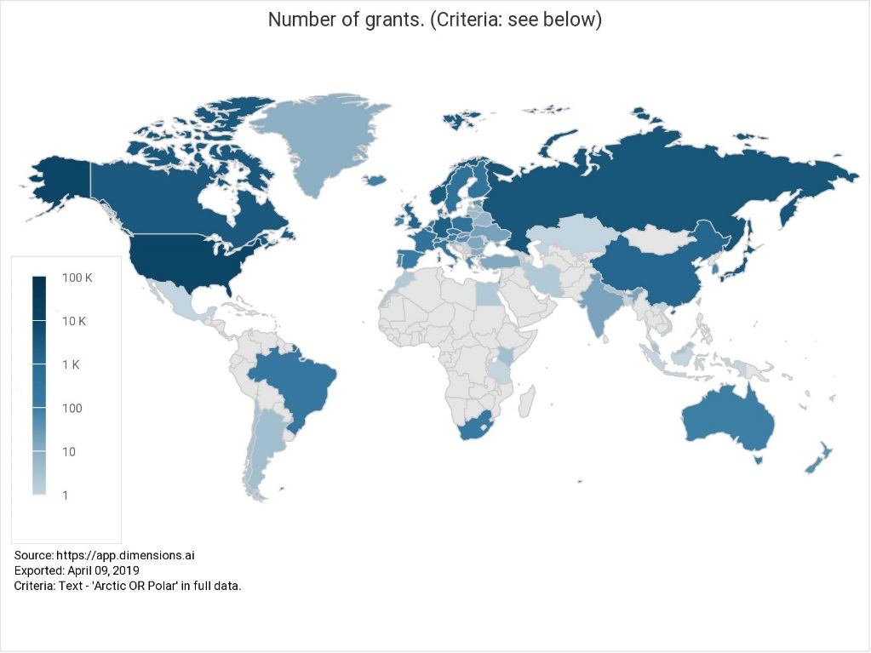
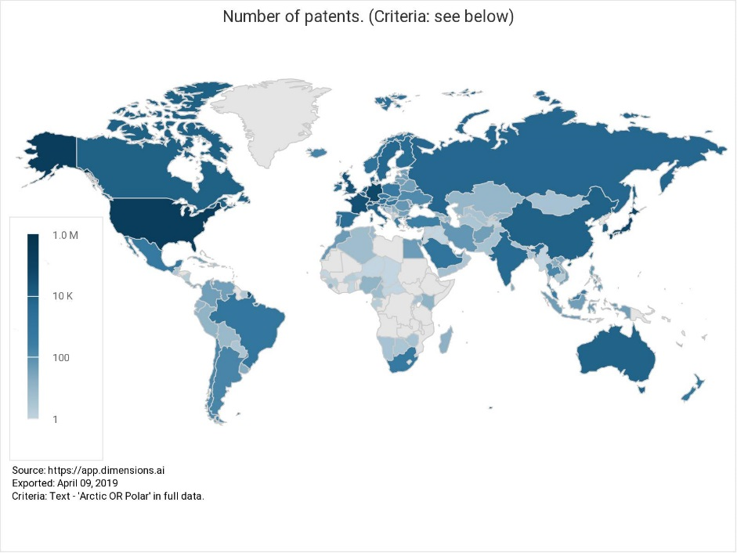
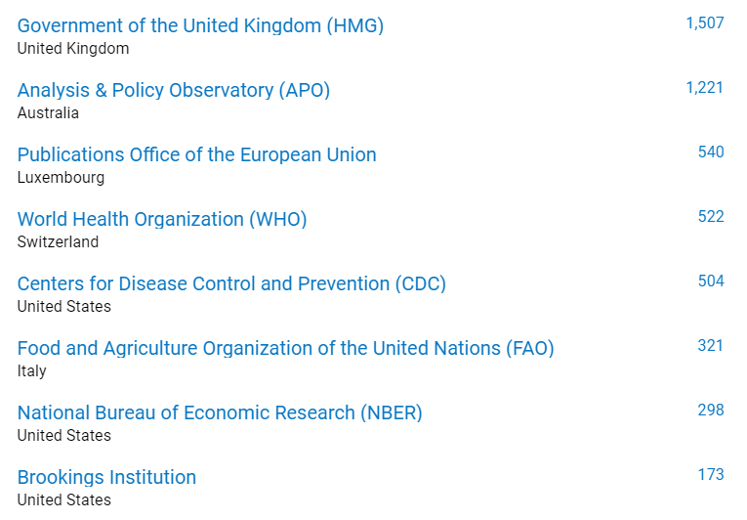
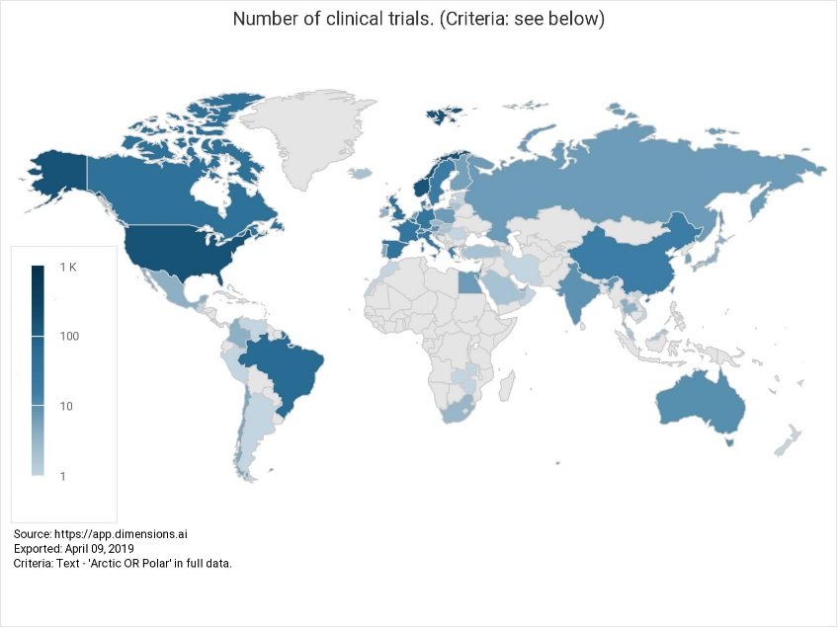
Why it changed they way we look at science:

Slide 18
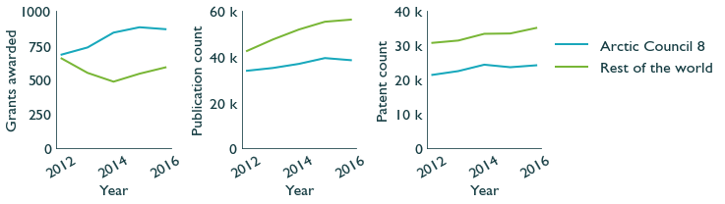
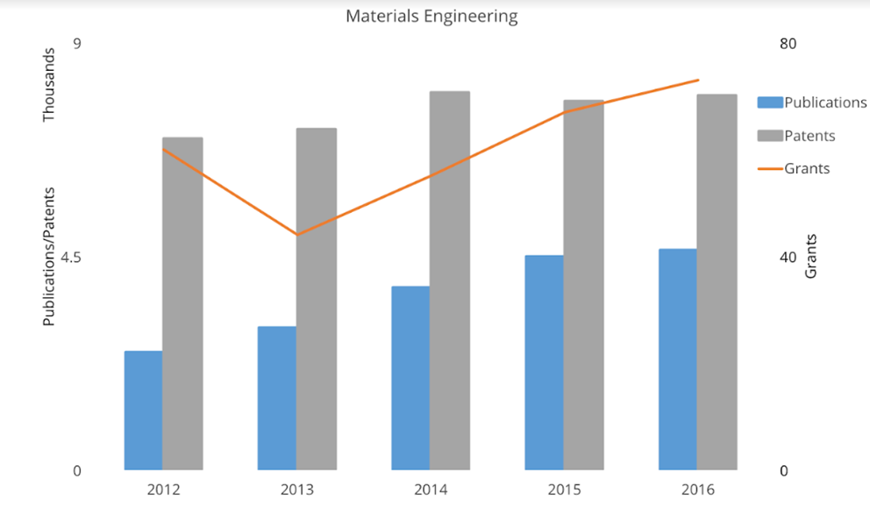
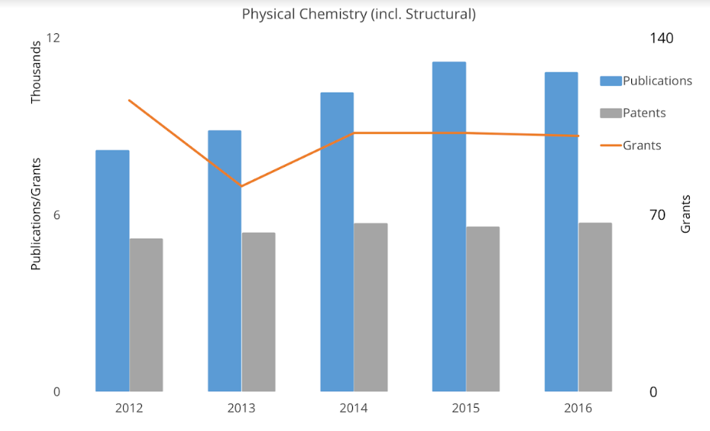
Trends, innovation, collaboration and policy

Slide 19
Shaping Research Strategy Example: Aramids

Slide 20
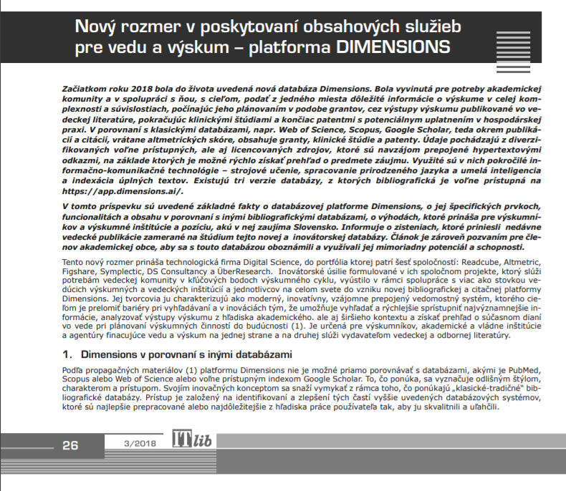
Slovakia Engagement

Slide 21
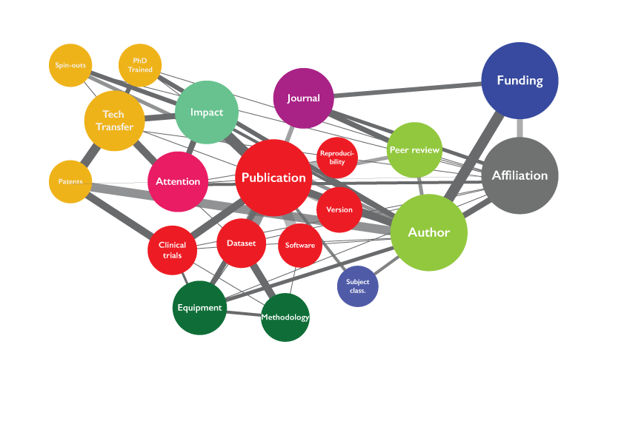
New Paradigm: Data and Platforms

Slide 23
THANK YOU! QUESTIONS?
Igor Osipov, PhD
i.osipov@digital-science.com
Direct: +44 774 185 3233

