Slide 1
Web of Science developments
Guillaume Rivalle
Manager Consultants, Europe
Guillaume.rivalle@Clarivate.com
April 2019

Slide 2
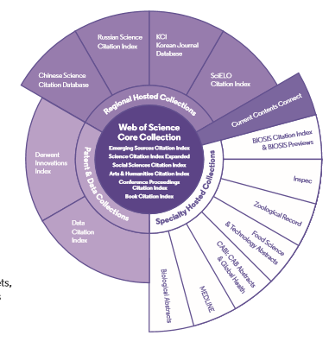
What powers the Web of Science Group?
Comprehensive content
254
1.6 Billion
Subject categories
Cited references
34,200+
11.2 Million
Total journals across the full platform
Records with funding data
21,000
80 Million
Total journals in select Web of Science Core Collection
Patents for over 40 million inventions
155 Million
Archives to 1900
Record – patents, data sets, articles, and proceedings
With cover-to-cover indexing

Slide 3
Our foundation
Notes:
Why is the Web of Science Group in the right position to improve the entire research workflow—from discovery to assessment?

Slide 4
Unbiased curation is a hallmark of Web of Science Core Collection
A trusted, high-quality list of journals, books, and conference proceedings
Journals are selected by experts with:
150 years of experience
0 affiliations with any journals or publishers
Online Submission Form
In-house Web of Science Core Collection Editors
Initial Triage
Editorial Triage
Editorial Evaluation
282 titles were added to the 3 primary WoS index in 2018
827 titles were added to ESCI in 2018.
203 titles moved from ESCI to one of the 3 main indexes in 2018
4 titles moved from WoS 3 to ESCI in 2018
1
2
3
Quality criteria
Impact criteria
Review of fundamental bibliographic information, peer review policies, publisher, content access, etc.
Scholarly content confirmation, author and editorial board details, publication volume and timeliness, ethics statements, etc.
Content relevance, funding examination, author distribution, journal self-citations, etc. | Content significance and multi-perspective citation analysis.
Successful outcomes
Starts editorial triage
Starts editorial evaluation
Enters Emerging Sources Citation Index and is evaluated for impact
Enters Science Citation Index Expanded, Social Sciences Citation Index, or Arts & Humanities Citation Index
Notes:
The diagram on this slide depicts the evaluation process we use to select content for the Core Collection. Our commitment to relevance, responsibility, and integrity in research is very apparent in this process, which is a time-tested, publisher-neutral approach to content selection. The Web of Science Core Collection editorial objective is to provide you with access to a deep, multidisciplinary collection of content that is exceptionally valuable.
Simply put, our careful curation ensures that you discover high-quality research in Web of Science Core Collection. But once you pass the quality threshold, there is still a lot to learn about where, specifically, journals are in our world of quality. Impact metrics and indicators, like Journal Impact Factor or citations, help you determine just this. They build/fill out our understanding of the research landscape.
We are continuously evaluating both new and currently indexed sources, and if a journal falls below the quality threshold for one reason or another, we will drop it. Our full-time team of editors makes sure that WoS Core Collection remains a trusted, high-quality white list of journals, books, and conference proceedings.

Slide 5
Unbiased curation is a hallmark of Web of Science Core Collection
A trusted, high-quality list of journals, books, and conference proceedings
Journals are selected by experts with:
150 years of experience
0 affiliations with any journals or publishers
Online Submission Form
In-house Web of Science Core Collection Editors
Initial Triage
Editorial Triage
Editorial Evaluation
282 titles were added to the 3 primary WoS index in 2018
827 titles were added to ESCI in 2018.
203 titles moved from ESCI to one of the 3 main indexes in 2018
4 titles moved from WoS 3 to ESCI in 2018
1
2
3
Quality criteria
Impact criteria
Review of fundamental bibliographic information, peer review policies, publisher, content access, etc.
Scholarly content confirmation, author and editorial board details, publication volume and timeliness, ethics statements, etc.
Content relevance, funding examination, author distribution, journal self-citations, etc. | Content significance and multi-perspective citation analysis.
Successful outcomes
Starts editorial triage
Starts editorial evaluation
Enters Emerging Sources Citation Index and is evaluated for impact
Enters Science Citation Index Expanded, Social Sciences Citation Index, or Arts & Humanities Citation Index
Notes:
The diagram on this slide depicts the evaluation process we use to select content for the Core Collection. Our commitment to relevance, responsibility, and integrity in research is very apparent in this process, which is a time-tested, publisher-neutral approach to content selection. The Web of Science Core Collection editorial objective is to provide you with access to a deep, multidisciplinary collection of content that is exceptionally valuable.
Simply put, our careful curation ensures that you discover high-quality research in Web of Science Core Collection. But once you pass the quality threshold, there is still a lot to learn about where, specifically, journals are in our world of quality. Impact metrics and indicators, like Journal Impact Factor or citations, help you determine just this. They build/fill out our understanding of the research landscape.
We are continuously evaluating both new and currently indexed sources, and if a journal falls below the quality threshold for one reason or another, we will drop it. Our full-time team of editors makes sure that WoS Core Collection remains a trusted, high-quality white list of journals, books, and conference proceedings.

Slide 6
Emerging Sources Citation Index
Notes:
Why is the Web of Science Group in the right position to improve the entire research workflow—from discovery to assessment?

Slide 7
Emerging Sources Citation Index today
(2005-2019)
7718
3M
40%
47%
Journals indexed
in ESCI
ESCI
Documents
2005-2019
Open Access
Documents
% of European
Journals
“ESCI has a positive effect on research assessment and it accelerates communication in the scientific community.”
Early Insight on the ESCI: an overlay map-based bibliometric study
Scientometrics, 18 March 2017
“Indexing in the ESCI will improve the visibility of a journal, provides a mark of quality, and is good for authors. We have already seen examples of institutions and funders suggesting publication in an ESCI listed journal, similar to what already takes places with other Web of Science databases.”
James Hardcastle, Senior Manager, Product Analytics, Taylor & Francis
13 February 2017

Slide 8
Emerging Sources Citation Index today
(2005-2019)
7718
3M
40%
47%
Journals indexed
in ESCI
ESCI
Documents
2005-2019
Open Access
Documents
% of European
Journals
Poland:
Hungary:
187
50637
17
7285
ESCI
Documents
2005-2019
Journals indexed
in ESCI
ESCI
Documents
2005-2019
Journals indexed
in ESCI
Journals indexed
in ESCI
Journals indexed
in ESCI
Slovakia:
Czech
Republic:
27
8740
37
13109
Journals indexed
in ESCI
Journals indexed
in ESCI
Journals indexed
in ESCI
ESCI
Documents
2005-2019
Journals indexed
in ESCI
ESCI
Documents
2005-2019

Slide 9
The “ESCI Effect”
(2005-2019)
Papers without ESCI: 32,2M
+9%
Papers with ESCI: 35,1M
World:
Citations without ESCI: 327M
+7%
Citations with ESCI: 350M
Europe:
Papers without ESCI: 10,3M
+9%
Papers with ESCI: 11,2M
Citations without ESCI: 128M
+7%
Citations with ESCI: 137M
Papers without ESCI: 75,4K
+11%
Papers with ESCI: 84K
Slovakia:
Citations without ESCI: 579K
+7%
Citations with ESCI: 618K
Journals indexed
in ESCI
+11%
Papers with ESCI: 490,6K
Poland:
Papers without ESCI: 440,7K
Citations without ESCI: 3,8M
+8%
Citations with ESCI: 4,1M
Papers without ESCI: 241,4K
+5%
Papers with ESCI: 254,2K
Czech Republic:
Citations without ESCI: 2,2M
+5%
Citations with ESCI: 2,3M
Hungary:
Papers without ESCI: 127,6K
+5%
Papers with ESCI: 134,8K
Citations without ESCI: 1,5M
+6%
Citations with ESCI: 1,6M

Slide 10
ISI
Notes:
Why is the Web of Science Group in the right position to improve the entire research workflow—from discovery to assessment?

Slide 11
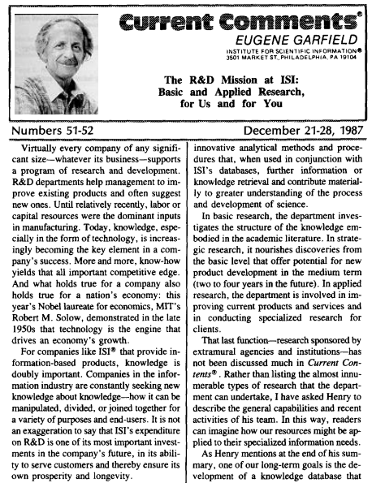
Institute for Scientific Information (ISI): the “university” of Clarivate Analytics
ISI has been re-established to extend the pioneering work of Dr. Eugene Garfield
Jonathan Adams
Director, ISI
Thought Leadership
Data Strategy
Indicators
Interpret
Monitor Research
Editorial Excellence
Notes:
We have a long history of delivering insights and solutions to the market with integrity. For 50 years ISI was the key source of research and product development in the world of scientometrics. It was the place where cutting edge and responsible research metrics were first pioneered. It not only led the market – it created and then shaped the market – and in turn our Web of Science product.
We relaunched ISI in 2018, and this group functions as the “university” of Clarivate. ISI will maintain a body of bibliometric knowledge that informs our product development, conduct new research, and disseminate the knowledge maintained and produced by the group.
Eugene Garfield’s ISI has been synonymous with innovation, utility, and integrity. Foundational concepts developed by ISI include:
Identification of a key corpus
The meaning and information content of citations
Gold standards in data quality and analytics
ISI has been re-established to affirm and extend those principles
An information repository about content, products, analytics and best practice
Work with product teams and sales to use our assets effectively
Engagement with stakeholders in research policy, funding, management and publishing
Identification of opportunities through new data, analytics and visualisation
Capacity to maintain and extend our capabilities responsively to user needs
The ‘university’ of Clarivate
Library of knowledge
Research to maintain and enhance the knowledge and utility base
Teaching inside and outside the company about best practice
Publishing and speaking to disseminate best practice and to demonstrate value

Slide 12
Institute for Scientific Information (ISI): the “university” of Clarivate Analytics
ISI has been re-established to extend the pioneering work of Dr. Eugene Garfield
Jonathan Adams
Director, ISI
The report looks to provide an unbiased and data-driven background analysis to inform debate around Plan S, based on journal data taken from the Web of Science Core Collection
The report examines potential implications for funders, publishers, institutions and researchers
Questions posed in the report are backed up by Web of Science Core Collection data
Web of Science Group remains unbiased in Plan S discussions
Notes:
We have a long history of delivering insights and solutions to the market with integrity. For 50 years ISI was the key source of research and product development in the world of scientometrics. It was the place where cutting edge and responsible research metrics were first pioneered. It not only led the market – it created and then shaped the market – and in turn our Web of Science product.
We relaunched ISI in 2018, and this group functions as the “university” of Clarivate. ISI will maintain a body of bibliometric knowledge that informs our product development, conduct new research, and disseminate the knowledge maintained and produced by the group.
Eugene Garfield’s ISI has been synonymous with innovation, utility, and integrity. Foundational concepts developed by ISI include:
Identification of a key corpus
The meaning and information content of citations
Gold standards in data quality and analytics
ISI has been re-established to affirm and extend those principles
An information repository about content, products, analytics and best practice
Work with product teams and sales to use our assets effectively
Engagement with stakeholders in research policy, funding, management and publishing
Identification of opportunities through new data, analytics and visualisation
Capacity to maintain and extend our capabilities responsively to user needs
The ‘university’ of Clarivate
Library of knowledge
Research to maintain and enhance the knowledge and utility base
Teaching inside and outside the company about best practice
Publishing and speaking to disseminate best practice and to demonstrate value

Slide 13
Open Access
Notes:
Why is the Web of Science Group in the right position to improve the entire research workflow—from discovery to assessment?

Slide 14
Leading innovation in Open Access discovery and delivery
50%
11k
In 2014, we funded ImpacStory and invented Open Access discovery with DOAJ filtering.
In 2017, we funded ImpactStory’s algorithm and implemented it in the Web of Science
~50% of recent scholarly papers are estimated to be freely available¹
Gold OA Journals²
100+
5k+
Funder OA mandates³
Institutional repositories⁴
Web of Science is the first & only editorially curated and publisher-neutral discovery resource for trusted, peer-reviewed Open Access content.
420k+
1
articles published in “predatory” OA journals since 2000⁵
¹Archambault É. et al. (2014). Proportion of open access papers published in peer-reviewed journals at the European and world levels–1996–2013. ScienceMetrix ; Piwowar H. et al. (2017). https://doi.org/10.7287/peerj.preprints.3119v1
²https://doaj.org/faq
³http://roarmap.eprints.org/
⁴Unpaywall Source List: http://unpaywall.org/sources
⁵Shen C. & Bjork , B. (2015). ‘Predatory’ open access: a longitudinal study of article volumes and market characteristics. BMC Med 13: 230 doi: 10.1186/s12916-015-0469-2
Notes:
Ask customer– any initiatives around OA going on here? Does the library have a fund to pay APC charges for faculty?
Open Access is growing at an exponential pace– recent studies estimate that roughly 50% of papers currently published are Open Access, due to a number of factors:
Availability: the rise of OA journals (over 11K listed in the DOAJ as of March 2018, other studies estimate the total number to be 20K).
Funder Mandates: Over 100 mandates registered in ROARMap
Institutional Repositories: We know of over 5K in the Unpaywall (ImpactStory) source list– there are likely far more.
Clarivate analytics supports Open Acess. However, there are some problems associated with it:
Predatory material– you don’t want to inadvertently publish in a predatory J, don’t want your faculty reading & citing it– can be very hard to evaluate
It's not open if you can't find it
Massive growth in green OA -- impossible/impractical for researchers to search all these IR’s
Using something like Google, you have to know where to go– could be free somewhere else, just not at the link google scholar is showing you
Many versions of the same paper exist online: how are faculty & students supposed to tell what version is the right version?
In this scenario, our objective is to help you and your researchers find the OA literature available to you– but not just any OA literature. We want to point you peer-reviewed content from vetted journals, and point you to the best available version of this material.
Works Cited:
¹Archambault É. et al. (2014). Proportion of open access papers published in peer-reviewed journals at the European and world levels–1996–2013. ScienceMetrix ; Piwowar H. et al. (2017). The State of OA: A large-scale analysis of the prevalence and impact of Open Access articles. PeerJ Preprints 5:e3119v1 https://doi.org/10.7287/peerj.preprints.3119v1
²https://doaj.org/faq
³http://roarmap.eprints.org/
⁴Unpaywall Source List: http://unpaywall.org/sources
⁵Shen C. & Bjork , B. (2015). ‘Predatory’ open access: a longitudinal study of article volumes and market characteristics. BMC Med 13: 230 doi: 10.1186/s12916-015-0469-2
Despite prevalence of OA, critical painpoints remain:
OA full-text is published in disparate locations and has historically been hard to find
Lack of uniform OA publishing conventions makes it challenging to validate the provenance of a specific publication
Institutions and funders lack insight into their OA footprint

Slide 15
What types of Open Access are identified in the Web of Science?
DOAJ Gold 100% of the articles published within a journal are open access.
Other Gold a.k.a. “Hybrid” Individual articles that are available at no charge from otherwise subscription-based journals. These papers have been identified by Impactstory as having a Creative Commons (CC) license that are not in DOAJ journals.
Bronze
A freely accessible final version of an article on a publisher's website. Bronze OA on Web of Science can contain free-to-read copyrighted "public access" versions and free-to-read versions where license information was unidentifiable.
Green Published Papers are final published articles available without charge from a repository.
Green Accepted Papers are peer-reviewed, accepted manuscripts available without charge from a repository.
Notes:
Note: Bronze is not new OA content identified and labeled in WoS, we’re just introducing the concept of "Bronze" for content that might have previously been labeled as "Gold" only. Identifying 'public access'/'free to read' content as Bronze OA has gained some acceptance within the OA community and communicates a broad definition that more accurately represents some of the ambiguity associated with identifying license information for all content freely available from a publisher's web site.

Slide 16
Web of Science covers both Green and Gold Open Access Versions
Source: Crossref/Unpaywall/Impactstory/Elsevier/Clarivate Analytics
Else, H. (2018). How Unpaywall is transforming open science.
Nature, 560(7718), 290-291. doi:10.1038/d41586-018-05968-3

Slide 17
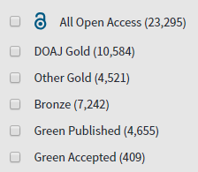
Open Access content in Slovak papers
20,7% of Open Access publications since 1990

Slide 18
Access to Full Text
Notes:
Why is the Web of Science Group in the right position to improve the entire research workflow—from discovery to assessment?

Slide 19
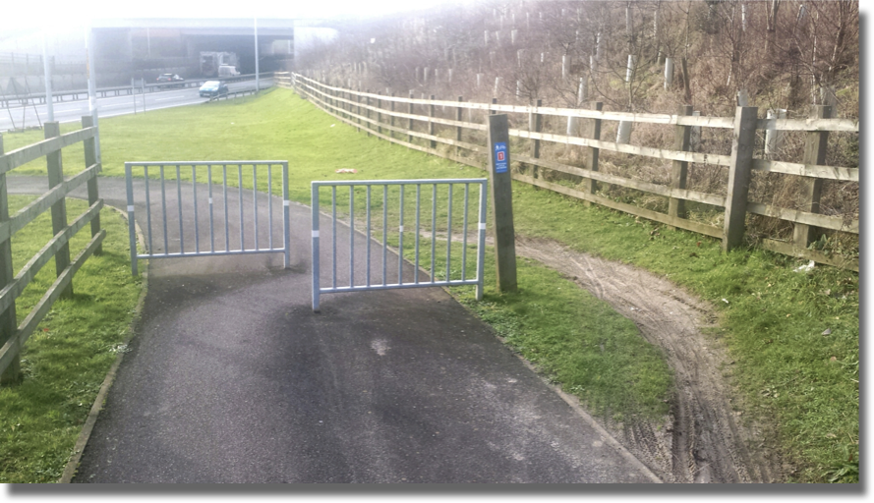
The path to Full Text

Slide 20
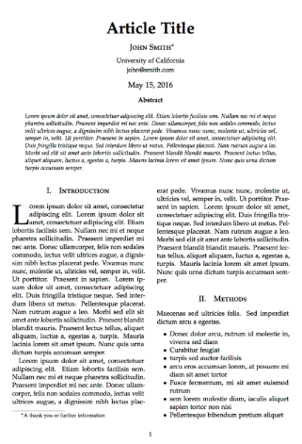
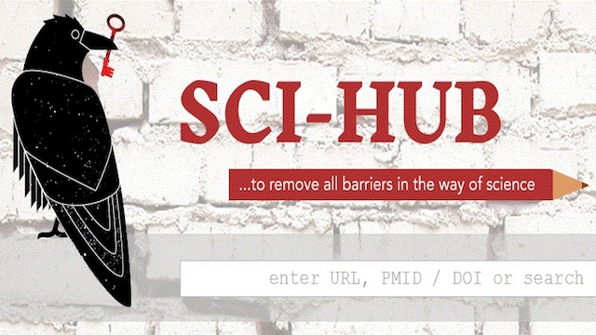
A typical path to Full Text
Go to library website
Click “access” button
Log in via proxy
Navigate to the article again…if available. (If not, request via ILL).
Find the journal
Encounter article paywall on open web
#icanhazpdf

Slide 21
A typical path to Full Text
Go to library website
Click “access” button
Log in via proxy
Navigate to the article again…if available. (If not, request via ILL).
Find the journal
Encounter article paywall on open web
One click

Slide 22
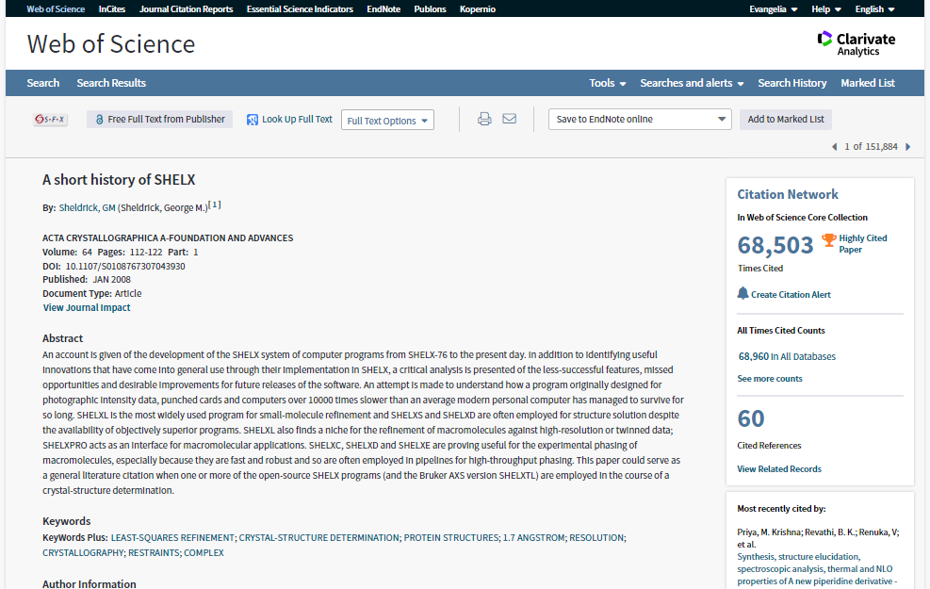
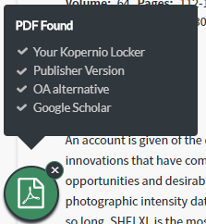
Kopernio will search (where possible) your university's subscriptions and open databases to find the best version of the paper for you.
Kopernio makes library budgets go further by adding free alternatives where no subscriptions are available.
One click access
to journal articles
Kopernio integrates with library proxies and library authentication systems to retrieve research articles via library subscriptions.
Kopernio always tries to source the journal article from the publisher platform first

Slide 23
+
=
“The powerful combination of Web of Science, Impactstory and Kopernio provides users with access to free full text via a single click.”

Slide 24
Researcher visibility
Notes:
Why is the Web of Science Group in the right position to improve the entire research workflow—from discovery to assessment?

Slide 25
Publons was the first to address unique challenges of researchers
Credit
Peer review represents a valuable, time-consuming contribution to the scholarly record, but is not commonly acknowledged on C.V.s and in faculty activity reporting. Quantifying peer review and making it trackable allows faculty to be recognized for their efforts.
Transparency
While rare, peer review fraud can occur. Verifying peer review activity in a public forum makes the process more transparent.
Journal Evaluation
Publons provides data points beyond bibliometrics that faculty can use to evaluate a journal. Crowd-sourced journal endorsements indicate a journal’s efficiency & trustworthiness. View the Publons Journal List
API
Enrich your Research Information Management System with verified review and journal editor data. The API makes available: peer review records, editorial board membership records, and handling editor records. Learn More
Notes:
What is the researcher need that Publons serves? Getting credit for a time-consuming activity that was completely hidden BUT essential for science!
It also provides transparency–peer review fraud is rare, but documented cases have been discovered– a system like Publons makes this impossible.
One of the features of the system is that reviewers can endorse journals they enjoy working with. This provides a crowd-sourced data point that others can use to decide whether or not to get involved with a publication.
API → Let’s investigate how we can work with you (for customers who express interest)

Slide 26
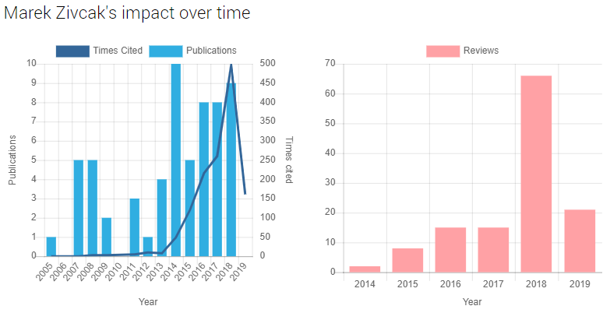
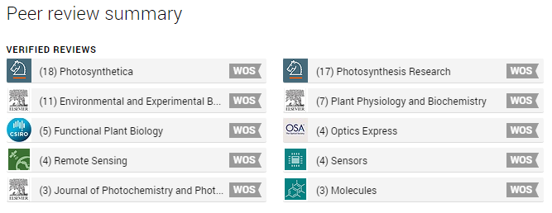
Researcher-centricity: Increasing visibility and discoverability of contributions via Publons
All ResearcherID’s are all coming to
Publons on the 15th of April
600k+
Reviewers
3.7M+
Reviews
3,000+
Partnered journals
90+
Publisher partners
Notes:
The new Publons profile allows you to track publications, citation metrics, peer reviews, and journal editing work in one, easy-to-maintain profile. This helps you boost the visibility and discoverability of your multi-faceted contribution to a field of research.

Slide 27
Analytics
Notes:
Why is the Web of Science Group in the right position to improve the entire research workflow—from discovery to assessment?

Slide 28
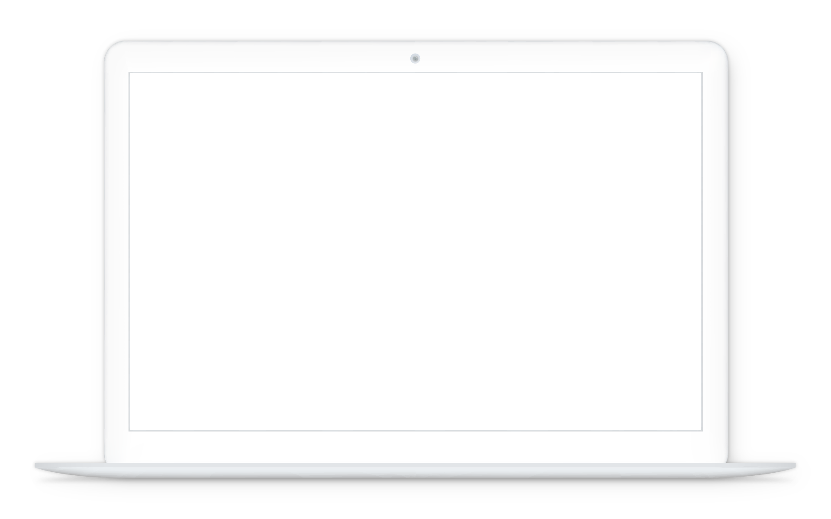
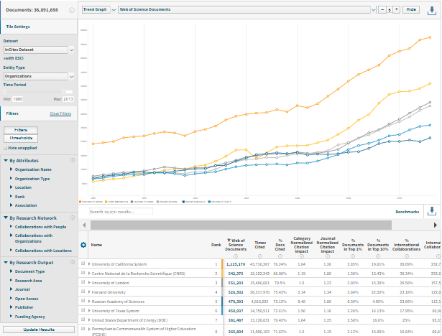
InCites Benchmark & Analytics An objective analysis of people, programs and peers
Web of Science Core Collection Data
62 M+ records (20,300 K Journals, 198 K+ Conferences, 1.4 M+ Books/Book chapters)
https://clarivate.com/products/incites/

Slide 29
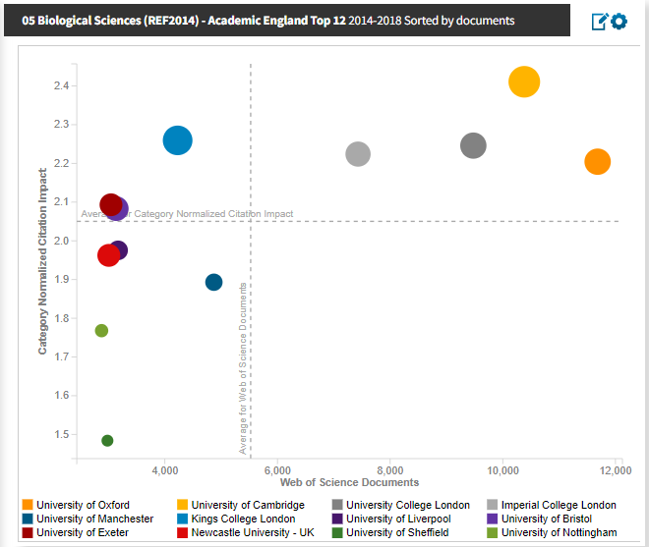
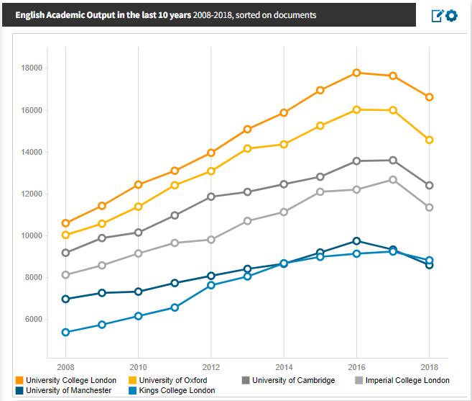
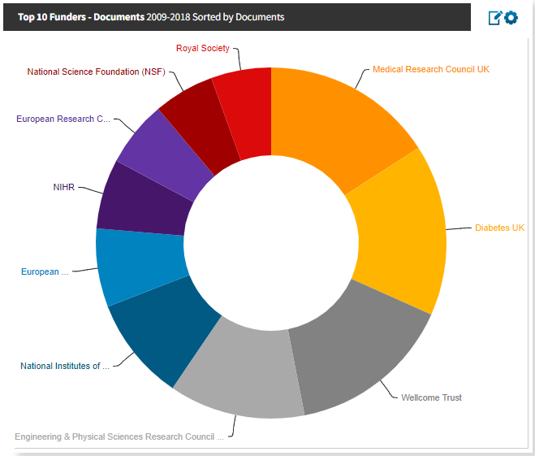
InCites Benchmark & Analytics visualizing the data

Slide 30
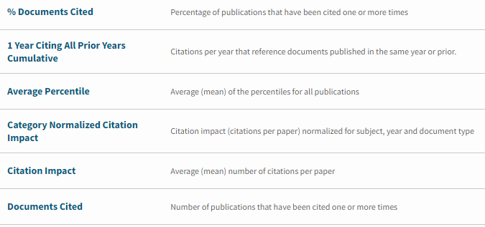
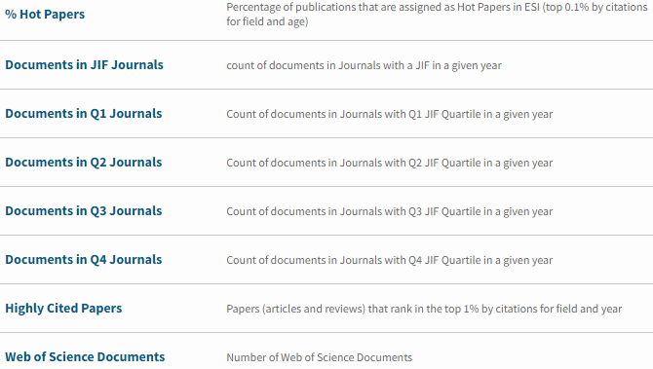
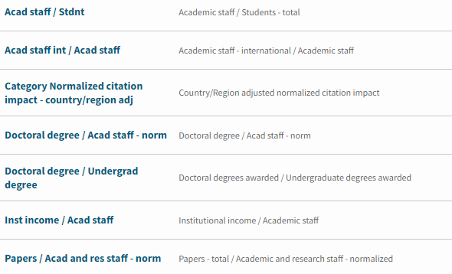
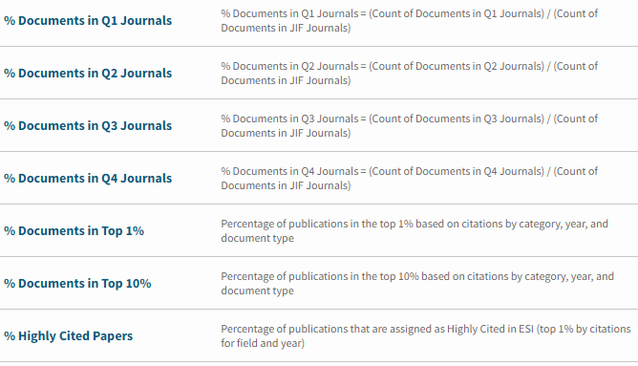
InCites Benchmark & Analytics ‘bag of metrics’

Slide 31
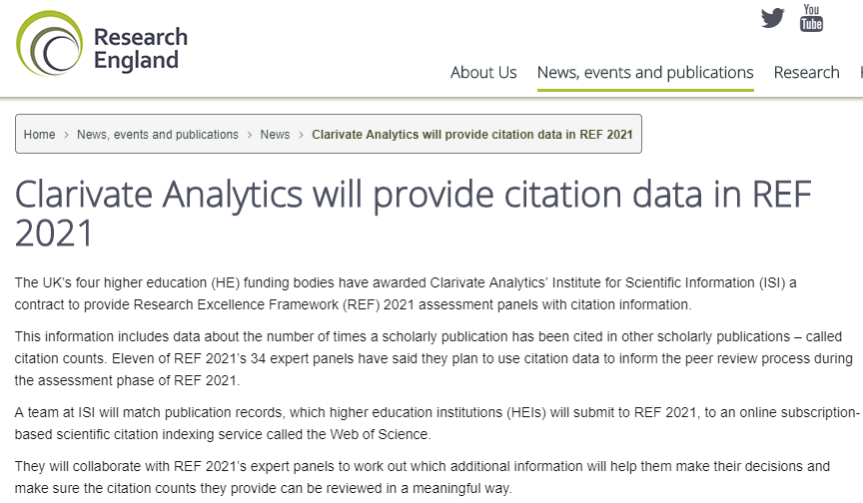
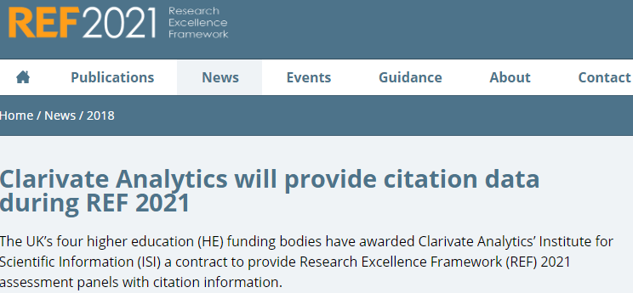
The Web of Science data will be used for the UK’s national research evaluation exercise, REF 2021
High Quality Content
Well founded coverage
Consistent indexing standards
Depth
Increase in Computer Science conference proceedings from 65% to 98%.
Provide a Matching API
Return accurate bibliographic information
Include Citation Counts
Relevant contextual citation data
Contextual information
WOSG work with Research England to provide an agreed range of carefully chosen reference points to enable panels to evaluate academic impact while considering global and domestic trends in discipline
Expert Support throughout
Support REF panels during assessment, in partnerships with the UK Forum for Responsible Research Metrics to ensure responsible use of our data.

Slide 32
Thank you
Guillaume Rivalle
Manager Consultants, Europe
Guillaume.rivalle@Clarivate.com

