Slide 1

Use of bibliometrics for the evaluation of institutes at the Czech Academy of Sciences
David Jiří Šlosar
Notes:
Good afternoon ladies and gentlemans, my name is … i am from library of czech academy of sciences and i would like to tell you something about bibliometrics in context of libraries, and about institutional evaluation in which was library of czech academy of sciences involved.

Slide 2
Role of libraries in evaluation of scientific institutions
Established, prestigious institution with access to data about scientific production
Bibliometric neutral
Administration of CRIS system, management and cleansing of data about scientific production
Human resources
Citation databases
Notes:
Why libraries should participate in institutional evaluation? Well, they can earn some money and add another argument for justifying their existence or budget.What more, In Czech republic we have got law which says something about necessity of evaluation of scientific organizations. We have got evaluation on national level, Metodika M17+, which is inspired by evaluation of Czech Academy of sciences. Czech Academy have got independency from this national level evaluation but still needs to make a high quality evaluation.
-Library is…
-According to WoS, when i made an advanced search with organization „Library“ selected, then i found that there is only one library, in the whole world, where can be bibliometrics successfully applied. It is National library of medicine in Bethesda. Only this one institution produced more than 250 documents (Articles, Proceedings, Reviews) in last five years. I assume that, there is need for at least 50 documents in year for satisfying statistics. This example is not perfectly accurate but is sufficient for illustration. Libraries are practicaly immesurable by bibliometrics.
-Libraries could provide… current research information systém.
-But they need to acquire or to have human resources (CRIS administrators, programmers). Libraries in scientific organizations often has these resources.
-and the last point is about citation databases. Libraries are supposed to make an acquisition of electronic information resources, so they also could buy an access to citation database or databases.
- It sound heavily bibliometric oriented and it is. This presentation is based on evaluation of CAS. And in this last evaluation of Czech academy peer-review was realized by another institution. If the library is brave enough, then it could contain also peer-review.

Slide 3
Bibliometrics as a background for evaluation
Evaluations of institutions and teams in CAS in period 2010-2014 was splited into two phases.
Phase one: Evaluation of choosen outputs
Phase two: Evaluation of all outputs and analysis on national level
Notes:
Now, i will talk specifically about evaluation in the Czech academy of sciences in period from 2010 to 2014. There is five year period for evaluation.
In the phase one scientific teams choosed ouputs which were evaluated with bibliometrics and these bibliometrics evaluation reports were used as a background for peer-review of these choosen outputs. Bibliometrics evaluations were applied only on outputs which had identifiers like UT WOS or ID Scopus. (5594 outputs, 377 teams)
In the phase two bibliometrics were applied on all outputs of CAS indexed in CRIS (Current research information system) system ASEP AND indexed in (WoS OR Scopus). Articles, proceedings and reviews were only considered documents.

Slide 4
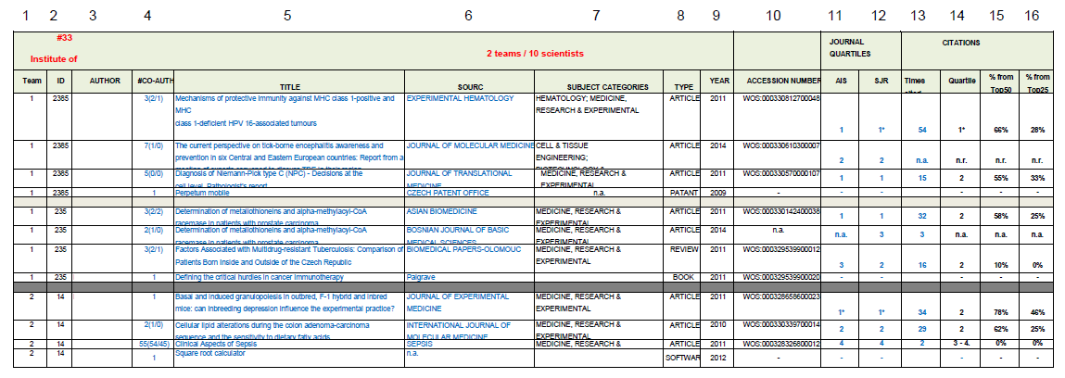
Phase one background
Notes:
So, the bibliometric background from the phase one looked like this. Names of institutions, teams and authors were erased in whole presentation. Columns from 3 to 10 are for bibliographic description. In columns 11 to 16 are situated bibliometric indicators which i will describe later. This was used as backgroud to peer-review.

Slide 5
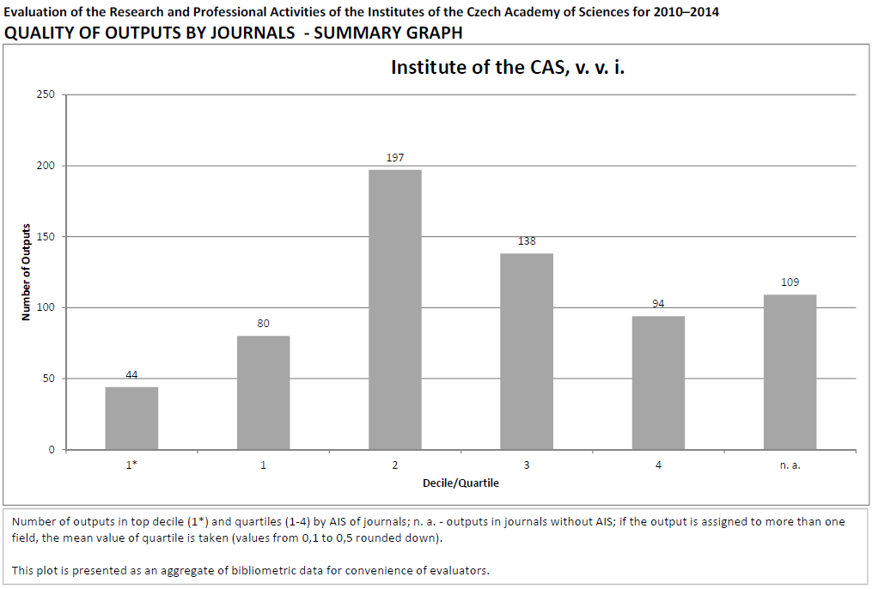
Phase two background
Notes:
This graph is from phase two. It is report at institutional level. This one page shows distribution of outputs according to Decile or Quartiles by quality (better to say visibility) of journals.

Slide 6
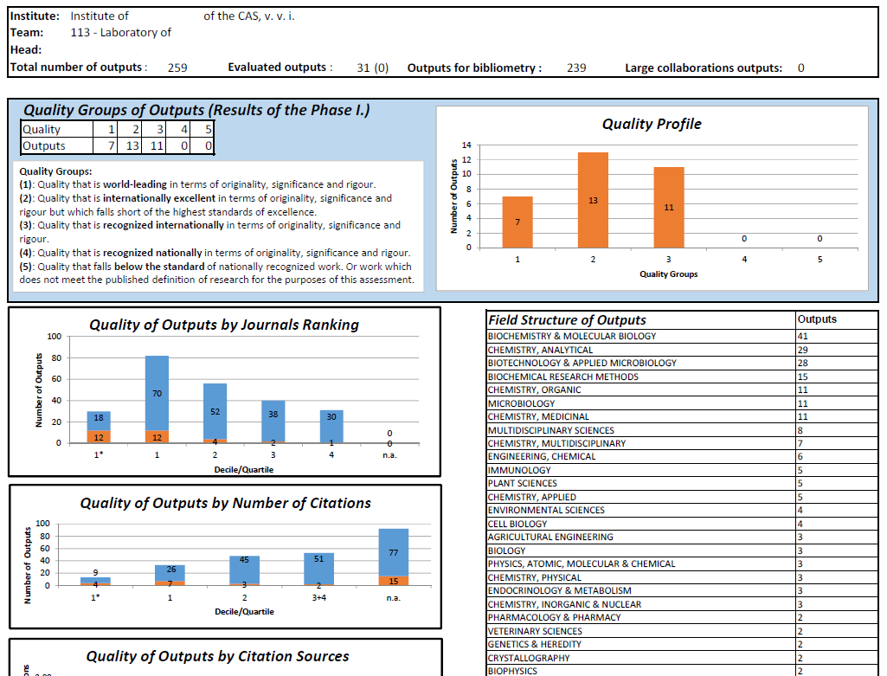
Notes:
This is one of the aggregated bibliometric report also from phase two. It is on team level. Values of bibliometric indicators are displayed by graphs. As we can see, there is also Field structure of outputs.

Slide 7
Used indicators
Number of outputs
Times Cited
Journal quartile
Quartile by citations
Quality of citations
Number of authors
Notes:
Used bibliometric indicators:
There were simple number of outputs and number of citations.
In Journal quartile Outputs were distributed into Journal decile and quartiles by AIS and Scimago JR in their subject categories and years.
Quartile by citations means that outputs were ranked with quartile according to their position by number of citations in their respective subject categories, years and document types.
And in quality of citations were examined from where were citations recieved. Specifically, in which quartile, was journal, which published document, which cited measured output.
At last, point Number of authors means, that every output with more than 30 autors were marked and partialy excluded.

Slide 8
Acquirement of data
List of outputs from teams and from CRIS – ASEP
Citation data from Web of Science
Journal data from WoS JCR and from ScimagoJR
Connections through identifiers UT WOS and ISSN
Articles, Proceedings papers and Reviews only
Notes:
Of course it is neceassary to get data to do bibliometrics. do list of the outputs, connect them with citation databases throught identifiers, download them, clean them and so on.
Each of this steps needs some kind of operational level data cleansing a repairing. We have got corrupted UT WOS in our CRIS ASEP, format of CERN outputs, also journal deduplications and so on.

Slide 9
Calculations and tools
Suitable tools are programming languages Python or R. For partial controls MS Excel/Calc can be used.
It is possible to do whole calculations in MS Excel/Calc and notepad.
Notes:
So we have got data, we know which counts we needs, now we need to proces them.
Python is realy fast, got a lot of useful libraries and offer very strict control on basic level of data processing.
R is useful for statistics, also a lot of libraries but there are few land mines which can ruin your own calculation without knowing it. But it is more user-friendly than Python.
It is far from elegant and it is much more slower, but you do not need human resources with programming skills. It depends on how big are data that you have.

Slide 10
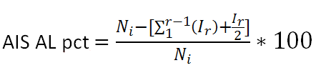
Improvements for next evaluation
Removal of Quality of citations
Parcialization of citations between autors
Improved calculation of Quartile by citations
Notes:
So, this was brief introduction of last evalauation of czech academy of sciences, where library got a key role. Now, some possible improvements.
First point is because there is a lot of effort for minimal outcome. A lot of downloaded data, a lot of countings and minimal information contribution.
Second point is under heavy discussion right now. How we can do parcialization of citations between authors.
Last point includes evaluation of outputs not only in one selected subject category but in all subject categories with weighted average. Also distributions into quartiles, counts with different sizes of journals. You can see an example.
And that in not all. We have made our own interface which works directly with our CRIS ASEP and provide bibliometrics reports automaticaly. As far as i know, that this is unique in Czech republic. These reports can be displayed only at the appropriate institutions. There is limitation that no one else could see these reports.
Ni is sum of citable units of whole subject category of given year. R is rank of journal if journals are descending by AIS.

Slide 11
Thank you for your attention
Slosar@lib.cas.cz

