Slide 1
THE OFFICE FOR SCHOLARLY COMMUNICATION/ Responsible metrics: Why management matters

Slide 2
The Office for Scholarly Communication

Slide 3
Why metrics for research evaluation?
This 3?
0, 0, 0, 0, 0.1, 0.2, 0.7, 0.8, 0.83, 3
Or this 3?
3, 5, 12, 24, 67, 89, 93, 105, 213

Slide 4
The problem with targets?
People aim at them

Slide 5
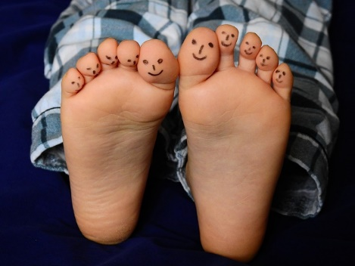
What are institutions doing?
Responsible Metrics statements:
Implementation:
Leiden Manifesto
San Francisco Declaration on Research Assessment
The Metric Tide
Individual policy
Target Setting
Evaluation
Promotions
Hiring
Training

Slide 6
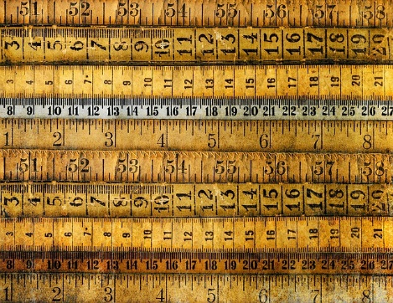
Explaining research metrics to management
Proactive engagement
Education
What management can do
Resources

Slide 7
Proactive engagement
Knowing in advance is better than explaining afterwards
Measure what matters
Good practice is sustainable
Highlighting expertise

Slide 8
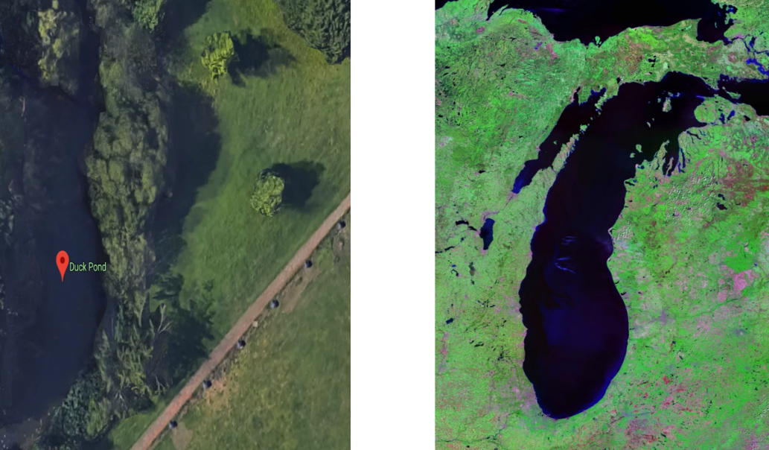
Education

Slide 9
What management can do
Data quality:
Disambiguation
ORCiD
Scopus/Web of Science/Google Scholar etc.
Single/archive copies, not multiple platform (single source of truth)
Make the output Open Access (pre-print, green, gold, …) as soon as possible
Encourage inclusion of Open Data reporting/references in the article
Have a contact for specific advice or queries
Compare apples with apples, but if you want fruit salad, don’t only water the apple trees

Slide 10
Resources
Leiden Manifesto (https://www.nature.com/news/bibliometrics-the-leiden-manifesto-for-research-metrics-1.17351) points 6-10 give relevant examples of fluctuation which are accessible.
Metrics toolkit (http://www.metrics-toolkit.org/)? This gives the limitations of different types of metrics (e.g. http://www.metrics-toolkit.org/field-normalized-citation-impact/).
Good examples such as “Metrics: journal's impact factor skewed by a single paper” (https://doi.org/10.1038/466179b) and Stephen Curry’s ‘I am not my H-index’ https://twitter.com/stephen_curry/status/1005118764369825794?lang=en
https://libereurope.eu/blog/2018/06/28/scholarlymetricsreport/
https://libereurope.eu/blog/2017/03/21/update-libers-metrics-working-group/

Slide 11
Notes:
This

