Slide 1
In a search for the Impact

Slide 2
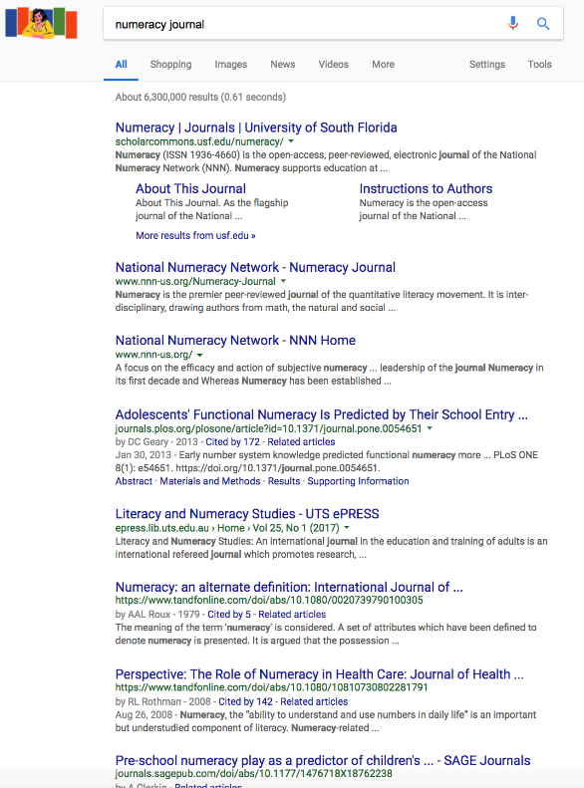
Top ranking for journals
Strong performance against major journals platforms
Notes:
DC Journals tend to rank highly, even against other commercial journal platforms.
Here Numeracy ranks higher than PLOS, Taylor and Frances and Sage.

Slide 3
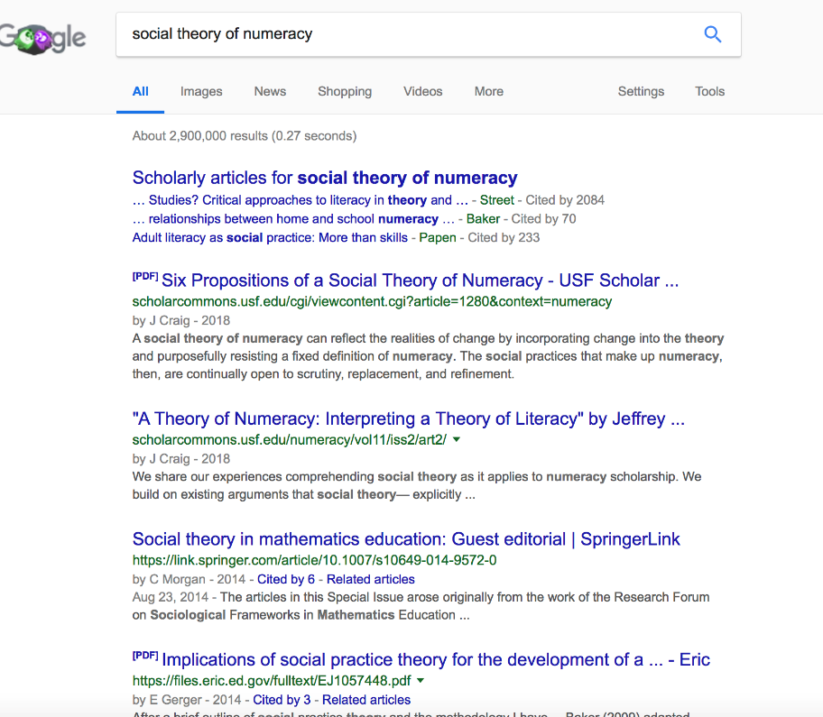
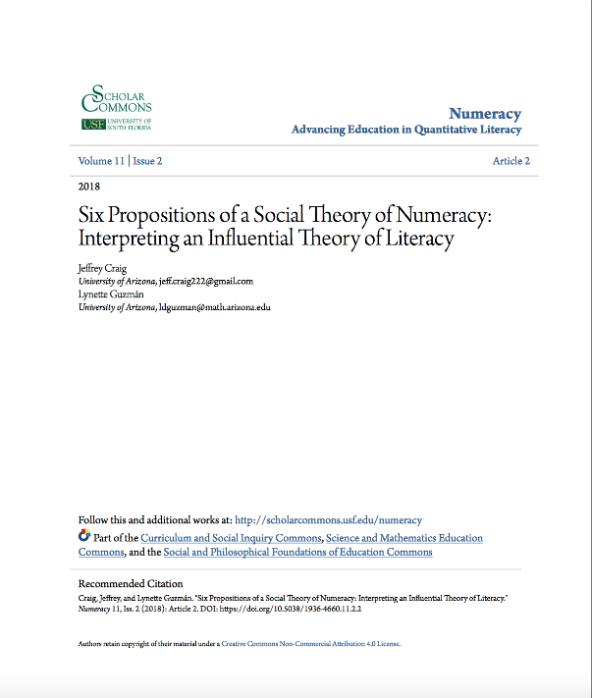
Notes:
Most people tend to search for keywords or phrases rather than names of articles, and journals. We perform very highly in keyword search. In this example we are above Springer.
Some good phrases for Google searches are:
When is a school Liable for negligence (Australian Journal of Teacher Education)
curriculum evaluation models for teachers. (Australian Journal of teacher education)
Social Theory of Numeracy (Numeracy Journal)
Rural focused Nursing Certificate (Quality Advancement in Nursing Education)

Slide 4
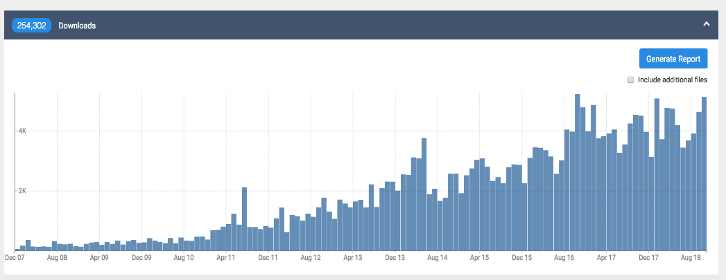
Increased visibility means more downloads

Slide 5
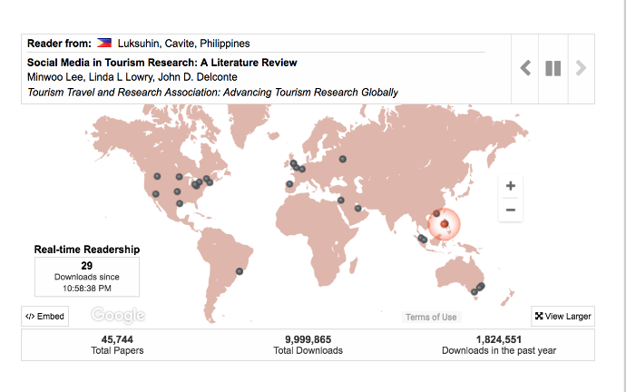
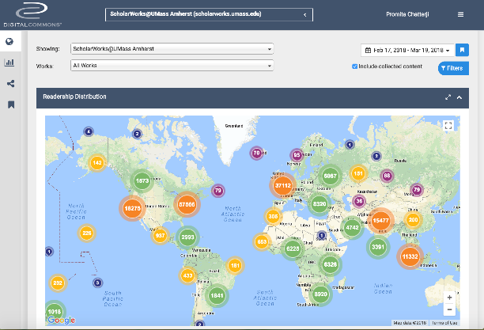
Impact for Editors and University
Real-time downloads maps show global readership
Editor Dashboards with granular data and reporting features

Slide 6
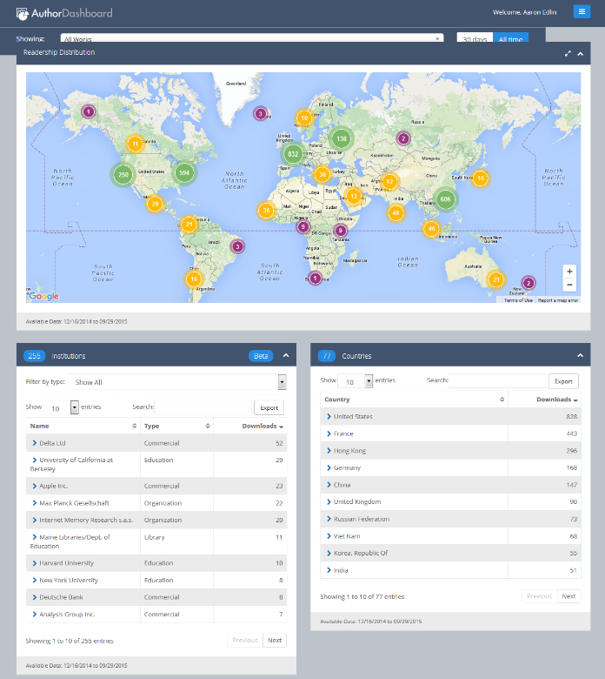
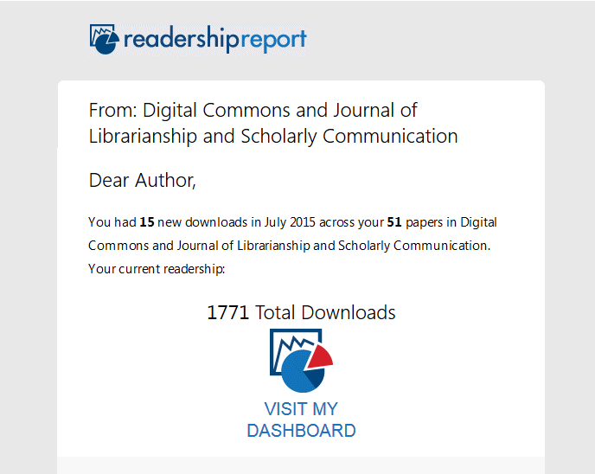
Impact Metrics for Authors

Slide 7
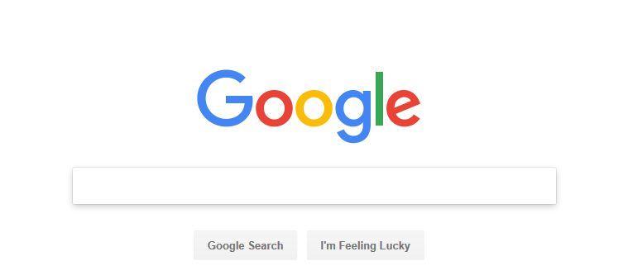
Start Here*
*70% of faculty and 89% of students begin search with Google or Google Scholar
Notes:
Having a professional looking journal is important. However, an attractive design is only truly effective if it can be found. An Ithaka report found that today, approx. Arecent Ithaka Report found that 72% of scholars start their research wia a search engine (whether Google, Google Scholar, or something else). It is increasingly important for academic journals to be discovered on the open web. That’s why Digital Commons spends a great deal of effort to make sure all content on our sites shows up highly on google.
Everything is indexed in Google scholar,
Bepress Metadata schema is one of 4 formats accepted by google
Industry leading work done on filtering downloads.
https://sr.ithaka.org/wp-content/uploads/2015/08/Faculty_Study_2009.pdf
Also we can reference the “Google Generation”
70 percent of faculty and 89 % of students begin their search with
https://sr.ithaka.org/wp-content/uploads/2015/08/Faculty_Study_2009.pdf

Slide 8
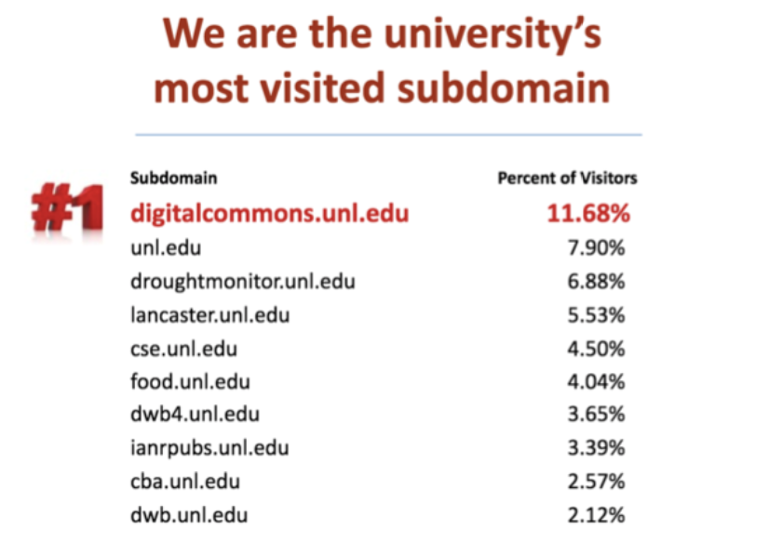
IR best outreach vehicle?

Slide 9
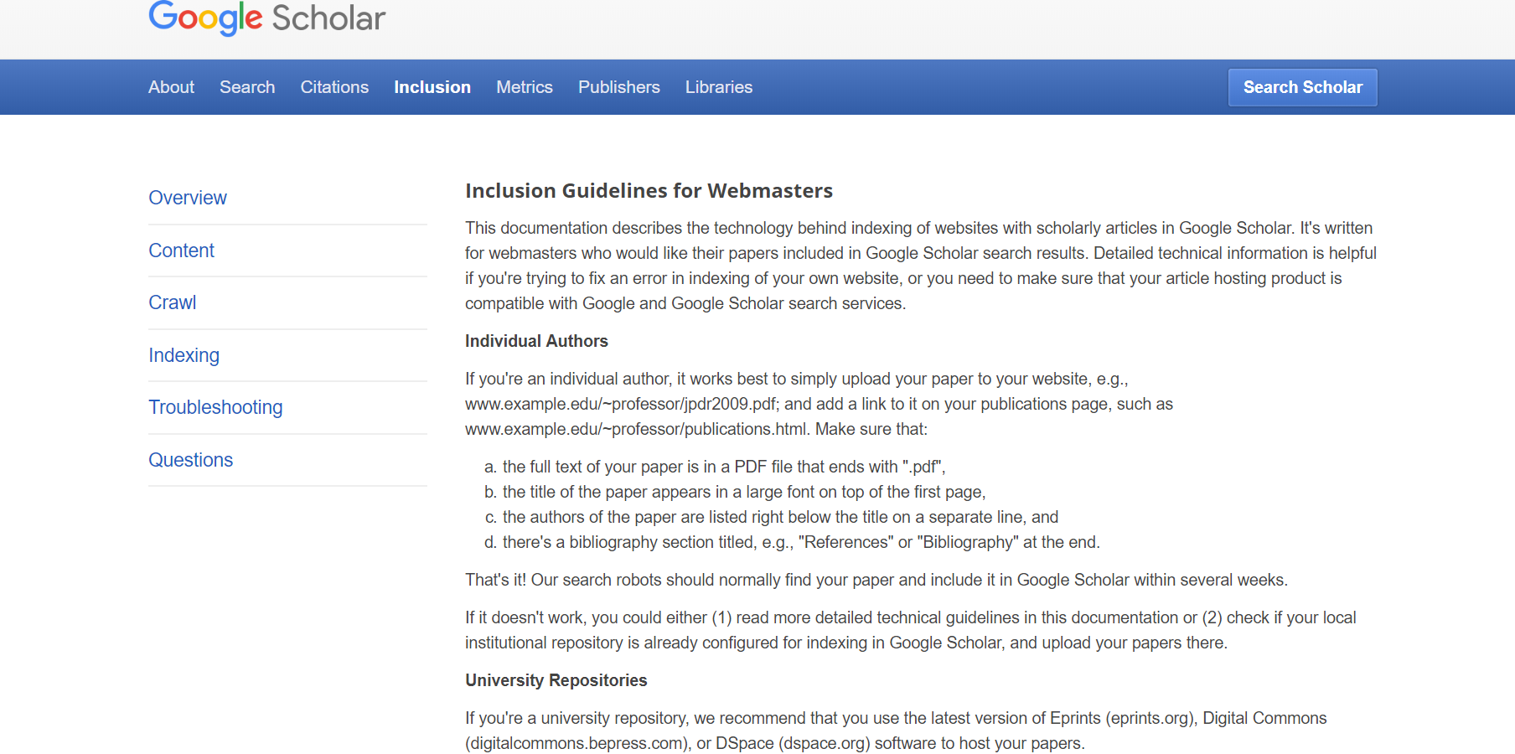
Google Indexing

Slide 10
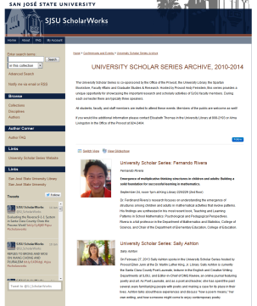
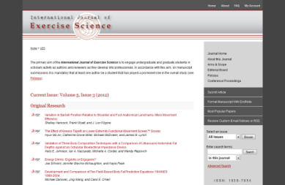
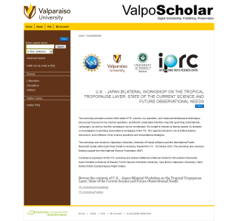
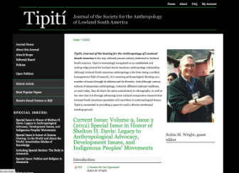
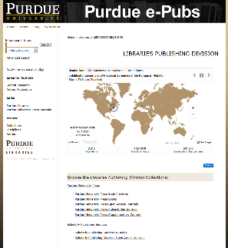
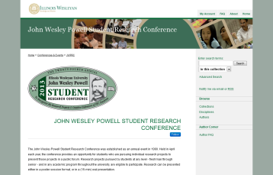
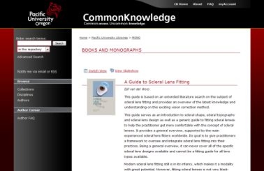
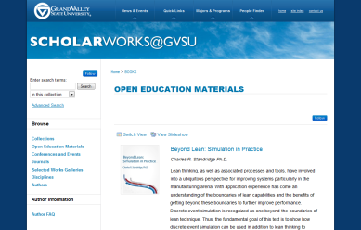
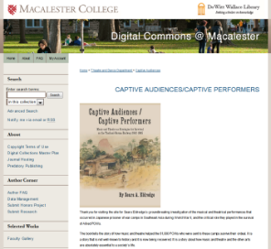
Scalable Digital Publishing
Journals
Conferences
Books

Slide 11
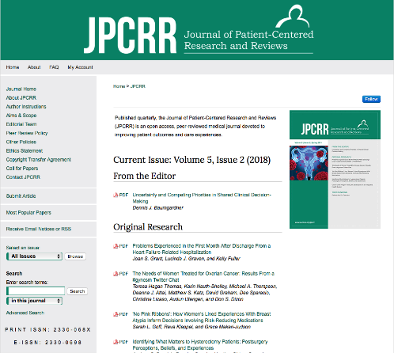
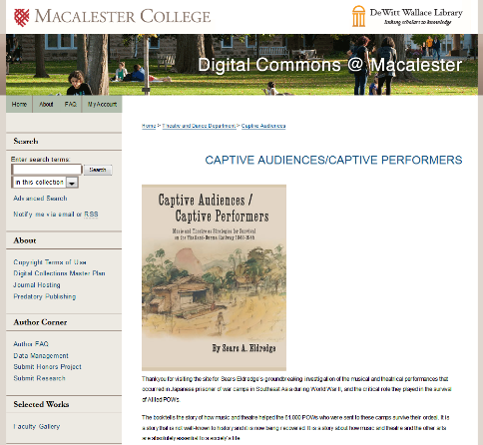
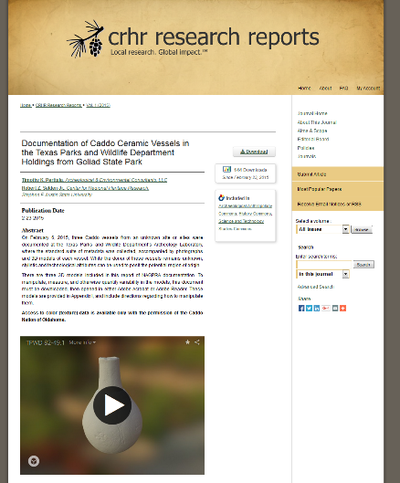
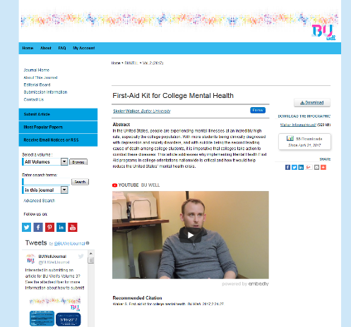
Enhanced Web Presence
Video and Audio streaming
Twitter plug-ins
Threaded Comments
Notes:
Publications on Digital Commons can experiment with all sorts of multimedia, social media, and reader tools.

Slide 12
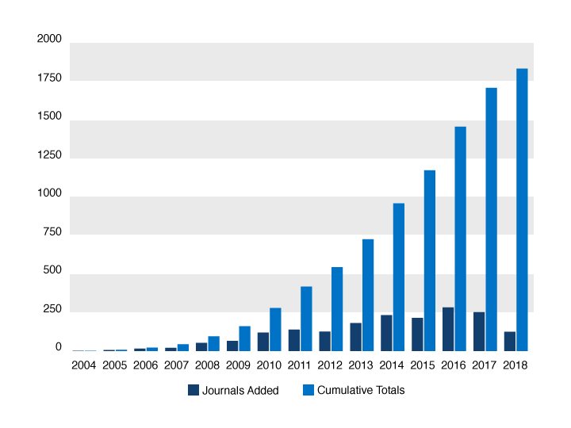
Journal Growth in Digital Commons
Notes:
Over the years the Digital Commons journal model has grown rapidly and has proved to be a model that successfully scales

Slide 13
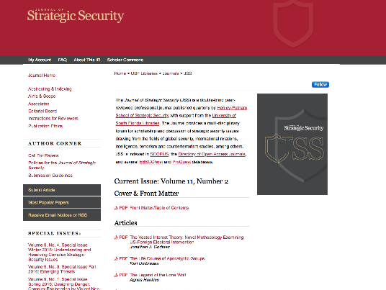
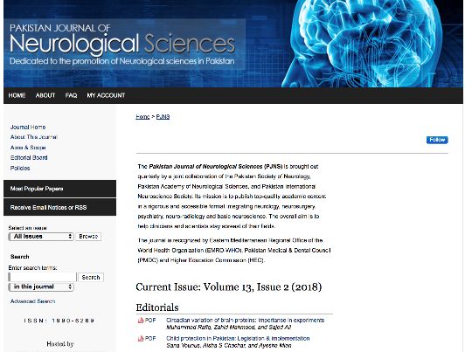
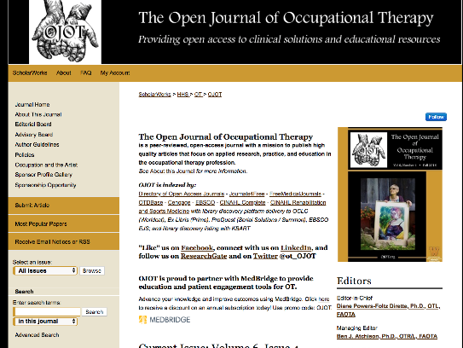
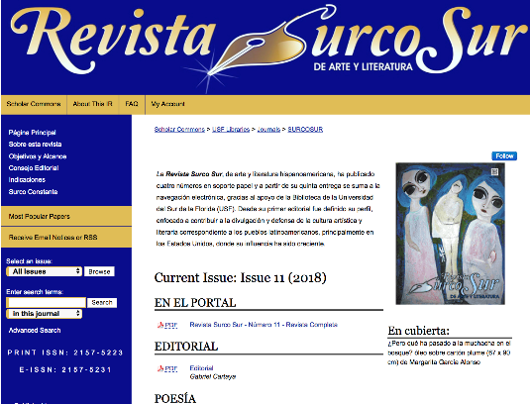
Fully Hosted Journals Custom Design Visibility Language Support Complies with Scopus requirements
Notes:
Note to Sales: It’s Best to click out to a relevant journal early on and show off the main features on live site. Then come back to the deck and talk about the main

Slide 14
Facilitating Citation Databases Compliance
 |  | facilitated by Digital Commons
Basic Criteria | Peer-reviewed content | ✔
 | Description of peer review process | ✔
 | References in Roman script | ✔
 | English abstracts | ✔
 | Public publishing ethics statement | ✔
Advanced Criteria
Journal Policy | Convincing editorial policy
 | Type of peer review | ✔
 | Diversity in geographical distribution of editors
 | Diversity in geographical distribution of authors
Content | Academic contribution to the field
 | Clarity of abstracts
 | Quality of and conformity to the stated aims and scope of the journal
 | Readability of articles | ✔
Journal Standing | Citedness of journal articles in Scopus/WoS
 | Editor standing
Publishing Regularity | No delays or interruptions in the publication schedule | ✔
Online Availability | Full journal content available online | ✔
 | English language journal home page available | ✔
 | Quality of journal home page | ✔
Notes:
Our platform is technically compliant with Scopus. Over 70 journals using Digital Commons are indexed in Scopus.

Slide 15
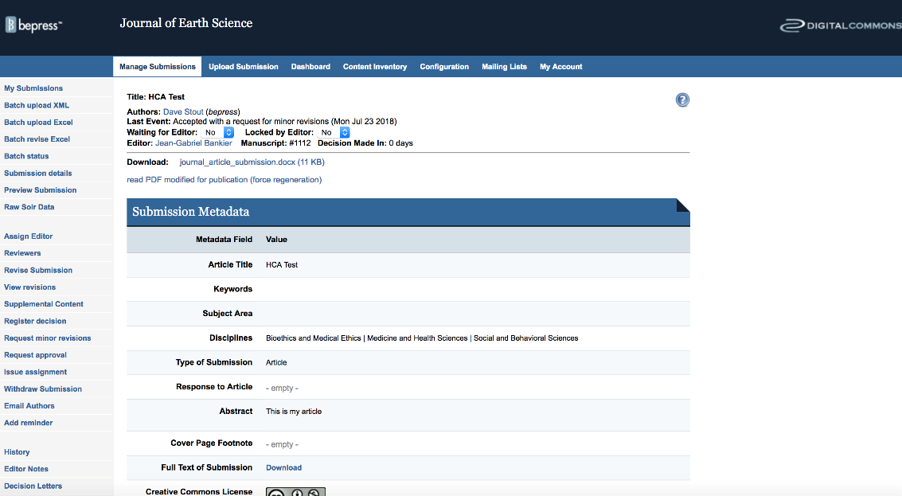
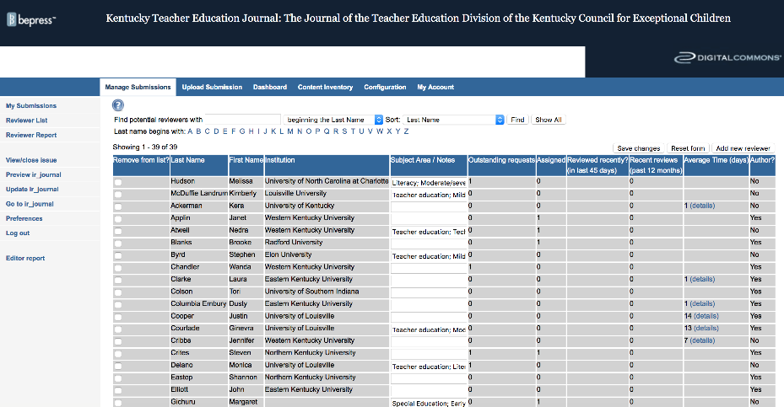
Easily track and manage reviews
All steps in publication process organized in editor toolbar
Notes:
Refined over 10 years, the editorial management workflow is set-up to offer flexibility and enhance efficiency. Editors have a number of tools like Reviewer reports, data on time to submission and status queues that enable them to quickly easilty understand status, make decisions, and build discovery.

Slide 16
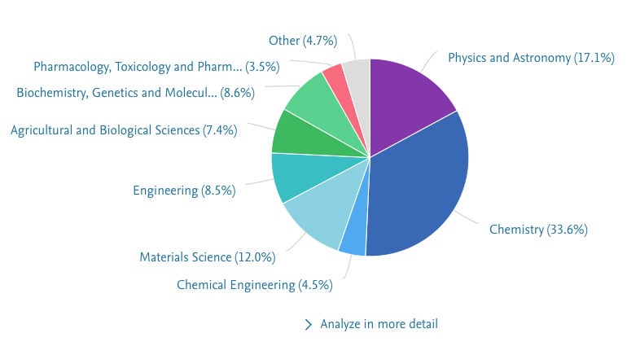
More impact? Where is your research data?
We have checked publications from Slovenia from 2013 to 2018 in SciVal.
Out of 33771 publications, 383 (1.1%) are linked to 902 datasets, according to Scholix.
Source: SciVal, Scholix, data extracted on Aug 28, 2018;
Figshare dataset are removed – most of them are in-article data like figures/tables.
Notes:
T1: %
T2: %
Figshare data are mostly in-article data such as Figures/tables. These data are the processed data.
Mendeley data focus on the supplement research data – which are normally not published together with an article.

Slide 17
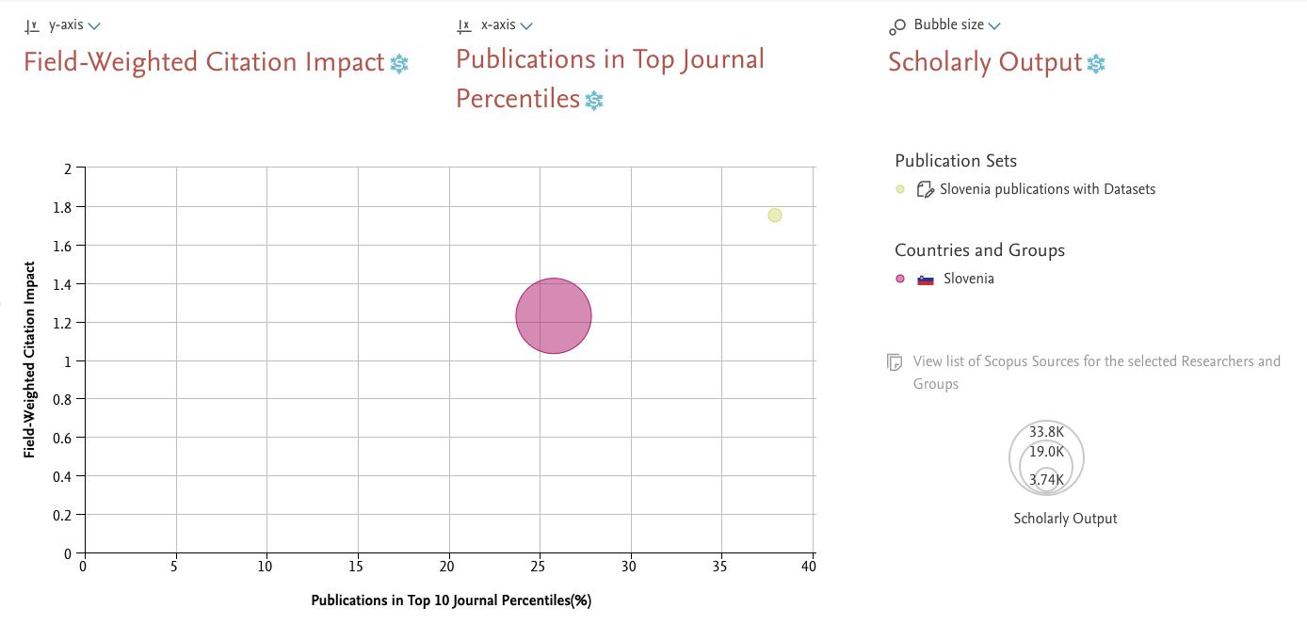
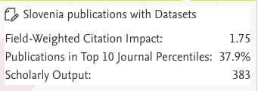
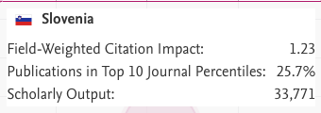
The impact of RDM best practices on publications
Source: SciVal, data extracted on Aug 28, 2018
Notes:
Output – include papers books etc
Outputs in Top Percentiles indicates the extent to which outputs are present in the most-cited percentiles of the data source. The citation counts that represent the thresholds of the 1%, 5%, 10% and 25% most-cited papers in Scopus per Publication Year are calculated.
Publications in Top Journal Percentiles indicates the extent to which publications are present in the most-cited journals in the data source. This calculates how many publications are in the top 1%, 5%, 10% or 25% of the most cited journals indexed by Scopus.

Slide 18
For your impact story write to:
k.szymanski@elsevier.com

Slide 19
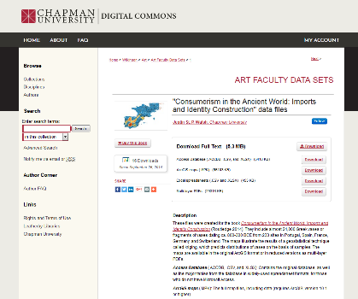
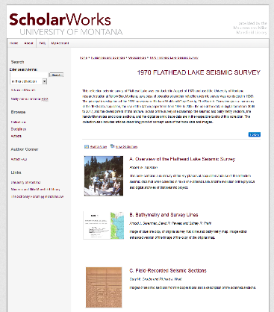
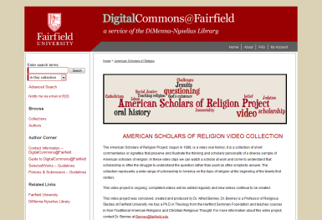
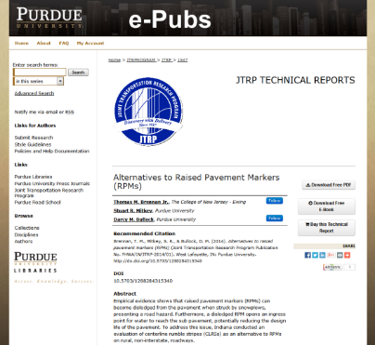
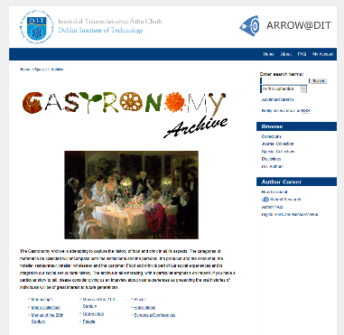
What Else?

Slide 20
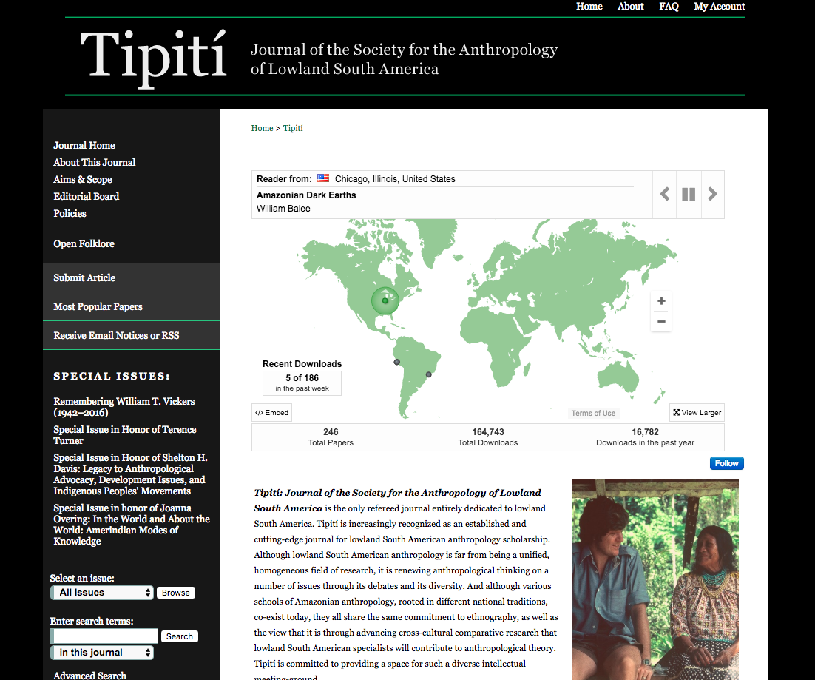
In Action : Tipití
“The move to digital publication through Trinity’s repository reduced the expense of producing the journal so drastically that it was no longer necessary to rely on subscription revenue in order to keep the journal going. And that allows the editors to focus on publishing great research and increasing the journal’s international impact in its field.”
Richard Reed, Professor of Anthroplogy at Trinity University and former president of SALSA (Society of Lowland South America, and editor of Tipiti)

Slide 21
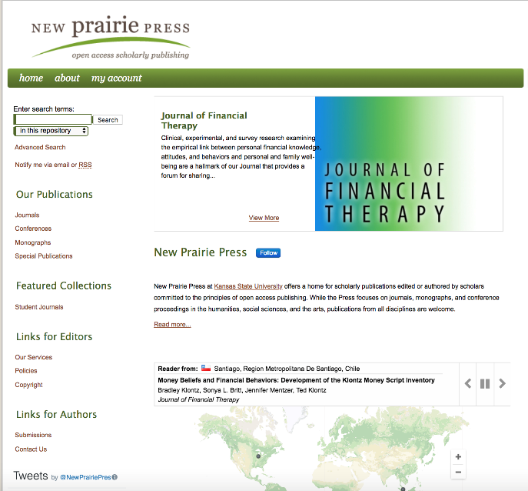
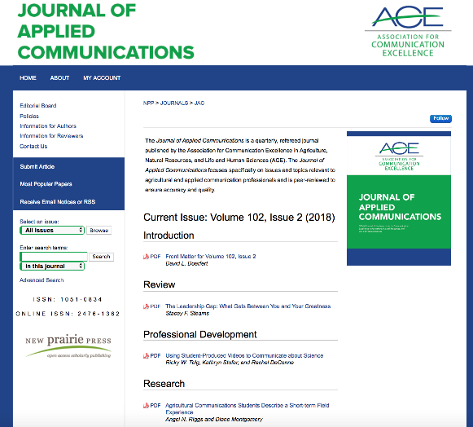
Faculty “are amazed by the amount of people they can see are reading their work and actively use the dashboards to see potential industry partners and other schools that are adopting their textbooks.”
Rebel Cummings-Saul
Former Director of the Center for the Advancement of Digital Scholarship

Slide 22
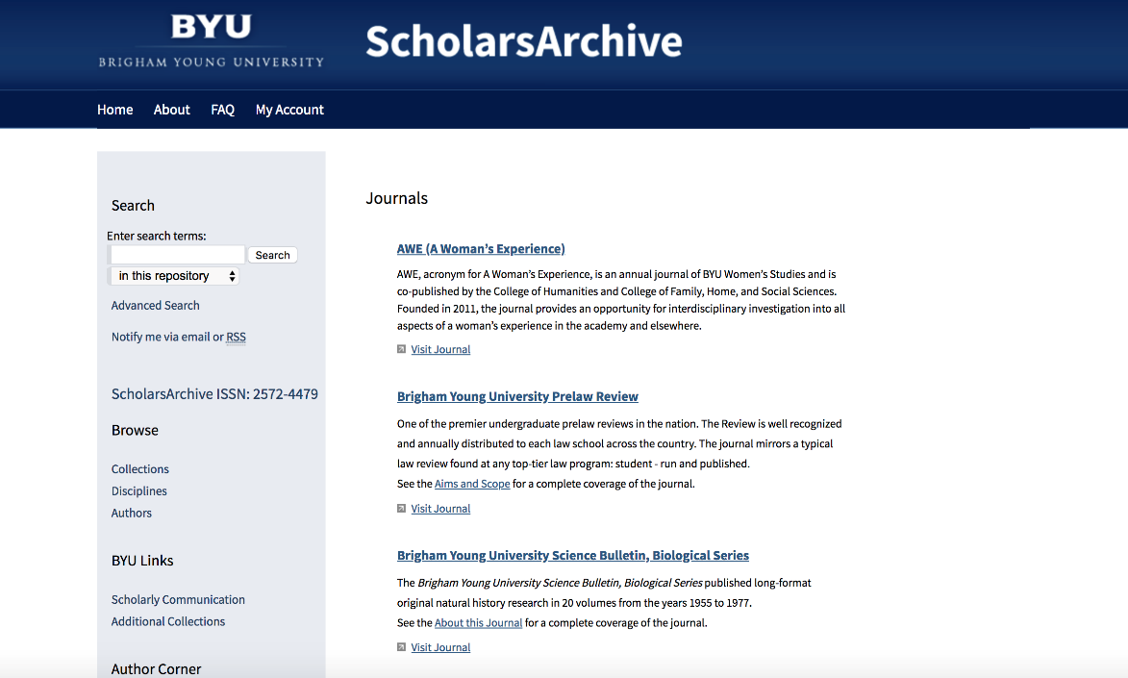
Moving from OJS
“Much easier submission process on the backend for both authors and administrators. Less fields, less screens to find the fields you need to update or fix, and easier editing/review workflow for journal editors. I have one journal editor who is begging to be one of the first to switch their journal to Digital Commons because he is so tired of OJS.”
Mandy Oscarson BYU

Slide 23
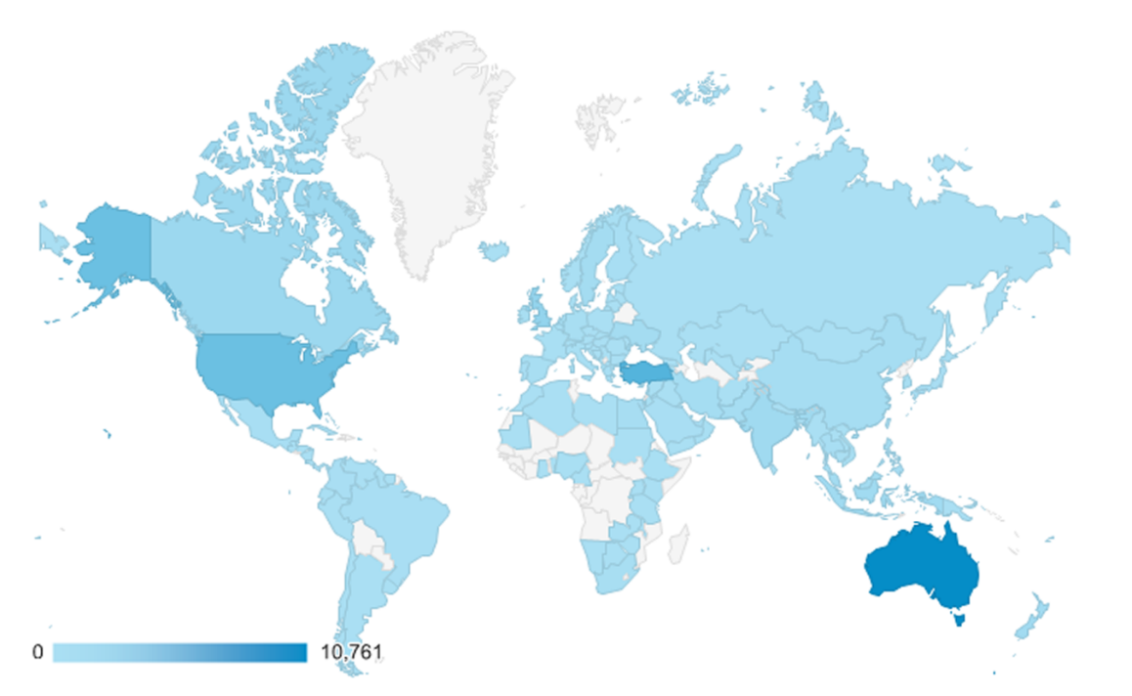
International Diversity of Readers
Australian Journal of Teacher Education
Notes:
From “Open Access Publishing Advantages: A Case Study at the Australian Journal of Teacher Education.” http://digitalcommons.bepress.com/webinars/44/

Slide 24
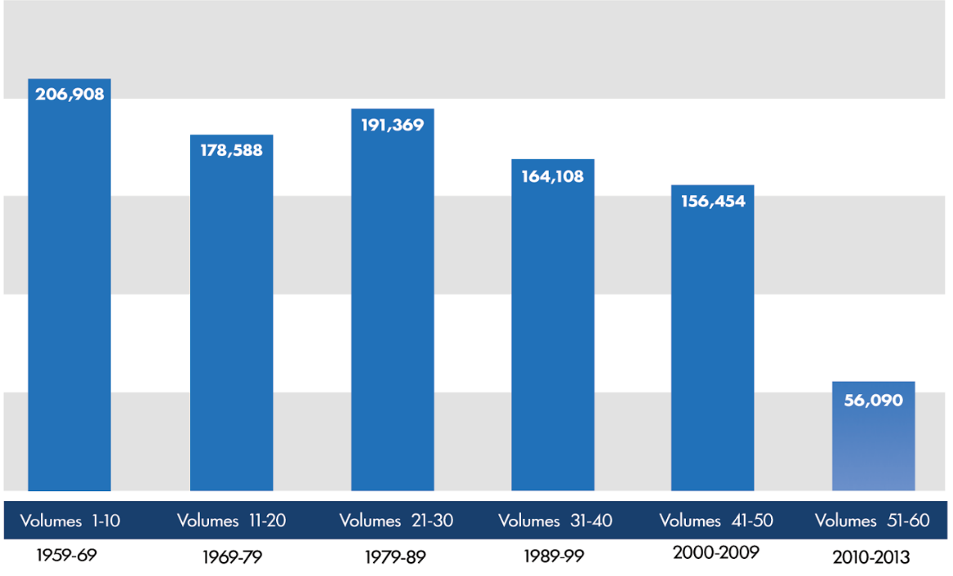
Exposure for back files
All-time downloads by volume and decade of publication, Boston College Law Review

Slide 25
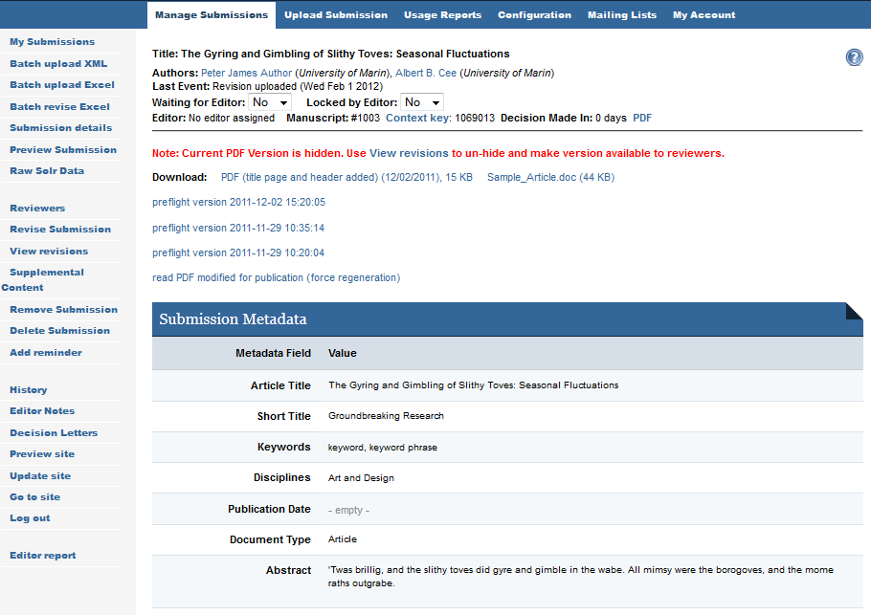
Professional editorial-management software
Customizable workflows
Single- or double-blind review
Unique editor views
Supports multiple editors
Automated reminders

Slide 26
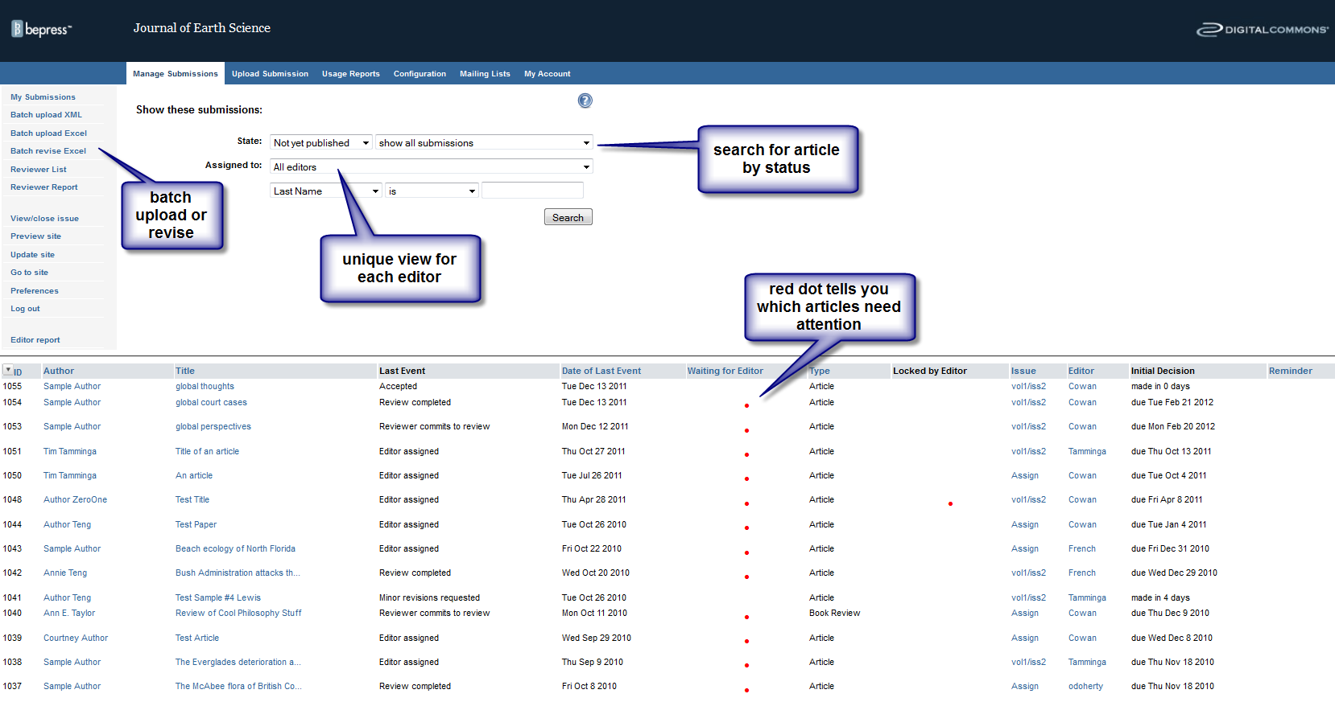
Editor view: queue

Slide 27
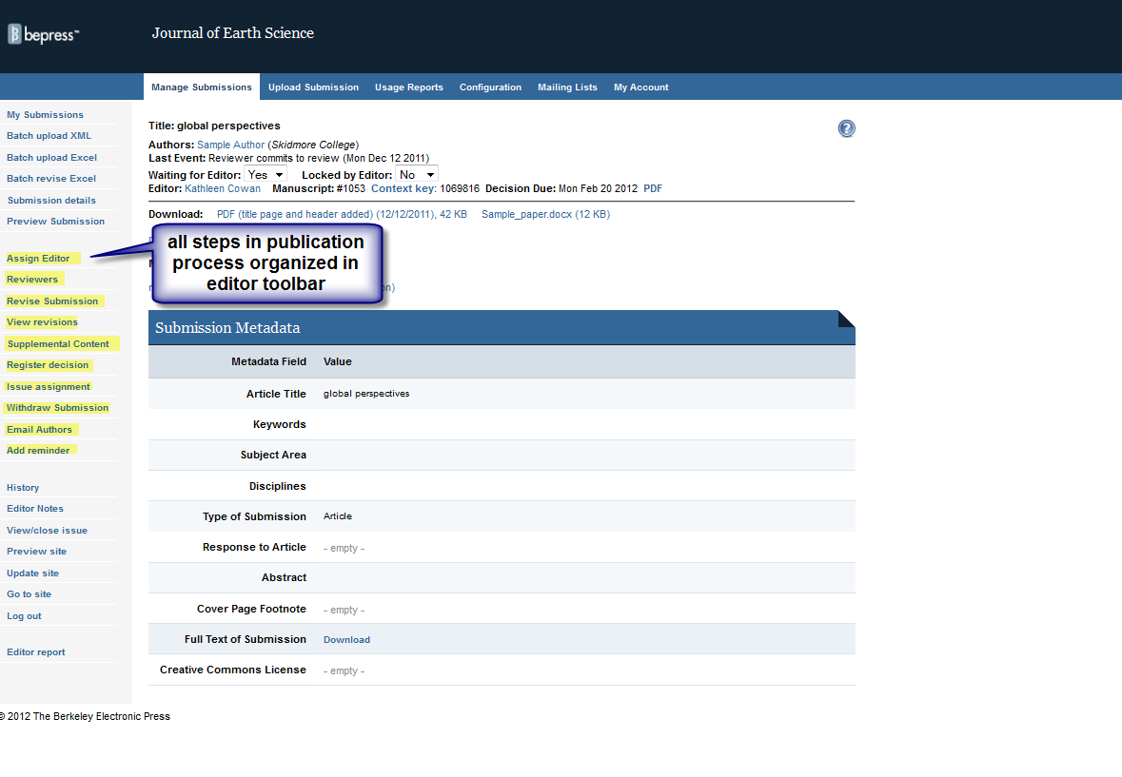
Editor view: Article metadata

Slide 28
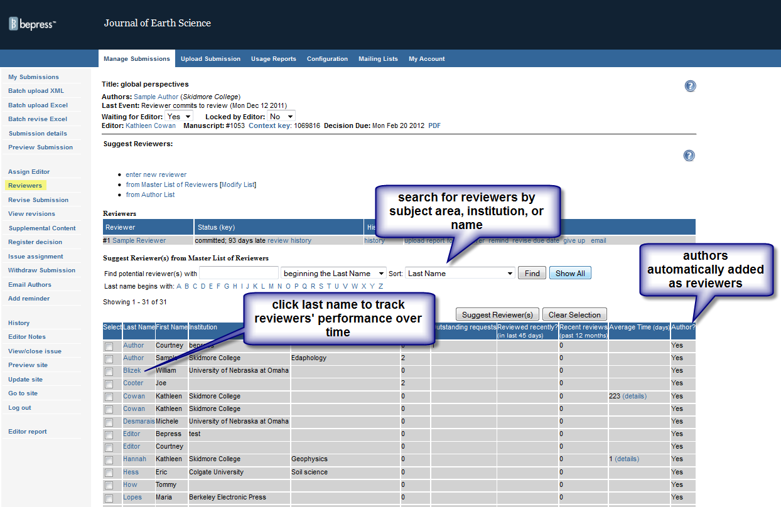
Editor view: Reviewers

Slide 29
Editor view: Article history

