Slide 1
Open Science Approaches at the University of Edinburgh
Dominic Tate
Head of Library Research Support
Library and University Collections
University of Edinburgh

Slide 2
The University of Edinburgh
Research-led institution
Annual turnover now over £1bn
Mission: the creation, dissemination and curation of knowledge
13,800 staff (6,800 academic)
39,500 students
20 schools in 3 Colleges:
Arts, Humanities & Social Sciences
Medicine & Veterinary Medicine
Science & Engineering

Slide 3
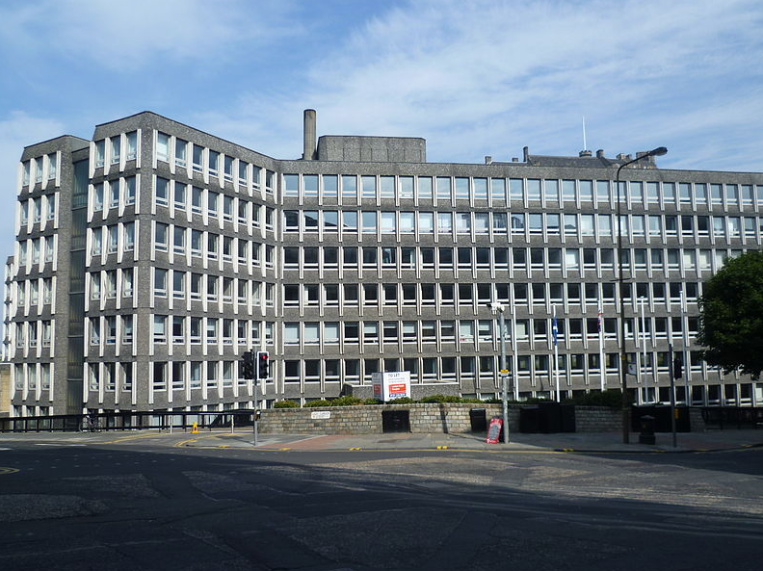
Information Services Directorates
Library & University Collections
Applications
IT Infrastructure
Learning, Teaching & Web
User Services
Information Security
EDINA
Digital Curation Centre
Argyle House https://commons.wikimedia.org/wiki/File:Argyle_House_2010.JPG
Kim Traynor [CC BY-SA 3.0 (https://creativecommons.org/licenses/by-sa/3.0)]

Slide 4
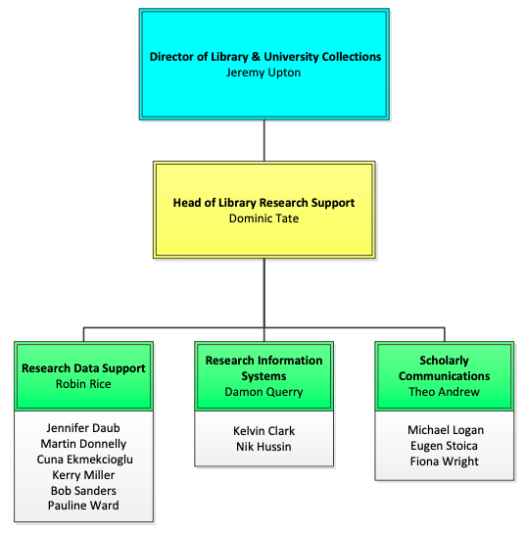
Library Research Support

Slide 5
Research Data Service
Brings together multiple Information Services teams
Provides tools and services for researchers
Trains staff and students on all matters relating to Research Data Management (RDM)
Advises on improvements to University infrastructure to support activities throughout the RDM lifecycle
Supports researchers with data management planning
Provides a helpdesk
Delivers consultancy

Slide 6
Edinburgh’s policy approach…
Formal commitments to research integrity, Open Access, DMPs, open data
Articulates clear responsibilities of the researcher and of the institution
Open?
Current publications policy is “Open (Access) where appropriate”: now moving away from supporting hybrid OA, in line with Plan S
Current data management policy (2011) doesn’t really use the word Open: it predates the popularisation of this terminology
Both policies due for updates in the coming year…
Are we moving towards “Open by default”?
Notes:
Data policy refers to not allowing publishers to *prevent* data from being made openly available

Slide 7
Benefits of/drivers for Openness
INTEGRITY, TRANSPARENCY and QUALITY: The evidence that underpins research can be made open for anyone to scrutinise, and attempt to replicate findings. This leads to a more robust scholarly record, and reduces risk of academic fraud
IMPACT and LONGEVITY: Open outputs/resources receive more citations, over longer periods
SPEED: The research process becomes faster overall
DURABILITY: Fewer important datasets will be lost
EFFICIENCY, ACCESSIBILITY and RE-USE: Research can be funded once, and outputs used many times for a variety of purposes. Interested third parties can (where appropriate) access and build upon publicly-funded research outputs with minimal barriers to access

Slide 8
Benefits of Openness: for research
Journal of Open Archaeology Data, CC-BY 3.0

Slide 10
“28 classic and contemporary psychology findings replicated in more than 60 laboratories each across three dozen nations and territories” https://cos.io/about/news/28-classic-and-contemporary-psychology-findings-replicated-more-60-laboratories-each-across-three-dozen-nations-and-territories/
Klein, R. A., Vianello, M., Hasselman, F., Adams, B. G., Adams, R. B., Jr., Alper, S., … Nosek, B. A. (2018, November 19). Many Labs 2: Investigating Variation in Replicability Across Sample and Setting. https://doi.org/10.31234/osf.io/9654g

Slide 11
“The solutions adopted by the high-energy physics community to foster reproducible research are examples of best practices that could be embraced more widely. This first experience suggests that reproducibility requires going beyond openness.”
Chen et al. “Open is not enough”
https://www.nature.com/articles/s41567-018-0342-2

Slide 12
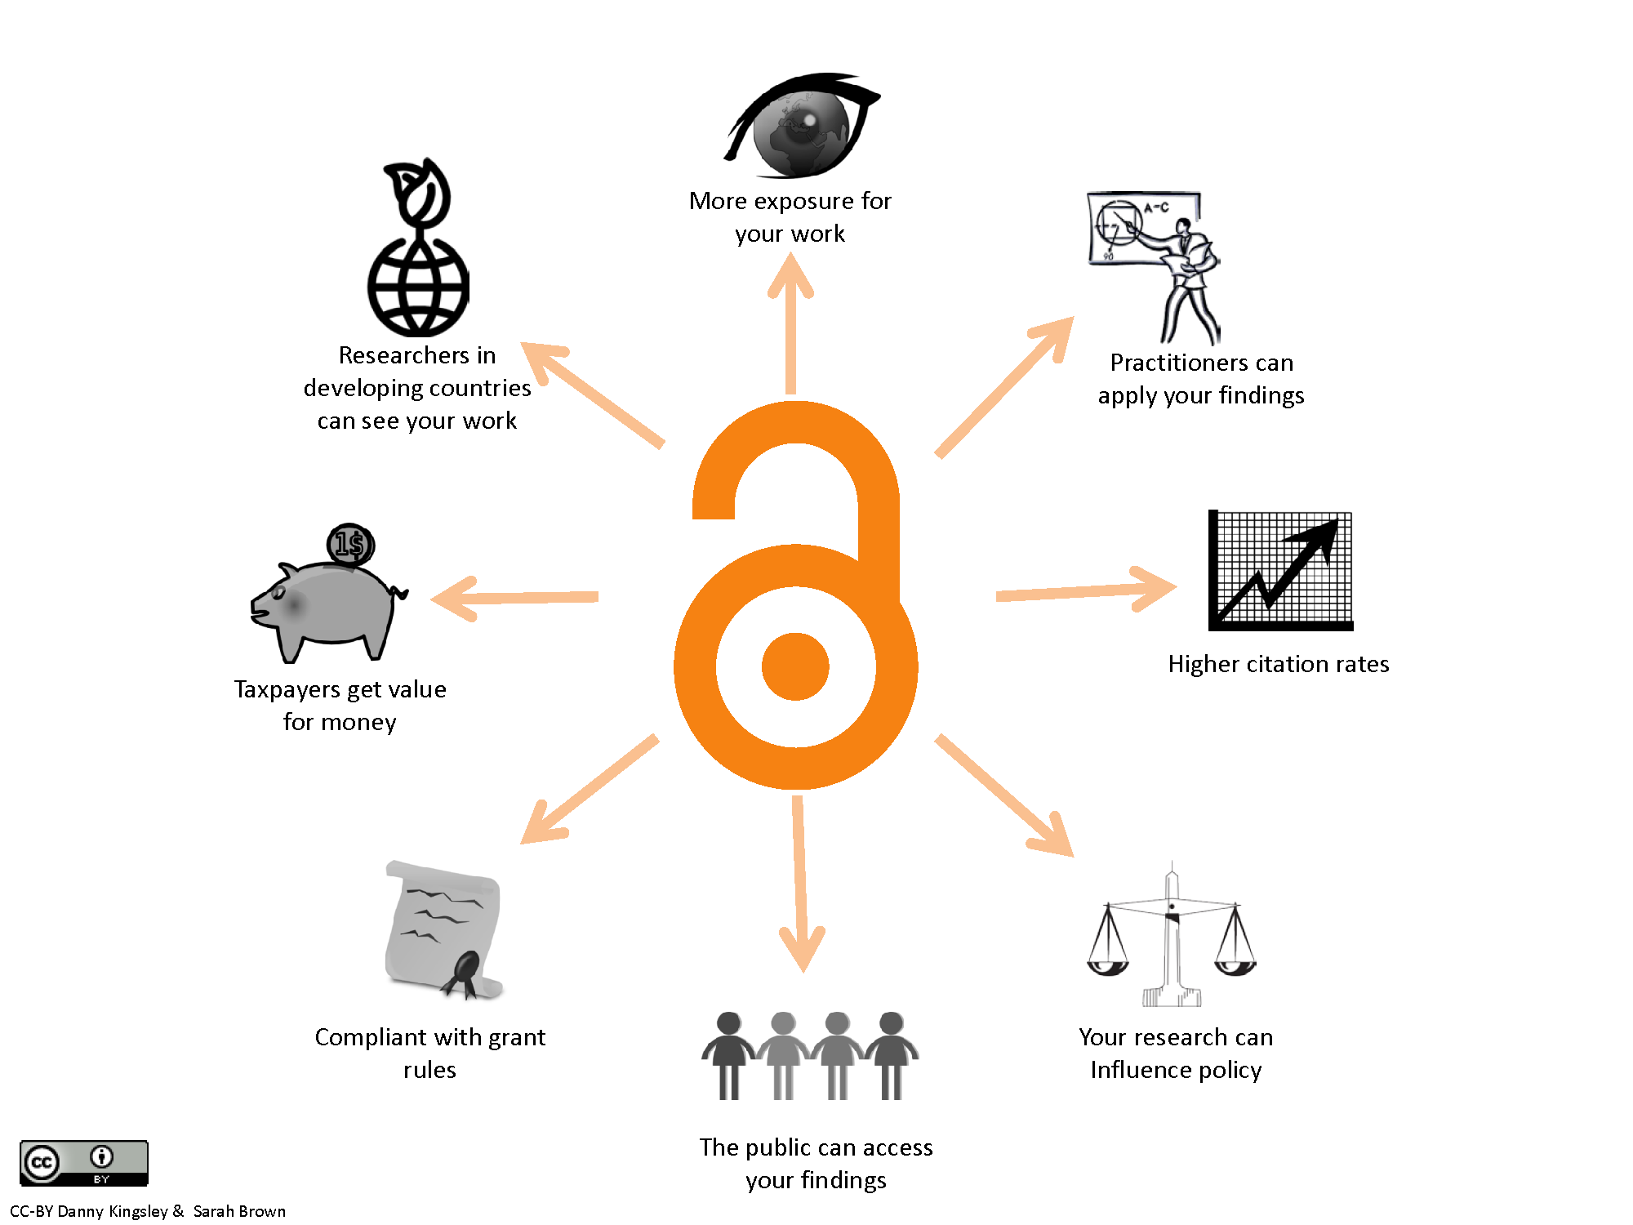
Benefits of Openness: other
Global Collaboration
Efficiency
Quality & Integrity
Innovation & Knowledge Transfer
Public Engagement

Slide 13
City Region Deal
Overall investment of £1.1billion from UK and Scottish governments and industry partners
Involves UoE and other regional HEIs & FE colleges
Aims to establish the region as the data capital of Europe, attracting investment, fuelling entrepreneurship and delivering inclusive growth via data-driven innovation
Training 100,000 people in data applications over 10 years
http://www.acceleratinggrowth.org.uk/
Notes:
Investment of up to £1.1bn - Over 10 years, the University and partners aim to train 100,000 people in the application of data across the region’s major industry sectors. It will work with the private and public sectors to grow awareness of data science’s implications. As it takes effect, the programme will enable both established and start-up businesses to capture these opportunities.
Five sectoral programmes:
• Research, Development and Innovation • Employability and Skills • Transport • Culture • Housing

Slide 14
Notes:
Investment of up to £1.1bn - Over 10 years, the University and partners aim to train 100,000 people in the application of data across the region’s major industry sectors. It will work with the private and public sectors to grow awareness of data science’s implications. As it takes effect, the programme will enable both established and start-up businesses to capture these opportunities.
Five sectoral programmes:
• Research, Development and Innovation • Employability and Skills • Transport • Culture • Housing

Slide 15
First, can we define it?
“Open Science is the practice of science in such a way that others can collaborate and contribute, where research data, lab notes and other research processes are freely available, under terms that enable reuse, redistribution and reproduction of the research and its underlying data and methods.” - EU FOSTER Project
NOTE: EU references to “science” do cover social sciences, humanities, and to some extent the arts, but the UoE’s preferred term is more likely to be “Open Research”

Slide 16
Constituent parts of Open Science
OA publications
Data sharing
Software preservation
Open notebooks, workflows and methods
Pre-registration
Open peer review
Open hardware
Open rewards/recognition

Slide 17
Constituent parts of Open Science I
Mapping them to (our) infrastructure…
OA publications [SCHOLARLY COMMS]
Data sharing [RESEARCH DATA SERVICE, DIGITAL CURATION CENTRE]
Software preservation [SOFTWARE SUSTAINABILITY INSTITUTE]
Open notebooks, workflows and methods [EDINA, RSPACE, OTHERS]
(ALL OF THE ABOVE EITHER IN PLACE OR ADVANCED)

Slide 18
Current state of play
Library Research Support is taking the lead on the Open Research agenda across the University.
Initial paper taken to Research Policy Group in February 2018.
An Open Science Roadmap for the University is in preparation (draft presented to RPG in October.)
Draft includes 37 recommendations, based on the LERU declaration, with a RAG status for each Question (see next slide.)
Working with research managers and Deans of Research to design cultural change. Thought leadership from academics, then implemented by managers… not forgetting community engagement and targeted measures, accountability and monitoring.
Some OS-related changes are beyond LRS’s immediate sphere of influence – e.g. academic recruitment, promotion and reward.

Slide 19
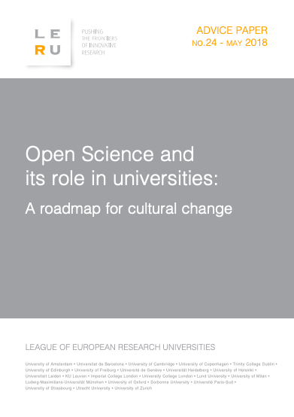
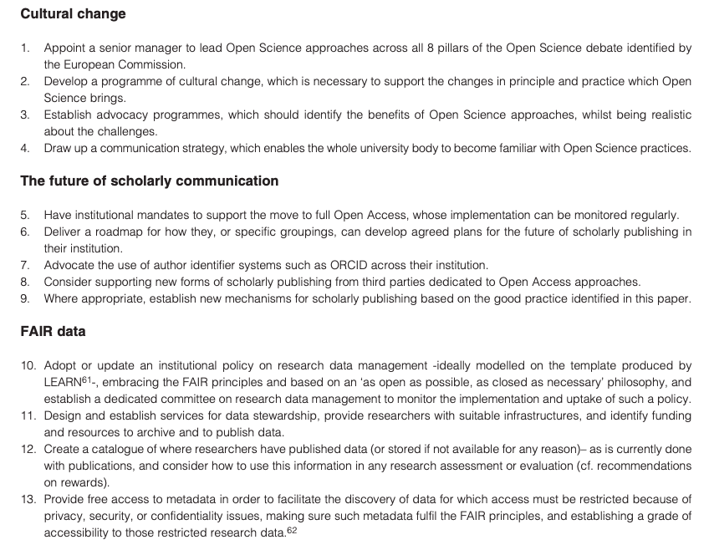
LERU roadmap

Slide 20
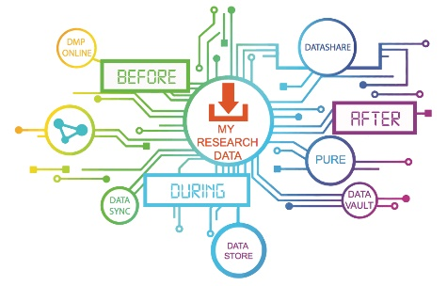
Research Data Service Roadmap
Research Data Service Roadmap: August 2017-July 2020, approved by academic-led steering group. Building on (mostly) success of earlier two Roadmaps, starting 2012
Divided into five themes
Theme A: Unification of the service - from RDM programme to unified research data service
Theme B: Research data management planning
Theme C: Working with data
Theme D: Sharing and preserving research data
Theme E: Training and support
32 challenging objectives with associated actions, milestones and deliverables
https://www.ed.ac.uk/is/rdm-roadmap
Notes:
1st, August 2012 –May 2015: Rollout and consolidation of primary services (active storage, open repository); minimally meeting funders’ requirements
2nd, September 2015 – July 2016: Transition from RDM programme to Research Data Service; training programme & DMP support
3rd, August 2017-July 2020: Filling known gaps through major development projects, increasing usage beyond early adopters, tuning the user journey

Slide 21
Roadmap Challenges
Getting through the sheer volume of work in a coordinated way
Managing stakeholder expectations as we go
Keeping up with developments in data science and data stewardship and being responsive to signals of change
Reaching beyond enthusiast and early adopters to the majority of researchers
Publish or perish culture: anything beyond publications perceived as second class research objects
Scholarly publishing commercial giants competing for the data space
Balancing FAIR data with GDPR: “As open as possible, as closed as necessary…”

Slide 22
Near future activities
A selection from the Roadmaps…
Identify senior Open Science champion(s)
Develop networks within the University
Continue to unify look and feel of components, and emphasise a straightforward and coherent narrative
Improve in-person and online training provision, particularly around dealing with sensitive data
Encourage data management plans and sharing at postgraduate level, incorporating software management as next step in the Open Science chain
Continue to explore and define requirements for electronic (lab) notebooks

Slide 23
References, resources and links
LERU Roadmap for Open Science
https://www.leru.org/publications/open-science-and-its-role-in-universities-a-roadmap-for-cultural-change
LIBER Open Science Roadmap
https://libereurope.eu/blog/2018/07/03/liber-launches-open-science-roadmap/
DCC / SPARC Europe Open Data Policy Analyses
https://sparceurope.org/update-analysis-open-data-policies-finds-new-activity-around-oa-od-policies-multiple-countries/
UoE links
https://www.ed.ac.uk/is/research-data-service
https://www.ed.ac.uk/is/research-data-policy
https://www.ed.ac.uk/is/rdm-roadmap

Slide 24
Dominic Tate
Head of Library Research Support
Library and University Collections
University of Edinburgh
dominic.tate@ed.ac.uk
This work is licensed under the Creative Commons Attribution 4.0 International License.

