Slide 1
ORCID: ADDING VALUE TO THE GLOBAL
RESEARCH COMMUNITY
ILIDE CONFERENCE, JASNÁ, SLOVAKIA | 8 APRIL 2019
Ivo Wijnbergen
Manager, EMEA Engagement
i.wijnbergen@orcid.org
orcid.org/0000-0001-5540-748X

Slide 3
Open
Researcher and
Contributor
IDentifier

Slide 4
WHAT IS ORCID?
An identifier for researchers
A registry
A set of standard procedures for connecting researchers to their affiliations and activities
A committed community building connectors
An international-scale open research effort

Slide 5
ORCID IS OPEN
Non-profit and platform-neutral
International service that integrates with other researcher identifiers
Registry use is free for individuals
Independent non-profit membership organization
Open data, software, APIs, and documentation

Slide 6
Current Worldwide ORCID Adoption
Over 6 million registered users
1000+ Member Organizations
21 Consortia worldwide
*As per April 1st 2019, ORCID data
Notes:
2018 was the year that we passed 5m users and 1000 members. 2019 will be another year of first’s for us, as we are set to become financially self-sustaining as an organisation, and we will pass the 6m users mark. We’re very proud to be part of this community and being in a position where we are contributing to more trust, transparency and efficiency research.

Slide 7
RESEARCHERS

Slide 8
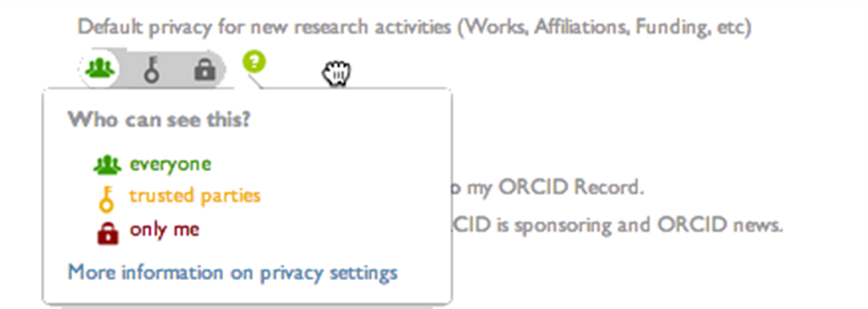
ORCID PUTS THE RESEARCHER IN CONTROL
Researchers sign in to their ORCID account to:
Connect their iD to research systems
Control who can access their information and what they can do with it
Choose what information to make public

Slide 9
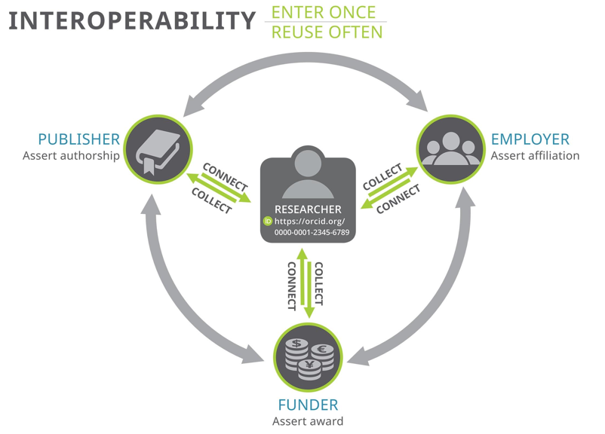

Slide 10
2019: THE YEAR OF THE RESEARCHER
Enhancing ORCID records to show more activities, contributions, and affiliations.
Enable researchers to display richer pictures of more kinds of career.

Slide 11
INFRASTRUCTURE:
TRUSTED ASSERTIONS

Slide 12
Assertion Assurance & Transparency
Establish ORCID as a credible hub for asserting and re-using researcher information.
Encourage the re-use of data in ORCID records by helping data “re-users” to assess the trustworthiness of assertions. (RIPEN)
Explore ways of easing reporting to funders and supporting organizations. (ORBIT)
Notes:
Project ORBIT: ORID Reducing Burden and Improving Transparency Build and test ORCID integration in funding workflows, and help to find shared solutions to common problems.

Slide 13
STRATEGIC RELATIONSHIPS:
3 KEY GLOBAL PROJECTS

Slide 14
ACADEMIA & BEYOND

Slide 15
ACADEMIA & BEYOND
2019 strategic project to expand understanding, use, and adoption of ORCID in Arts & Humanities (phase 1) and Clinical Medicine (phase 2) communities
APPROACH
Analyse ORCID adoption in each community
Form steering group of community experts globally
Implement user journey project to understand researcher workflows
Interview community experts about their own experience of ORCID and the needs of their communities

Slide 16
ORCID
Reducing
Burden and
Improving
Transparency

Slide 17
Funders wield the power to improve the value and openness of research information.
Unique researcher identifiers have the potential to bring efficiency and transparency to the creation and re-use of that information.

Slide 18
ORBIT: AN OVERVIEW
The initial focus is on:
Automatically populating funding applications with CV and career information + Benefits the Researcher & Funder
Sharing grant funding information via the ORCID Registry + Builds trust and transparency
Extending the availability of research information, and making it easier to re-use + Builds trust and transparency

Slide 19
ORCID FUNDER OPEN LETTER
An open letter from funders to indicate their intent to integrate ORCID into their grant management workflows has now been signed by 11 funding organizations.
Signatories “commit to implementing ORCID iDs in accordance with their best practice guidelines for funders. We encourage other funders to join us in this initiative. We hope that our action inspires the community, including researchers, scholars, scientists, and research institutions, as well as other funding bodies, to join us in adopting ORCID.”
https://orcid.org/organizations/funders/open-letter

Slide 20
RESEARCH INFORMATION PLATFORM ENGAGEMENT

Slide 21
RIPEN
We care about three relationships in an assertion:
Item origin - whoever published the activity or is the affiliated party
Assertion origin - whoever collects the ORCID iD and makes the connection to an item
Source - whoever adds the information to the researcher’s ORCID record
RIPEN will enable authenticated ORCID iD collection and secure cross-platform sharing of ORCID permission tokens (using JSON Web tokens)
Blog

Slide 22
THANK YOU!
Ivo Wijnbergen - Manager, EMEA Engagement
i.wijnbergen@orcid.org - orcid.org/0000-0001-5540-748X
Notes:
Ending with Special thanks from all the ORCID, 30 people serving more than 6 million user in one way or another. So a big thank you from all the ORCID team because without the support of members and the research community ORCID would never exist.

Slide 23
Useful Links
2019 Project Roadmap
ORCID for research organizations
Learn more about membership
Publishers Open Letter
Funders Open Letter
ORCID Blog

