Slide 1
“Here be dragons”: Open Access to Research Data in the Humanities
09.04.2019 | Jasná (Slovakia)
Innovative Library in Digital Era 2019 (ILIDE)
http://ilideconference.schk.sk/wordpress/
Dr. Ulrike Wuttke
(v_1.0)
DOI: http://doi.org/10.5281/zenodo.2630155
Ulrike Wuttke, University of Applied Sciences Potsdam / RDMO
@UWuttke @rdmorganiser | CC-BY 4.0 | https://rdmorganiser.github.io/
Unless otherwise stated the content of these slides is under the license CC-BY 4.0

Slide 2
Introduction
01

Slide 3
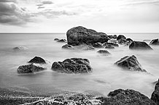
90% of all digital research data is lost (estimation 2011) ^{[1]}
Picture: Rocks at Vlychada Beach in Exomytis, Santorini, Greece, by Dietmar Rabich, CC BY-SA 4.0, https://commons.wikimedia.org/w/index.php?curid=63225571
[1] See: Stefan Winkler-Nees (from the Deutschen Forschungsgemeinschaft-DFG), Vorwort, In: Büttner, Stephan; Hobohm, Hans-Christoph; Müller, Lars (ed.): Handbuch Forschungsdatenmanagement, Bad Honnef 2011, p. 5.

Slide 4
Do your data sparkle joy? Are your data FAIR?
Source pictures: Left ‘Adam’s Creation Sistine Chapel ceiling’ by Jörg Bittner Unna, CC BY 3.0, https://commons.wikimedia.org/w/index.php?curid=46496746, Right ‘Hand’ by Ulrike Wuttke, CC BY 4.0

Slide 5
Open Science has many facets
Source Picture: https://www.fosteropenscience.eu/content/what-open-science-introduction, CC BY 4.0

Slide 6
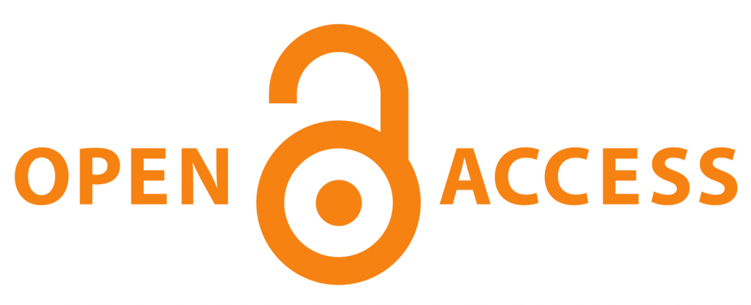
“Open research data (ORD) have the potential not only to deliver greater efficiencies in research, but to improve its rigour and reproducibility, to enhance its impact, and to increase public trust in its results.” ^{[1]}
^{[1]} Open Research Data Task Force. (2018, July). Realising the potential: Final Report of the Open Research Data Task Force. Open Research Data Task Force, N.P., p. 3. Retrieved from https://assets.publishing.service.gov.uk/government/uploads/system/uploads/attachment_data/file/775006/Realising-the-potential-ORDTF-July-2018.pdf.

Slide 7
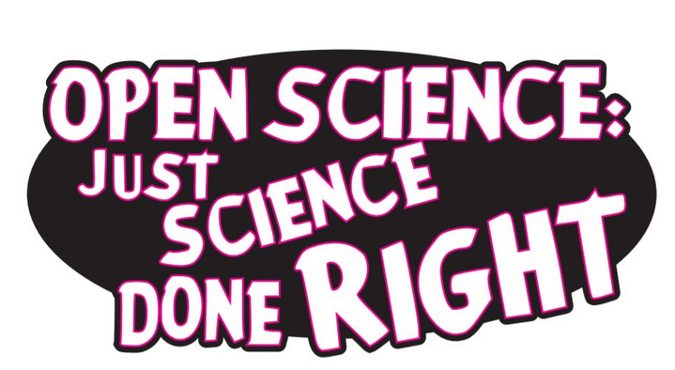
Source Picture: https://zenodo.org/record/1285575#.W09yZH59jOR (Melanie Imming, John Tennant, CC0)

Slide 8
Open Data & EOSC
“a virtual environment with open and seamless services for storage, management, analysis and re-use of research data, across borders and scientific disciplines”
https://www.eosc-portal.eu/about/eosc
European Open Science Cloud:
https://www.eosc-portal.eu/
Source Picture: https://library.ktu.edu/news/launch-of-the-european-open-science-cloud-eosc/

Slide 9
The FAIR Principles
FAIR Guiding Principles for scientific data management and stewardship
Baseline understanding for the value sharing data can deliver and the baseline requirements for doing so
Developed by FORCE 11 ^{[1]}
Findable
Accessible
Interoperable
Reusable
^{[1 ]} https://www.force11.org/group/fairgroup/fairprinciples

Slide 10
Vision for Humanities Data
Lost
Preserved
FAIR!
Photo background: “Digital hologram” by Ashwin Vaswani, https://unsplash.com/photos/JqZ7q_S3xOE

Slide 11
Here Be Dragons
02

Slide 12
Outline of the presentation
Introduction
Here be dragons (Key challenges)
Perspectives
RDMO
Conclusion

Slide 13
Here be dragons (Key challenges)
Ambivalence about the concept “data”
Key concepts and recommendations, e.g. FAIR principles little known in research communities
Publication of research data only as afterthought
Issues around incentivisation
Fears
Availability & sustainability of specialist support structures for humanities research data support

Slide 14
Progress!
“For example, the emergence of linked open data over the past decade has been supported both by the establishment of effective standards for modeling and disseminating such data, and the growth of practices and social expectations supporting its creation. These developments have meant that expertly modeled data from specific domains can be accessed and combined flexibly, rather than remaining in isolation or striving for self-sufficiency.” ^{[1]}
[1] Flanders, J., & Jannidis, F. (2019). Data Modeling in a digital humanities context: An introduction. In J. Flanders & F. Jannidis (Eds.), The shape of data in the digital humanities: Modeling texts and text-based resources (pp. 3–25). London, New York: Routledge, p. 20.

Slide 15
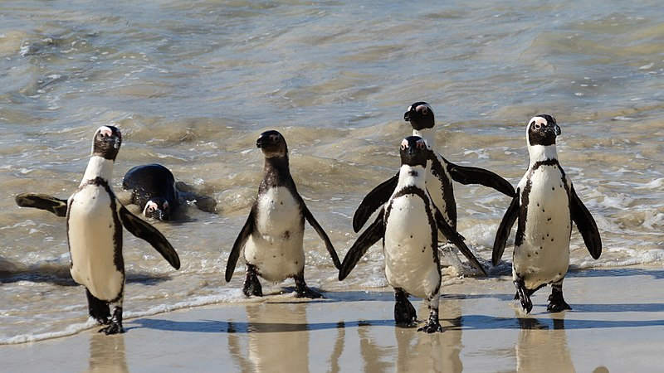
“Fellowship of the Data”
Picture: African penguins, Boulders beach, Simon's Town, South Africa by Pierre-Selim Huard
https://commons.wikimedia.org/wiki/File:Simon%27s_Town_-_African_Penguins_-_2018-07-27_-_9028.jpg, CC BY 4.0

Slide 16
Perspectives
03

Slide 17
DORA (San Francisco Declaration on Research Assessment)
For the purposes of research assessment, consider the value and impact of all research outputs (including datasets and software) in addition to research publications, and consider a broad range of impact measures including qualitative indicators of research impact, such as influence on policy and practice.
https://sfdora.org/

Slide 18
Invest in support infrastructure
“The interdisciplinary bundling of humanities data repositories and the development of adequate research tools and services for linked data represents a great opportunity for humanities research.” ^{[1]}
^{[1]} Translation from Schrade, T. (2018). Im Datenozean. F.A.Z. Retrieved from Permalink: https://www.faz.net/-in2-9h3jj, 31.03.2018

Slide 19
Training & Education
Next (and this) generation of researcers: awareness raising and skills
tool-agnostic vs. tool-dependent
data literacy and data infrastructure literacy ^{[1]}
^{[1]} data infrastructure literacy coined by Gray, J., Gerlitz, C., & Bonegru, L. (2018). Data infrastructure literacy. Big Data & Society, 1–13. https://doi.org/10.1177/2053951718786316

Slide 20
Research Data Management
Research Data Management describes the process to curate (or manage) research data along the research data lifecycle and includes various activities such as planning, producing, selection, analysis, archiving, and preparation for reuse. Because data are very heterogeneous, discipline and data specific solutions can be required.
Picture: Road Sign by Free Images
(www.inkmedia), CC BY 2.0 https://flic.kr/p/JoVNhU
Translated (UW) from: AG Forschungsdaten der Schwerpunktinitiative “Digitale Information” der Allianz der deutschen Wissenschaftsorganisationen, Forschungsdatenmanagement: Eine Handreichung, 2018, p. 4. Online: http://doi.org/10.2312/allianzoa.029 (CC BY 4.0)

Slide 21
RDMO
04

Slide 22
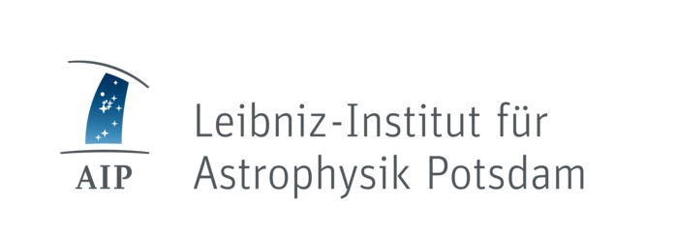
Research Data Management Organiser
Organiser instead of a static plan: Active Data Management
Local instead of central: Customization for local institutions and research fields
Engagement of all stakeholders
Guided Questionnaire
➽ https://rdmorganiser.github.io

Slide 23
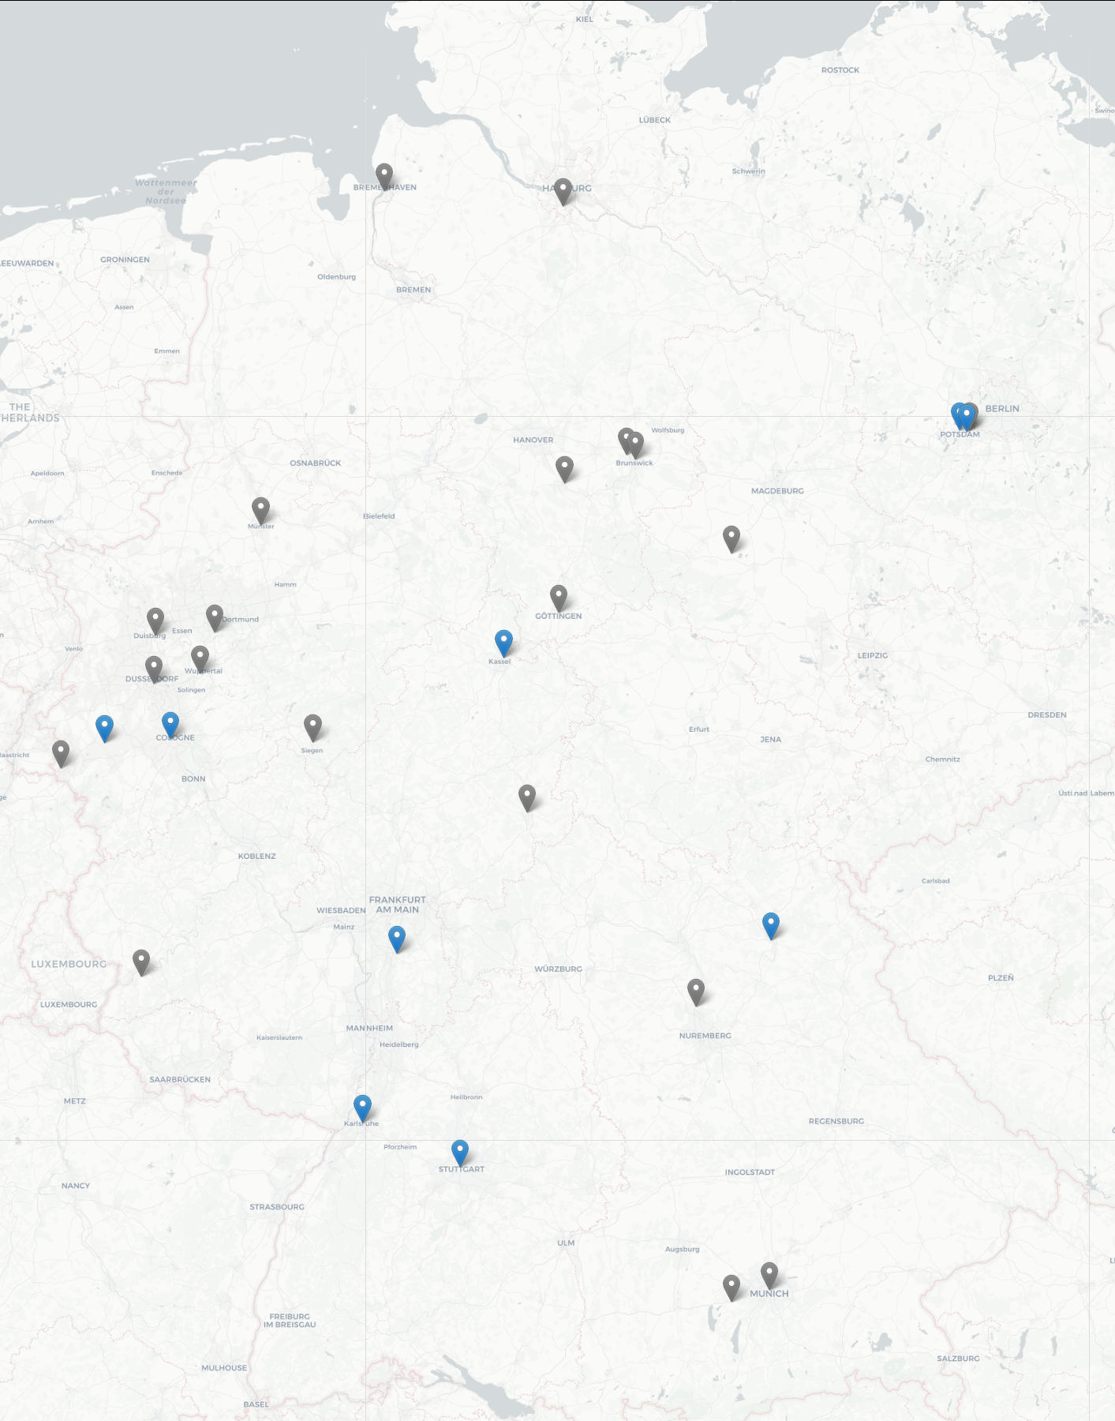
Research Data Management Organiser
Independent operation by
Universities
Research Institutions
Libraries
Collaborations
https://rdmorganiser.github.io/kooperationen/

Slide 24
Conclusion
05

Slide 25
I want it all, and I want it now!
This is the cover art for the single I Want It All by the artist Queen. The cover art copyright is believed to belong to the label, Parlophone, Capitol, or the graphic artist(s). Marked for FAIR Use. https://upload.wikimedia.org/wikipedia/en/6/6f/Queen_I_Want_It_All.png

Slide 26
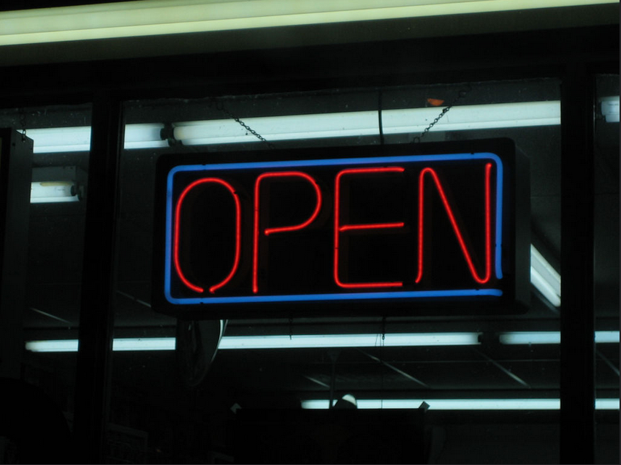
Viva la Open Revolution!
To create a broad culture of FAIR data sharing in the humanities, we have to roll up our sleeves, team up, and distribute hats:
Embrace Open principles
Bridge the gap between the digital and the humanities
Look what we can learn from the Digital Humanities and other data savvy disciplines
Picture: open by velkr0 CC BY 2.0, https://flic.kr/p/mzqM

Slide 27
CONTACT:
Dr. Ulrike Wuttke University of Applied Sciences Potsdam (FHP)
wuttke@fh-potsdam.de
@UWuttke
RDMO:
➽ Open Source: https://github.com/rdmorganiser
➽ Demo Instance: https://rdmo.aip.de/
➽ Twitter: https://twitter.com/rdmorganiser
➽ Public Mailing List (German): https://www.listserv.dfn.de/sympa/info/rdmo

