Slide 1
The Thomson Reuters CITATION CONNECTION
Digital Library 2014
31st March – 3rd April 2014, Jasná
David Horký
Country Manager – Central and Eastern Europe
david.horky@thomsonreuters.com

Slide 2
The Citation Connection A comprehensive gateway to the most relevant research information: reliable, integrated, multidisciplinary
Unified subject classification
Web of Science
Conference Proceedings Citation Index
51 Million+ patents
Book Citation Index
Data Citation Index
Cited references from 1900
Current Chemical Reactions
BIOSIS Citation Index
Thomson Reuters Web of Knowledge
Index Chemicus
18,000+ journals
Derwent Innovation Index
Current Contents Connect
90 Million + records
Zoological Record
Medline
Regional Citation Indexes
49% of European publishers

Slide 3
The Web of Knowledge advantage:
a single classification system for all content
Web of Science: 1900 - Journal Category
Current Contents Connect: 1998 Discipline Name
Biosis Citation Index: 1926 Major Concept
Zoological Record: 1864 Descriptors / Systematics
MEDLINE: 1950 MeSH Heading, Major Topic, Qualifier
Derwent Innovations Index: 1963 Derwent Class Code
Data Citation Index WoS Journal Category
“RESEARCH AREAS”
ENGINEERING -28070
INSTRUMENTS & INSTRUMENTATION -15896
COMPUTER SCIENCE -13724
PHARMACOLOGY & PHARMACY- 8591
MATHEMATICS- 8375
BIOCHEMISTRY & MOLECULAR BIOLOGY- 7854
CHEMISTRY-7602 ......
One single index
Unified subject classification
Coverage from 1864
Cited references from 1900
18,000+ journals
88+ millions records

Slide 4
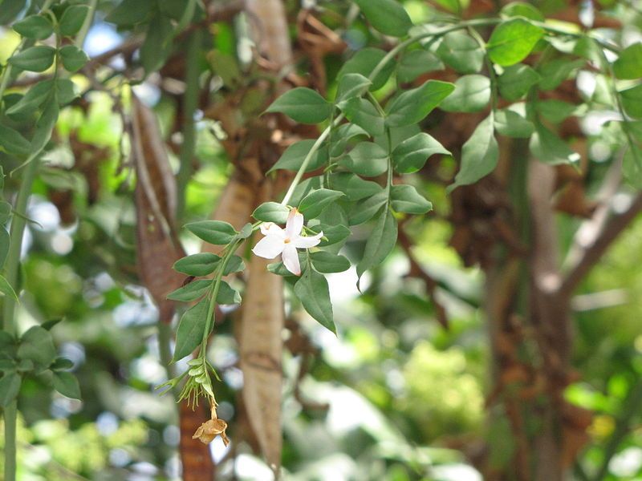
A PRACTICAL EXAMPLE
JASMONATE BIOSYNTHESIS AND SIGNALING
Jasminum grandiflorum

Slide 5
Research Fronts 2013 100 Top-Ranked Specialties in the Sciences and Social Sciences
http://sciencewatch.com/articles/research-fronts-2013-100-top-ranked-specialities-sciences-and-social-sciences

Slide 6
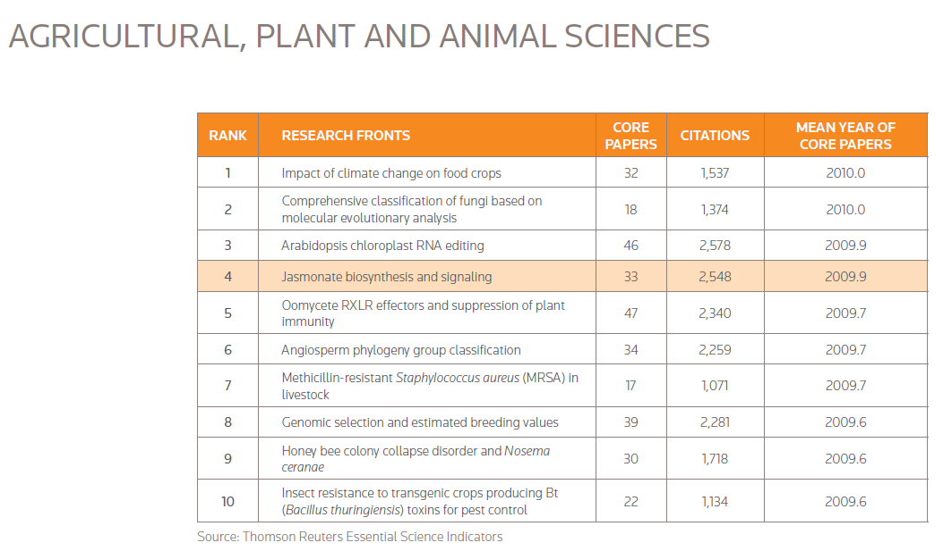
Research fronts in agricultural, plant and animal
Jasmonates are a family of plant signaling compounds which
regulate the expression of plant genes in response to stress and damage, while also mediating such routine developmental processes as root
growth, tuber formation, and flower development. Jasmonate signaling, for example, initiates plant defense responses in reaction to pathogens, or to damage from herbivores.
Recent research has also determined that jasmonates display toxicity toward mammalian cancer cells, inducing such cells to undergo programmed death. These findings have prompted increased investigation into jasmonates as potential therapeutic anticancer agents.

Slide 7
Search all Web of Science databases for jasmonates
Datasets
Journals, Conferences, Books
Biological research
Patents

Slide 8
Search all Web of Science databases for jasmonates
Access various types of research content

Slide 9
Depth of data: this topic has deep roots
Searching data all the way back to 1864

Slide 10
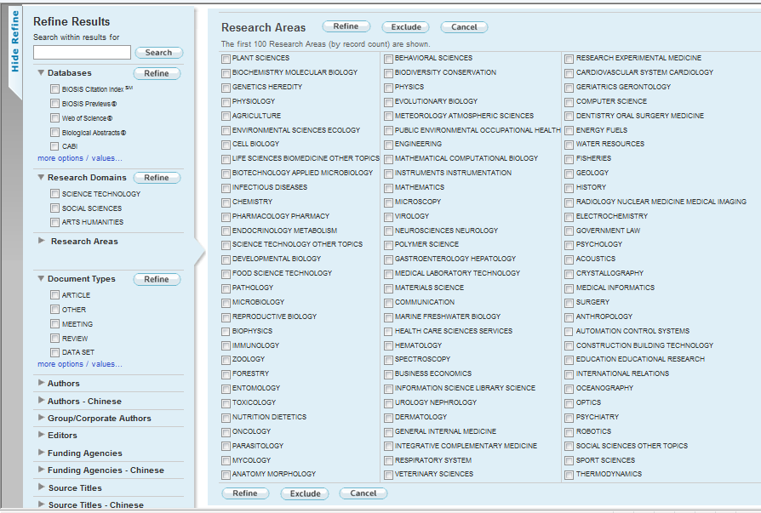
Truly multidisciplinary content
This topic crosses many areas of scholarship.
Drill down to one research area to explore further.

Slide 11
Rank results by “times cited” to find the most high-impact material

Slide 12
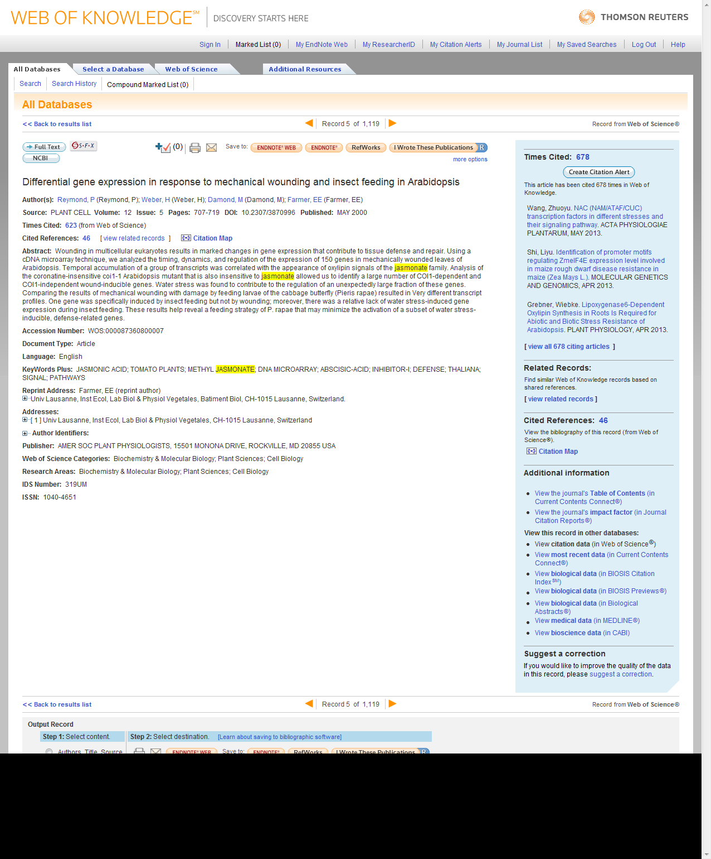
Take advantage of all information available about this article
Web of knowledge:
Citation connection to the other Web of Knowledge citation databases
Citations from/to other BIOSIS publications
Web of Science: How many times was this cited and by whom?
Access to the most recent discoveries on the subject
BIOSIS Citation Index:
A citation network of 22 Million records
This article is also in BIOSIS Citation Index

Slide 13
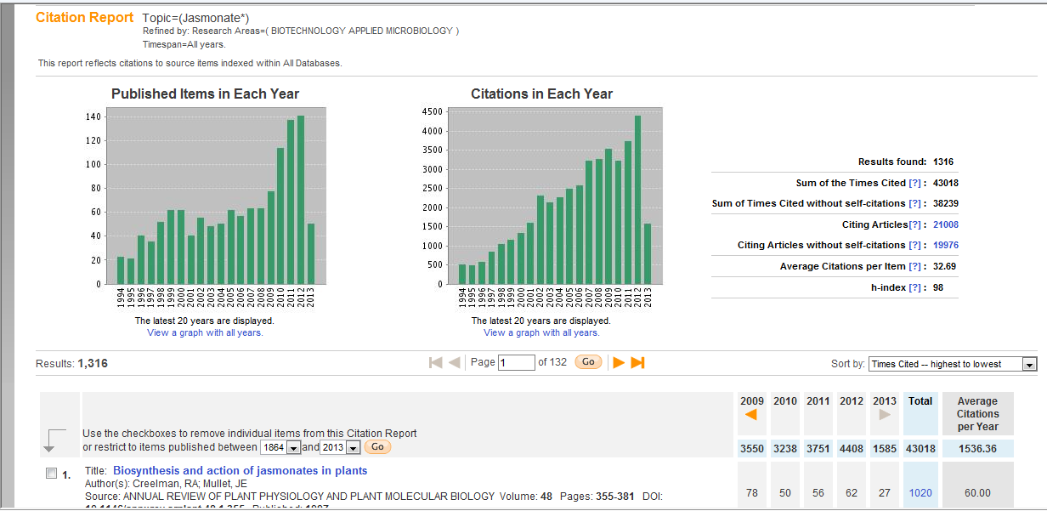
Create a citation report to analyze trends
These citation metrics are calculated across the whole Web of Science citation universe

Slide 14
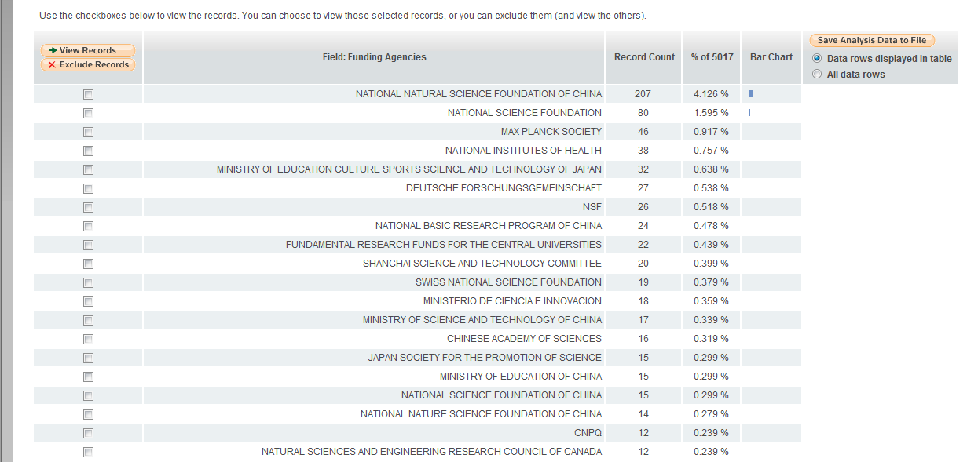
Analyze Results Example: Funding agency
Who is funding research in this area?

Slide 15
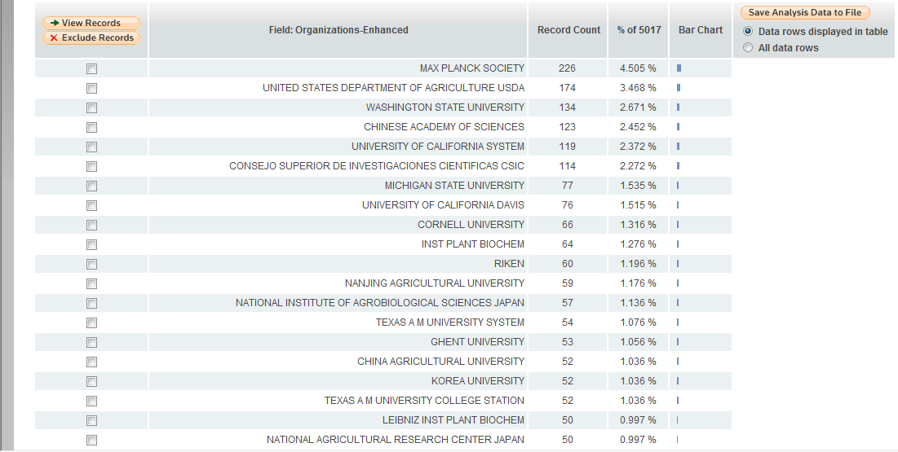
Analyze Results Example: Institution
What institutions are researching this topic?

Slide 16
Analyze Results Example: Authors
Who are the experts on this topic?

Slide 17
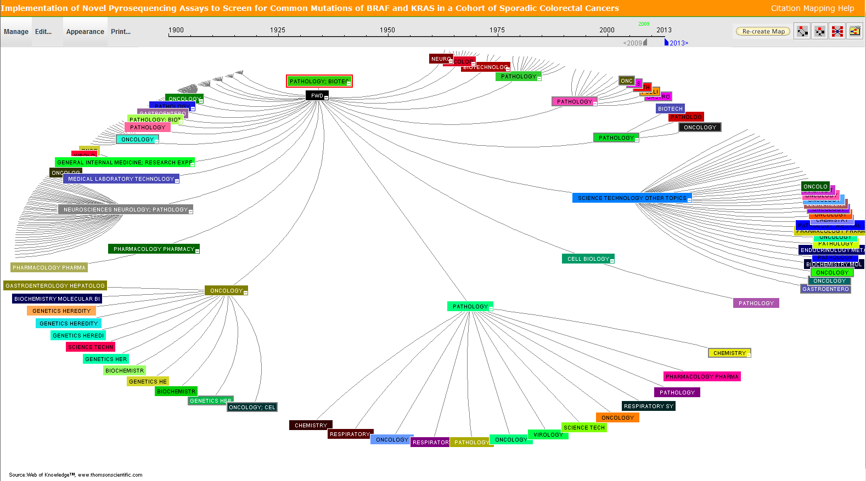
Use citation map visualization to analyze citation activity
What fields has this paper impacted? Analyze two generations of citation activity.

Slide 18
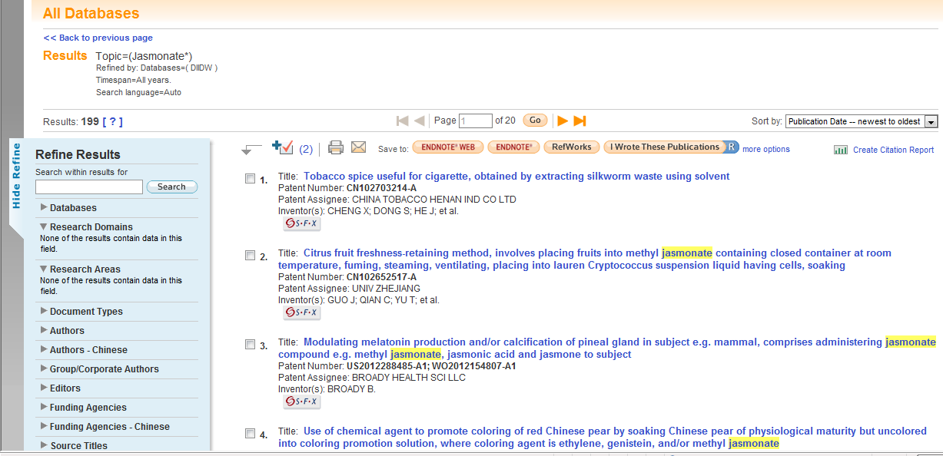
Track this topic from basic to applied research
What are the most recent, global patents on this topic?

Slide 19
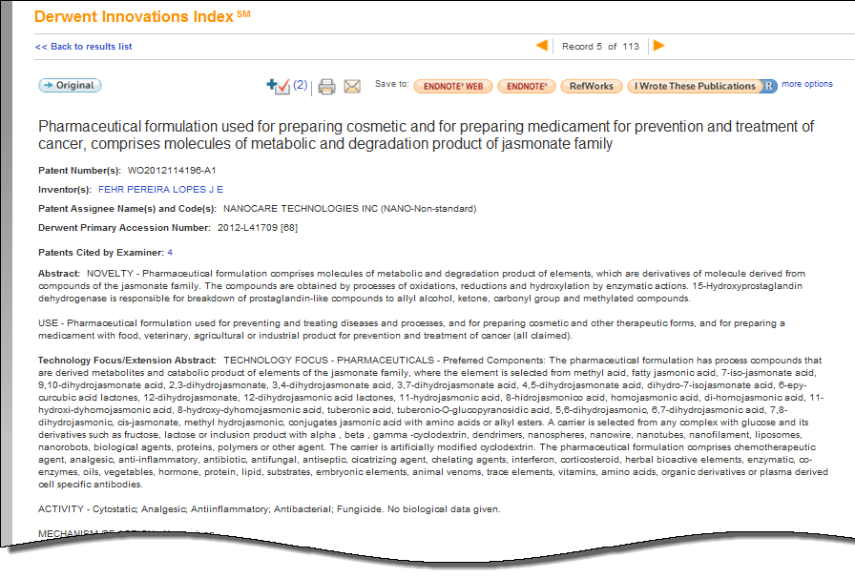
Derwent Innovations Index makes patents accessible to non-experts
Derwent Innovation Index:
22 Million patent families
Our indexers add a plain-language title, and descriptive abstract.

Slide 20
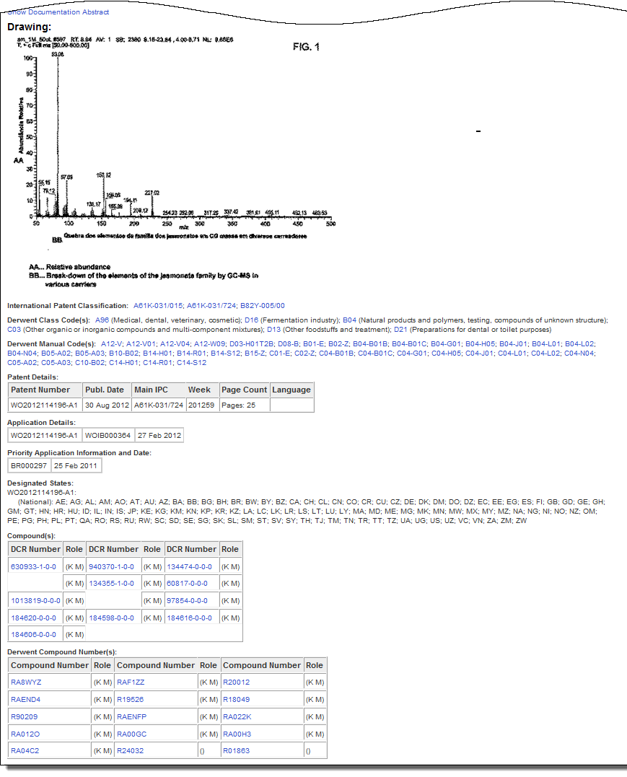
Derwent Innovations Index makes patents accessible to non-experts
Derwent Innovation Index:
22 Million patent families
Drawings are included where available.
Derwent coding classifies this patent into subjects.
Compound information in available and searchable.

Slide 21
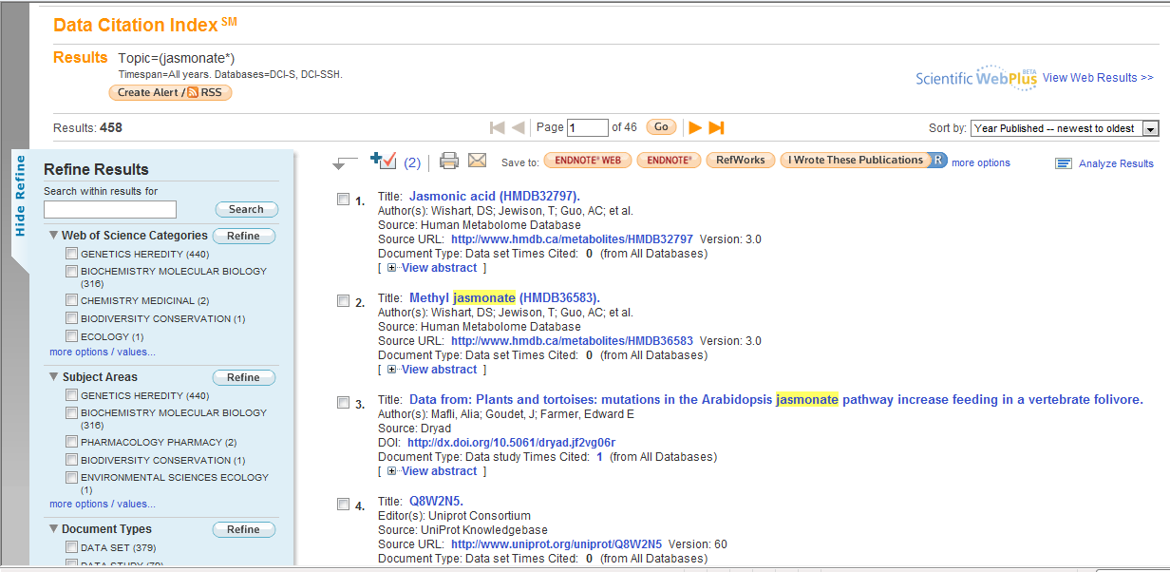
Find datasets related to this topic: Data Citation Index- making research datasets accessible, discoverable, and citable
The Data Citation Index:
2.5 million datasets (growing fast)

Slide 22
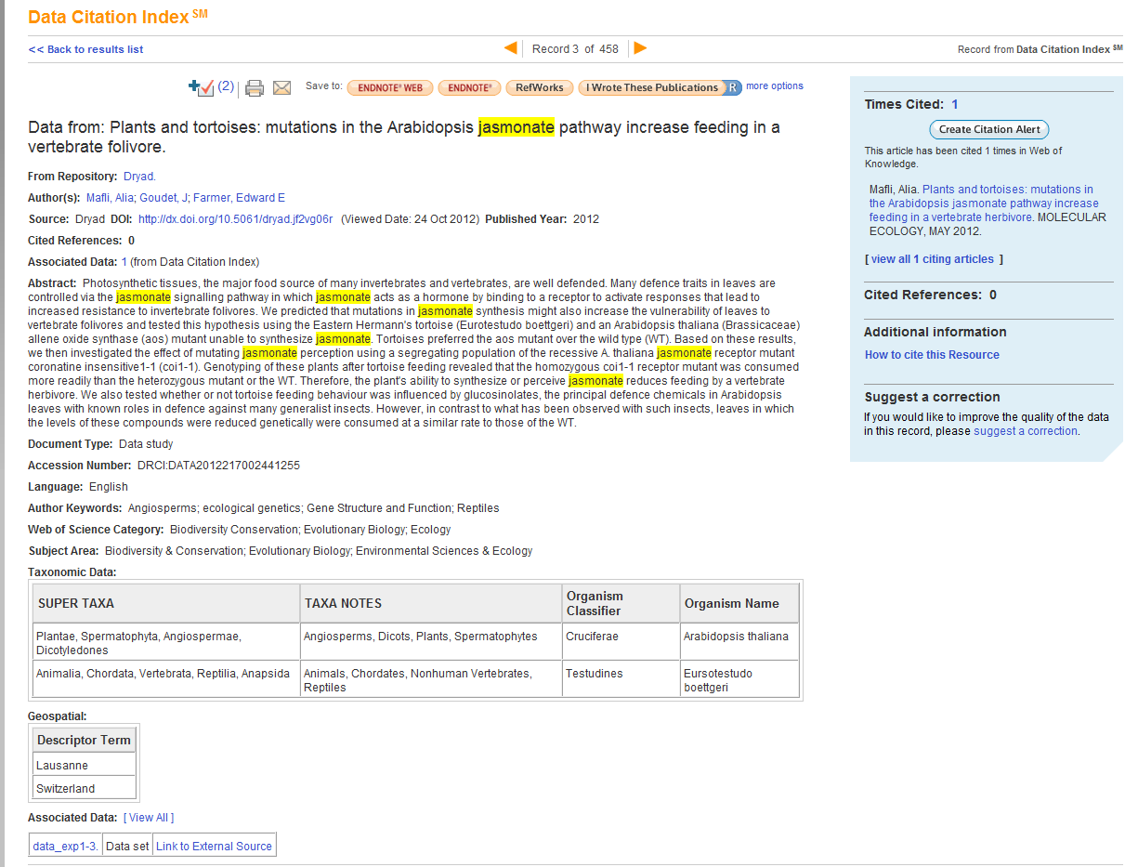
This data study was cited by an article.
Descriptive metadata from the parent repository is retained and searchable.
Link to the repository to access the dataset.

Slide 23
Web of Knowledge
Start at a single point…
and end with the complete picture.

Slide 24
Thank you
David Horký
Country Manager – Central and Eastern Europe
david.horky@thomsonreuters.com

