Slide 1
Managing Data across the Archive Harm-Jan Wijngaarden EMEA Business Development Director April 2014

Slide 2
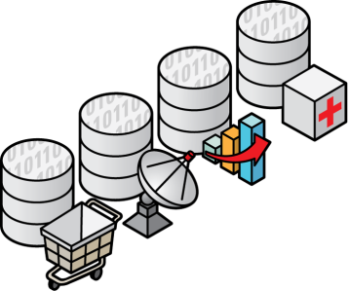
Today’s Paradigm: Data Has Infinite Value
Collaboration and Re-Use with new and old, private and shared content
Data analysis resulting in successful products and corporate strategy development
Applications
Web
Questions
Answers
Instrumentation
Historical

Slide 3
Data growth and access requirements
The nature of storage and data management has to change
40 Zettabyte
40,000 Exabytes
2020
300x Growth from 2005 to 2020
80% of data is never used after 90 days. Why?
2005
>130 Exabytes
Source: IDC Document 1414_v3: THE DIGITAL UNIVERSE IN 2020: Big Data, Bigger Digital Shadows, and Biggest Growth in the Far East, 2012
http://www.avanade.com/Documents/Research and Insights/Collaboration Research - Spring 2010 - Executive Summary.pdf
Notes:
3
Not just growth but recognizing the value of data and increased usage of data
Increasing diversity of data types
80%+ of data is unstructured
The re-use of data is shrinking
80% of data is never used after 90 days
Is it because it truly has no value or because they cannot access it?????
But the need to archive is growing
The good news is companies are seeing value in information. 80% see collaboration is the key to success.
90% had big data initiative’s in place by the end of 2012. They are ready and staged to use the data to achieve success in product development and in corp strategy.
update 30x to 40x; making "increasing" lowercaseas IDC reecntly documented, it was is estimated that in the 10 years between 2010 and 2020, the size of the “Digital Universe” will increase 29X That’s a 41% increase in content every year. And many thing this is even conservative and that we may see closer to 60% annual growth, which would give us a 100x increase in digital data. Source: IDC Digital Universe Study, 2011
The combination of growth in data and on-going data center evolution means that both the mix of data and it’s anticipated usages are changing as well. Here are 5 key items that are driving not just the growth of data but how we deal with it. And how we deal with it will be key to the data center of the future.
Increasing variety of data :: People have typically thought of Oracle as a database company, but 80% of data created and available is actually unstructured. This means that the majority of your capacity is going towards e-mail, document and video storage – which probably has a different value per gigabyte than the data in your core databases. If you are treating all of your data equally, like it was all a high-performance business critical database, you may be behind the benchmarks set by your competitors.
Similarly, 80% of data is never used after 90 days. This is tightly tied to the unstructured number, but is also the case with structured data. For instance, how often do you look at e-mail that is over 90 days old? Similarly, once you are outside of a fiscal quarter, you are less likely to need to dig down into orders and shipments for that quarter and can probably do your Business Intelligence work from summary data.
Or, consider that we are seeing a significant increase in requests for 100 year archives – and these are not just from digital libraries (the preservation and duration of data in digital libraries is a whole other topic). We are seeing these from governments, research organizations, and industries that need to keep track of data on population wide drug interactions or individual airplanes for 10, 20 or 50 years – and not just have them locked away in a cave somewhere but have them available quickly (if not immediately) when called on to do so. One question for you to think about is what your organization’s archive horizon ought to be.
Or, how are you going to deal with the energy consumed by storage? It’s already 40% of the power consumed and is growing 20% per year. With systems actually requiring less power every year. Within 10 years, the total power consumed by storage could increase to more than 6x what it is today – representing over 75% of the energy consumed in the data center. Considering that 80% of the data is never looked at again, and after 6 months that number increases further, we need a better way of dealing with massive amounts of storage.
And of course the cost of managing this data is exploding as well. The increasing number of data sources, data formats, government regulations and the business critical nature of data is driving up management costs by 25% per year – even faster than energy utilization rates – so that data and storage management will become the number one cost within many data centers.
With all of this growth in size and capacity, it is more important than ever to align the value of data with the capabilities and cost of the storage it is stored on. We need to drive the cost of storage used for data that is never referenced again to virtually zero, we need to accelerate access to critical data so we can run our businesses faster and smarter, and we need to do this in an efficient manner which doesn’t overwhelm storage and database administration staffs.

Slide 4
CIO Concerns
77% - How to Manage Growth of the Archive
80% - Plan to Keep Data 50+ Years
They need to manage their archived data!
Source: Gartner
Notes:
That data growth is a concern to the majority of CIOs and its compounded by the fact that 80% of companies plan to keep their data 50+ years.

Slide 5
Challenges
Organizations need to ensure the longevity of digital assets in alignment with institutional policies and in a sustainable, cost-effective manner
Data must be securely retrievable and re-usable over time, across disciplines and accessible by different stakeholders
Organizations need to respond to the increased scrutiny on data and outcomes by governments & other parties involved

Slide 6
So, how do you manage this?

Slide 7
Oracle’s approach towards (the management of) digital archiving
Provide an integrated archiving infrastructure with hardware and software that work together to ...
Preserve data forever (or as long as necessary)
While making it always accessible / retrievable
Minimizing TCO
Offer solutions based on Open Standards / Open Formats
Mix and match software and systems that meet the needs of the archive
Notes:
Oracle offers an Archiving Infrastructure, a Red Stack Solution, that offers forever data preservation, with everlasting availability and the lowest possible TCO. And this is done in such a way that it requires a minimum of management.
We understand the needs and issues of our archiving customers and we offer a solution, which IS based on open standards. This is important for our customers, as this allows them to integrate parts of our solution stack with their existing IT environment. But also, this provides customers with a so-called “exit-strategy”. Should they want to move away from the Oracle solution (maybe Oracle isn’t around any more in x number of years), they can, because Oracle is using open standards and protocols.

Slide 8
Open Archive Formats
Why build an archive on an Open Format?
How much confidence do you have in your archive application?
How do you get to your data if the application goes away?
Have you written your data in an open format?
Oracle is committed to the continued development of archive solutions based on open formats

Slide 9
Archiving Infrastructures in general
Archive Software:
Content Management
Manages what the data does and means
Data Management
Manages where the data resides within the hierarchy of storage
Protects the data with advanced features (integrity checks, WORM, encryptions, etc)
Archive Hardware:
Tiered Storage (Flash, Disk & Tape)
Notes:
This is a GENERIC picture of the components that make up an archiving infrastructure.
Archiving Software:
Content management software, manages what data means, what retention-settings are put to it, who gets access etcetera. (For this, Oracle has WebCenter Content)
Data management software, manages where the data is put in a tiered storage environment. It usually moves the data between different tieres, based on rules and policies. It also protects the data, by doing security features, like integrity checks, WORM (write ones, read many), encrition etcetera. For this, Oracle has a the SAM-QFS product.
Database software, for archiving structured data and also for storing and archiving the metadata for the unstructured data. (For this, Oracle of course has it’s Database 11g/12c)
Archiving hardware:
tiered storage is the concept of having different ‘tiers’ of storage, Tape, Capacity Disk, Performance Disk and Flash. This gives the benefit of having data always available, at the lowest cost and the optimal performance. (Oracle has one the best perceived Storage offerings in the market, covering all 4 tiers of storage).

Slide 10
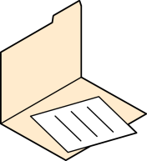
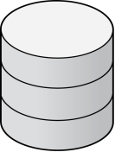
Manage your content through Content Management
Deliver content in context seamlessly
Share through workflows
Secure mark-up & annotation
Conversations
Discussions
Instant
Messages
Access documents via Applications
Activity Streams
Consolidate documents
Presence
Recommendations
E-BUSINESS SUITE PEOPLESOFT SIEBEL | JD EDWARDS
Capture paper, forms, faxes,
Audio, & Videos
Store in a secure, centralized repository
Blogs
Wikis
Lists
Notes:
WebCenter Content gives you this capability.
Our strategy is to bring Unstructured content Seamlessly within context of business processes
Examples: Claims processing (License, Police Reports, Audio testimony) employee onboarding (signed new employee documents, Copy of Passport/Drivers License, new hire’s resume)
Providing content in context – within the application where people are comfortable doing their work
- Examples: EBS, PSFT, JDE, Siebel, etc.
- Also in Cloud: Fusion Apps content platform
- For 3rd Party Apps: We have our Enterprise App Adapter Framework
HOW: accelerators, templates, best practices
Our strategy is to seamlessly bring structured and unstructured content together so they can easily and intuitively have access to the right content when they need it For example, onboarding…signed security agreements before creating login credentials. Another example, Insurance Claim…drivers lic, police report, Audio testimonies, etc.
One way we do this is to capture and transform paper documents and audio or video files at the earliest point of a process.
Also, we continue to build our content solution to work OOTB with our business applications with increased templates and accelerators so you can realize the ROI of your investment quicker. For example, A/P
Finally, we are the content solution for Fusion applications
----------------
Productized integrations & connectors
Out of the box templates and starter kits
Solution accelerators
Embedded functionality
----------------
SPEAKER NOTES:
#1 - Secure mark-up & annotation to input feedback
#2 - Consolidate supporting documents in a virtual folder
#3 - Store all business documents in a secure, centralized repository
#4 - Capture paper, electronic & fax documents via integrated scan & import
#5 - Access documents via Business Applications
#6 - Share outside Business Applications through automated workflow notifications
Intuitive User Experience for Application Users
Optimized for Oracle Enterprise Applications
The Content Solution for Fusion Applications

Slide 11
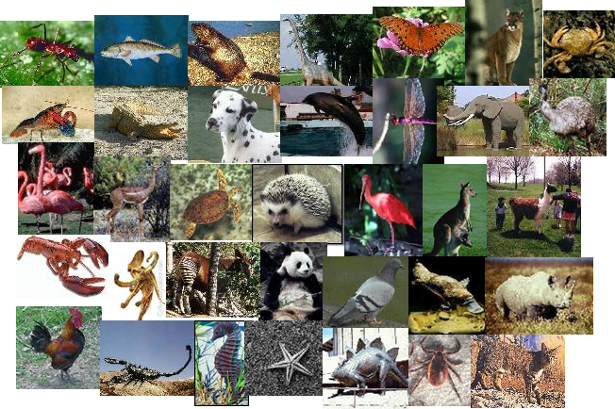
Categorization and Search
Metadata provides
Data about the content
Classification and placement
Search and retrieval
Process (workflow) and subscription notifications
Security rights
Copyright enforcement and protection
Retention and storage rules
Adoptions of taxonomies, common metadata standards
Search
Across metadata and full text
Across multiple repositories
Cross-application search
Notes:
This is an important slide in that maintaining rich metadata is important. The metadata needs to be linked to the content and needs to be retrievable in in a Preservation environment. Data without metadata is useless. ECM allows for searching across both!

Slide 12
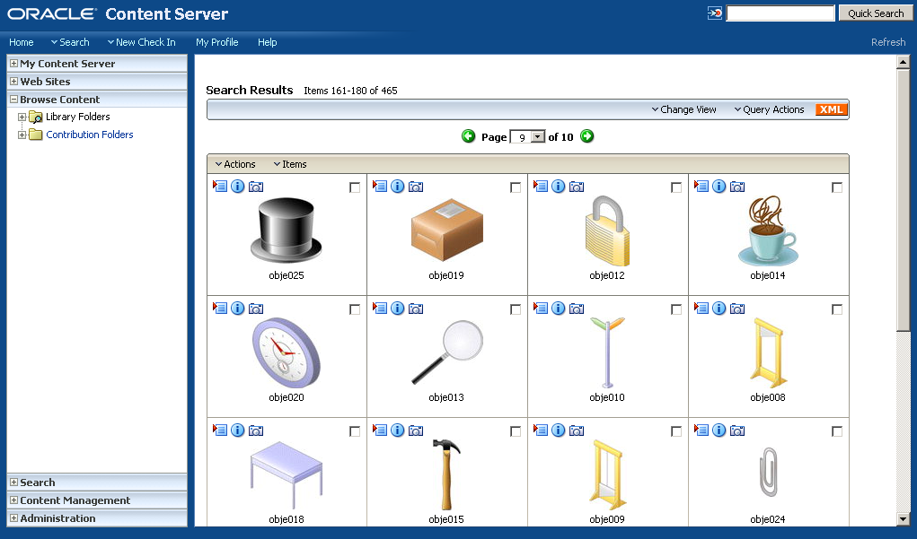
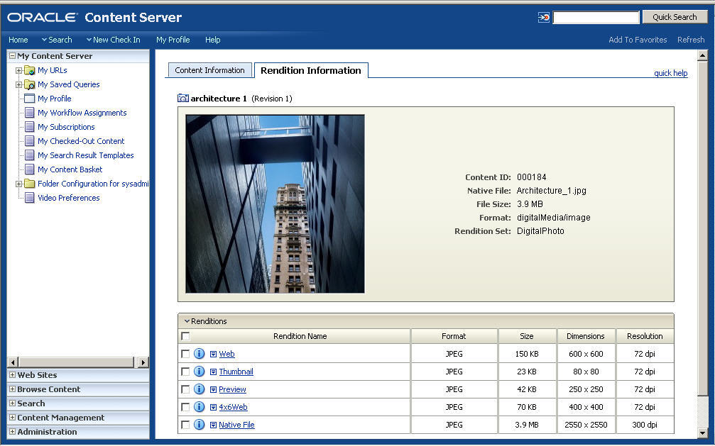
Easily Manage Images, Audio & Video
Digital Asset Management
Protects valuable assets:
Patient Images, Records, and Known Identifiers
Manages all file types:
DICOM, XDSi, XDS
EPS, JPEG, TIFF, BMP, SWF, Quicktime, Real, WMA, AVI, MP3
Multiple renditions, multiple uses:
Web, Lo/Hi Res Print, Color/B&W
Easy search and retrieval
Maintain security and privacy
Notes:
Example: WebCenter Content’s comprehensive capabilities include Digital Asset Management. Easily manage images, audio and video files.

Slide 13
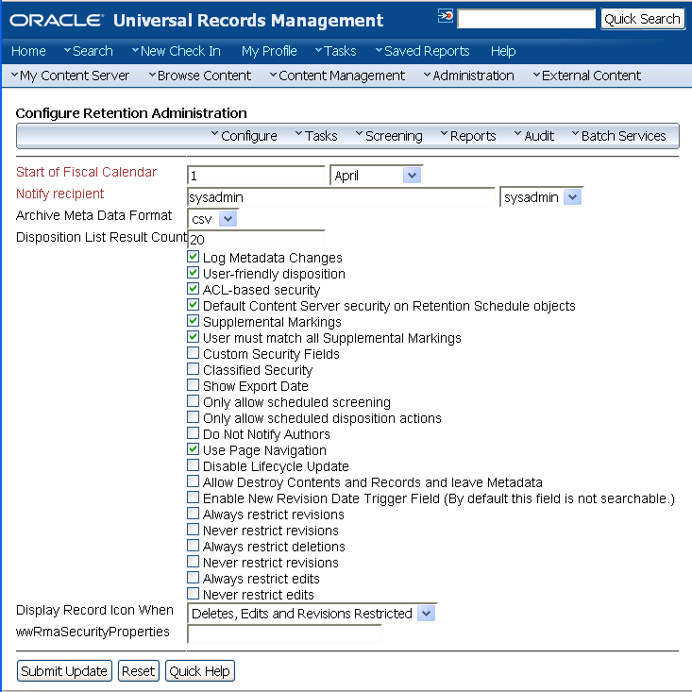
Improved Lifecycle Management
Policy-based Content Management
Intelligent Classification and Storage
Automatically apply retention policies
Lower costs and simplify maintenance
Notes:
Business Need = context driven ILM (information lifecycle management). WebCenter Capability = intelligent classification and storage, automatic assigning of retention policies. Uniformly apply retention and security policies.

Slide 14
Tiered Storage is Standard
IDC Market Analysis. Worldwide Archival Storage Solutions Forecast: Archiving Needs Thrive in an Information-Thirsty World. (IDC #230762)
Notes:
Storage for archive and retention is a $3B Market growing to over $7B in 2017
Archive is distinct from primary or backup use case
Tape is established as primary storage tier for long-term retention
Some customers are using an archive strategy of just putting everything on disk and letting the systems continue to populate as needed. The problem with that strategy is the cost in time and management continue to grow out of control. IDC’s research demonstrates that we see active disk, capacity disk and tape all being used within archive and when just looking at the bar charts (demonstrating storage capacity), the vast majority (72% today) of that data is going to tape. Disk archive is not the common strategy. Tiered storage is and that will almost always include the majority of the data being archived to tape!

Slide 15
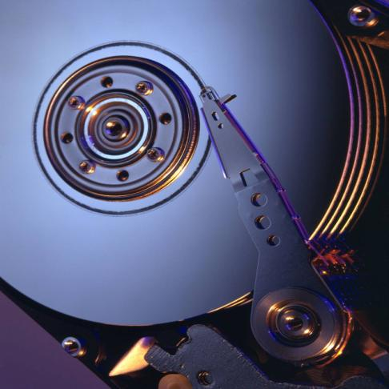
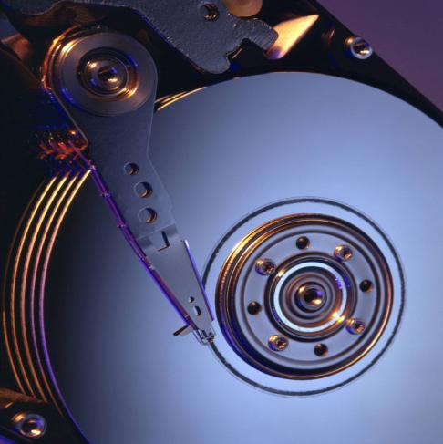
Tape is best for long term archive storage
A tape tier lowers costs while increasing robustness and efficiency
Tape offers exascale capacity at the lowest cost
much more economical, with 4% of the TCO and 1/4th the footprint of disk*
enables data growth on a massive scale with less maintenance complexity
Tape offers data integrity validation
detects corrupted data before it is written to tape and simplifies digital auditing
Tape eases technology migration
offers longer technology lifecycles and the ability to reuse existing media
Tape offers scalable performance
additional tape drives are added non-disruptively to increase parallel access to data
For more details on the benefits of tape storage, please reference the following presentation: Oracle Open Systems Tiered Data Protection
* The Clipper Group, “Revisiting the Search for Long-Term Storage — A TCO Analysis of Tape and Disk,” May 13, 2013
Notes:
On TCO, some customers may ask, but surely that is going to change – disk prices are declining and dedupe can help this… Actually, price declines are governed by areal density improvements. I.e. by getting more bits on the same material, your $/bit costs decrease. The areal density improvements on disk have slowed as they near the “super paramagnetic” effect of current media and recording technologies. INSEC projects even with new advancements in media and recording technologies, the areal density of disk will only increase at a 20% CAGR going forward (or conversely, you can expect price decreases at 20% / year). Tape on the other hand has >1000 times the recording space of disk and still has lots of runway for areal density improvements using current media and recording technologies. INSEC projects that going forward tape areal density improvements will continue at a 40% CAGR (and conversely that will drive the costs of tape down at approximately 40% CAGR. So the advantage tape has over disk today is projected to increase, not decrease.
2. StorageTek End-to-End Data Integrity: StorageTek Data Integrity Validation will protect your data from the time the data leaves an application until if is securely stored on tape. Since the application initially generates the CRC it is an independent verification that the data is still good. This CRC can be checked without transferring the data to the application.
Process:
SAM Generates a CRC (T10 ANSI standard) For Each Record
StorageTek T10000D Checks CRC as Each Record is Received
The CRC of Each Record is Written to Tape and Checked on Every Read
3. Tape has a longer media life than disk. Disk traditionally needs to be changed every 3-5 years and tape can range past 8-12 years (on next slide).
4. Scalability is important from the customer aspects of both extreme and unpredictable growth. The SL8500 is on a path to hit 3 Exabytes of data (shown in roadmap slide). The SL3000 and SL8500 can use LTO 6 or T10000 drives allowing flexibility.

Slide 16
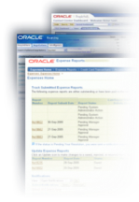
Archive Automation: Eases Data Management Burden
Primary Disk
Applications
Standard POSIX File System API
Disk Archive
Archive Manager
Tape Archive

Slide 17
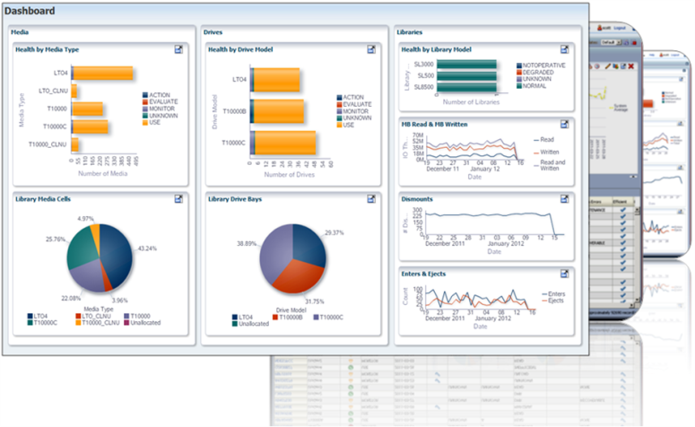
Proactively manage the entire Tape Storage System from a single interface
Tape Analytics
Simplify Tape Management Monitors your drives and media
Leverage Intelligent Analytics Provides proactive health indicators
Worry Free Deployment Collects performance data without entering your live data path
Grow with Peace of Mind Scales easily and monitors globally dispersed libraries from a single interface

Slide 18
Why Oracle?

Slide 19
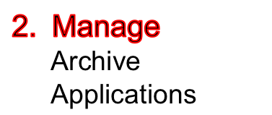
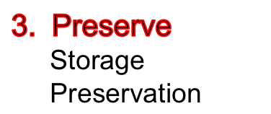
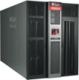
Oracle’s Archiving Infrastructure
Oracle WebCenter Content 11g
Storage Archive Manager
Flash
Disk
Tape

Slide 20
In summary: Oracle’s Archiving Strategy
SEAMLESS
PROACTIVE
SUSTAINABLE
Automated policies
Data migration
Open formats
Proactive monitoring
Data integrity
Media validation
Limitless capacity
Fastest performance
Highest availability
Complete management of all data in your archives

Slide 21
September 15-19, Frankfurt - Germany
200 participants from private and public sector
Goals:
In-depth exploration of preservation and archiving issues
Sharing of Best Practices
Discussion on the use of solutions
Logistics:
FIZ – Frankfurt - http://www.fiz-cl.de/en/fiz-conferencelab/
Website: https://www.asis.org/Pasig/index.html

