Slide 1
The Digitization Project of the Vatican Library within the complex relationships between sets of metadata Paola Manoni (Biblioteca apostolica vaticana)
Družba, Jasná, April 2nd 2014

Slide 2
Metadata is the core of any information retrieval system
The overall goal of this presentation is to provide information about metadata infrastructures that afford interoperability among heterogeneous, autonomous library services implemented for the OPACs, digital library, shared projects of the Vatican Library .
Metadata architecture fits into our established infrastructures and promotes interoperability among existing and de-facto metadata standards.

Slide 3
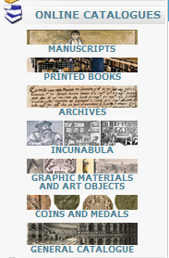

Slide 4
Timeline of catalogues
Printed books
Visual materials
Coins and medals
Manuscripts
Archives
Incunabula
General catalogue
1985 1990 1998 2000 2002 2007 2009 2012

Slide 5
catalogues
Manuscript catalogue: it is a work in progress; it includes complete or partial data taken from inventories, bibliographies, printed catalogues, card indexes
The online catalogues use two main systems for the management of different metadata: TEI-P5 and EAD in XML syntax for manuscripts and archival units (in two separate collections of data but in the same application named InForMA,
developed at the Vatican Library using open-source Java/XML technology for data archive, authority indexes and search engine)
Archival material: structured in the same XML language, but according to the EAD (Encoding Archival Description) standard.
InForMA can handle different collections of data or documents that refer to different metadata schemas

Slide 6
Catalogues in MARC21
General Printed books catalogue: It includes the description of the entire collection of printed volumes (monographs and periodicals) from the XVIth century to the new acquisitions
Graphic prints and Drawings catalogue: It includes the descriptions of the prints, maps, drawings, photographs and plates which are kept in the various collections of the Library
Coins and Medals catalogue: it includes descriptions of the coins and medals kept in the Library.
Incunabula catalogue: It includes bibliographic records related to the VISTC (Vatican Incunabula Short Title Catalogue) and the BAVIC (Bibliothecae Apostolicae Vaticanae Incunabulorum Catalogus) is the analytical cataloging of 8,600 incunabula.

Slide 7
OPAC MARC21
Subsets:
Individual OPACs:
Mainly Printed
books
Printed Books Departments / Catalog Section
Graphic materials / art objects
Printed Books Departments /
Prints Cabinet
Coins /
medals
Numismatic Department
Printed Books Departments / Rare Books Section
Incunabula

Slide 8
InForMA
Manuscripts
Archives
Link to digital library
Authority file

Slide 9
V-Smart
Incunabula
Printed books, Coins and medals, Graphic Prints
Link to digital library
Authority file

Slide 10
Web OPACs→ general catalogue
MARC21
Visual Materials
TEI-P5 / EAD native XML database
Manuscripts
Coins
Medals
Archives
Printed books
Multi-platform system
harvsesting

Slide 11
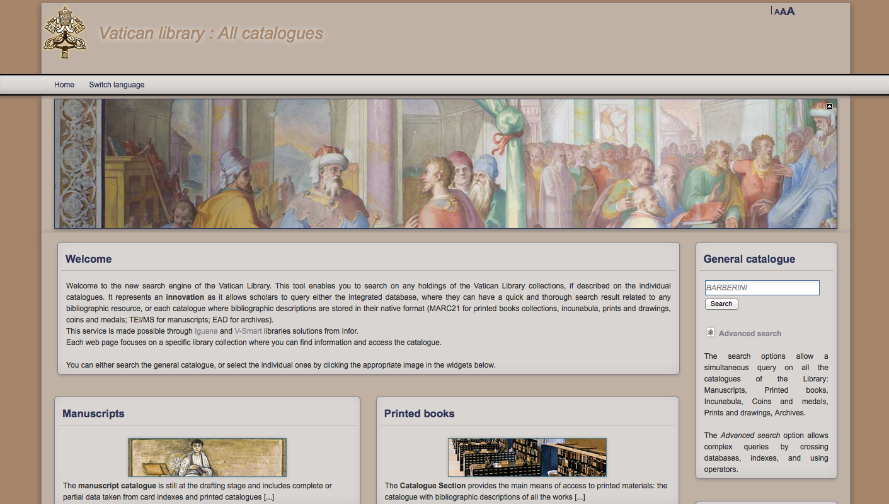

Slide 12
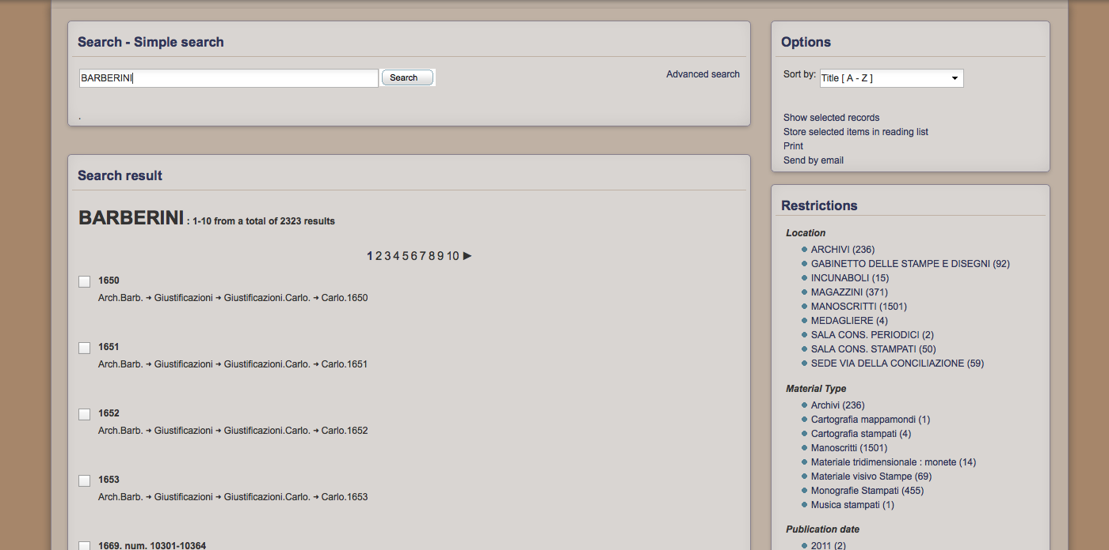

Slide 13
General catalogue
All the stored instances of a persistent class compose the extent of the class, in which an instance belongs to the extent of each class, of which it is an instance
Multi- platform system

Slide 15
Digitization project of the Vatican Library
The Library is putting into practice the digitization both in a view of long-term storage, and in the implementation of a digital library accessible via the web site and through links to the catalogues.

Slide 16
Access to the digital library
The purpose is to offer digital objects information linked to the OPAC. This means that a scholar could query the OPAC and knows if the document related to that record has a digital copy. From the OPAC he could directly link to it. Another way to find out if a manuscript / incunabula has been digitized, is the reference of its shelfmark in a section of the web site. From these web pages a scholar could get information about current projects and have a look at the list of shelfmarks in order to link the digital library.

Slide 18
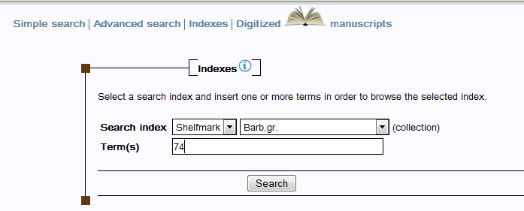

Slide 19
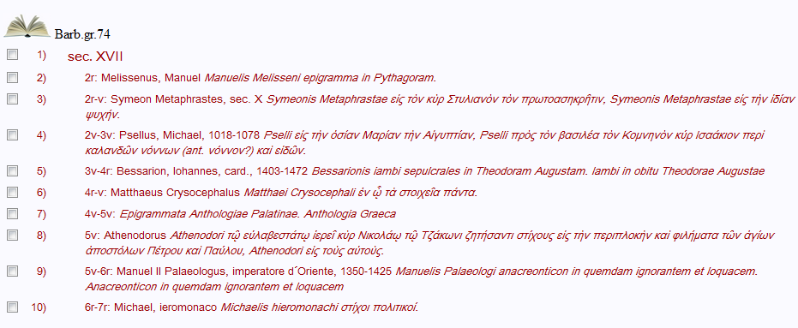

Slide 20
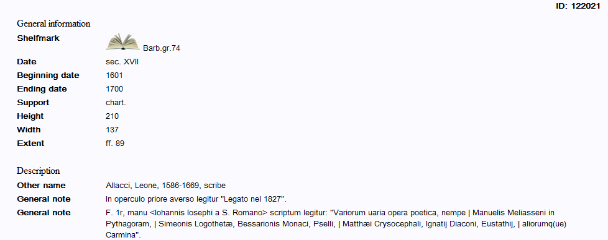

Slide 21
4x3
16x9

Slide 22
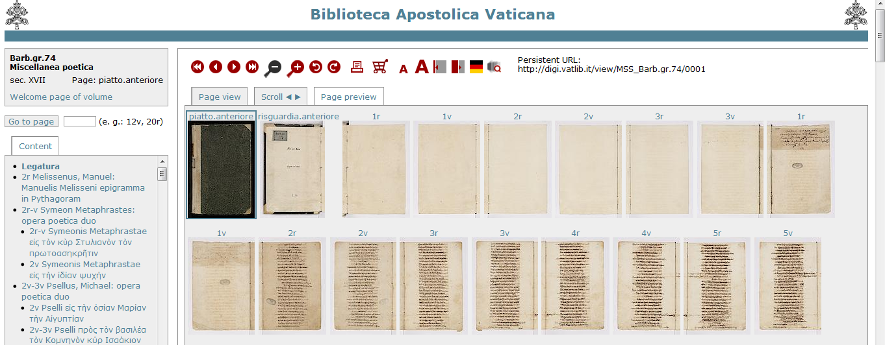

Slide 23
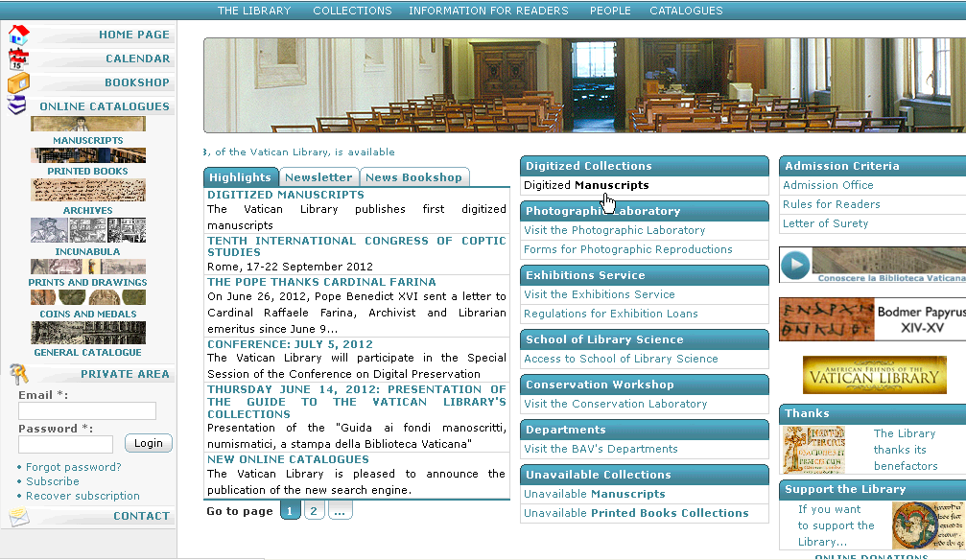

Slide 24
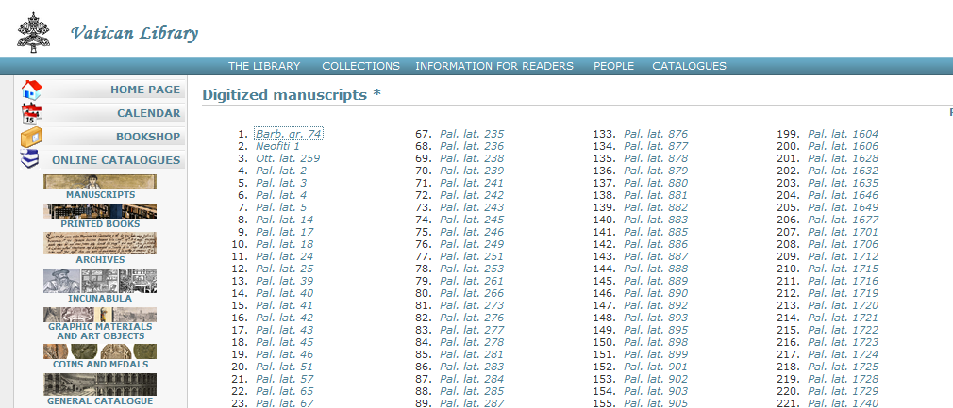
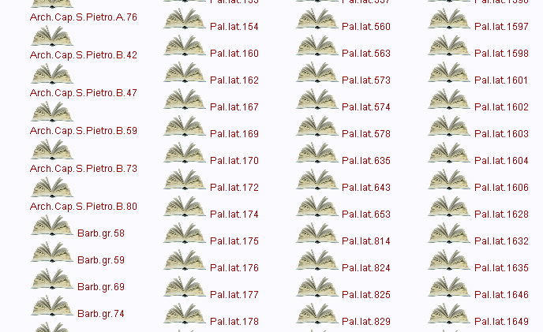

Slide 25
Web presentation
The DWORK supports the process flow of digitization and the web presentation of the digital objects.
This software as a web application thereby supports all single steps: from the creation of metadata, scan processing, creation of the web presentation to the storage of scans and metadata.

Slide 26
Naming files in the Vatican digital project context
Each file name is composed by the following elements
Collection
Statement: The standard abbreviation of a collection. The field is closed by a dot.
Vat.sir.623.p.II_0004_fa_0132v.[02.fn.0000].tif
Identifier of the ms
Statement: The numeric or alphanumeric expression able to locate a ms within the collection. The field is closed by an underscore.
Vat.sir.623.p.II_0004_fa_0132v.[02.fn.0000].tif
Sequence
Statement:An integer, four digits. The field is closed by an underscore
Vat.sir.623.p.II_0004_fa_0132v.[02.fn.0000].tif

Slide 27
Naming files is an automated procedure required from the Vatican Library
Sorting code
Statement: The coded description of the peculiarities of folio/page. The element is composed by 2 values,
Nature / position
Type of numbering.
eventually followed by a specific wording:
The field is closed by an underscore.
Ex.fa_
Vat.sir.623.p.II_0004_fa_0132v.[02.fn.0000].tif
Vat.sir.623.p.II_0091_zz_scala.millimetrica.tif

Slide 28
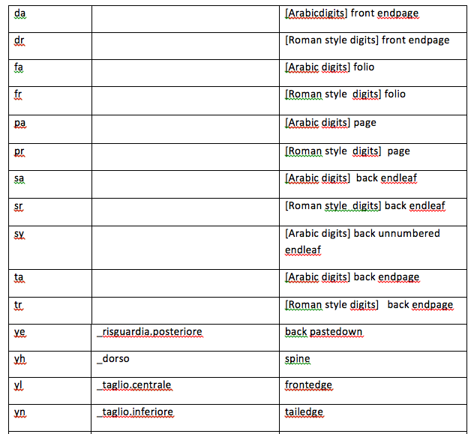
Table of codes

Slide 29
Regular folios
Pages / Folios
Statement: The numbering of a folio / page and its exceptions. Exceptions are in square brackets and they follow the numbering of the folio / page.
Vat.gr.2_0002_fa_0001v.tif

Slide 30
Exceptions
Pages / Folios
Statement: The numbering of a folio / page and its exceptions. Exceptions are in square brackets and they follow the numbering of the folio / page.
fn– numbered folios / pages + bis/ter, a/b... etc."
Meaning: “We find one or more folios /pages numbered with the same number of the last shot image but, in addition, on this folio / page there is also written bis/ter or a/b, ecc. For example, we find ‘3r’folio followed by‘3rbis’, or ‘3ra’ etc.”
Ex.: . Vat.gr.2_0002_fa_0001v.[02.fn.0000].tif

Slide 31
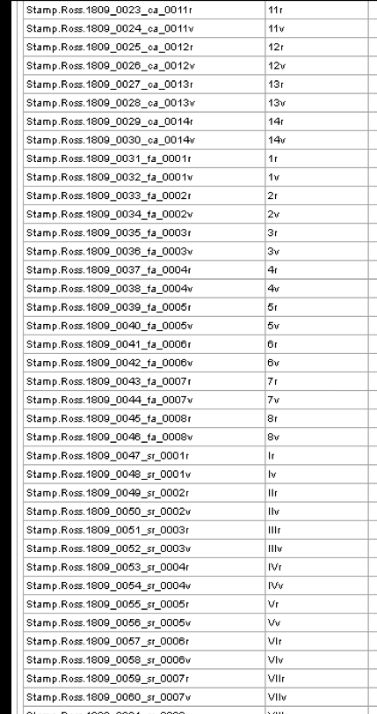
DWORK
parses the
file names in
sequence

Slide 32
4x3
16x9

Slide 34
Structural metadata
4x3
16x9

Slide 35
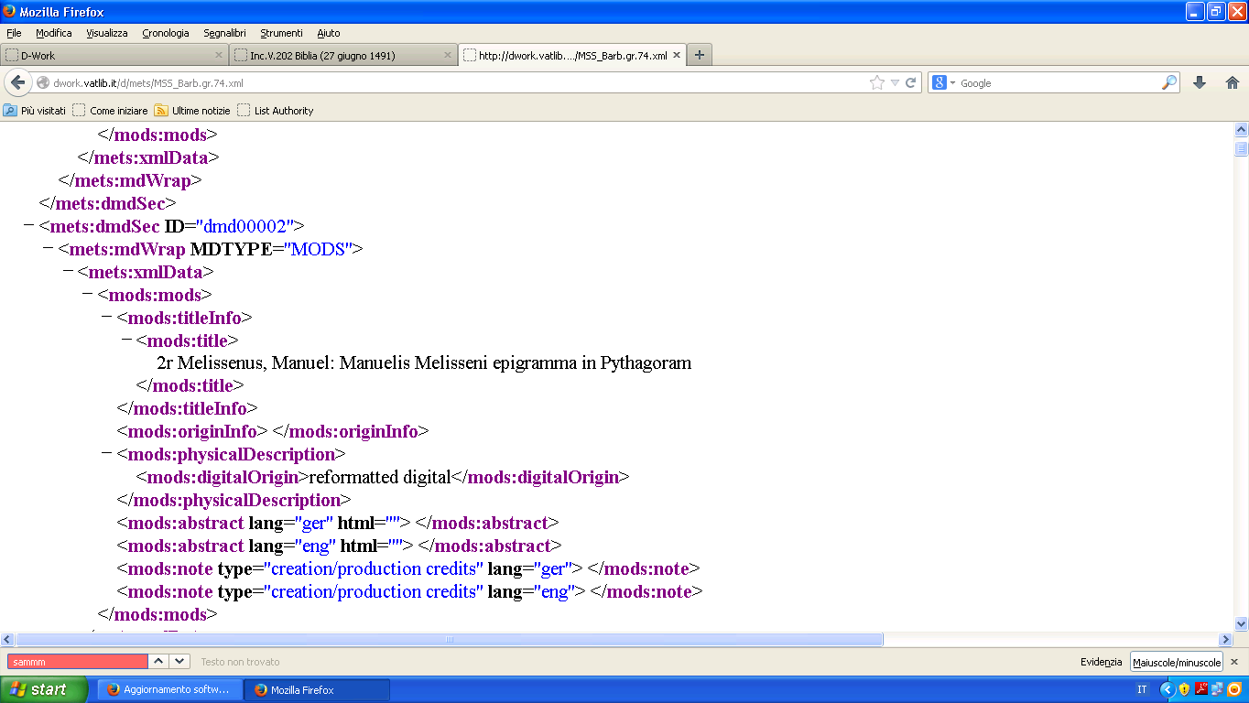

Slide 36
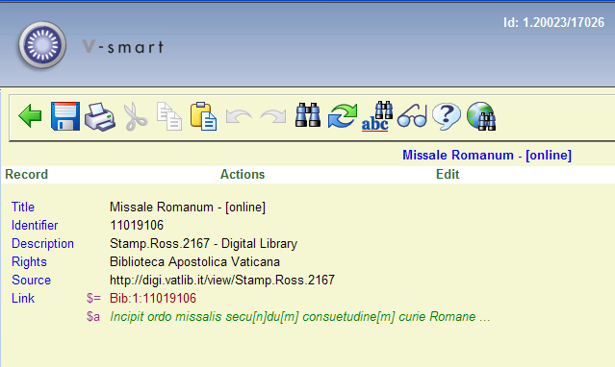

Slide 37
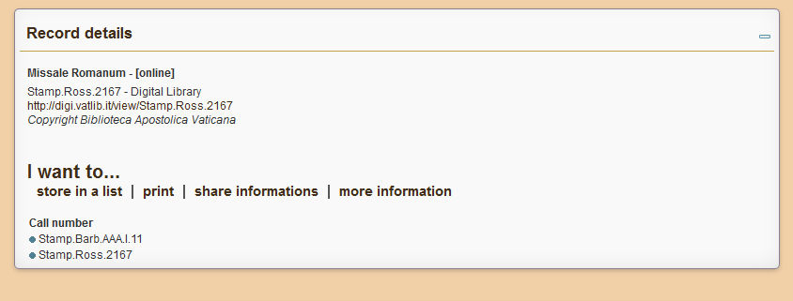

Slide 38
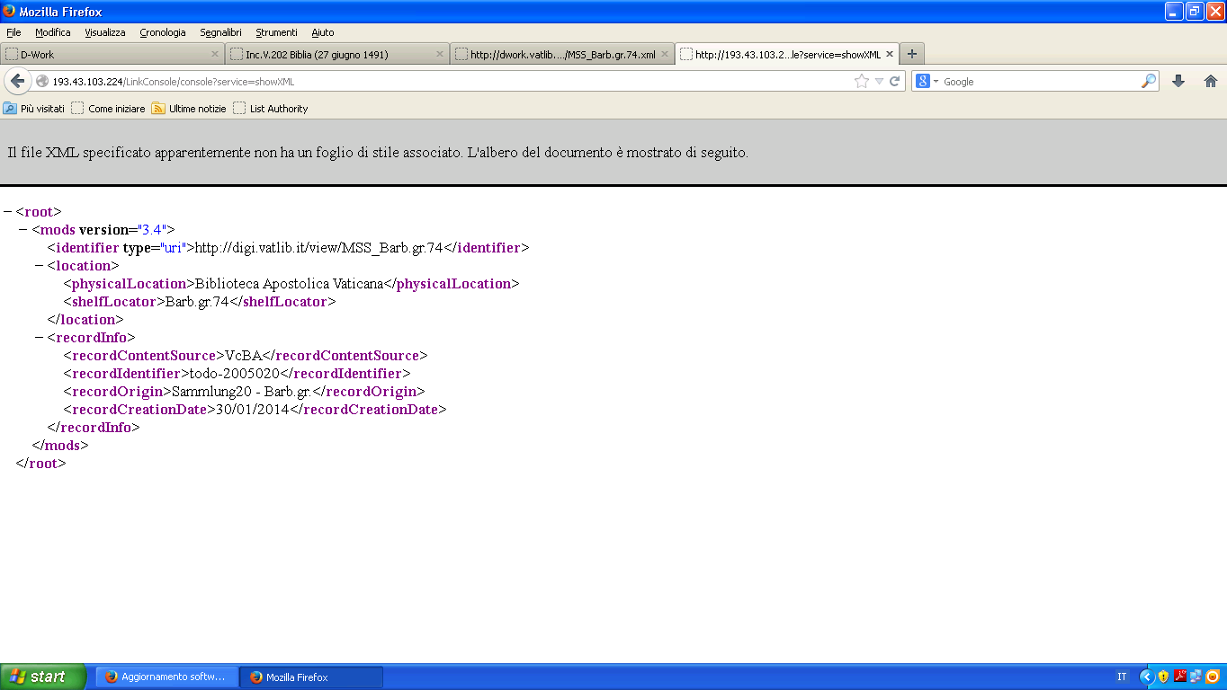

Slide 39
With the same search engine you can do a search for a digitized manuscript even its bibliographic record is not yet available.

Slide 40
Metadata workflow – digital library
File name (acquisition)
Technical metadata
Other information
(e.g. log files from the acquisition devices)
Logical structural relationships and descriptive metadata
TIF→
JPEG ; Creation of METS file
Web presentation
Links to OPAC (DC / MODS)
HTTP URI:
http://digi.vatlib.it/view/[+shelfmark]
Long-term preservation
Embedded data in file format ←-
managing of the preservation repository

Slide 41
Metadata in use
description
MARC21
container
METS
long –term preservation
PREMIS
(long-term preservation)
TEI-Ms
EAD
Dublin Core
MODS
[*Next implementation*]

Slide 42
PREMIS / Object
The extension container (objectCharacteristicsExtension) gives a place to record technical metadata defined by other data dictionaries

Slide 43
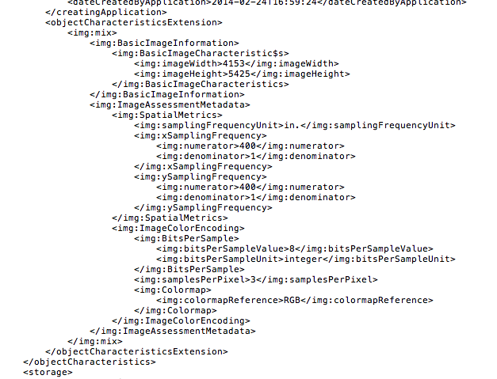

Slide 44
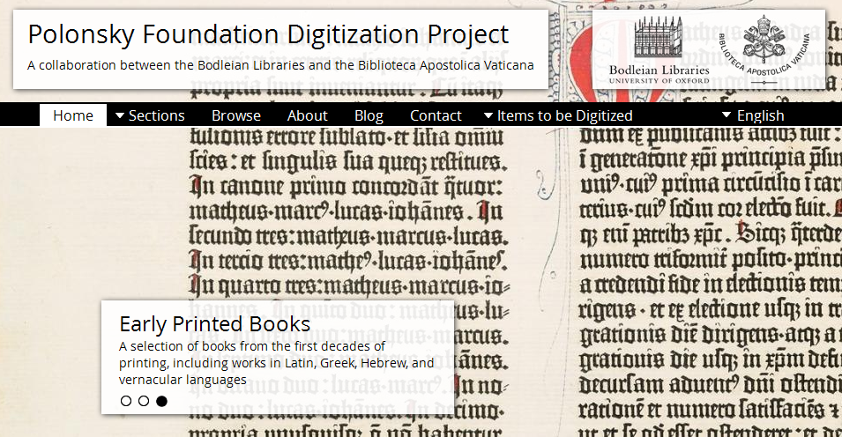
Interaction of metadata in a collaborative digitization project

Slide 45
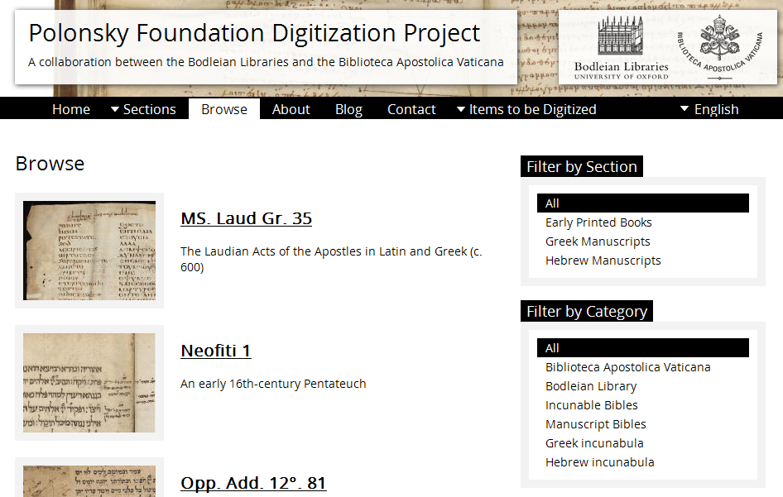

Slide 47
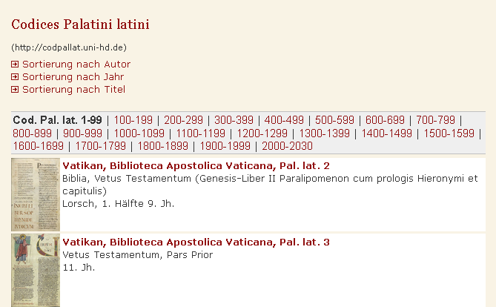

Slide 48
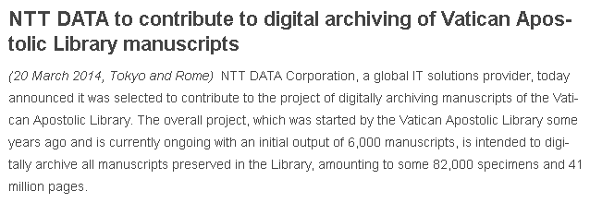

Slide 49
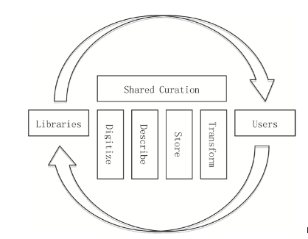
Co-curation : new oppotunity for libraries strategies for crowd sourcing

Slide 50
The goal of the Shared Canvas data model is to provide a standardized description of the digital resources in order to enable interoperability between repositories, tools, services and presentation systems

Slide 51
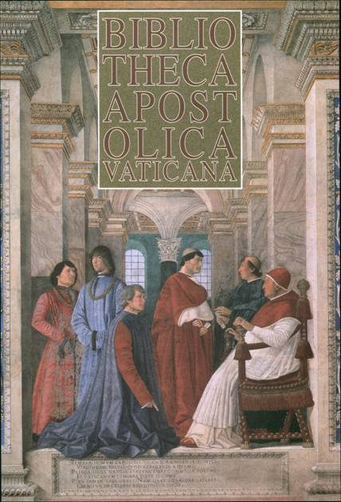
Thank you for your attention!
manoni@vatlib.it
Vatican Library – All rights reserved

