Slide 1
Succeed with us
recommendations for mass digitization projects
Tomasz Parkoła
Poznan Supercomputing and Networking Center
Succeed is supported by the European Union under FP7-ICT and coordinated by Universidad de Alicante.
Notes:
Overview of the work we’ve done in Succeed on recommendations for mass digitisation projects

Slide 2
Digital Library Conference, 31.03-03.04.2014
Agenda
Background information
Recommendations for mass digitisation projects
General objectives
Scope & Approach
Summaries
Digitisation Days
Succeed is supported by the European Union under FP7-ICT and coordinated by Universidad de Alicante.
Notes:
Objectives
Improve interoperabitliy, preservation, accessibility and usability of tools and resources
Simplify takeup of new tools and resources

Slide 3
Digital Library Conference, 31.03-03.04.2014
IMPACT Center of Competence in Digitisation
IMPACT CoC
Services providers
Content providers (e.g. libraries)
Research Centers & experts
Other Centers of Competence
Europeana
Research infrastructures
http://digitisation.eu/
Succeed is supported by the European Union under FP7-ICT and coordinated by Universidad de Alicante.
Notes:
The whole story about Succeed begins with the IMPACT CoC

Slide 4
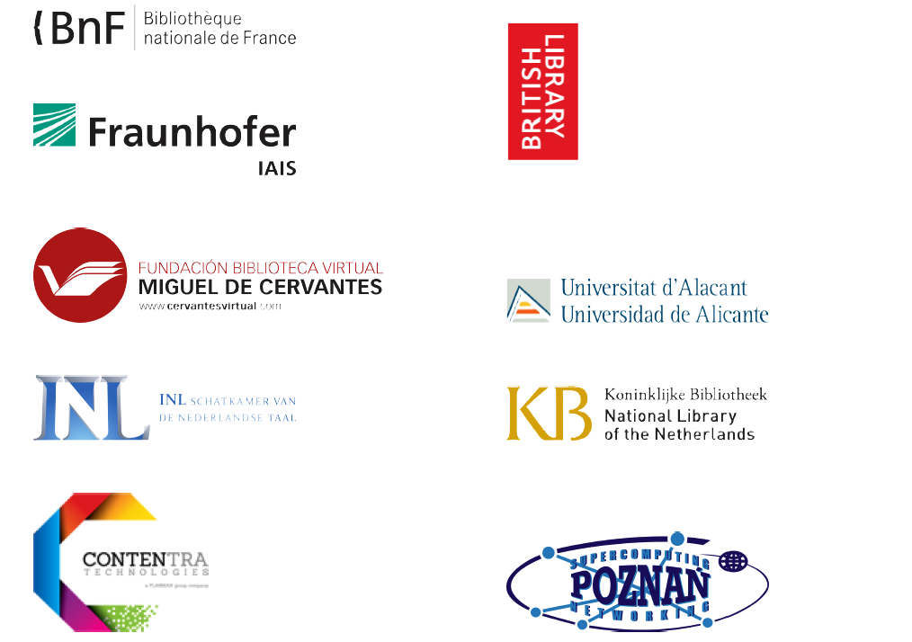
Digital Library Conference, 31.03-03.04.2014
IMPACT Center of Competence in Digitisation
http://digitisation.eu/
+20 new members in the last year!
Succeed is supported by the European Union under FP7-ICT and coordinated by Universidad de Alicante.
Notes:
Objectives
Improve interoperabitliy, preservation, accessibility and usability of tools and resources
Simplify takeup of new tools and resources

Slide 5
Digital Library Conference, 31.03-03.04.2014
Succeed project
Support Action for the EU in the context of mass text digitization
Duration: 2013-2014
Challenges addressed:
Advances in takeup of digitisation-related tools and resources
Greater cooperation between researchers, services/tools providers and customers
Roadmapping on business models and cooperation of European Centers of Compentence
Succeed is supported by the European Union under FP7-ICT and coordinated by Universidad de Alicante.
Notes:
Objectives
Improve interoperabitliy, preservation, accessibility and usability of tools and resources
Simplify takeup of new tools and resources

Slide 6
Digital Library Conference, 31.03-03.04.2014
Succeed
General objectives
Interope-rability
Preser-vation
Accessibility
Usability
Takeup
Succeed recommendations
Succeed is supported by the European Union under FP7-ICT and coordinated by Universidad de Alicante.
Notes:
Improve interoperabitliy, preservation, accessibility and usability of tools and resources
Simplify takeup of new tools and resources

Slide 7
Digital Library Conference, 31.03-03.04.2014
Succeed
General objectives
Succeed recommendations
Interope-rability
Preser-vation
Accessibility
Usability
Takeup
Succeed is supported by the European Union under FP7-ICT and coordinated by Universidad de Alicante.
Notes:
Improve interoperabitliy, preservation, accessibility and usability of tools and resources
Simplify takeup of new tools and resources

Slide 8
Digital Library Conference, 31.03-03.04.2014
Succeed recommendations
Stages
Recommendations on formats and standards
Recommendations on licensing
2013
2014
Succeed is supported by the European Union under FP7-ICT and coordinated by Universidad de Alicante.
Notes:
Improve interoperabitliy, preservation, accessibility and usability of tools and resources
Simplify takeup of new tools and resources

Slide 9
Digital Library Conference, 31.03-03.04.2014
Succeed recommendations
Stages
Recommendations on formats and standards
Recommendations on licensing
2013
2014
Succeed is supported by the European Union under FP7-ICT and coordinated by Universidad de Alicante.
Notes:
Improve interoperabitliy, preservation, accessibility and usability of tools and resources
Simplify takeup of new tools and resources

Slide 10
Digital Library Conference, 31.03-03.04.2014
Succeed recommendations
Scope
Areas
Formats
Online delivery
Long term preservation
Advanced practices
Content
Text
(e.g. ALTO)
Metadata
Descriptive (e.g. DC)
Structural (e.g. METS)
Image
(e.g. TIFF)
Administrative (e.g. PREMIS)
Linguistic resources (e.g. TEI)
Recommendations
Succeed is supported by the European Union under FP7-ICT and coordinated by Universidad de Alicante.
Notes:
Description and goals

Slide 11
Digital Library Conference, 31.03-03.04.2014
Succeed recommendations
Approach
Existing recommendations
Ongoing & emerging activities
Current practices
Recommendations
Succeed is supported by the European Union under FP7-ICT and coordinated by Universidad de Alicante.

Slide 12
Digital Library Conference, 31.03-03.04.2014
Succeed recommendations
Existing recommendations
Identification
Analysis
Outcomes
Institutional
Collaborative
17 items
Relevant information
Summary table / item
Overall summary
Relatively new
Metadata recommendations
Succeed is supported by the European Union under FP7-ICT and coordinated by Universidad de Alicante.

Slide 13
Digital Library Conference, 31.03-03.04.2014
Succeed recommendations
Existing recommendations – summary
Master file format for still images
First choice: TIFF
Delivery file format
First choice: JPEG
Second choice: JPEG2000 (JP2)
Second choice: PDF
OCR results format
First choice: ALTO
Second choice: TEI
Descriptive metadata format
First choice: DCMES
Second choice: MODS
Structural metadata format
First choice: METS
Administrative metadata format
First choice: PREMIS
Second choice: MIX
Succeed is supported by the European Union under FP7-ICT and coordinated by Universidad de Alicante.

Slide 14
Digital Library Conference, 31.03-03.04.2014
Succeed recommendations
Ongoing and emerging activities
Identification
Analysis
Outcomes
Projects
Formats
Linked data
Overall summary
Initiatives
OCR
Linguistic res.
Packaging
Metadata recommendations
Succeed is supported by the European Union under FP7-ICT and coordinated by Universidad de Alicante.

Slide 15
Digital Library Conference, 31.03-03.04.2014
Succeed recommendations
Ongoing and emerging activities
Europeana Data Model
Used in various initiatives across Europe
Interoperable and compatible with LOD paradigm
ALTO
Commonly used to represent OCR results
PAGE XML
Emerging format for representing OCR results
Used in large datasets of GT material (IMPACT) as well as in competitions (ICDAR)
Overcomes some limitations of standalone ALTO
TEI
Applicable for describing textual content, including digital humanities related information
Application packaging
Important for ease of use and increased takeup of tools and resources
Especially useful for medium and small size memory institutions
Very flexible, with targeted customizations available
Usually together with METS to benefit full feature set
Metadata recommendations
Succeed is supported by the European Union under FP7-ICT and coordinated by Universidad de Alicante.

Slide 16
Digital Library Conference, 31.03-03.04.2014
Succeed recommendations
Current practices – succeed survey
Preparation
Execution
Outcomes
Approach
15 channels of dissem.
Question and inter-question analysis
31 direct contacts
2 rounds of dissem.
Summary charts per question
86 answers worldwide
Solution: online survey (30 questions)
Scope
Metadata recommendations
Succeed is supported by the European Union under FP7-ICT and coordinated by Universidad de Alicante.

Slide 17
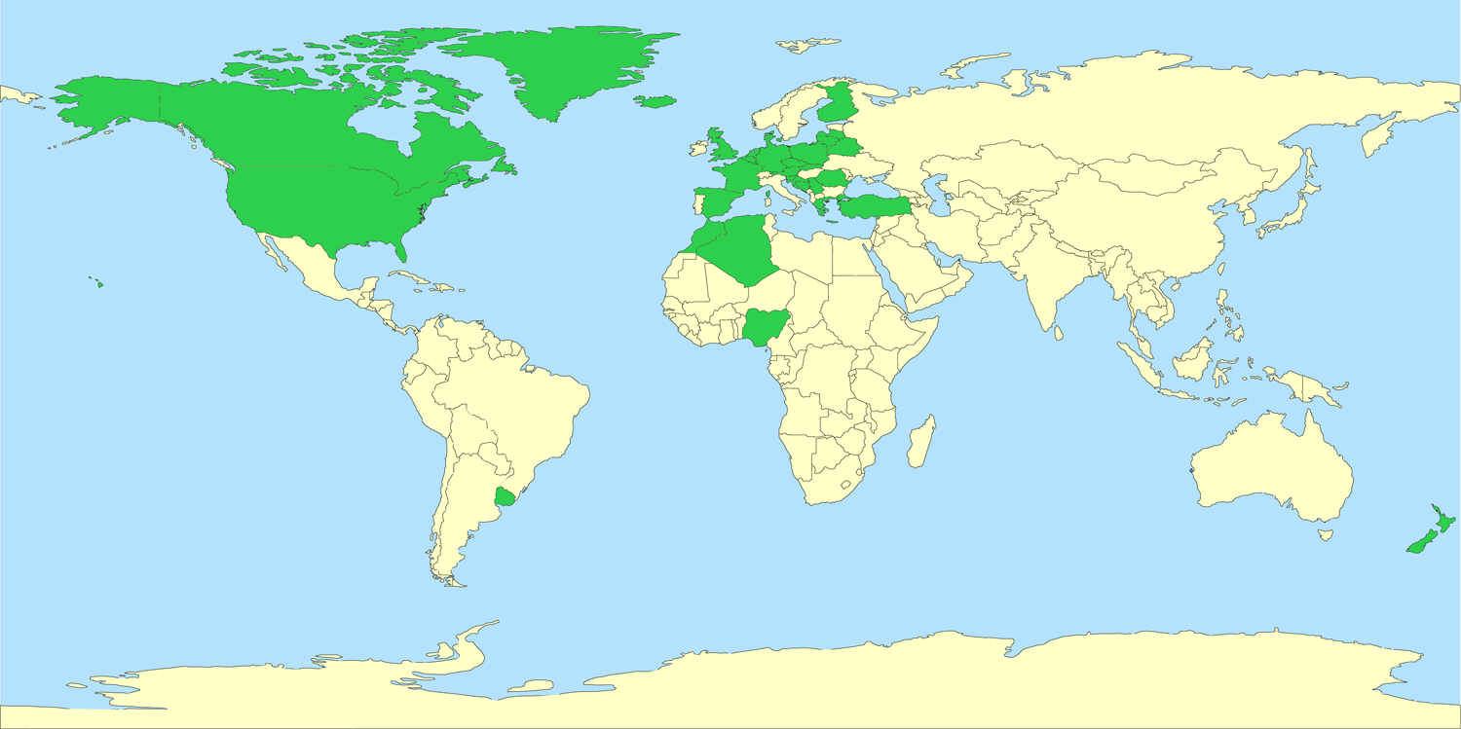
Digital Library Conference, 31.03-03.04.2014
Succeed recommendations
Succeed survey – respondents by country (worldwide)
Metadata recommendations
Succeed is supported by the European Union under FP7-ICT and coordinated by Universidad de Alicante.

Slide 18
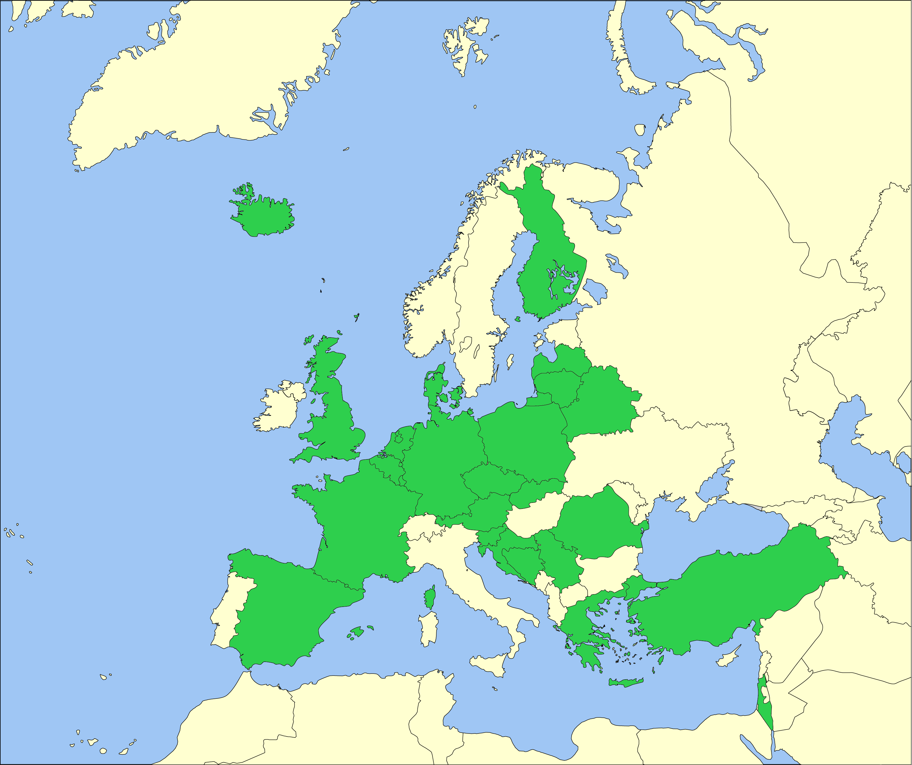
Digital Library Conference, 31.03-03.04.2014
Succeed recommendations
Succeed survey – respondents by country (Europe)
Metadata recommendations
Succeed is supported by the European Union under FP7-ICT and coordinated by Universidad de Alicante.

Slide 19
Digital Library Conference, 31.03-03.04.2014
Succeed recommendations
Succeed survey – summary of results
TIFF
Dublin Core
PDF
JPEG
Windows
Metadata recommendations
Succeed is supported by the European Union under FP7-ICT and coordinated by Universidad de Alicante.
Notes:
PDF (online, OCR)
TIFF (master)
Dublinc Core (metadata for preservation and online)
JPEG (online)
Windows (platform)
No for:
Digitisation workflow managemen
Master files not willing to provide (policy rather than copyright)

Slide 20
Digital Library Conference, 31.03-03.04.2014
Succeed recommendations
Approach
Existing recommendations
Ongoing & emerging activities
Current practices
Recommendations
Succeed is supported by the European Union under FP7-ICT and coordinated by Universidad de Alicante.

Slide 21
Digital Library Conference, 31.03-03.04.2014
Succeed recommendations
Preservation
Online
Metadata recommendations
Emerging
Succeed is supported by the European Union under FP7-ICT and coordinated by Universidad de Alicante.

Slide 22
Digital Library Conference, 31.03-03.04.2014
DigitisationDays – join our community!
19-20 May, 2014 in Madrid
DATeCH 2014 scientific conference
Digital Access to Textual Cultural Heritage
Latest and future technologies for text digitisation
Succeed awards ceremony
Best adoption of digitisation tools and techniques
Demonstrator Day
Dialogue between services/tools providers (companies, research centers) and customers
Panel discussion on hot topics in digitisation
Succeed is supported by the European Union under FP7-ICT and coordinated by Universidad de Alicante.
Notes:
Objectives
Improve interoperabitliy, preservation, accessibility and usability of tools and resources
Simplify takeup of new tools and resources

Slide 23
Thank you http://www.digitisation.eu/training/recommendations-for-digitisation-projects/ http://succeed-project.eu/digitisation-days http://datech2014.info
Digital Library Conference, 31.03-03.04.2014
tparkola@man.poznan.pl
Succeed is supported by the European Union under FP7-ICT and coordinated by Universidad de Alicante.

