Slide 1
Polona 2
Jan Mejor, Paweł Mazur Jasná 2014

Slide 2
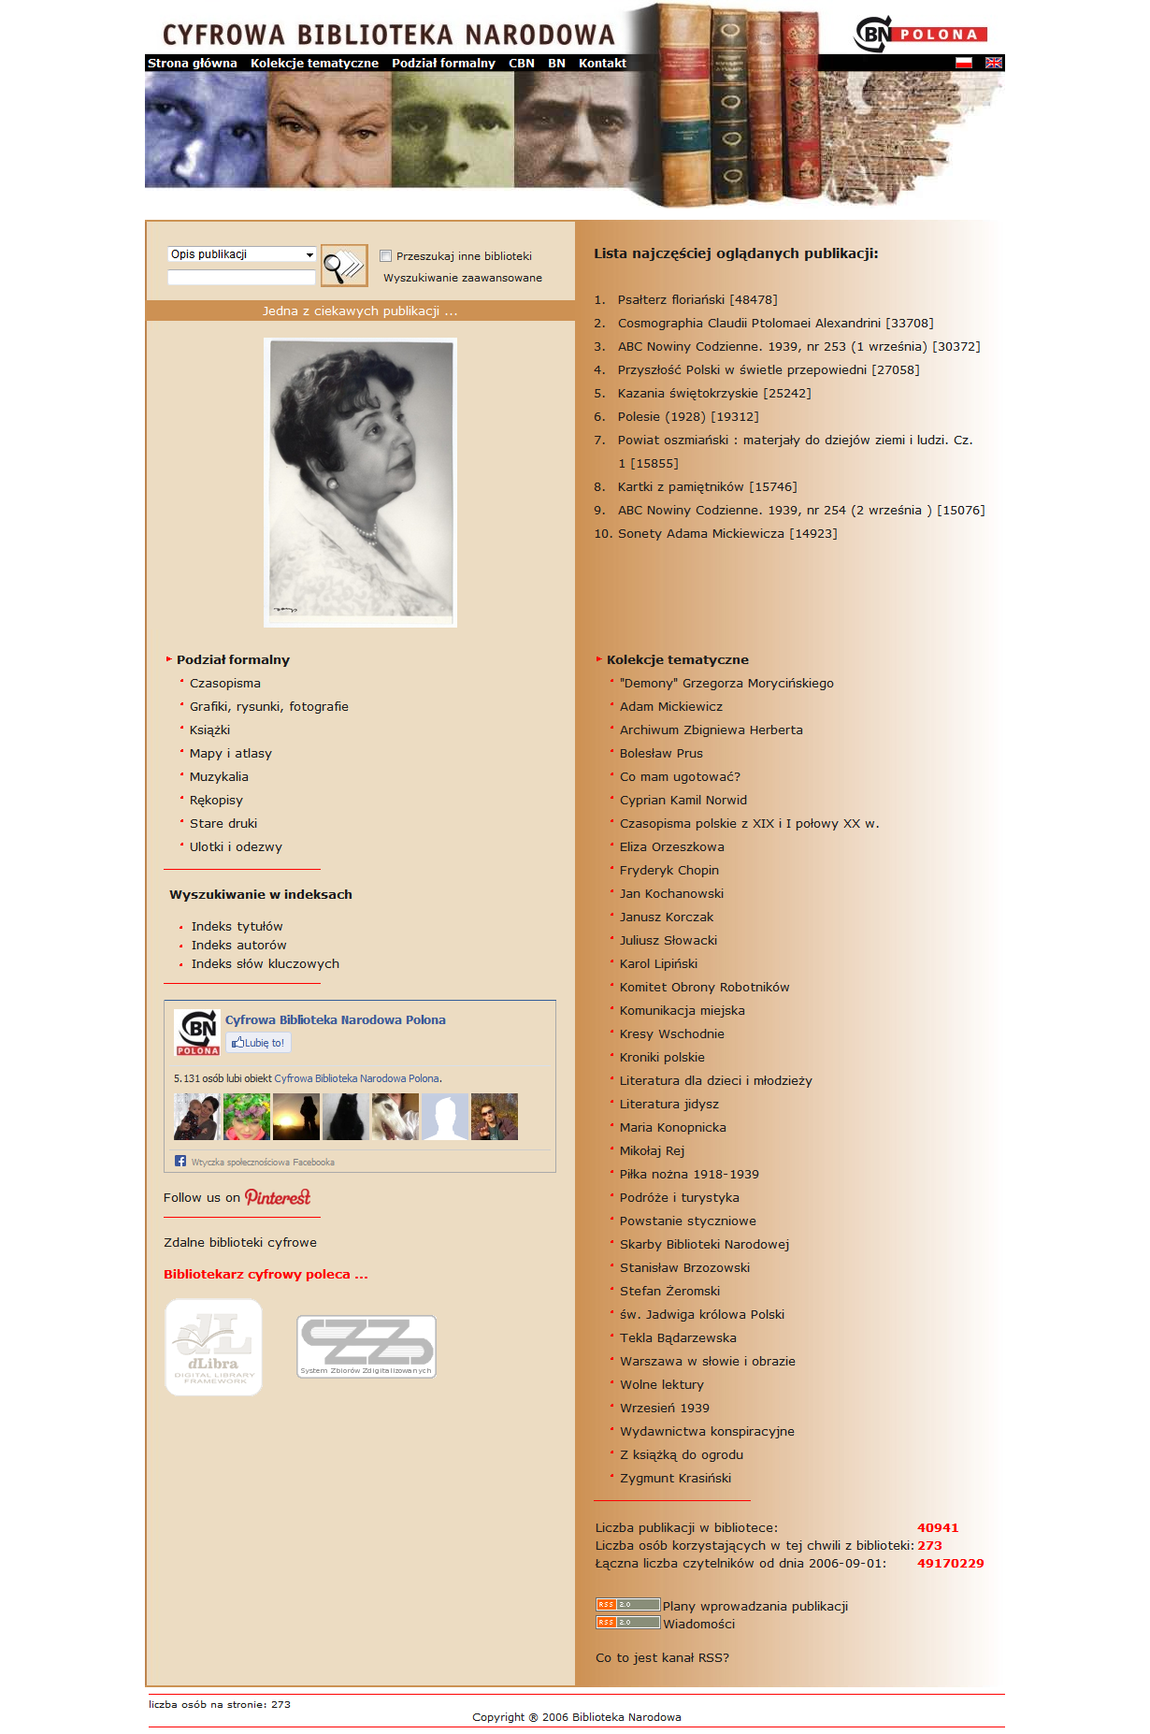
Polona 1.0 – in desperate need of changes
Low digitisation eficciency
Outdated software
Low number of publications
Old design

Slide 3
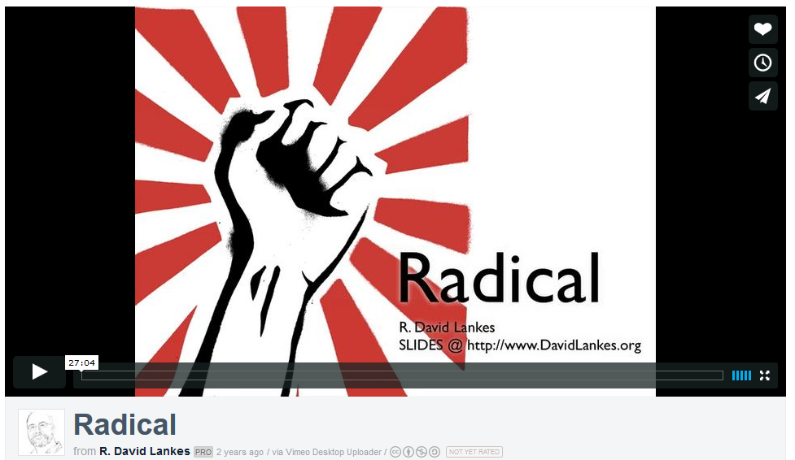
Polona 2.0 – time for changes
http://vimeo.com/23348812

Slide 4
Polona 2.0 - RADICAL
Responsivness, dynamic content, fresh design, internet search tools, muliple view methods, deep zoom images, simple user, services, full resolution files download, social media integration, muliple login options, multiple metadata standards...

Slide 5
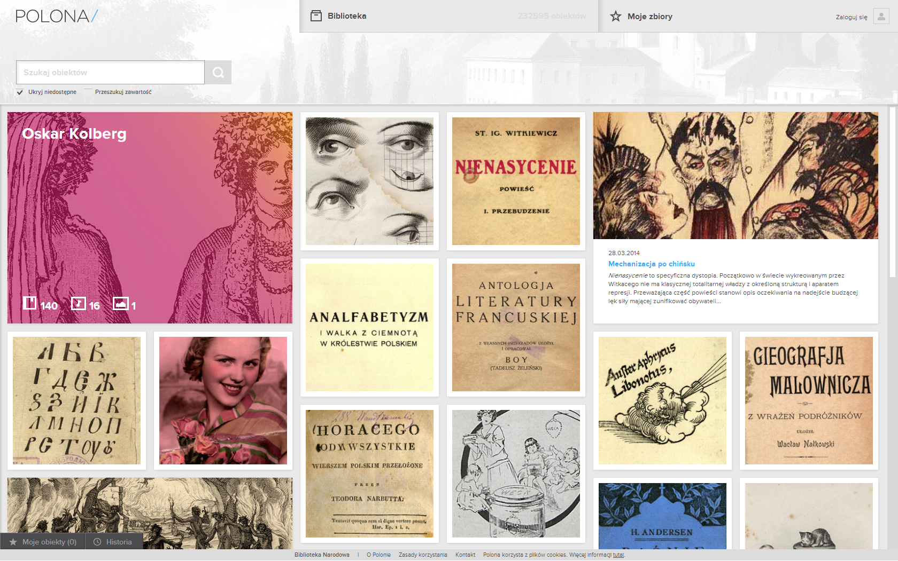
Home – new face of digital library

Slide 6
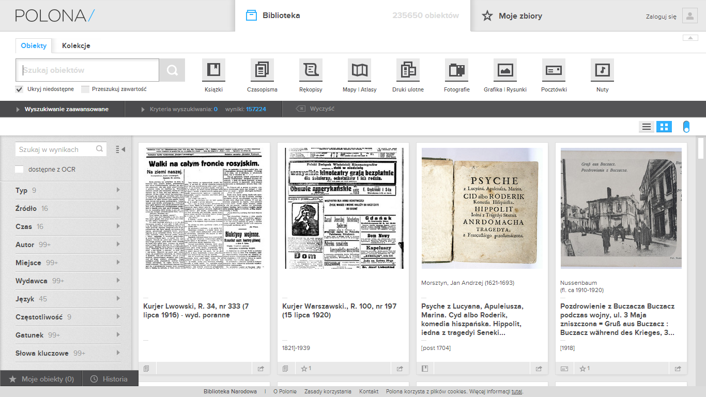

Slide 7
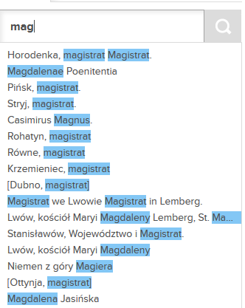
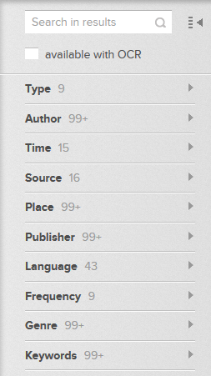
Search – the todays tehnology
Solr
Morflogic
MARC 21+

Slide 8
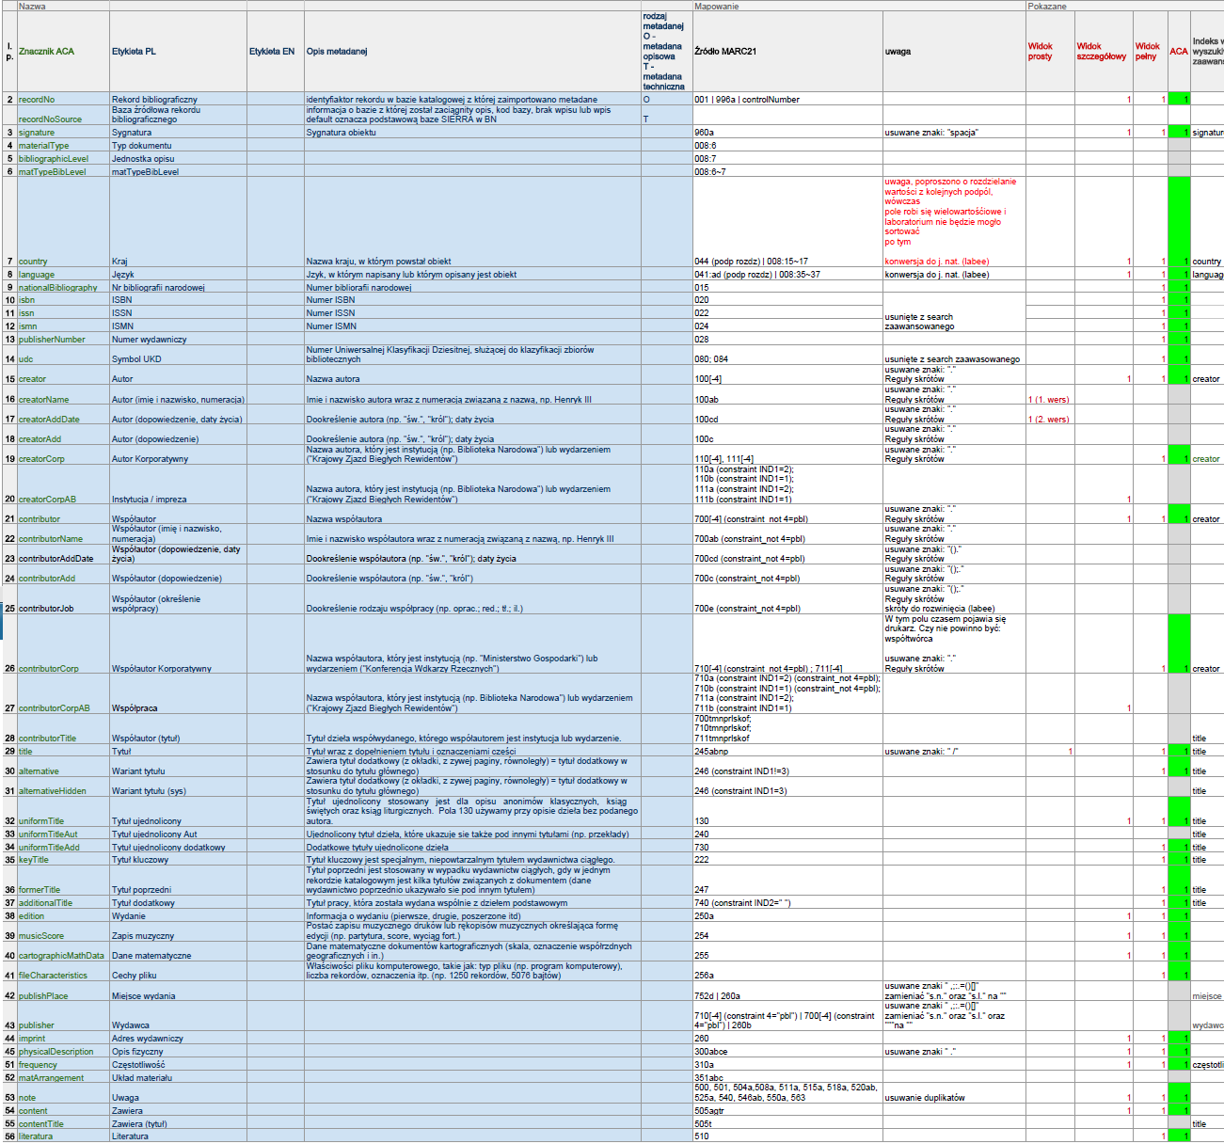

Slide 9

The epic part!

Slide 10
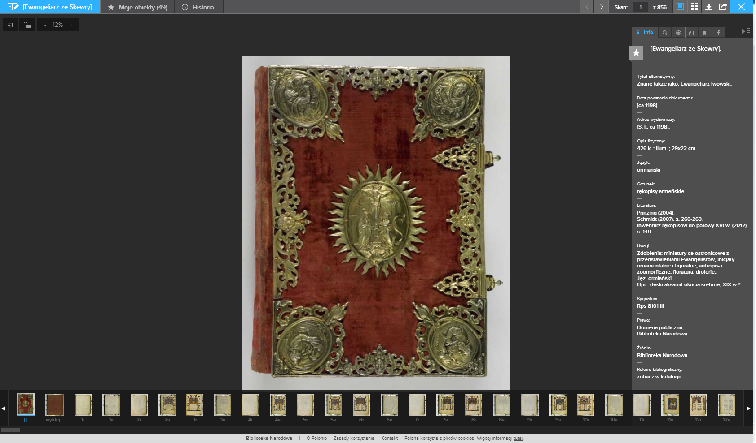

Slide 11
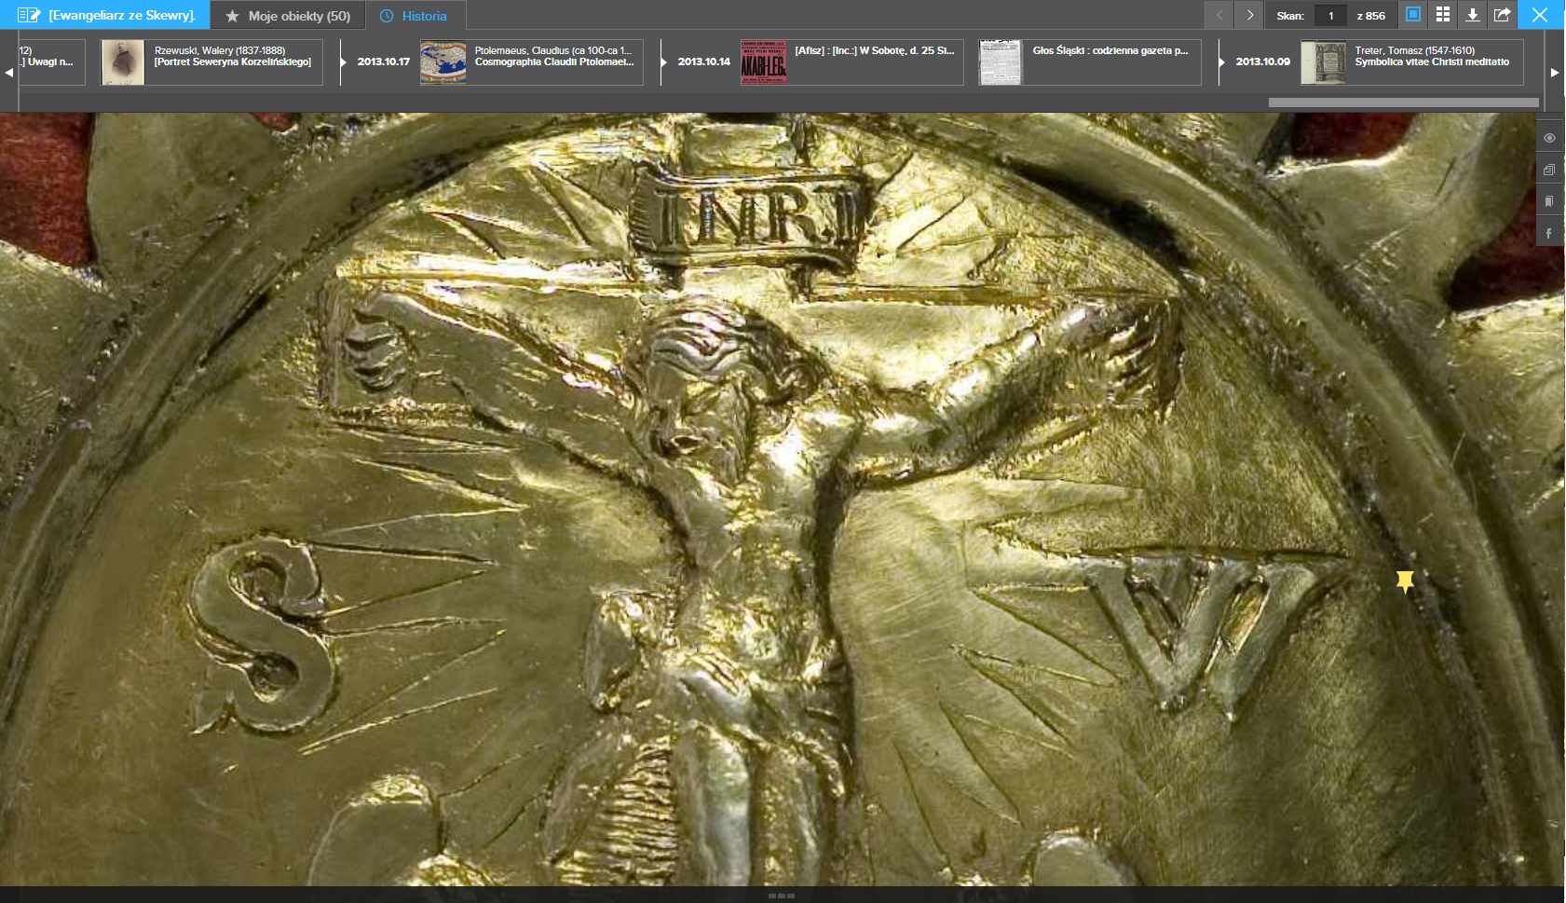
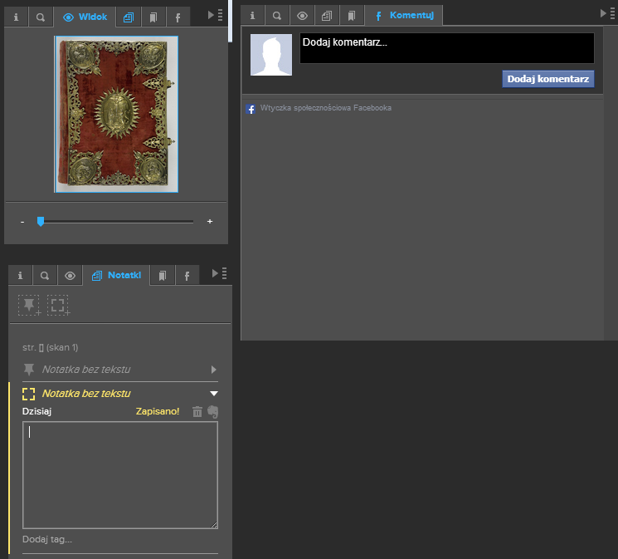

Slide 12
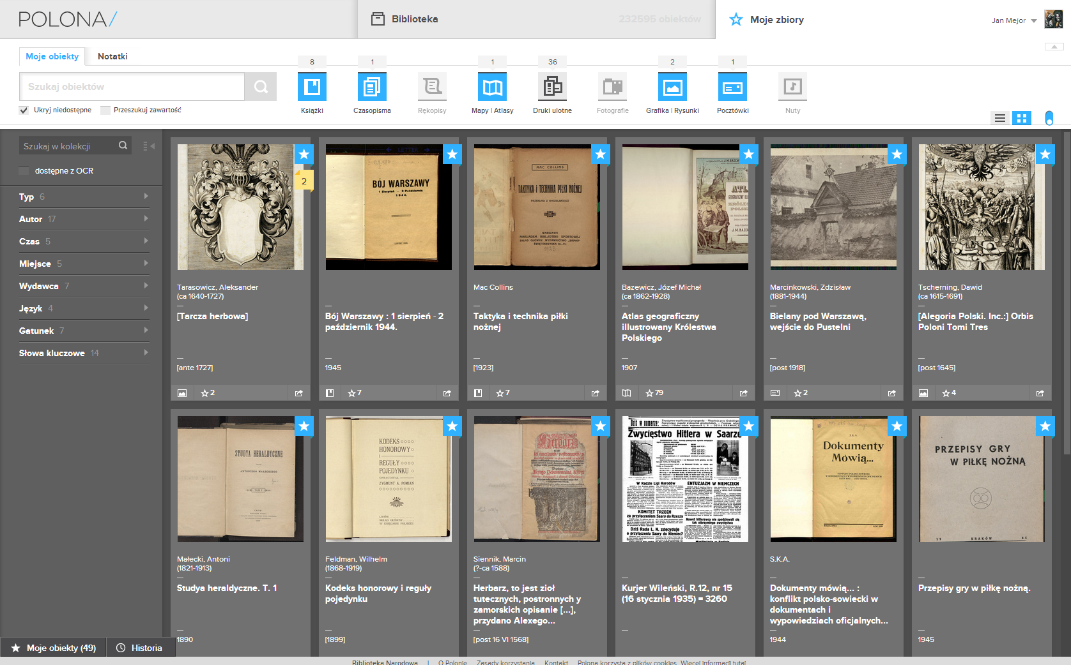
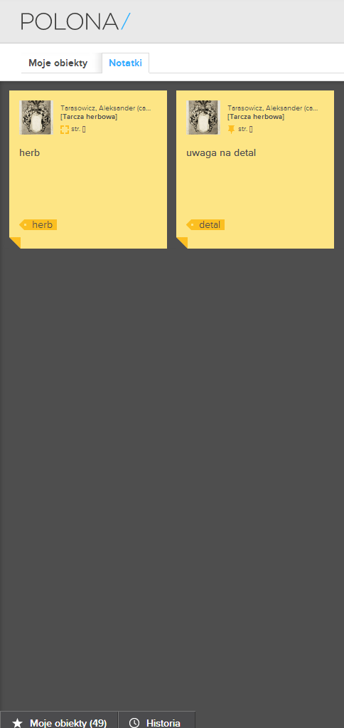
User and Community services

Slide 13
Underground
Polona
IIPImage server
Matrix
Tape library
Abbyy Recognition Server
backup
database
solr index + morfologic
content processors
solr index + morfologic
HCP
service monitoring
database
repository API
polona API
polona app
repository app
repository public API
online services
polona site
repository site

Slide 14

Project of the year
Projekt Roku 2013
Stowarzyszenie Twórców
Grafiki Użytkowej
http://stgu.pl/nasze-projekty/projekt-roku-2013/

Slide 15
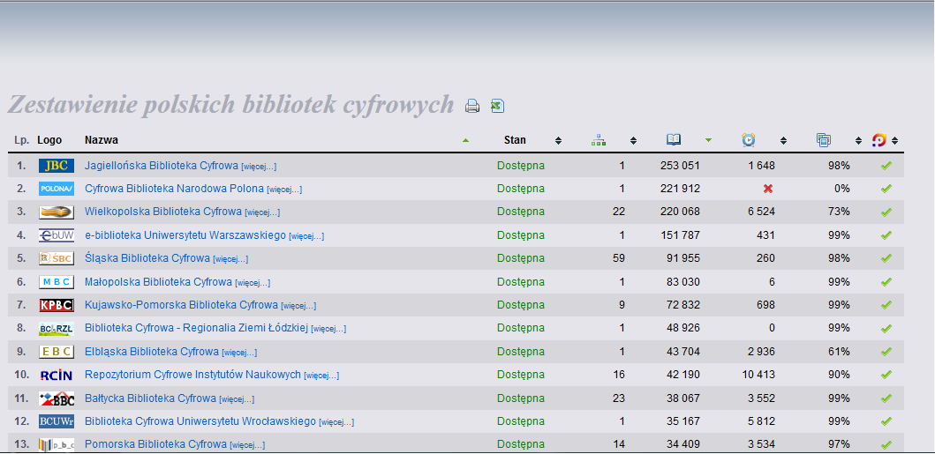

Future features

Slide 16
Thank You
Jan Mejor
National Library of Poland
j.mejor@bn.org.pl

