Slide 1
Bibliographic Data for Academic Digital Library
Jarmila Majerová
University of Žilina

Slide 2
The background for this presentation
Project: Memory of Slovakia - National Center of Excellence in research, digitization, conservation and accessibility of cultural and scientific heritage
Top trends in academic libraries (2012)

Slide 3

The strategic objective of the project is to establish national center of excellence for research, conservation and accessibility of cultural and scientific heritage with internationally recognized basic research
The project will contribute to improving the technical infrastructure of top research institutes in the field of protection and accessibility of cultural and scientific heritage in the Žilina region, with the current level of technical infrastructure. The implementation of the project will significantly improve the conditions of the educational process and will prepare a new generation of scientists
Research tasks:
  Text mining (theoretical research)
  Research of physico-chemical properties of analog media (theoretical and practical research)
  Research of fonts of historical book documents (theoretical and practical research)
  Research and evaluation methods and tools for making available digital content - Automatic Document Classification
  Heuristic and source research of History of Book Culture

Slide 4
Project - basic information
The project is co-financed by the European Regional Development Fund under the OP Research and Development (ITMS: 26220120061).
Period of project: 2010-2014
Money for the project: 4.3 million. €
Grantees: University of Žilina
Partner: the Slovak National Library in Martin
Specific objective: Achieve significant results in research, conservation and presentation of cultural and scientific heritage

Slide 5
The objective of research activity
Demonstrate the potential of the newly built center to produce quality scientific outputs using a new, high-quality infrastructure built under the proposed project
Design and develop ICT-based collaboration platform for staff of the Centre and various institutions (especially libraries, museums, archives, universities)
Specific outcome will be created and pilot projects using proven model of cultural, scientific and intellectual heritage for educational purposes in order to be fully implemented in the model in education using the latest technology

Slide 6
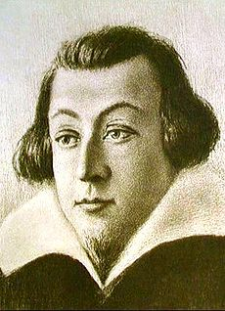
Library Tranovský
Juraj Tranovský (or Tranoscius Třanowský, Třánowsky, Trzanowski, Trzanovský; Georgius Tranoscius / Tranoscyus)
Born on March 27, 1592, Cieszyn - † May 29, 1637, Liptovský Mikuláš was a Slovak Lutheran pastor and creator of Czech and Latin spiritual songs and prayers. He is important representative of Slovak Baroque literature
His the most important work is the hymnal Cithara sanctorum ... which became the first Protestant hymnal printed in Slovakia - 1636

Slide 7
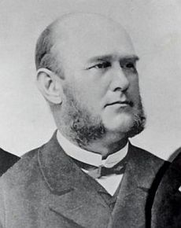
Library Tranovský
Foundation: end of the 19th century
Founder of the library: Ján Mocko, Protestant priest, bibliophile
Collection: 2 500 library and archival units,
unique set of hymns, theological and Protestant religious literature
Collection covers 16th – 20th centuries

Slide 8
Library Tranovský
Objective: to carry out its professional processing, treatment, digitize its collection, cataloguing and scientific analysis, and on the basis of archival and library materials to prepare its complex history, to create a model process and instructions on how to proceed in modern processing and presenting the history of library

Slide 9
The most significant subcollections
Collection Cithara sanctorum (215 editions)
Collection of hymn books except Cithara sanctorum
Collection of Lutheran hymnal
Collection of Bibles
Collection of manuscripts
Collection of church records
Collection of musical scores
Collection of extra books

Slide 10
Bibliographic description of collection items
Current Status:
card catalog
SNL owns inventory of documents in the dBASE system (complete list)
records contain minimum of descriptive metadata

Slide 11
Cataloguing – what to achieve?
Full bibliographic description
Create authorized access points (for names of persons, geographic names, corporate bodies, subjects)
Metadata elements (in accordance with RDA Core Elements, Dublin Core, ESE – mandatory elements)
MARC 21 structure implemented in the VTLS Virtua ILIS – Tranoscius has its own location

Slide 12
AACR2 vs. RDA – pros and cons
More suitable for analog resources, problems when cataloguing digital resources
Not inclusion of FRBR study - FRBR conceptual model of entity-relationship offers a more effective means for realizing user tasks; not adapted to the digital world
AACR2 are organized by ISBD areas - RDA is organized by FRBR entities and relationships
AACR2 are orgnized in chapters for classes of materials - RDA is organized in 10 sections that contain separate elements based on user tasks
AACR2 are more presentation (display) standard - RDA is a Content Standard - Not a display
Change in vocabulary - The new vocabulary (heading – authorized access point, author – creator, physical description – carrier description ...)
ICP - „take what you see,“ „accept what you get“
Total change of GMD – content type, carrier type, media type – controlled (closed) vocabularies
No more „rule of 3“
3 levels of description (AACR2) – Core Elements (RDA)

Slide 13

Why RDA?
„New generation“ cataloguing rules
Suitable for both analog and digital formats of resources
Test of new structure of information organization based on FRBR entities
Suitable for all types of resources – primarily for libraries but consulted with museums and archives
Sustainability of RDA development and upgrades

Slide 14
Sample of a record
Cithara Sanctorum : Apocalyps. 5. v. 8. Pjsně Duchownj, Staré y nowé kterýchž Cýrkew Křesťanská při Wýročnjch Slawnostech a Památkách, gakož y we wsselikých potřebách swých obecnjch y obzwlásstnjch, s mnohým prospěchem vžjwá / K obecnému Cýrkwe Božj wzdělánj, někdy shromážděné a wydané od Kněze Giřjka Tranowského, Služebnjka Páně při Cýrkwe Swato=Mikulášské w Liptowě. – Wydánj 36. Pessťanské s Přjdawkem 1040 Pjsnj obsahugjcým. – W Pessti : Nákladkem P. J. M. Trattnera a Št. Károlyiho, 1849 ([Pešť] : [Ján Matej Trattner a Štefan Károlyi]. – [1], xiv, 1184, [64] s. ; 8°
Call numbers: SNK SD 40633; UKB SF 1186; UKB SD 87885; Tranoscius X.F.64; ...

Slide 15
AACR2 | RDA
100 1# $a Tranovský, Juraj | 100 1# $a Tranovský, Juraj $e author
245 10 $a Cithara Sanctorum $b Apocalyps. 5. v. 8. Pjsně Duchownj, Staré y nowé kterýchž Cýrkew Křesťanská při Wýročnjch Slawnostech a Památkách, gakož y we wsselikých potřebách swých obecnjch y obzwlásstnjch, s mnohým prospěchem vžjwá $c K obecnému Cýrkwe Božj wzdělánj, někdy shromážděné a wydané od Kněze Giřjka Tranowského, Služebnjka Páně při Cýrkwe Swato=Mikulášské w Liptowě | 245 10 $a Cithara Sanctorum $b Apocalyps. 5. v. 8. Pjsně Duchownj, Staré y nowé kterýchž Cýrkew Křesťanská při Wýročnjch Slawnostech a Památkách, gakož y we wsselikých potřebách swých obecnjch y obzwlásstnjch, s mnohým prospěchem vžjwá $c K obecnému Cýrkwe Božj wzdělánj, někdy shromážděné a wydané od Kněze Giřjka Tranowského, Služebnjka Páně při Cýrkwe Swato=Mikulášské w Liptowě
250 ## $a Wydánj 36. Pessťanské s Přjdawkem 1040 Pjsnj obsahugjcým | 250 ## $a Wydánj 36. Pessťanské s Přjdawkem 1040 Pjsnj obsahugjcým
260 ## $a W Pessti $b Nákladkem P. J. M. Trattnera a Št. Károlyiho $c 1849 | 260 ## $a W Pessti $b Nákladkem P. J. M. Trattnera a Št. Károlyiho $c 1849
300 ## $a [1], xiv, 1184, [64] s. $c 8° | 300 ## $a [1], xiv, 1184, [64] strán $c 8°
 | 336 ## $a text $2 marccontent
 | 337 ## $a unmediated $2 marcmedia
 | 338 ## $a volume $2 marccarrier
INFOS 2011

Slide 16
RDA Core elements (Manifestation) | DC | ESE
ISBN | contributor | country
Publisher number | coverage | dataProvider
Title | creator | isShownAt
Statement of responsibility | date | isShownBy
Edition statement | description | language
Place of Publication | format | object
Publisher’s name | identifier | provider
Date of publication | language | rights
Extent | publisher | type
Content | relation | ugc
Media | rights | unstored
Carrier | source | uri
Title proper of series | subject | userTag
Numbering within series | title | year
Title proper of subseries | type

Slide 17
What should we do in the field of standards?
Translate RDA
Understand and interprete DC (DCterms) and ESE elements properly
Prepare manuals for training cataloguing with RDA
Prepare manual for cataloguing old and rare books including specific issues

Slide 18
Future of the Centre of Excellence
Running projects:
Digitization of Library Tranovský
Digitization of Mediamatic and Cultural Heritage Department Branch Library of the Faculty of Human Sciences (about 550 volumes)
Future projects:
Digitization of other Protestant church libraries (West Slovakia District)
Digitization of other faculties and departmental branch libraries – the intention is to connect digitized textbooks with respective courses for education purpose ... in this connection I go back to ...

Slide 19
Top trends in academic libraries (2012)
Data curation - the initiative addresses the need for data from publicly funded research to be made widely available and publicly accessible to broad scientific communities. Librarians and information workers have a vital role to play in helping their research communities design and implement a plan for data description, efficient storage, management and reuse
Digital preservation - academic libraries will “increasingly focus on distinctive and unique collections in service to regional and national scholar audiences.” Many of these collections, particularly those that include rare and unique content or institution-specific materials such as university records and grey literature, are or will be digitized
Higher education - online education may provide sustainable path forward for institutions of higher education

Slide 20
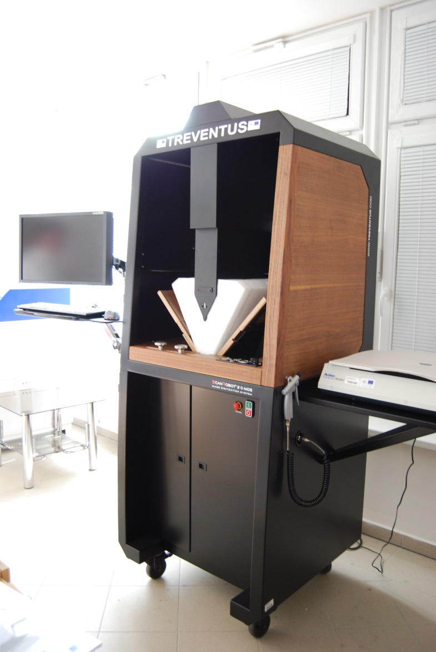
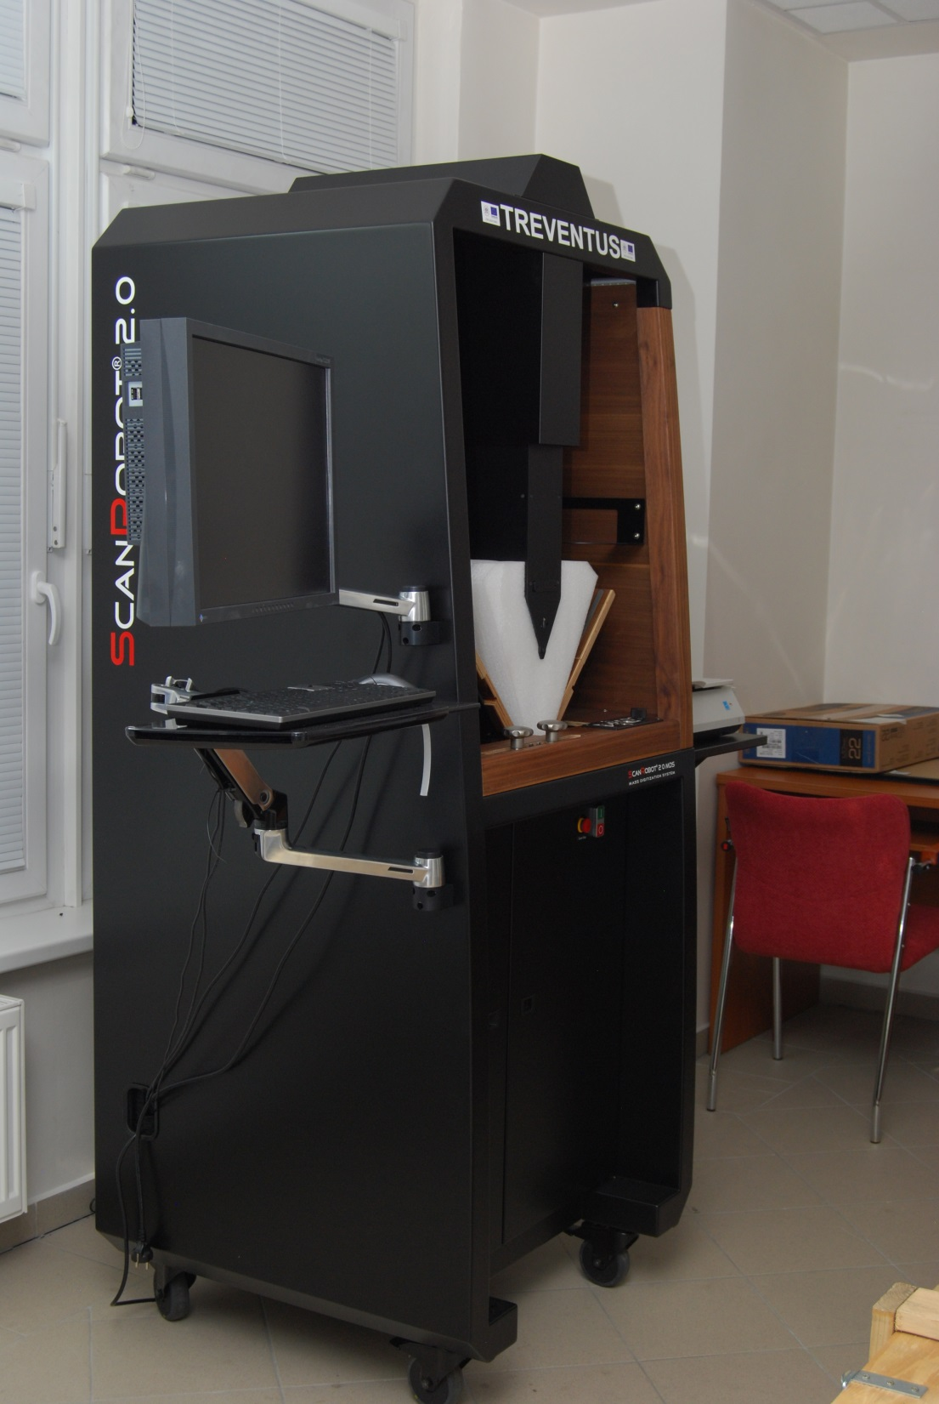

Slide 21
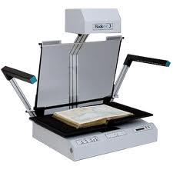
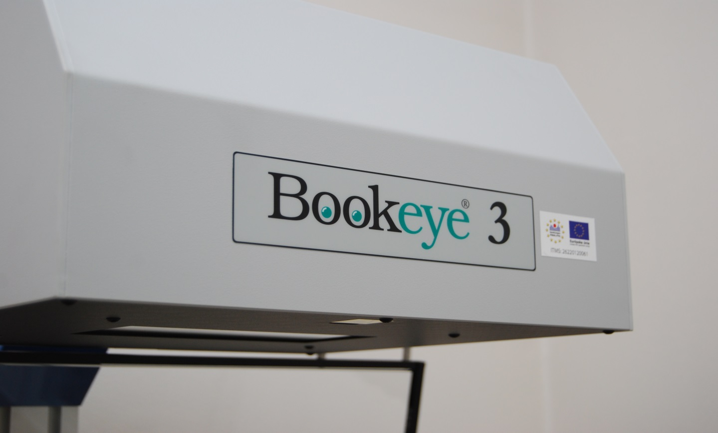
BOOKEYE 3

Slide 22
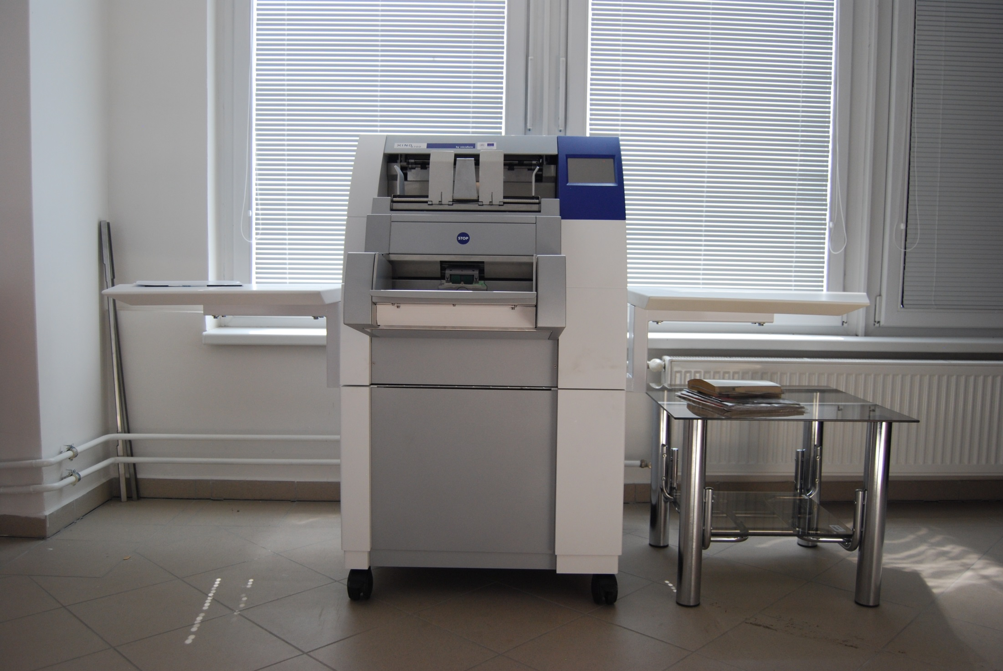
XINO
Notes:
Na základe prvej fázy digitalizácie a získaných údajov z už prezentovaných meraní, odborníci nášho centra kategorizujú jednotlivé dokumenty podľa stavu a typu historického dokumentu Tranovského knižnice na jednotlivé skenery. Skenovanie je aj súčasťou vzdelávacieho procesu. Dokumenty skenujú študenti Katedry mediamatiky a kultúrneho dedičstva, ktorí praxou v digitalizačnom centre získavajú základné zručnosti, nielen čo sa týka skenovania, ale taktiež sú súčasťou prvej fázy digitalizácie, a to najmä získavaní údajov o dokumente.
22

Slide 23
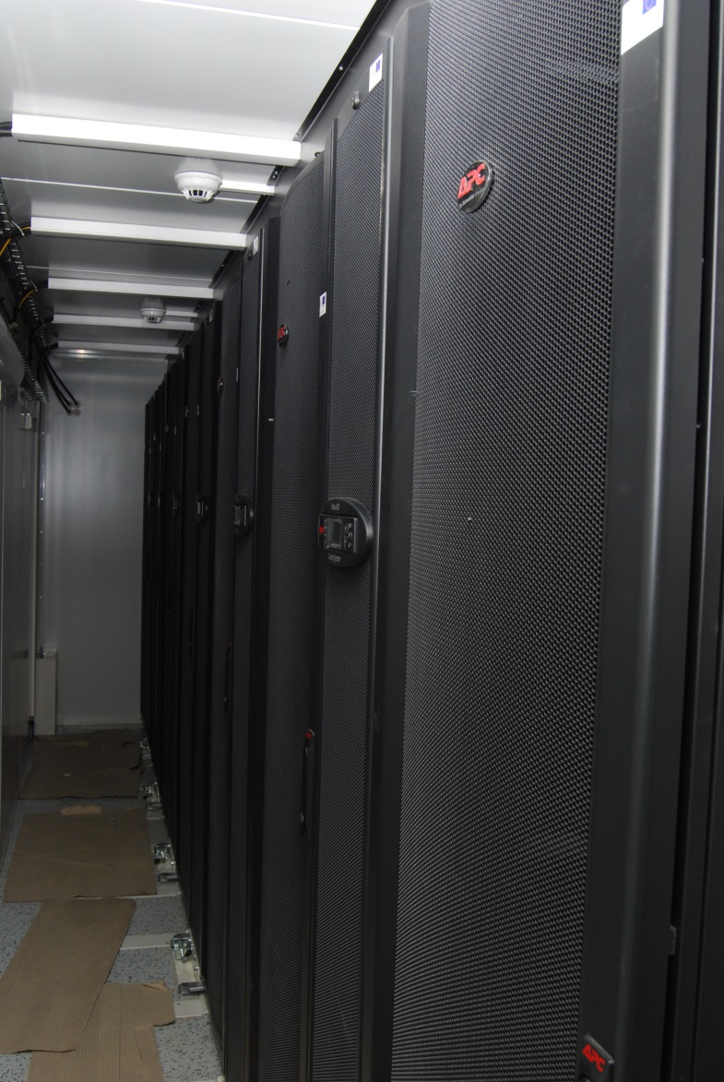
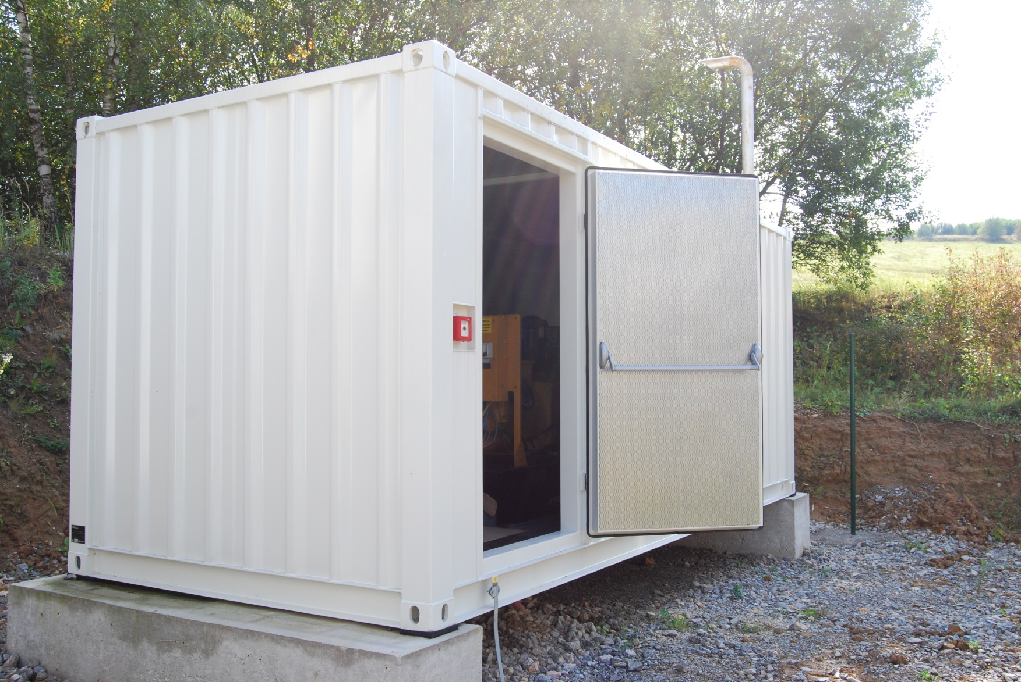
MOBILE DATA CENTRE

Slide 24
Thank you for your attention

