Slide 1
Clarivate + ProQuest
How bringing two leaders together will enable libraries to fulfill ambitious research missions
Radek Budzichowski
6 September 2022

Slide 2
Agenda
Clarivate + ProQuest
How we’re complementary
What we share
Library challenges and opportunities
Creating Big Solutions
Clarivate as infinite data ocean

Slide 3
Clarivate + ProQuest
ProQuest
Content that drives research excellence and student success
Complementary resources and expertise that enable libraries and universities to fulfill ambitious missions
Clarivate
Analytics for better decision-making
Ex Libris and Innovative
SaaS solutions for more efficient library and university workflows
3
Notes:
TEN THOUSAND FOOT VIEW BRINGING THESE COMPANIES TOGETHER

Slide 4
Clarivate + ProQuest
Incite
Research, Teaching and
Learning Tools
Resources and analytics that improve insights and user workflows, producing better results, faster
Researcher Tools
ETD / Scholar One
Publishing Tools
Web of Science
Analytics
TDM Studio
Text and Data Mining
Leganto
Reading List
Summon Primo
Discovery
Refworks Endnote
Reference Manager
Pivot-RP
Research Funding
Esploro Converis Publon
Research Services
Dialog Cortellis
Systematic Reviews Research
Campus M
Communication
ProQuest Central
Databases
AVON
Content and Data
Authoritative information that enables teaching, learning and research success
Video
PQDT
Dissertations
Academic Complete
Ebooks
PQ1 Literature PQ1 Business
Discipline Specific
Ebook Central
Ebooks
Historical Collections, GIS, News
Primary Sources
Open Layer
Open Access
Web of Science
Library Services
Resources that extend and enhance the value of library assets
A&I
ACT TMF
ProQuest Value-Added Insights
SAFE Microfilm
Preservation
Syndetics
Library Catalog Enrichment
Library Foundations
Must-have management and workflow resources that drive efficient, effective modern institutions. The base to build on
Alma
LSP/ILS
Rialto
Acquisition Workflow
Marketplace: Books +
Ebook Central
Selection & Acquisition Books
OASIS
Selection & Acquisition Books
Rapid Ill Rapido
Resource Sharing
Innovative
4
Public Library ILS
Notes:
TEN THOUSAND FOOT VIEW BRINGING THESE COMPANIES TOGETHER

Slide 5
Clarivate + ProQuest
Customer Success
Marcin Kapczynski
Klementyna Karlinska-Bartres
Adriana FIlip
Eniko Tot-Szasz
Global Channel Team
Laura Torres
Territory
Manager
Customer Success
Specialists
Operations/
CRM
Marketing
Professional Services
Pre Sales
Global Channel
Product Specialists
Books
Martin Blomquist
Research Office
Massimiliano Bearzot
PQIS
Krassi Anguelova
IP
Juliane Ferreira
Life Sciences
Olga Stysina
Software
Nina Keren-David
Pre Sales
Research Office
Jamal El Ouahi
IP/Patent
Walid Hassan
Benno Jensen
Software
Remy Marceron
Operation/CRM
Karolina Holk
Leesa Obie
Professional Services
Simon Thomson
Josh Schnell
Marketing
Tiina Krunniniva
5
Notes:
TEN THOUSAND FOOT VIEW BRINGING THESE COMPANIES TOGETHER

Slide 6
Shared goal that aligns with libraries
Contributing to a better world by improving research, learning and insights

Slide 7
Today’s library environment
Accelerating trends
Strained resources
Adapting to change
Transition from physical to electronic and mobile
Diversity of collections, in staffing, in technology
Analytics driving research workflows and engagements
Budget uncertainty
Staff shortages
Investigating new models, seeking ways to improve efficiency
In-person vs. remote staff
Shifting patterns of demand
Maintaining engagement with increasingly remote stakeholders and users

Slide 8
Big challenges need big solutions
Combining complementary strengths delivers:
Product innovation
Improved user experiences​
Deeper campus connections for libraries
Better insights for better decisions
More comprehensive solutions

Slide 9
Platform that serves the life-cycle of knowledge and research
Endless possibilities to innovate new solutions that increase library impact
Notes:
representative

Slide 10
Product integration in 2022
Connecting data & improving workflows across products
Web of ScienceTM
References export directly to RefWorks
Linking to discovery platforms from article record (meta-data CDI)
Connect ProQuest full-text to Web of Science citations
ProQuest Platform
Integrate Web of Science article and journal metrics
EndNoteTM
Connect to full-text using AlmaTM-PrimoTM links
Search ProQuest® platform within EndNote
Direct exports from ProQuest platform to EndNote
Primo/Summon
Integrating Web of Science backfiles and full Core Collection for discovery
Integrate Web of Science article and journal metrics
Pivot-RP
Awarded grants information from Pivot-RP profiles with ResearcherIDs displayed on Web of Science Author profiles
Linking funding information in Web of Science to Pivot-RP Awarded Grants
Esploro
Integrate Web of Science metrics/data
SDG publication metrics added to Author Profiles
Funding data from Web of Science added to Author Profiles

Slide 11
Product integration in 2023
International Dissemination of PhD Theses via PQDT Global®
PQDT Global® Benefits to University and Authors
Promote graduate research to a global academic audience
Subject indexing services, Google Scholar, and (to come) Web of Science
Improved discoverability of relevant content and authors through full text indexing, abstract translation, and citation connections
Enhanced metadata increases potential for being seen and cited
Non-exclusive license by ProQuest and take-down option for authors
Easy to setup automated harvesting of content from repositories
Tracking of usage and impact in PQDT with the free ETD Dashboard
Royalty payments for registered authors on sales of individual copies
Content included in tools for in text and data mining projects
All services above are free of charge to universities and authors

Slide 12
Selected roadmap ideas
Enhancements ahead for customers and users
Better collection management
Enriched product value
Unified researcher profile
Research administration efficiencies
Integrate Alma and InCites Benchmarking & AnalyticsTM for a more complete picture of collection needs across the Institution
Web of Science expands to include dissertations and government/policy index
Linking from Web of Science Book Citation Indexes to books on eBook CentralTM
Combining author/ researcher profiles across Web of Science, Esploro, and Pivot for a complete 360 view of the researcher
ConverisTM + EsploroTM for joint view of systems. Bringing the best of both solutions for world-class research management

Slide 13
Clarivate as infinite data ocean
Web of Science
Derwent Innovation
Cortellis
TDM Studio
WoS Core Collection XML
Custom Data
WoS Core Collection API
BIOSIS CI API
MEDLINE API
Journal API
InCites API
Global IP Custom Data XML
DWPI APIs
Cortellis, BioWorld XML
Cortellis, Incidence and Prevalence Database (IPD) XML
Cortellis, Active Pharmaceutical Ingredients for Manufacturing (CGI) XML
Cortellis Drug Discovery Intelligence Dataset (CDDI) XML
End-to-end text and data mining solution solution for research at all levels and all disciplines
Leverages the power of a library’s content to help researchers make new connections and uncover career-defining outcomes

Slide 14
Web of Science APIs: Primary Use Cases
Data Integration (on-going)
Research Projects (one-off)
Research Intelligence & Strategy / Planning
Dashboards & Visuals
Citation Networks & Mapping
Scientific Trends and Impacts over time
Combining scholarly impact data with other external datasets
IR and Public Researcher Engagement Platforms
3rd party integration – FAR/CRIS/RIMS and Discovery Services
Publication & Research Presentations / Findings
Measuring and Modeling the Dynamics of Science
Hypothesis testing and validation

Slide 15
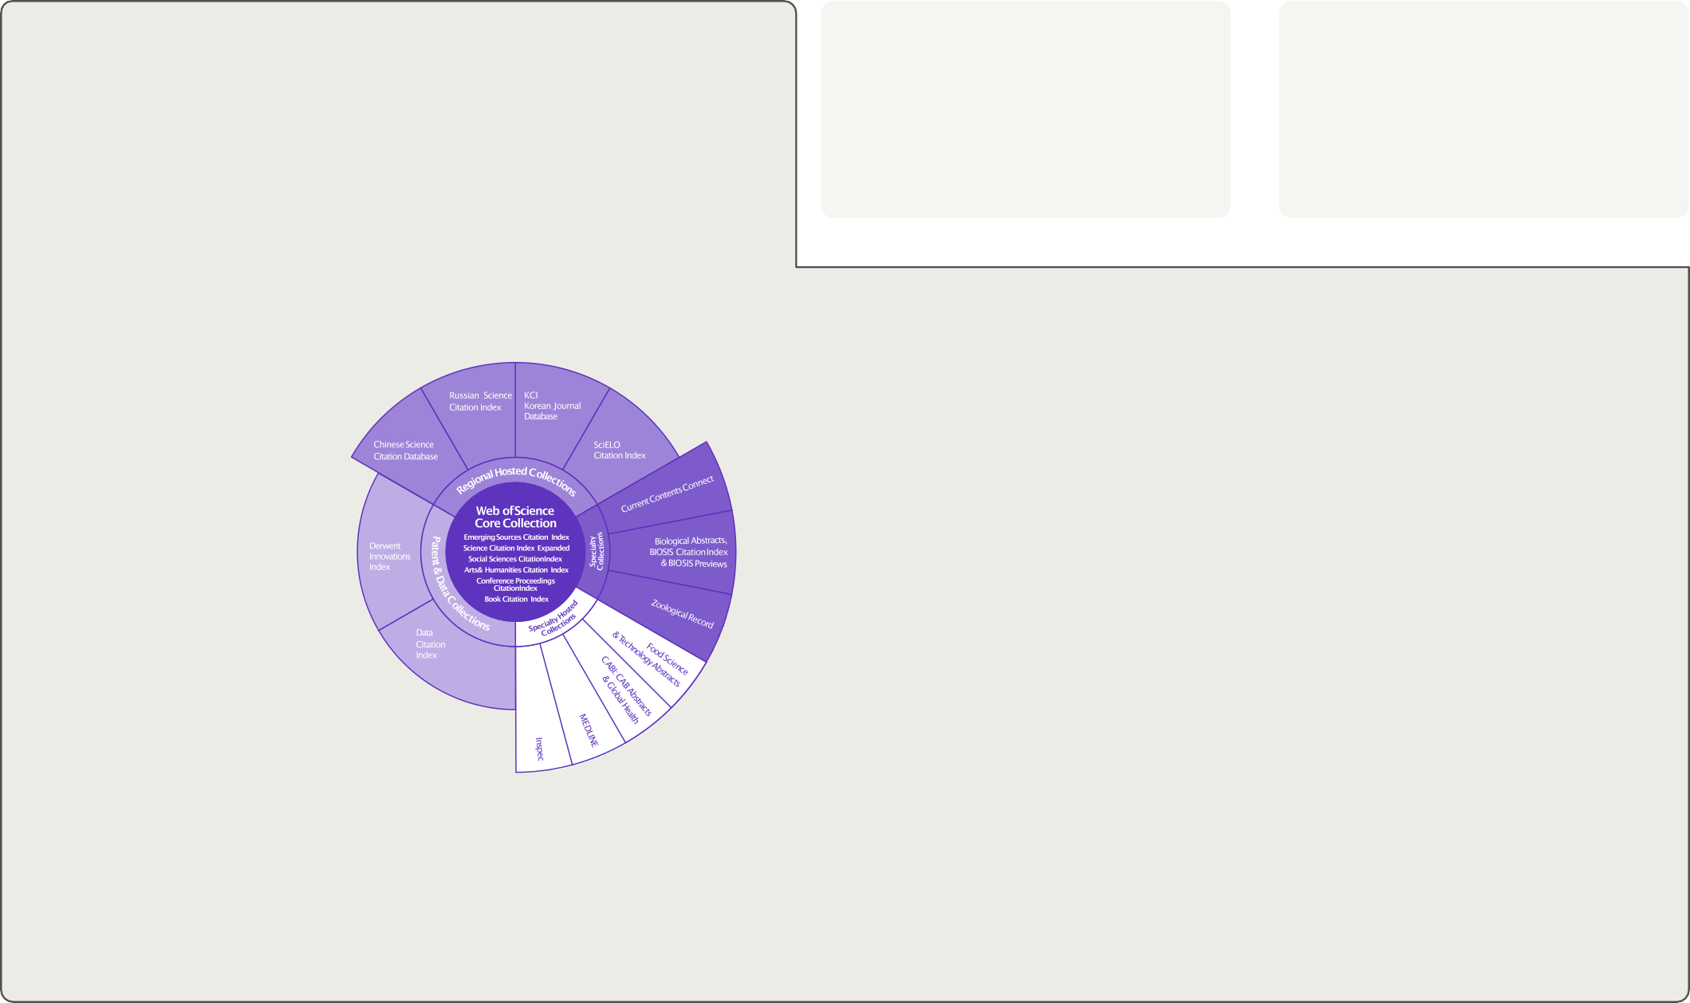
Web of Science™ APIs
May 2021
InCites Benchmarking & Analytics™ | Journal Citation Reports™ | Web of Science™
The Web of Science Publication APIs complement our suite of RESTful Web of Science APIs to provide complete publication metadata from the Web of Science
Publication metadata
Publication metrics
Journal metadata/metrics
Web of Science API Lite Support search and data integration using limited Web of Science data re- turned as JSON or XML
Web of Science API Expanded Support search and data integration using full Web of Science data re- turned as JSON or XML
InCites API
Support bibliometric analysis and integration of document-level metrics
Web of Science Journals API Support bibliometric analysis and integration of journal-level metrics
Coverage
Example use cases
WoS API Lite
Includes the following data sources:
WoS API Expanded
Includes the following data sources:
Library: publication repository updates, advanced search for institute papers
Clarivate Converis; Symplectic Elements; Elsevier Pure; Interfolio Faculty180; Lyrasis Dspace, VIVO
Research management: benchmark, collaborations, citations, integration with CRIS
Research: publication and citation analysis, network data, AI, machine learning
Web of Science Core Collection
BIOSIS family (BCI, BIOABS, BIOSIS)
Current Contents
Data Citation Index
Derwent Innovations Index
Medline
Zoological records (ZR)
Web of Science Core Collection
BIOSIS family (BCI, BIOABS, BIOSIS)
CABI
Current Contents
Data Citation Index
Derwent Innovations Index
FSTA
INSPEC
Medline
Regional content
Zoological records (ZR)
Data fields
API usage
WoS API Lite
Authors, Author keywords, RID, Document type, Title, Issue, Pages, Publication date, Source title, Volume, DOI, ISBN, ISSN
WoS API Expanded
WOS Lite fields + PMID, Times cited, Author addresses/affiliations, Grants, Publisher, Related records, citing articles, citing references, Organization enhanced, Author Identifiers
Query for all publications using WoS advanced search field tags
Get cited references and citing articles
Get times cited counts
Get WoS UTs to quickly identify new publica-
tions for your collection
Queries
Boolean AND/+, OR and NOT operators are supported, along with ‘*’ wildcards. Queries can be filtered by values and ranges
See https://developer.clarivate.com/apis/wos and https:// developer.clarivate.com/apis/woslite for more information

Slide 16
InCites Benchmarking & Analytics API™
May 2021
InCites Benchmarking & Analytics™ | Journal Citation Reports™ | Web of Science™
The InCites API complements our suite of RESTful Web of Science APIs to provide complete document-level metrics from InCites
Publication metadata Publication metrics
Journal metadata/metrics
Web of Science API Lite Support search and data integration using limited Web of Science data re- turned as JSON or XML
Web of Science API Expanded Support search and data integration using full Web of Science data re- turned as JSON or XML
InCites API
Support bibliometric analysis and integration of document-level metrics
Web of Science Journals API Support bibliometric analysis and integration of journal-level metrics
Coverage
Example use cases
InCites API
Includes the following data sources:
Key features
Includes the following data sources:
Library: publication repository updates, metrics for institute papers
Research management: benchmark, collaborations, citations, integration with CRIS
Research: Retrieve metrics and citation topics for bibliometrics studies
Science Citation Index Expanded
Social Sciences Citation Index
Arts & Humanities Citation Index
Conference Proceedings Citation Index (SCI & SSH)
Book Citation Index (SCI & SSH)
Emerging Sources Citation Index
Reliable citation indicators
Global evaluation schema
Collaboration indicators
Open access indicators
Citation Topics
Trend analysis
Institutional profiles
Web of Science™ Core Collection
Science Citation Index Expanded Social Sciences Citation Index Arts & Humanities Citation Index Emerging Sources Citation Index
Conference Proceedings Citation Index Book Citation Index
Data fields
API usage
Times Cited
Document Type
Journal Impact Factor
Highly Cited/Hot Paper
Collaboration indicators (International, industry, International)
Open Access type (DOAJ Gold, Other Gold, Green Published, Green Accepted, Bronze)
Normalized metrics (Category Normalized Citation Impact (per category), Journal Normalized Citation Impact)
Percentile per category
Queries
Search by WoS accession number (UT) to get document- level metrics
See https://developer.clarivate.com/apis/incites for more information
GET metrics by institution ID endpoint
GET metrics by UT endpoint
Set global evaluation schema for regional con- text

Slide 17
Web of Science™ Journals API
July 2021
InCites Benchmarking & Analytics™ | Journal Citation Reports™ | Web of Science™
The new Journals API complements our suite of RESTful Web of Science APIs to provide complete journal metadata and metrics from the Journal Citation Reports
Publication metadata
Publication metrics
Journal metadata/metrics
Web of Science API Lite Support search and data integration using limited Web of Science data re- turned as JSON or XML
Web of Science API Expanded Support search and data integration using full Web of Science data re- turned as JSON or XML
InCites API
Support bibliometric analysis and integration of document-level metrics
Web of Science Journals API Support bibliometric analysis and integration of journal-level metrics
Coverage
21,000 +
journals covered* Includes the sciences (SCIE), social sciences (SSCI), and now both the arts & humanities (AHCI) and emerging sources (ESCI)
All Web of Science Core Collection™ Journals
A new normalized journal metric*
Journal Citation Indicator
calculated for all Web of Science Core Collection journals, along with:
Journal name & ISSN/eiSSN
Category and rank
Total cites
Immediacy Index
Journal Impact Factor™
5-year JIF
JIF quartile
Average JIF percentile
Eigenfactor and Article Influence Score
Cited/citing half-life
Citable items
Open access
Source data counts
12,000 +
have a Journal Impact Factor™ (JIF)
SCIE and SSCI
*From July 2021
Example use cases
API usage
Integrate with internal systems
For example, to pass Journal Impact Factors (JIFs) and Journal Citation Indicators (JCIs) to journal web pages
Bibliometric studies
Access and retrieve core journal metrics for entire categories of groups and journal to include in analyses
Journal
Query for all journals or by journal ID
Get cited and citing journals
Get journal metrics
Queries
Boolean AND/+, OR and NOT operators are supported, along with ‘*’ wildcards. Queries can be filtered by val- ues and ranges
See https://developer.clarivate.com/apis/wos-journals for more information
Category
Query for all categories or by category ID
Get cited and citing categories
Get category metrics

Slide 18
Radek Budzichowski
radek.budzichowski@Clarivate.com

