Slide 1
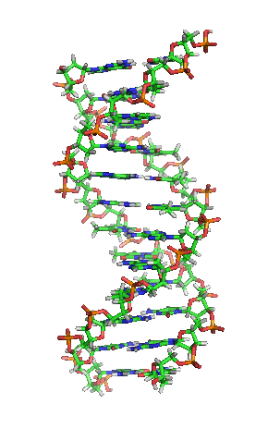

OAIS-compliant digital archiving of research and patrimonial data in DNA
Pierre-Yves Burgi
University of Geneva

Slide 2
What’s the problem ?
Data growth and its environmental impacts
Error rate
Technology reaches its limits
Hardware lifetime
Why DNA ?
Costs
OAIS Architecture
Conclusions

Slide 3
Technology breakdown ?

Slide 4
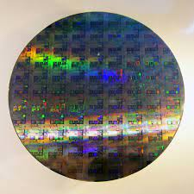
Data growth
By 2040, global memory usage will surpass the supply of silicon available to store it

Slide 5
Environmental impacts
A single 2-g chip requires:
1.6 kg secondary fossil fuel
72 g chemical inputs
For each cm² silicon wafer:
1.5 KWh
18-27 L of water
From Williams et al. 2002

Slide 6
Taiwan Semiconductor Manufacturing Company uses almost 5% of all Taiwan’s electricity, predicted to rise to 7.2% in 2022, and it used about 63 million cubic meters of water in 2019.
Media and hardware used to store and manage the data have to be replaced every 5-10 years, with the old media/hardware either recycled, incinerated, or dumped in a landfill.

Slide 7

Error rate
The requirement of a 50% chance that a petabyte will survive for a century translates into a bit half-life of the order of 10¹⁸ years.
According to a CERN study representing a wide range of state-of-the-art enterprise storage systems (mostly RAID arrays) in which a total of ~ 10¹⁷ bytes were written, ~ 2 × 10⁸ bytes were found to have suffered silent corruption over a 6-month period.
This corresponds to a bit half-life of the order of 10⁸.
To reach the petabyte target for a century requirement, we need to improve the performance of current enterprise storage systems by a factor of
10¹⁰

Slide 8
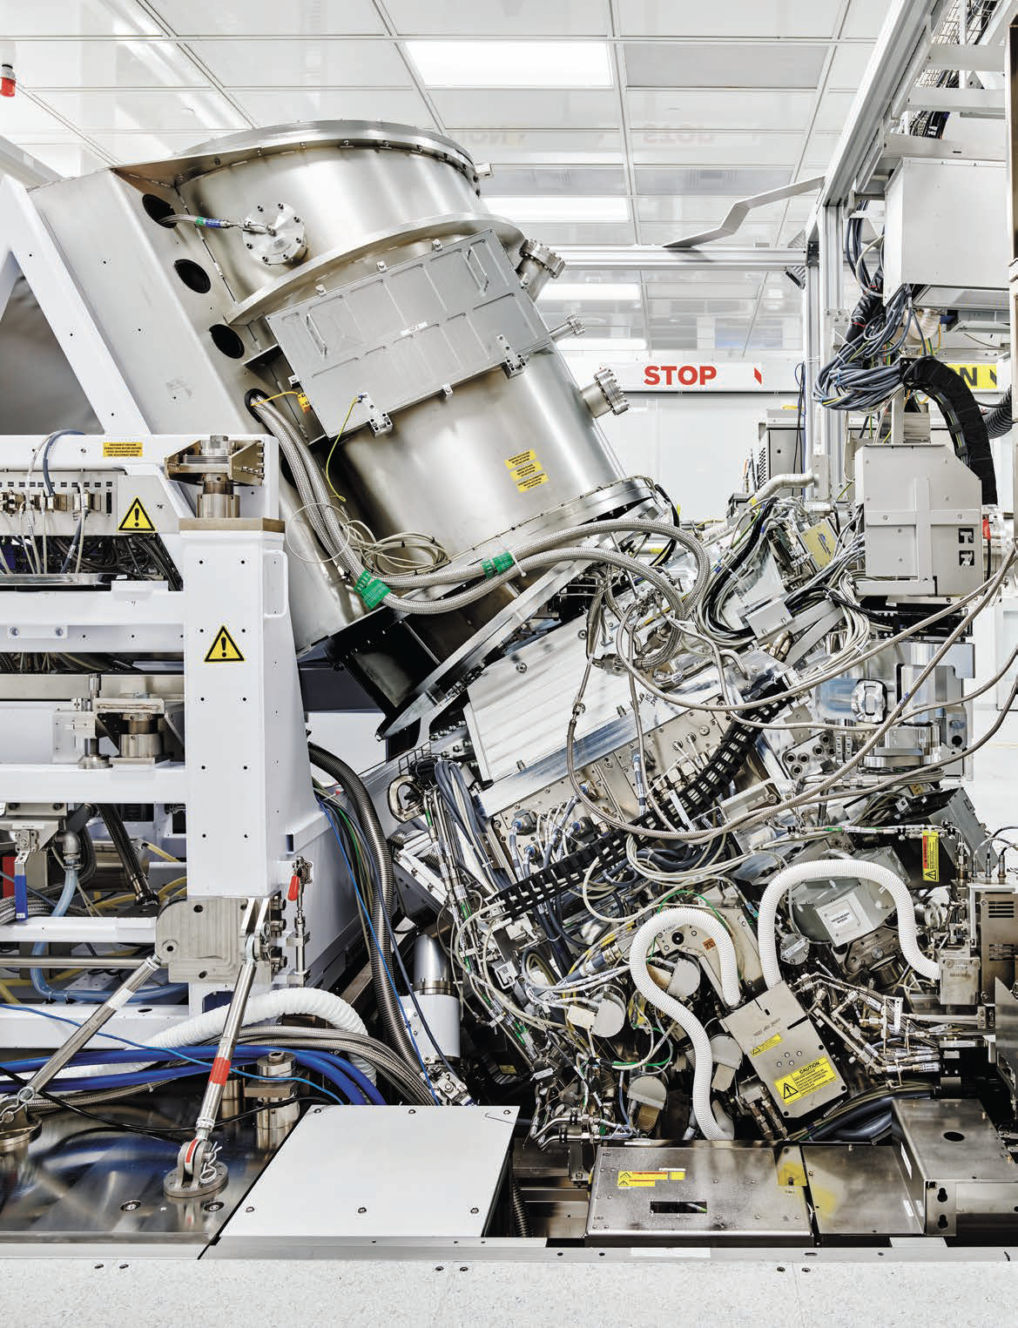
Technology reaches its limits
Quantum tunnelling effect:
Electron-based memory: limited to 10-15 nm technology
ASML $9 billion of R&D and 17 years of research to get to 13 nm and could reach less than 10 nm by 2025

Slide 9
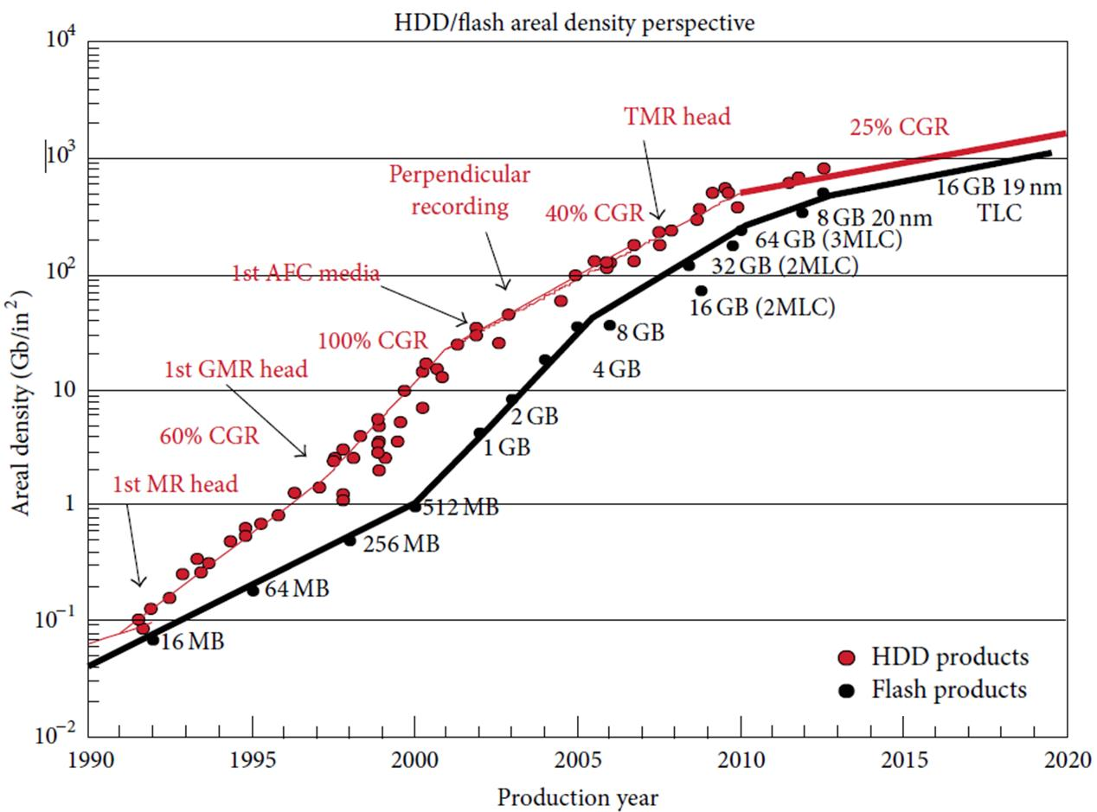
Silicon density reaches its limits
(H. Li, 2016)

Slide 10
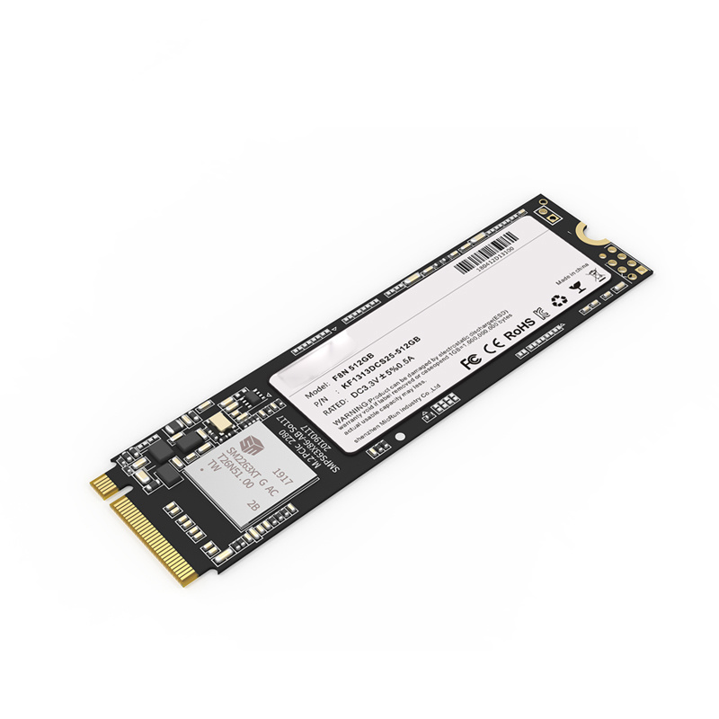


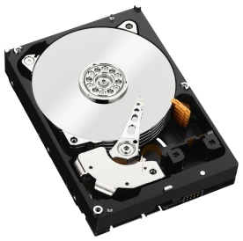
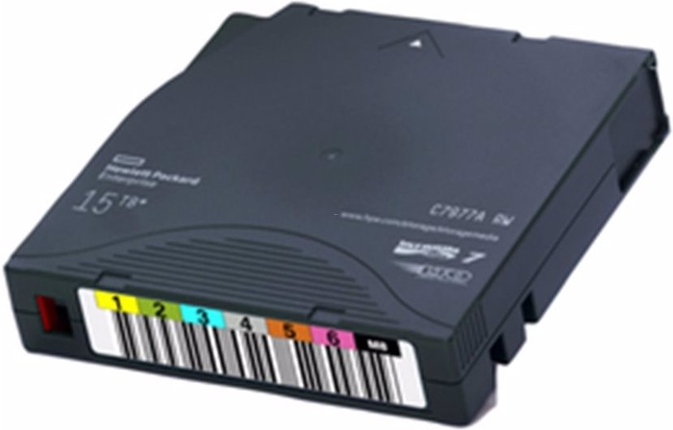
Hardware lifetime
Depends on number of writes, but usually 3-5 years
5-50 years
3-5 years
2 generations (8-10 years)

Slide 11
Why DNA?

Slide 12
Data growth and DNA
1 g of DNA can contain (in theory) 455 EB
175 ZB can be contained within about 400 g of DNA
In practice currenly about 30 PB/g
DNA is only synthesized on demand
Giga = 10⁹
Tera = 10¹²
Peta = 10¹⁵
Exa = 10¹⁸
Zetta = 10²¹
Yotta = 10²⁴

Slide 13
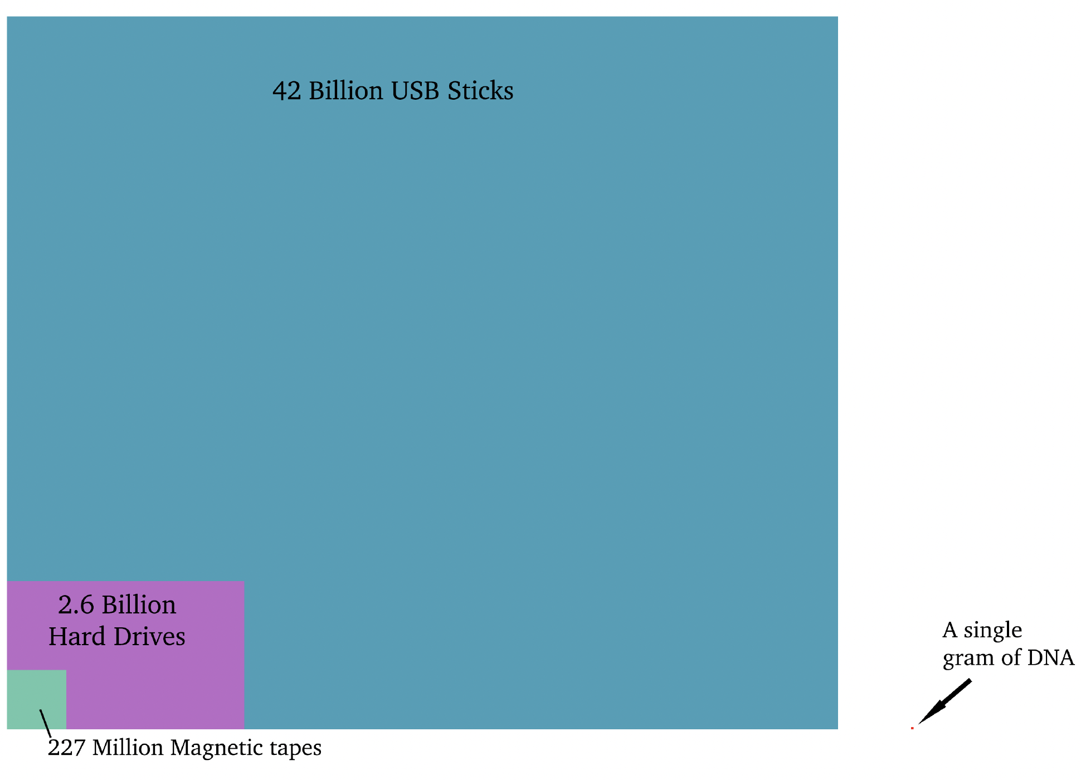
Density comparison: Example for 40 ZB
Source: the future of DNA storage, DNA Storage Alliance (sept. 2018)

Slide 14
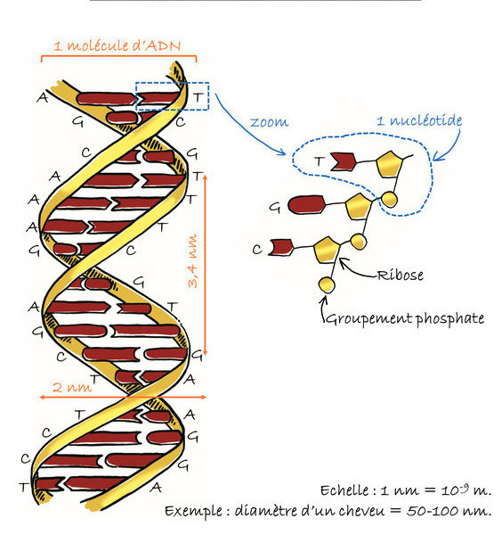
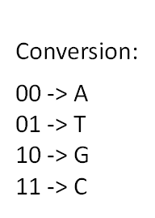
No quantum tunneling effect because made of molecules (14 atoms / bit)
Fabric of life: no obsolescence
Purine : Adenine (A) and Guanine (G)
Pyrimidine : Thymine (T) and Cytosine (C)
0.34 nm
Illustration de Jeanne Le Peillet

Slide 15
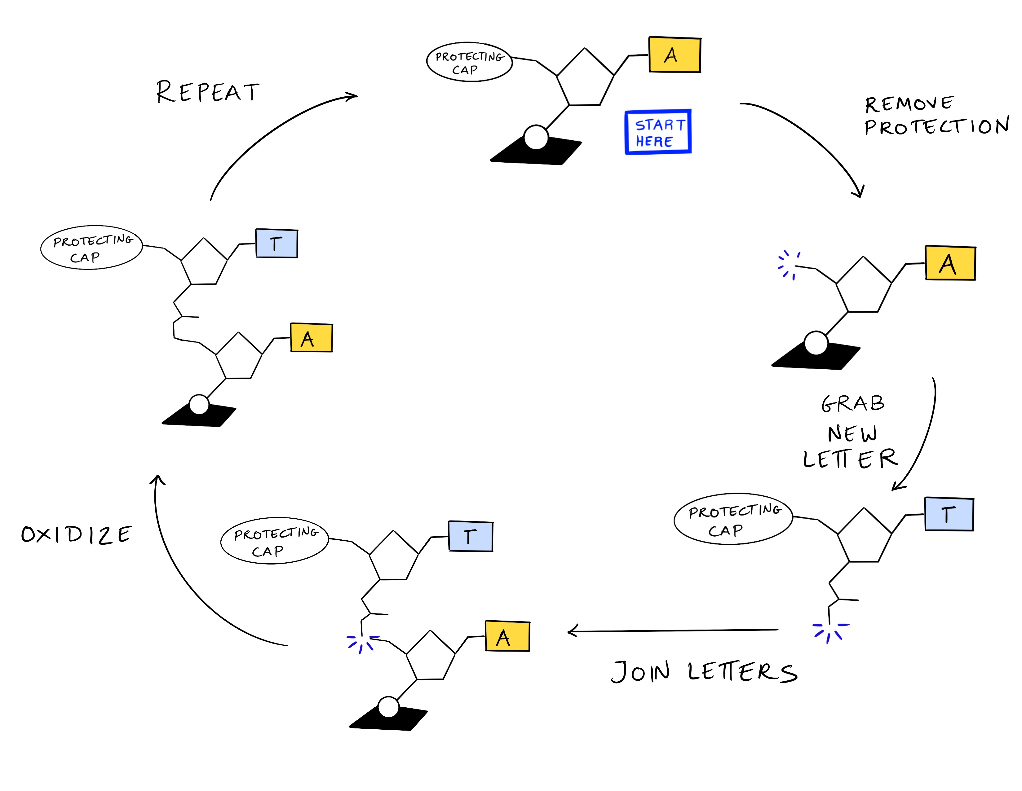
Environmental Impacts
Some chemistry for the manufacture of oligonucleotides:
Of the order of 3 L of solvent for 1 g of oligonucleotide
Phosphoramidite Oligonucleotide Synthesis

Slide 16
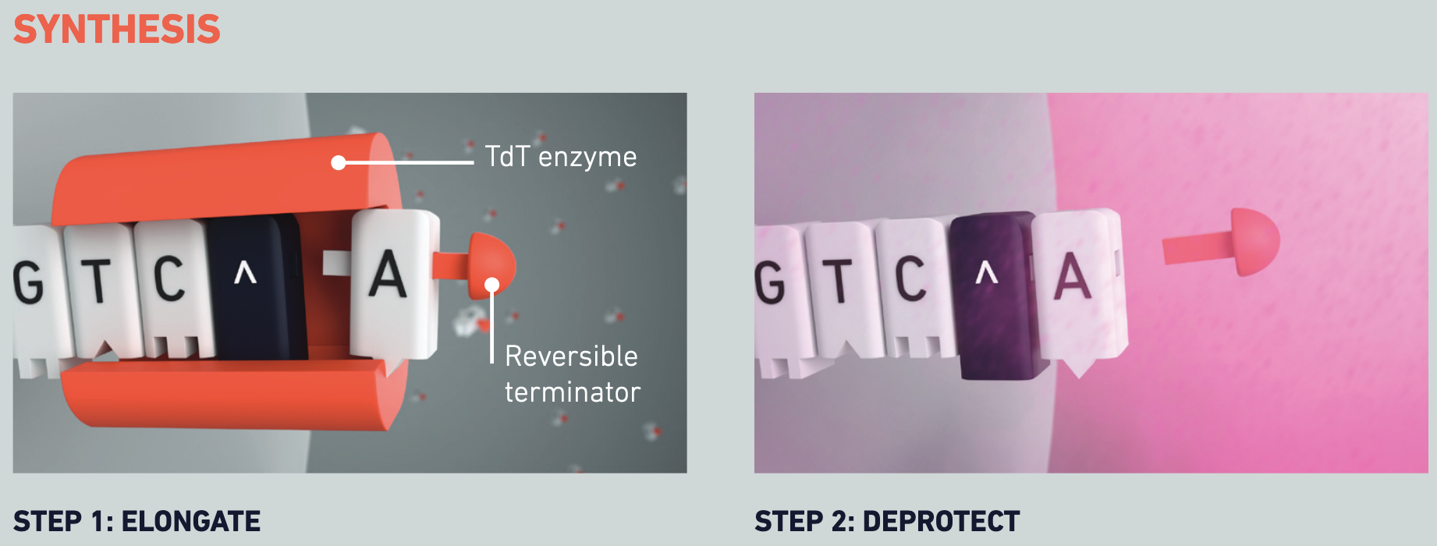
The enzymatic process, inspired by nature will:
avoid the use of toxic reagents and thus contribute to reducing the ecological footprint of this industry
improve speed and efficiency by several orders of magnitude
From DNAScript

Slide 17
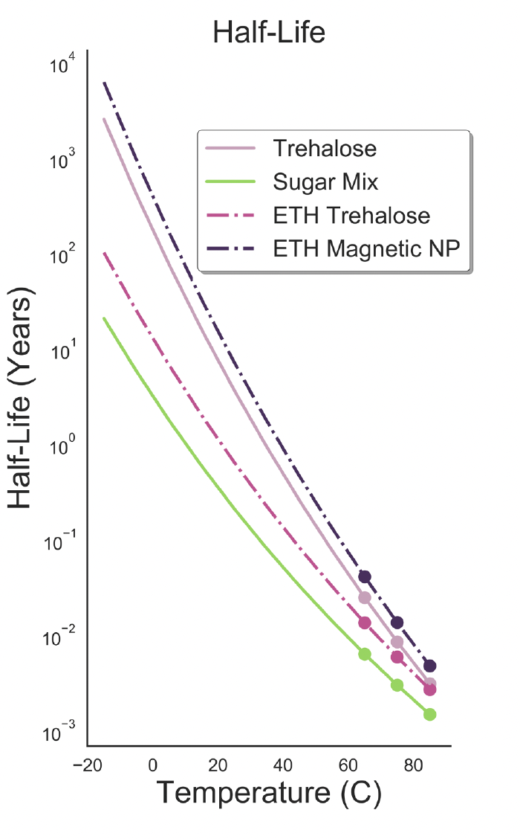
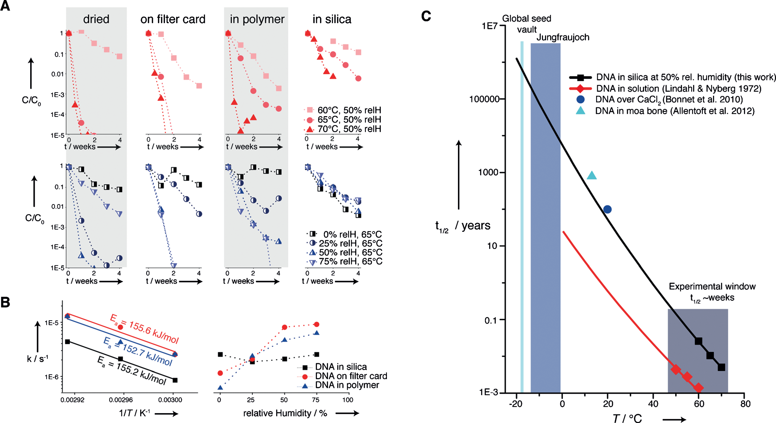
Storage preservation: Depends on process & temperature
Target temperature range
Organick et al. 2020
Grass et al. (2015)

Slide 18
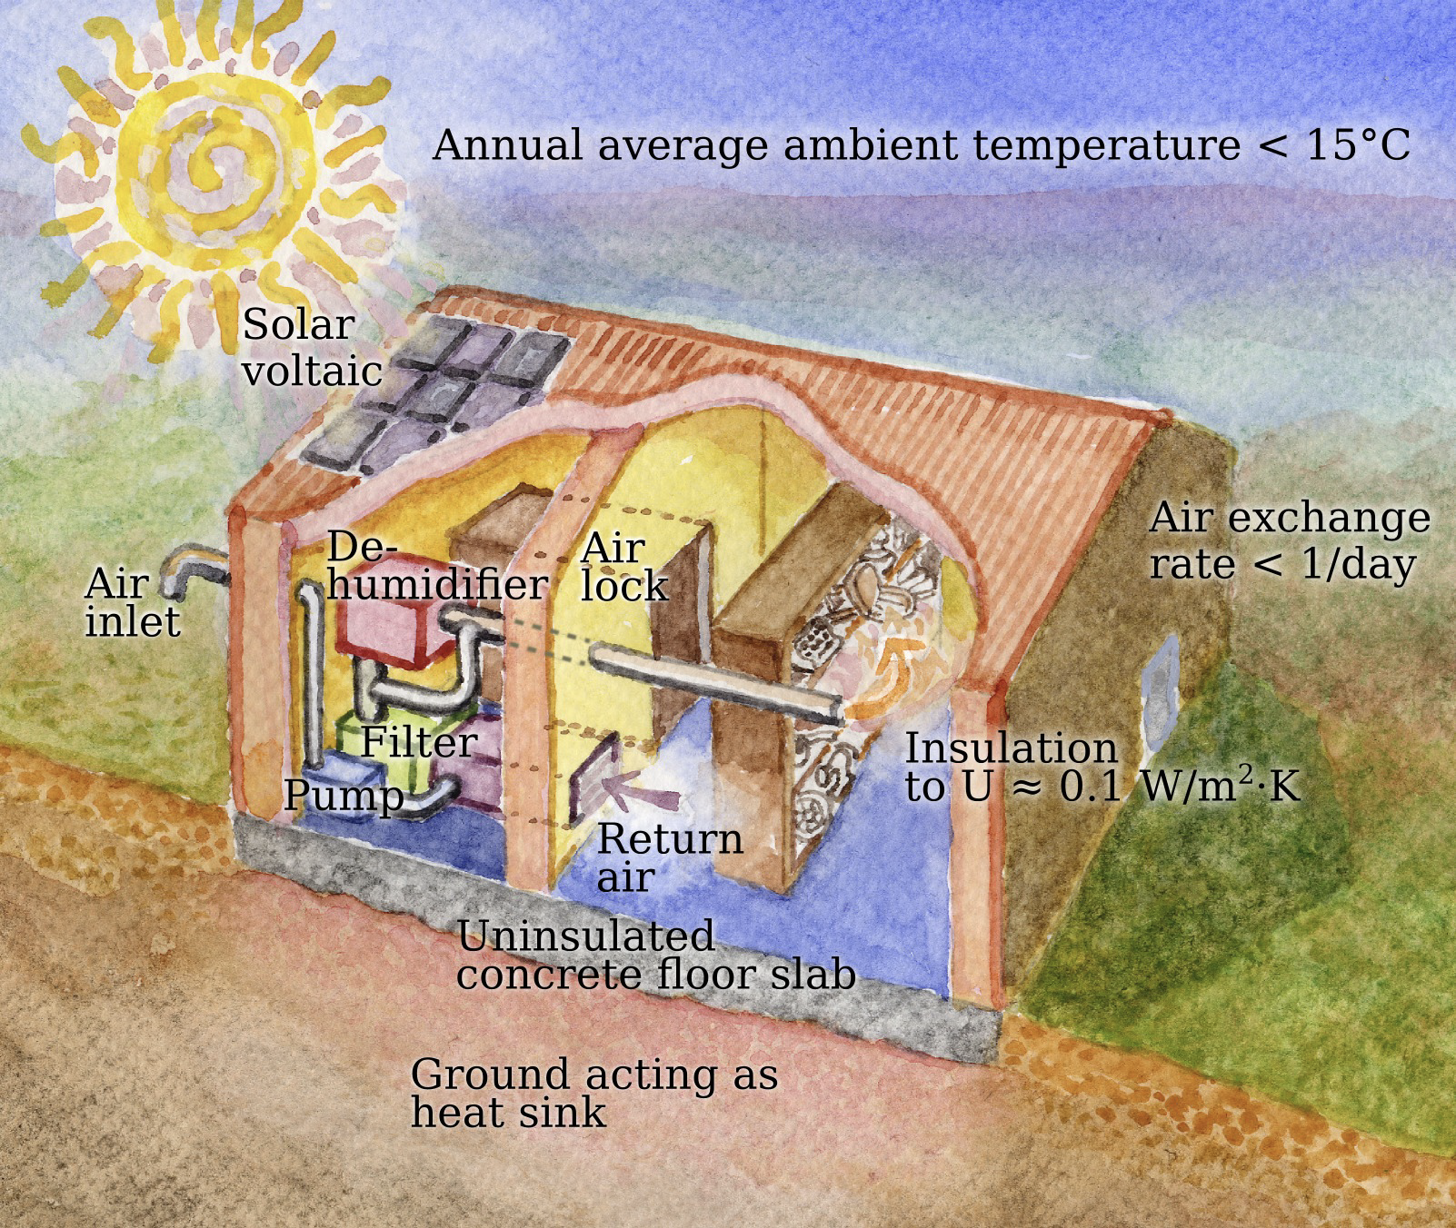
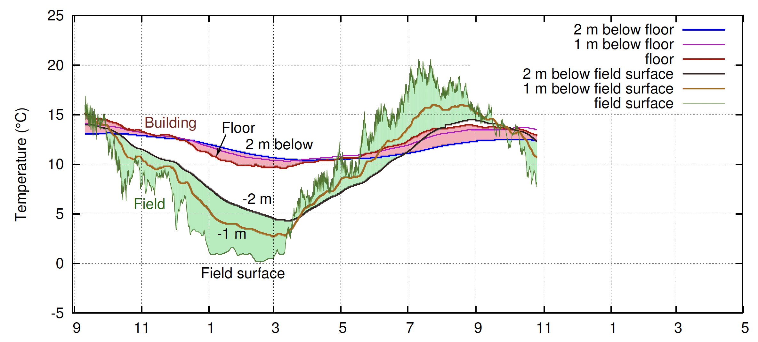
No energy to keep information
(passive house concept)
From Padfield et al. 2018
Month

Slide 19
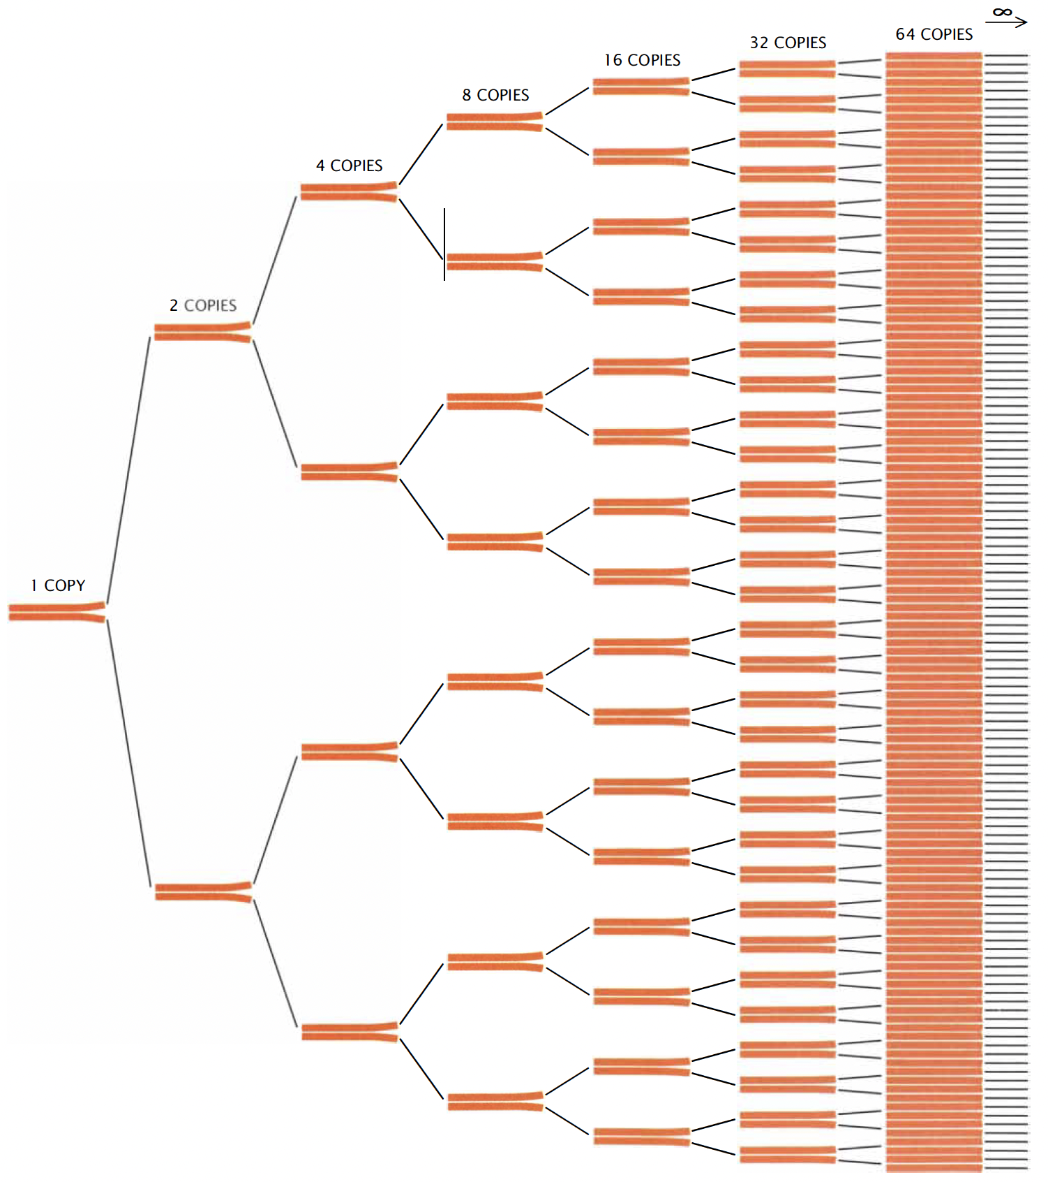
Easy to make copies
(2⁶)
Polymerase chain reaction (PCR)
Fixed time thermal cycling process - does not depend on the volume of data
Average power of approximately 1.0 W per cycle !
See for instance https://www.thermofisher.com/ch/en/home/life-science/cloning/cloning-learning-center/invitrogen-school-of-molecular-biology/pcr-education/pcr-reagents-enzymes/pcr-cycling-considerations.html
Mullis, 1990

Slide 20
Requirement of a 50% chance that a petabyte will survive for a century ?
DNA half-life 1’000 years : could be more or less depending on preservation conditions
Make 100’000 copies: very cheap and easy to do with PCR technology
We know the statistics of the errors and have good algorithms to correct them
After 100 years, 93% of information is still there

Slide 21
Costs
(From D.S.H. Rosenthal, 2010)

Slide 22
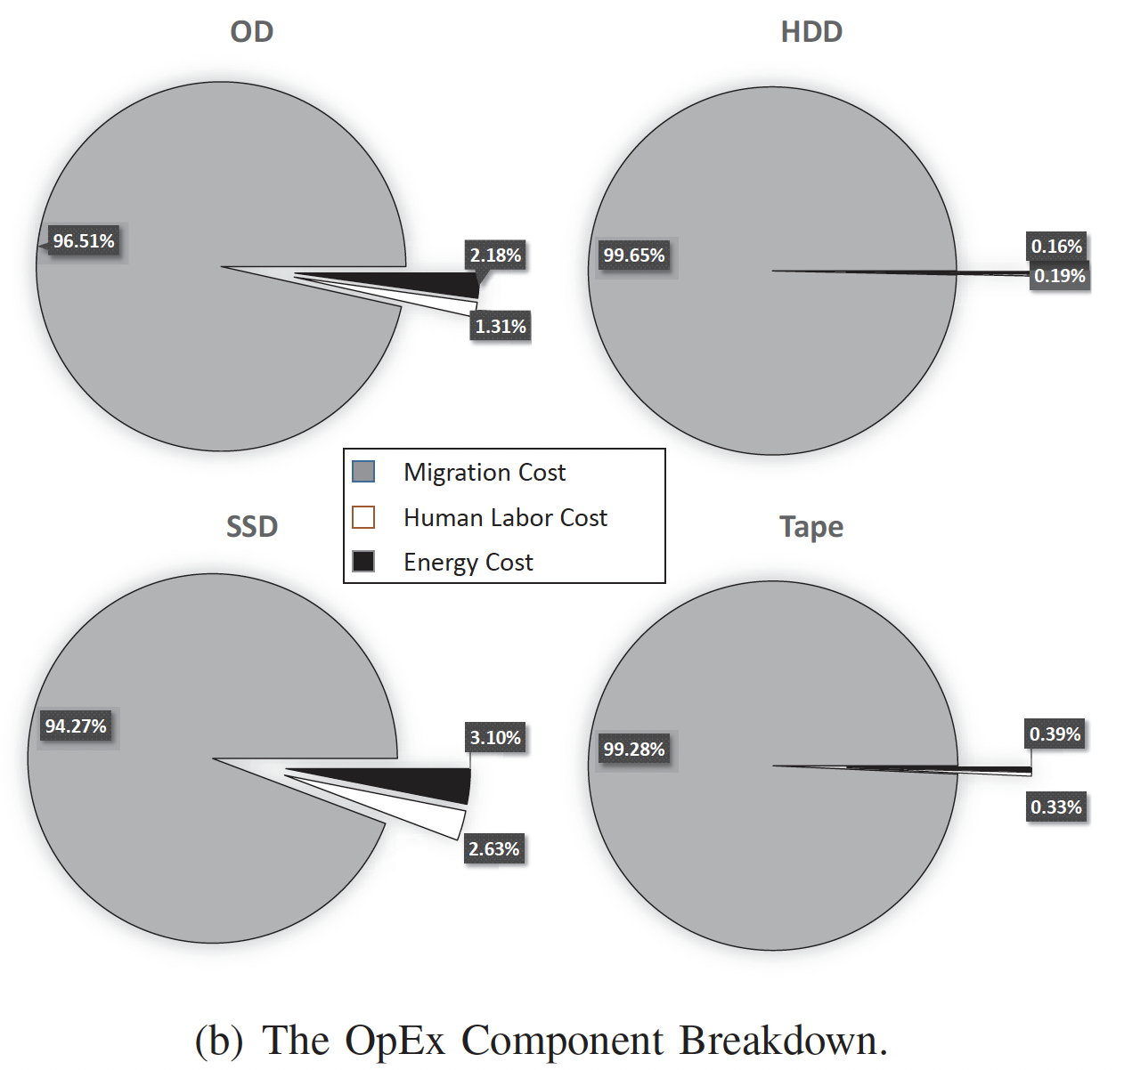
1 PB Migration Cost is $ 300 K
For tapes (10 year-cycles)
$ 3 M over 100 years only for migration without taking into account hardware
From Yan et al. 2019

Slide 23
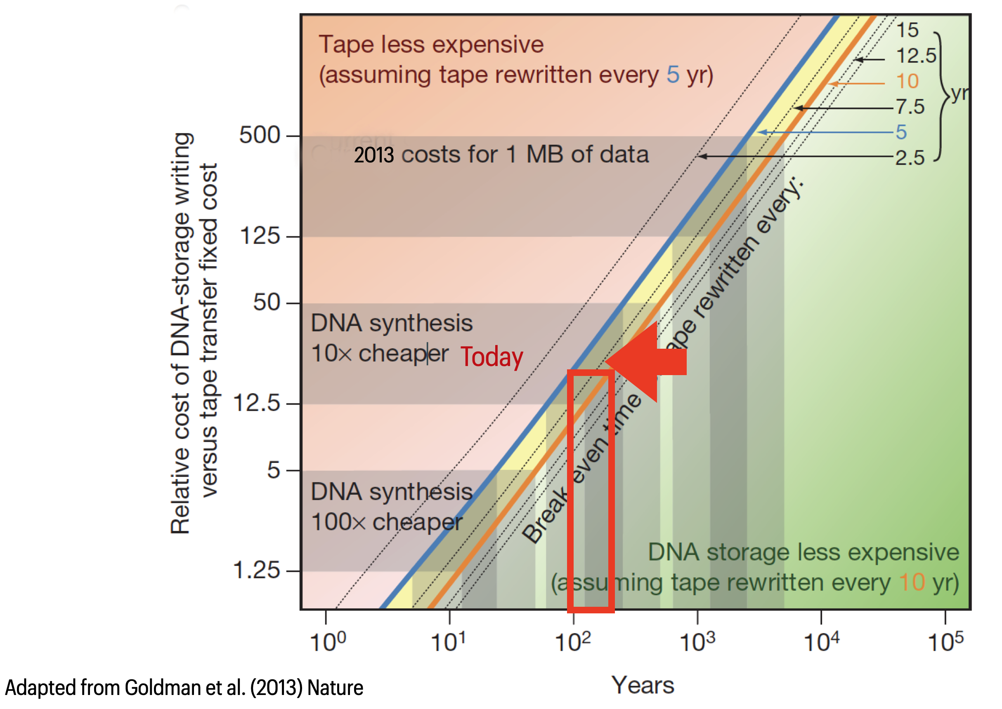
Tapes vs. DNA
10 x cheaper
Adapted from Goldman et al. 2013

Slide 24
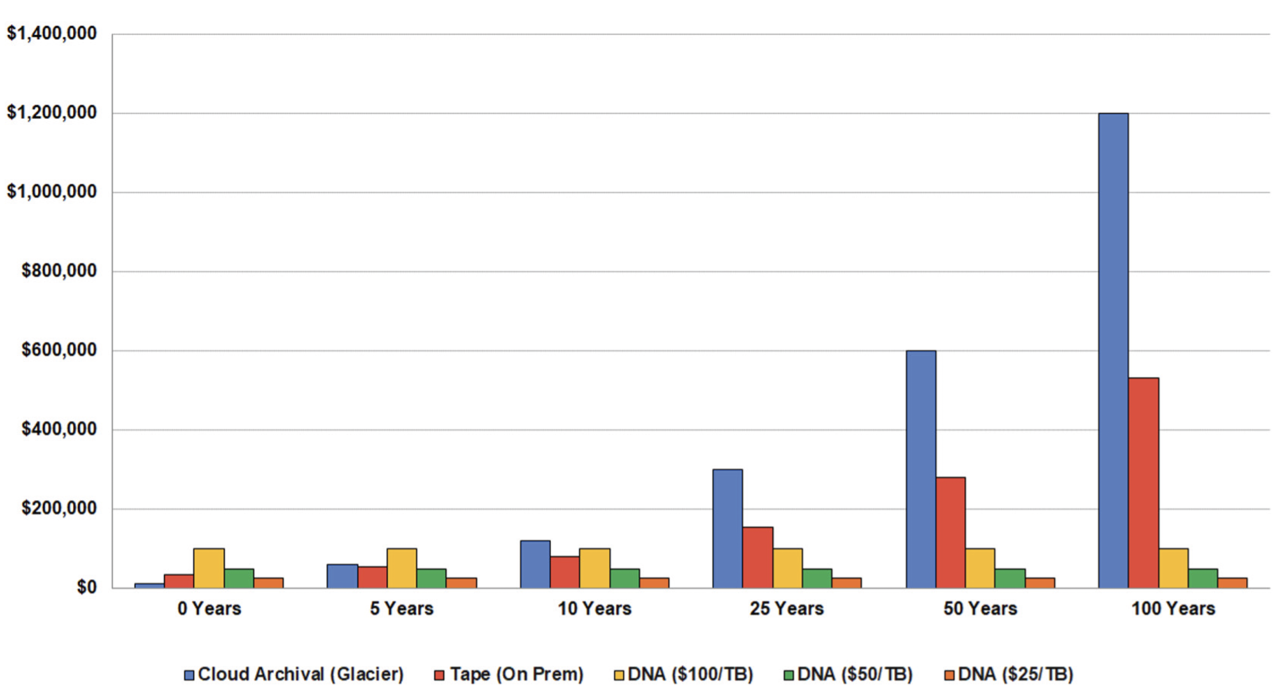
Estimated Cost of Writing and Storing 1PB - Cloud Archival (Glacier Deep Archive), Tape (On-Prem) and DNA
DNA
From: The future of DNA storage, DNA Storage Alliance (sept. 2018)

Slide 25
And OAIS ?
Managing DNA is like managing a tangible archive
Must be self-described, which asks for documenting the encoding algorithms such as the Reed-Solomon error correcting method (that we use in our prototype) and also the Python programming language
Must have a disaster recovery plan, which again requires self-description of some key parameters
Mechanisms to update metadata – DNA editing is not yet easily achievable (e.g., CRISPR)

Slide 26


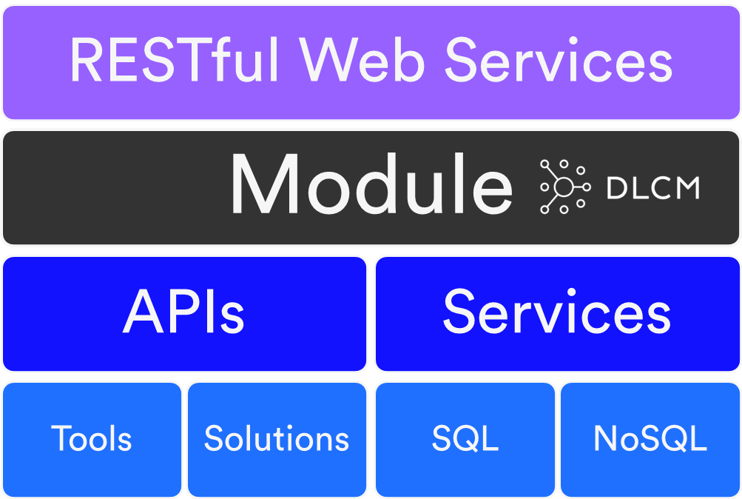


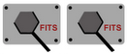

DLCM architecture with a DNA connector
User Web Portal
Submission
Dissemination
Pre-Ingest
Ingest
Access
OAI-PMH
Archival
Storage
Data
Mgmt
Common Modules
Admin
Preservation
Planning
File
Storage
Object
Storage
[S3]
DNA
Storage
DLCM APIs
Tool APIs

Slide 27
Conclusions
DNA environmental impacts are not commensurate with those of silicon/electronic technologies
Eight orders of magnitude more dense than traditional media
Solution for storing large volumes of data over hundreds of years
Is already being made available to institutions aiming at very long-term preservation
DNA technology is evolving faster than Moore’s law
Get ready for the next storage revolution !

Slide 28
Thanks for your attention !
pierre-yves.burgi@unige.ch
hugues.cazeaux@unige.ch

