Slide 1


A Multifaceted Solution to Digital Assets Preservation
Data Life-Cycle Management (DLCM):
The Swiss Way
Hugues CAZEAUX
hugues.cazeaux@unige.ch
Head of e-Research @ UNIGE & DLCM CTO
September 5, 2022

Slide 2
Agenda
Origin & Context
Technical Architecture
Main Features
DLCM in the wild

Slide 3
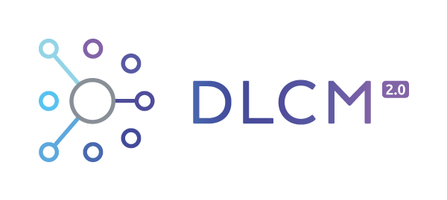
Origin & Context

Slide 4
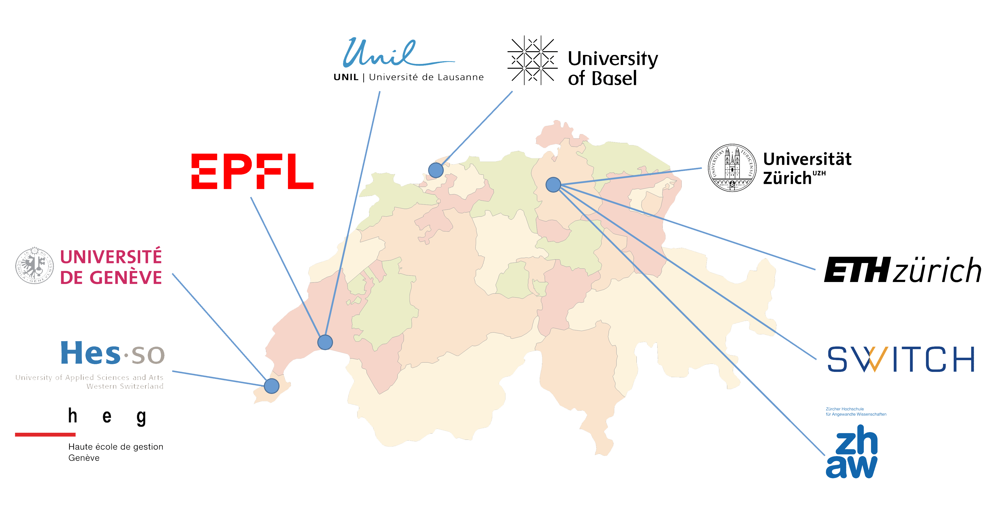

Partners

Slide 5
DLCM Project Phases
Phase #1
2015-2018
Prototype
Templates
Phase #2
2018-2020
DLCM Solution
National Coordination Desk
Phase #3
2021
OLOS Association
OLOS.swiss in production
DLCM Backend
National Coordination Desk
Institutional policies
DMP
Backend
Portal
OLOS
Patnerships (Switch, CERN, EOSC,…)
Webinars & Trainings

Slide 6
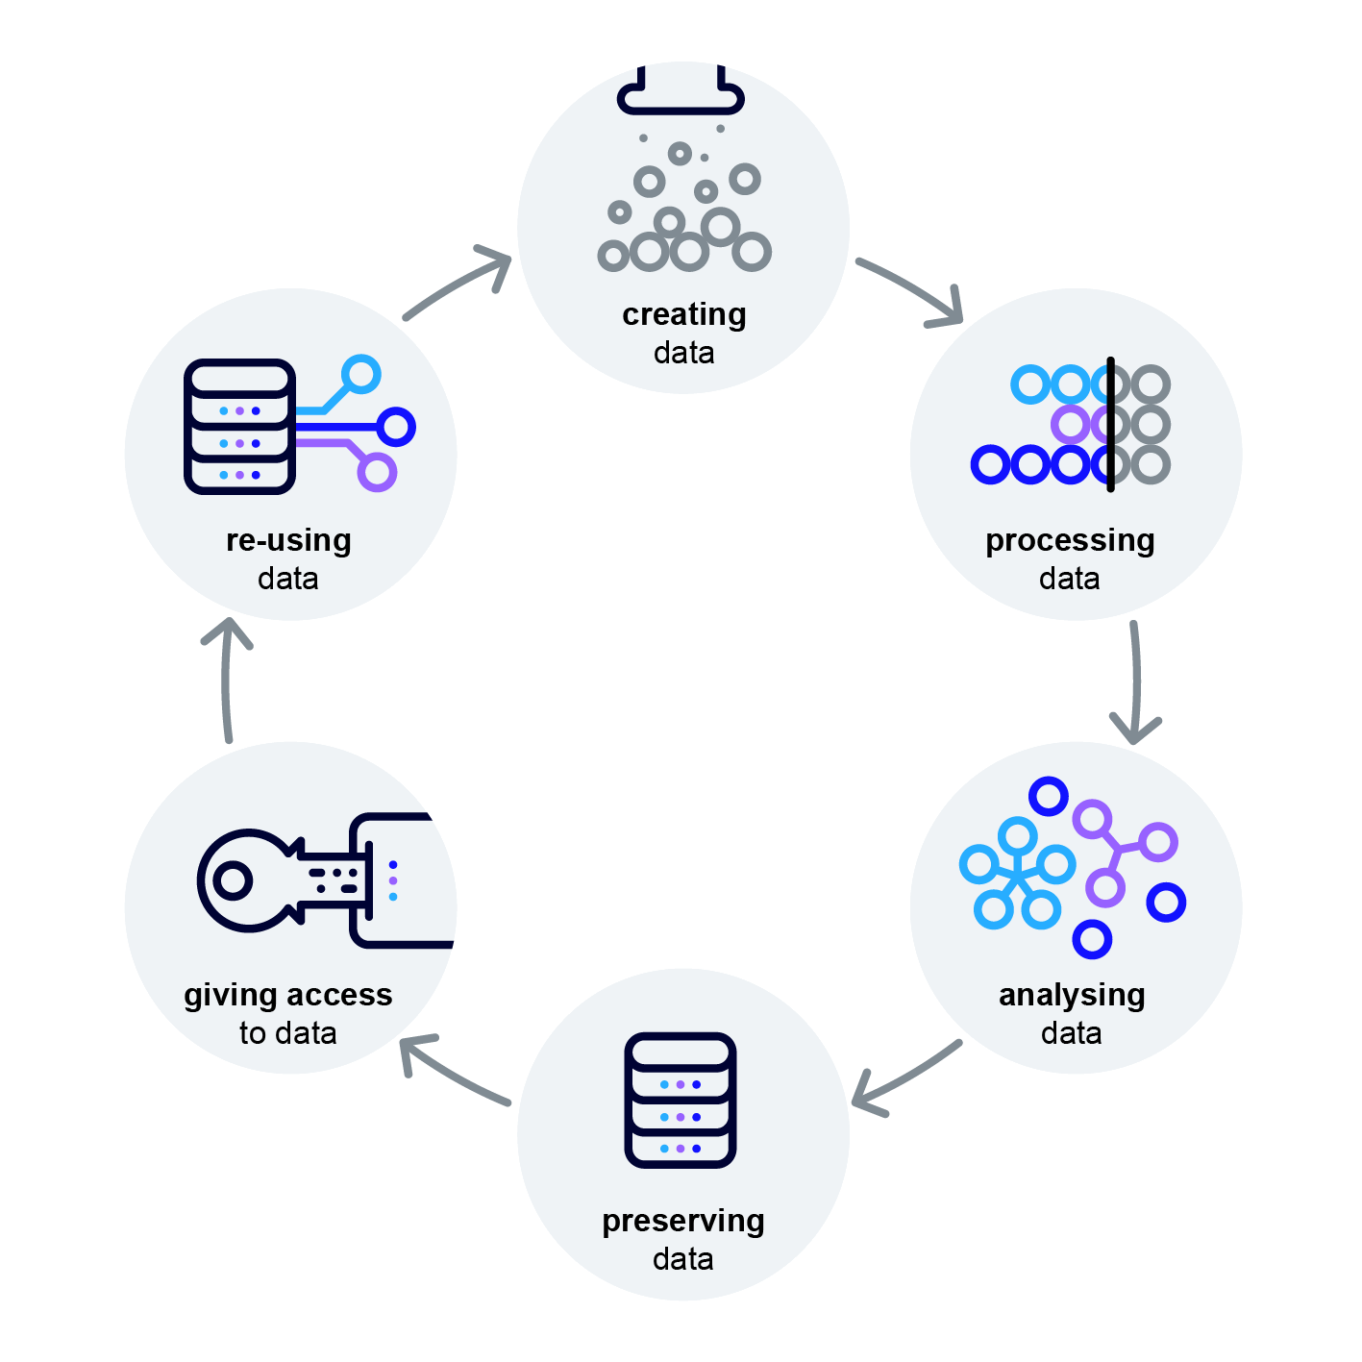




Research Process

Slide 7
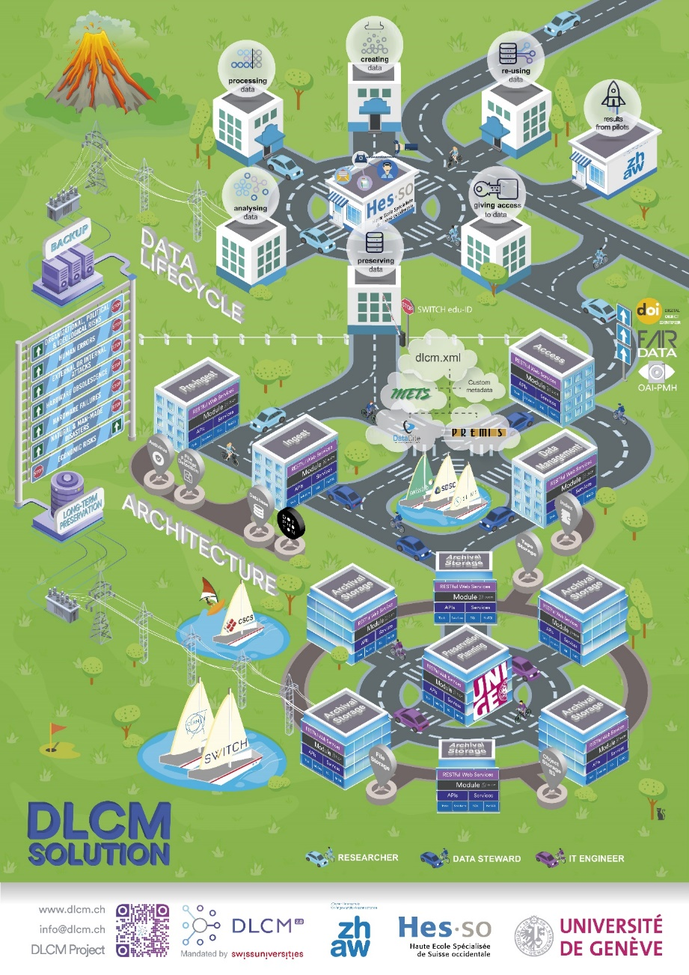
DLCM Movie
Presented at iPRES 2019
in Amsterdam
Direct link:
https://mediaserver.unige.ch/play/122839

Slide 8
Technical Architecture

Slide 9
OAIS Model
OAIS
Producer
Preservation Planning
Consumer
Ingest
Data Management
Access
Open Archival
Information System
ISO 14721
SIP
AIP
DIP
Archival Storage
Administration
Management

Slide 10
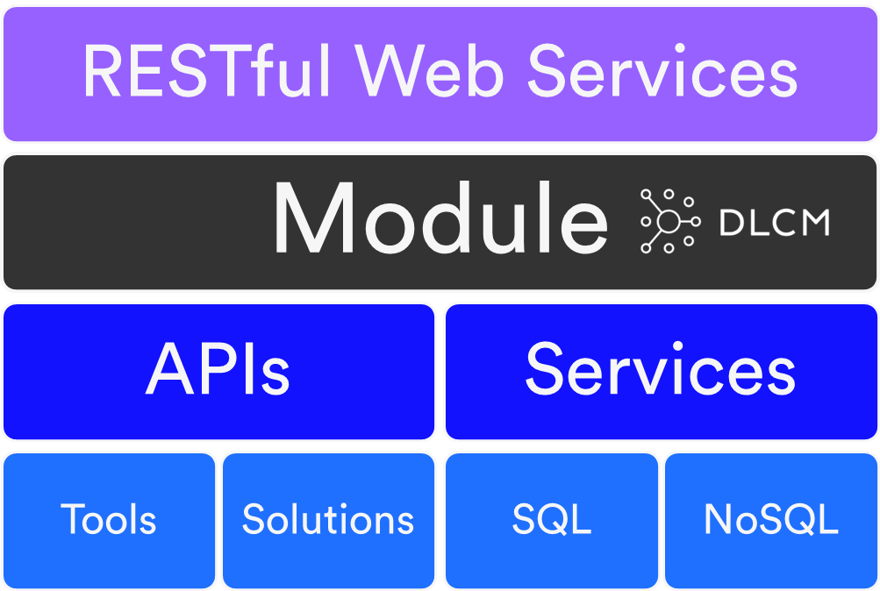


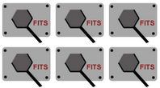

Architecture
User Web Portal
Submission
Dissemination
Pre-Ingest
Ingest
Access
OAI-PMH
Archival
Storage
Data
Mgmt
Common Modules
Admin
Preservation
Planning
File
Storage
Object
Storage
[S3]
DLCM APIs
Tool APIs

Slide 11


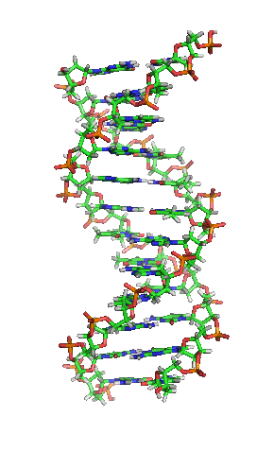
Architecture
User Web Portal
Submission
Dissemination
Pre-Ingest
Ingest
Access
OAI-PMH
Archival
Storage
Data
Mgmt
Common Modules
Admin
Preservation
Planning
File
Storage
Object
Storage
[S3]
DNA
Storage
DLCM APIs
Tool APIs

Slide 12
Architecture
User Web Portal
Submission
Dissemination
Pre-Ingest
Ingest
Access
OAI-PMH
Archival
Storage
Data
Mgmt
Common Modules
Admin
Preservation
Planning
File
Storage
Object
Storage
[S3]
DNA
Storage
DLCM APIs
Tool APIs

Slide 13


Storage View
Preservation
Planning
Archival
Storage
Archival
Storage
Archival
Storage
Archival
Storage
Archival
Storage
Archival
Storage
Storage Type
File storage
Object storage [S3]
DNA storage

Slide 14
Storage View
Archival
Storage
Archival
Storage
Archival
Storage
Preservation
Planning
Archival
Storage
Archival
Storage
Storage Type
File storage
Object storage [S3]
Archival
Storage
DNA storage

Slide 15

DLCM Metadata
dlcm.xml
METS
container
Descriptive
metadata
Administrative
metadata
Custom
Metadata

Slide 16













Underlying Technologies
Java 11
Configuration Server
Database
JMS Broker
Indexing
Dashboard
Identity Provider
Optional Tools
  FITS
  ClamAV
Angular 13 / Node.js 16
DevOps compatible

Slide 17
Main Features

Slide 18






What is the Data Preservation Workflow?
Creation
Pre-Ingestion
Ingestion
Disposal
Preservation
✓
✓
Metadata
RESEARCHERS
DATASETS
DEPOSIT
ARCHIVE
TOMBSTONE
Time
Active Data Management
Data Retention
Based on the OAIS Model (Open Archival Information System, ISO 14721)

Slide 19



1. Ensure Identification and Attribution
Integrates the DataCite Metadata Schema
«Designed to support dataset citation, discovery and persistence» (Bernal, 2019)
  Intended to be generic to the broadest range of research datasets
  Not intended to replace the discipline or community specific metadata
Delivers DOI with the “Reserve a DOI” functionality
Proposes open licenses to protect your copyrights and ensure attribution, e.g. CC BY

Slide 20
2. Automatic Assessment of File Format
The Data Compliance Level
☆☆☆
★★☆
★★★
★☆☆
No assessment
File size
Media type (MIME type)
Format file (PUID)
Golden Format
✓
✓
✓
✓
PUID = PRONOM Unique Identifiers
(The National Archive, UK)
https://www.nationalarchives.gov.uk/PRONOM
Golden Format = recommended format for long term preservation
(Library of Congress, USA) https://www.loc.gov/preservation/resources/rfs/

Slide 21
3.a Control the Access to your Data
Access level & embargo
OPEN
To make archiving as flexible as possible
Select the suitable access level:
  Open > public
  Restricted > team members (i.e. Org. Unit)
  Closed access > restricted team members
Place an embargo to postpone the openness of your data
RESTRICTED
CLOSED

Slide 22










3.b Control the Sensitivity of your Data
Data tag & Access level
Define how the data sensitivity:
Assign a data tag to your dataset
The data tag must be compatible with the Access Level
Access Level
Data Sensitivity (Data tag)
Compatibility | Public | Restricted | Closed
Not defined | ✓ | ✓ | ✓
Public | ✓ | ✓ | ✓
Controlled public | ✗ | ✓ | ✓
Accountable | ✗ | ✗ | ✓
More accountable | ✗ | ✗ | ✓
Fully accountable | ✗ | ✗ | ✓
Maximum restricted | ✗ | ✗ | ✓
Public
Restricted
Closed

Slide 23
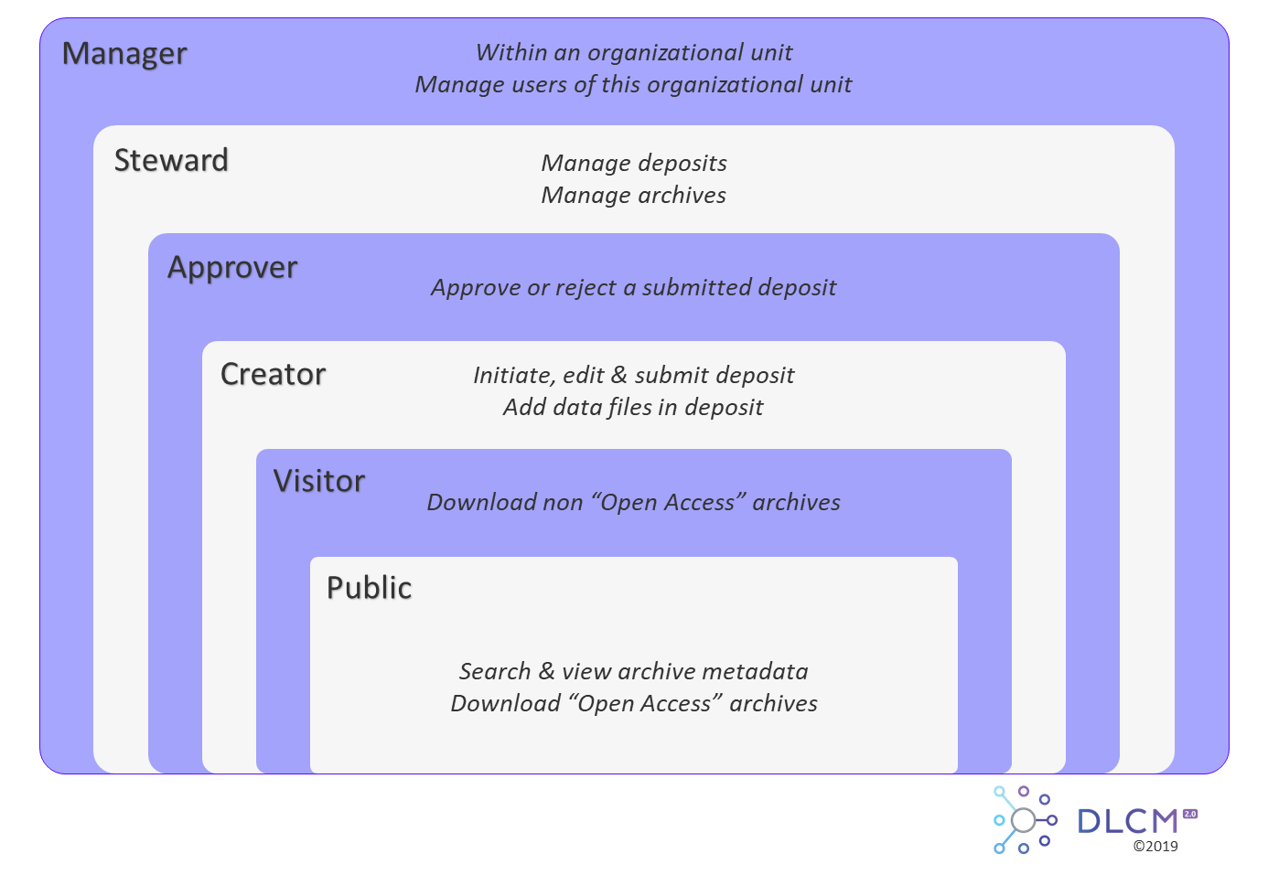





4. Manage your Preservation Space
ORGANIZATIONAL UNIT
~ Preservation space
May archive data from a research project, a department, a laboratory, a research team…
No strict institutional guidelines
Read the Institutional policy of research data management
USER ROLES

Slide 24





5. Data Mass Import
Active Data Mgmt
Long Term Preservation
Validate & Preserve data
Work as usual
Projects
NAS
Import
Tool
Long Term
Preservation
Solution
User Portal
Deposits
Personal
Computers
External
Hard Disks
Folders
Select & Organize data to preserve
Data
Run DLCM tool to import data files
Create deposits ready to preserve
Researcher work
Batch
DLCM APIs

Slide 25






6. Latest new features
Metadata update
Email notification
Bibliography & citation generation
“FAIRness” improvement
Objects
Individuals
Research
Organizations
Licenses

Slide 26
7. Roadmap
[Feature] New role : Institution manager
[Feature] Submission Agreement
[Feature] Data Use Agreement
[Improvement] Full support of data tag for sensitive dataset
[Feature] Support OCFL as AIP container
[Feature] Support WARC as AIP container
…

Slide 27
8. And more
Open-source Code
Themes
Backlog
New features
Best Practices
White Label Solution
GIT repositories
Guided Tours
Issues
Improvements
Archiving
Data Mgmt

Slide 28
In the wild

Slide 29







On-premise
SaaS
Hybrid
2019
2021
Future?
UNIGE
Switch
or
or

Slide 30
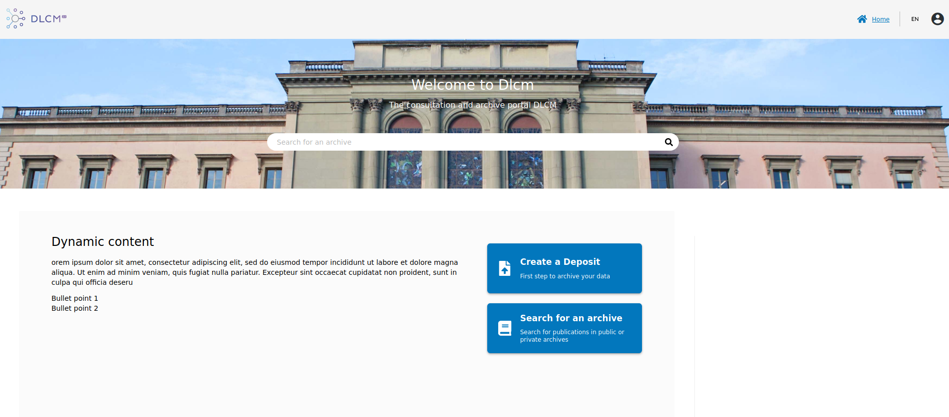
Demo Environment
Go to https://sandbox.dlcm.ch/portal

Slide 31
Thank you

Slide 32
References
2022
  GIT repository: https://gitlab.unige.ch/dlcm/community/dlcm-backend
2021
  Yareta videos https://mediaserver.unige.ch/search/yareta
  OLOS videos https://mediaserver.unige.ch/search/olos
  « Le projet Data Life-Cycle Management (DLCM) en Suisse : une gestion des données de la recherche pensée pour ses utilisateurs »
  http://dx.doi.org/10.3917/i2d.212.0087
  « SwissEnvEO: A FAIR National Environmental Data Repository for Earth Observation Open Science »
  http://dx.doi.org/10.5334/dsj-2021-022
2019
  « DLCM Poster for iPRES 2019 » http://dx.doi.org/10.26037/yareta:frtet5s3njcubib7vgyg5vvzci
  « A Versatile Solution for Long Term Preservation of Research Data - Data Life-Cycle Management (DLCM): The Swiss Way »
  https://ipres2019.org/static/pdf/iPres2019_paper_32.pdf
  DLCM movie https://mediaserver.unige.ch/play/122839
2018
  « Le projet DLCM : gestion du cycle de vie des données de recherche en Suisse »
  http://dx.doi.org/10.1515/9783110553796-014
2017
  « Research data management in Switzerland: National efforts to guarantee the sustainability of research outputs »
  http://dx.doi.org/10.1177/0340035216678238
2016
  « DLCM : une approche globale pour une meilleure gouvernance du cycle de vie des données de la recherche en Suisse »
  https://www.researchgate.net/publication/316686422_DLCM_une_approche_globale_pour_une_meilleure_gouvernance_du_cycle_de_vie_des_donnees_de_la_recherche_en_Suisse

