Slide 1
The Librarian: One of the Best OSINTers
Jan Černý, PhD
Department of Information Technology
Open-source intelligence foundations and librarianship perspectives
Notes:
I come from Prague University of Economics and Business…

Slide 2
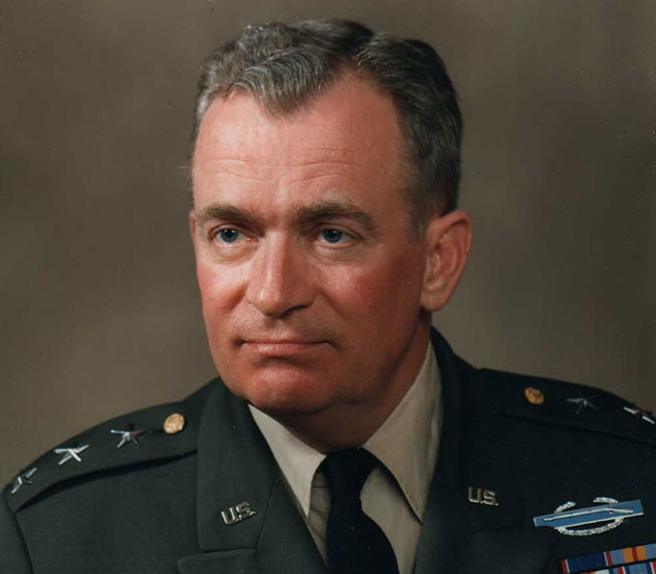
A real intelligence hero
“Ninety percent of intelligence comes from open sources. The other 10 percent, the clandestine work, is just the more dramatic. The real intelligence hero is Sherlock Holmes, not James Bond.”
Samuel V. Wilson, former Director of the Defense Intelligence Agency
Notes:
A great advocate of open source data and information
This quote represents how heavily agencies rely on open source investigations.
And market size: 2021 10bn USD, it is expected to grow 5 times by the end twenties.

Slide 3
A real former-librarian OSINTer
“I literally thought OSINT was a programming language like COBOL. I didn’t know what it was. And when they described to me what OSINT was and the guy said to me what did you call it when you were a librarian, I said doing my job.”
Tracy Maleef, Security Researcher, a former librarian
Notes:
She has a significant influence in the OSINT community in US. But she also delivers OSINT to information and library science audiences

Slide 4
What is Open-source intelligence?
Open-source intelligence is the process of gathering, analyzing, synthesizing and reporting open, and therefore publicly available information.
Open-source intelligence, or OSINT, is unclassified information that has been deliberately discovered, discriminated, distilled and disseminated to a select audience in order to address a specific question. (NATO OSINT Handbook, 2001)
The most critical skills in OSINT are searching for, organization of, and differentiation of information. (Glassman, Ju Kang, 2016)
Notes:
Many definitions from scientific papers, academic works, grey literature, publicly available reports,
My summary
NATO security perspective
Even if the paper of Glassman and Ju Kang does not address a library community, there are particular signs that librarians are the experts who should deal more with OSINT.

Slide 5
Real-world examples of OSINT activities
Jan Černý, PhD
cerj07@vse.cz

Slide 6
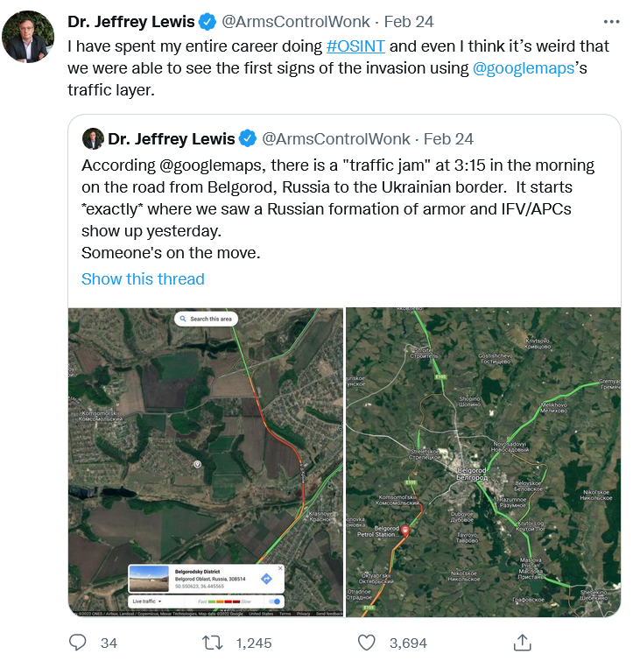
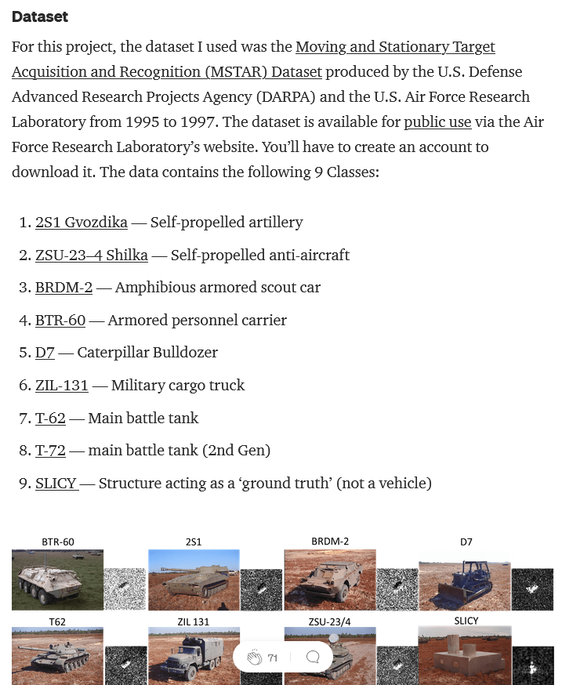
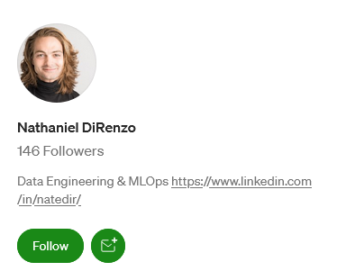
Notes:
This was not a traffic jam, or waves of Russian refugees, but we all know that these were Russian tanks. We could wach it live on Google maps
Using Tensorflow, one of the well-known deep learning applications, to track fighting in conflict zone with a DARPA dataset – DiRenzo created model based on nine military vehicle classes that can be used on any satellite imaginery data today to track (not only) Russian tanks with high precision..

Slide 7
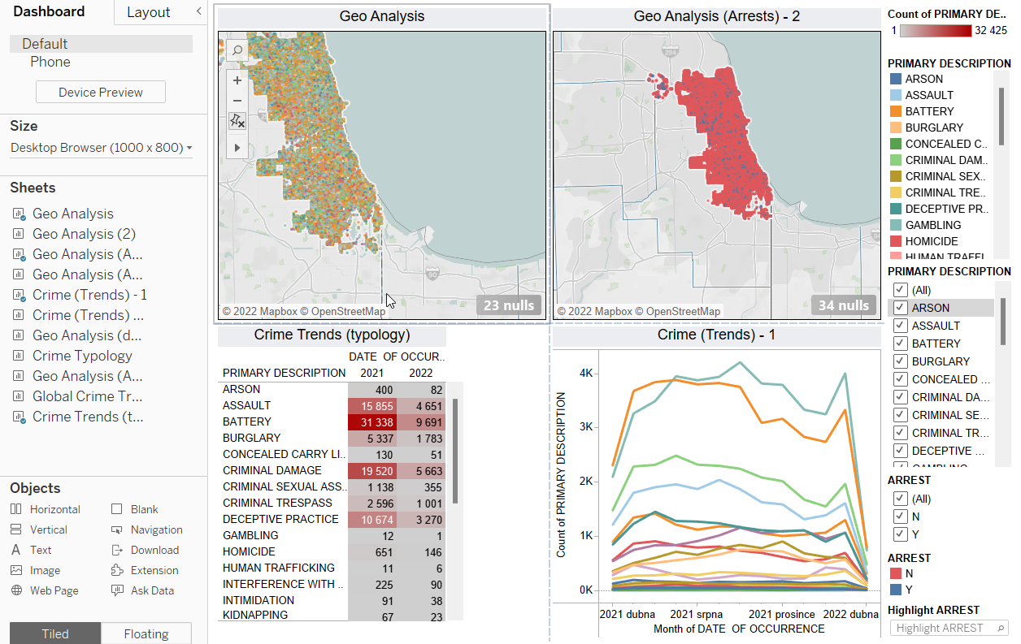
Chicago crime analysis
Notes:
Another example is coming from argueably, one of the more volatile and violent cities in the US…
What is possible with one dataset? This Chicago Criminality dataset is being updated daily.
I used it in Tableau, a business intelligence tool
Imagine that you are able to identify most problematic locations, types of crimes, arrests., recent crime trends… or to see what kind of crimes are committed in the Chicago libraries?

Slide 8
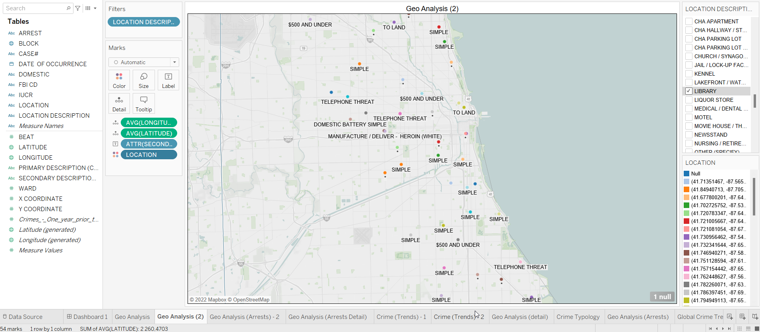
Notes:
Is it increasing number of telephone threats?
Or simple battery?
Or white heroin delivery?

Slide 9
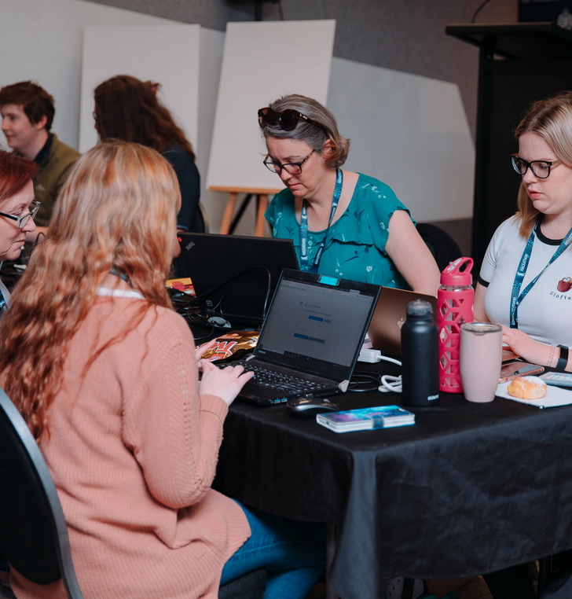
Trace Labs: A Global Approach to the Missing Persons Dilemma
#OSINTForGood
Helping to find missing persons
Decreasing level of human trafficking and similar illegal activities with people
Operation Request Forms
Search parties
Notes:
A non-profit global OSINT project that helps to descrease a number of missing persons and reduce negative trends such as human trafficking and other illegal activities.
Trace Labs allows to use a special request form if you have missing person case – and it must also be published by law enforcement. Trace Labs team reviews the case regarding their requirements and publishes if it meets them.
Search Parties: 4 member teams

Slide 10
OSINT and librarians. Where do they meet?
Jan Černý, PhD
cerj07@vse.cz
Notes:
For starters, is there any relevant research in this context?

Slide 11
Any relevant research in the librarianship-OSINT context?
Only one relevant editorial in past 12 years:
Brown-Syed, Christopher. ‘Library and information studies and open-source intelligence’ (2011) in Library and Archival Security, 24 (1), pp. 1–8, Cited 0 times. DOI: 10.1080/01960075.2011.551935

Slide 12
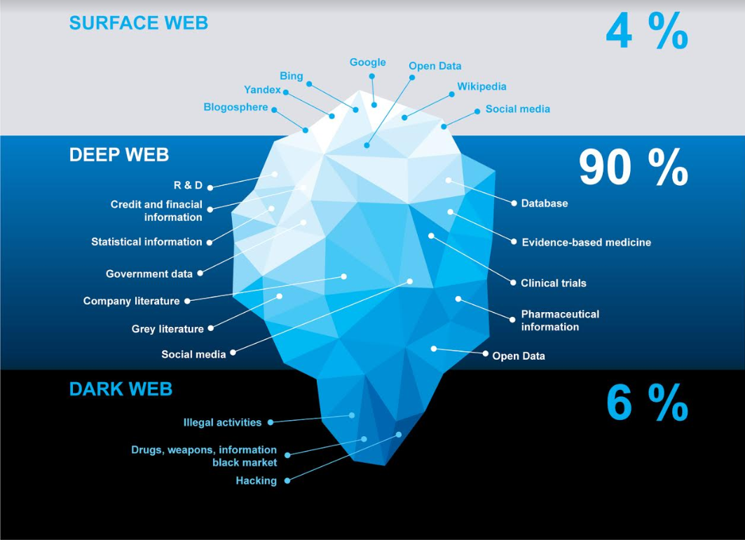
How librarians can help
Notes:
They are great Google hackers and Google Dorkers
They use advanced search methods in the deep web
They could play critically needed roles regarding dark web discovery, supporting investigation activity,or perhaps to educate relevant users such as law enforcement
Moreover, the dark web serves in more and more cases investigative journalism, investigative journalist

Slide 13
Key competencies of librarians
Information-literate individuals who are quickly and rigorously able to:
Read, edit and transform various information needs
Determine relevant data and information sources
Effectively search, find and analyze
Synthesize and summarize
Report
Notes:
Strategic issue management - explanation

Slide 14
It’s not only about security
OSINT for Conservation Biology (Katzner et al., 2022)
The Use of Tools for Obtaining Data From Publicly Accessible Sources for the Purpose of Competitive Intelligence in Enterprises (Primc, 2021)
Utility and Potential of Rapid Epidemic Intelligence from Internet-based Sources (Yan, Chungtai, Macintyre, 2017)
Notes:
How to use OSINT for strengtening public health… we mined open human medicine data..

Slide 15
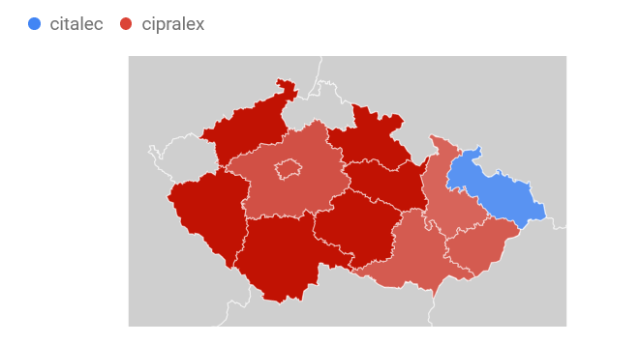
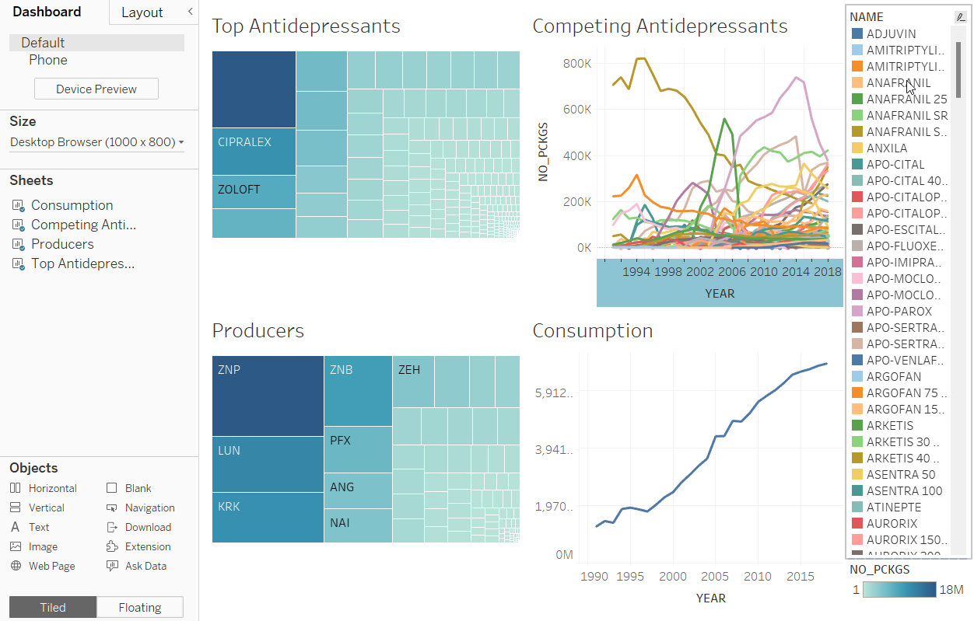
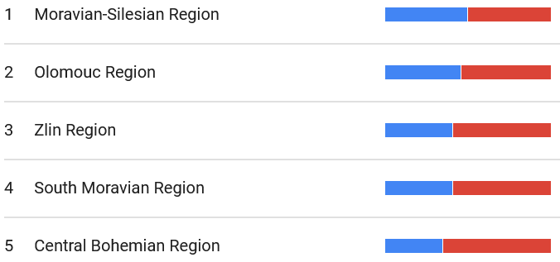
OSINT for better mental health
Notes:
My colleague Martin Potančok and I used open human medicine data to uncover mental health trends in the Czech Republic.
We were able to identify antidepressant comsumption trend, top producers operating in the Czech Republic, most prescribed antidpressant medicine.
The problem appeared when we wanted some geolocation data. My first intention was an analysis on pharmacy level, lets say city level. Of course that the regulátory office did not provide anything.
So how to hack this situation? The answer is information-seeking behaviour. Our hypothesis was that people who got any medicine will search for information such as side effects, doses and so on.
Yes, Google answered our question at least on regional level…

Slide 16
So the answer is…?
Librarians will be:
Great data scenario makers
Data scientists and analysts
Critical thinkers
Critically needed personnel in security, the military, medicine, and other fields.
They are the first-class OSINTers (even they sometimes do not know it yet)

Slide 17
What can we do?
Increase research activities of OSINT in all the relevant web layers
Surface web (mitigating disinformation, fighting against deep fakes)
Deep web (contextual linking, advanced search methods)
Dark web (indexing process, dark data persistence, dark web search tactics)
Implement OSINT as crucial subject in library and information science university programs and their curriculums.
Present libraries as vital bodies that should be a part of national security eco-systems

Slide 18
I would like to ask you…
If you would be interested in:
Research cooperation
Spreading the word about OSINT in your research community
…and supporting OSINT activities at the national level in your country

Slide 19
Thank for your attention
Jan Černý, PhD
cerj07@vse.cz

