Slide 1
Library as a Repository -
Gaining Wider Relevance and Visibility. Supporting Open Science
maria@figshare.com
visit figshare.com

Slide 2
Agenda
Introduction - the Open landscape
Figshare, an integrated software as a service solution
Supporting Open Science - thought leadership initiatives (Africa)

Slide 3
The complex open landscape
Open Access
Open Research
Open Data
Open Science
Open Educational Resources (OER)
Open Textbooks
Open University presses
Notes:
The open landscape is complex with multiple, and potentially conflicting views, about open systems. The 21st century has seen a growth of several open initiatives that have had particular resonance with libraries. These include Open Access, Open Research, Open Data, Open Science, Open Educational Resources (OER), Open Textbooks, and Open University Presses. All these initiatives have gained traction over the last decade and are supported by a variety of open source and proprietary technologies.
Librarians have engaged with open-source solutions from the early stages, since in 1999 the open-source Koha library system was developed, and first installed in 2000. Many open-source solutions are now largely developed and funded by commercial companies. Most of the big name technology companies such as Google, Microsoft and Amazon are now heavily invested in open source. Microsoft, historically known for its opposition to open source software made investments in Linux development, and in 2018 acquired GitHub, the largest host for open-source project infrastructure. As open-source has become more pervasive, it may have lost some of its commons-based peer production original ethos.
In terms of repositories, in 2008, JISC in the UK set up RSP, the Repository Support Project, “to support and develop the UK network of institutional repositories”. It helped some universities create their own IR, typically managed by librarians and largely, though not exclusively, based on open-source solutions such as EPrints (which was developed at the University of Southampton) and DSpace. It ran until 2013 and then closed.
Non-open source, proprietary repository solutions can also define themselves as open - the rationale for this is around the use of open application programming interfaces (APIs) for interoperability and custom development, and data standards, that are made publicly available - Figshare falls within this category so…

Slide 4
What is Figshare?
Figshare is a SaaS (software as a service), proprietary solution, supporting Open Science by
Building leading repository software on a cloud-based platform
Running, updating and continuously developing the software for you
Offering full technical and user support
Fostering a global community, shared learning and collaboration

Slide 5
Who do we work with?
Researchers, universities, publishers, bio-pharma companies, funders and governments in 16 countries around the world.
Notes:
As well as working with individual institutions in 16 countries around the world, from UK and Ireland, where we have over 30 university clients, to Denmark and the Netherlands, to the US, Australia and South Africa, we also work at the international and national level, and we keep growing at a fast rate - librarians over the world trust us to deliver and maintain their data and institutional repository solutions for them. So, why are we successful?...

Slide 6
Compliance to securely store and
access all your research outputs
Cloud-based platform on a single operating system
ISO 27001 certified
WCAG 2.1 AA
Secure Figshare-provided Amazon Web Storage (or any compatible storage provider)
Integrate with institutional Single Sign On for quick and easy access
API and FTP uploader for programmatic uploads
Researcher or administrator-led deposit workflows
Notes:
Figshare is a risk proof solution - cloud based platform with no downtime and all compliance and accessibility certifications taken care of for you to ensure your data or institutional repository meets all legal requirements

Slide 7
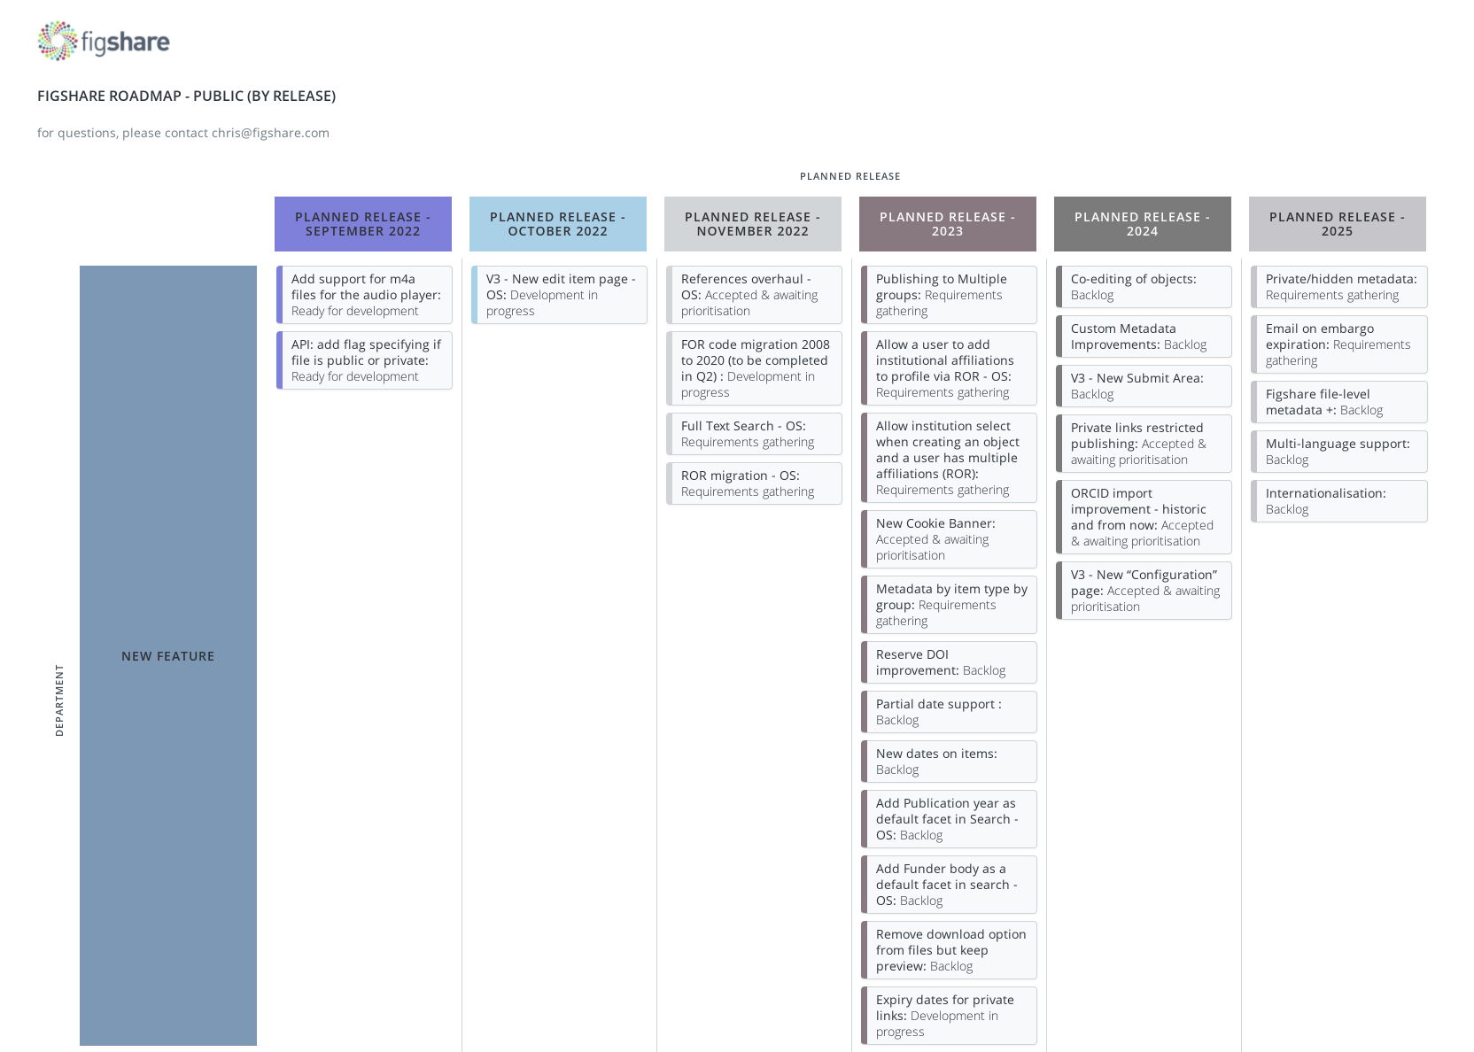
Keeping Figshare relevant
Chief Technology Officer
Team of full time developers
Public product roadmap
Feature request forum
Regional community calls
Community Slack channel
Notes:
According to the 2022 Library Perceptions Survey “Many libraries avoid open source products due to a perception that the would need more staff with technical skills”. Also, it can result on a lack of overall strategic direction. So, how do we keep Figshare relevant to our users and maintain a very clear strategic direction? We have a long-standing Chief Technology Officer that provides the required strategic oversight and a large team of full time developers. Public product roadmap, informed by a feature request forum. Regional community calls and our Community Slack channel.
Our USP (unique selling point) is that while, figshare was initially developed to hold and share very large data sets (Mark’s story), it can now hold all types of materials…

Slide 8
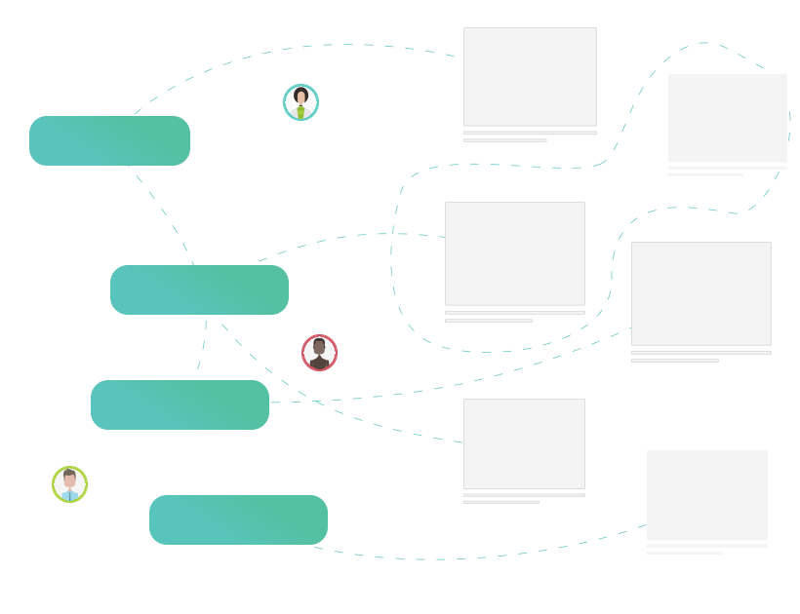
Very large files / all types of content can be deposited on Figshare repository
Datasets
Journal publications
Theses and Dissertations
Conference and workshop outputs
Open Educational Resources
10 TB of storage provided as standard

Slide 9
Included in a Figshare-powered repository
Annual software subscription - includes hosting, 10 TB storage, DataCite and new features and maintenance updates
Implementation within two-four weeks of agreement signed; ongoing configuration support
Dedicated account manager to support with public engagement and promotion plans
Figshare community access
Industry guidance and best practices
Flexible, customisable package options to suit your specific needs

Slide 10
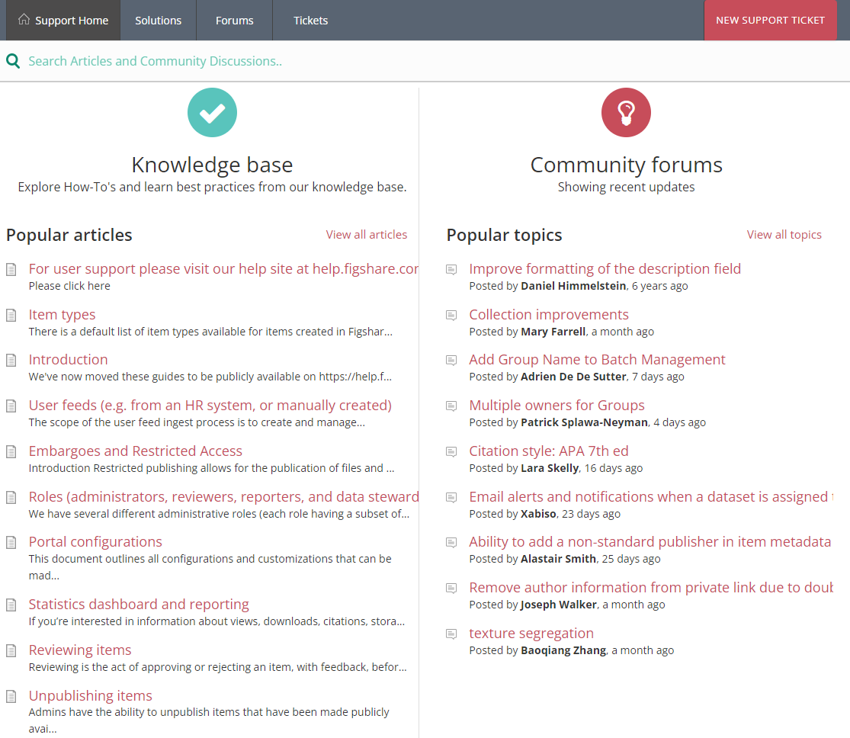
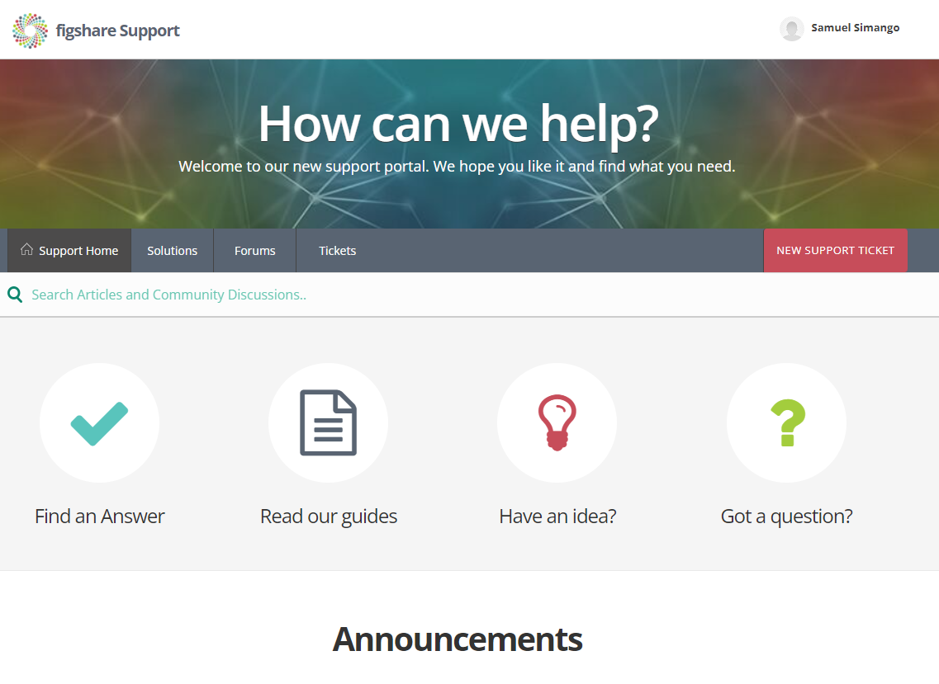
Notes:
Public guidance on how to use the system on help.figshare.com and our Knowledge Base
Get help with new features:
1. in our monthly customer newsletter 2. through your account manager 3. ongoing trainings 4. from other Figshare customers on community calls 5. with support from your buddy institutions

Slide 11
Benefits of working with Figshare
Serving the needs of over 100 academic institutions over the world
Notes:
We are part of a research portfolio advancing the research ecosystem; we were all funded and develop individually but work together we make open, collaborative and inclusive research possible.

Slide 12
We believe in better, open, collaborative and inclusive research.
In creating the next generation of tools and working in partnership with the community we tackle some of the biggest challenges to research.
Rooted in research, most founders have an academic research background and started a company around solving a self-encountered problem.
Digital Science invests in, supports and nurtures innovative start-up software companies and products.
Notes:
Digital Science invests in, supports and nurtures innovative start-up software companies and products. Rooted in research, most portfolio founders have an academic research background and started a company around solving a self-encountered problem. Mark started figshare from Imperial College London to solve his own problem.
Differentiation between big companies and us - we don’t report profits to stakeholders, we re-invest our profits in developing products to advance research and in acquiring new solutions, we are an incubator for innovation. DS mission: forging partnerships to overcome global research challenges.
We believe in better, open, collaborative and inclusive research. We don’t just have a portfolio of technology products, we have created an entire research ecosystem that brings efficient, integrated workflows to manage and evaluate your research outputs.
In creating the next generation of tools and working in partnership with the community we tackle some of the biggest challenges to research. We offer linked up systems, training and support for interoperability. For example, Zambia has access to ur sister company Dimensions through Research4life, linking it to our data repository Figshare will help you to make more science open through green open access routes and take care of research data.

Slide 13
Figshare partnership with
UNESCO Global Open Science
"Figshare’s efforts to not only share and store but also enable citations for the range of scientific knowledge products are a valuable contribution to the global effort for open science. We acknowledge these efforts as contributing to the pillar of open scientific knowledge, but also to the transformation of research assessment based on a more comprehensive and equitable framework... I am pleased to welcome Figshare into the UNESCO Global Open Science Partnership. We look to the Global Open Science Partnership for technical advice and guidance as we support countries around the world to implement the [UNESCO Open Science] Recommendation."
Ms. Shamila Nair-Bedouelle,
Assistant Director General for Natural Sciences, UNESCO

Slide 14
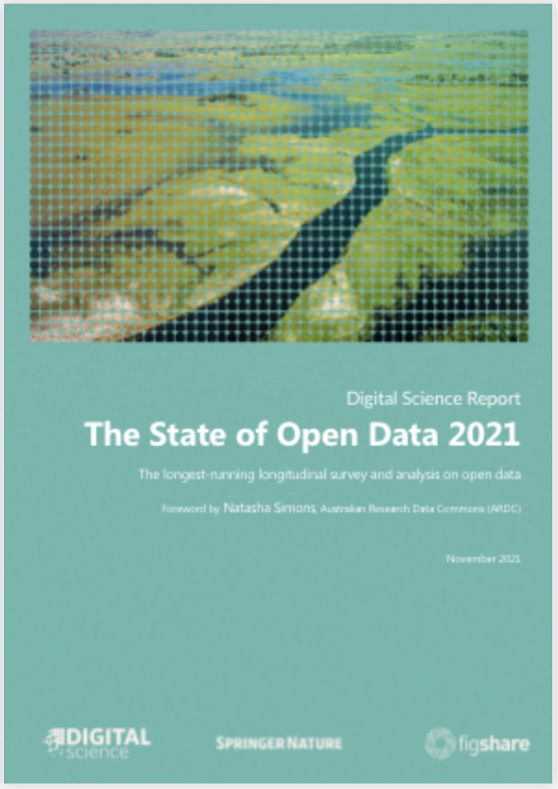
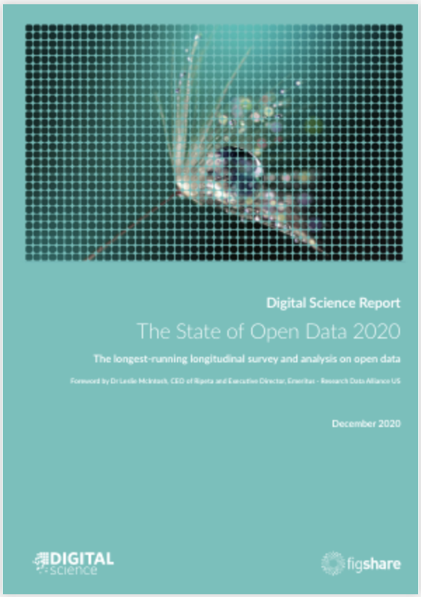
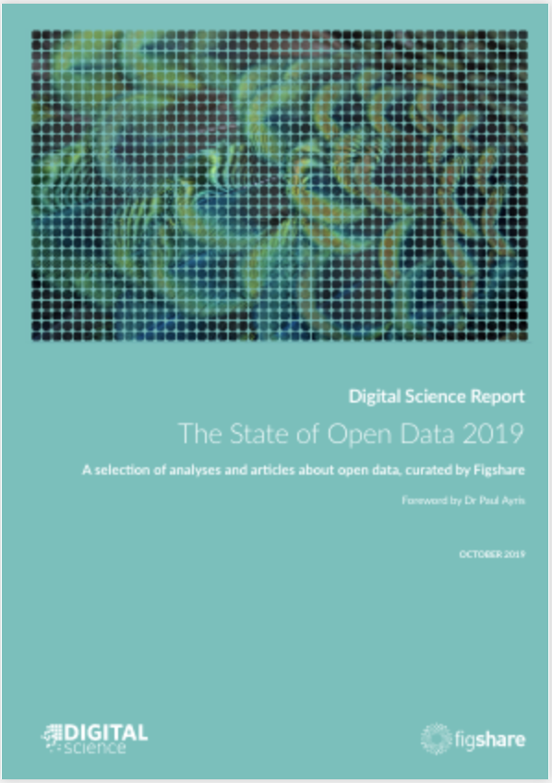
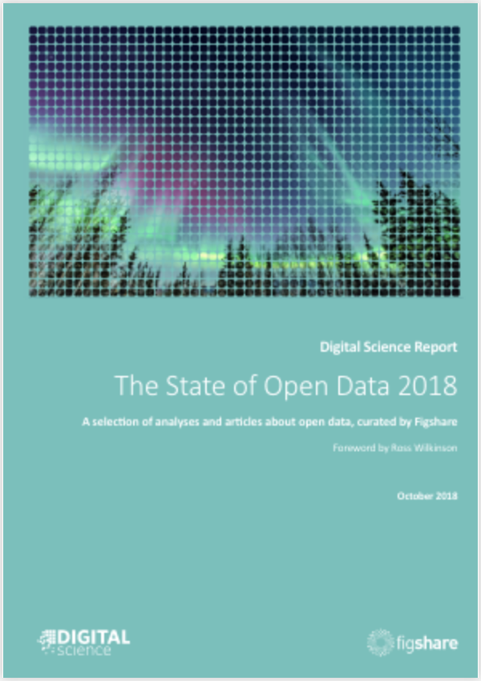
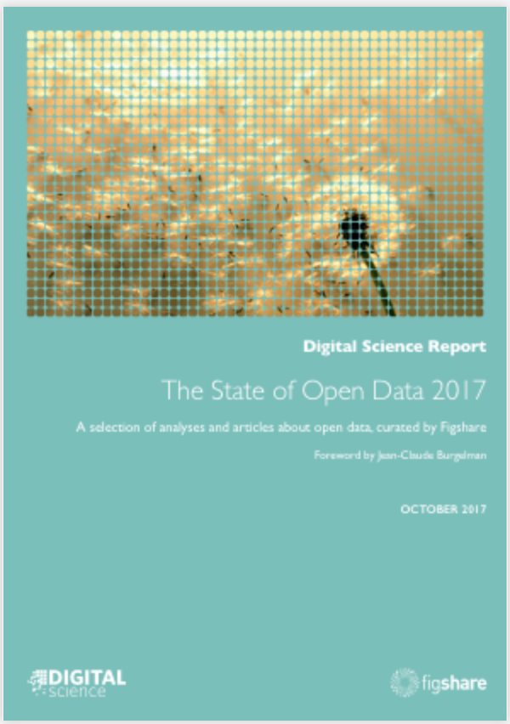
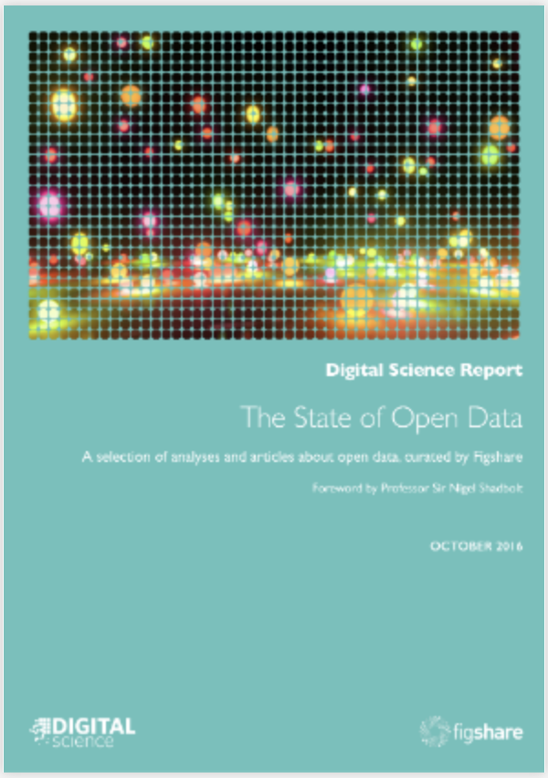
Figshare contributes to the global data ecosystem
The State of Open Data Annual Report
We conduct and report on the leading survey into opinions on open data, with 26,000 respondents to date.
Decision makers work with us to define best practices.
Notes:
This report gets expert recommendations from research discipline specific institutes and organisations to comment on best practices for sharing data. This year it will focus on Health Data, climate, national policies and how they are implemented.

Slide 15
Figshare large scale Open Science projects support nations around the world
Notes:
In the Middle East, every university and research institute in Qatar will shortly access to a figshare repository through the Qatar Foundation and Qatar National Library.
In Africa, TENET supports South African institutions with the procurement of figshare.

Slide 16
Supporting Open Science movement in Africa for Africa
Pillars 1 & 7
Digital Science / Dimensions have partnered with the Training Centre in Communication (TCC Africa) since 2019 to:
provide solutions to support provision of high quality research in Africa.
increase use and awareness of Open Access (OA) content by African researchers
increase African Journals’ research output included in Dimensions Data
We are currently working in a partnership with TCC Africa to bring figshare to Zambia (national development plans and SDGs monitoring initiative)
Notes:
A Prosperous Africa, based on Inclusive Growth and Sustainable Development.
Africa as A Strong, United, Resilient and Influential Global Player and Partner.
Digital Science / Dimensions have partnered with the Training Centre in Communication (TCC Africa) since 2019 to:
provide solutions to support provision of high quality research in Africa.
increase use and awareness of Open Access (OA) content by African researchers
increase African Journals’ research output included in Dimensions Data
We are currently working in a partnership with TCC Africa to bring figshare to Zambia (national development plans and SDGs monitoring initiative)

Slide 17
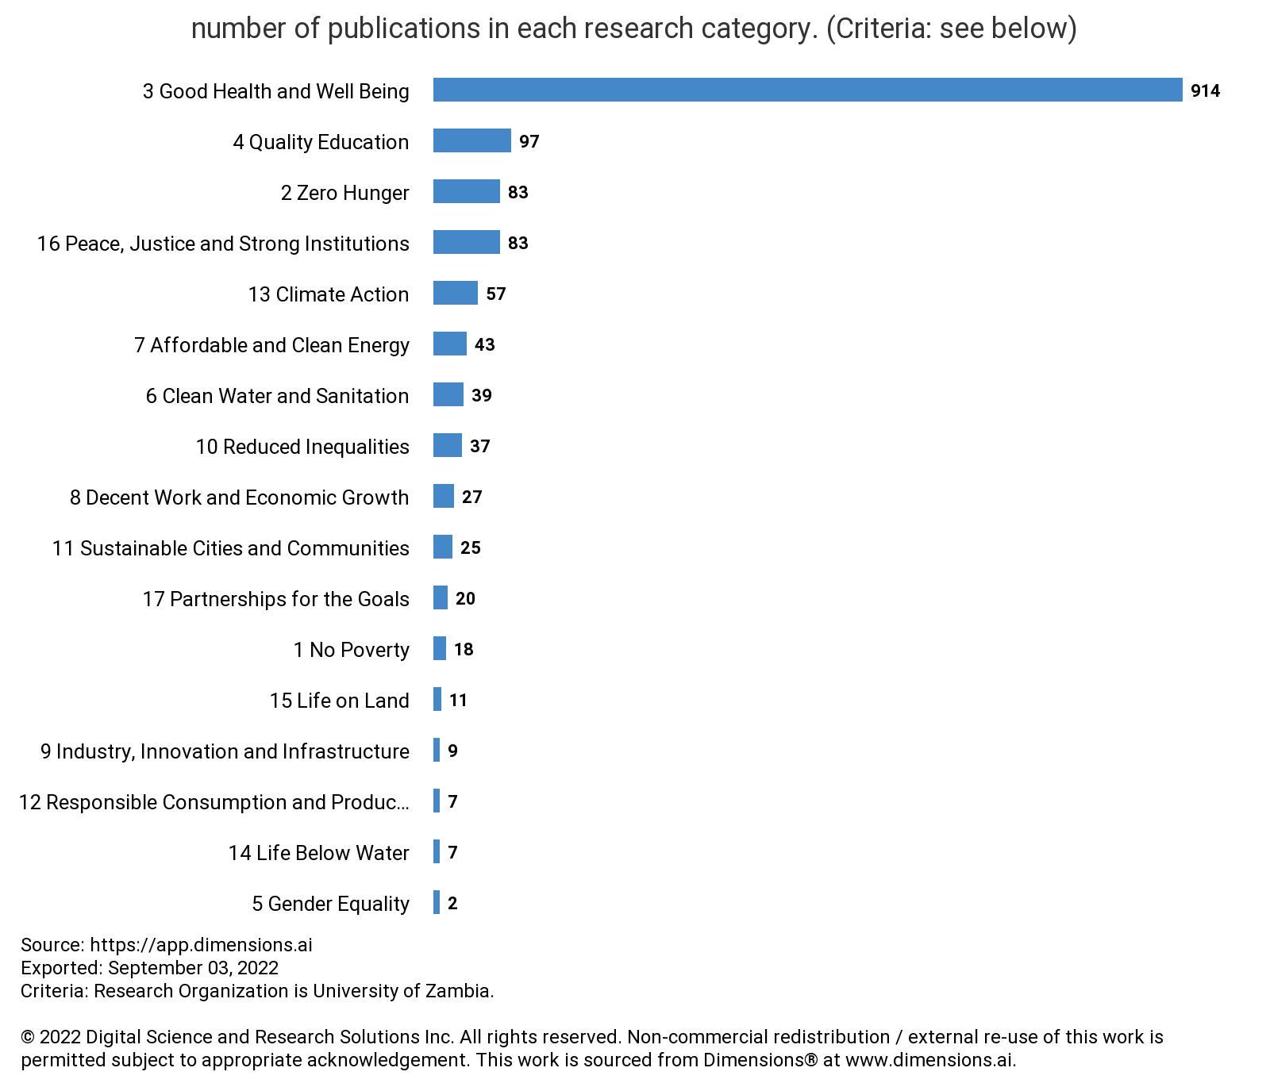
Tracking research for development
4,515
University of Zambia publications output (1965-2022)

Slide 18
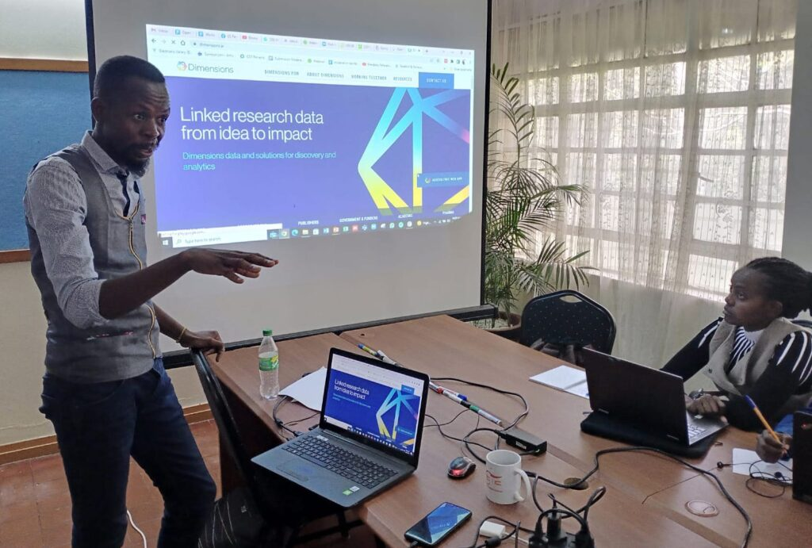
2021-Date
Launched Open Access research discovery solution Dimensions in 12 countries, in partnership with SGCI, Ministries of Education and Library Consortia
Notes:
In 2022 ICC Africa lead by Joy Owango have delivered workshops on using OA research discovery solutions to improve research outcomes in Democratic Republic of Congo, Zimbabwe, Nigerian, Kenyan and Tanzanian institutions. Next training is this month (Zambia and University of Namibia), national launch Tanzania.

Slide 19
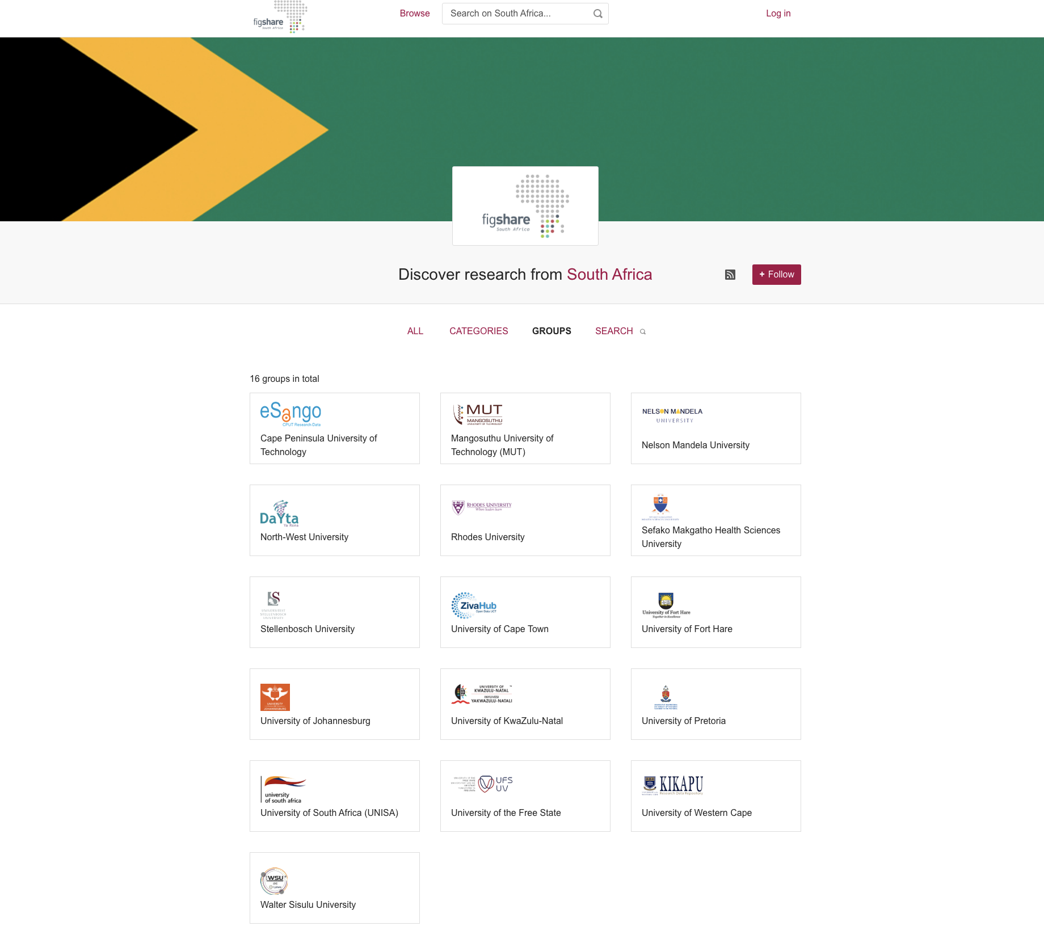
Notes:
Figshare’s ongoing relationship with South Africa - 16 institutions

Slide 20
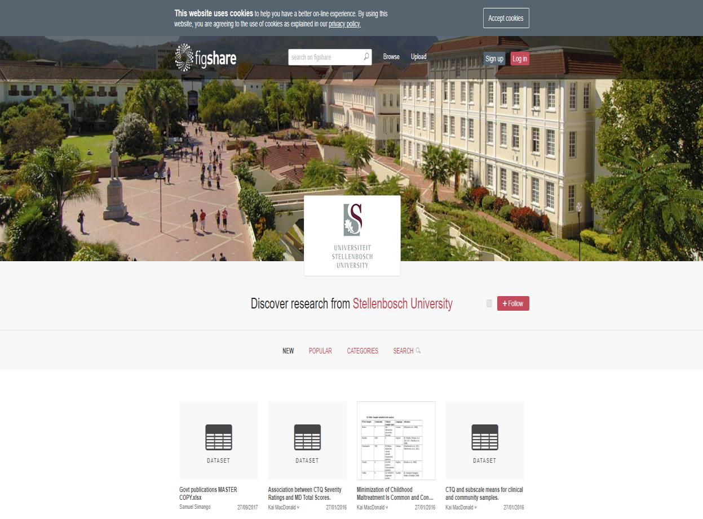

Slide 21
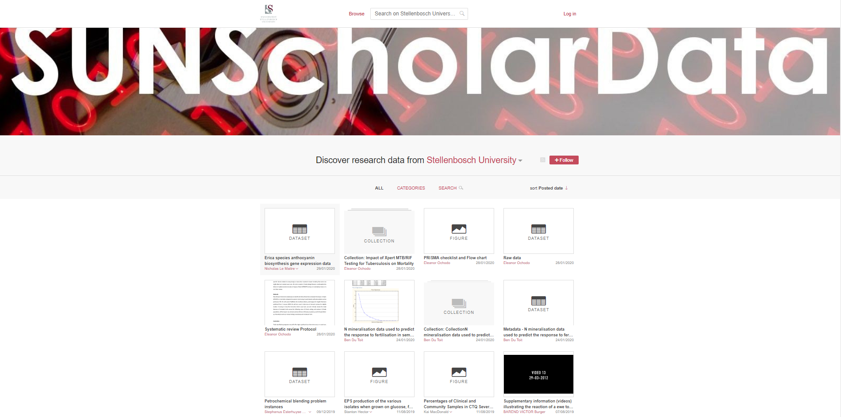

Slide 22
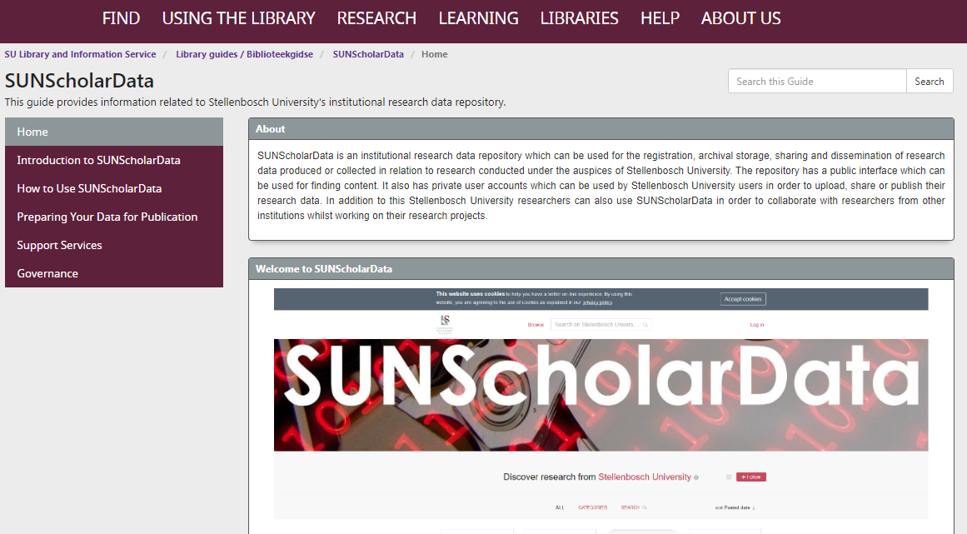

Slide 24
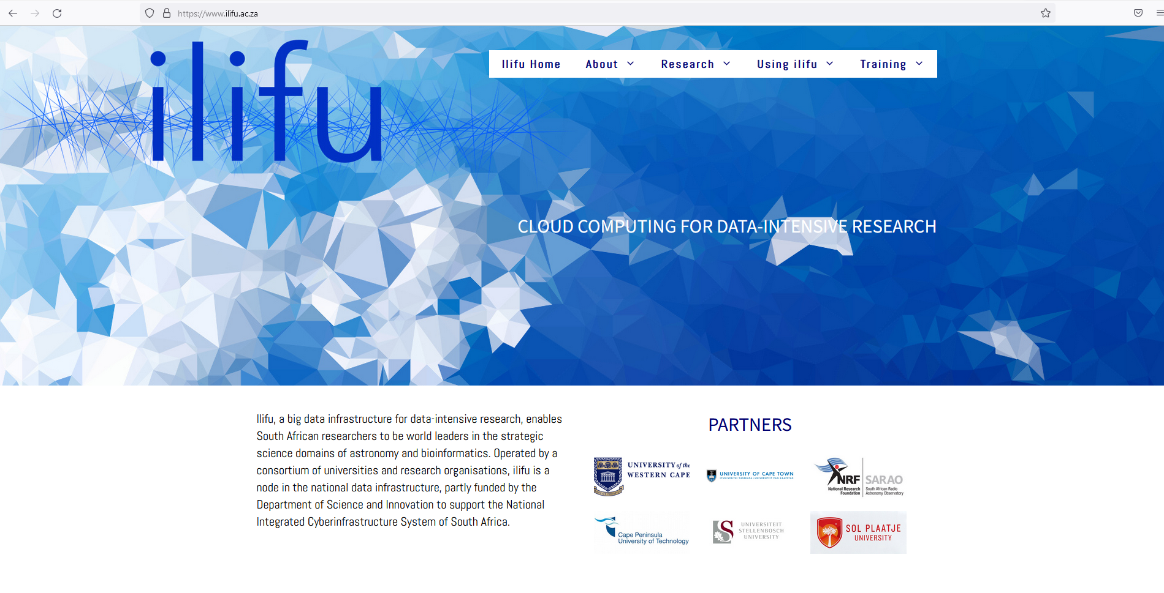

Slide 26
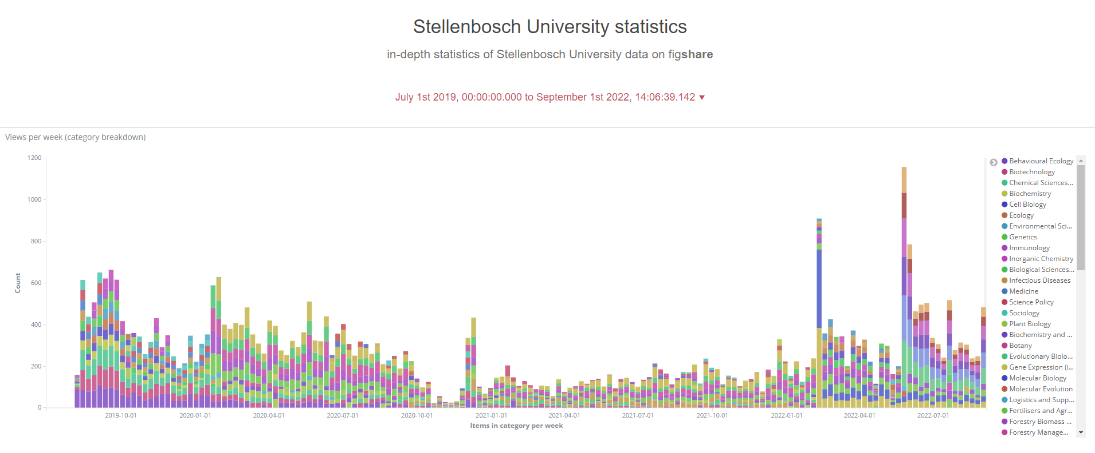

Slide 27
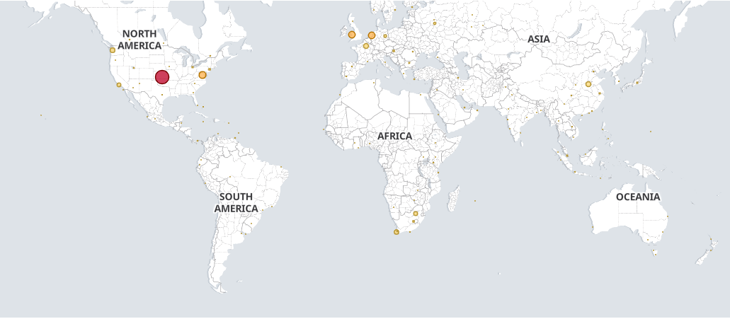
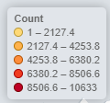

Slide 28
Figshare is helping to decolonise research in Africa
The issue - foreign funding mandates = passing over data to the global North. Helicopter science
How is Figshare helping to decolonise science and research outputs in Africa?
African researchers depositing research outputs in Figshare and obtaining a DOI are claiming / reclaiming ownership of their research
Harvesting the contributions of researchers globally undertaking research on, about or including Africa
Notes:
Figshare has been told by our African partners we are supporting Africa for Africa
Funders dynamics (data sharing is required as a condition of funding, which, at times overrides ethical concerns with personal data sharing and ownership) Helicopter science
This "scientific colonialism" practice is similar to historical colonialism in that data are extracted rather than natural resources, undermining local infrastructure and depriving academics in low income medium countries in the Global South of the same papers, patents, and expertise as their more affluent counterparts

Slide 29
“Figshare, an integrated software as a service solution that enables institutions to develop and adopt data standards and to build and maintain a Data or Institutional Repository for collaboration, visibility and research impact is proud of its mission supporting Open Access.“
Dr Mark Hahnel
Founder and CEO, Figshare
Notes:
In conclusion, Figshare, offers an integrated SaaS solution that integrates within the research ecosystem and will enable institutions to develop and adopt data standards including metadata, sharing and interoperability and to build and maintain a data and institutional repositories for collaboration, visibility, and impact, and it is also

Slide 30
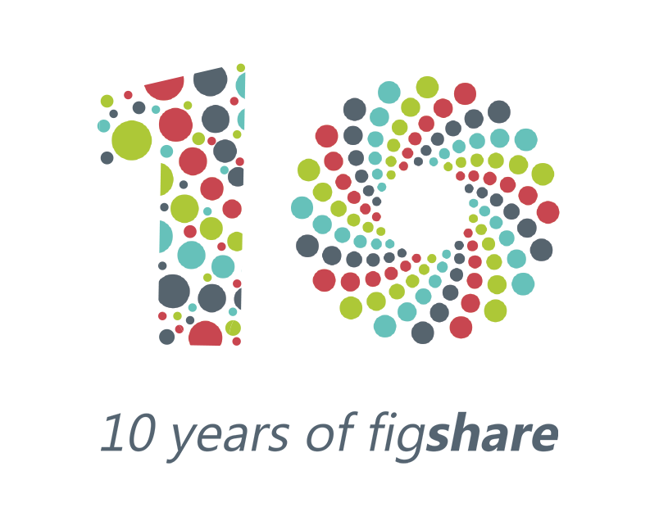
Thank you!
Maria Cotera
Business Development Manager, Figshare
maria@figshare.com
@mariacotera
@figshare
10 years of…
open data
open access
striving for FAIR-ness
empowering researchers
…for the goodness of humankind

Slide 31
References
Partnerships - Digital Science (digital-science.com)
Library Perceptions 2022: Results of the 15th International Survey of Library Automation (librarytechnology.org)
https://www.dimensions.ai/blog/dimensions-includes-new-research-category-filters-for-sustainable-development-goals/ https://www.altmetric.com/blog/how-to-the-sustainable-development-goals-search-filter-in-altmetric-explorer/
figshare works with Institutions
UNESCO Global Open Science Partnership
State of Open Data (figshare.com)
The effect of data sources on the measurement of open access: A comparison of Dimensions and the Web of Science | PLOS ONE
figshare in South Africa
Support : figshare Support

