Slide 1
From DSpace to Islandora: why and how

Slide 2
Short introduction
DSpace and Islandora
Systems for building repositories and/or digital libraries
Intended to store and describe digital content – digital objects
Provide services (browse, search, retrieve, …)
Interoperability support (OAI-PMH, …)

Slide 3
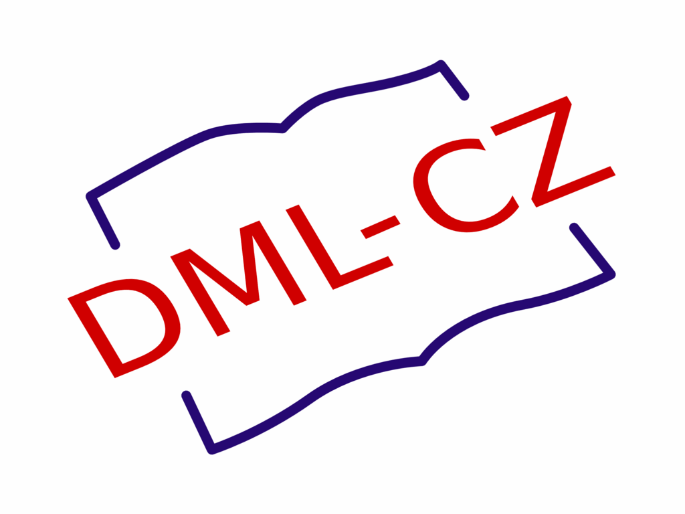
A bit of a history I
Investigation of DL systems started at about 2003/2004
Fedora, ePrints, Greenstone, CDSware, R.I.B. and DSpace
Needed(?) out-of-the-box solution for a university repository => DSpace won
Java, growing community, well defined workflows etc.
2005: we were asked by the czech mathematicians to help to build up Czech Digital Mathematics Library (a national project)
With the perspective to join the European Digital Mathematics Library project

Slide 4
A bit of a history II
We quickly found that DSpace is not enough for pre-processing:
Historical materials needed to be scanned (incl. OCR), completed and described
DSpace workflow system is intended for self-archiving of born-digital stuff
Metadata Editor was developed from scratch (based on Ruby)
DSpace as a platform for providing the content together with services to end users
DSpace Java API used to import content from ME
DSpace XMLUI high flexible interface used to develop necessary (many) customizations
Check the references on the last slide for details
DSpace as a connection point to EuDML (via OAI-PMH)
https://dml.cz/

Slide 5
A bit of a history III
Later on we used the same schema for dedicated digital libraries at the university:
Digital Library of the Faculty of Arts
Digital Library of the Faculty of Law
All of them need to be customized (both DSpace and ME)
Because we want them to have added value for users/community
… time for maintenance and upgrades was still increasing
While the IT stuff not
Especially ME got outdated because of Ruby versions incompatibility
However, DSpace is quite fine with Java

Slide 6
Situation summary
ME as an inhouse developed system is very expensive
And we don't have enough capacity to develop a new one
DSpace has to be customized
DSpace is intended to be more like a self-archiving institution repository
A lot of features need to be developed (expensive) and consequently upgrades are expensive
DSpace 7 release: a new UI not compatible with previous one
Most of our customizations need to be rewritten
Let's try to look around if there's something to suit our needs better
Samvera and Hydra: very small community, lack of support (4 years ago)
Islandora looks promising... Why? See next slides.

Slide 7
DSpace and Islandora: architecture
Java based monolithic system developed from scratch
Distributed as a compact open-source package
Intended to be self-archiving institution repository
=> larger customizations allowed but not primarily supported
A compilation of cooperating subsystems based on different technologies
Drupal, Fedora, SOLR, ...
Very good support for doing large UI customizations easily because of Drupal

Slide 8
DSpace and Islandora: philosophy
DSpace is fully ready to do certain things and you must follow the prepared schema
Must use Communities and Collections to organize content (fixed content types)
Have to use ingest workflow schema
If you want it as it is, you're very happy,
… because DSpace and its features are perfectly ready for you.
Islandora does not want you to follow certain workflow
You can use prepared schema like Repository item (= digital object), but you don’t have to
You can use full power of Drupal (own content types, own UI, …), but you don't have to
If you want to customize it, you're very happy,
… but there are few nice features missing.

Slide 9
DSpace and Islandora: features examples
DSpace has a perfect ingest workflow system, including supervising and collaborative features
However, once published item cannot be returned to the workflow system in DSpace
There's a suppport in Islandora, but not so rich
DSpace has perfect authorization support, Islandora does not
You can set up authorization support in Islandora, but it's not straightforward
DSpace metadata are flat key:value, Isladora can use complex metadata types
You can't have separate fields for name and surname in DSpace
OAI-PMH support is much better in DSpace
Handle.net supported by default in DSpace, Islandora DIY

Slide 10
DSpace and Islandora: maintenance
DSpace is more consolidate out-of-the box solution: one package = one version = one GIT repository => robust
DSpace has larger community
Perfect documentation
Islandora is more fragmented to various packages spread around various GIT repos
Technically Islandora is just a Drupal module + a few backend packages and configurations that makes them to work together
Two major versions (7, 8), several installation options
Islandora community is smaller, but very supportive
Documentation not so perfect

Slide 11
DSpace and Islandora: summary
Both systems are good and do the job
DSpace is more specialized
Islandora is more customizable and DYI
Many customizations done via configurations => easy to upgrade
Since we want to build up more specialized customized digital libraries with added value, Islandora is a better option for us
Islandora has proved to be more effective for our needs
But good knowledge of Drupal necessary
Drupal is very popular => Drupal modules are treasure :-)
Drupal is very popular => need to be careful about security :-(

Slide 12
DSpace to Islandora migration
No one-click automatized migration support both data and features
Especially for features there are no general rules/advice
Data migration: semi-automatic
DSpace: export CSV
Drupal/Islandora: configure migration (import) and run it
Features migration: by hand
Many general features are available by default in Islandora
Customized features need to be done by hand
Yes, it's not for free

Slide 13
Islandora: what we have done so far
Support from LINDAT/CLARIAH-CZ EU project on digital humanities
We have built up few digital libraries on top of Islandora
Standard documents (PDFs: articles, chapters, books)
Archeological artefacts (images, 3D models, rich metadata)
Historical cinematic database (including interactive map)
Database of beauty patterns (will be released)
See our infrastructure overview page:
https://digitalia.phil.muni.cz/en

Slide 14
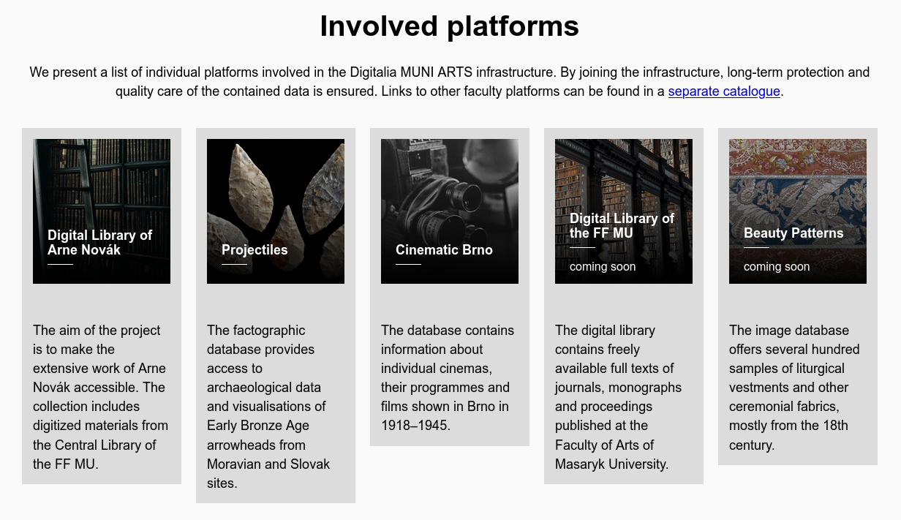
Our team (project head, developers, data curator) is here and ready for questions and discussions.

Slide 15
References
Building the Czech Digital Mathematics Library upon DSpace system https://dml.cz/handle/10338.dmlcz/702539
DML-CZ Metadata Editor https://dml.cz/handle/10338.dmlcz/702537
Digitalia https://digitalia.phil.muni.cz/en
Digital Library of the Faculty of Arts https://digilib.phil.muni.cz/
Digital Library of the Faculty of Law https://digi.law.muni.cz/
Arne Novák Digital Library https://arne-novak.phil.muni.cz/?language=en
Projectiles https://projectiles.phil.muni.cz/
Cinematic Brno https://cinematicbrno.phil.muni.cz/

