Slide 1
“It´s better to burn out than to fade away” The Changing Role of a University Library in the World of Open Science and Responsible Research
Pekka Olsbo, director, Open Science Centre, University of Jyväskylä
ILIDE Conference 6.9.2022

Slide 2
University of Jyväskylä
One of the top universities in Finland
Student recruitment across Finland and internationally
Rector Keijo Hämäläinen
158–year history (Teacher Seminary in 1863)
Unique campus near the city centre

Slide 3
University of Jyväskylä
6 Faculties
14 000 Degree students
+ 26 500 Students in the Open University
2 600 Employees
900 Researchers
Around 216 M€ Total income

Slide 4
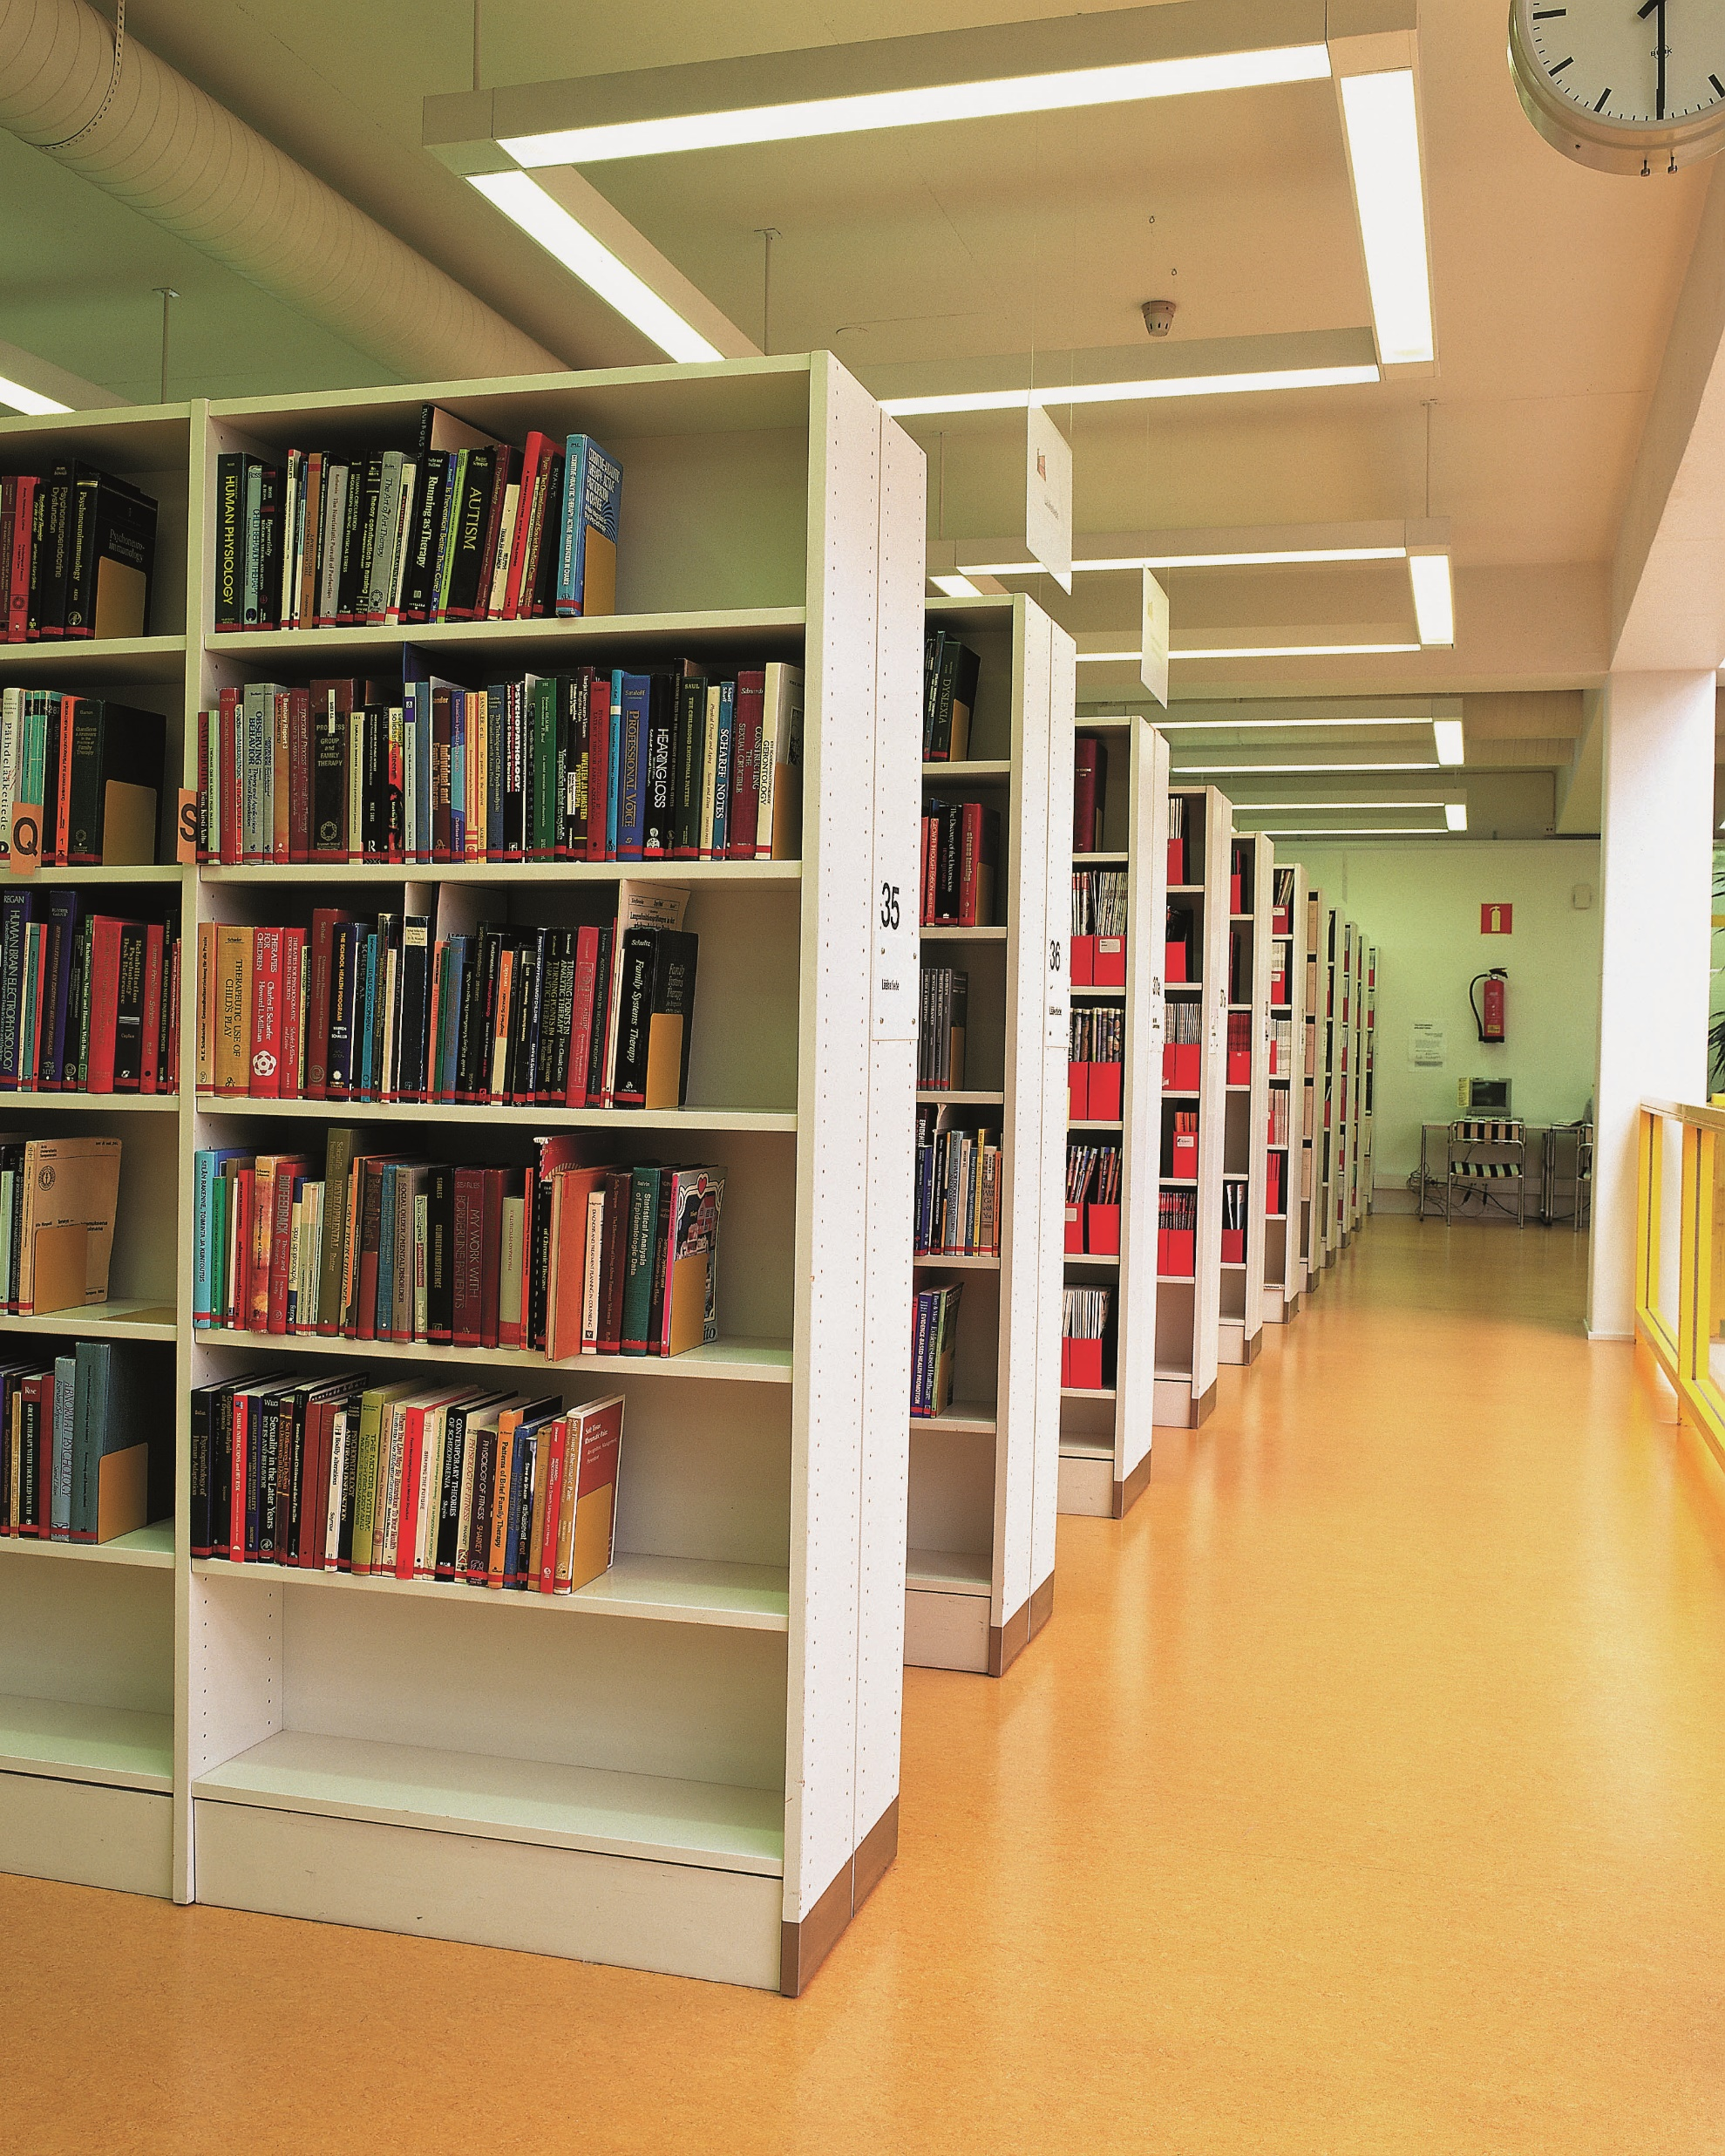
Beginning of a change
25 years ago, Jyväskylä University Library was… well just a library
In 1997 a publishing unit was founded, bringing 6 research-oriented people along.
Publishing theses and dissertations online, small publishing house, own book production mostly in print, but some experiments with open access
Print-on-demand and digital printing as first in Finland, co-operation with Council of Europe Print-on-demand and New Book Economy projects.

Slide 5
Then came Open Access
But then Budapest open access initiative and writings of Stevan Harnad… and open access was suddenly the most important target.
The first version of Library´s Digital Repository in 1997. Already in 1998 most of the master theses and dissertations of the Jyväskylä University were archived in digital format and almost half also published online open access.
The push for open access was only because we saw that it will be the future and our focus was moving towards green open access by the influence of Stevan Harnad and others writing about green oa.

Slide 6
Change of thinking
In 2000: Publishing unit should not be a publisher but an internal service center for the needs of the University in the field of publishing and research services.
The big strategical aim 2001: ”Aim is to improve the availability of scientific information for the scientific and general audience in Finland and abroad”
This meant push for open access, cutting down print, development of repository and renewal of all publishing processes.
The new repository was launched in 2007 and the new name of the repository JYX Jyväskylä University Digital Archive spoke out once again the new attitude; it was no longer the repository of the university library, but of the University. This was a clear signal that the service was for the whole university, not just for the needs of the library.

Slide 7
Paving the way for green open access
In 2014 CRIS reporting and maintenance of publication information was centralized in the Library. An opportunity to develop whole new process for self-archiving and green open access
Finnish Open Science and Research Initiative (2014-2017) was a project of Ministry of Education and Culture, which developed important guidelines for promoting Finnish open science. By the time of this initiative JYU was already the leading university in open access in Finland.
AS a result of this initiative a national project was started lead by the Jyväskylä University Library aiming to develop green open access processes in Finnish Universities.

Slide 8
Open Science Centre
By 2017 open science and research related activities formed so important part of University Library, that it was time to re-organize
University Library and University Science Museum merged, and Open Science Centre was born
This gave us an opportunity to really enlarge our services: metrics, responsible researcher assessment, data management services, publishing services, research impact and policy analysis, science for all, digitation, own RI, development of natural and cultural historical campus area…

Slide 9
Responsible metrics
With DORA declaration and other demands for responsible researcher assessment and responsible metrics came an idea of developing more responsible solutions for using metrics.
JYUCite was developed by our information specialist Janne-Tuomas Seppänen
Other innovations followed: head hunting metrics, using Overton for analyzing the societal engagement of University, combining metrics, policy impact, societal engagement and other research activities as the basis of research evaluation…
Building up a research and innovation team

Slide 10
Science for all and citizen science
JYUniorit
Open Science Center
Public events
University Marketing and Communications unit
Open Science Center
Exhibitions
Open Science Center
Collections and archives
Summer University of Jyväskylä
Summer University of Jyväskylä
Faculties and Departments
Faculties and Departments
Open Science Center
Faculties and Departments
Summer University of Jyväskylä
Collaboration with Faculties and Departments
Central Finland LUMA Center

Slide 11
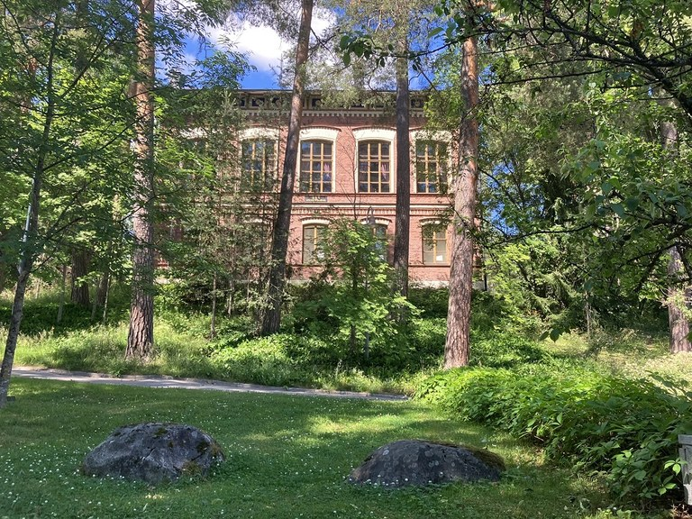
Cultural Heritage
European Heritage Label
Cultural heritage team
Cultural historical and Science historical collections
University history Photo collections
University Art collections
Natural heritage team
Natural historical collections
Botanical garden
Science education and public engagement team
Science for all consept
Childrens university JYUniorit
University Museums
Heritage and identity,
Museum practices,
Popularization of academic heritage
The European Commission has awarded the European Heritage Label to the JYU Seminaarinmäki campus (April 2022).

Slide 12
Open Science Centre now
Jyväskylä University Library
Jyväskylä University Museum
Open Science Services
Research Services
Publishing Services
Analytics and metrics
Science education for kids, citizens, students, researchers and staff
Cultural Heritage and botanical garden
Citizen Science Hub of the University
70 people working for the University´s success
Kuva: Johanna Kinnunen
Kuva: Johanna Kinnunen
Kuva: Johanna Kinnunen
Kuva: Tytti Leppänen

Slide 13
It´s better to burn out…
University Libraries have shown their capability to change
In 20 years from University Library to Science, Culture and Art Hub of the University
Look forward… and act.
Seize the Day!

Slide 14
Thank You!
pekka.o.olsbo@jyu.fi
osc.jyu.fi

