Slide 1
ScienceDirect Find Your Path from Hypothesis to Discovery
Helena Paczuska
Regional Manager
Eastern Europe, Russia, Central Asia
Reference Solutions/ScienceDirect eBooks
Jasna, 2022, September 06

Slide 2
Agenda:
How ScienceDirect can help in educational and scientific processes
Topic Pages – game changer

Slide 3
How ScienceDirect Can Help in Educational and Scientific Processes

Slide 4
ScienceDirect supports all stages of research and learning
8
Journals (Primary research)
Advanced
Journals
2.700+
7
Journals
(Review Journals)
6
In-depth explorations of recent developments in a field
6600+ Book Series (Serials)
5
Cover an In-depth body of knowledge over multitude subject areas
35 000 + eBooks (Monographs)
4
At a higher level than pure textbooks and ideal for graduates or post-docs as well as early career and interdisciplinary researchers
Foundational
Books
44.000+
3
700+ Hybrid eBooks function as textbooks
Text/Reference Hybrids
2
Engineering & Computing, Life and Biological Sciences,
Medical Sciences , Physical Sciences , Social Sciences
280+ Textbooks | 5 Key Subject Areas
1
Comprehensive, foundational introduction to a discipline; Encyclopedias
200+ Major Reference Works
Relevance of information over time

Slide 5
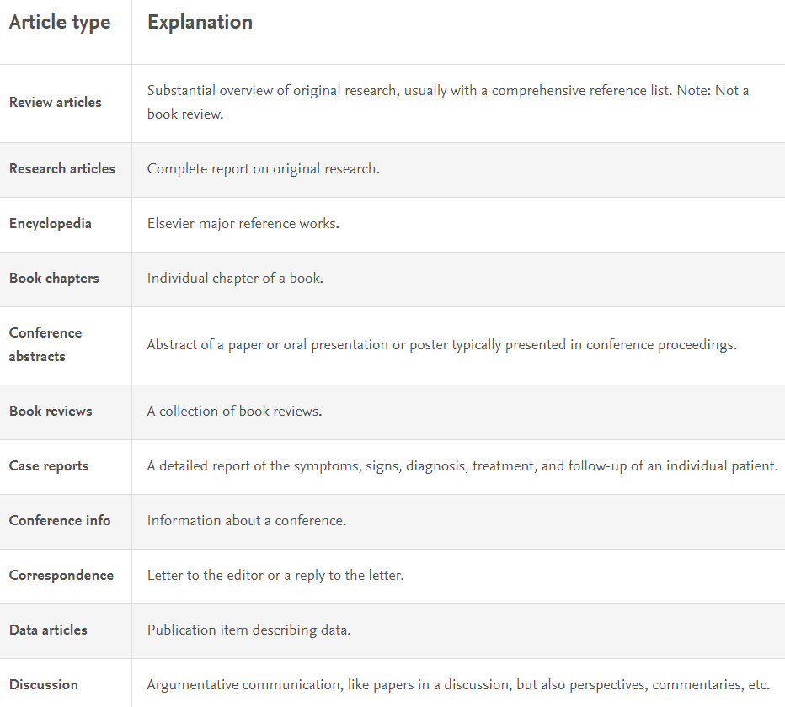
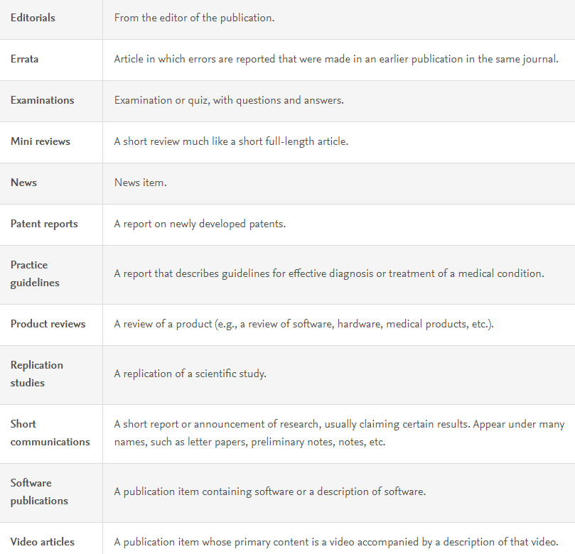
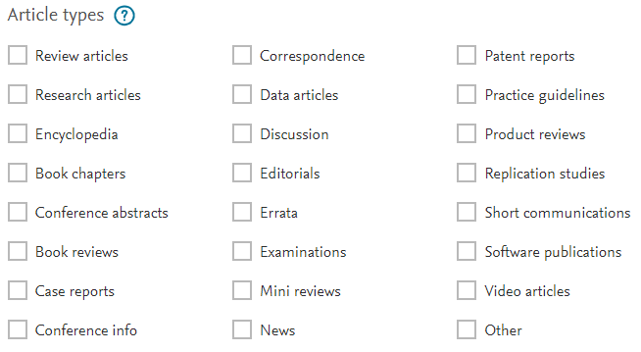
What types of scholarly output are there?
https://service.elsevier.com/app/answers/detail/a_id/27955
Notes:
Scopus Content

Slide 6
Building knowledge should be seamless
ScienceDirect uniquely offers cross-links and advanced technology, enabling researchers to find relevant information at their point of need. The different content types work in harmony on ScienceDirect to deliver the best source of knowledge, no matter what research stage a user is at.
220+ Major Reference Works
Provides foundational information that opens up a fundamental overview of the existing body of knowledge.
30,011 eBooks / Monographs
330,000 ScienceDirect Topics
Presents sustained arguments that broaden the sphere of investigation and open up new paths of inquiry.
Authoritative introductory overviews of topics to help researchers uncover critical and contextual information.
6,668 Serials / Series and Handbooks
2,500 Journals
Offers a fresh and in-depth perspective on the current state of research that uses the latest scholarship.
Brings new cutting-edge findings to your research.

Slide 7
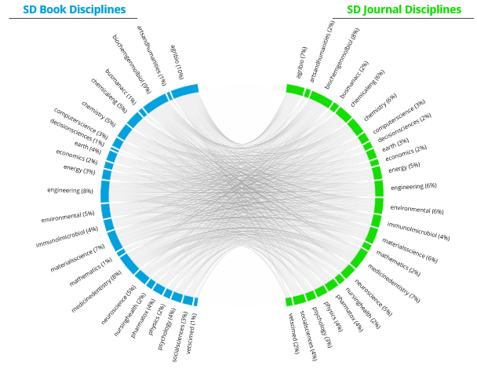
ScienceDirect is designed to meet the evolving needs
of interdisciplinary researchers
78%
6,3 million books and journals were used together on ScienceDirect in the same research session in 2021
often do interdisciplinary research
90%
of surveyed users agree that in their work they benefit from using books and journals in the same search
…that is more than 528,000 times per month
Source: TechValidate survey TVID: 39C-DC2-A29 & 9D4-230-2AD
6 Million Books and journals were used together in the same research session in 2018
Notes:
Unlock the power of co-usage with an uninterrupted research workflow on ScienceDirect
Today’s researchers have broad, multidisciplinary workflows. To connect the dots and see the big picture, they need access to reliable interdisciplinary research using a wide range of content types.
With co-usage we can clearly see the path of researchers, moving across subject areas and across content types. ScienceDirect is uniquely positioned to provide seamless access across content and topics to answer user needs.
Researchers’ behaviour demonstrates the need for interdisciplinary research is more prevalent than ever
Researchers use reference books and journals in conjunction to get the full picture of a subject
Users are only getting part of the answer if they only have access to journal content
SD is uniquely positioned to offer seamless access to both

Slide 8
Topic Pages – Game Changer

Slide 9
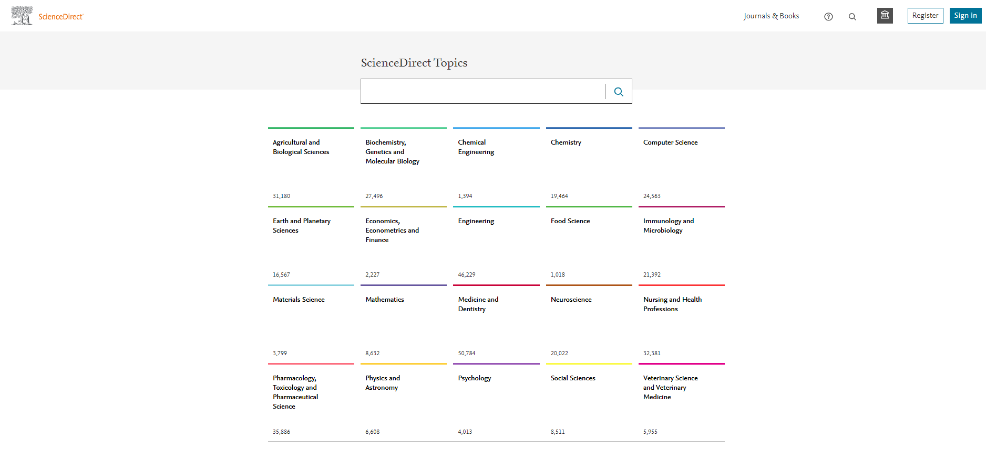
New to the topic? Cross-check the definitions and concepts
363.000 topic pages have been developed and the number is growing every month
https://www.elsevier.com/solutions/sciencedirect/topics
Notes:
Scopus Content

Slide 10
New to the topic? Cross-check the definitions and concepts
https://www.elsevier.com/solutions/sciencedirect/topics
Notes:
Scopus Content

Slide 11
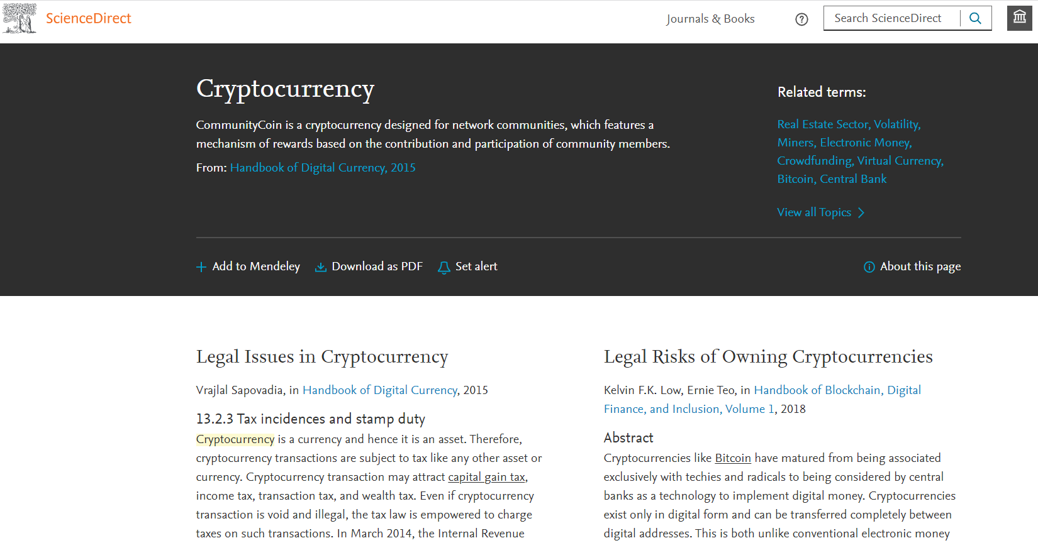
New to the topic? Cross-check the definitions and concepts
Notes:
Scopus Content

Slide 12
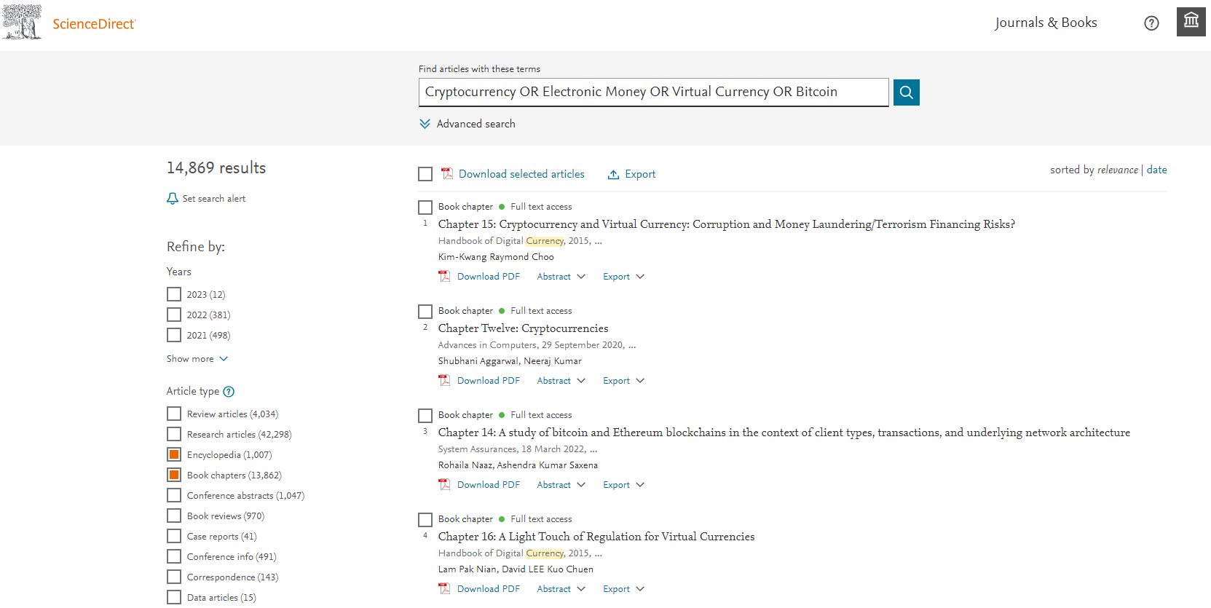
Use new knowledge to discover literature
Notes:
Scopus Content

Slide 13
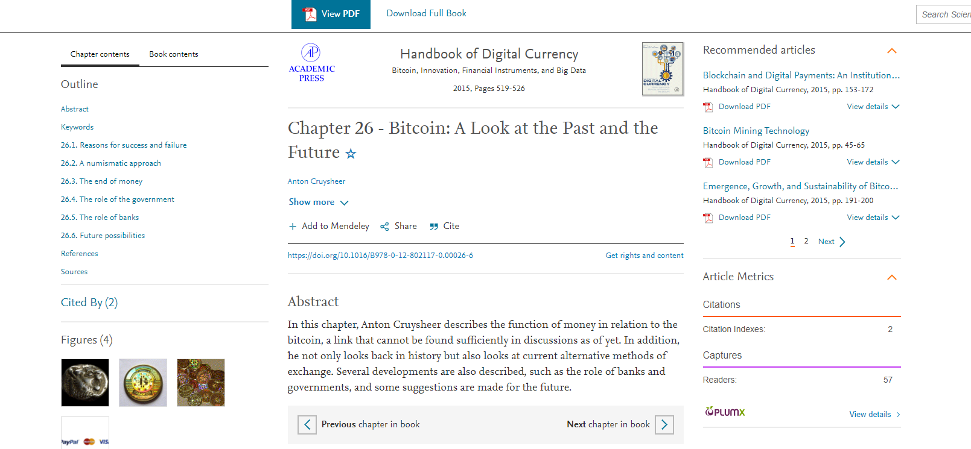
What is in for me?
Notes:
Scopus Content

Slide 14
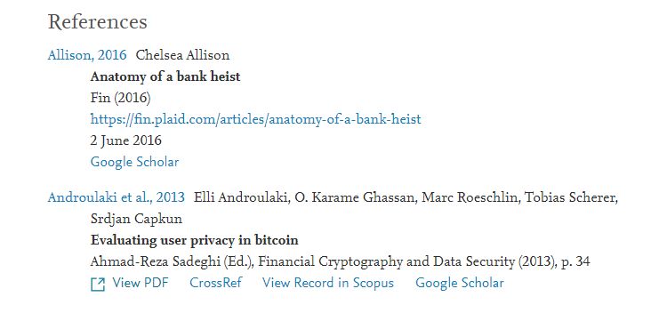
Use new knowledge to discover literature
Suggested content from outside of ScienceDirect
Notes:
Scopus Content

Slide 15
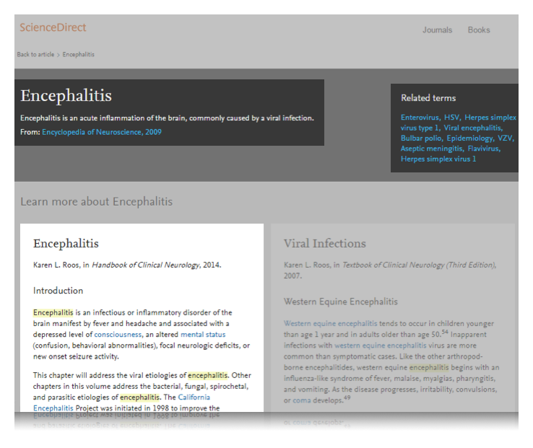
ScienceDirect Topics help researchers and students get a quick overview on a topic and related content
1
Clear definition extracted from books
Related terms to explore more
Short extracts of the most relevant information from books
Links to relevant Book content
1
2
4
2
3
3
4

Slide 16
Discover the Difference with ScienceDirect
Topic pages as the second largest driver for SD traffic
~ 500,000 co-usage sessions each month
Over 1 billion article and chapter downloads per year
25 million monthly unique visitors with 20% via mobile
78% of searches are interdisciplinary
1.7 million recommendations emails sent per month
Notes:
There is simply no other platform that provides such seamless and integrated access to not only the most relevant and high quality content, but made as discoverable and accessible as we do…it’s a winning platform that sets us apart from everyone else. Here are some examples of what kinds of outcomes we see when we look at the whole of ScienceDirect across all content.

Slide 17
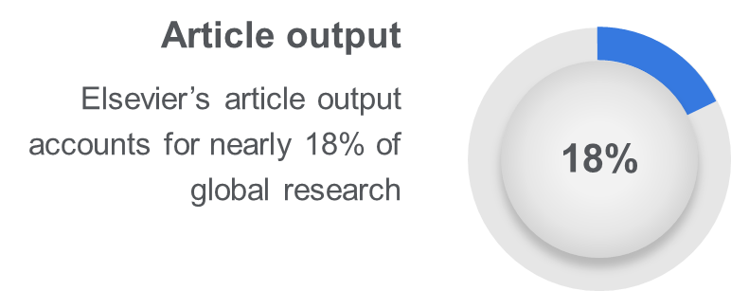
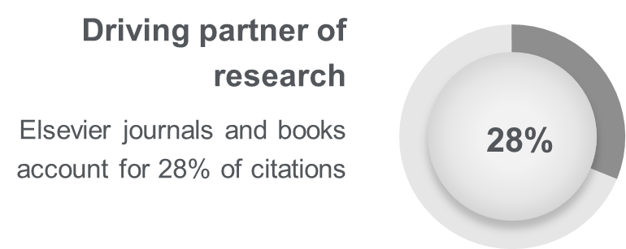
> 19M
articles
> 2,700 journals
>43k eBooks
>363k
Topic pages
Article growth details
Sources: https://www.elsevier.com/__data/assets/pdf_file/0005/1095953/Fast-Facts.pdf
https://www.elsevier.com/about/this-is-elsevier

Slide 18
Thank You
Helena Paczuska
Regional Manager
Eastern Europe, Russia, Central Asia
Reference Solutions/ScienceDirect eBooks
h.paczuska@elsevier.com
Notes:
Contact Sales to get a copy of the Gap Analysis for your institution

